Slide 1
Disjoint Paths Problem
Zhiyuan Wang 12032878
Supervisor: Ke Tang
Greedy Algorithm

Slide 2
Content
Introduction to the Disjoint Paths Problem.
The example about Disjoint Path Problem with c=2

Slide 3
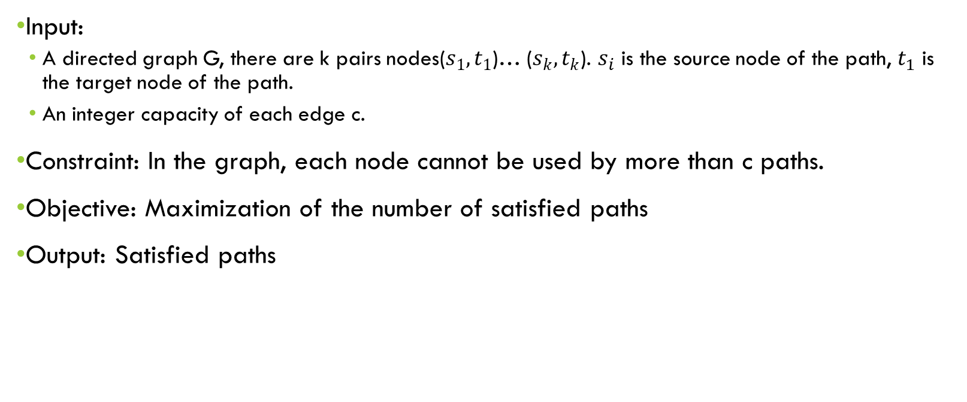
Disjoint Paths Problem
Input:
A directed graph G, there are k pairs nodes($s_{1},t_{1}$)… ($s_{k},t_{k}$). $s_{i}$ is the source node of the path, $t_{1}$ is the target node of the path.
An integer capacity of each edge c.
Constraint: In the graph, each node cannot be used by more than c paths.
Objective: Maximization of the number of satisfied paths
Output: Satisfied paths

Slide 4



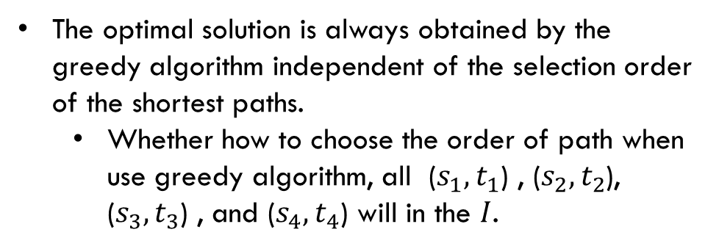





Example1
$$t_{1}$$
c=2
$$t_{2}$$
The optimal solution is always obtained by the greedy algorithm independent of the selection order of the shortest paths.
Whether how to choose the order of path when use greedy algorithm, all ($s_{1},t_{1}$) , ($s_{2},t_{2}$), ($s_{3},t_{3}$) , and ($s_{4},t_{4}$) will in the $I$.
$$s_{2}$$
$$s_{1}$$
$$t_{4}$$
$$t_{3}$$
$$s_{3}$$
$$s_{4}$$

Slide 5



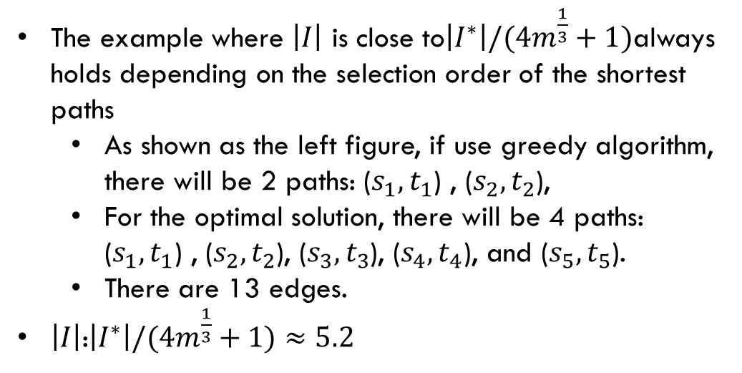





Example2
$$t_{4}$$
$$s_{3}$$
$$s_{4}$$
$$t_{1}$$
$$t_{3}$$
The example where $\left|I\right|$ is close to$\left|I^{∗}\right|/(4m^{\frac{1}{3}}+1)$always holds depending on the selection order of the shortest paths
As shown as the left figure, if use greedy algorithm, there will be 2 paths: ($s_{1},t_{1}$) , ($s_{2},t_{2}$),
For the optimal solution, there will be 4 paths: ($s_{1},t_{1}$) , ($s_{2},t_{2}$), ($s_{3},t_{3}$), ($s_{4},t_{4}$), and ($s_{5},t_{5}$).
There are 13 edges.
$\left|I\right|$:$\left|I^{∗}\right|/(4m^{\frac{1}{3}}+1)≈5.2$
$$s_{2}$$
$$s_{1}$$
$$t_{2}$$
c=2

Slide 6




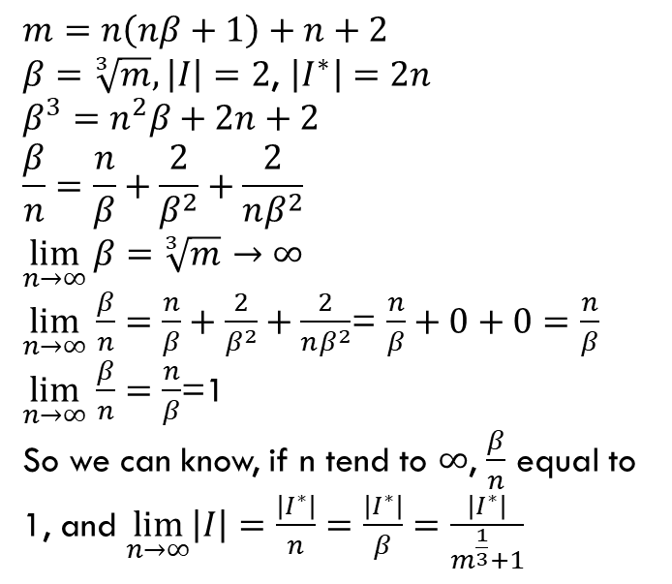















Example2
From the last page, we can get an pattern and extend it.
$$m=n\left(nβ+1\right)+n+2$$
$β=\sqrt[3]{m}, \left|I\right|=2$, $\left|I^{∗}\right|=2n$
$$β^{3}=n^{2}β+2n+2$$
$$\frac{β}{n}=\frac{n}{β}+\frac{2}{β^{2}}+\frac{2}{nβ^{2}}$$
$$\lim_{n→∞}{β=\sqrt[3]{m}}→∞$$
$\lim_{n→∞}$ $\frac{β}{n}=\frac{n}{β}+\frac{2}{β^{2}}+\frac{2}{nβ^{2}}$= $\frac{n}{β}+0+0=\frac{n}{β}$
$\lim_{n→∞}$ $\frac{β}{n}=\frac{n}{β}$=1
So we can know, if n tend to $∞$, $\frac{β}{n}$ equal to 1, and $\lim_{n→∞}\left|I\right|=\frac{\left|I^{∗}\right|}{n}=\frac{\left|I^{∗}\right|}{β}=$ $\frac{\left|I^{∗}\right|}{m^{\frac{1}{3}}+1}$
$$t_{4}$$
$$t_{6}$$
$$t_{2n}$$
$$t_{3}$$
$$t_{5}$$
$$t_{2n−1}$$
…
…
$$nβ−4$$
…
$$s_{3}$$
$$s_{5}$$
$$s_{7}$$
$$t_{1}$$
$$s_{4}$$
$$s_{6}$$
$$s_{8}$$
$$s_{2}$$
$$n−5$$
$$s_{1}$$
…
$$t_{2}$$
…
$$nβ−4$$

Slide 7
Thank You !
Q&A

