Slide 1
Set Cover Problem
Zhiyuan Wang
12032878
Choice the machine by Greedy Set Cover Algorithm

Slide 2
Content
Set Cover Problem
Greedy Set Cover Algorithm
The example where a good solution is not obtained by the greedy algorithm (for example, w(C) > 2w(C*))

Slide 3
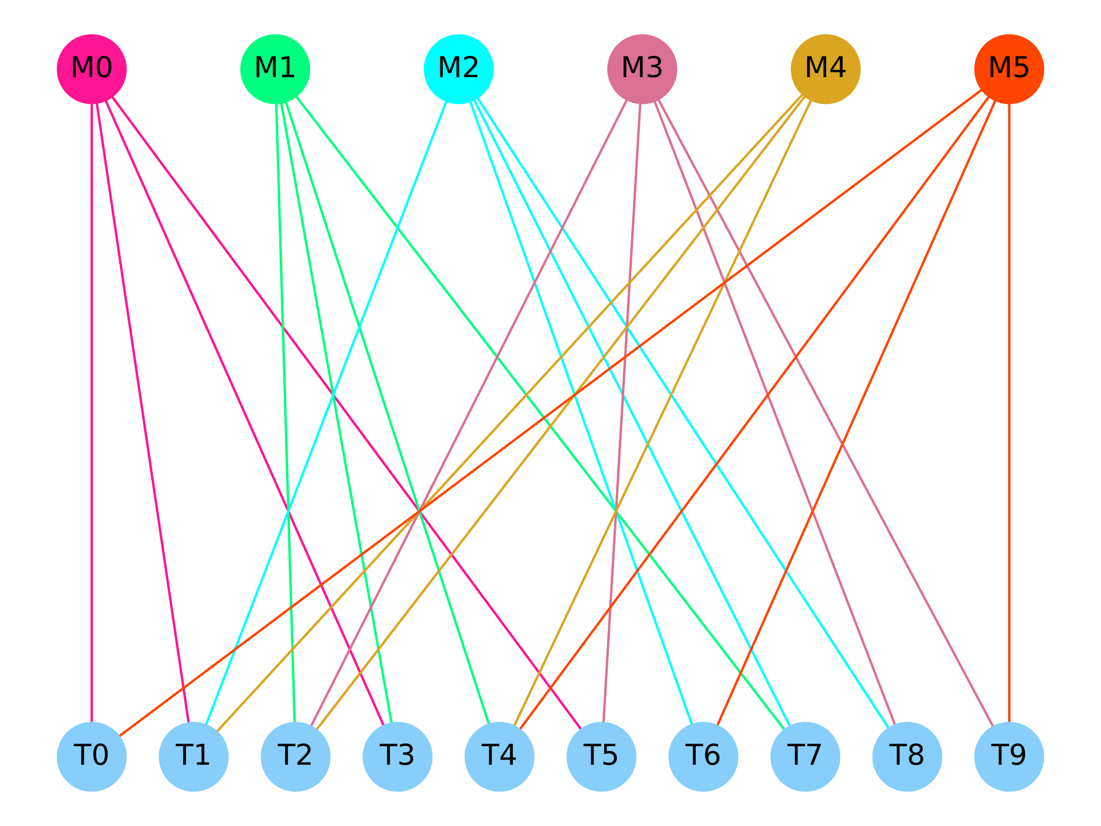
Set Cover Problem
This problem’s target is choosing subsets to cover all of the elements and minimize the total cost.

Slide 4
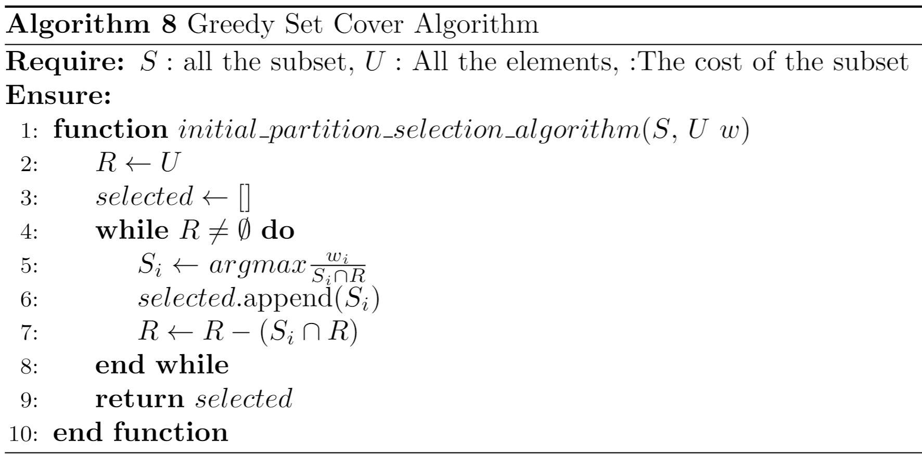

Greedy Set Cover Algorithm
This algorithm will select the subset with the best evaluation. The evaluation is calculated by the following formula:
$$\frac{w_{i}}{S_{i}∩R}$$

Slide 5
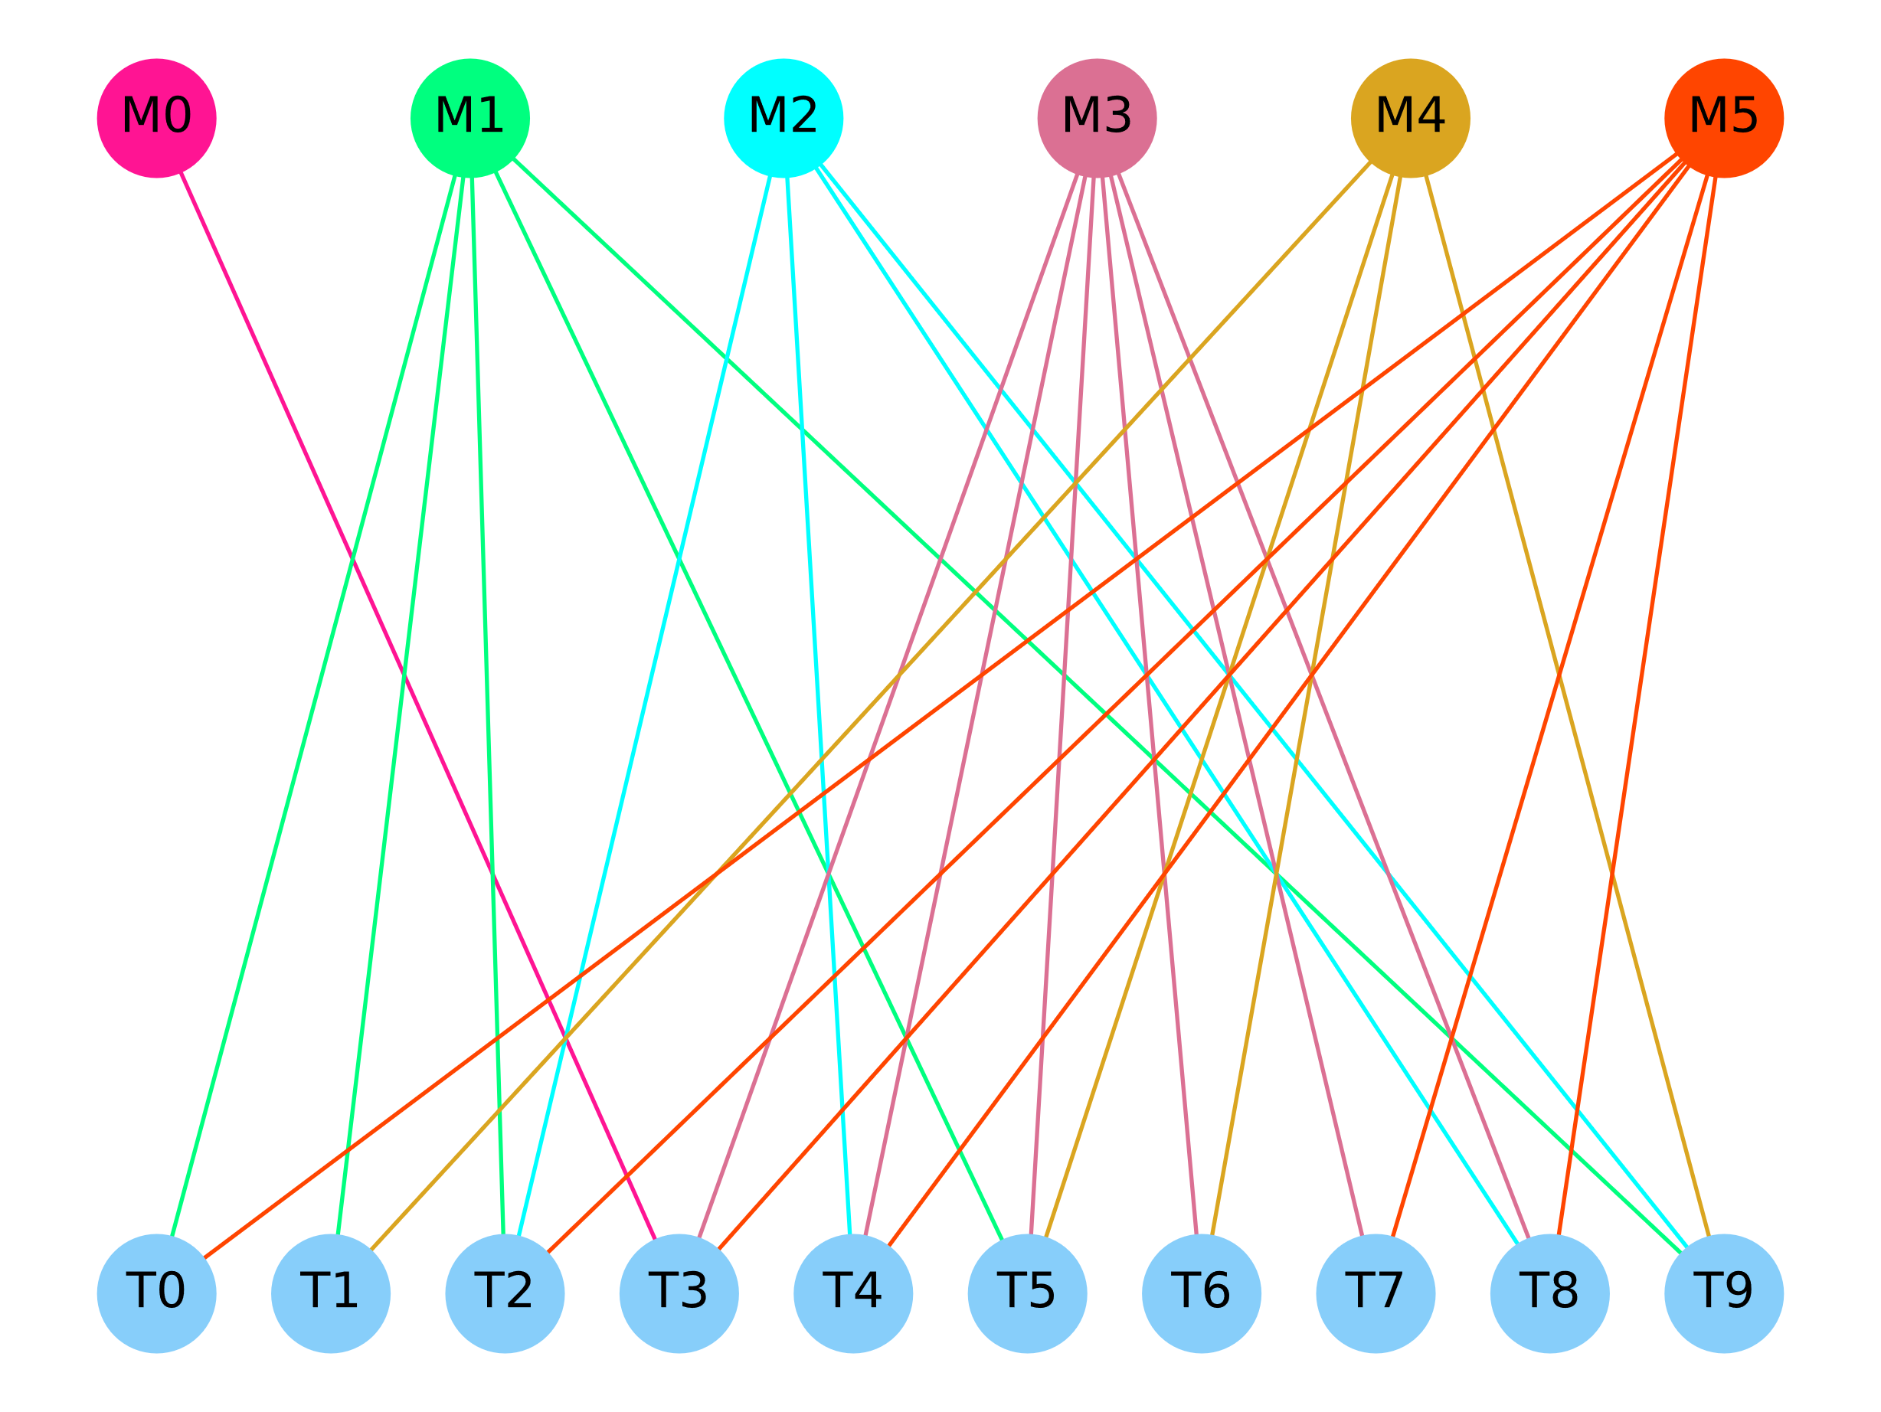
Example
Subset | Elements | Cost
M0 | T3 | 3.955
M1 | T0、T1、T2、T5、T9 | 6.295
M2 | T2、T4、T8、T9 | 4.776
M3 | T3、T4、T5、T6、T7、T8 | 14.842
M4 | T1、T5、T6、T9 | 6.759
M5 | T0、T2、T3、T4、T7、T8 | 7.987

Slide 6
Example
Subset | Elements | Cost
M0 | T3 | 3.955
M1 | T0、T1、T2、T5、T9 | 6.295
M2 | T2、T4、T8、T9 | 4.776
M3 | T3、T4、T5、T6、T7、T8 | 14.842
M4 | T1、T5、T6、T9 | 6.759
M5 | T0、T2、T3、T4、T7、T8 | 7.987
The optimal solution is：T4+T5=14.746

Slide 7
Example
Subset | Elements | Cost | w
R | T0、T1、T2、T3、T4、T5、T6、T7、T8、T9
M0 | T3 | 3.955 | 3.955
M1 | T0、T1、T2、T5、T9 | 6.295 | 1.250
M2 | T2、T4、T8、T9 | 4.776 | 1.194
M3 | T3、T4、T5、T6、T7、T8 | 14.842 | 2.473
M4 | T1、T5、T6、T9 | 6.759 | 1.690
M5 | T0、T2、T3、T4、T7、T8 | 7.987 | 1.331
The Greedy solution is :
M2+…

Slide 8
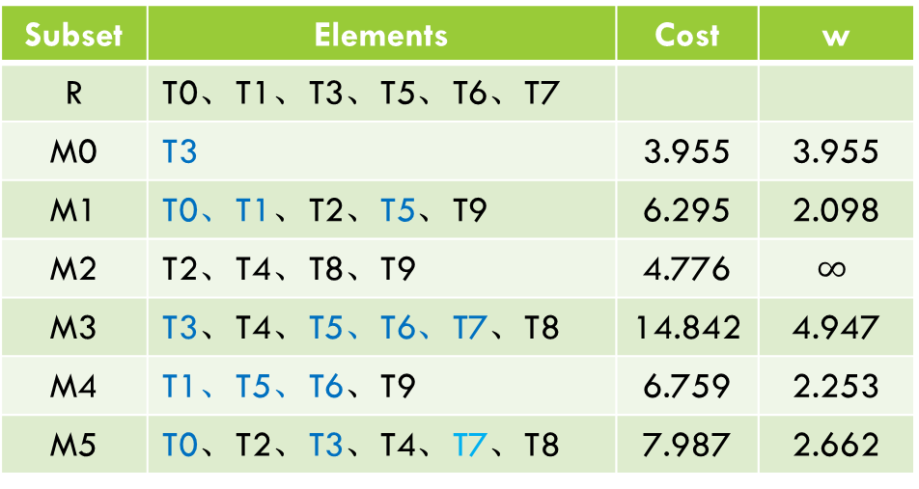
Example
Subset | Elements | Cost | w
R | T0、T1、T3、T5、T6、T7
M0 | T3 | 3.955 | 3.955
M1 | T0、T1、T2、T5、T9 | 6.295 | 2.098
M2 | T2、T4、T8、T9 | 4.776 | $$∞$$
M3 | T3、T4、T5、T6、T7、T8 | 14.842 | 4.947
M4 | T1、T5、T6、T9 | 6.759 | 2.253
M5 | T0、T2、T3、T4、T7、T8 | 7.987 | 2.662
The Greedy solution is :
M2+M1…

Slide 9
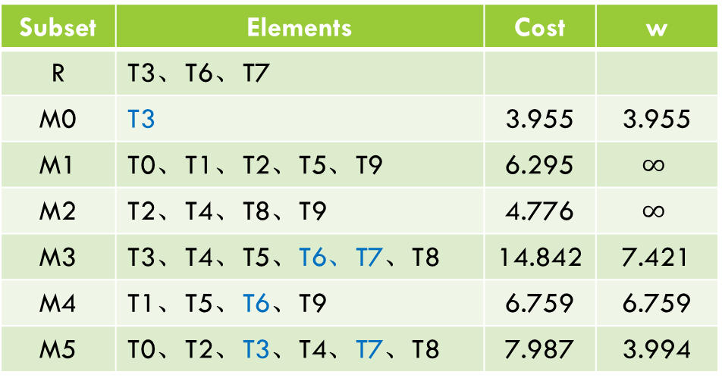
Example
Subset | Elements | Cost | w
R | T3、T6、T7
M0 | T3 | 3.955 | 3.955
M1 | T0、T1、T2、T5、T9 | 6.295 | $$∞$$
M2 | T2、T4、T8、T9 | 4.776 | $$∞$$
M3 | T3、T4、T5、T6、T7、T8 | 14.842 | 7.421
M4 | T1、T5、T6、T9 | 6.759 | 6.759
M5 | T0、T2、T3、T4、T7、T8 | 7.987 | 3.994
The Greedy solution is :
M2+M1+M0…

Slide 10
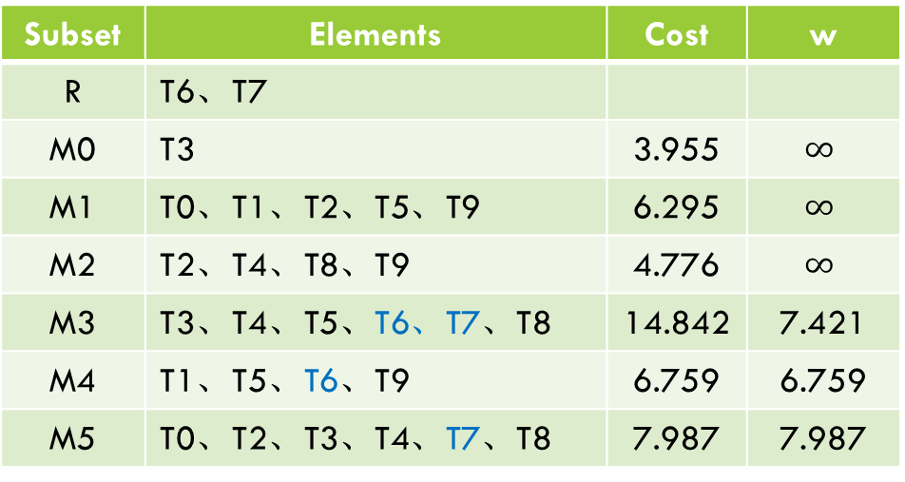
Example
Subset | Elements | Cost | w
R | T6、T7
M0 | T3 | 3.955 | $$∞$$
M1 | T0、T1、T2、T5、T9 | 6.295 | $$∞$$
M2 | T2、T4、T8、T9 | 4.776 | $$∞$$
M3 | T3、T4、T5、T6、T7、T8 | 14.842 | 7.421
M4 | T1、T5、T6、T9 | 6.759 | 6.759
M5 | T0、T2、T3、T4、T7、T8 | 7.987 | 7.987
The Greedy solution is :
M2+M1+M0+M4…

Slide 11
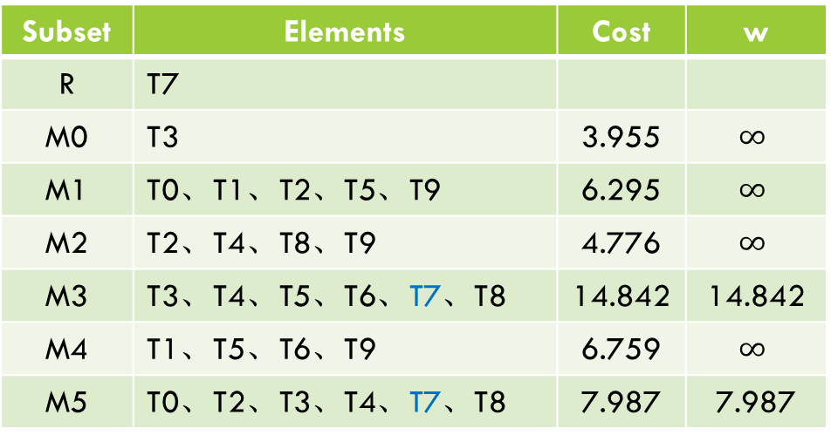
Example
Subset | Elements | Cost | w
R | T7
M0 | T3 | 3.955 | $$∞$$
M1 | T0、T1、T2、T5、T9 | 6.295 | $$∞$$
M2 | T2、T4、T8、T9 | 4.776 | $$∞$$
M3 | T3、T4、T5、T6、T7、T8 | 14.842 | 14.842
M4 | T1、T5、T6、T9 | 6.759 | $$∞$$
M5 | T0、T2、T3、T4、T7、T8 | 7.987 | 7.987
The Greedy solution is :
M2+M1+M0+M4+M5…

Slide 12
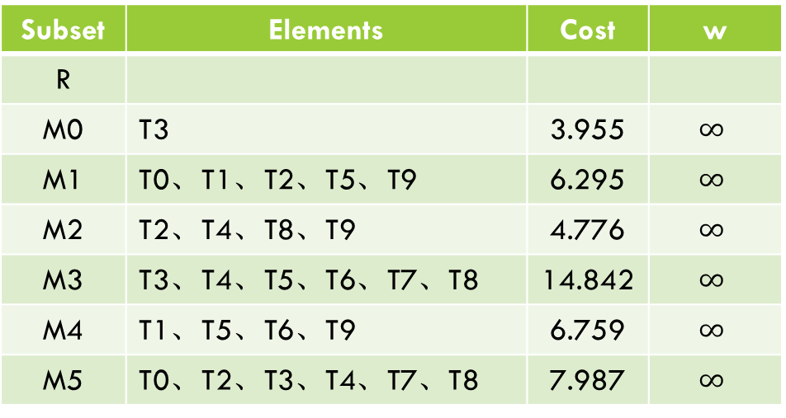
Example
Subset | Elements | Cost | w
R
M0 | T3 | 3.955 | $$∞$$
M1 | T0、T1、T2、T5、T9 | 6.295 | $$∞$$
M2 | T2、T4、T8、T9 | 4.776 | $$∞$$
M3 | T3、T4、T5、T6、T7、T8 | 14.842 | $$∞$$
M4 | T1、T5、T6、T9 | 6.759 | $$∞$$
M5 | T0、T2、T3、T4、T7、T8 | 7.987 | $$∞$$
The Greedy solution is :
M2+M1+M0+M4+M5=29.772

Slide 13
Example
Subset | Elements | Cost
M0 | T3 | 3.955
M1 | T0、T1、T2、T5、T9 | 6.295
M2 | T2、T4、T8、T9 | 4.776
M3 | T3、T4、T5、T6、T7、T8 | 14.842
M4 | T1、T5、T6、T9 | 6.759
M5 | T0、T2、T3、T4、T7、T8 | 7.987
The optimal solution is：T4+T5=14.746
The Greedy solution is : M2+M1+M0+M4+M5=29.772
So, W(C) = 2.019*W(C*)

Slide 14
Thank You !
Q&A

