Slide 1
Vertex Cover Problem
Zhiyuan Wang
12032878
Choice the vertex to cover all the edge

Slide 2
Content
Vertex Cover Problem
Convert to Set Cover Problem
Price Method Algorithm
The example that chooses the edge in different orders
The example where a good solution is not obtained by the pricing method
The example that the vertex cover problem where better results are always obtained by the greedy set cover algorithm than the pricing method
The example that the vertex cover problem where better results are always obtained by the pricing method than the greedy set cover algorithm

Slide 3
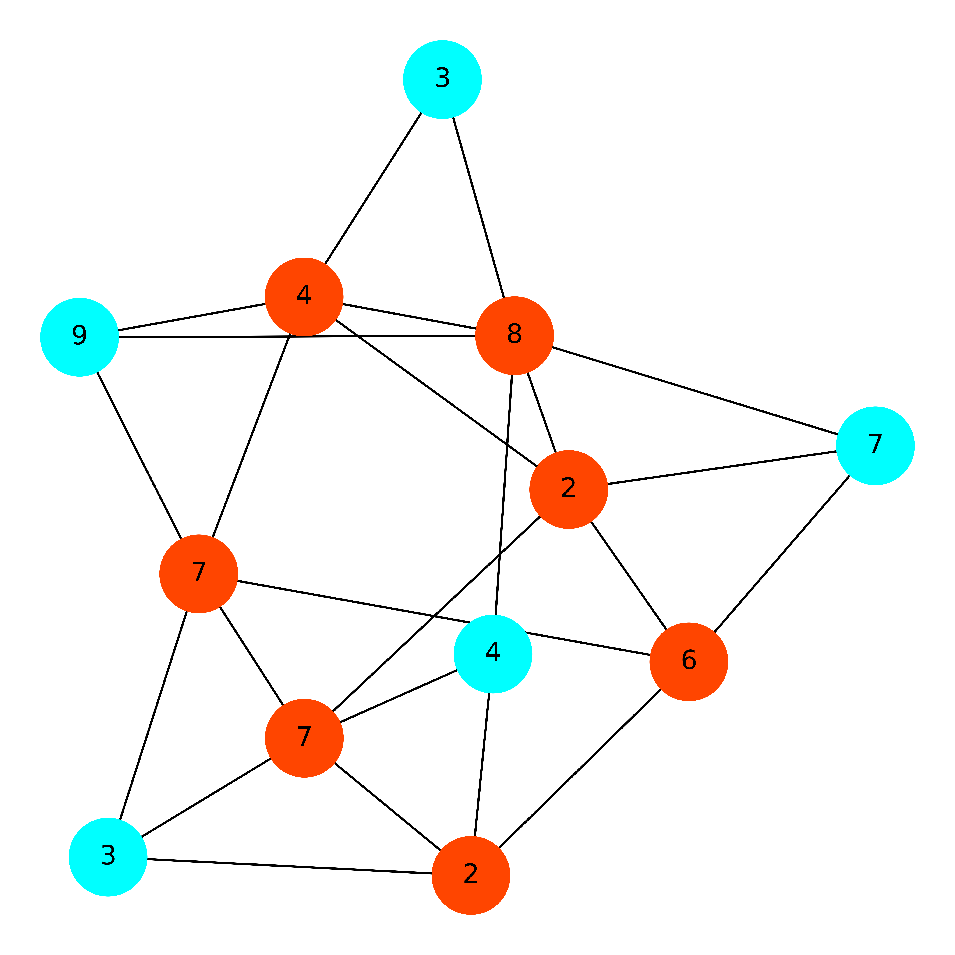
Vertex Cover Problem
This problem’s target is choosing vertex to cover all of the edges and minimize the total cost.

Slide 4
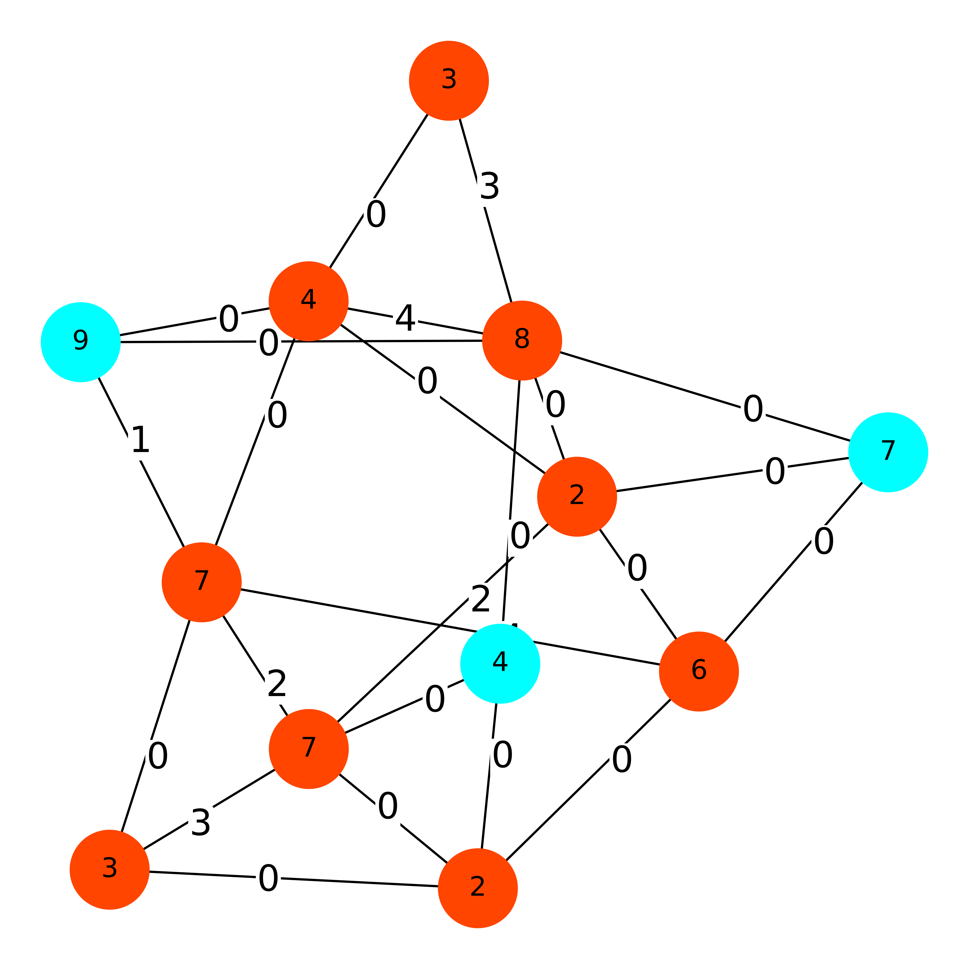
Price Method Algorithm
In this algorithm, all the edge will be initialization with value 0. In each iteration, we will increase one edge to let one of it’s vertexes be tight without violating fairness.

Slide 5
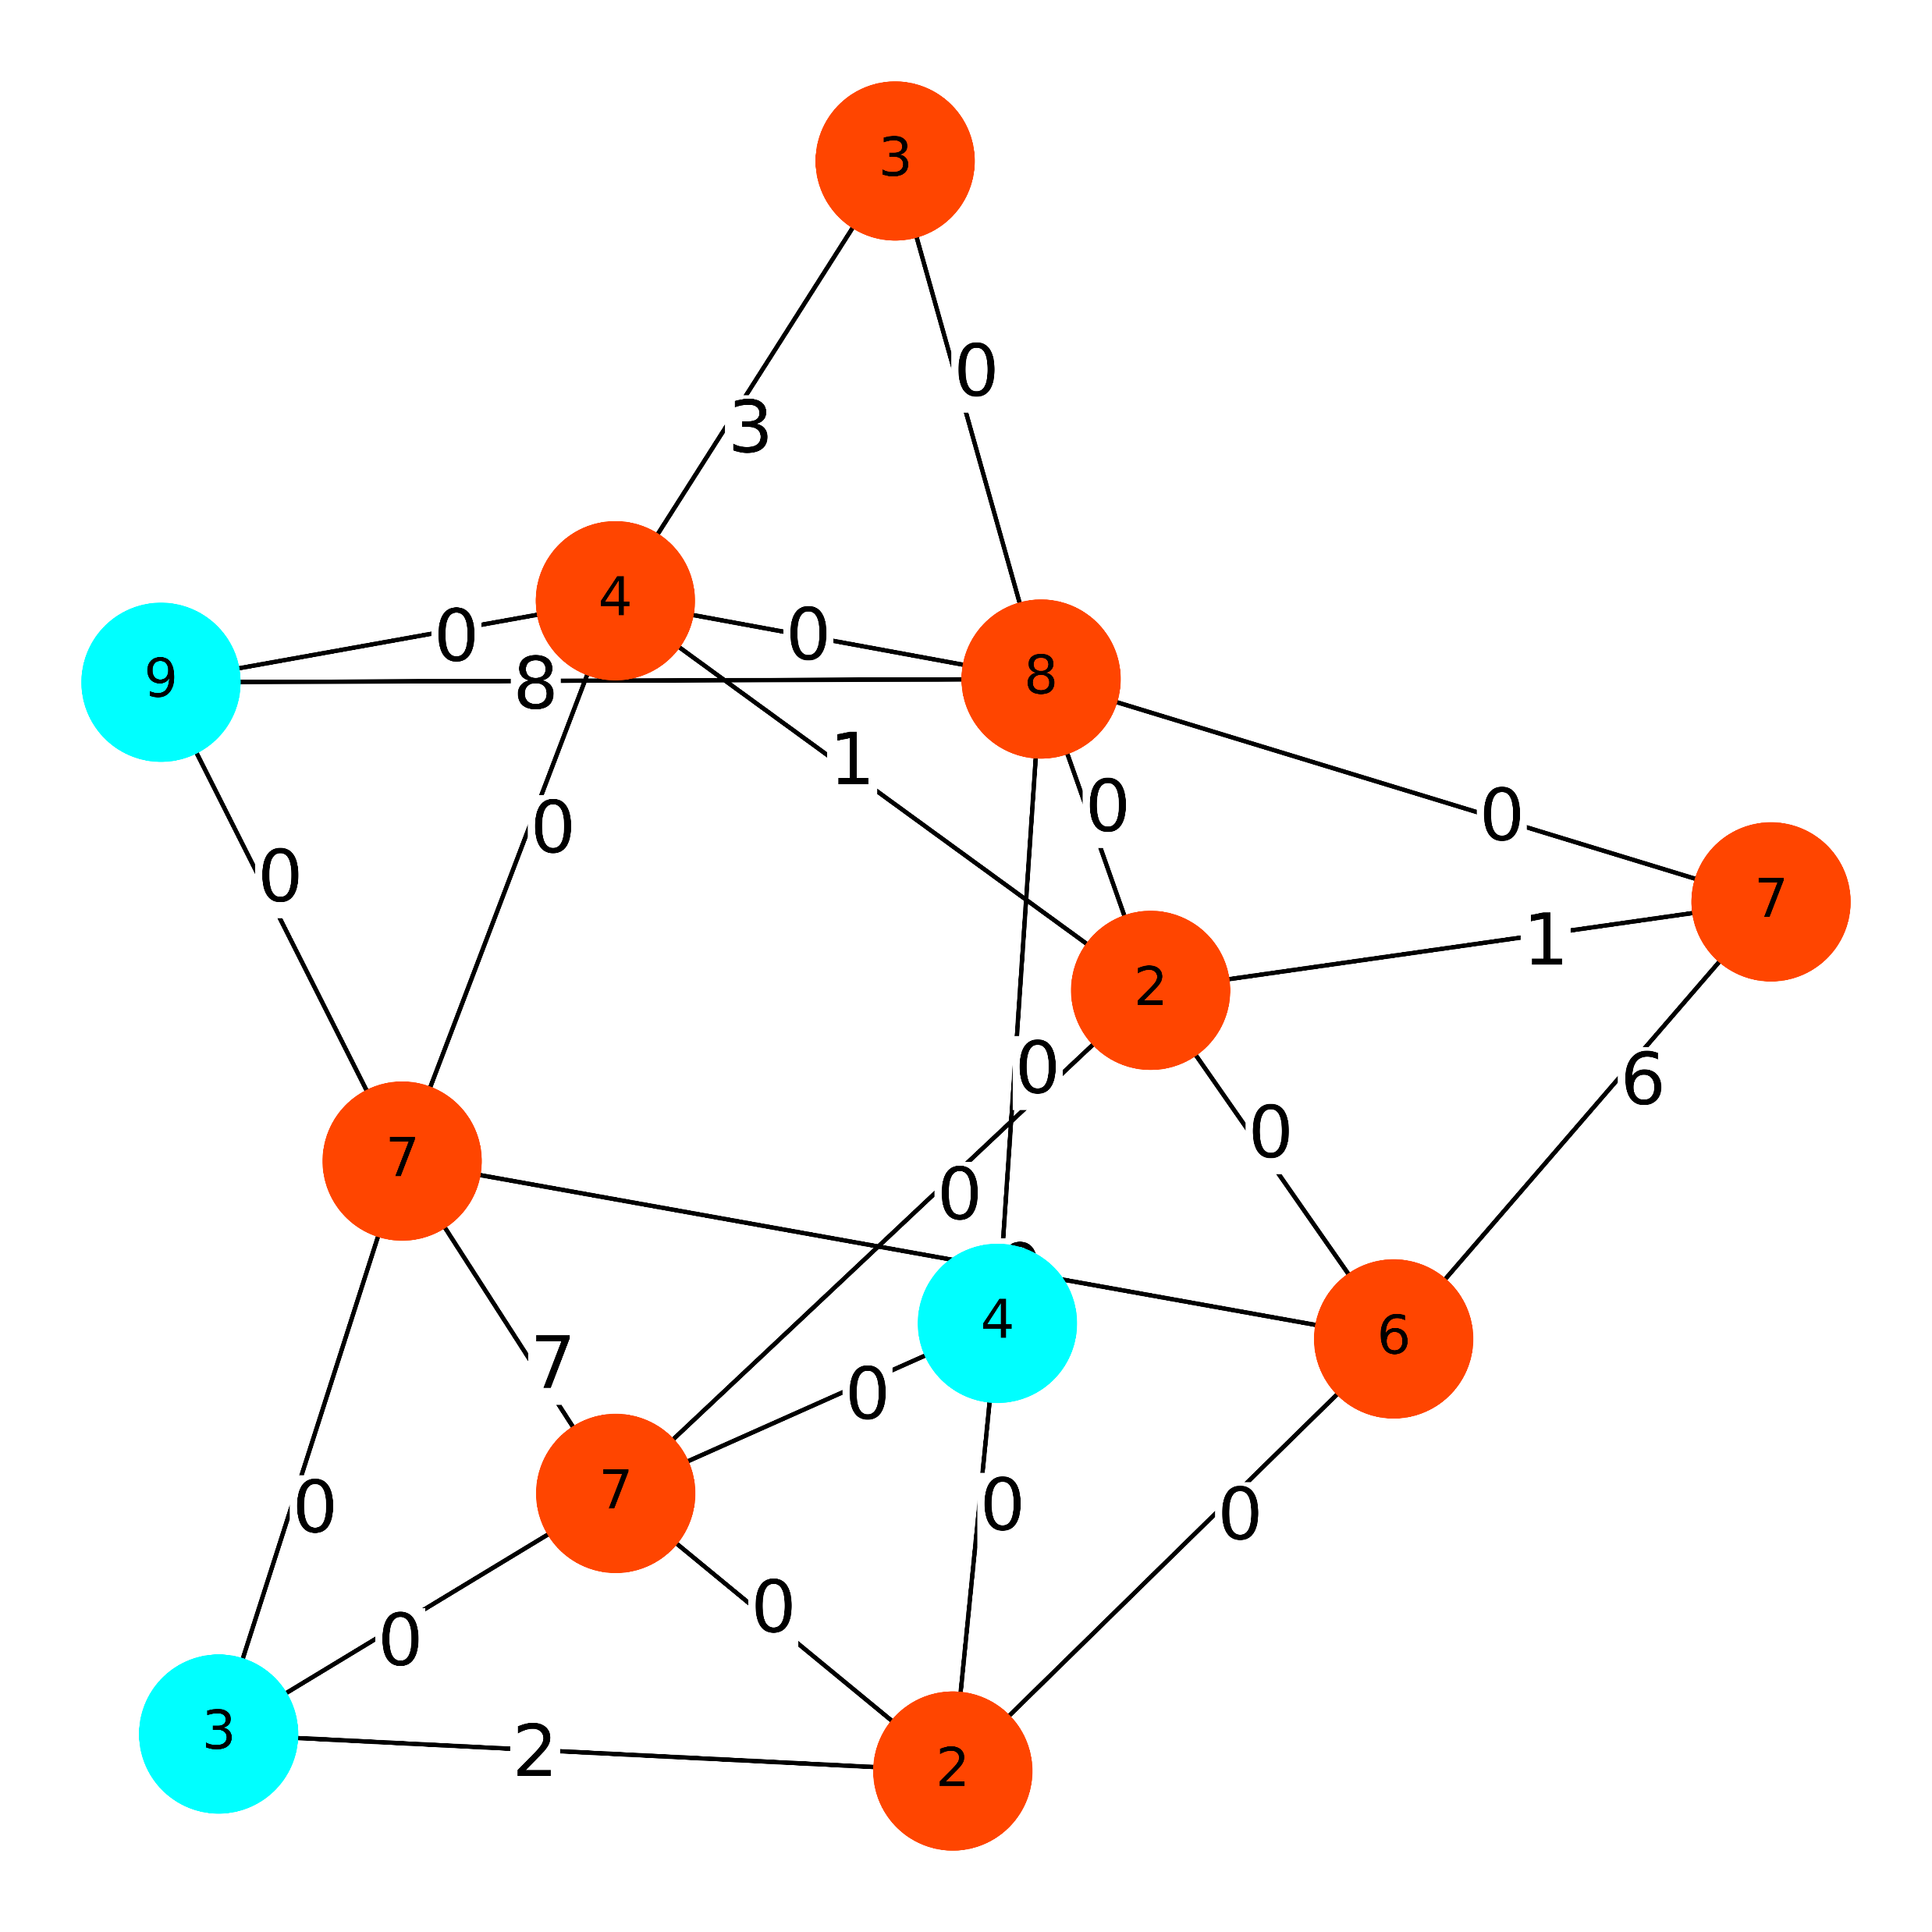
Example 1
Choice the min edge firstly
Choice the max edge firstly

Slide 6
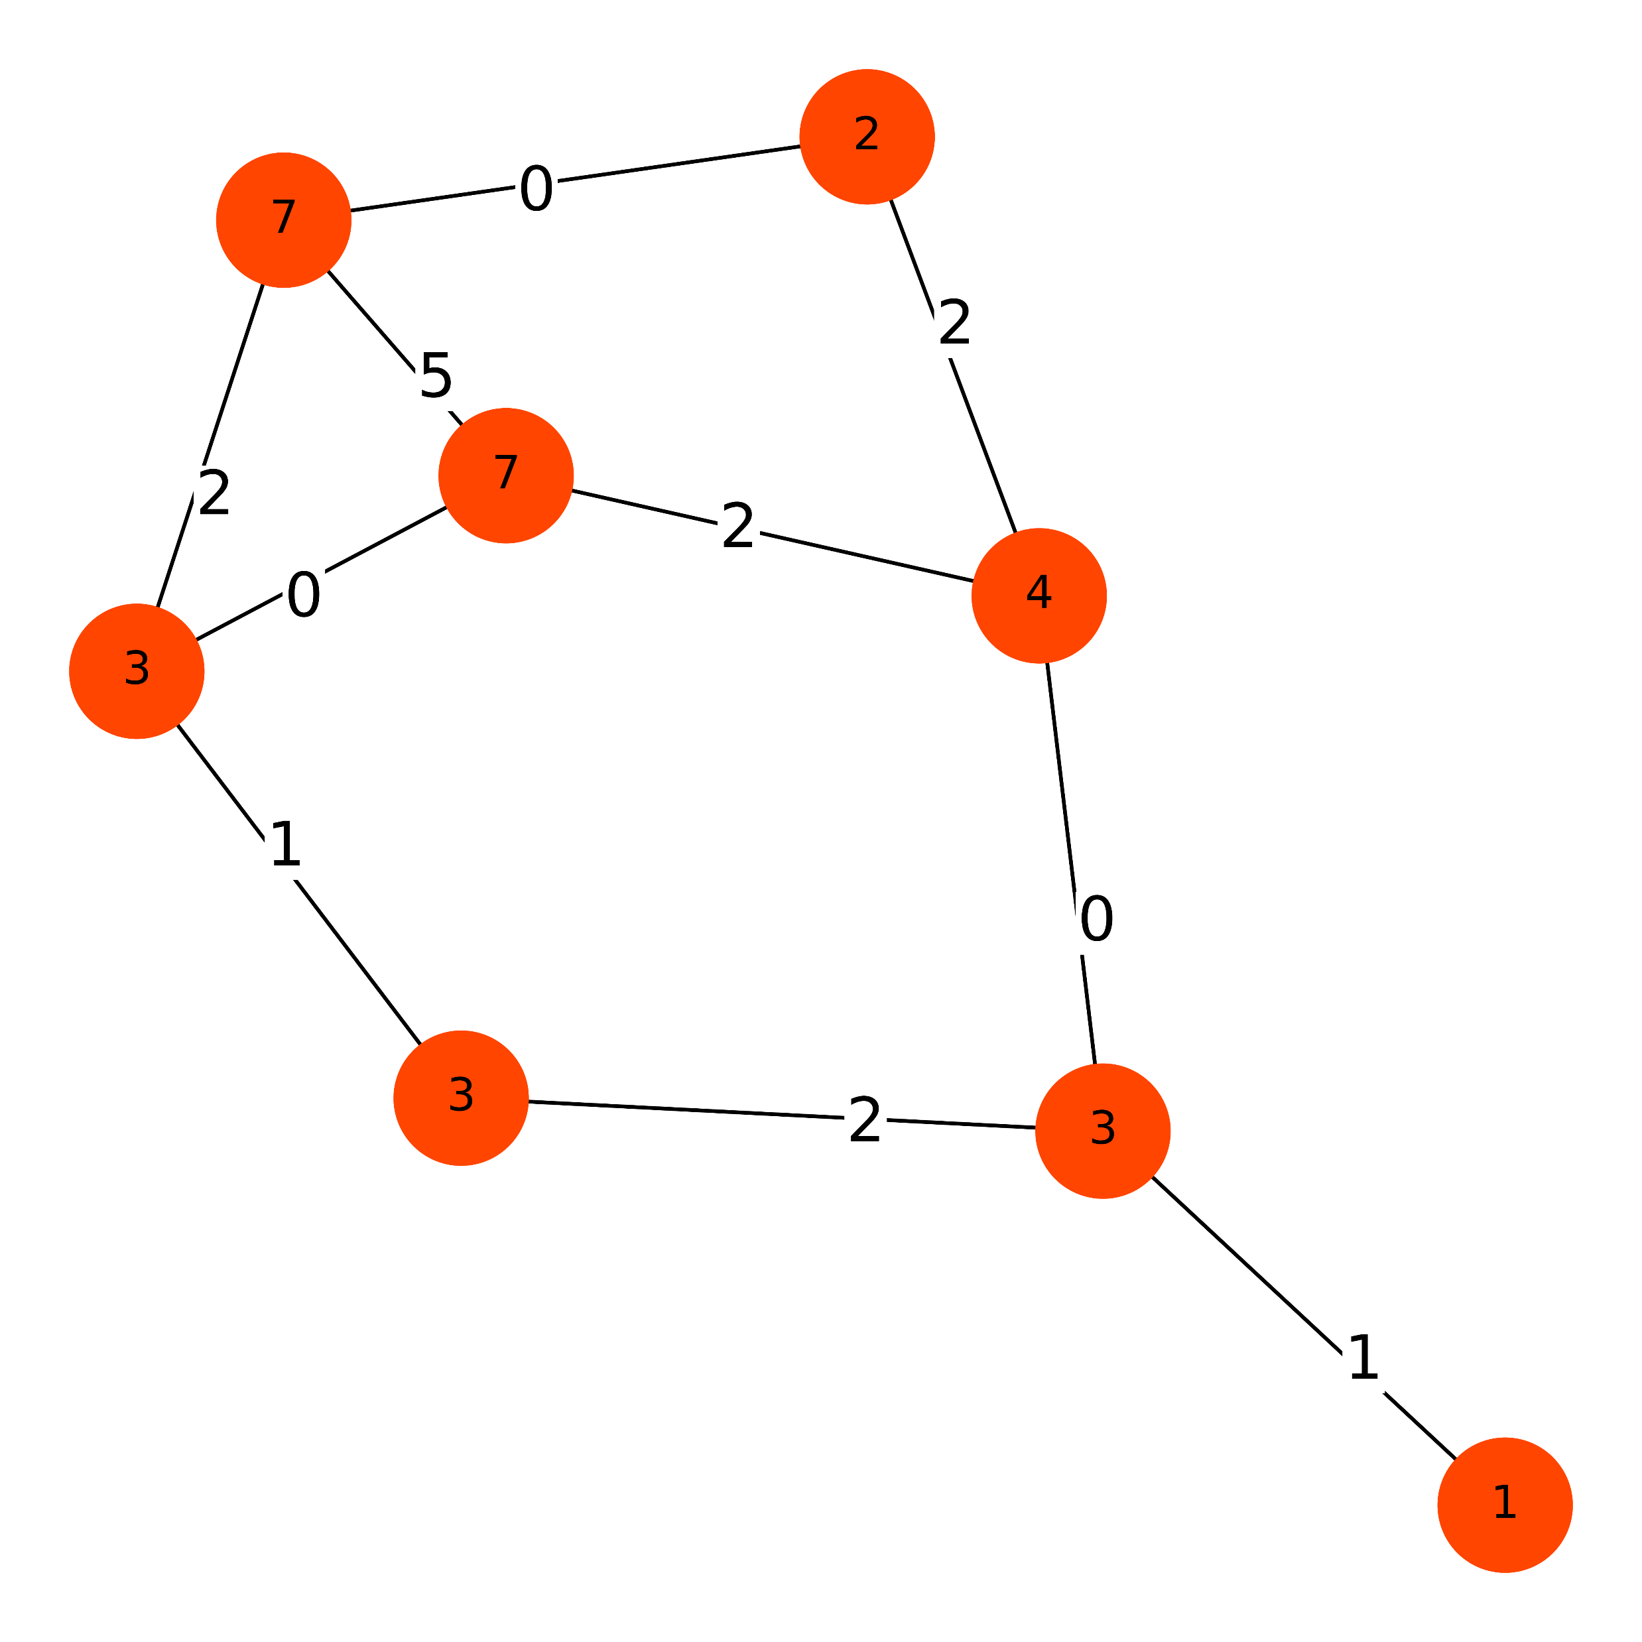
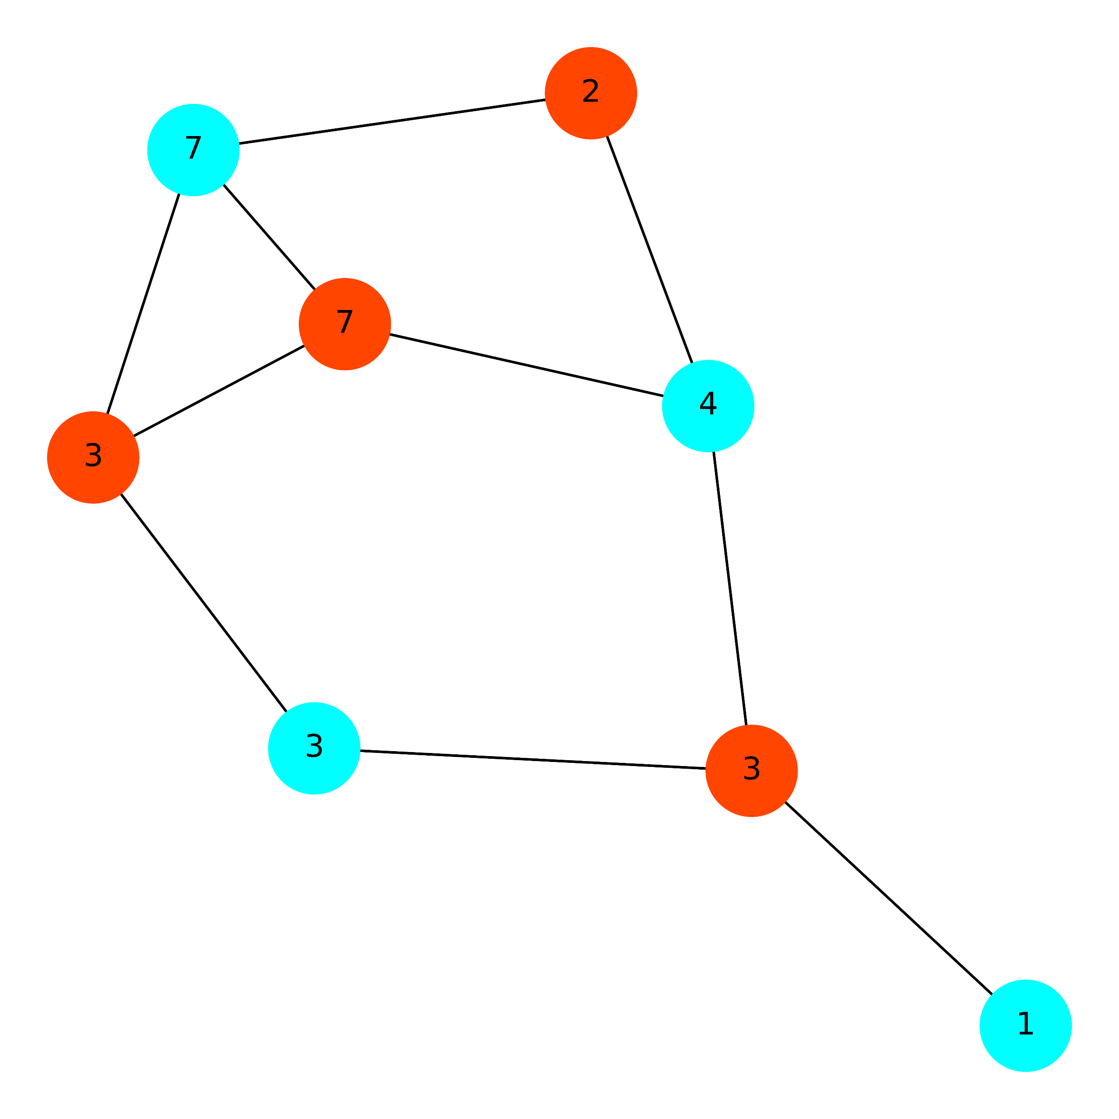
Example 2
Use the Price Method Algorithm
Cost is 48
Use the Brute Algorithm
Cost is 24

Slide 7
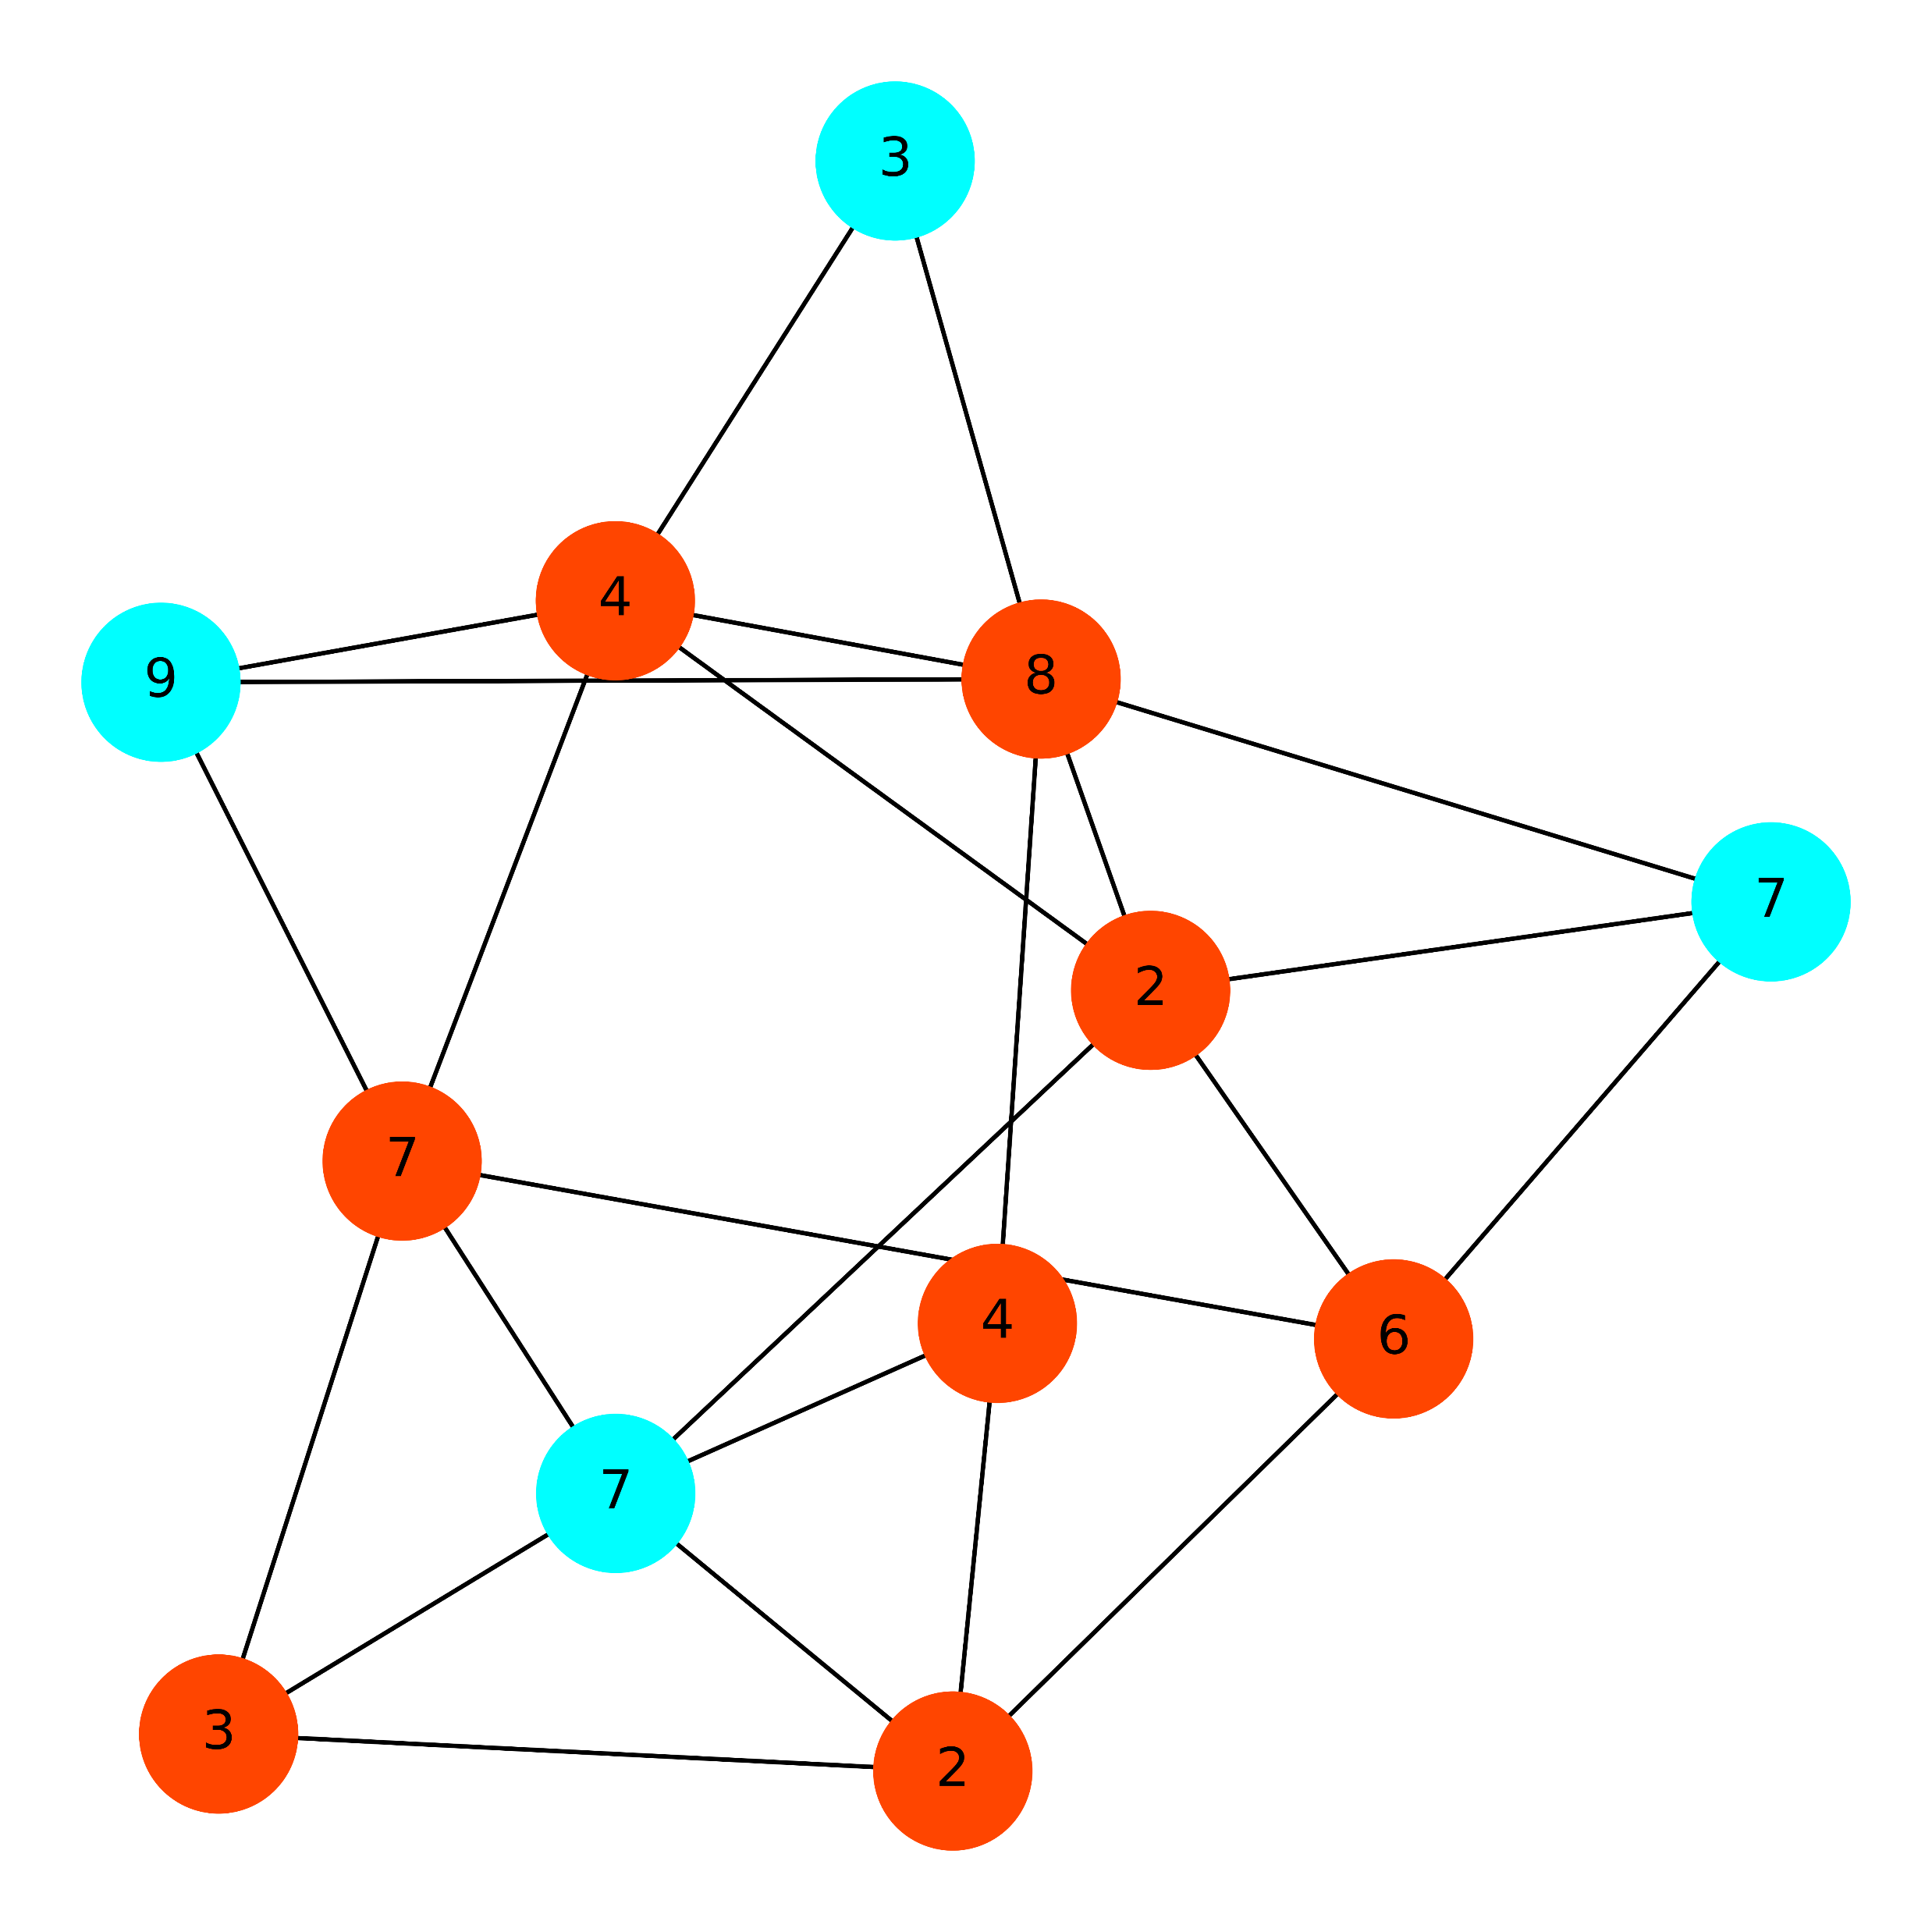
Example 3
Use the Price Method Algorithm
Cost is 46
Use the Greedy Set Cover Algorithm
Cost is 36

Slide 8
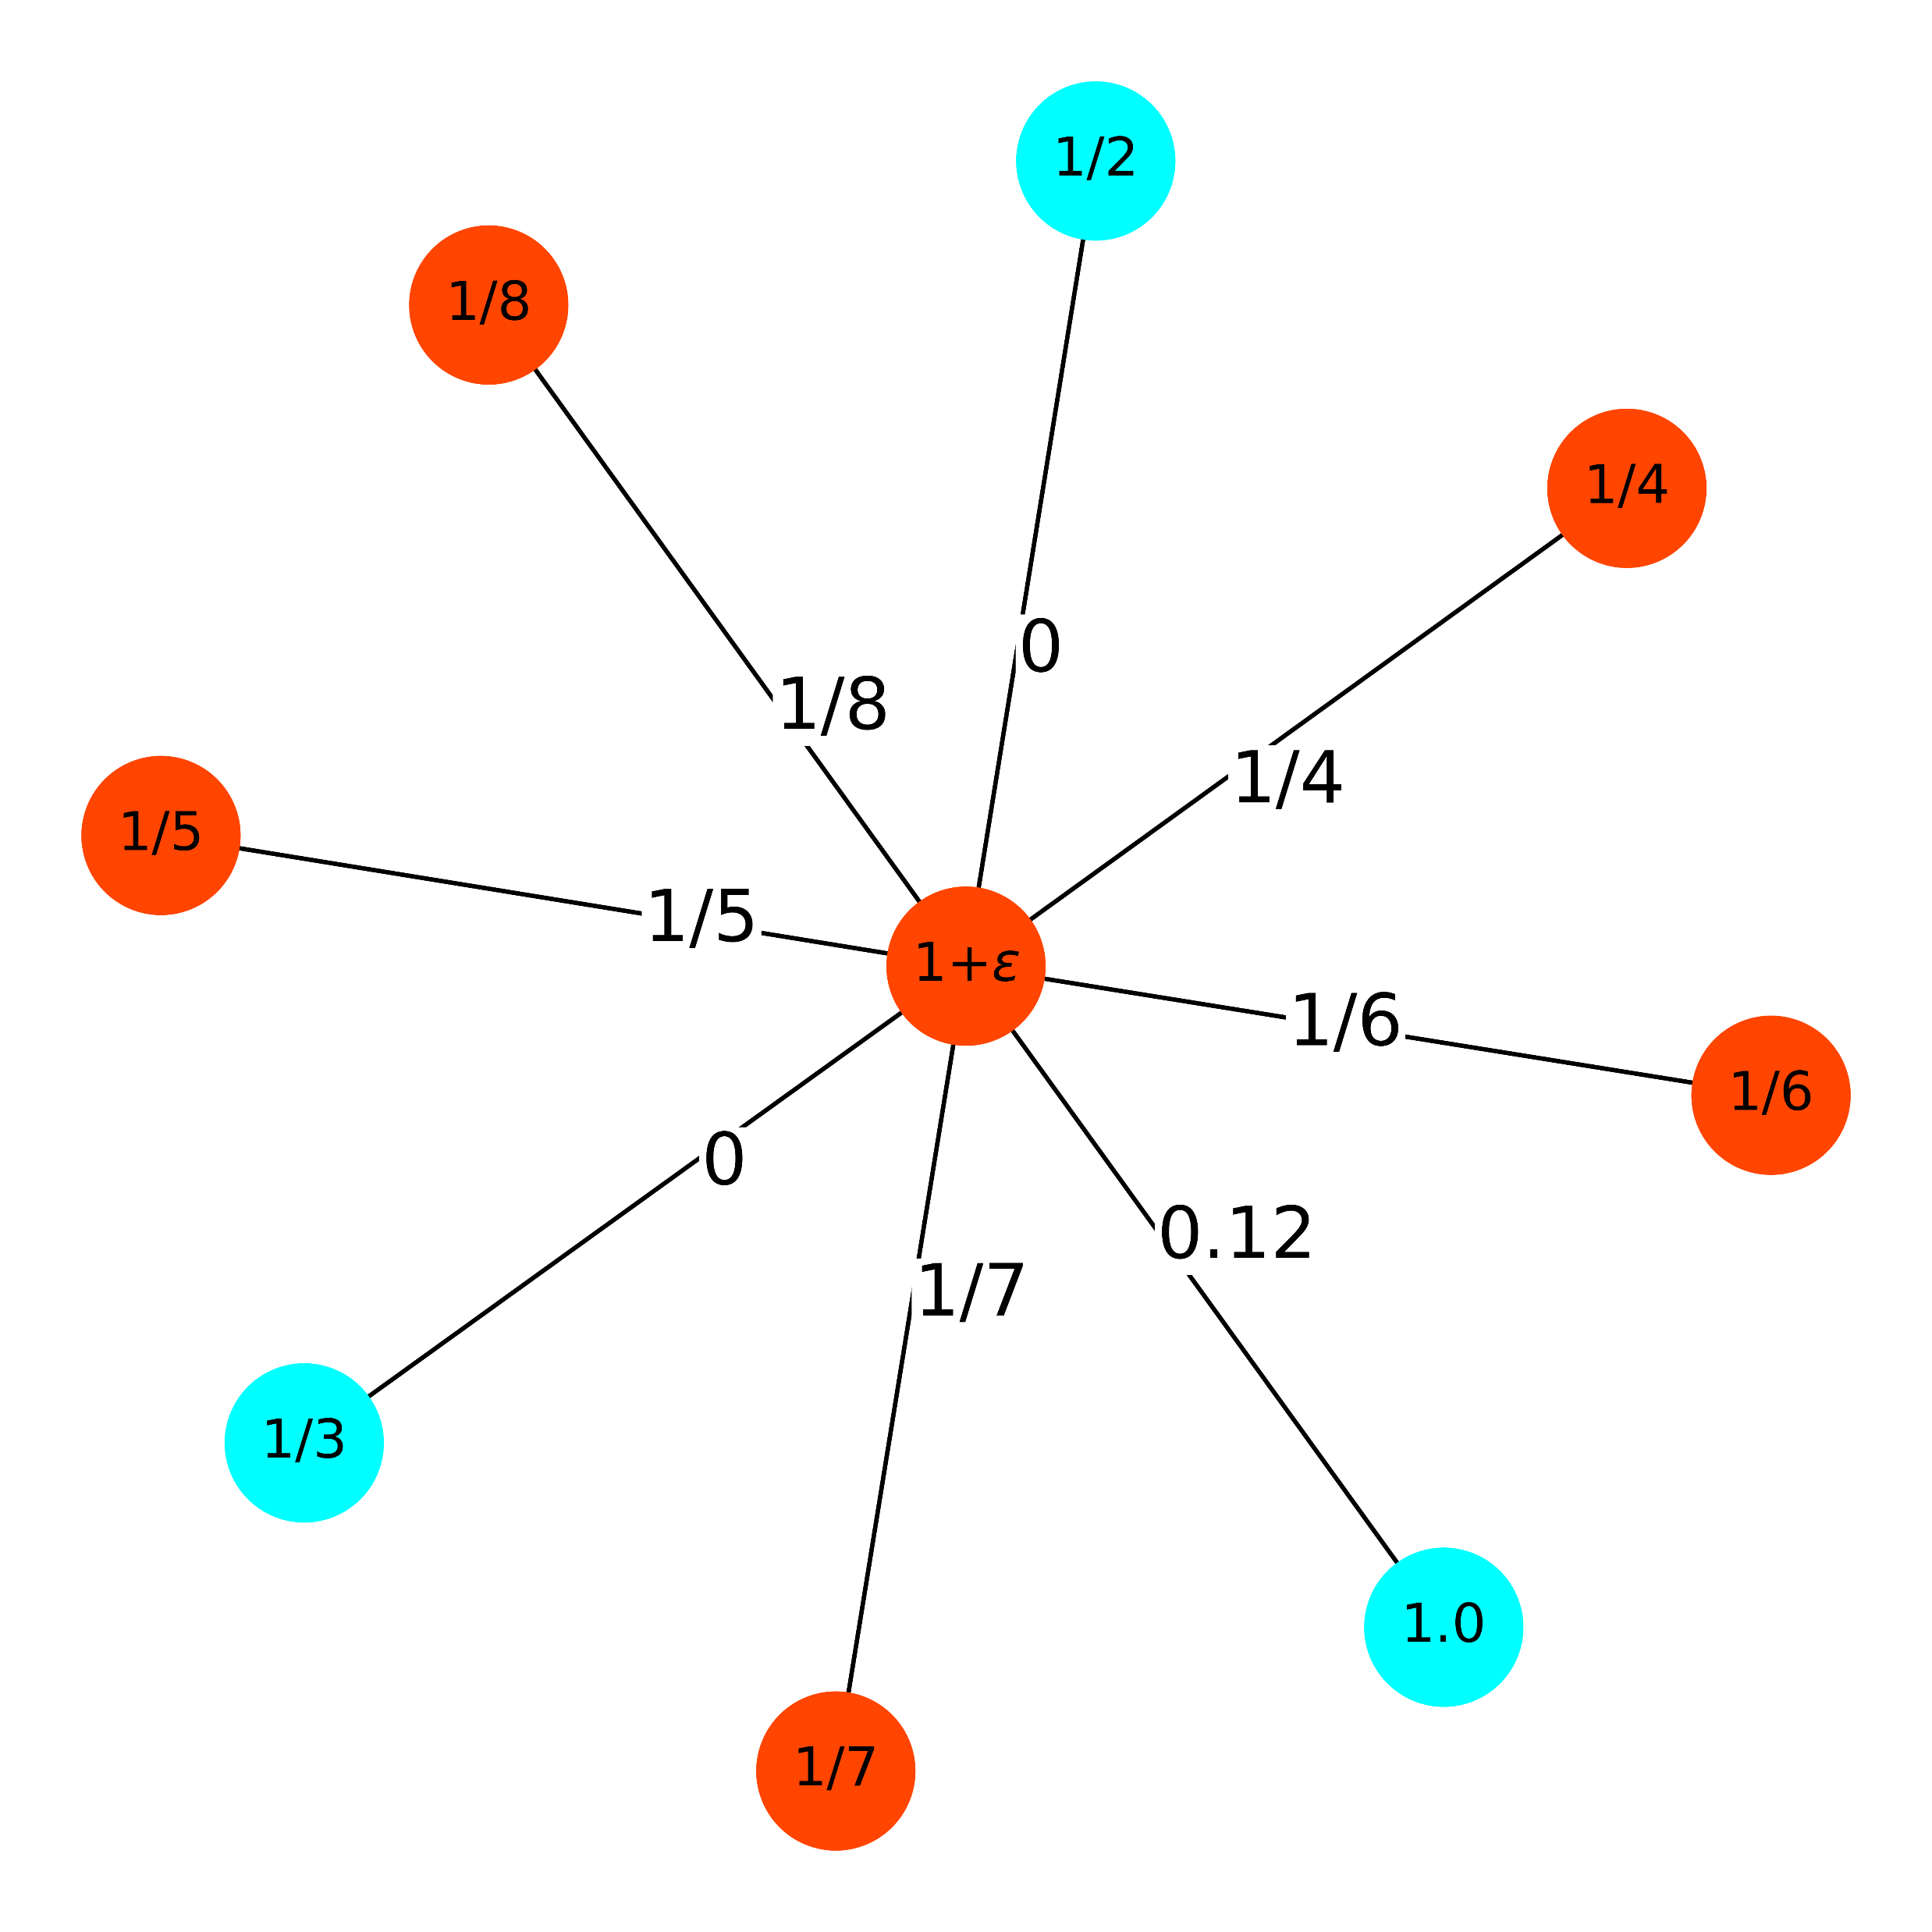
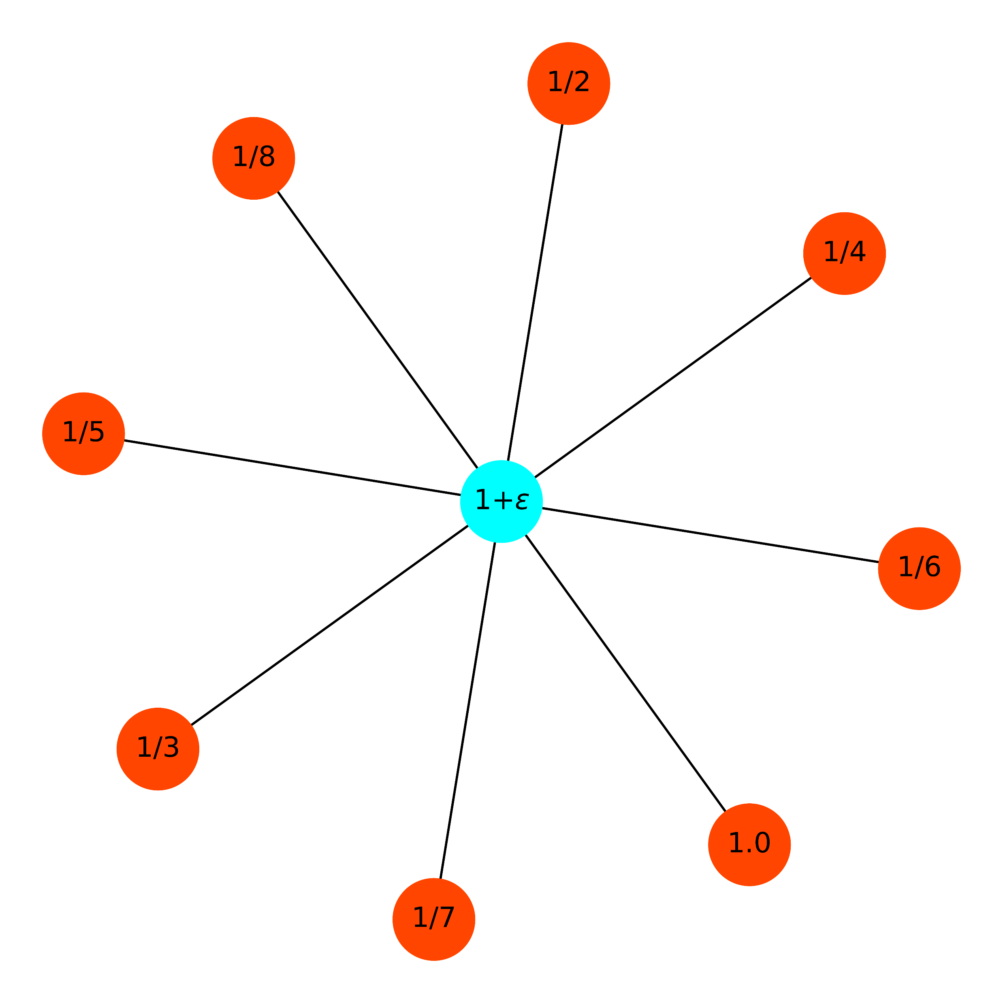
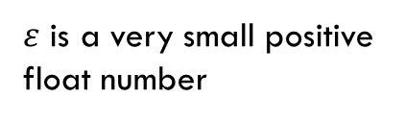
Example 4
$ε$ is a very small positive float number
Use the Price Method Algorithm
Cost is 1.8845238
Use the Greedy Set Cover Algorithm
Cost is 2.7178571

Slide 9
Thank You !
Q&A

