Slide 1
Linear Programming
Zhiyuan Wang
12032878

Slide 2
Content
Linear Programming Software
A small example
A large example
A huge example

Slide 3

Linear Programming Software
The software which I use is Mathematica. It is a numerical calculation software published by the Wolfram company.

Slide 4
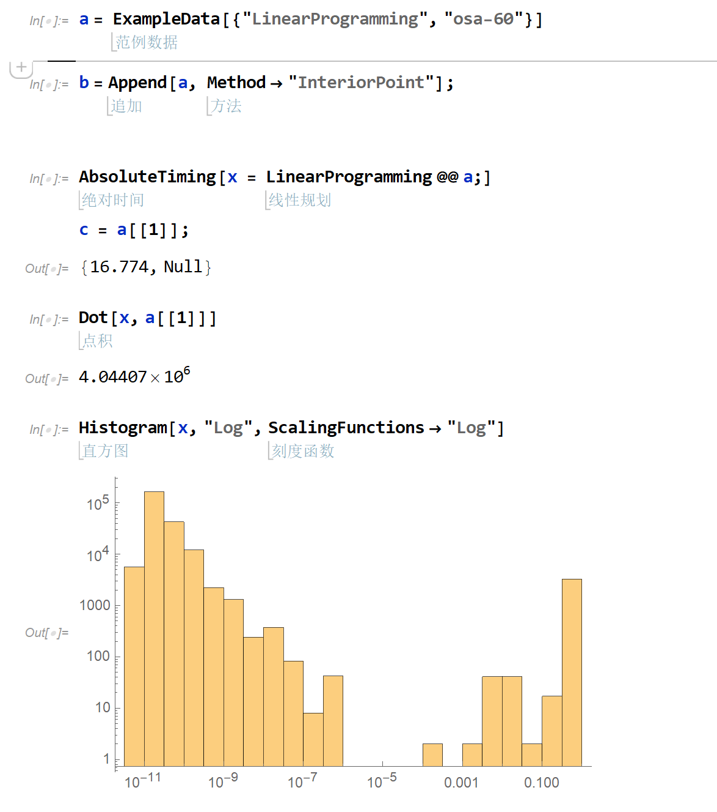
Mathematica
Mathematic is a popular numerical calculation software.
It integrates a large number of commonly used numerical computation functions and detailed documentation. And its calculation engine is very powerful.
For linear programming, it have built-in function to solve the problem. It also can provide some open source dataset to run the benchmark.
It can calculate the linear programming problem by many method, including “Interior Point” method, “Simplex” method and “Revised Simplex” method

Slide 5
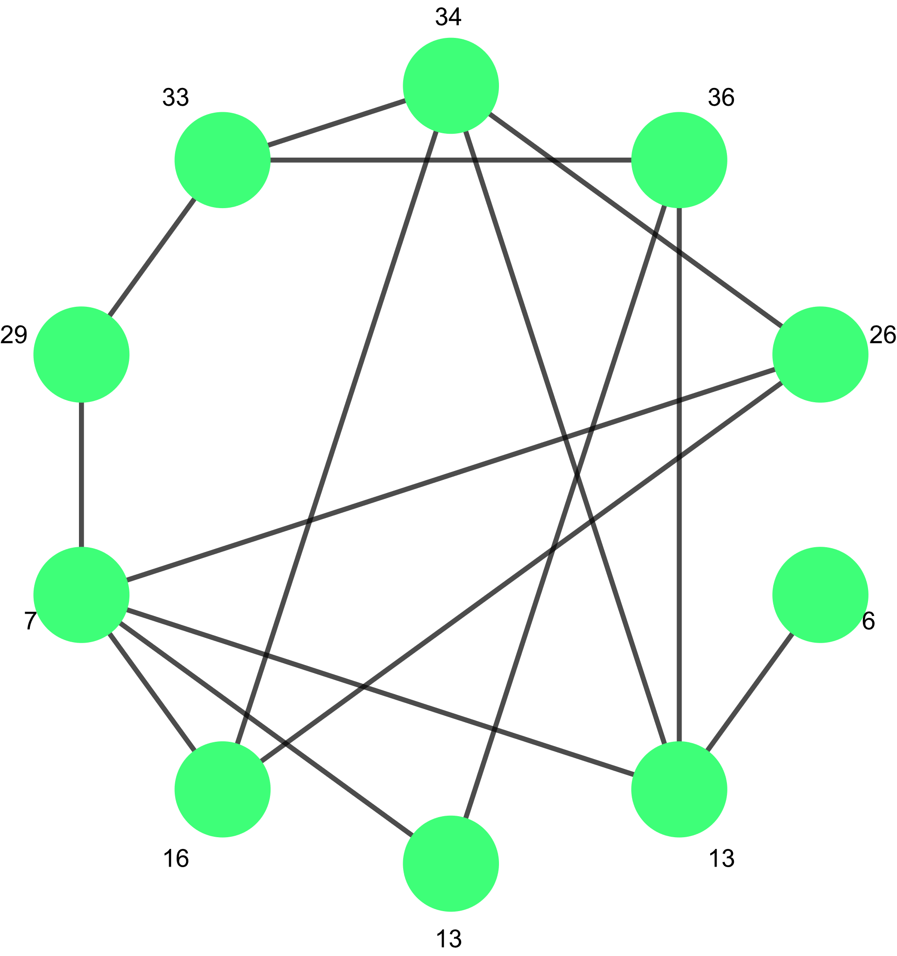
Small Example
The small example which I choose is a Vertex problem.
There are ten nodes in the graph, and the graph is connected

Slide 6
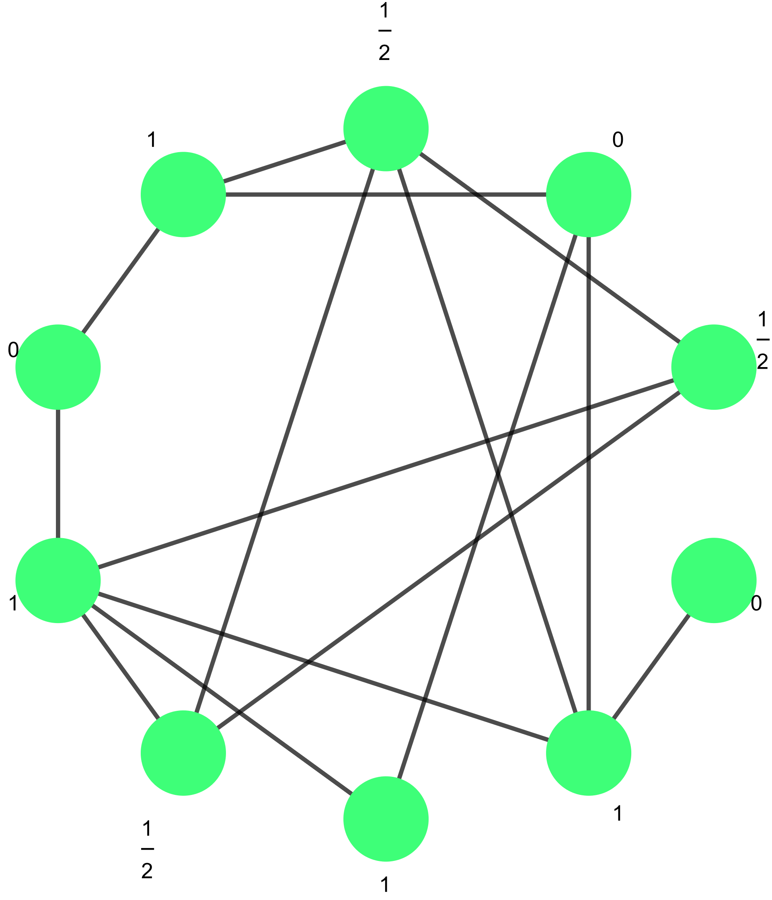
Small Example
After the linear programming, we can the optimal result.
The number near the node is the x.

Slide 7
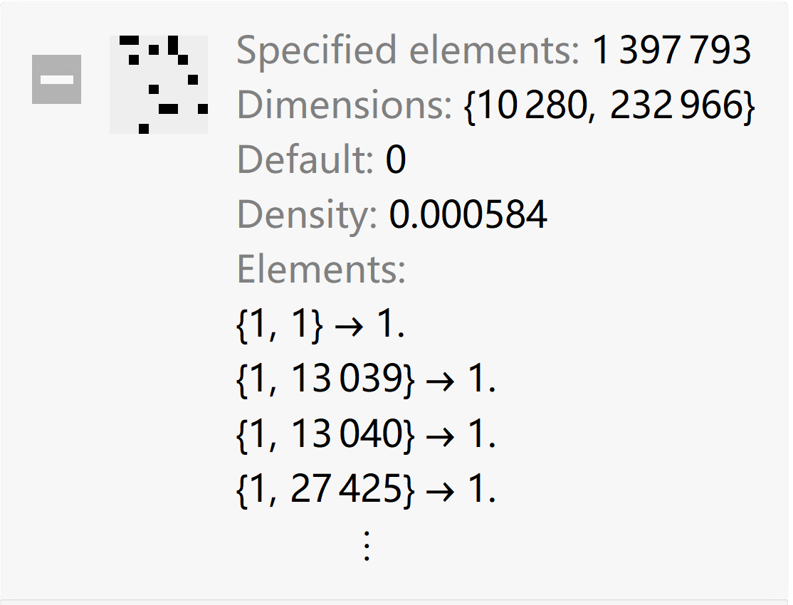
Large Example
The large example is a dataset from website: www.netlib.org.
On the right is its constraint matrix, which is a sparse matrix with 1,397,793 elements which’s value is not 0.
We can find it have 232,966 elements and 10,280 constraint conditions.

Slide 8
Large Example
The large example is a dataset from website: www.netlib.org.
For this large example. It will be solved in 16.774s, in a laptop with 8 cores and 16GB memory.

Slide 9
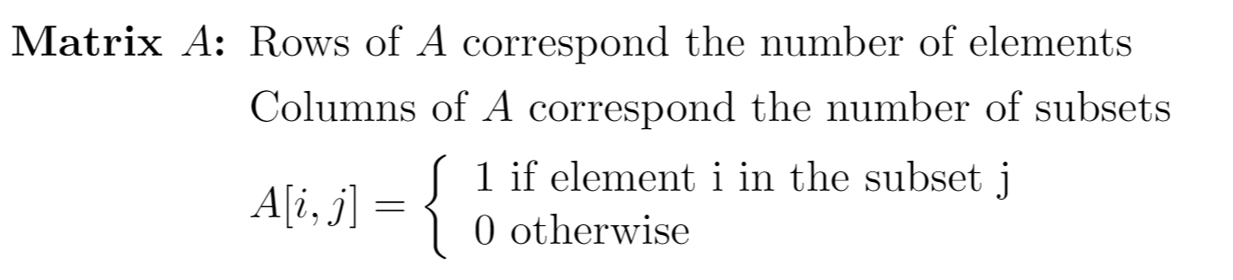
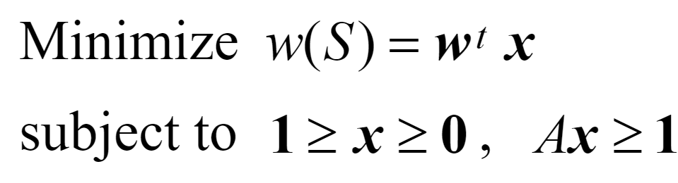
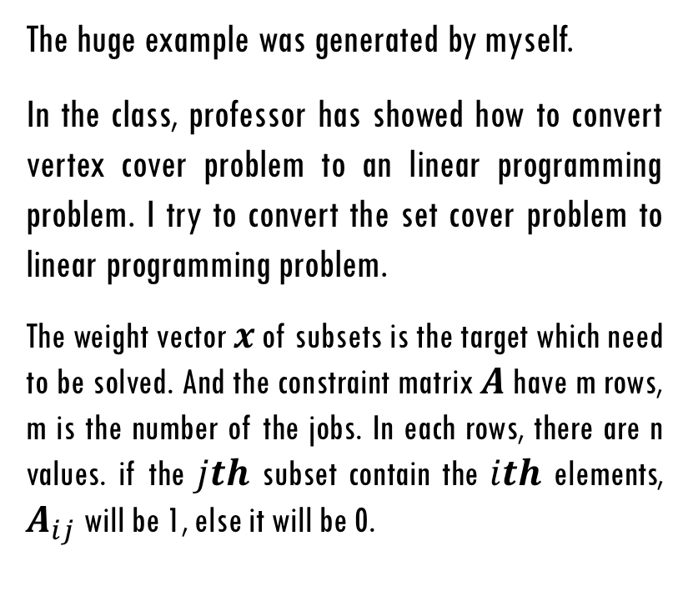
Huge Example
The huge example was generated by myself.
In the class, professor has showed how to convert vertex cover problem to an linear programming problem. I try to convert the set cover problem to linear programming problem.
The weight vector $x$ of subsets is the target which need to be solved. And the constraint matrix $A$ have m rows, m is the number of the jobs. In each rows, there are n values. if the $jth$ subset contain the $ith$ elements, $A_{ij}$ will be 1, else it will be 0.

Slide 10
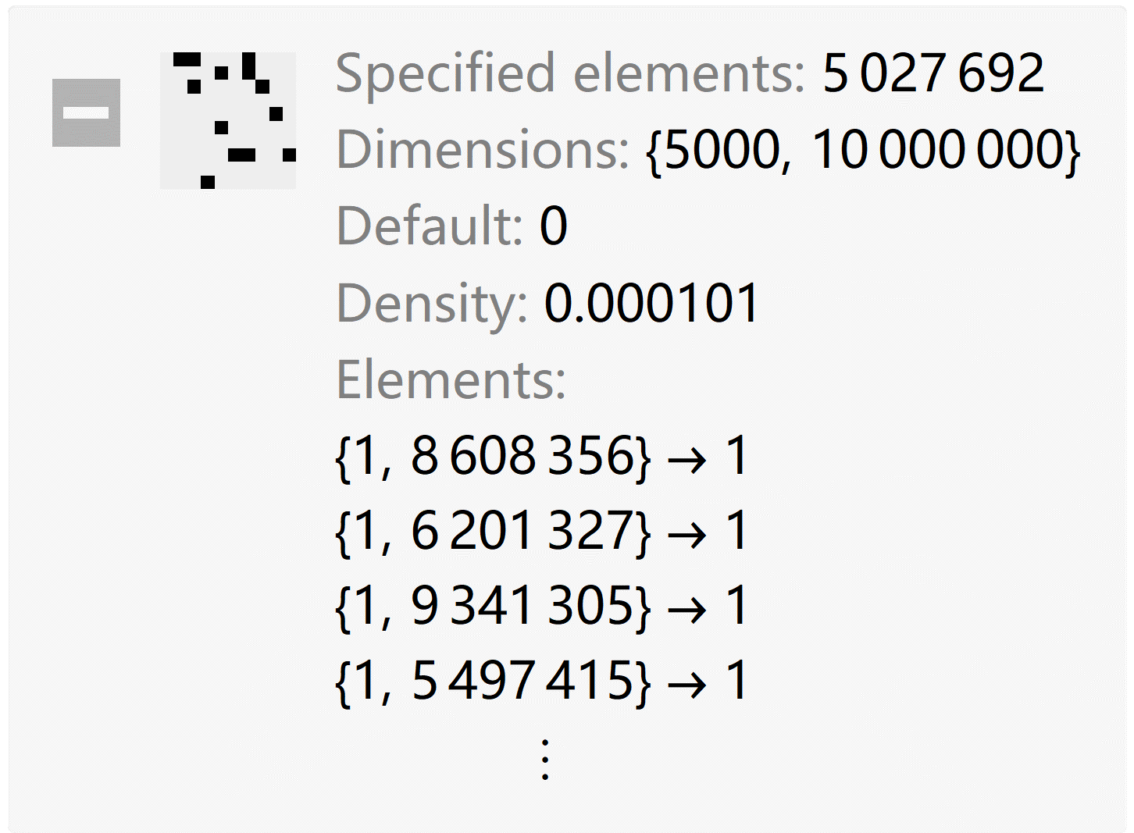
Huge Example
On the right is its constraint matrix, which is a sparse matrix with 5,027,692 elements which’s value is not 0.
We can find it have 10,000,000 elements and 5,000 constraint conditions.

Slide 11
Huge Example
The huge example was generated by myself.
For this huge example. It will be solved in 269.93s, in a server with 20 cores and 64GB memory.

Slide 12
Thank You !
Q&A

