Slide 1
Nearest Neighbor Greedy
Zhiyuan Wang
12032878
The quality of the greedy solution for TSP

Slide 2

Travelling Salesman Problem (TSP)
This Problem’s target is to find the shortest tour to visit all cities and return to the starting city. (Fine the shortest circuit in an map which can traverse all the nodes.)
INPUT:
City set: n cities (i = 1, 2, ..., n)
Distance between each pair of cities (i, j): $d_{ij}=d_{ji}$
OUTPUT:
A list which storage the order to the city
The distance of this travel plan.
In this pre, we suppose the num of cities is 10.

Slide 3
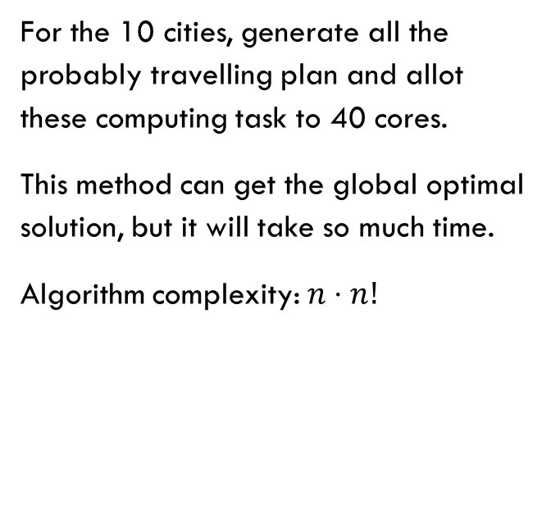
Brute Force To get optimal Solution
Num of Cities | Time/Second
10 | 2.3
11 | 27.83
12 | 364.32
13 | 5130.84
14 | 77357.28
For the 10 cities, generate all the probably travelling plan and allot these computing task to 40 cores.
This method can get the global optimal solution, but it will take so much time.
Algorithm complexity: $n⋅n!$

Slide 4
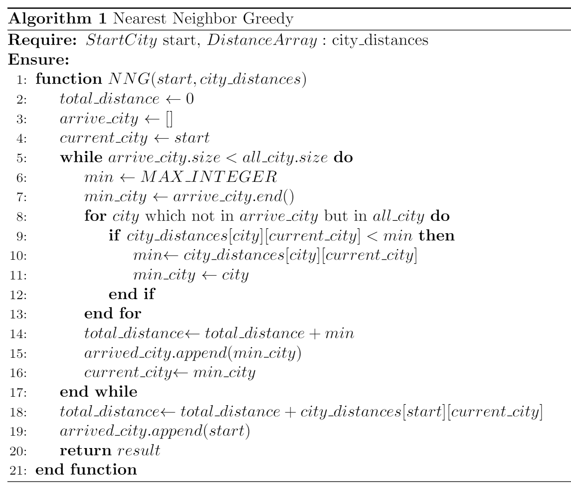
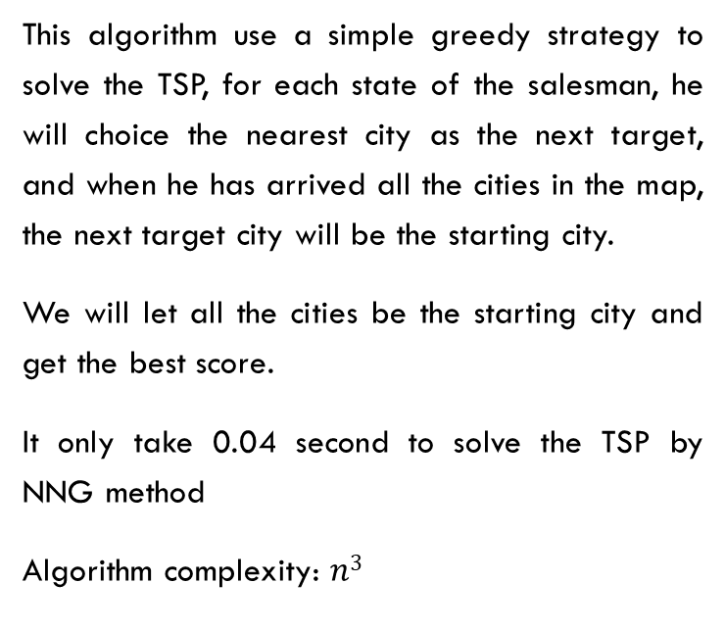
Nearest Neighbor Greedy(NNG)
This algorithm use a simple greedy strategy to solve the TSP, for each state of the salesman, he will choice the nearest city as the next target, and when he has arrived all the cities in the map, the next target city will be the starting city.
We will let all the cities be the starting city and get the best score.
It only take 0.04 second to solve the TSP by NNG method
Algorithm complexity: $n3$

Slide 5
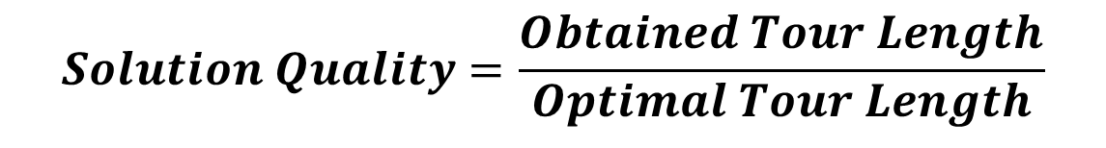
Result and quality
The quality of the obtained solution (obtained tour) is evaluated by the following quality measure (in this formulation, the larger values show the worse solutions: 1 is the optimal solution).
$$Solution Quality=\frac{Obtained Tour Length}{Optimal Tour Length}$$

Slide 6
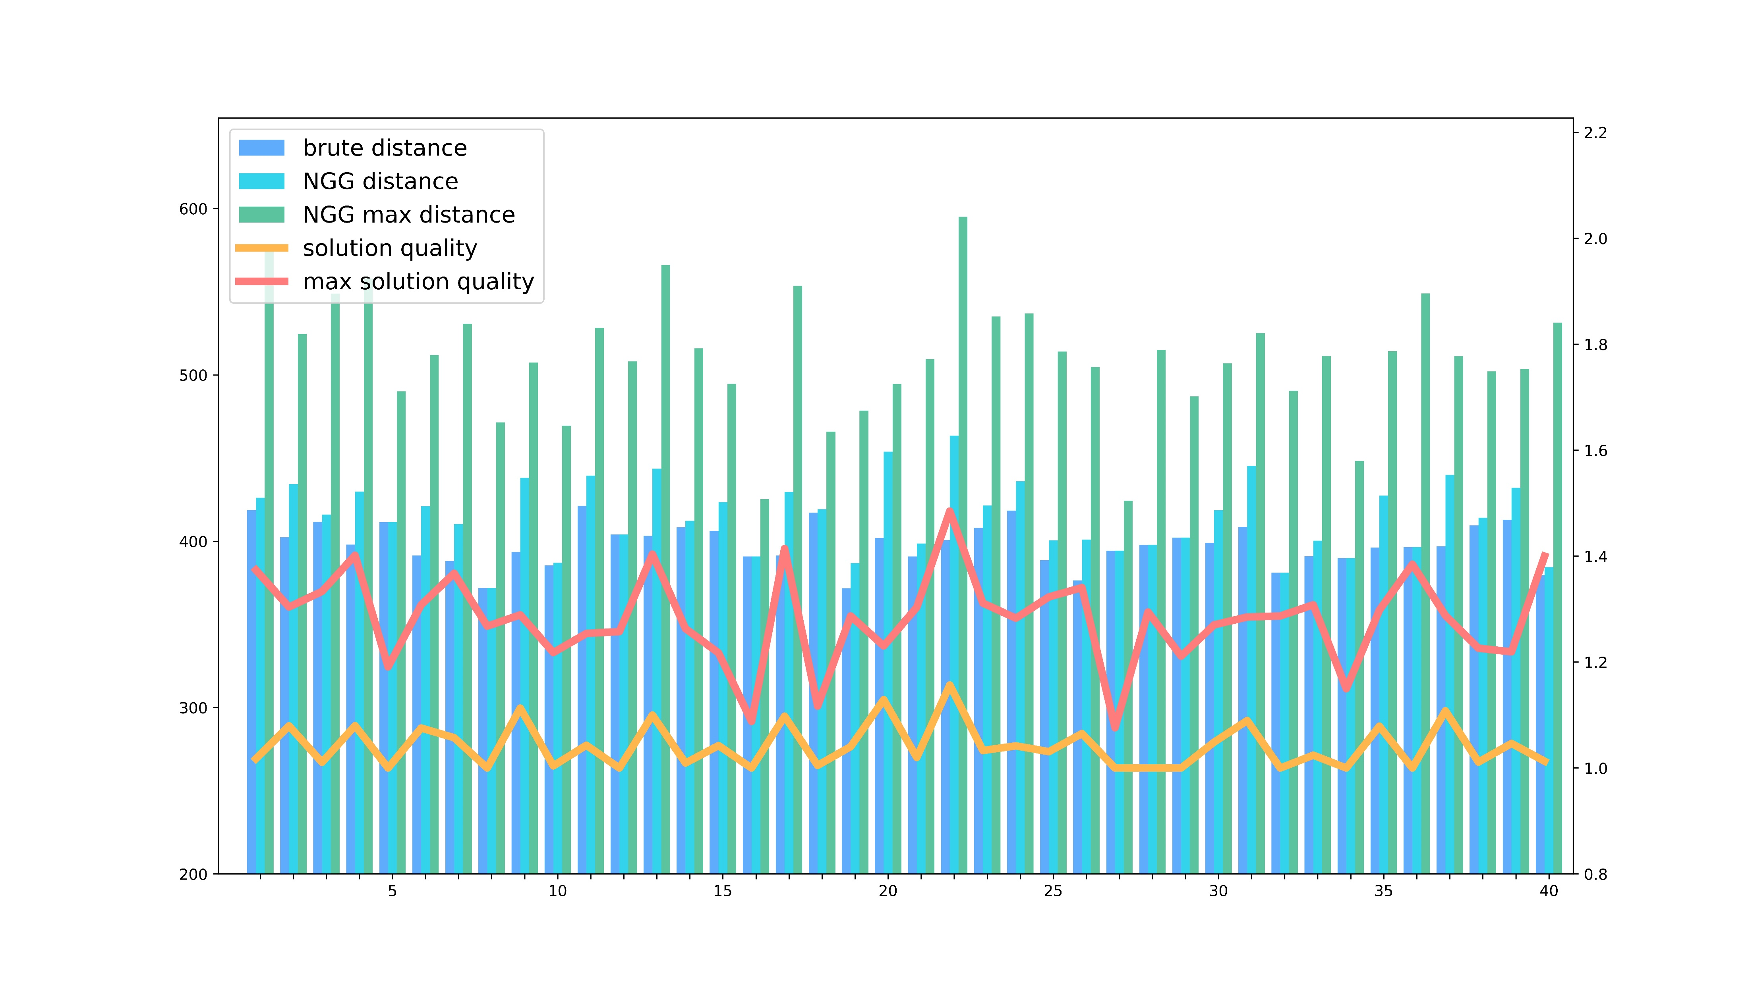
Result and quality
I generate 200 map randomly, and solve the TSP in them by using brute force and NGG method.
In the chart right, I statistic 40 map of them.

Slide 7
Result and quality
Perfect !
How terrible !
In 200 maps, the NNG can get the optimal solution in only 31 maps. And the biggest quality factor is 1.30, which means NNG’s solution will take 30% distance additionally

Slide 8
Result and quality
This is an example which the NNG’s solution is optimal if it choice current initial city. But if it choice a bad initial city, the solution will be so terrible

Slide 9
Conclusion
For the experiment above, we can know:
For some complex case, we can use greedy algorithm to approximate the optimal solution.
In TSP, if we want to use nearest neighbor greedy algorithm, the choice of the initial city is very important.

Slide 10
Thank You !
Q&A

