Slide 1
Loading Balance Problem
Zhiyuan Wang
12032878
Sorted greedy loading balance strategy

Slide 2
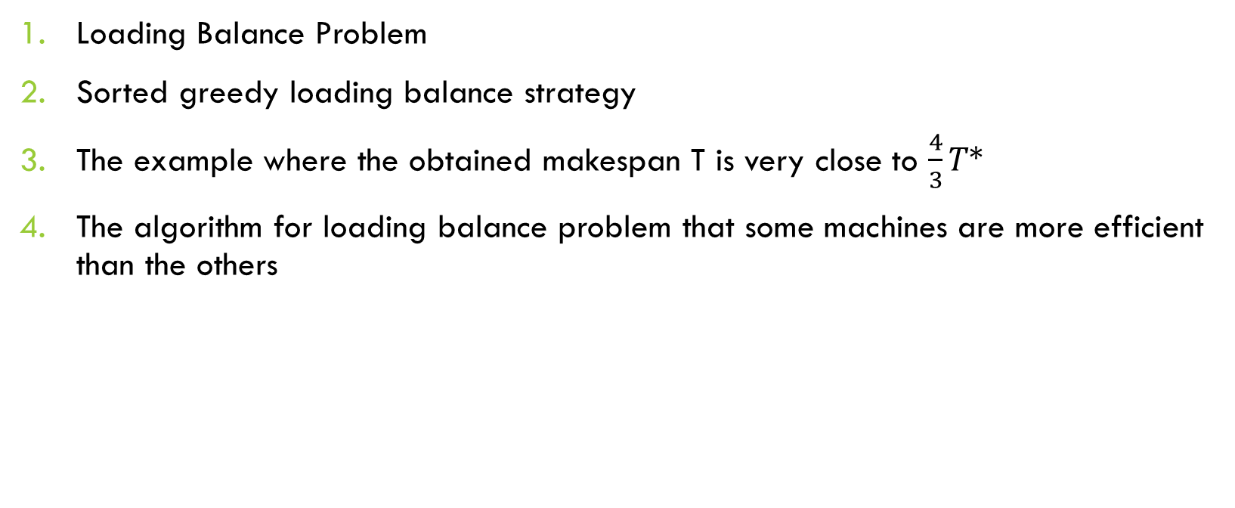
Content
Loading Balance Problem
Sorted greedy loading balance strategy
The example where the obtained makespan T is very close to $\frac{4}{3}T∗$
The algorithm for loading balance problem that some machines are more efficient than the others

Slide 3
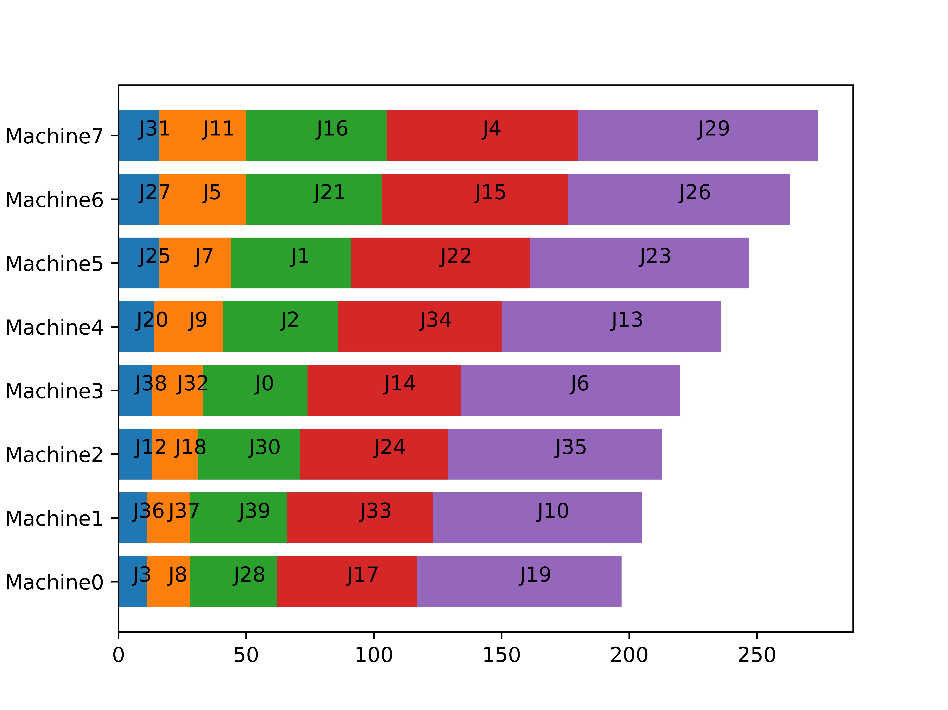
Loading Balance Problem
This problem’s target is assign jobs to computing machines to minimizes the total time consumption.

Slide 4
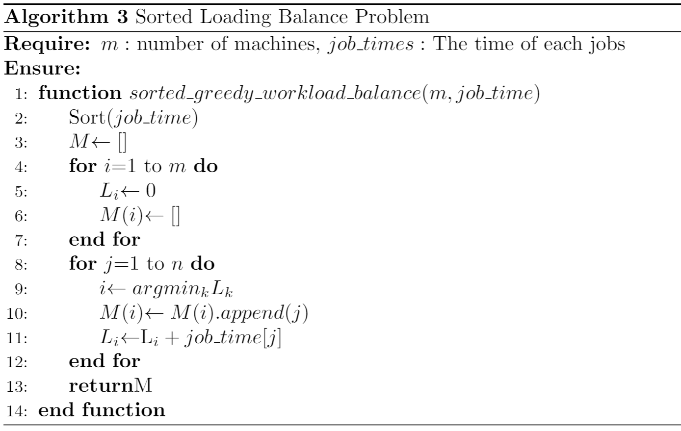
Sorted greedy loading balance strategy
This strategy will assign the longest job to the machine with the smallest load in an arbitrary order of jobs.

Slide 5


Effect of algorithm
If the theoretical optimal makespan of the job queue is T*, then the sorted greedy algorithm’s makespan T will not worse than $\frac{4}{3}T∗$.
$$T^{∗}≤T≤\frac{4}{3}T^{∗}$$

Slide 6
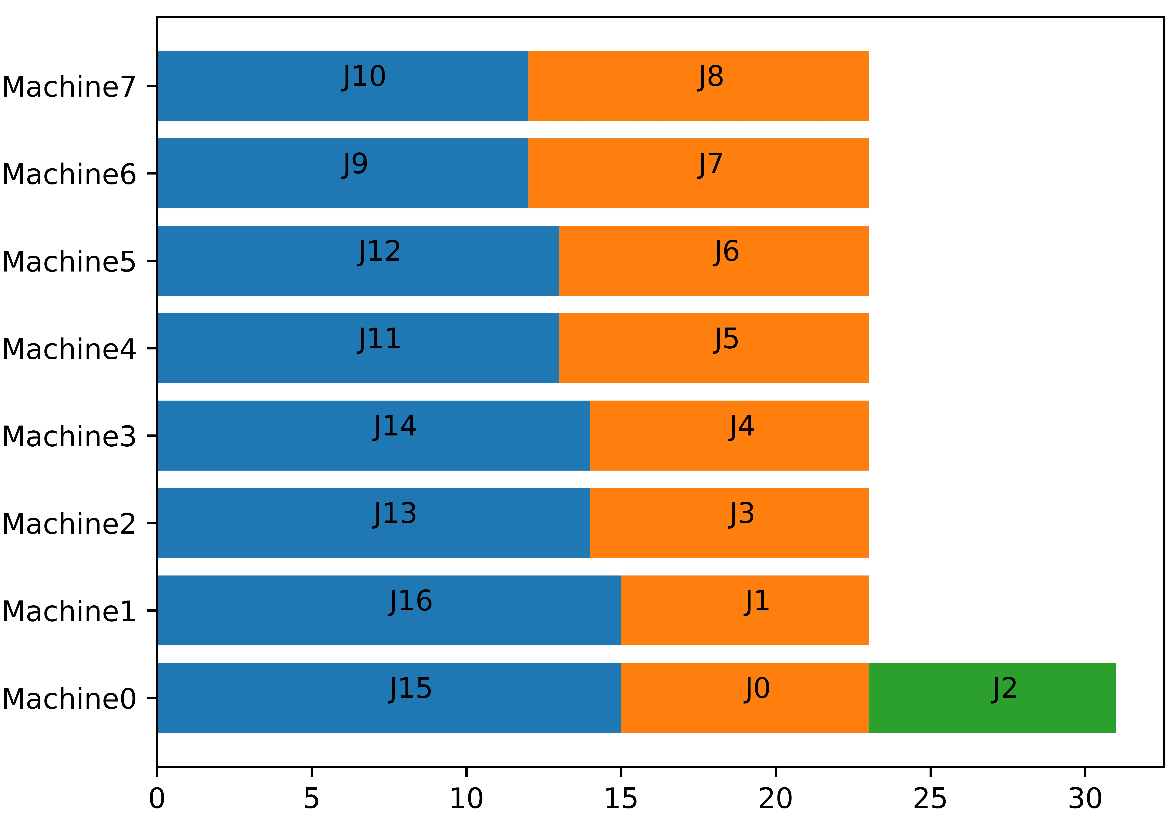
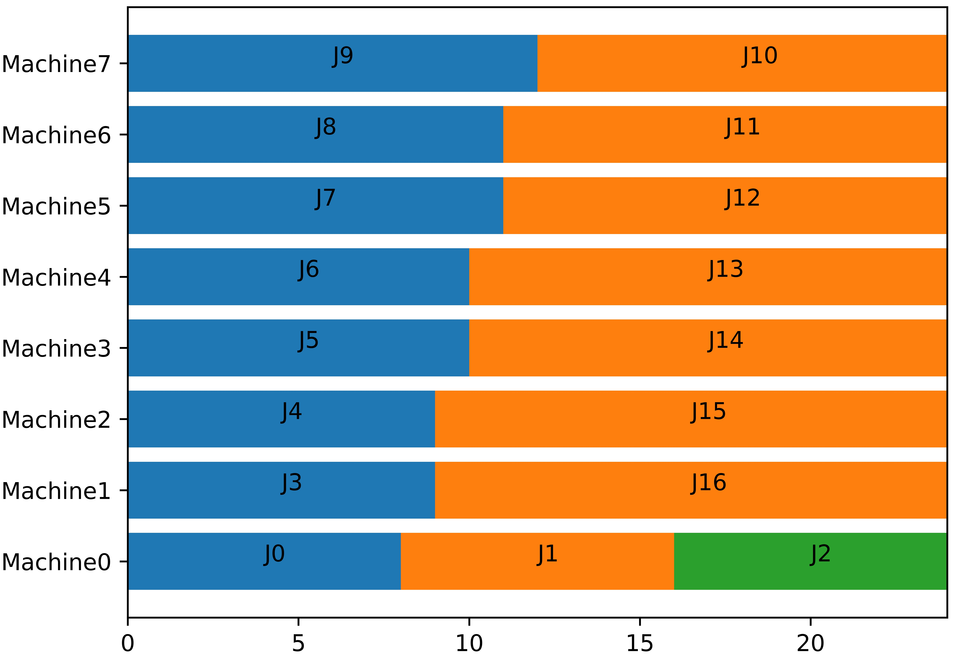
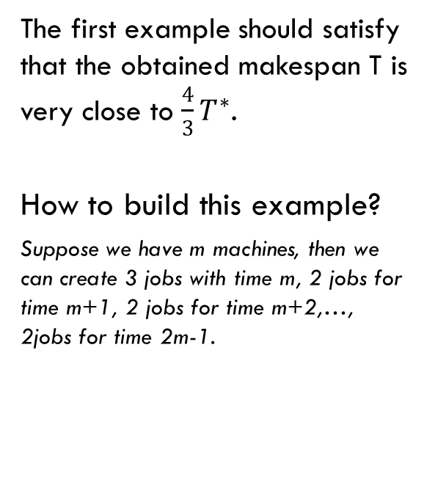
The first Example
Result of sorted greedy algorithm
The first example should satisfy that the obtained makespan T is very close to $\frac{4}{3}T^{∗}$.
How to build this example?
Suppose we have m machines, then we can create 3 jobs with time m, 2 jobs for time m+1, 2 jobs for time m+2,…, 2jobs for time 2m-1.
Optimal result

Slide 7
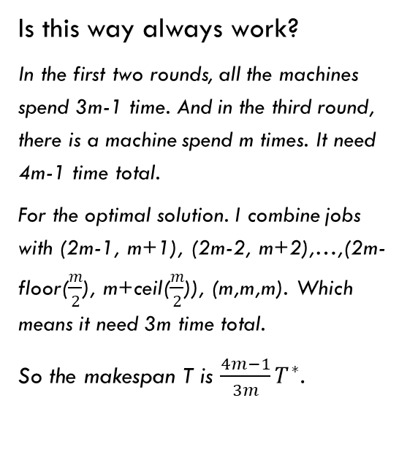
The first Example
Result of sorted greedy algorithm
Is this way always work?
In the first two rounds, all the machines spend 3m-1 time. And in the third round, there is a machine spend m times. It need 4m-1 time total.
For the optimal solution. I combine jobs with (2m-1, m+1), (2m-2, m+2),…,(2m-floor($\frac{m}{2}$), m+ceil($\frac{m}{2}$)), (m,m,m). Which means it need 3m time total.
So the makespan T is $\frac{4m−1}{3m}T^{∗}$.
Optimal result

Slide 8
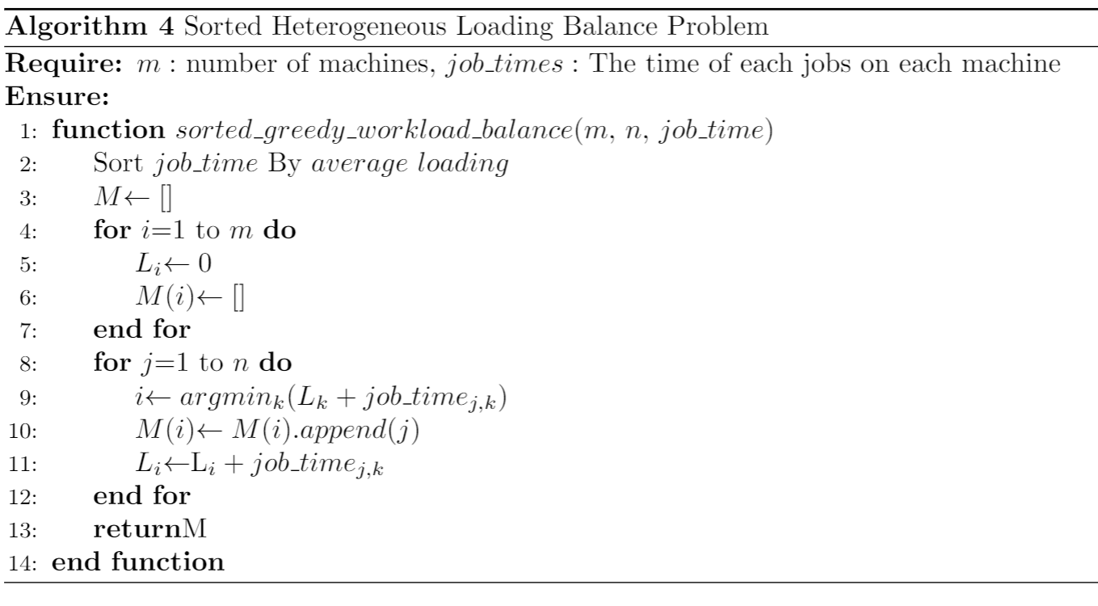
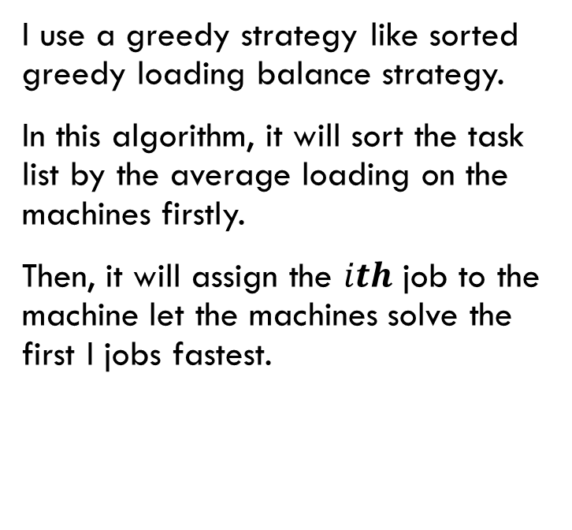
Algorithm for the case that Some machines are more efficient than the others
I use a greedy strategy like sorted greedy loading balance strategy.
In this algorithm, it will sort the task list by the average loading on the machines firstly.
Then, it will assign the $ith$ job to the machine let the machines solve the first I jobs fastest.

Slide 9
Thank You !
Q&A

