Slide 1
Star Wars Rebellion
25th anniversary patch
Content
Game version: 1.02 (includes various community fixes)
DirectX libraries: DgVoodoo 2.82.5 (2024-04-16)
New Galaxy map using Top 200 Star Wars planets (using 2023 canon & positioned as accurately as possible)
2 modes: compatible with base game or accurate positions (savegames/multi not compatible with base game ones)
20/20 new Sector names
200/200 new Planets including:
Names & encyclopedia (picture, name, position, area, connections, geology, species, economy, history, sources)
Individual Planets sprites (instead of only 26 base game sprites reused for 200 planets)
61/61 new Character sprites (closer to canon/legends character real faces)
118/118 sprites displaying base stats (optional)
10/10 troops, 9/9 special forces, 8/8 fighters, 30/30 capital ships, 61/61 characters
30/30 new Capital Ships Encyclopedia (picture, faction, full name, size, easy stats, company, history)
8 Capital Ships changed to use more known ones (+ 7 names improved)
15/29 new Capital Ships 3D models (+14 other 3d models still to redo)
80/80 new Space Fighters sprites for 3D battles (X-wing, ...)
16/16 HD background musics (44KHz vs 11KHz rebuilt from CDs and completed with AI remasters)
Capital Ships changes
[Alliance] Mon Calamari Cruiser → MC80 Liberty Cruiser (name change)
[Alliance] Bulk Transport → Bulk Freighter (name change)
[Alliance] Alliance Dreadnaught → MC40a Light Cruiser (ship change)
[Alliance] CC-9600 Frigate → MC30c Frigate (ship change)
[Alliance] Bulwark Battlecruiser → Viscount Star Defender (ship change)
[Alliance] Dauntless Cruiser → MC80a HomeOne Cruiser (ship change)
[Empire] Strike Cruiser → Vindicator Heavy Cruiser (ship change)
[Empire] Interdictor Cruiser → Immobilizer Cruiser (name change)
[Empire] Carrack Light Cruiser → Arquitens Light Cruiser (ship change)
[Empire] Victory Destroyer → Victory I Star Destroyer (name change)
[Empire] Imperial Star Destroyer → Imperial I Star Destroyer (name change)
[Empire] Assault Transport → Gladiator Star Destroyer (ship change)
[Empire] Galleon → Acclamator Drop Ship (ship change)
[Empire] Star Galleon → Star Galleon Frigate (name change)
[Empire] Imperial Dreadnaught → Imperial Dreadnought (name change)
Capital Ships 3D models
2024-01-02 [Alliance] Action 6 Transport Bulk Freighter
2024-01-02 [Empire] Executor Super Star Destroyer
2024-01-02 [Empire] Immobilizer 418 Cruiser
2024-01-02 [Empire] Imperial Dreadnought Class Heavy Cruiser
2024-01-08 [Empire] Vindicator Heavy Cruiser
2024-01-08 [Empire] Victory Class Start Destroyher Mark 1
2024-01-18 [Alliance] CR90 Corellian Corvette
2024-02-11 [Alliance] MC80 Liberty Type Star Cruiser
2024-02-11 [Alliance] Assault Frigate Mark 1
2024-03-17 [Alliance] CC-7700 Frigate
2024-03-17 [Alliance] DP20 Frigate Correlian Gunship
2024-04-19 [Empire] Acclamator-Class Dropship
2024-04-19 [Empire] Arquitens Light Cruiser
2024-04-28 [Alliance] GR-75 Medium Transport
2024-04-28 [Alliance] MC30C Frigate

Slide 2
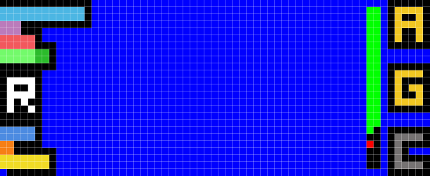
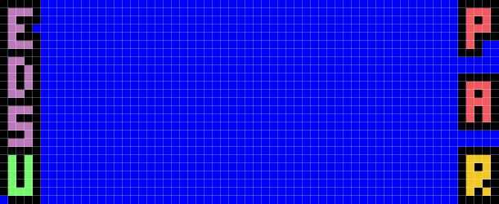


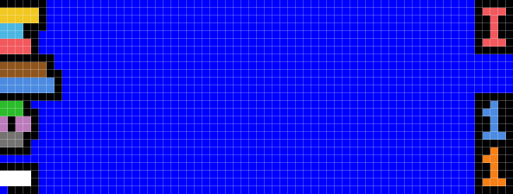

Diplomacy
Espionage
Combat
Leadership (+Emperor on Coruscant Bonus)
Recruiter
Ships Research
Troops Training
Facilities Research
CHARACTERS STATS
Jedi Trainer
Ranks : Can or Cannot be
Admiral (capital ships fleet boost)
General (troops boost)
Commander (fighters boost)
SPECIAL FORCES STATS
Espionage
Decoy
Sabotage
Uprising (Incite or Subdue)
Prisoners (Abduct, Rescue)
Assassinate
Recon
TROOPS STATS
Attack
Defense
Detection
Uprising Defense
Bombardment Defense
Each pixel before a black one is worth 10 pixels.
Ex: this is 31 pixels
Laser Canon (vs Fighters)
Ion Cannon (disabler)
Turbo Lasers (vs Capital Ships)
Hull
Shield
Uprising Defense
Detection
Bombardment Defense
Sublight Speed
CAPITAL SHIPS STATS
Interdictor ship
Max Fighters cargo
Max Troops cargo
FIGHTERS STATS
Laser Canon (vs Fighters)
Ion Cannon (disabler)
Torpedoes (vs Capital Ships)
Shield
Detection
Bombardment Defense
Sublight Speed
Hyperdrive

