Slide 1
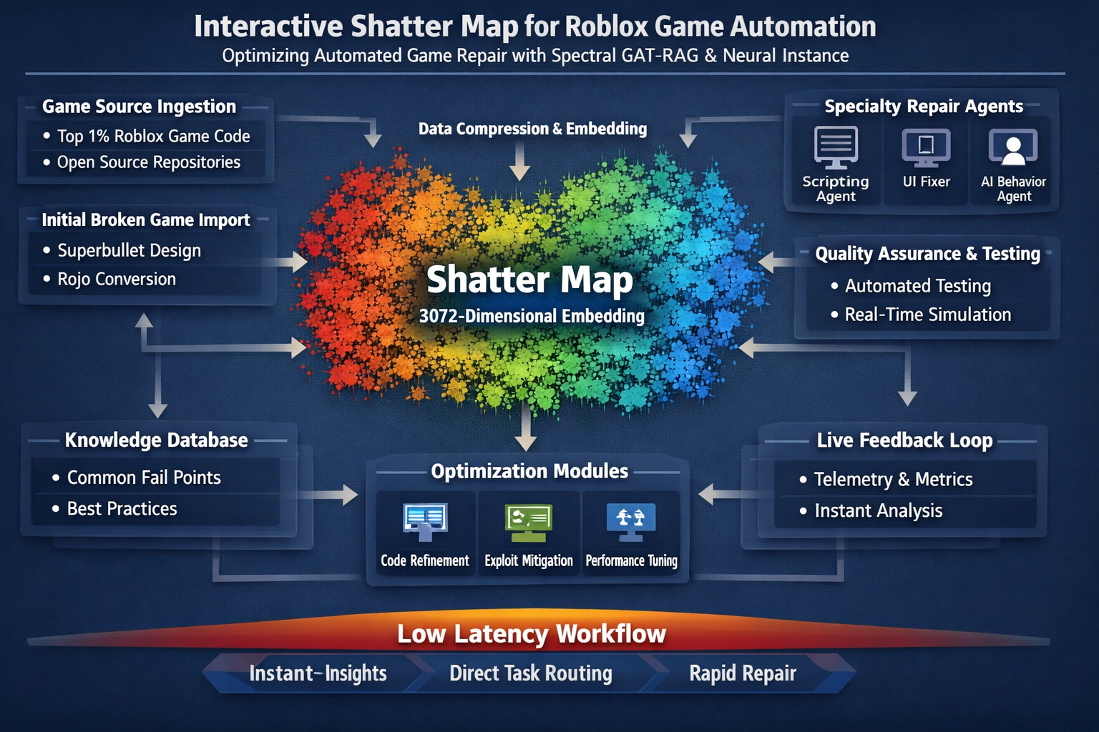
Interactive Shatter Map Architecture
Optimising 3072‑D Spectral GAT‑RAG & Neural Instances for Roblox Game Automation

Slide 2
Agenda
1
Tri‑Map Shatter Concept
2
Ingestion & Data Pipeline
3
Embedding & Spectral GAT‑RAG
4
Designing the Shatter Map
5
Latency & Training Optimisation
6
Considerations & Conclusions
[1] [2] [3] [4]

Slide 3
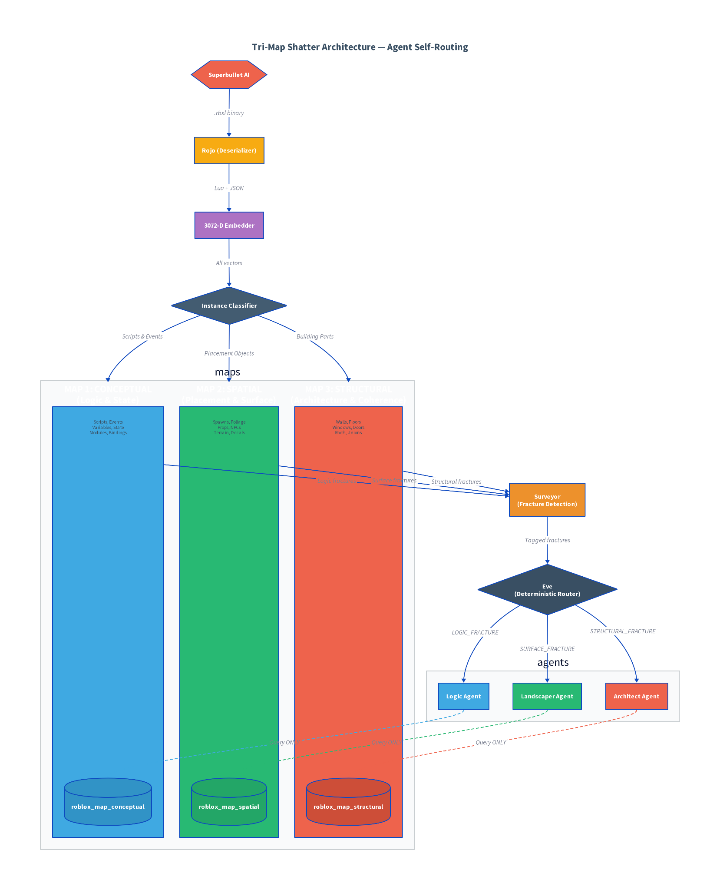
Tri‑Map Shatter Concept
Conceptual Map Scripts, events and modules representing logic & narrative.
Spatial Map Terrain, foliage and spatial features; positions of in‑game objects.
Structural Map Walls, floors and building parts defining the world geometry.
[2]

Slide 4
Ingestion & Data Pipeline
We bootstrap a playable world from Superbullet, convert it to JSON with Rojo, embed objects into a 3072‑D vector space, classify their roles, and scatter them into conceptual, spatial and structural shards for repair.
Superbullet (Base world)
Rojo Conversion (Lua → JSON)
3072‑D Embedder
Instance Classifier
Tri‑Map Shatter
[1] [3]

Slide 5
Embedding & Spectral GAT‑RAG
Model | Dim | Retrieval & Expressiveness
ada‑002 | 1 536 | Good performance; moderate dimension
text‑embedding‑3‑large | 3 072 | Higher accuracy (↑3.6% on MTEB); slower retrieval
TE3‑large (256) | 256 | Compressed; faster retrieval; still beats 1 536‑D baseline
Higher dimensions encode richer structure but increase latency and compute requirements. Your choice should reflect the query volume and latency budget Graph RAG integrates topological awareness into retrieval. By indexing ego‑subgraphs and pruning irrelevant nodes, it overcomes document RAG limitations and reduces hallucinations.
[1] [3]

Slide 6
Graph RAG & GAT
Why Graph RAG? • Overcomes context window limitations by retrieving subgraphs relevant to a query • Exploits relationships across documents that classic RAG misses • Provides unified, fine‑grained representation enabling mathematical operations (clustering, path search) Graph Attention Networks • Use masked self‑attention on graphs to weight neighbours • Avoid costly matrix inversions and handle unknown graph structures • Achieve state‑of‑the‑art performance on inductive and transductive tasks
# GRAG retrieval and generation pipeline def grag_query(query, KG):
emb_q
= embed(query, dim=3072)
# 1. Retrieve ego‑subgraphs most similar to the query
subgraphs
= retrieve_subgraphs(KG, emb_q)
# 2. Soft‑prune nodes unrelated to the query
pruned
= soft_prune(subgraphs, emb_q)
# 3. Aggregate information via Graph Attention
context
= graph_attention(pruned)
# 4. Generate the answer with the LLM
return LLM.generate(context, query)
[2] [3] [4]

Slide 7
Designing the Shatter Map
Logic Agent
Landscaper Agent
Architect Agent
Router (Eve)
Conceptual Shard
Vector Index
Structural Shard
Spatial Shard
Central vector index holds 3072‑D embeddings for all shards. A deterministic router dispatches queries to specialised agents who read/write via the index. This arrangement minimises network hops and exploits locality within shards.
[2] [4]

Slide 8
Latency & Training Optimisation
1
Vector Compression Compress selected shards to 256‑D for latency‑critical queries, retaining 3072‑D variants offline.
2
Hierarchical Caching Maintain per‑agent L1 caches and a shared L2 cache; minimise network hops for repeated queries.
3
Precomputed Subgraphs Index ego‑subgraphs and cluster centroids; prefetch likely nodes during idle time.
4
Metadata Enrichment Prefix embeddings with rich metadata to improve retrieval quality and reduce false negatives.
[1] [2]

Slide 9
Roblox Fail Points & Resilience
Common Fail Points • Script failures & race conditions • Unbounded memory usage due to poor cleanup • Exploits from unvalidated remote events • Performance bottlenecks on large maps Roblox Protections • Server‑client model isolates physics and critical logic • Permission systems restrict who can modify code • Sandboxing and runtime checks prevent malicious calls Our Approach
• Start from a semi‑playable world then repair via automation
• Use top‑performing open‑source games to inform best practices
• Embed and classify everything; repair via specialised agents with minimal training

Slide 10
Conclusion & Next Steps
Key Takeaways • Tri‑Map shards simplify reasoning by separating logic, spatial and structural aspects. • High‑dimension embeddings capture rich semantics; Graph RAG & GAT maintain topology for coherent retrieval. • A deterministic router and central vector index minimise latency and enable specialised agents. Next Steps • Evaluate compression strategies (e.g. 256‑D) on retrieval speed vs recall. • Integrate live telemetry to adaptively prioritise shards based on playtime metrics. • Extend Graph RAG to incorporate player behaviour graphs and exploit mitigation patterns.
[1] [2] [3] [4]

