Slide 1

Project MetaVal: Enterprise Email & PDF Data Ingestion Pipeline
Transitioning Manufacturing Operations from Fragmented Manual Logging to Intelligent Automation
Operational Strategy & Implementation Architecture

Slide 2
The Paradigm Shift: Manual Bottleneck vs. MetaVal
CURRENT MANUAL PROCEDURE
• Fragmented Inputs: Operators manually download varying supplier quotes, invoices, and spec layouts from corporate mailboxes.
• Data Loss Vulnerabilities: Physical typing of multi-page tabular data leads to keying fatigue, typos, and format errors.
• Operational Delays: Sifting through 10-to-500 page logs creates extreme bottlenecks before procurement choices can be processed.
METAVAL AUTOMATION SYSTEM
• Lean Processing: Scrapes incoming emails and attachments hands-free, routing them instantly into a data parser.
• Unified Ingestion Matrix: Automatically separates, structuralizes, and standardizes digital and scanned paper layers.
• Near-Zero Latency: Translates raw unstructured grids into a pristine data store within moments, keeping procurement agile.

Slide 3
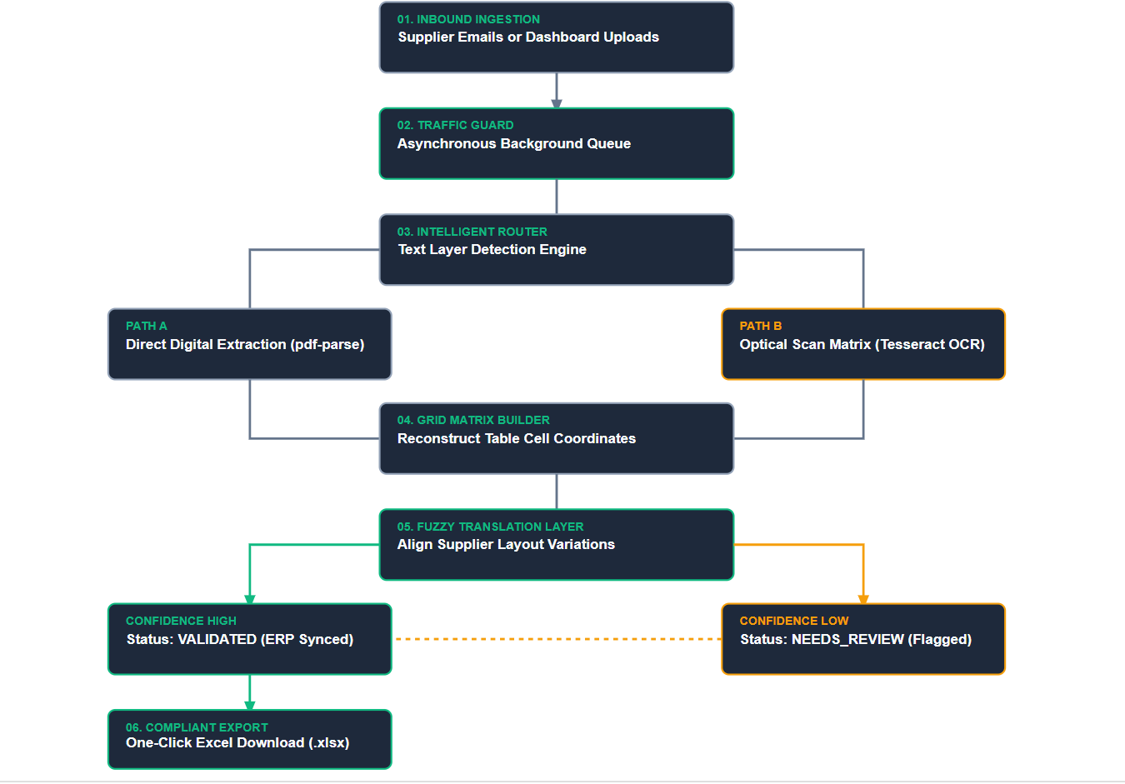
System Execution Flowchart: Inbound File to Database Target

Slide 4
Strategic Business Advantages: Lean & Accountability
📈 1. Lean Process Optimization: The primary goal is leaning out the data processing pipeline, shifting employee bandwidth from data entry to strategic analysis.
📈 2. Frozen Accountability & Total Traceability: Essential for industrial compliance. Locks down exact chronological context on when, how, who, and where component parts were quotationed, routed, or sold across the enterprise.
📈 3. Defined Process Boundaries: Assigns precise ownership vectors to every segment of data integration. Prevents tracking gaps, locks down data validity, and highlights step responsibility.
📈 4. Eliminating Waste (Non-Productive Action Cleansed): Kills repetitive data manipulation, double manual review cycles, and spreadsheet corrections. Removes operational delays entirely.

Slide 5
Strategic Business Advantages: Growth & System Integration
🚀 5. Driving Scalable Business Volume: Faster parsing speeds let engineering teams respond to customer quotes instantly, capturing higher transaction volumes and winning more market opportunities, increase in costumer confidence.
🚀 6. Central Control (Single-Screen Dashboard): Consolidates multi-department actions into one single accessible dashboard monitor, provides cross-team insight at all levels on any device.
🚀 7. Real-Time Integration with Enterprise Resource Planning (ERP): Keeps master databases up to date with automated record pipelines, removing the delayed synchronization lag standard in manual data entry loops.
🚀 8. Data-Driven Insights (Daily Success records): The telemetry layer computes and prints daily success rates on the dashboard, giving managers immediate clarity on parsing quality trends.

Slide 6
The Enterprise Operations Control Screen Layout
MetaVal OS 📊 Overview 🗃️ Traceability ⚙️ ERP Synced 💬 Anomalies Form
TOTAL UPLOADS
14,250 Files
EMAIL REVERTS
0 Pending ✅
DAILY UPDATES
+342 Records
DAILY SUCCESS RATE
98.4% Accuracy Ticker
📤 Manual Ingestion Box (Multer Hook)
📥 Direct Excel Output Export (.xlsx)
Traceability Ledger — Real-Time Parts Auditing Logs
Part Serial Quoted To Status Accountability Signature
P-100-9921 Logistics B [VALIDATED ✅] Operator ID: #9042 (Synced to ERP)

Slide 7
The Production Technology Stack & Dependencies
Core Runtime
Node.js (Express) & React.js
Forms a clean, full-stack environment running VITE on the frontend for snappy UI state changes and Express for file routing.
Extraction Engines
pdf-parse / Tesseract.js
Uses dual-path parsing logic: instant text reads for selectable files, and automatic pdf-poppler rendering for image-scanned OCR files.
Grid Reconstruction
pdf2json matrix maps
Extracts underlying layout coordinates to reconstruct cells into precise JSON structures, preserving row/column relationships.
Enterprise Database
PostgreSQL (JSONB Storage)
Saves varying tabular data inside high-performance JSONB formats, allowing deep index searches without altering static core database systems.
Output System
ExcelJS Engine
Bypasses risky, format-breaking CSV translation entirely, exporting records straight from memory buffers into fixed cell locations.

