Slide 1
CONTOSO CLOUD FOUNDATION
CONTOSO CLOUD FOUNDATION
A pragmatic first step to Azure
Proof-of-concept, architecture direction & Terraform IaC — prepared for Contoso's CTO & Head of Engineering
7 August 2026

Slide 2
Agenda
01
The situation at Contoso
Where the portal runs today, and why it matters for a bank
02
Why Azure, why PaaS-first
The direction, and the alternatives we ruled out
03
Architecture walkthrough
Compute, data, identity, network, observability
04
Infrastructure as Code & CI/CD
Terraform module design, dev/prod isolation, GitHub Actions
05
Live demo
Deploy, call the API, tail the logs
06
AI in the workflow
Where an LLM genuinely helps, and where it doesn't
07
Trade-offs, risks & next steps
What we'd do with more time, and why we didn't do it now
Contoso Cloud Foundation
2 / 12

Slide 3
The situation at Contoso
Discover
Today
Constraints we must respect
One VM running the customer portal API
PostgreSQL co-located on the same VM
Logs written to local files only — no central audit trail
A single environment: no dev/test/prod separation
Deployments are manual ("click-ops")
Regulated industry (financial services) — EU data residency
Availability ≥ 99.9%
RPO ≤ 1 hour · RTO ≤ 4 hours
Application + infrastructure logs retained centrally ≥ 12 months, access-restricted
Cost must be defensible to leadership
Why this matters
No environment separation + no central logging = limited incident-response capability and audit risk for a regulated bank.
Contoso Cloud Foundation
3 / 12

Slide 4
Why Azure, why PaaS-first
Define & Design
Recommendation: a single-region, PaaS-first “modernize-while-moving” pattern on Microsoft Azure — not a VM lift-and-shift, not Kubernetes.
Considered
Chosen instead
VM lift-and-shift (IaaS)
AKS / container orchestration
Multi-region active-active
Full landing zone (policy, hub-spoke) on day one
App Service (Linux, container) — managed patching & TLS
Same PostgreSQL engine on Flexible Server — zero data-model rewrite
Single EU region (France Central) — meets RPO/RTO within-region
Reusable Terraform module + dev/prod instances now; landing zone deferred
Contoso Cloud Foundation
4 / 12

Slide 5
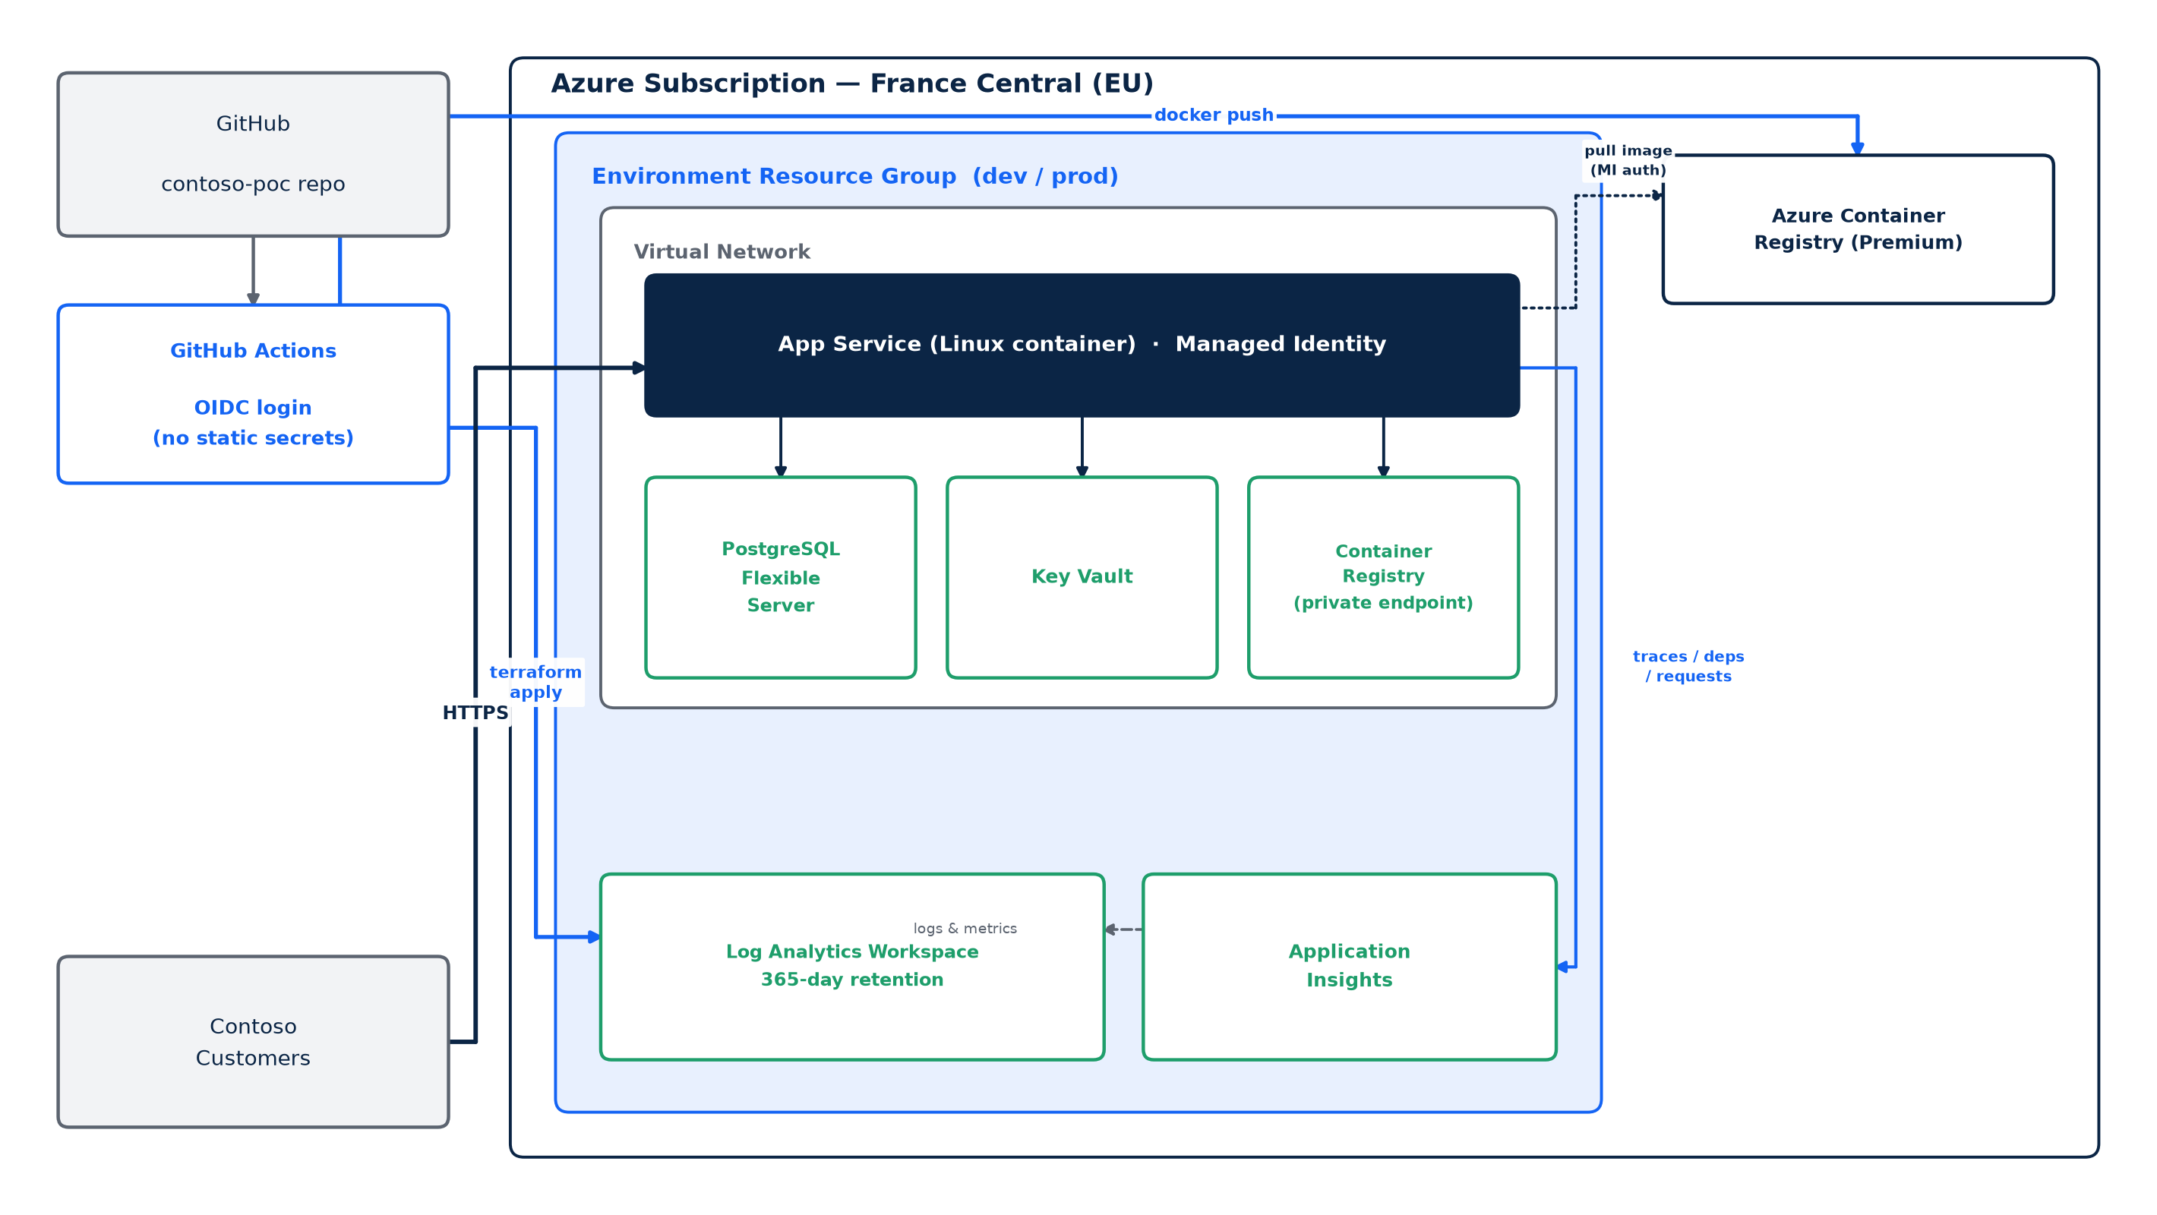
Proposed architecture
Only the App Service is publicly reachable; data plane services sit behind private endpoints (prod).
Contoso Cloud Foundation
5 / 12

Slide 6
Core building blocks
Compute
App Service (Linux, container)
Image registry
Azure Container Registry (Premium)
Hosts the FastAPI app; managed patching, TLS, autoscale-ready
Stores the API image; pulled via managed identity
Data
PostgreSQL Flexible Server
Secrets
Azure Key Vault
Drop-in for the on-prem DB; zone-redundant HA in prod
DB credentials & app secrets
Identity
User-assigned Managed Identity
Observability
Log Analytics + App Insights
Passwordless access to ACR, Key Vault, PostgreSQL
Central logs, 365-day retention for audit
Network
VNet, 2 subnets, NSG
Delivery
GitHub Actions (OIDC) + Terraform
Isolates data plane behind private endpoints
Repeatable, auditable, click-ops-free
Contoso Cloud Foundation
6 / 12

Slide 7
Two environments, one Terraform module
dev
prod
Public network access enabled — faster inner-loop testing
Single-zone PostgreSQL, no HA
App Service P0v3 · PostgreSQL B_Standard_B1ms
Synthetic / anonymized data only — never real customer data
Private endpoints only — data plane off the public internet
Zone-redundant HA + geo-redundant backup
App Service P0v3 · PostgreSQL GP_Standard_D2s_v3
Meets availability ≥ 99.9%, RPO ≤ 1h, RTO ≤ 4h
Same cs-api Terraform module, instantiated per environment with isolated state (.tfbackend) and sizing (.tfvars) — dev and prod share identical logic, never the same blast radius.
Contoso Cloud Foundation
7 / 12

Slide 8
Repeatable delivery — no click-ops
1
2
3
4
Push / PR to main
run-tf-plan.yml
build-api-acr.yml
run-tf-apply.yml
Developer pushes code or infra changes
Azure OIDC login, terraform init/plan, diff surfaced on the PR
Docker image built & pushed to the environment's ACR
terraform apply on merge to main — infra converges
No stored cloud secrets
All workflows authenticate via Azure OIDC federated credentials (azure/login) — GitHub proves its identity to Azure AD per run, no long-lived client secret sits in GitHub.
Getting started (same steps CI runs automatically):
cd iac/instances/frc
terraform init -backend-config="dev/dev.tfbackend"
terraform plan -var-file="dev/dev.tfvars"
terraform apply -var-file="dev/dev.tfvars"
Contoso Cloud Foundation
8 / 12

Slide 9
Live demo
Deploy to dev · call the API · tail Log Analytics / App Insights
9 / 12

Slide 10
Using AI as part of the workflow
AI is used where it adds real leverage in a cloud/IaC workflow — not as a checkbox.
AI IaC Reviewer
AI Architecture Explainer
AI Log Insights Helper
Flags missing tags, public endpoints exposed unintentionally, and diagnostic settings gaps in Terraform before apply.
Turns the technical architecture into a one-page, non-technical rationale leadership can read in 5 minutes.
Summarizes app/infra logs from Log Analytics and suggests likely next diagnostic steps during an incident.
In this PoC: minimal working examples that show how context (a Terraform plan, a log excerpt) is fed to an LLM and how the response is used — see /ai for the helper + README.
Contoso Cloud Foundation
10 / 12

Slide 11
Trade-offs, risks & next steps
Biggest trade-offs accepted
Next, in priority order
Dev has public network access — cheaper/faster, but not representative of prod
Single region (France Central) — no cross-region DR yet
No WAF / Front Door in front of App Service yet
No formal landing zone / Azure Policy guardrails yet
Front Door + WAF, App Service fully private
Lightweight landing zone: mgmt groups + Azure Policy, hub-spoke if a 2nd workload lands
Key Vault references instead of app settings; automatic credential rotation
CI quality gate: lint, unit tests, terraform validate before apply
Formal DR restore drill against the RTO ≤ 4h / RPO ≤ 1h target
Being explicit about scope
This is a single-region, PaaS-only footprint — deliberately not a full landing zone yet. That's a scope choice, not an oversight.
Contoso Cloud Foundation
11 / 12

Slide 12
Questions & discussion
docs/architecture-summary.md · docs/assumptions.md · iac/modules/cs-api/README.md
Thank you
12 / 12

