Slide 1
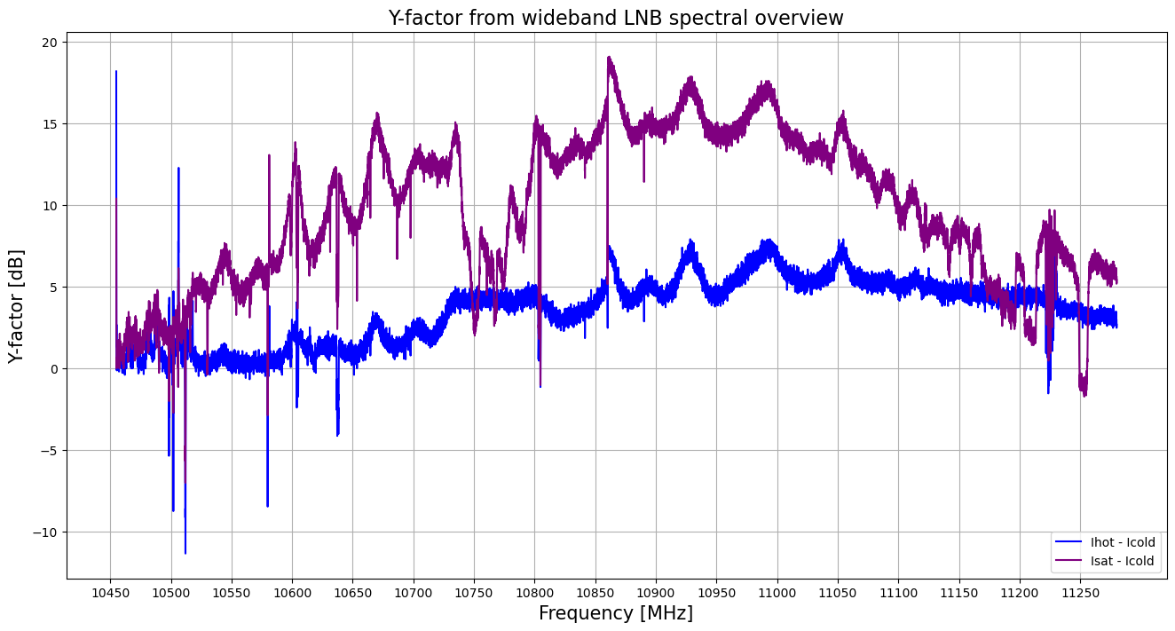
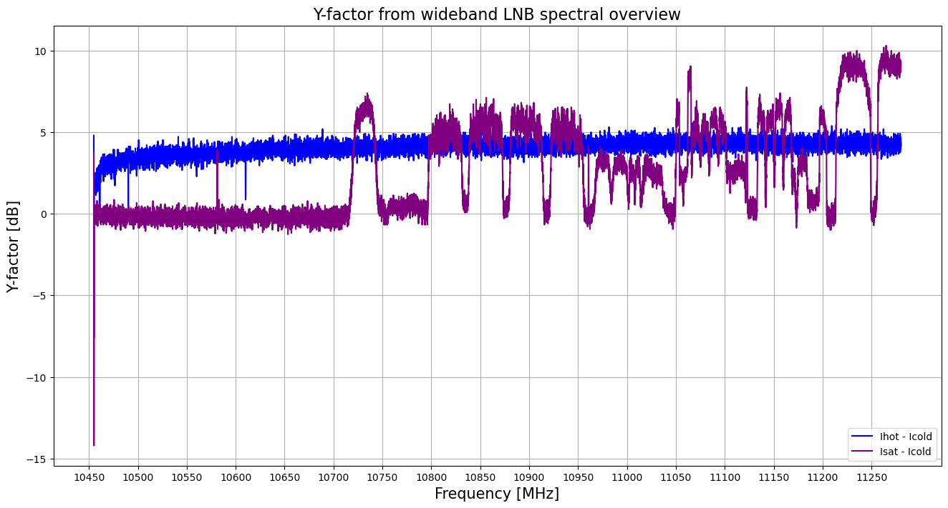
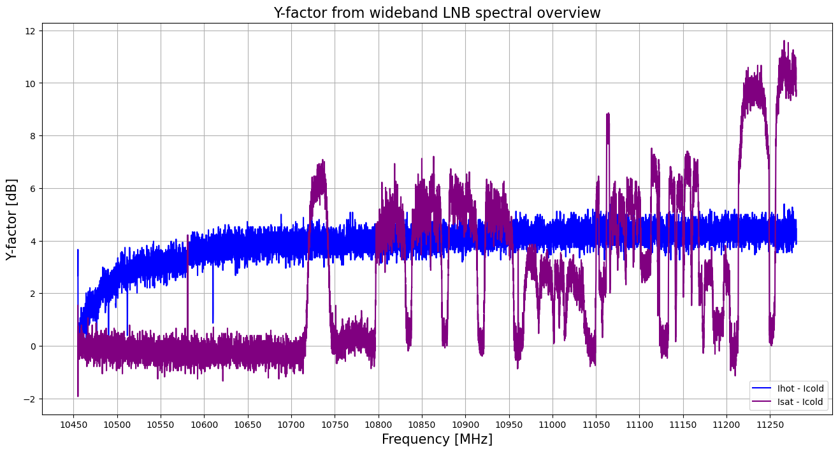
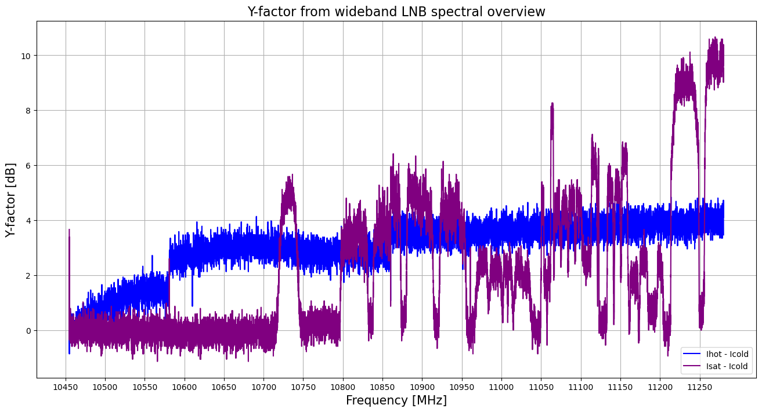
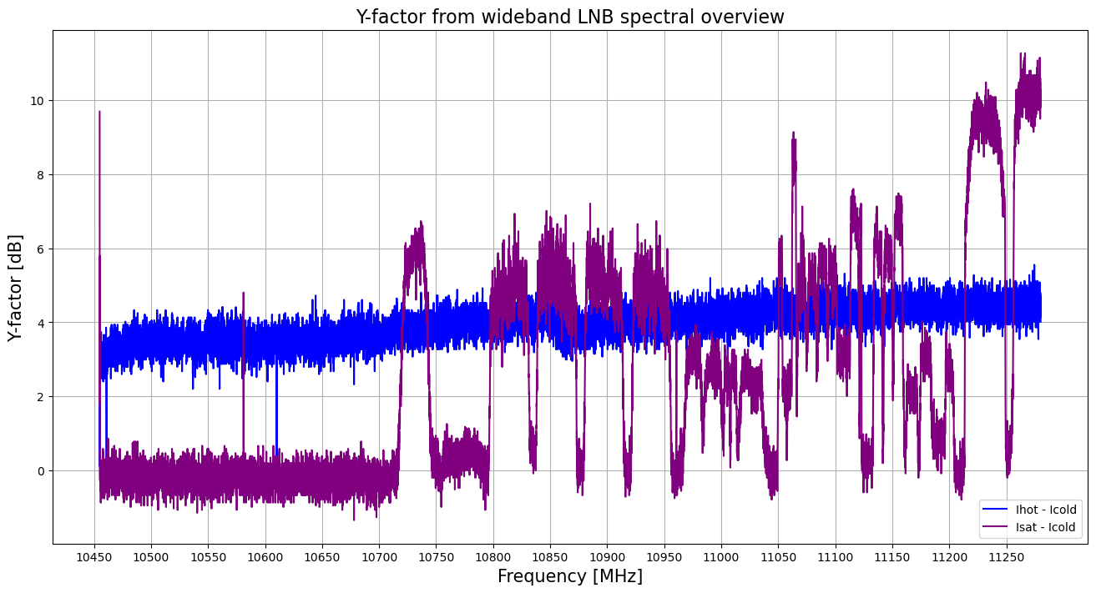
With SAT-Finder, gain 122d No SAT-Finder, gain 82d No SAT-Finder, gain 82d, -10 dB ATT
SAT-Finder advantage: Higher Y-factor
SAT-Finder disadvantage: Only at dedicated frequencies
No SAT-Finder advantage: Flat spectrum No SAT-Finder disadvantage: Lower Y-factor
No SAT-Finder, gain 82d, -20 dB ATT No SAT-Finder, gain 123d, -20 dB ATT
Y-factor Sky-Ground in blue, Y-factor Satellite-Ground in purple

Slide 2
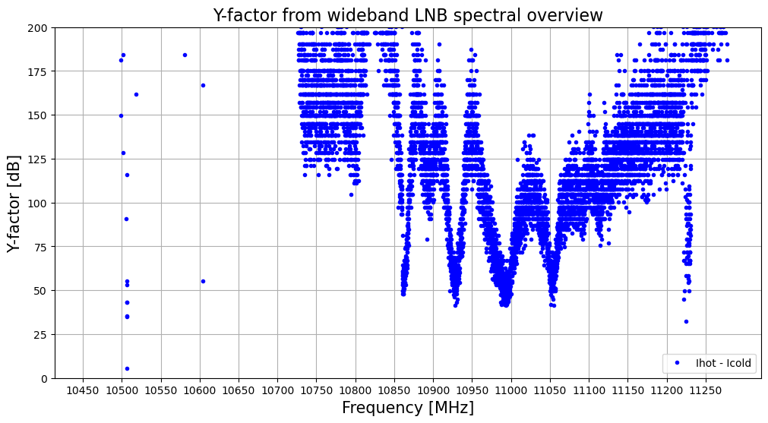
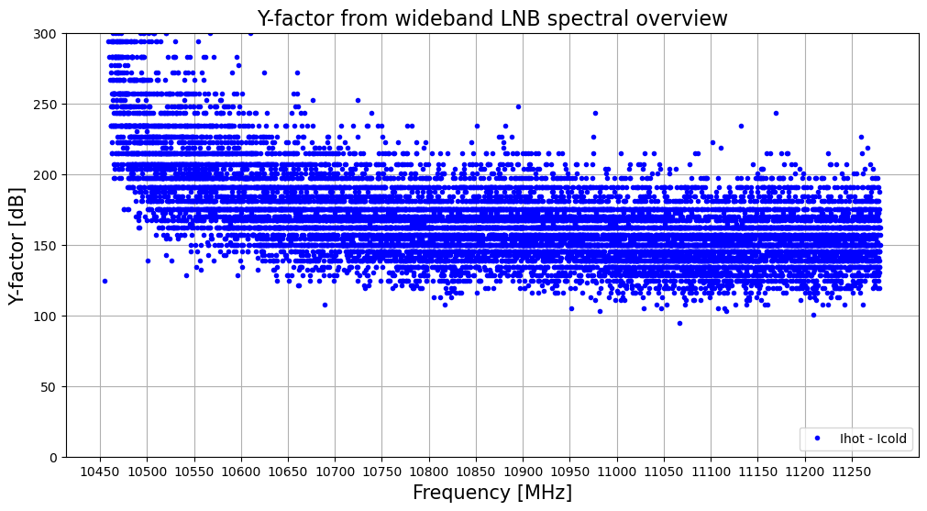
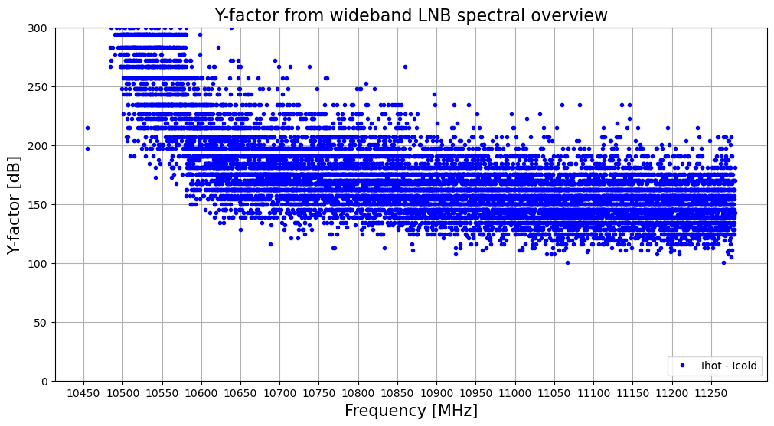
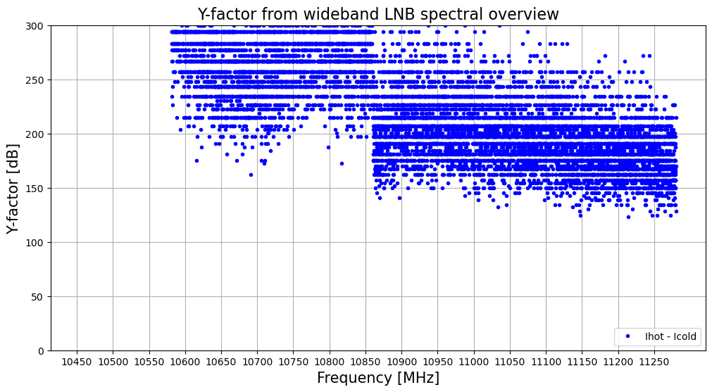
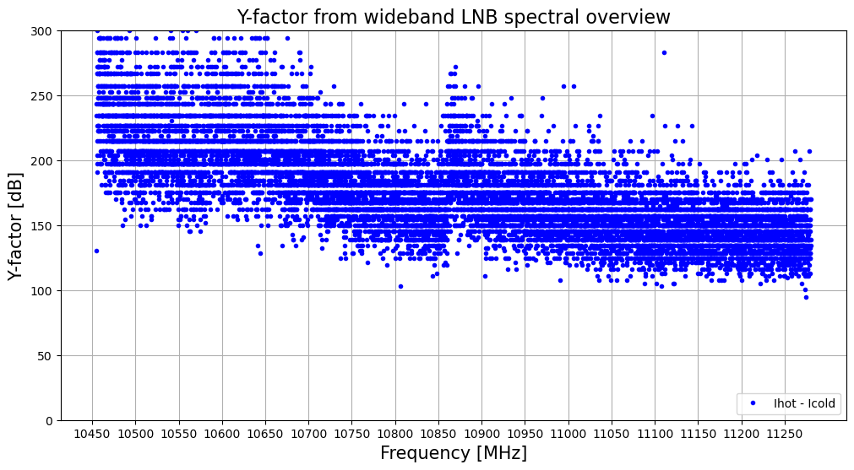
With SAT-Finder, gain 122d No SAT-Finder, gain 82d No SAT-Finder, gain 82d, -10 dB ATT
Instrument noise temperature
Is best WITH SAT-Finder,
although only at dedicated frequencies
Which need to be found out for a
specific configuration.
No SAT-Finder, gain 82d, -20 dB ATT No SAT-Finder, gain 123d, -20 dB ATT
System temperature: Sky/Ground

