Slide 1
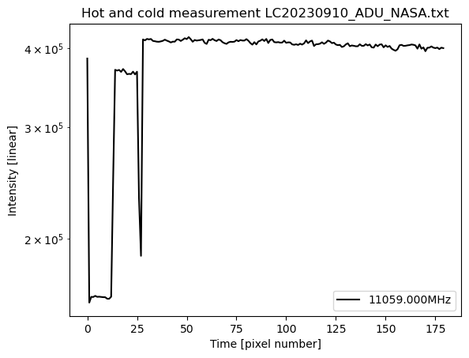
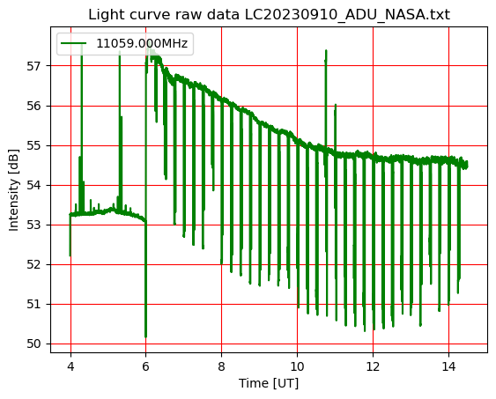
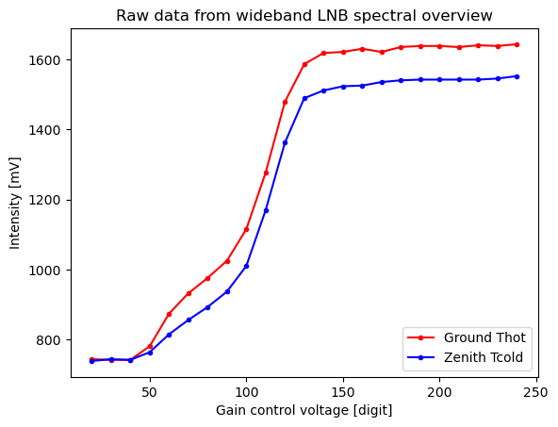
Datagram CALLISTO
callisto.cfg
scheduler.cfg
ssfree.exe
Every 15 min.
Option:
do.bat + ftp-gz.pl
upload to FHNW
Java Viewer or
RappViewer or FV.exe
Manual operation
Callisto.exe
C++
15 minutes
*.fit
PlottAndCalibratefromFIT-loop.py
10…40 sec
On request
Real time
LC*.txt
OVS*.prn
LOG*.txt
PlottAndCalibrateLC-4Hz.py
Notepad, Excel,
Wordpad, …
Callisto-gain-sweep.py
ReadPlot:OVS.py

Slide 2
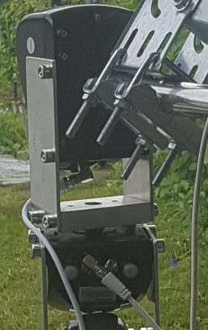
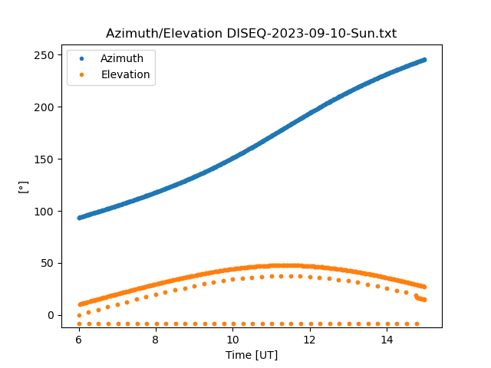
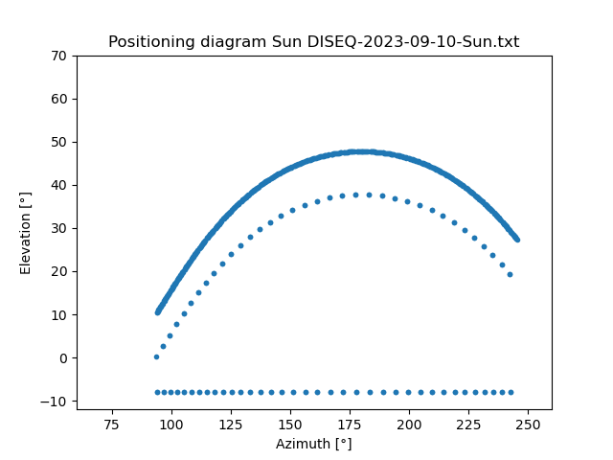
Datagram DiSEqC Tracker
configsun.ini or
configmoon.ini
ssfree.exe
Every minute
sunpos_AZI_ELE.py or moonpos_AZI_ELE.py
DiSEqC
interface
USB
PlotDiSEqC.py
DISEQC*.txt

