Slide 1
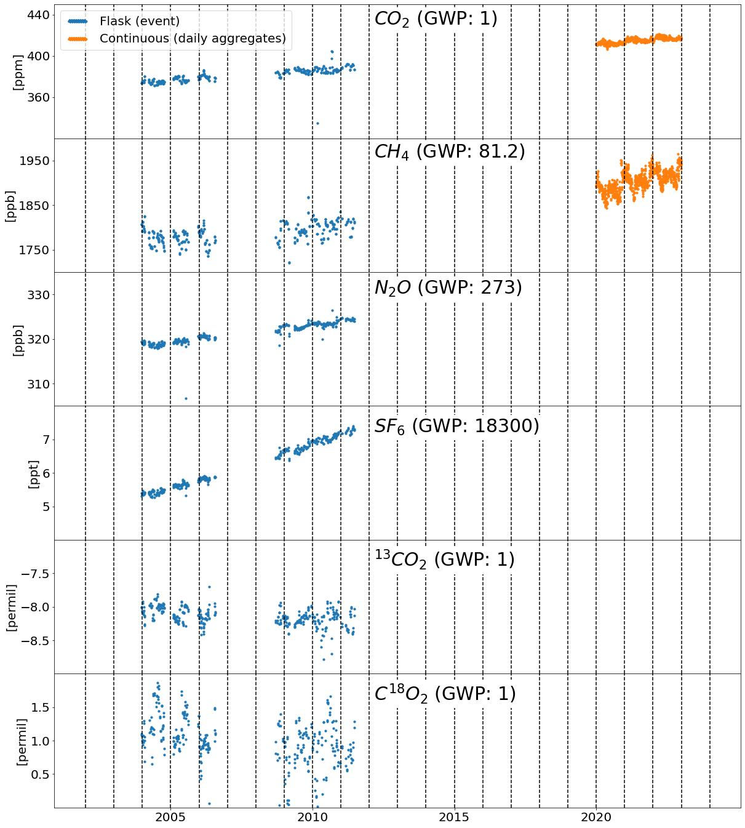
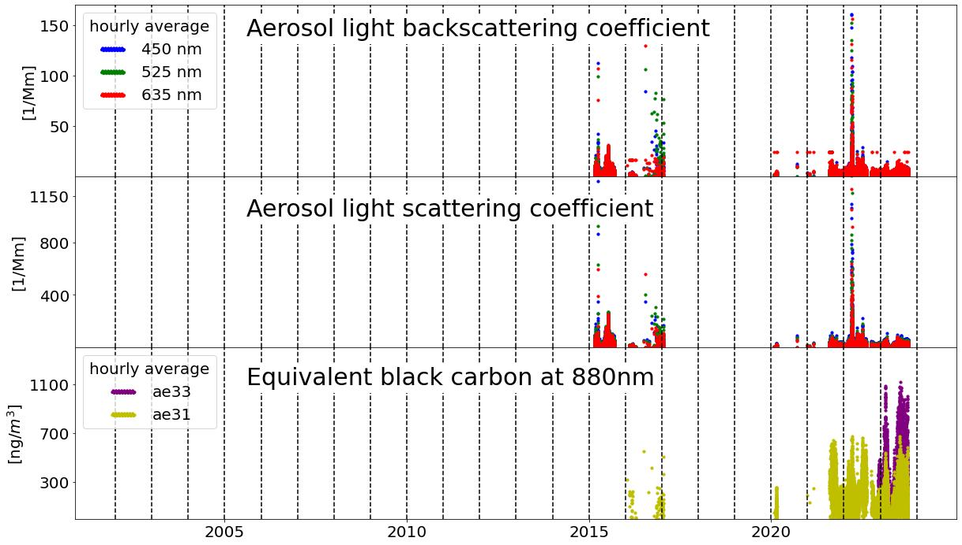








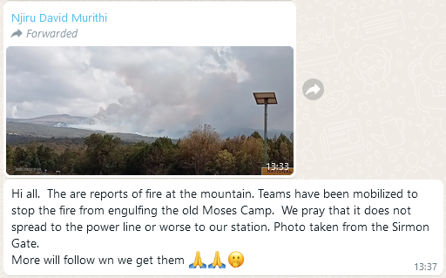
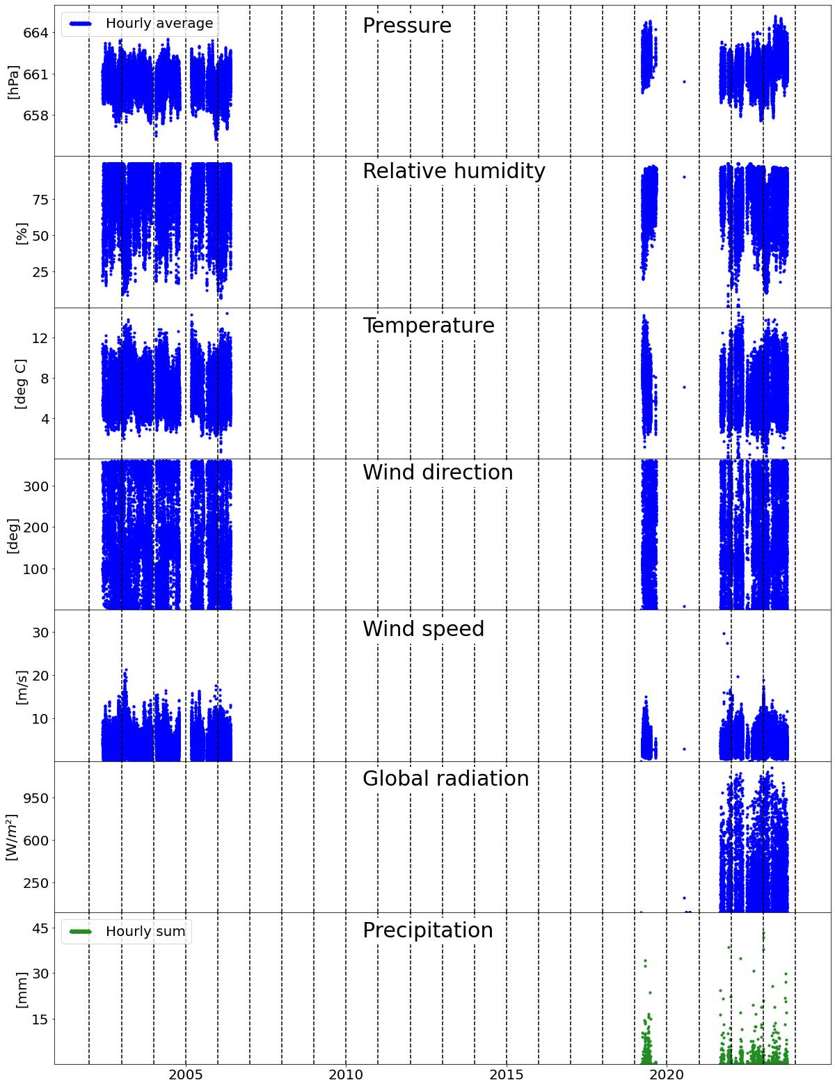
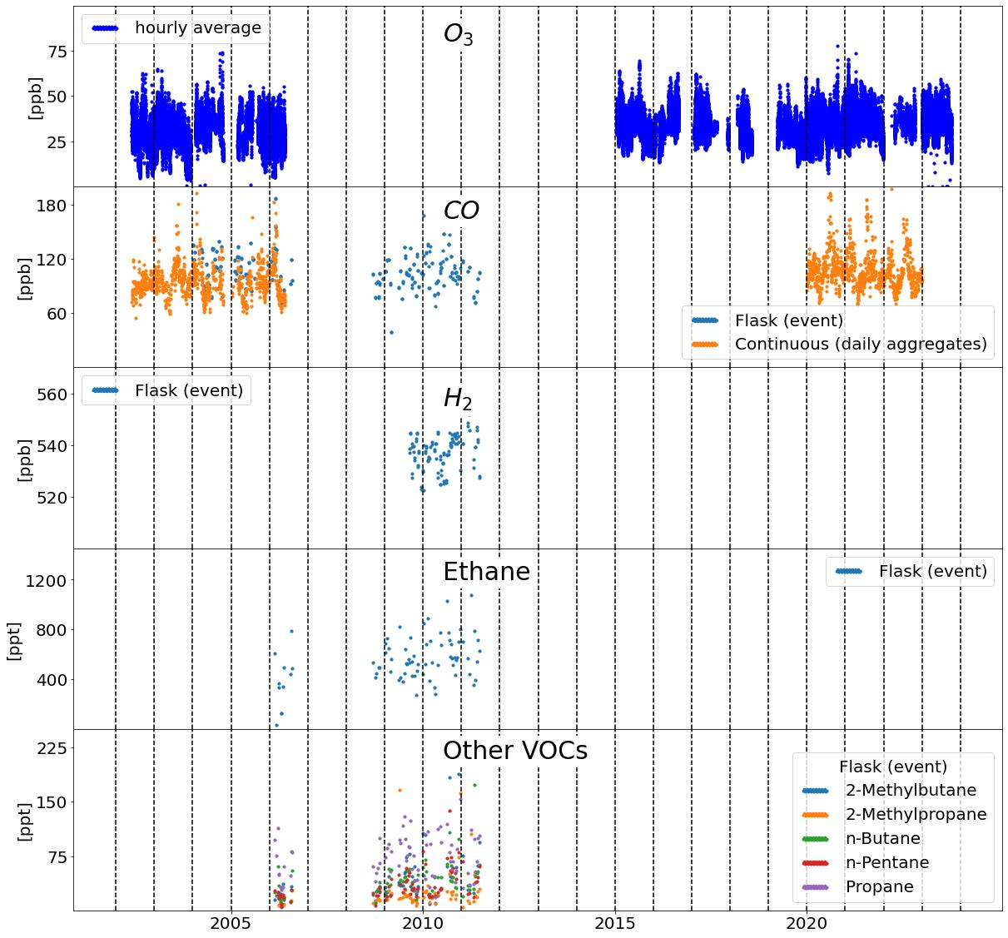
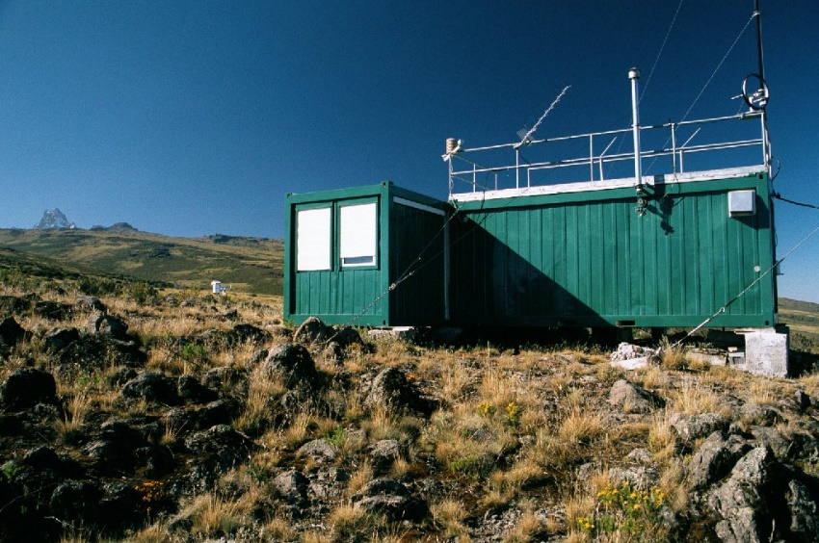


Mount Kenya (MKN)
Available Data
Greenhouse gases |  | Aerosol particles
 |  |  |  | References
 |  |  |  | World Data Centre for Greenhouse Gases Xin Lan (NOAA), Atmospheric CO2 at Mt. Kenya by Global Monitoring Laboratory, NOAA , datasets published as CO2_MKN_ surface-flask_NOAA_ccgg at WDCGG, ver. 2023-08-29-0912 CH4_MKN_ surface-flask_NOAA_ccgg at WDCGG, ver. 2023-08-29-1037 N2O_MKN_ surface-flask_NOAA_ccgg at WDCGG, ver. 2023-08-29-112 SF6_MKN_ surface-flask_NOAA_ccgg at WDCGG, ver. 2023-08-29-1238 Christoph Zellweger (Empa), Mathew Mutuku (KMD), David Murithi Njiru (KMD), Martin Steinbacher (Empa), Jörg Klausen (MeteoSwiss), Atmospheric CO2 at Mt. Kenya by Kenya Meteorological Department , datasets published as CO2_MKN_ surface-insitu_KMD_data1 at WDCGG, ver. 2023-08-10-1309, https://doi.org/10.50849/WDCGG_0040-1005-1001-01-01-9999 CH4_MKN_ surface-insitu_KMD_data1 at WDCGG, ver. 2023-08-10-1309, https://doi.org/10.50849/WDCGG_0040-1005-1002-01-01-9999 CO_MKN_ surface-insitu_KMD_data1 at WDCGG, ver. 2023-08-10-1309, https://doi.org/10.50849/WDCGG_0040-1005-3001-01-01-9999 James White (INSTAAR), Bruce H Vaughn (INSTAAR), Sylvia Michel (INSTAAR), Atmospheric 13CO2 at Mt. Kenya by Global Monitoring Laboratory, NOAA , datasets published as 13CO2_MKN_ surface-flask_NOAA_sil at WDCGG, ver. 2022-07-05-152 C18O2_MKN_ surface-flask_NOAA_sil at WDCGG, ver. 2022-07-05-1524 Gabrielle Petron (NOAA), Atmospheric CO at Mt. Kenya by Global Monitoring Laboratory, NOAA , datasets published as CO_MKN_ surface-flask_NOAA_ccgg at WDCGG, ver. 2023-08-29-1326 H2_MKN_ surface-flask_NOAA_ccgg at WDCGG, ver. 2023-07-06-0837 World Data Centre on Aerosols and Reactive Gases Nicolas Bukowiecki, aerosol_light_backscattering_coefficient, aerosol_light_scattering_coefficient - nephelometer at Mt. Kenya, data hosted by EBAS at NILU Detlev Helmig, 2-methylbutane, 2-methylpropane, ethane, n-butane, n-pentane, propane - glass_flask at Mt. Kenya, data hosted by EBAS at NILU Stefan Henne, John Aseyo, Kennedy Thiong'o, ozone - uv_abs at Mt. Kenya, data hosted by EBAS at NILU Constance Okuku, Zablon Shilenje, ozone - uv_abs at Mt. Kenya, data hosted by EBAS at NILU Martin Oloo, ozone - uv_abs at Mt. Kenya, data hosted by EBAS at NILU David Njiru, ozone - uv_abs at Mt. Kenya, data hosted by EBAS at NILU Stefan Henne, John Aseyo, Kennedy Thiong'o, carbon_monoxide - ndir at Mt. Kenya, data hosted by EBAS at NILU Joerg Klausen, John Aseyo, Kennedy Thiong'o, pressure, relative_humidity, temperature, wind_direction, wind_speed - aws at Mt. Kenya, data hosted by EBAS at NILU Reference date: 2023/09/28
 |  | Meteorology
Other gases
Global Warming Potential (GWP) according to IPCC AR6
i
Automatic weather station (AWS), Radiation station, Surface land meteorological station (SYNOP)
Location: 0.0621999986°S, 37.2971992493°E, 3678m
Established 1999/01/01
*
Metadata
 Editors:
Sarina Danioth, Jörg Klausen
(Federal Office of Meteorology and Climatology MeteoSwiss)
 Contact:
Joerg.Klausen@meteoswiss.ch
* Wind speed data between 2002 and 2007 were corrected by a factor of 1/1.852.
Notes:
https://gml.noaa.gov/aero/software/aerosols/cpd2variables.html >> Ecotech Neph; plot Bs[BGR] und Bbs[BGR]

