Slide 1
Computer and Robot Vision I
Chapter 3
Binary Machine Vision:
Region Analysis
Presented by: 傅楸善 & 王維謙
D08922038@ntu.edu.tw
指導教授: 傅楸善 博士

Slide 2
Outline
Region properties
- connected-components
- Signature analysis

Slide 3
3.1 Introduction
region properties: measurement vector input to classifier

Slide 4
3.2 Region Properties
regions: produced by connected components labeling operator
region intensity histogram: gray level values for all pixels
mean gray level value: summary statistics of regions intensity

Slide 5




3.2 Region Properties (cont’)
bounding rectangle: smallest rectangle circumscribes the region
area:
centroid:
 | 1 | 2 | 3 | 4 | 5 | 6
1 | 0 | 0 | 0 | 0 | 1 | 0
2 | 0 | 1 | 1 | 1 | 1 | 0
3 | 0 | 0 | 1 | 1 | 0 | 0
4 | 1 | 1 | 1 | 0 | 0 | 0
5 | 0 | 0 | 0 | 0 | 0 | 0
A=9
$\overline{r}$=26/9
$c$=27/9
Notes:
在周圍畫線；限制；為……下定義；為……劃界線

Slide 6

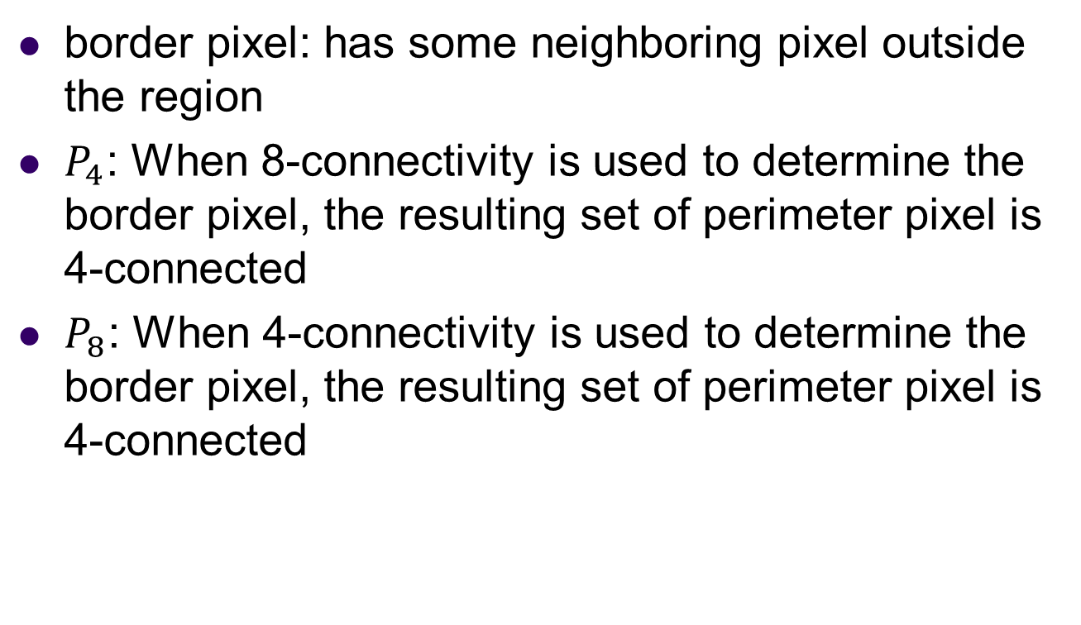
3.2 Region Properties (cont’)
border pixel: has some neighboring pixel outside the region
$P_{4}$: When 8-connectivity is used to determine the border pixel, the resulting set of perimeter pixel is 4-connected
$P_{8}$: When 4-connectivity is used to determine the border pixel, the resulting set of perimeter pixel is 4-connected
Notes:
邊界像素: 像素的相鄰像素包含了非區塊內像素.我們稱為border pixel
P4:用8連通方式來決定邊界像素
P8:用4連通方式來決定邊界像素

Slide 7

3.2 Region Properties (cont’)
Perimeter: It is a sequence of interior border pixels
Eg: center is in but not in for

Slide 8
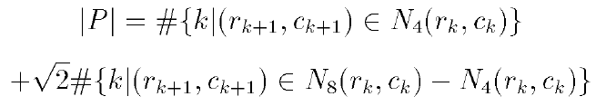


3.2 Region Properties (cont’)
length of perimeter , successive pixels neighbors
where k+1 is computed modulo K i.e.

Slide 9

3.2 Region Properties (cont’)
e.g
 | 1 | 2 | 3 | 4 | 5 | 6
1 | 0 | 0 | 0 | 0 | 0 | 0
2 | 0 | 1 | 1 | 1 | 1 | 0
3 | 1 | 1 | 1 | 1 | 0 | 0
4 | 1 | 1 | 1 | 1 | 0 | 0
5 | 0 | 0 | 0 | 0 | 0 | 0
|P| = 8+2$\sqrt{2}$

Slide 10


3.2 Region Properties (cont’)
mean distance R from the centroid to the shape boundary
standard deviation R of distances from centroid to boundary

Slide 11


3.2 Region Properties (cont’)
Haralick shows that has properties:
1. digital shape circular, increases monotonically
2. similar for similar digital/continuous shapes
3. orientation (rotation) and area (scale) independent

Slide 12


3.2 Region Properties (cont’)
Average gray level (intensity)
Gray level (intensity) variance
right hand equation lets us compute variance with only one pass

Slide 13


Slide 14
3.2 Region Properties (cont’)
microtexture properties: function of co-occurrence matrix
S: set of pixels in designated spatial relationship e.g. 4-neighbors co-occurrence matrix P
Notes:
這邊我們要介紹另一個特性，微紋理特性，首先要介紹一個co-occurrence matrix

Slide 15
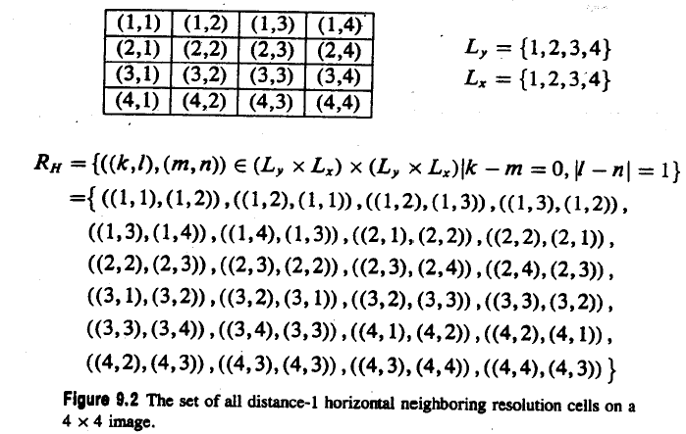
3.2 Region Properties (cont’)
region
Notes:
兩個像素點距離為1 角度為0

Slide 16

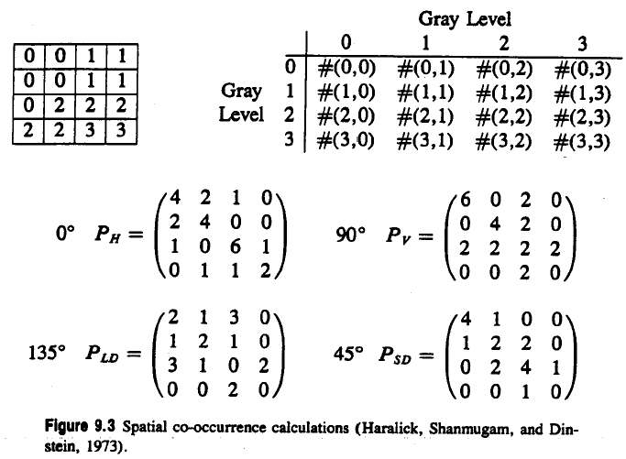



3.2 Region Properties (cont’)
Region(gray value intensity)
Co-occurrence matrix
Notes:
左邊為一個region的灰階值, 我們考慮投影角度為0 距離為1的的時co-occurance(灰階共現矩陣如右圖), index 為0

Slide 17
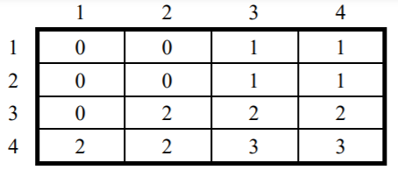
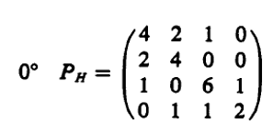
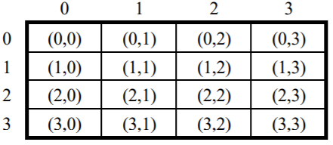
3.2 Region Properties (cont’)
P(0,0)={[(1,1),(1,2)], [(2,1),(1,1)], [(2,1),(2,2)], [(2,2),(2,1)], } = 4

Slide 18
3.2 Region Properties (cont’)
P(0,0)={[(1,1),(1,2)], [(2,1),(1,1)], [(2,1),(2,2)], [(2,2),(2,1)], } = 4

Slide 19
3.2 Region Properties (cont’)
P(0,0)={[(1,2),(1,3)], [(2,2),(2,3)]} = 2

Slide 20



3.2 Region Properties (cont’)
texture second moment (Haralick, Shanmugam, and Dinstein, 1973)
texture entropy
texture correlation

Slide 21
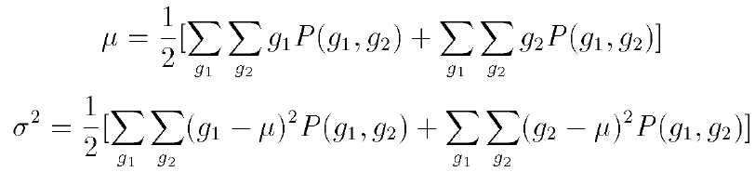

3.2 Region Properties (cont’)
where
texture contrast

Slide 22

3.2 Region Properties (cont’)
texture homogeneity
where k is some small constant

Slide 23

https://www.youtube.com/watch?v=z99-8B5ol0k&feature=youtu.be&fbclid=IwAR0pK2KWoIrAJUfsoAIZ8gWa_bhkSO4yEBRnpkVr1SFgXLKi5nRBAPRRkt4

Slide 24
3.2.1 Extremal Points
Bounding rectangle has eight distinct extremal pixels: topmost right, rightmost top, rightmost bottom, bottommost right, bottommost left, leftmost bottom, leftmost top, topmost left

Slide 25
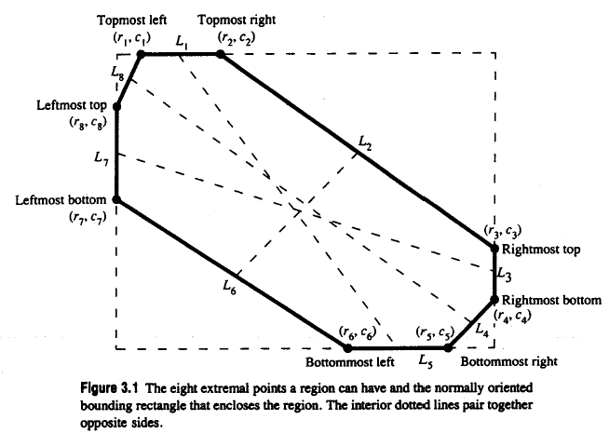
3.2.1 Extremal Points (cont’)

Slide 26
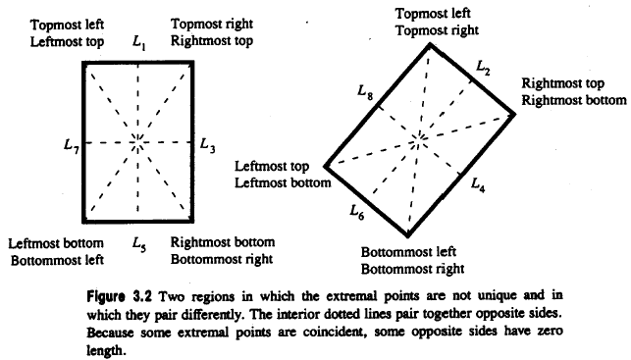
3.2.1 Extremal Points (cont’)
different extremal points may be coincident

Slide 27
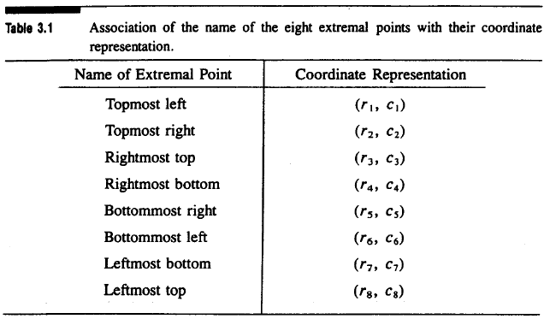
3.2.1 Extremal Points (cont’)
association of the name of the eight extremal points with their coordinates

Slide 28
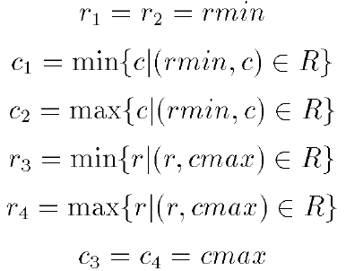
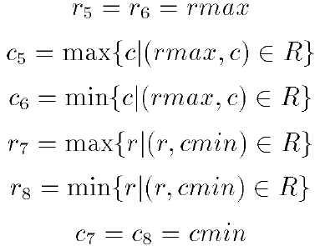
3.2.1 Extremal Points (cont’)
directly define the coordinates of the extremal points:

Slide 29
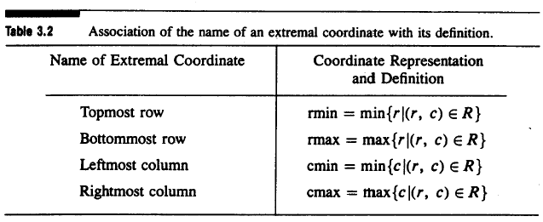
3.2.1 Extremal Points (cont’)
association of the name of an external coordinate with its definition

Slide 30

3.2.1 Extremal Points (cont’)
extremal points occur in opposite pairs: topmost left bottommost right, topmost right bottommost left, rightmost top leftmost bottom, rightmost bottom leftmost top
each opposite extremal point pair: defines an axis
axis properties: length, orientation
Notes:
opposite

Slide 31
3.2.1 Extremal Points (cont’)

Slide 32
3.2.1 Extremal Points (cont’)

Slide 33
3.2.1 Extremal Points (cont’)

Slide 34
3.2.1 Extremal Points (cont’)

Slide 35
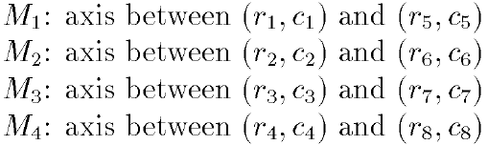
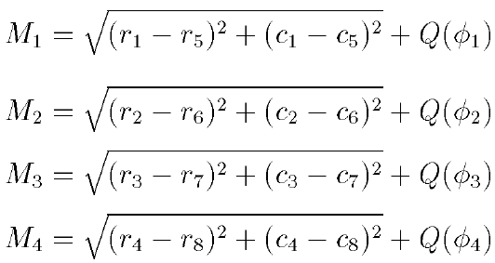
3.2.1 Extremal Points (cont’)
distance calculation: add a small increment to the Euclidean distance

Slide 36
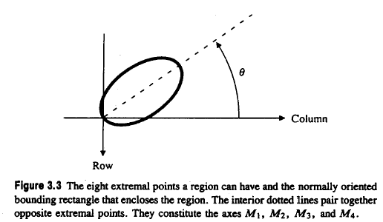
3.2.1 Extremal Points (cont’)
orientation taken counterclockwise w.r.t. column (horizontal) axis

Slide 37


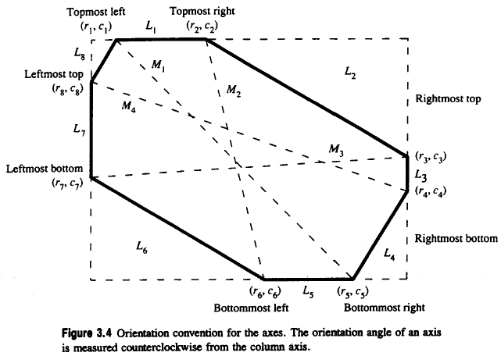
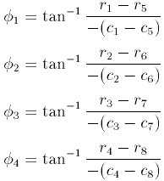
3.2.1 Extremal Points (cont’)
orientation convention for the axes
axes paired: with and with

Slide 38
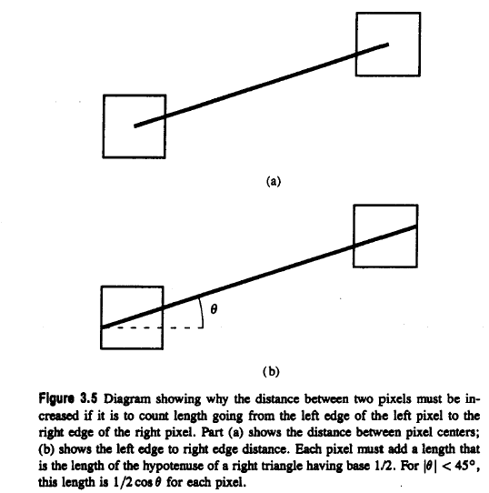

3.2.1 Extremal Points (cont’)
length going from left edge of left pixel to right edge of right pixel

Slide 39
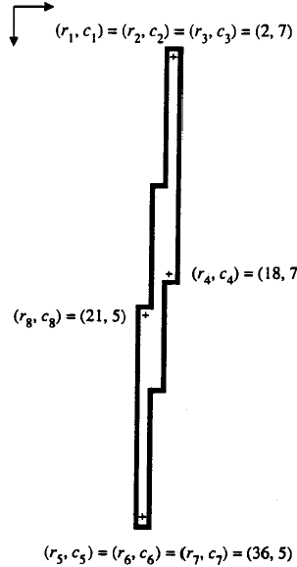
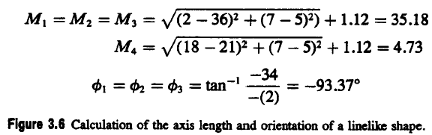
3.2.1 Extremal Points (cont’)
calculation of the axis length and orientation of a line-like shape.

Slide 40



3.2.1 Extremal Points (cont’)
distance between ith and jth extremal points
average value of = 1.12, largest error 0.294 = - 1.12

Slide 41



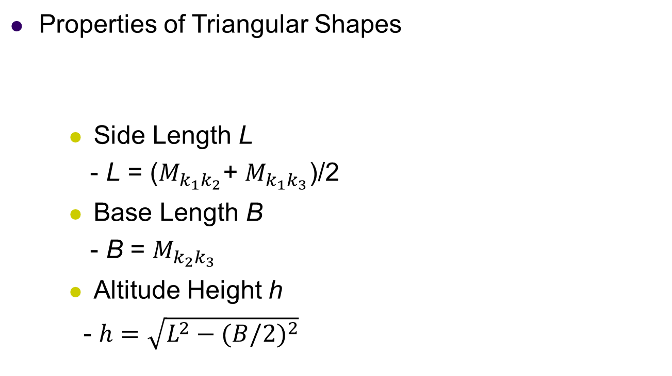
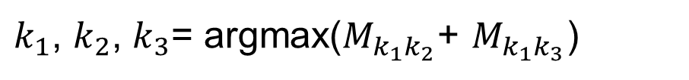


3.2.1 Extremal Points (cont’)
Properties of Triangular Shapes
Side Length L
- L = ($M_{k_{1}k_{2}}$+ $M_{k_{1}k_{3}}$)/2
Base Length B
- B = $M_{k_{2}k_{3}}$
Altitude Height h
- $h=\sqrt{L^{2}−{(B/2)}^{2}}$
$$k_{1}$$
$k_{1}$, $k_{2}$, $k_{3}$= argmax($M_{k_{1}k_{2}}$+ $M_{k_{1}k_{3}}$)
L
h
$$∅$$
$$k_{2}$$
$$k_{3}$$
$$B$$

Slide 42
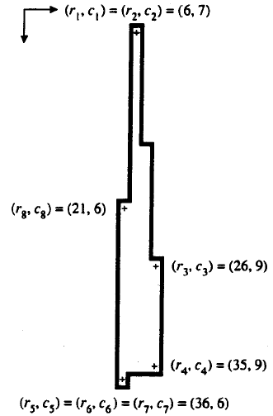
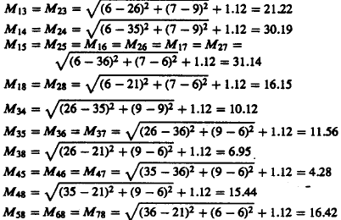
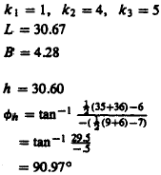
calculations for length of sides base and altitude for a triangle

Slide 43


Slide 44
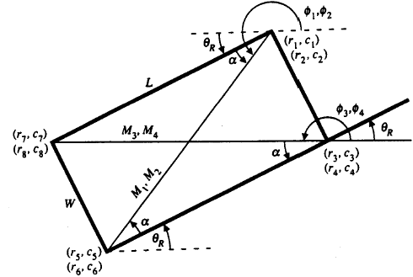


3.2.1 Extremal Points (cont’)
geometry of the tilted rectangle
Notes:
Tilted 傾斜的

Slide 45
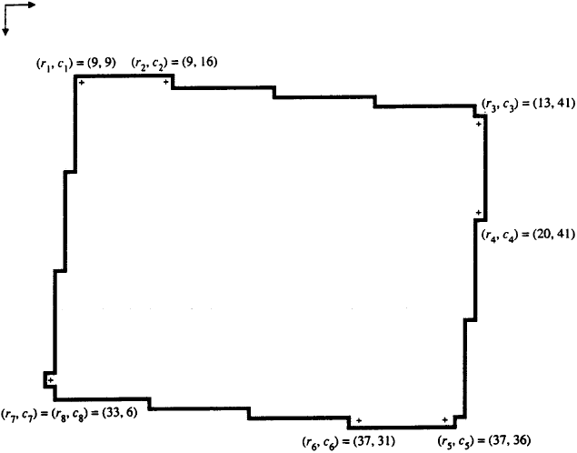
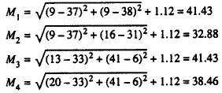
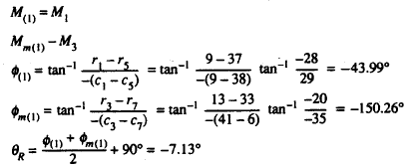
calculation for the orientation of an example rectangle

Slide 46
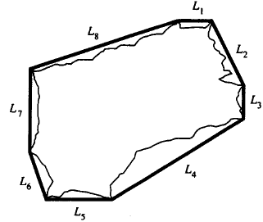
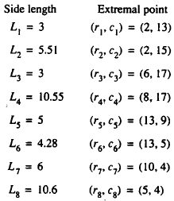
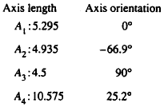
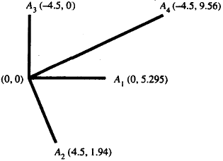
3.2.1 Extremal Points (cont’)
axes and their mates that arise from octagonal-shaped regions
Notes:
octagonal八角形

Slide 47
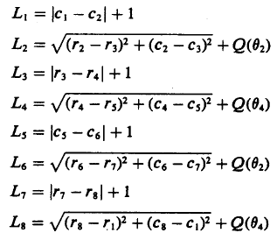
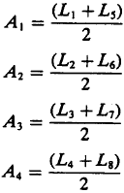
3.2.1 Extremal Points (cont’)

Slide 48



3.2.2 Spatial Moments
Second-order row moment
Second-order mixed moment
Second-order column moment

Slide 49
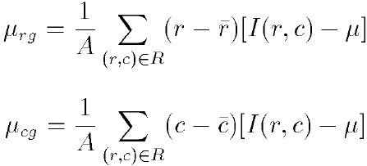
3.2.3 Mixed Spatial Gray Level Moments
region properties: position, extent, shape, gray level properties
Second-order mixed gray level property with spatial moments properties
Notes:
Extent 長度 範圍

Slide 50
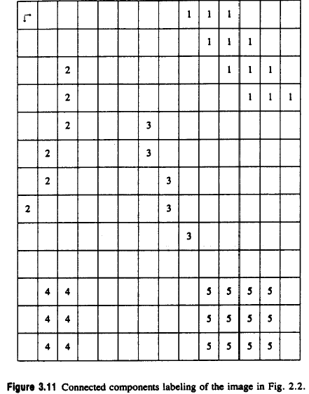
3.2.3 Mixed Spatial Gray Level Moments (cont’)
1 2 3 4 5 6 7 8 9 10 11 12 13 14 15
01 02 03 04 05 06 07 08 09 10 11 12 13
connected components labeling of the image in Fig 2.2

Slide 51
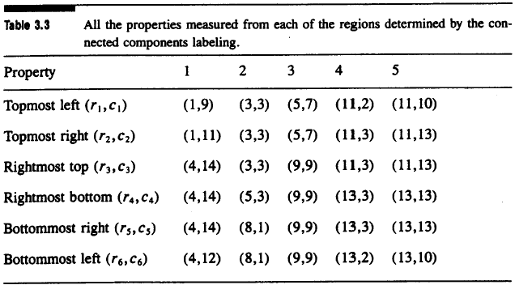
3.2.3 Mixed Spatial Gray Level Moments (cont’)
all the properties measured from each of the regions

Slide 52
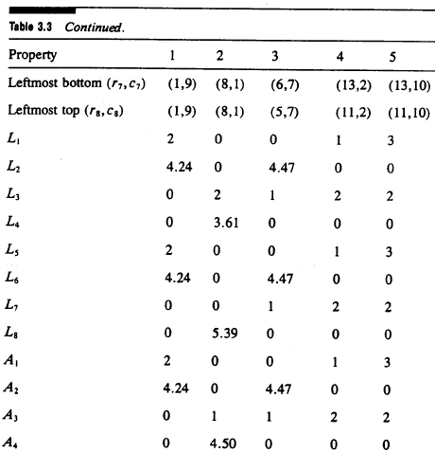
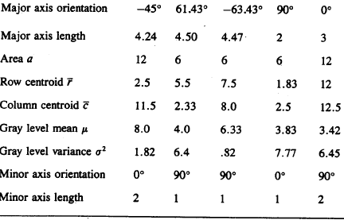
3.2.3 Mixed Spatial Gray Level Moments (cont’)

Slide 53


Slide 54
3.3 Signature Properties
vertical projection
horizontal projection
diagonal projection from lower left to upper right
diagonal projection from upper left to lower right

Slide 55




3.3 Signature Properties
$P_{D}$ 1 1 1 2
 | 1 | 2 | 3 | 4 | 5
1 | 0 | 0 | 0 | 0 | 0
2 | 0 | 1 | 1 | 0 | 0
3 | 0 | 0 | 1 | 1 | 0
4 | 0 | 0 | 1 | 0 | 0
5 | 0 | 0 | 0 | 0 | 0
$$P_{H}$$
2
2
1
$P_{V}$ 1 3 1
$P_{E}$ 1 2 2

Slide 56

3.3 Signature Properties (cont’)
Projections: easily obtainable in pipeline hardware
compute properties from projections
area

Slide 57
3.3 Signature Properties (cont’)
rmin: top row of bounding rectangle
rmax; bottom row of bounding rectangle
cmin: leftmost column of bounding rectangle
cmax: rightmost column of bounding rectangle

Slide 58
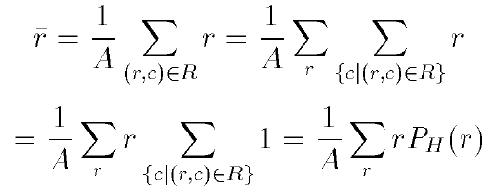
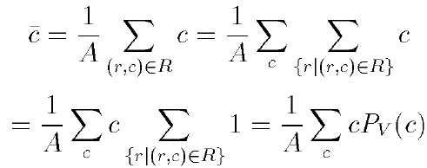


3.3 Signature Properties (cont’)
row centroid
column centroid
diagonal centroid
another diagonal centroid

Slide 59



3.3 Signature Properties (cont’)
second row moment from horizontal projection
second column moment from vertical projection
second diagonal moment

Slide 60



3.3 Signature Properties (cont’)
second diagonal moment related to
second mixed moment can be obtained from projection
second diagonal moment related to

Slide 61


3.3 Signature Properties (cont’)
second mixed moment can be obtained from projection
mixed moment obtained directly from and

Slide 62


Slide 63
3.3.1 Signature Analysis to Determine the Center and Orientation of a Rectangle
signature analysis: important because of easy, fast implementation
surface mount device (SMD) placement: position and orientation of parts

Slide 64


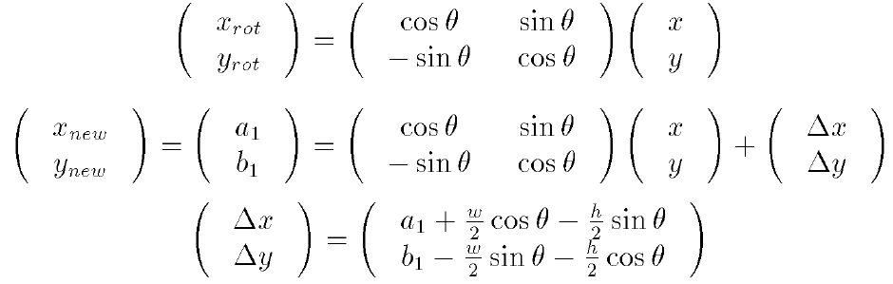

3.3.1 Signature Analysis to Determine the Center and Orientation of a Rectangle (cont’)
determine center of rectangle by corner location
side lengths w, h orientation angle
(x, y) = ($\frac{w}{2}, −\frac{h}{2}$)
_
_
|
|

Slide 65
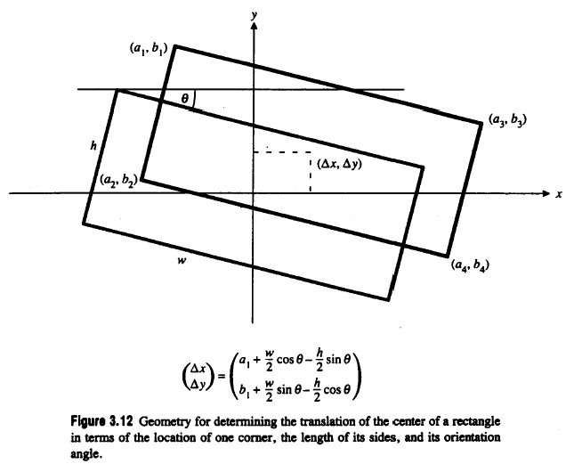
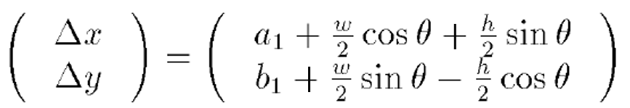
geometry for determining the translation of the center of a rectangle

Slide 66
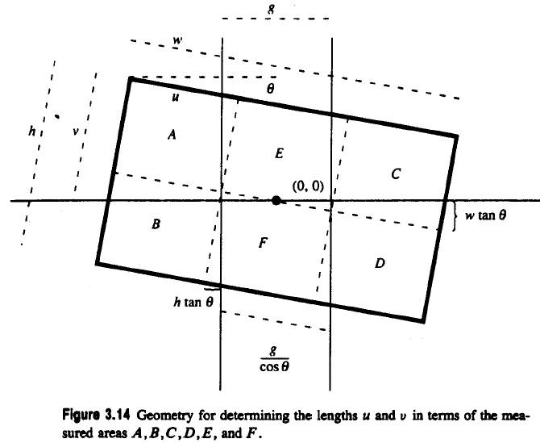
partition rectangle into six regions formed by two vertical lines
a known distance g apart and one horizontal line

Slide 67
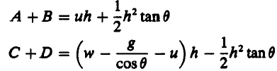
partition rectangle into six regions formed by two vertical lines
a known distance g apart and one horizontal line

Slide 68

partition rectangle into six regions formed by two vertical lines
a known distance g apart and one horizontal line

Slide 69


3.3.1 Signature Analysis to Determine the Center and Orientation of a Rectangle (cont’)
Calculate u
=>
=>

Slide 70


3.3.1 Signature Analysis to Determine the Center and Orientation of a Rectangle (cont’)
Calculate v
=>
=>

Slide 71



|
|
|
+
+
+$wsinθ$

Slide 72

3.3.1 Signature Analysis to Determine the Center and Orientation of a Rectangle (cont’)
Rotation angle:
- $E+F=h\frac{g}{cosθ}$
- $cosθ=\frac{hg}{E+F}$

Slide 73


Slide 74

3.3.2 Using Signature to Determine the Center of a Circle
partition the circle into four quadrants formed by two orthogonal lines which meet inside the circle
geometry for the circle its center and a chord

Slide 75






= $\frac{r^{2}}{2}\left[2\cos^{−1}\frac{d}{r}−2\frac{d}{r}\sqrt{1−(\frac{d}{r})^{2}}\right]$
= $\frac{r^{2}}{2}[2θ−2cosθsinθ]$
= $\frac{r^{2}}{2}[2θ−sin2θ]$
$$d=rcosθ$$

Slide 76

3.3.2 Using Signature to Determine the Center of a Circle (cont’)
circle projected onto the four quadrants of the projection index image

Slide 77





3.3.2 Using Signature to Determine the Center of a Circle (cont’)
each quadrant area from histogram of the masked projection
positive if A + B > C + D negative otherwise where
positive if B + D > A + C negative otherwise
Where $θ_{y}$ satisfies
Where $θ_{x}$ satisfies

Slide 78
3.4 Summary
region properties from connected components or signature analysis

Slide 79



Histogram Equalization (Homework)
pixel transformation
- r, s: original, new intensity,
T: transformation
-T( r ) single-valued, monotonically increasing
- for

Slide 80



Slide 81




Histogram Equalization (Homework)
Notes:
Source Image -> Histogram
利用 Histogram 算出各個灰階值的 probability density function
將PDF 做累加求出 CDF
將CDF 的結果 4捨5入後做出對照表
透過查詢剛剛建立的對照表，決定Transition 完各個灰階值的機率

Slide 82



Slide 83
Histogram Equalization (Homework)
Project due Oct. 13:
Write a program to do histogram equalization

Slide 84
End

