Slide 1
Computer Vision Chapter 4
Statistical Pattern Recognition
Presenter: 龔柏丞
Cell phone: 0978912582
E-mail: r08922a25@ntu.edu.tw
指導教授：傅楸善 博士
Digital Camera and Computer Vision Laboratory
Department of Computer Science and Information Engineering
National Taiwan University, Taipei, Taiwan, R.O.C.

Slide 2
Outline
4.1 Introduction
Pattern Discrimination
4.2 Bayes Decision Rules
Economic Gain Matrix
Conditional Probability
Decision Rule Construction
Fair Game Assumption
Bayes Decision
Continuous Measurement
4.3 Prior Probability
4.4 Economic Gain Matrix and the Decision Rule

Slide 3
Outline
4.5 Maximin Decision Rule
4.6 Decision Rule Error
4.7 Reserving Judgment
4.8 Nearest Neighbor
4.9 A Binary Decision Tree Classifier
4.10 Decision Rule Error Estimation
4.11 Neural Networks
4.12 Summary

Slide 4
4.1 Pattern Discrimination
Also called pattern identification
Process:
A unit is observed or measured
A category assignment is made that names or classifies the unit as a type of object
The category assignment is made only on observed measurement (pattern)

Slide 5
4.1 Introduction
Units: Image regions and projected segments
Each unit has an associated measurement vector
Using decision rule to assign unit to class or category optimally

Slide 6
4.1 Introduction (Cont.)
unit
measurement vector
(image regions or
projected segments)
decision rule
optimally assign unit to a class

Slide 7
4.1 Introduction (Cont.)
unit
measurement vector
(image regions or
projected segments)
decision rule
optimally assign unit to a class
smallest classification error

Slide 8
4.1 Introduction (Cont.)
How to reduce the dimensionality?
Feature selection and extraction
unit
measurement vector
(image regions or
projected segments)
Construction techniques
decision rule
Estimation of error
optimally assign unit to a class
smallest classification error

Slide 9
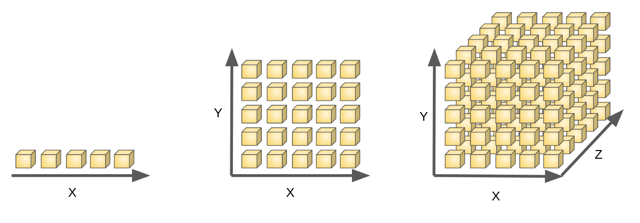
4.1 Curse of Dimensionality

Slide 10
Joke Time

Slide 11
4.1 Introduction (Cont.)
Statistical pattern recognition techniques:
Feature selection and extraction techniques
Decision rule construction techniques
Techniques for estimating decision rule error

Slide 12
4.2 Recall Some Definitions
t: true category identification from set C
a: assigned category from set C
d: observed measurement from a set of measurements D
(t, a, d): event of classifying the observed unit
P(t, a, d): probability of the event (t, a, d)
e(t, a): economic gain with true category t and assigned category a

Slide 13



4.2 Recall
unit
measurement vector
(image regions or
projected segments)
decision rule
optimally assign unit to a class

Slide 14
4.2 Economic Gain Matrix
correct
assign unit to a class
incorrect
Assigned State(a)
(t, a) | Good | Bad
Good | (g, g) | (g, b)
Bad | (b, g) | (b, b)
True State(t)

Slide 15
4.2 Economic Gain Matrix (Cont.)
We assume that the act of making category assignments carries consequences (t, a, d) economically or in terms of utility.
e(t, a): economic gain/utility with true category t and assigned category a

Slide 16
4.2 Economic Gain Matrix (Cont.)
Assigned State
e(t, a) | Good | Bad
Good | e(g, g) | e(g, b)
Bad | e(b, g) | e(b, b)
True State

Slide 17
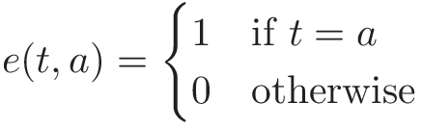
4.2 Economic Gain Matrix (Cont.)
Identity gain matrix
Assigned State
e(t, a) | Good | Bad
Good | 1 | 0
Bad | 0 | 1
True State
Notes:
考慮一個理想的人，他總是希望給出最準確的判斷，他的Economic Gain Matrix，就是一個單位矩陣

Slide 18

4.2 Jet Fan Blade

Slide 19
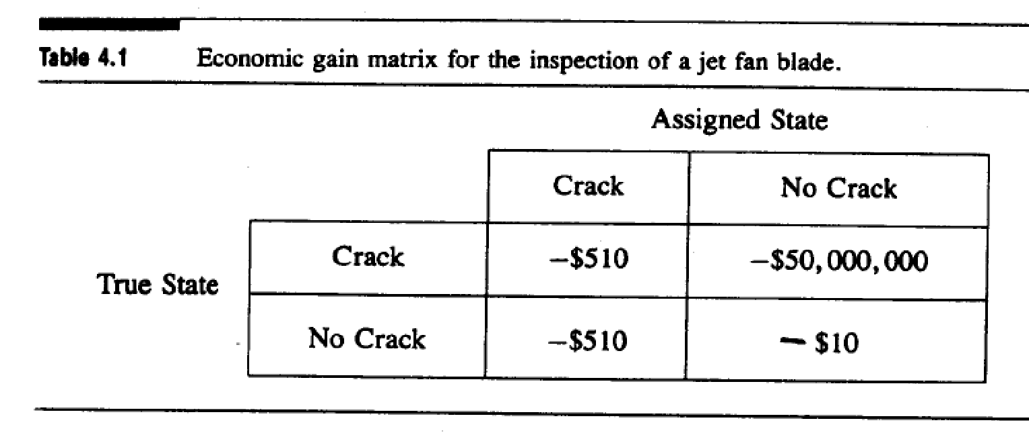
4.2 An Instance (Cont.)

Slide 20
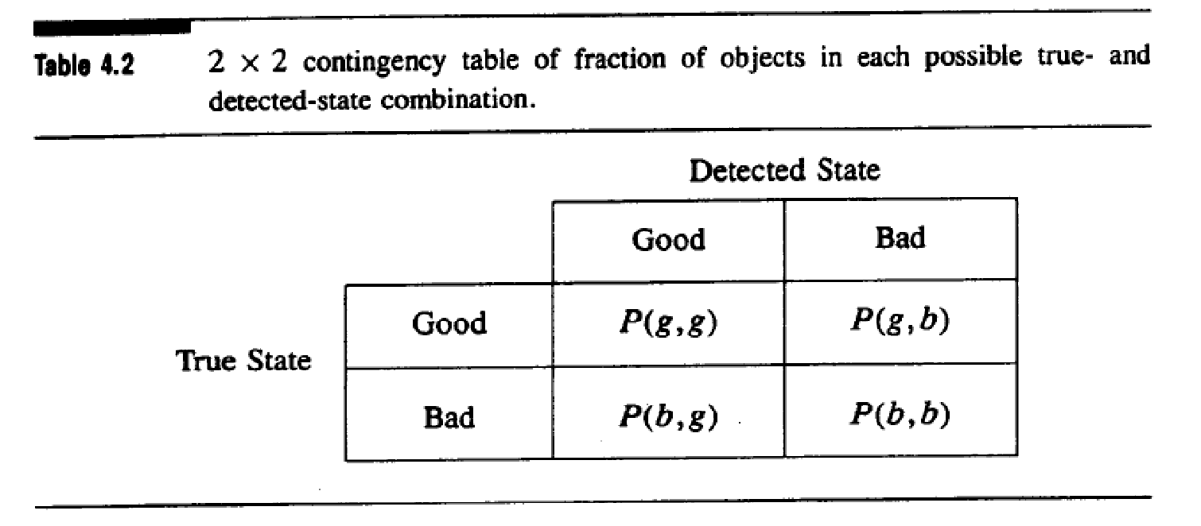
4.2 Another Instance (cont.)

Slide 21
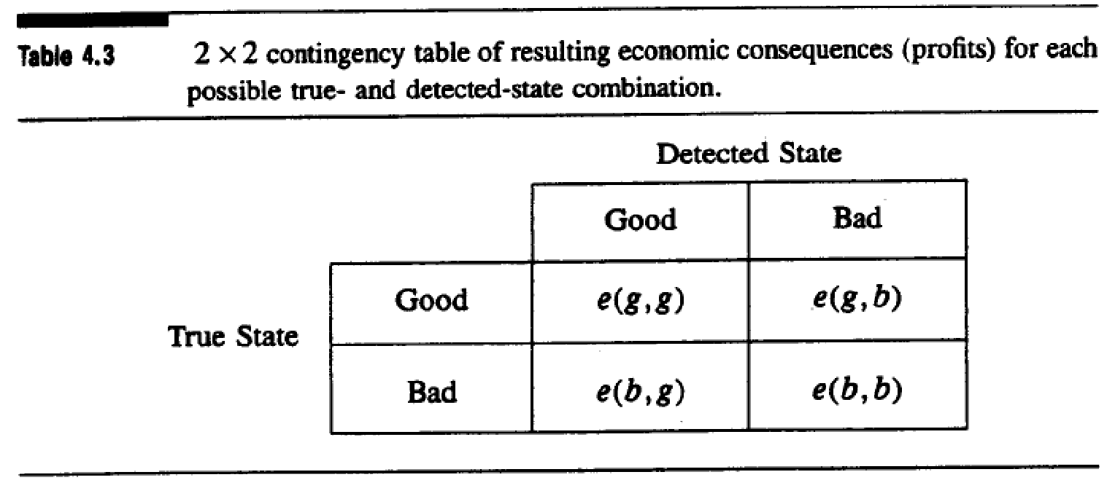
4.2 Another Instance (cont.)

Slide 22
Joke Time

Slide 23
4.2 Some notation
P(g, g): probability of true good, assigned good,
P(g, b): probability of true good, assigned bad,
...
e(g, g): economic consequence for event (g, g),
…
e positive: profit consequence
e negative: loss consequence

Slide 24


4.2 Expected profit per object
Fraction of good objects manufactured
Fraction of bad objects manufactured
Expected profit per object
Notes:
9/29 教到這裡

Slide 25
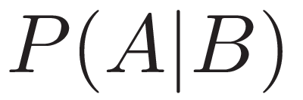
4.2 Conditional Probability
“Event that
already happened’’
“given’’

Slide 26
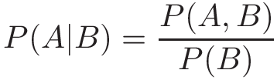
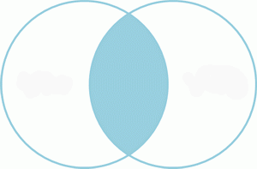



4.2 Conditional Probability (cont.)

Slide 27
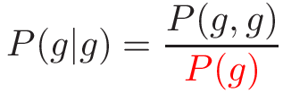

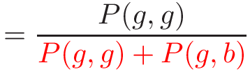
4.2 Conditional Probability (cont.)
Given that an object is good, the probability that it is detected as good:
“assigned’’
“true’’
“true’’
P(g, g)
P(g, b)
P(g)

Slide 28
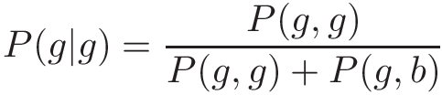
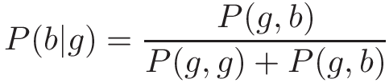
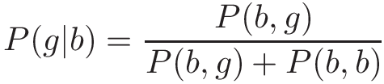
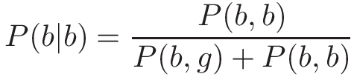
4.2 Conditional Probability (cont.)

Slide 29
4.2 Conditional Probability (cont.)
The machine’s incorrect performance is characterized:
P(b | g): false-alarm rate
P(g | b): misdetection rate

Slide 30


4.2 Conditional Probability (cont.)
From P(b | g) and P(g | b) the two other conditional probabilities P(g | g) and P(b | b) can be readily computed:

Slide 31
4.2 Expected profit per object
Another formula for expected profit per object

Slide 32
4.2 Expected profit per object (cont.)
Another formula for expected profit per object
Recall

Slide 33
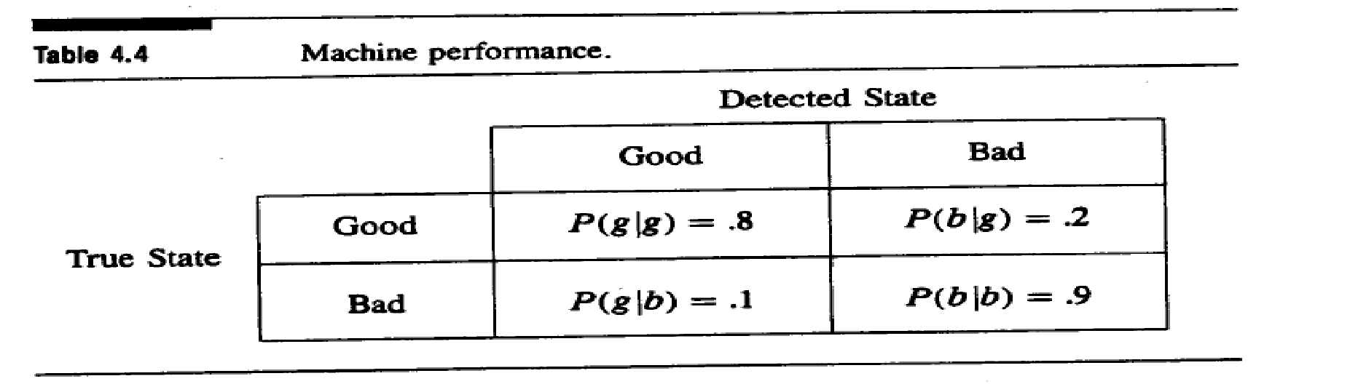
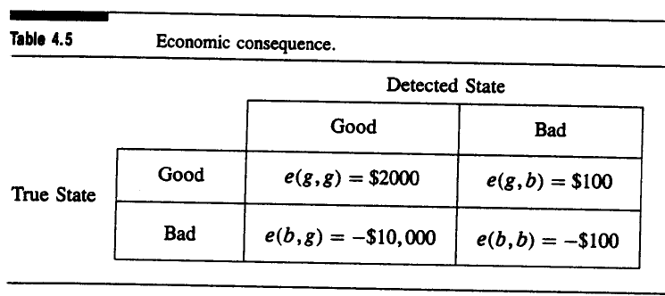
4.2 Example 4.1

Slide 34
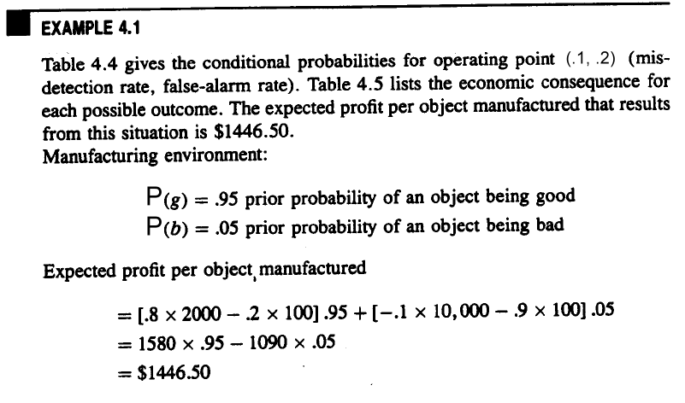
4.2 Example 4.1 (cont.)
 | Good | Bad
Good | P(g | g) = 0.8 | P(b | g) = 0.2
Bad | P(g | b) = 0.1 | P(b | b) = 0.9
 | Good | Bad
Good | e(g, g) = $2000 | e(g, b) = -$100
Bad | e(b, g) = -$10,000 | e(b, b) = -$100
Notes:
系統嚴格的例子

Slide 35
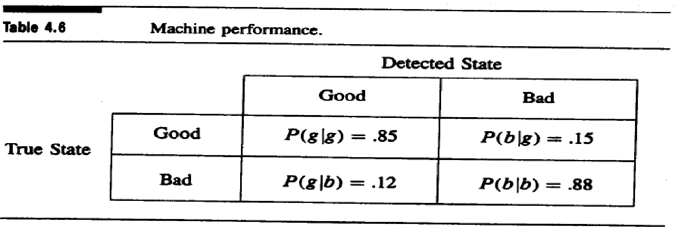
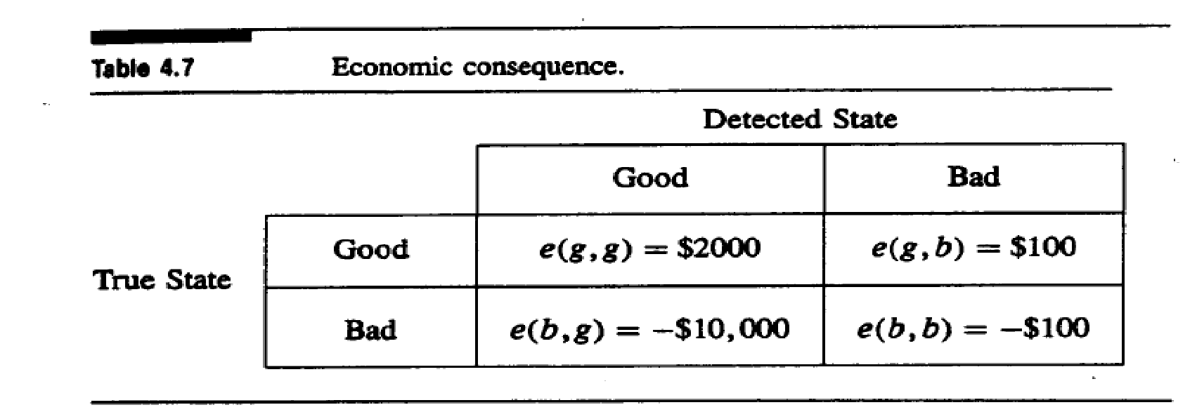
4.2 Example 4.2

Slide 36
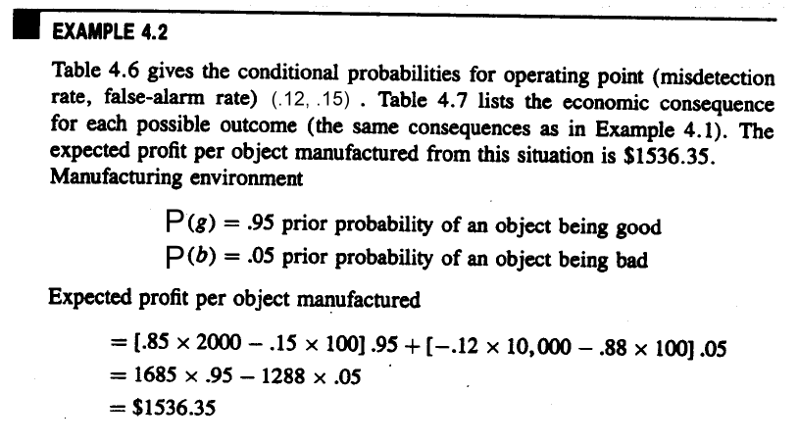
4.2 Example 4.2 (cont.)
Notes:
系統寬鬆的例子

Slide 37
Joke Time

Slide 38
4.2 Recall
How to reduce the dimensionality?
Feature selection and extraction
unit
measurement vector
(image regions or
projected segments)
Construction techniques
decision rule
Estimation of error
optimally assign unit to a class

Slide 39
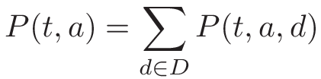
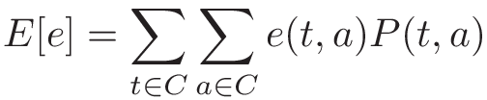
4.2 Decision Rule Construction
(t, a): summing (t, a, d) on every measurement d
Therefore,
Average economic gain
Notes:
(t, a, d): event of classifying the observed unit

Slide 40
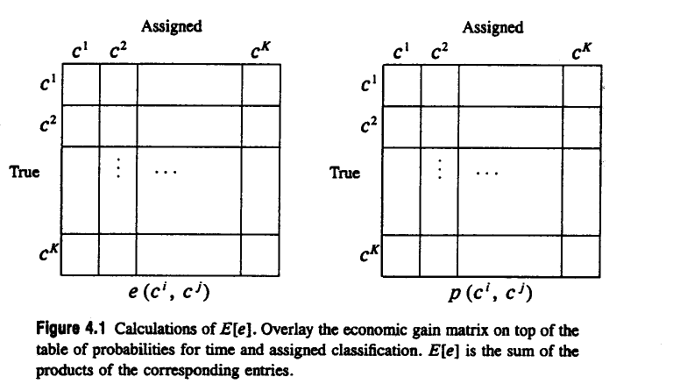
4.2 Decision Rule Construction (cont.)

Slide 41
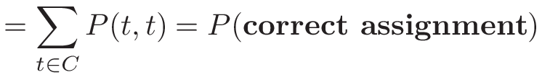
4.2 Decision Rule Construction (cont.)
We can use identity matrix as the economic gain matrix to compute the probability of correct assignment:

Slide 42
4.2 Fair Game Assumption
Decision rule uses only measurement data in assignment; the nature and the decision rule are not in collusion
In other words, P(a | t, d) = P(a | d)
“given t ’’
Notes:
Collusion 共謀

Slide 43
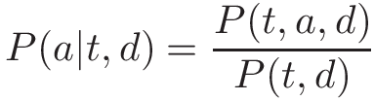


4.2 Fair Game Assumption (cont.)
From the definition of conditional probability
Fair game assumption:
So

Slide 44
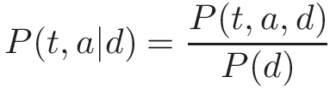
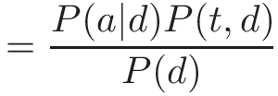
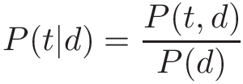

4.2 Fair Game Assumption (cont.)
By fair game assumption,
By definition,
Note:

Slide 45

4.2 Fair Game Assumption (cont.)
The fair game assumption leads to the fact that conditioned on measurement d, the true category and the assigned category are independent.

Slide 46
4.2 Fair Game Assumption (cont.)
P(t | d): a conditional probability that nature
determines
P(a | d): assigns category a to an observed unit
In order to distinguish them, we will use
f(a | d) for the conditional probability
associated with the decision rule

Slide 47
Joke Time

Slide 48

4.2 Deterministic Decision Rule
We use the notation f(a | d) to completely define a decision rule; f(a | d) presents all the conditional probability associated with the decision rule
A deterministic decision rule:
Decision rules which are not deterministic are called probabilistic/nondeterministic/stochastic

Slide 49
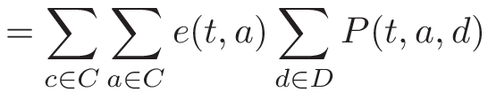


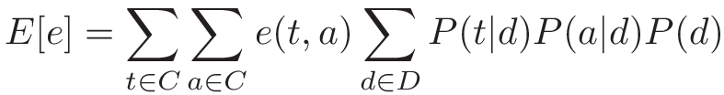

4.2 Expected Value on f(a|d)
Previous formula
By and
=>

Slide 50

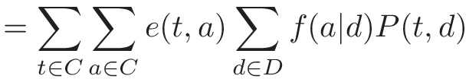

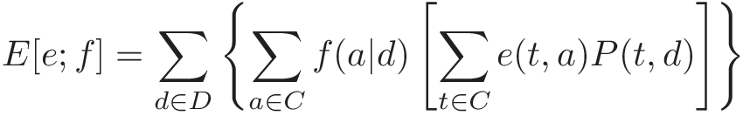
4.2 Expected Value on f(a|d) (cont.)
To analyze the dependence has on :
regroup

Slide 51

4.2 Maximizing Expected Economic Gain (cont.)
Maximize expected economic gain
Satisfy
for any decision rule g
Constructing the optimal f

Slide 52
4.2 Maximizing Expected Economic Gain (cont.)
How to Maximize expected economic gain?

Slide 53
4.2 Maximizing Expected Economic Gain (cont.)
Split by the first summation:
Maximize when each term meets its own maximum

Slide 54
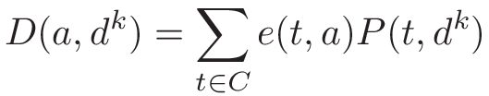

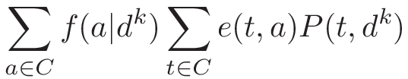
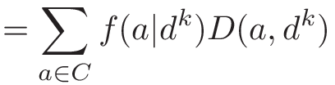
4.2 Maximizing Expected Economic Gain (cont.)
Set
The k-th term in :

Slide 55
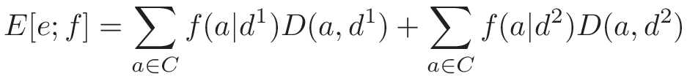
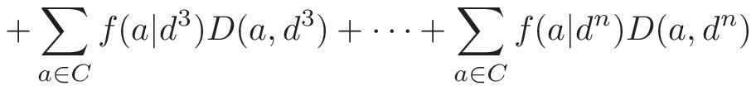
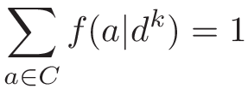
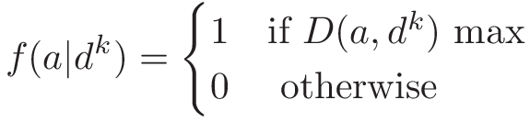
4.2 Maximizing Expected Economic Gain (cont.)
Note:
“decision rule’’
Choose
Bayes rule

Slide 56
Joke Time

Slide 57
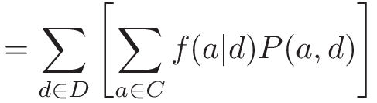
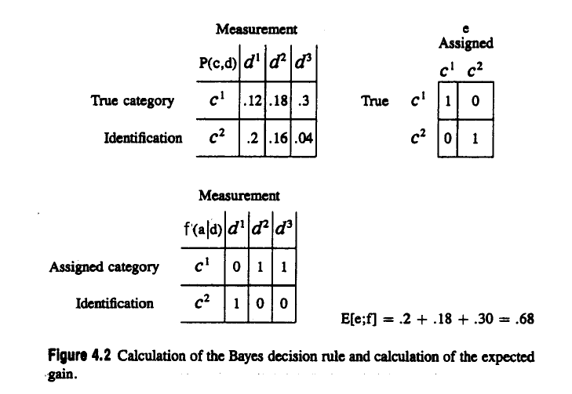
4.2 Discrete Example

Slide 58
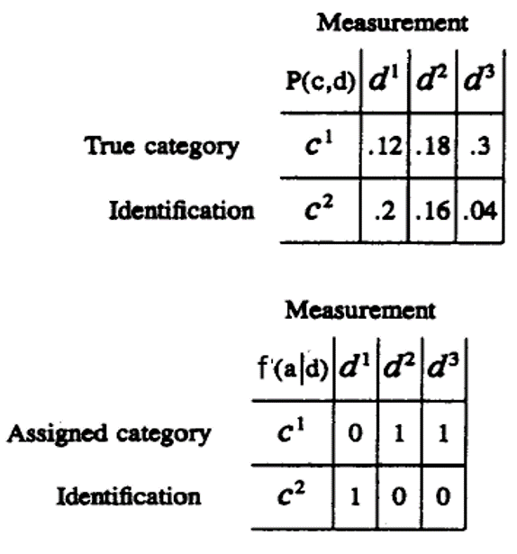
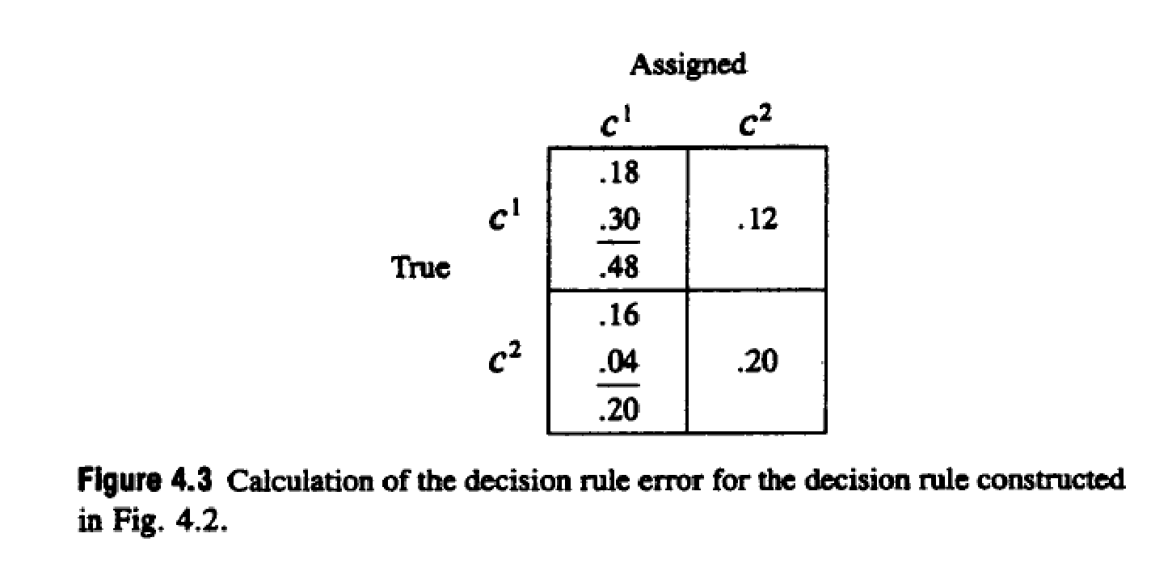

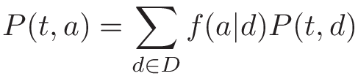
4.2 Discrete Example (cont.)
+
+

Slide 59
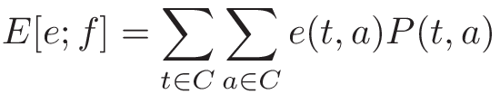
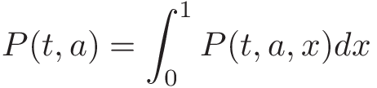
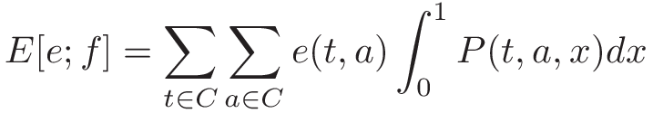
4.2 Continuous Measurement
Recall that
Discrete Measurement :
Continuous Measurement :

Slide 60
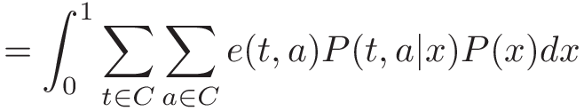

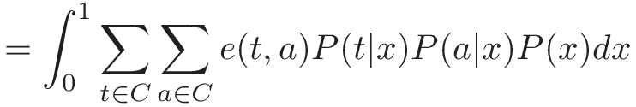
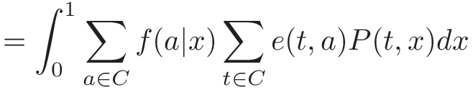
4.2 Continuous Measurement (cont.)
Note: by Fair Game Assumption

Slide 61

4.2 Continuous Measurement (cont.)
Choose
continuous measurement

Slide 62
Joke Time

Slide 63




4.2 Continuous Example
For the example, try the continuous density function of the measurements:
and
Prove that they are indeed density function
Notes:
Possible measurements x lie in the closed interval [0, 1]
P(x|t_1) = 3x^2
P(x|t_2) = 3(1-x^2)/2

Slide 64





4.2 Continuous Example (cont.)
Suppose that the prior probability of
is and the prior probability of is
and using an identity economic gain matrix
Note:
Notes:
x: measurement

Slide 65


4.2 Continuous Example (cont.)
By definition
Since economic gain is identity matrix:

Slide 66




4.2 Continuous Example (cont.)
When , a Bayes decision rule will assign an observed unit to t₁, which implies
When , a Bayes decision rule will assign an observed unit to t₂, which implies

Slide 67


4.2 Continuous Example (cont.)
Bayes decision rule:
Choose
and

Slide 68





4.2 Continuous Example (cont.)

Slide 69
Joke Time

Slide 70




4.3 Prior Probability
The Bayes rule:
Replace with
The Bayes rule can be determined by assigning any categories that maximizes
Notes:
用 prior probability 的觀點來看 Bayes rule
\sum_{t \in C} e(t, a)P(d|t)P(t) 這個形式是有用的
因為能把 P(t) 這個 Prior Probability 抽出

Slide 71




4.3 Prior Probability (cont.)
If the economic gain matrix is the identity matrix, and choose all the category prior probabilities to be equal. Therefore,
The Bayes rule:
Likelihood function
Maximum likelihood decision rule

Slide 72
Joke Time

Slide 73



4.4 Economic Gain Matrix
Suppose e₁(t, a) and e₂(t, a) are two different economic gain functions
This inequality is inequality to
for every
for every
Notes:
看不同的 economic gain matrix 對於 decision rule 的影響

Slide 74



4.4 Economic Gain Matrix (cont.)
for every
remove from both sides
for every
for every
Notes:
有一樣的 decision rule

Slide 75




4.4 Economic Gain Matrix
Identity matrix
Incorrect loses 1
A more balanced instance
General

Slide 76
Joke Time

Slide 77


4.5 Maximin Decision Rule
Define the conditional expected economic gain:
A decision rule f called a maximin decision rule if and only if
for any decision rule g
Notes:
E[e|e^j; f] 為 在 t=c^j 的情況下 f 的expected economic gain
Maxmin decision的意思是，要最大化所有可能的真實情況 c^j 中，最小的那個

Slide 78
4.5 Maximin Decision Rule
In order to determine a Bayes decision rule, we have to know the joint function f(c, d) or at least f(c | d)
To determine f(c | d) from f(d | c), we must also know the prior probability function P(c)
Bayes decision is not appropriate for the situation can not get or assume the prior probability function
Notes:
f(c, d)在measurement是d的情況下，unit指定為c的機率

Slide 79









4.5 Maximin Decision Rule (cont.)
Hence and , suppose that , and choose
for any decision rule g

Slide 80

4.5 Maximin Decision Rule (cont.)
If economic gain matrix is identity matrix

Slide 81

4.5 Example 4.3
Consider the case where there are two categories c¹ and c²; three possible measurements d¹, d², and d³; economic gain matrix is identity matrix, and a conditional probability function f(d | c) given by

Slide 82




4.5 Example 4.3 (cont.)
Maximin
Decision Rule
Notes:
有兩個 Maximin Decision Rule

Slide 83



4.5 Example 4.3 (cont.)

Slide 84






4.5 Example 4.3 (cont.)
,
The lowest Bayes gain is achieved when
and
Notes:
這裡要說明一個 maximin 的性質:
Bayes decision rule 的 economic gain 值得最小值，就會剛好是 miximin decision rule 對應的 economic gain值
nondeterministic

Slide 85
4.5 Example 4.3 (cont.)
0.6714

Slide 86

4.5 Example 4.3 (cont.)
Notes:
Miximin 發生在 stochastic decision (nondeterministic)

Slide 87
Joke Time
Notes:
10/6教到這裡

Slide 88


4.5 Example 4.4
Function f(d | c) is:
Economic gain matrix e is:

Slide 89

4.5 Example 4.4 (cont.)
Maximin
Decision Rule

Slide 90




4.5 Example 4.4 (cont.)

Slide 91

4.5 Example 4.4 (cont.)

Slide 92

4.5 Example 4.4 (cont.)

Slide 93
Joke Time

Slide 94


4.6 Decision Rule Error
The misidentification error αk
The false-identification error βk

Slide 95








4.6 An Instance

Slide 96
4.7 Reserving Judgment
Reserved judgment gives the decision rule one more option
Instead of giving assignments for every measurements d
The decision rule may opt to withhold judgment for some measurement
Notes:
保留的判斷為決策規則提供了另一種選擇
1. Reserved judgment可有效控制誤差率
2. 對於某些測量值，決策準則可能會抑制到某些判定結果。
3. 決策準則被對於那些它指定的測量值所抑制的判定結果和誤差率的時間比率所描述

Slide 97

4.8 Nearest Neighbor Rule
Assign pattern x to the closest vector in the training set
The definition of “closest”:
where is a metric or measurement space
Chief difficulty: brute-force nearest neighbor algorithm computational complexity proportional to number of patterns in training set
Notes:
brute-force nearest neighbor:暴力法

Slide 98

4.9 Binary Decision Tree Classifier
Assign by hierarchical decision procedure

Slide 99
4.9 Major Problems
Choosing tree structure
Choosing features used at each non-terminal node
Choosing decision rule at each non-terminal node

Slide 100
4.9 Decision Rules at the Non-terminal Node
Thresholding the measurement component
Fisher’s linear decision rule
Bayes quadratic decision rule
Bayes linear decision rule
Linear decision rule from the first principal component
Notes:
We can use any one of the following five decision rules at each nonterminal node

Slide 101
4.10 Error Estimation
An important way to characterize the performance of a decision rule
Training data set: must be independent of testing data set
Hold-out method: a common technique
construct the decision rule with half the data set, and test with the other half

Slide 102
Joke Time

Slide 103

4.11 Neural Network
A set of units each of which takes a linear combination of values from either an input vector or the output of other units

Slide 104
4.11 Neural Network (cont.)
Has a training algorithm
Responses observed
Reinforcement algorithms
Back propagation to change weights

Slide 105
4.12 Summary
Bayesian approach
Maximin decision rule
Misidentification and false-alarm error rates
Nearest neighbor rule
Construction of decision trees
Estimation of decision rules error
Neural network

Slide 106
Research
Method:
Computer vision techniques and YOLO v4 object detection
Step:
Result:
Good awl extension and pedicle bounding box
Binarize Image
Extend the Awl Tip
Connected-Component Labeling
Canny Edge Detector
Save the Result Image

