Slide 1
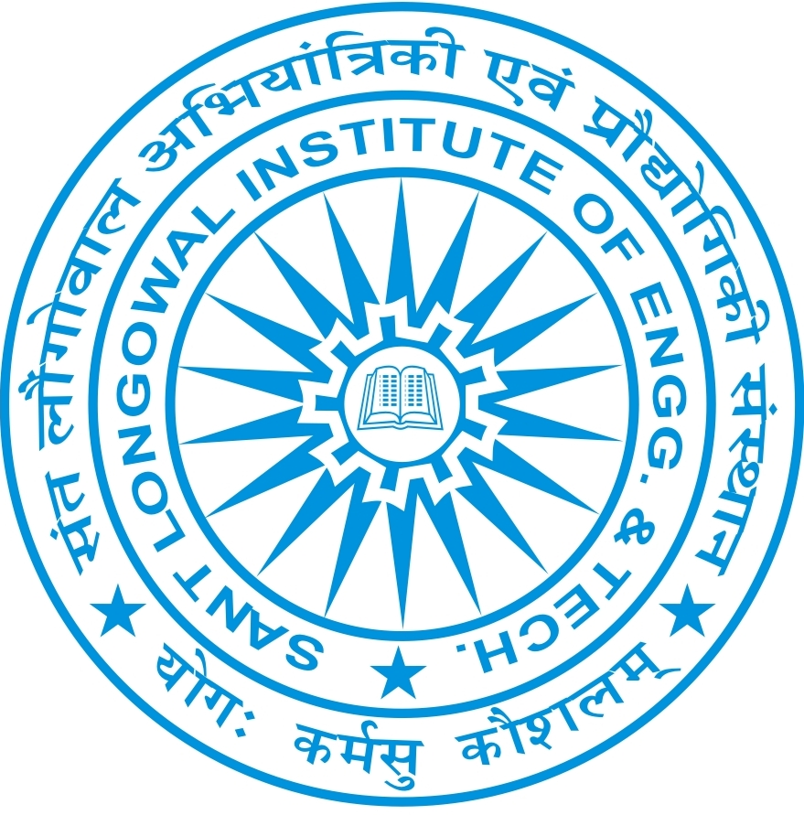
SANT LONGOWAL INSTITUTE OF ENGINEERING AND TECHNOLOGY
Zero Liquid Discharge
Process and Technology Selection
Team Name:
Presenters :
Bhaskar Kumar
Debjit Gayen
Devanshu Singh
Paras Chaurasia
AZ-5

Slide 2
Zero Liquid Discharge (ZLD)
Zero Liquid Discharge (ZLD) is a wastewater treatment process designed to recover almost all the water from the wastewater stream, leaving only a minimal amount of solid waste (such as sludge or salts). ZLD ensures that no liquid waste is discharged into the environment, making it an essential solution for industries that face stringent environmental regulations or want to minimize their environmental impact.

Slide 3
Importance of Industrial Wastewater Management
Environmental Protection: Prevents pollution by eliminating the discharge of harmful chemicals, heavy metals, and toxins into water bodies. Conserves water resources, making it especially crucial in areas with water scarcity.
Regulatory Compliance: Helps industries comply with stringent environmental regulations like those from the CPCB and EPA, which demand reductions in effluent discharge. Reduces risks of fines and legal penalties for violating wastewater discharge limits.
Economic Advantages: Cost Savings on water procurement and wastewater treatment
Resource Recovery: Extracts valuable by-products (like chemicals or salts) from wastewater, adding economic value.
Sustainability: Sustainable water use through recycling, decreasing the environmental footprint of industrial activities. Improved corporate image: Companies adopting ZLD demonstrate commitment to sustainable practices.

Slide 4
Overview of Bharat Petrochemicals Ltd. (BPL)
A leading petrochemical manufacturing company involved in the production of a wide range of chemicals and polymers. BPL, like many other industrial entities, faces challenges related to wastewater management, specifically dealing with high volumes and high TDS (Total Dissolved Solids) wastewater. BPL aims to optimize water recovery while minimizing operational costs and energy consumption in its ZLD processes.
BPL is evaluating and implementing advanced wastewater treatment technologies (like RO, MVR, and MEE) to meet Zero Liquid Discharge requirements and become an industry leader in sustainable operations.

Slide 5
Why BPL Needs to Adopt ZLD
Environmental Responsibility:
As a major player in the petrochemical industry, BPL has a responsibility to minimize its environmental footprint by adopting sustainable water management practices.
Zero Liquid Discharge (ZLD) ensures that wastewater is completely recycled with no effluent discharged, reducing environmental pollution and protecting local water sources.
Adopting ZLD helps BPL comply with increasingly stringent environmental regulations enforced by governing bodies like the Central Pollution Control Board (CPCB) and State Pollution Control Boards (SPCB).Sustainability Goals:.

Slide 6
Regulatory Challenges and Deadlines Tighter Regulations:
Government regulations are evolving, and companies in water-intensive industries, like petrochemicals, are facing stricter effluent discharge norms.
CPCB Guidelines:
CPCB mandates that industrial effluent must meet specific standards, including limits for Total Dissolved Solids (TDS), Biochemical Oxygen Demand (BOD), and Chemical Oxygen Demand (COD).ZLD Implementation Deadlines: Regulatory bodies are setting deadlines for industries to adopt ZLD or improve their wastewater treatment to avoid environmental penalties. Periodic Monitoring: The CPCB and SPCB regularly monitor compliance, and failing to meet standards can result in fines, shutdowns, or even legal actions.

Slide 7
Potential Consequences of Non-Compliance Legal Penalties:
Fines and Penalties: BPL could face significant fines for failing to meet effluent discharge standards or ZLD compliance.
Litigation: Non-compliance could lead to legal proceedings or restrictions imposed by environmental regulatory bodies.
Environmental Harm: Discharge of untreated or inadequately treated wastewater can lead to pollution of local water bodies, harming ecosystems, wildlife, and communities.
Operational Restrictions: Regulatory bodies may impose shutdowns or restrictions on industrial operations if ZLD standards are not met. In extreme cases, business operations can be suspended if pollution limits are violated.
Reputational Damage: Failing to comply with ZLD regulations can tarnish BPL’s reputation as an environmentally responsible company. Customers, investors, and the public are increasingly scrutinizing businesses' environmental performance, and non-compliance may negatively affect brand image.
Increased Costs: Non-compliance may lead to increased operational costs, such as higher disposal fees, emergency treatment costs, and investments needed to meet future regulations.

Slide 8
Daily Water consumption & Wastewater generated
Total Water Consumption: BPL, as a petrochemical manufacturing facility, has significant water requirements for various processes such as cooling, chemical processing, cleaning, and product formulation.
Estimated Daily Water Consumption: Approximately 100,000 to 500,000 liters/day .Wastewater Generation: Water used in industrial processes becomes contaminated and is subsequently treated before being discharged or recycled. This wastewater includes a variety of pollutants.
Estimated Wastewater Generation: Around 80,000 to 450,000 liters/day.
Water Recovery Efficiency: Efforts to recover water through processes like reverse osmosis (RO), mechanical vapor recompression (MVR), and multi-effect evaporation (MEE) can reduce the amount of wastewater generated.

Slide 9
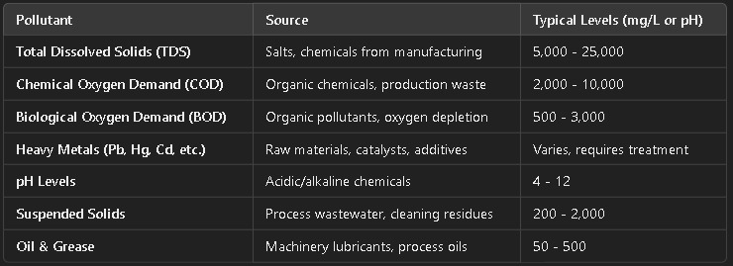
Pollutants & Effluent Characteristics

Slide 10
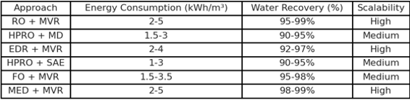
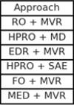
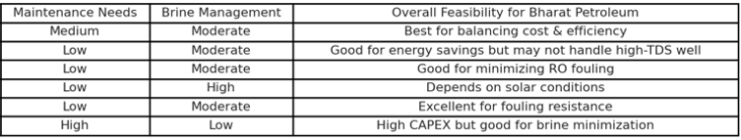
Available ZLD Technologies: A comparative Analysis

Slide 11
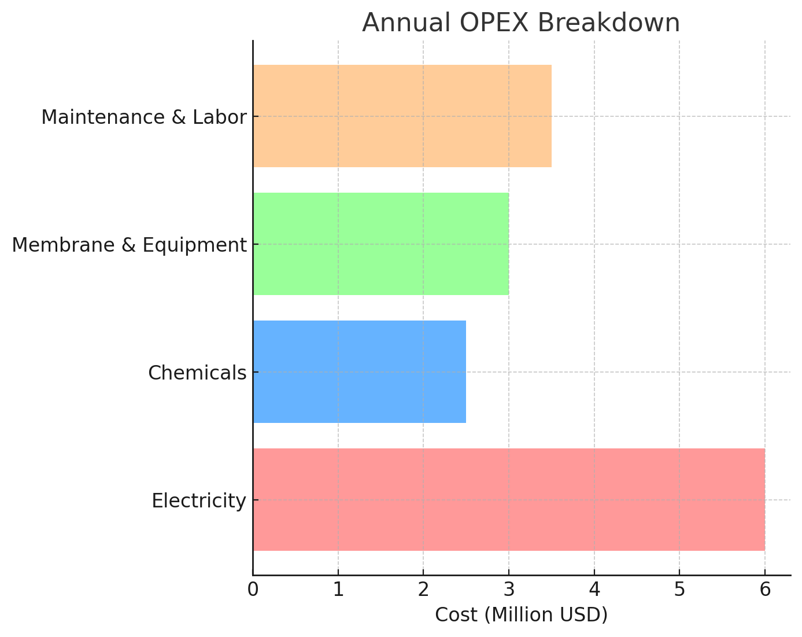
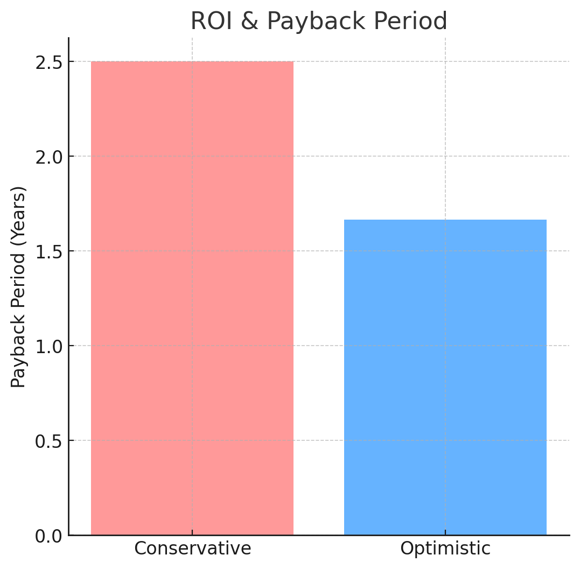
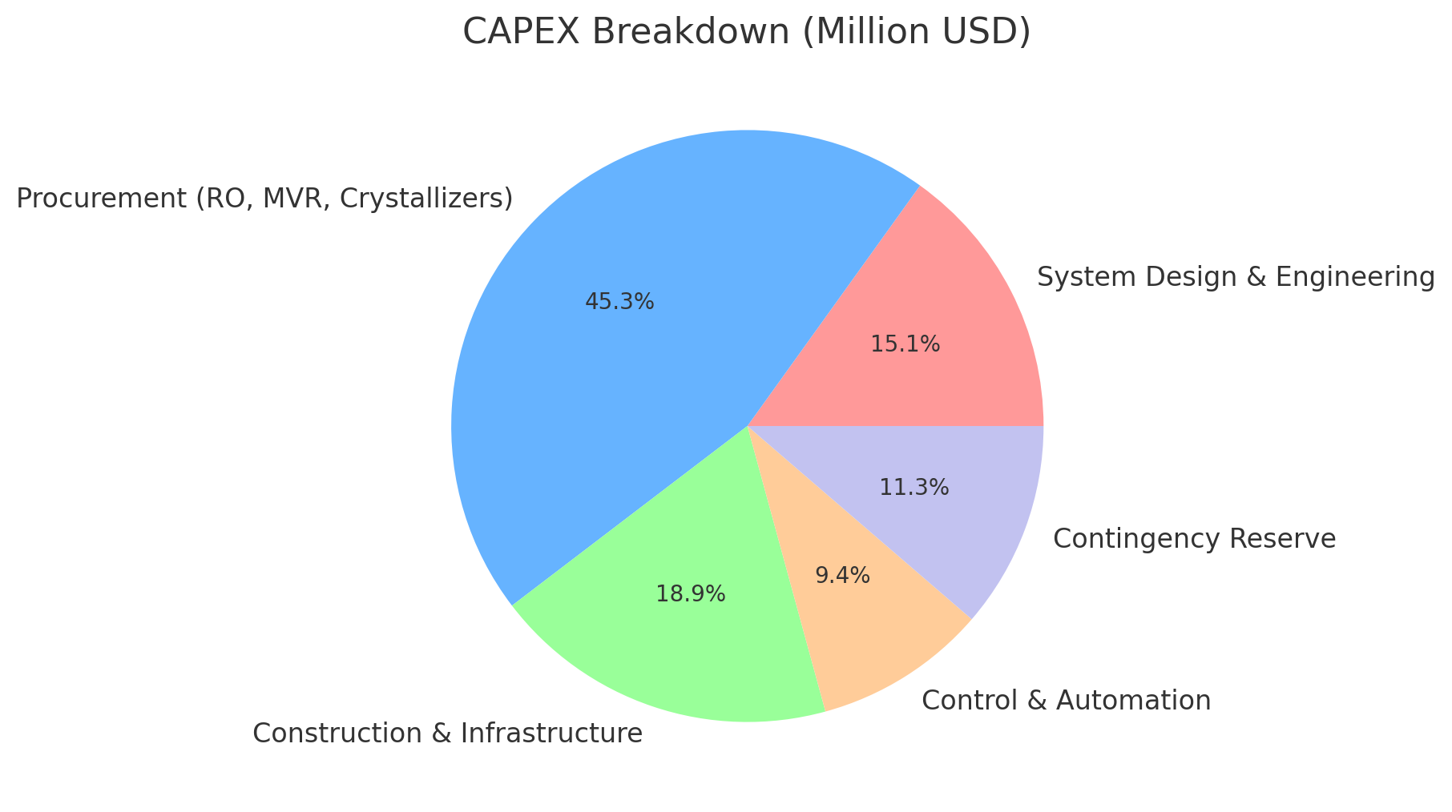
Case Solution Financial, Technical Analysis & Cost Benefit Assessment

Slide 12
Recommended ZLD Implementation Strategies
Phase 1: Pilot Testing and Hybrid System Development
Solid waste
Screening & Equalization
Coagulation & Flocculation
Sedimentation & Filtration
Solid waste
Reverse osmosis (RO)
Advance Oxidation and carbon
Softening & Ion Exchange
Brine Treatment(ZLD)
Sludge Management
Waste Heat from Plant
Fig- Visual Flow Chart for phase-1

Slide 13
Stages:1-3
Screening – Coagulation – Sedimentation/Filtration
Coarse & Fine Screens
Chemical Dosing
(PAC/Lime)
Tube Settler
Oil Skimmer (DAF)
Flocculation Tank
Dual Media Filter
Equalization tank
Coagulation & Flocculation
Sedimentation & Filtration
Screening and Equalisation

Slide 14
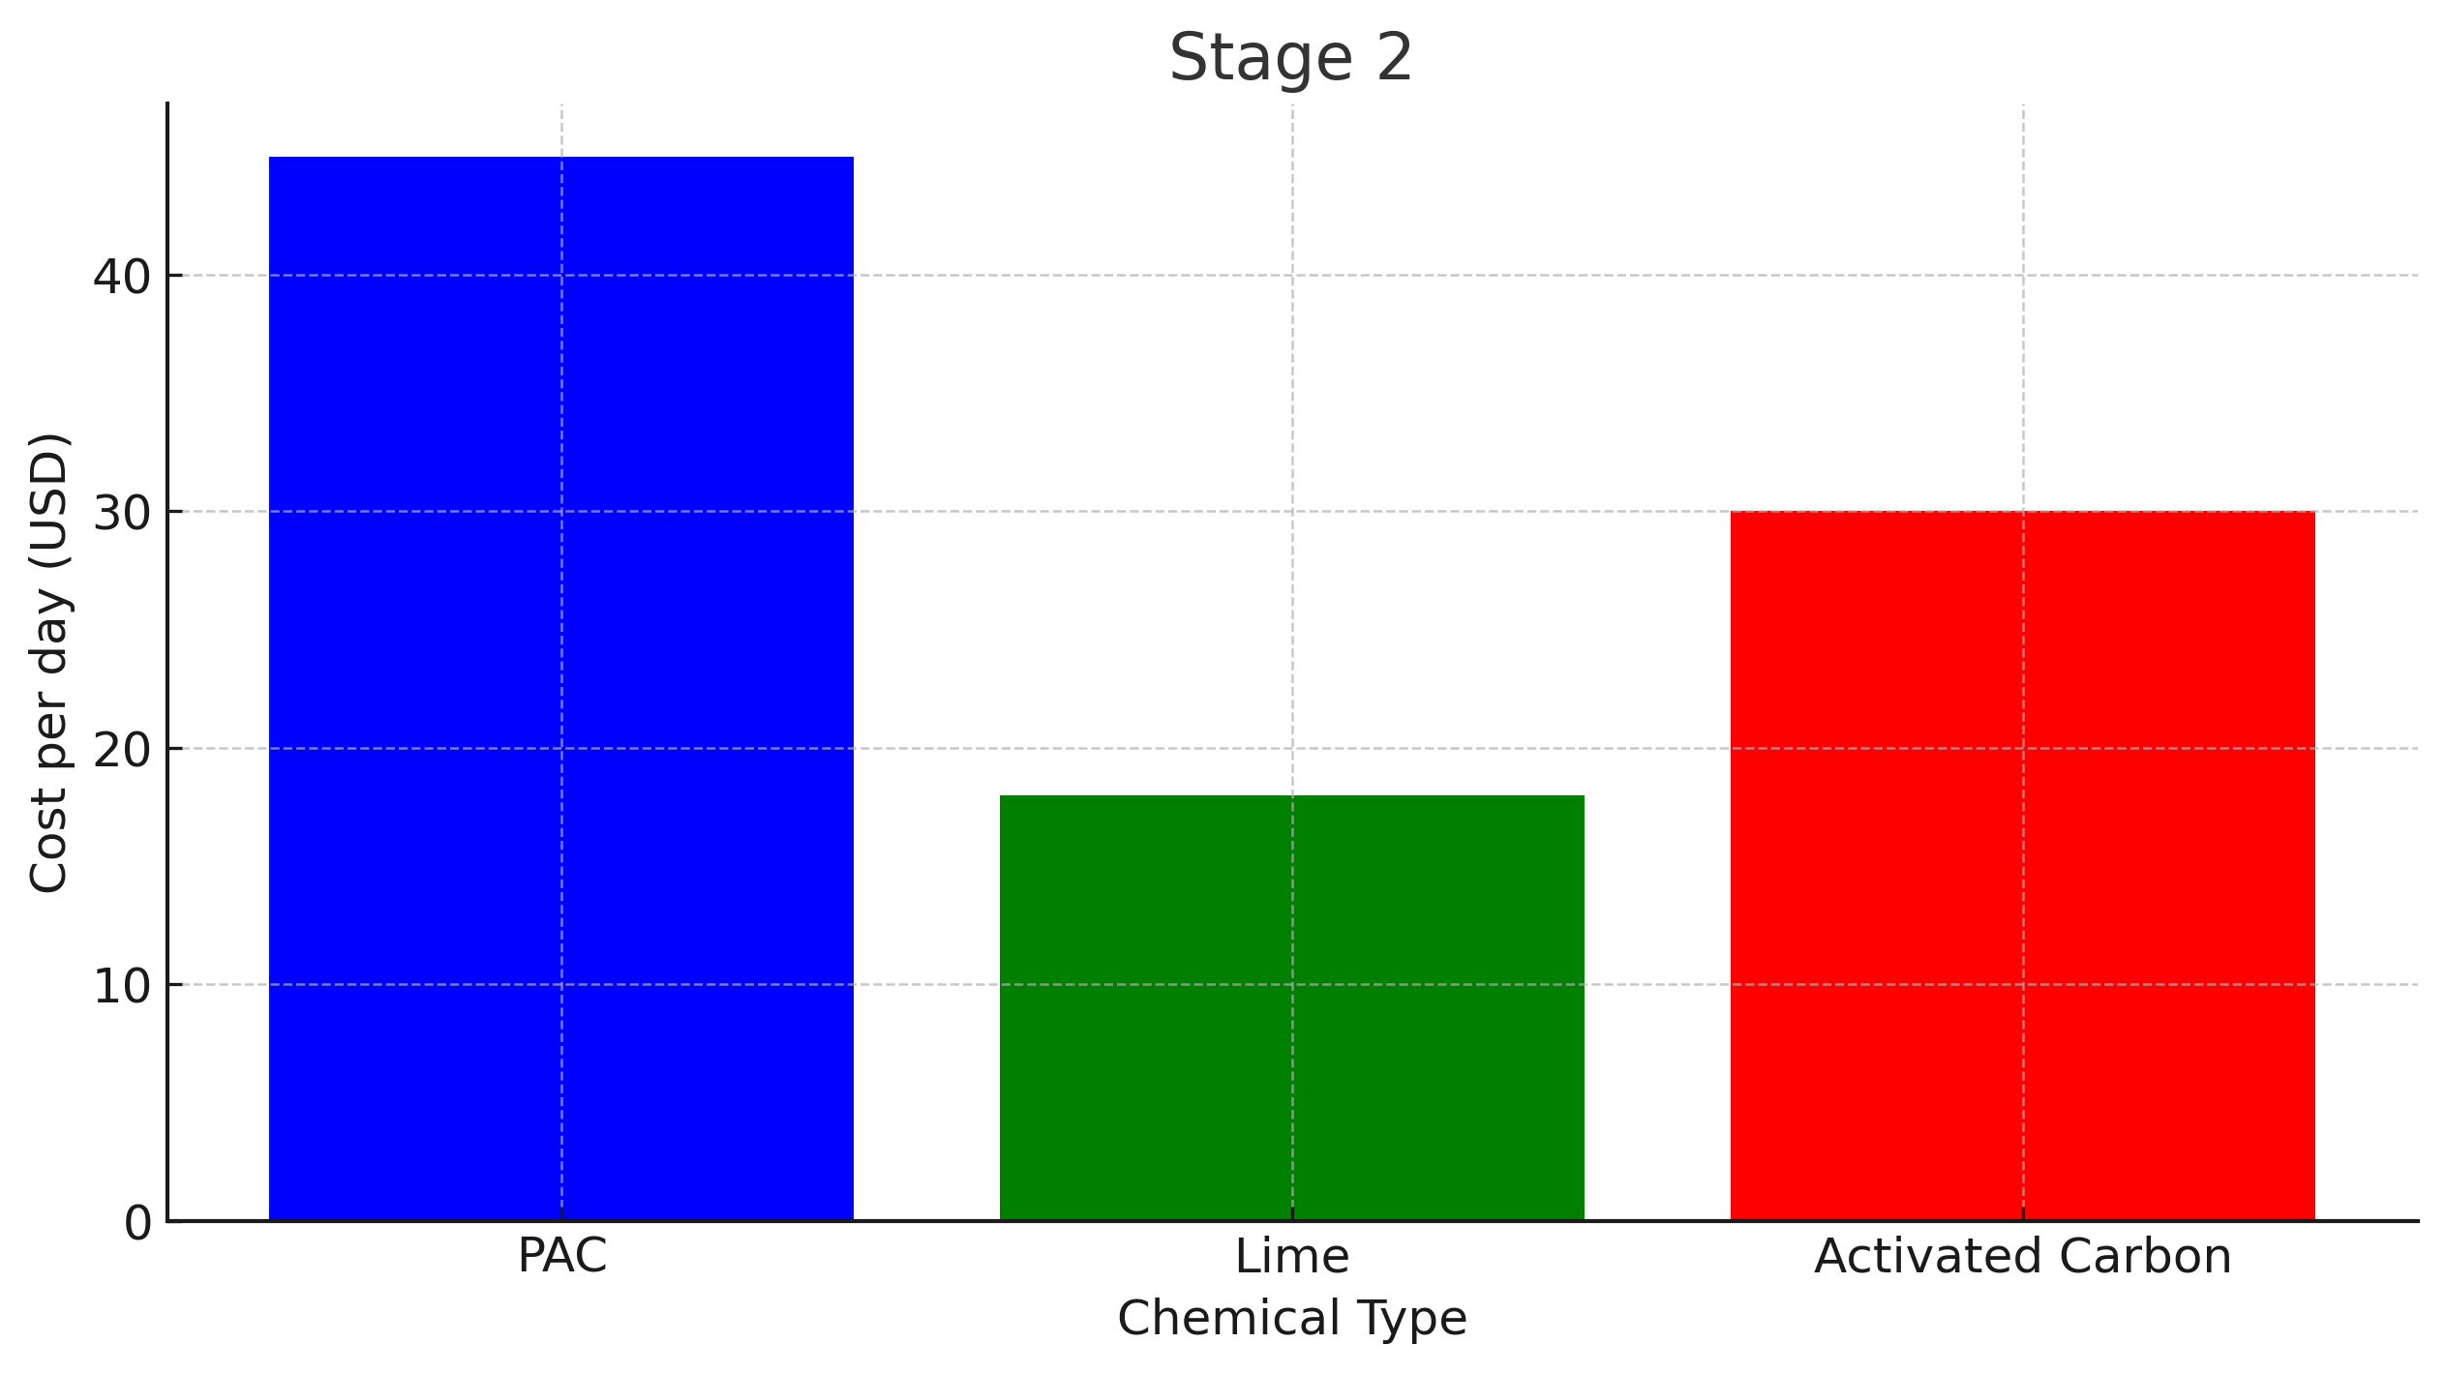
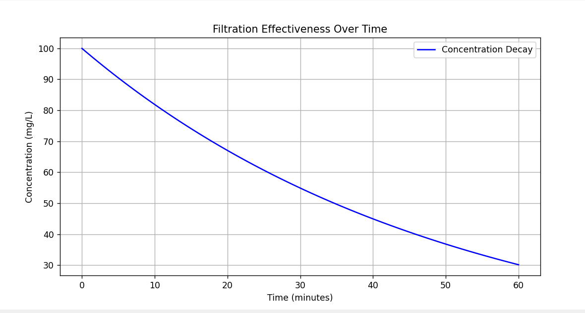
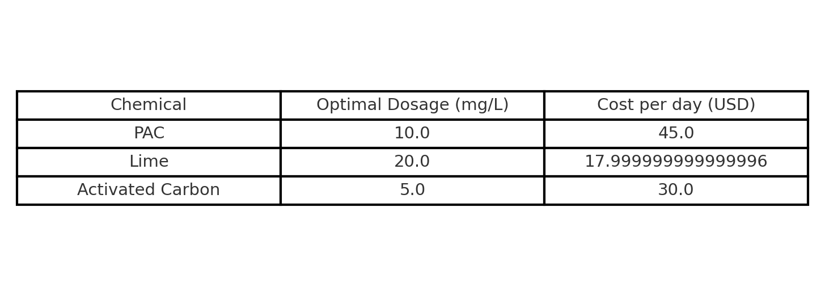

Slide 15
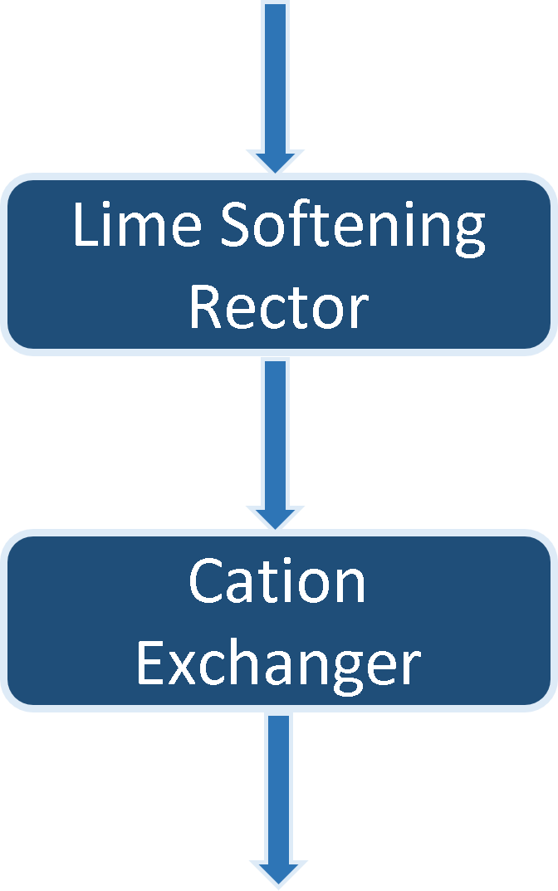
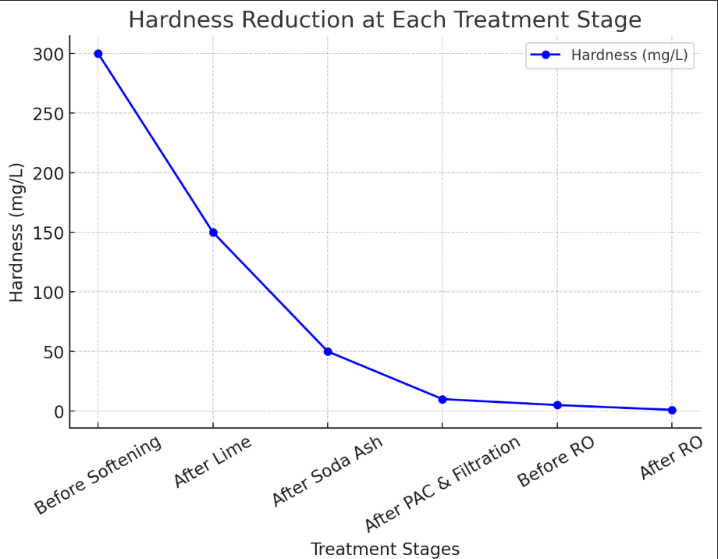
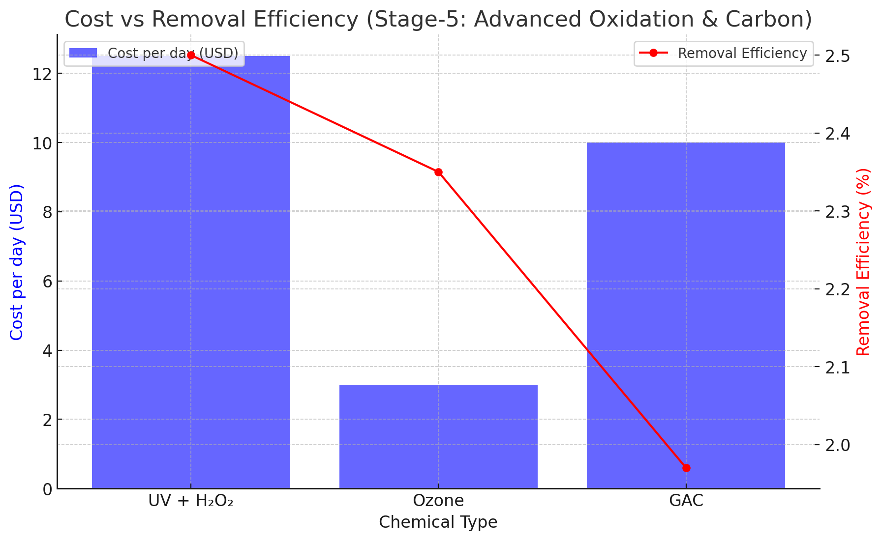
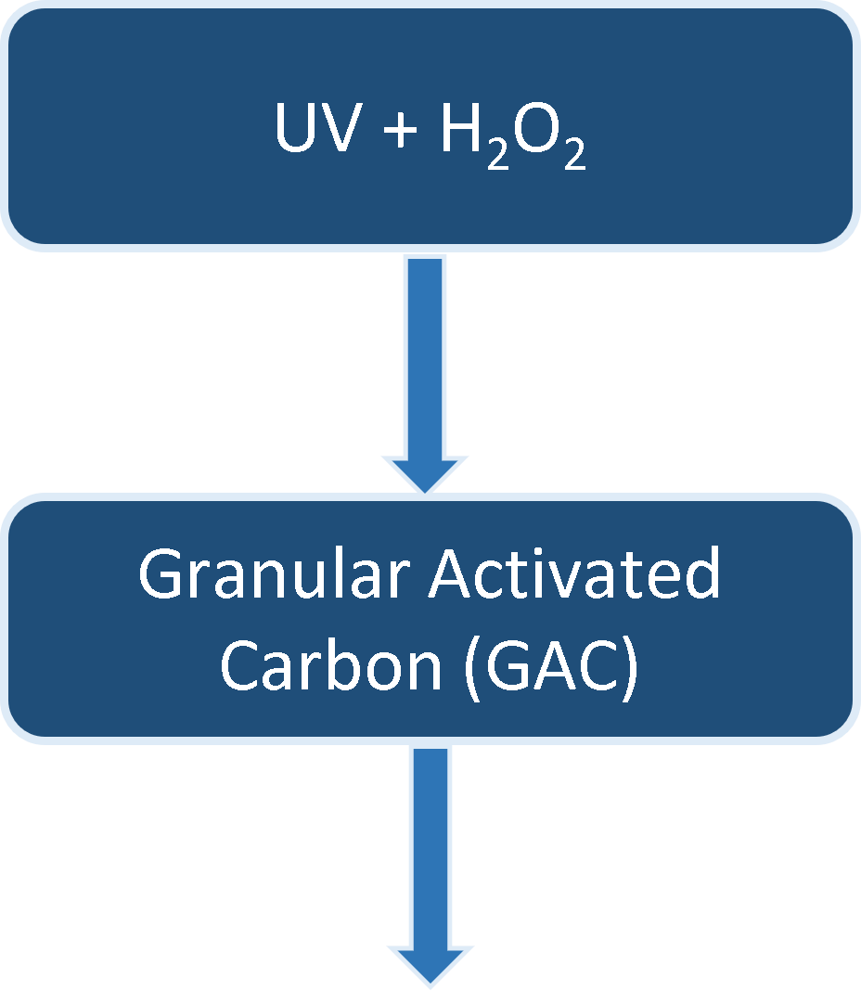
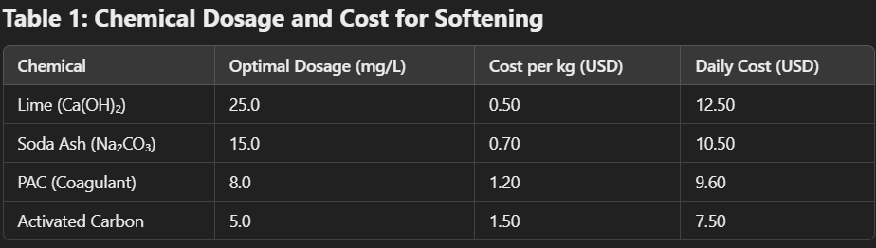
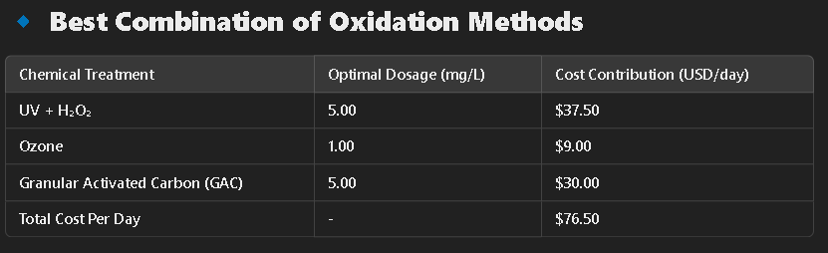
Stages:4-5
Softening – Advance Oxidation
Softening and Ion Exchange
Advance Oxidation and Carbon

Slide 16
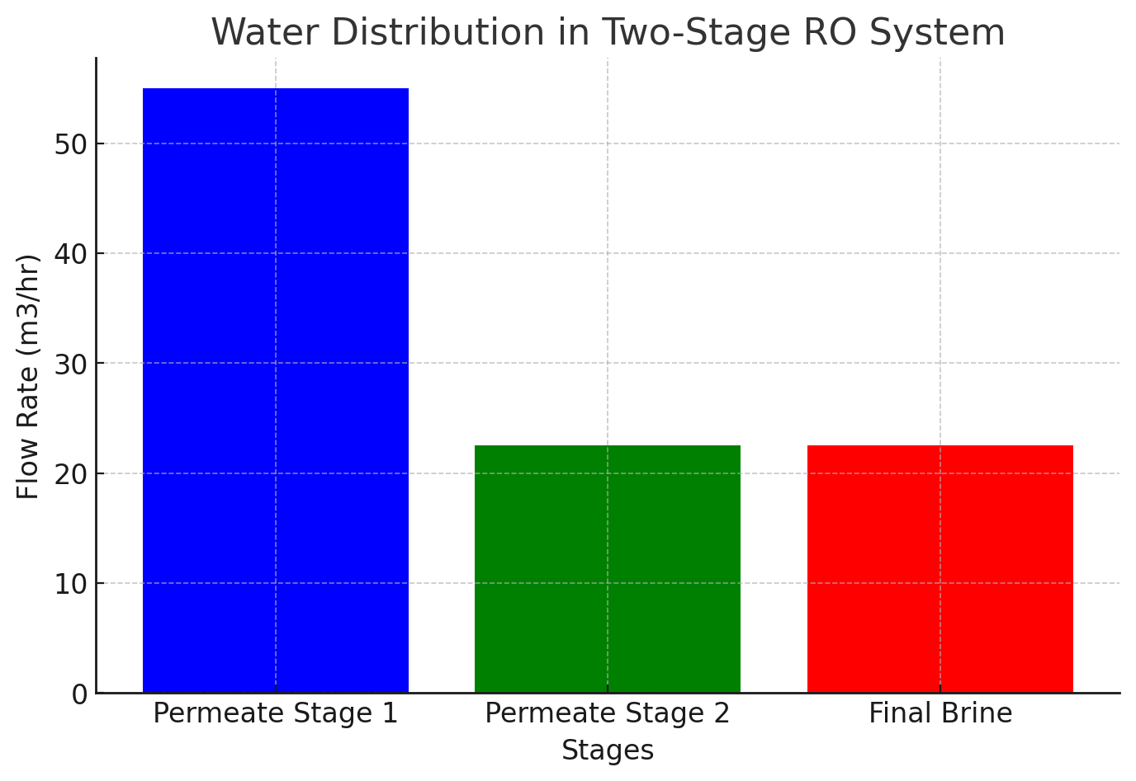
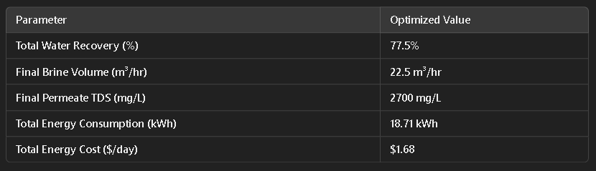
Stage: 6
Reverse osmosis (RO)
Two Stage High-pressure RO
Energy Recovery Device (ERD)
Reverse osmosis (RO)

Slide 17
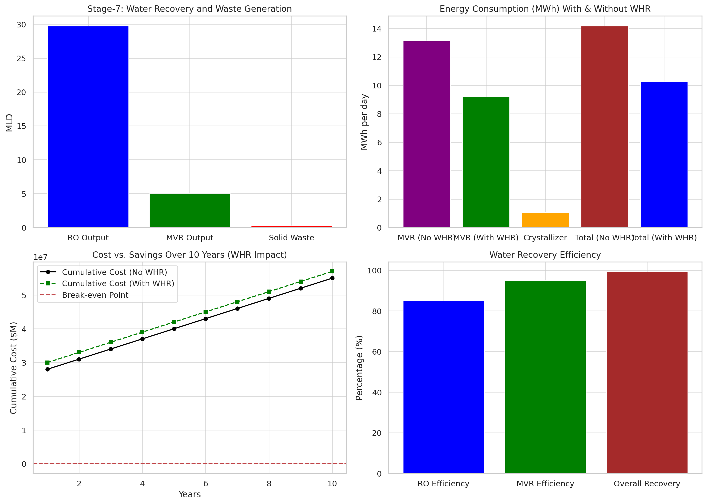
Stage: 7
Brine Treatment(ZLD)
MVR Evaporator
Crystallizer
Brine Treatment(ZLD)

Slide 18
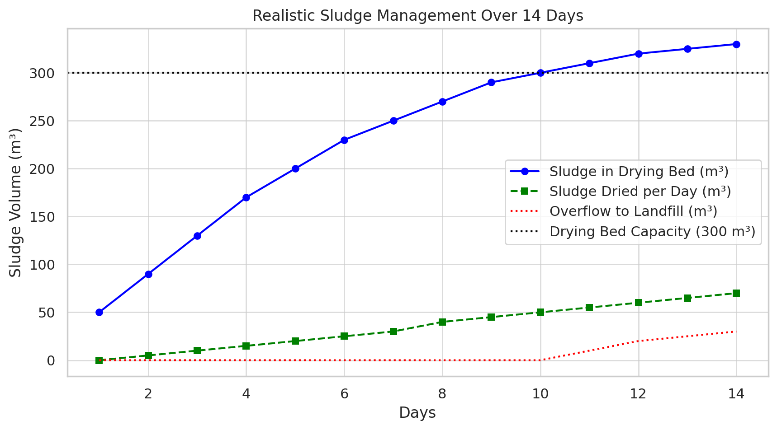
Stage: 8
Sludge Management
Filter Press
Sludge Drying Beds
Sludge Management

Slide 19
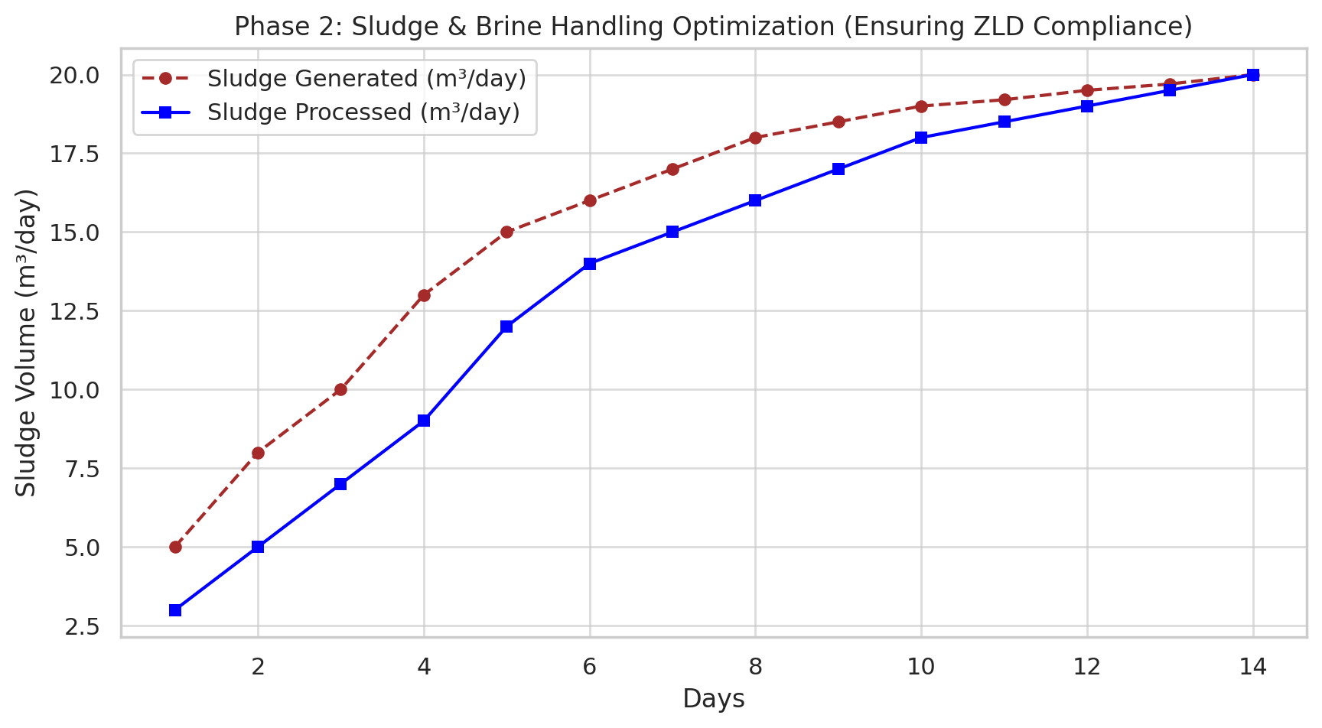
Phase 2 :
In phase two, expanding upon the evaporation and crystallisation capacity and testing automation strategies. In extending upon the pilot plant implementation to full scale implementation and process optimization. We implemented optimization strategies and generated data trends which are as follows:
The Graph shows a steady increase in sludge generation as full scale system operates which is compliance with regulations.
Optimized Sludge and Brine management through enhanced drying beds, mechanical dewatering units and alternative disposal strategies. This ensures compliances with CPCB ZLD regulations while maintaining full scale operations.

Slide 20
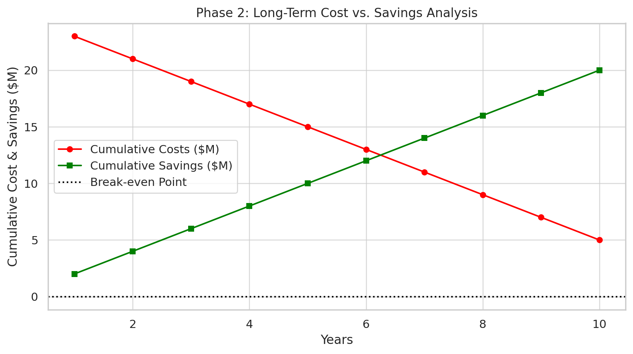
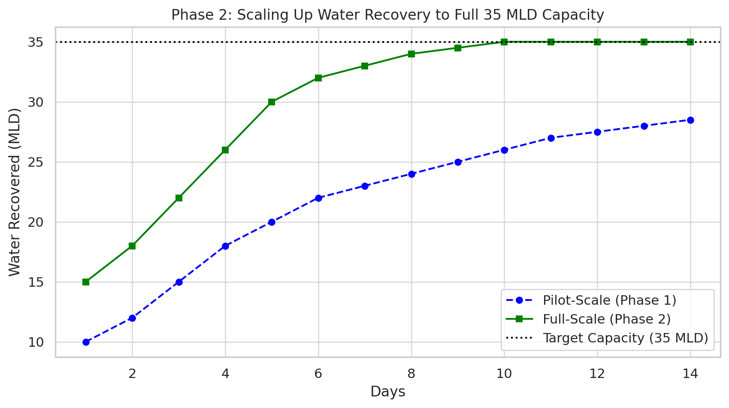
The Graph’s trend shows a decrease in CAPEX and OPEX over time as savings grow with a prediction of breaking even in 7 years.
Full Scale Implementation ensures long term effectiveness, making ZLD operations viable.
Graph 3 suggest a gradual increase in water recovery up to ~35 MLD in Phase 2 from 28 MLD of pilot scale.
After Successful Pilot testing in Phase 1, Full scale implementation has increased the capacity. Thus maintaining compliance with CPCB ZLD standards.

Slide 21
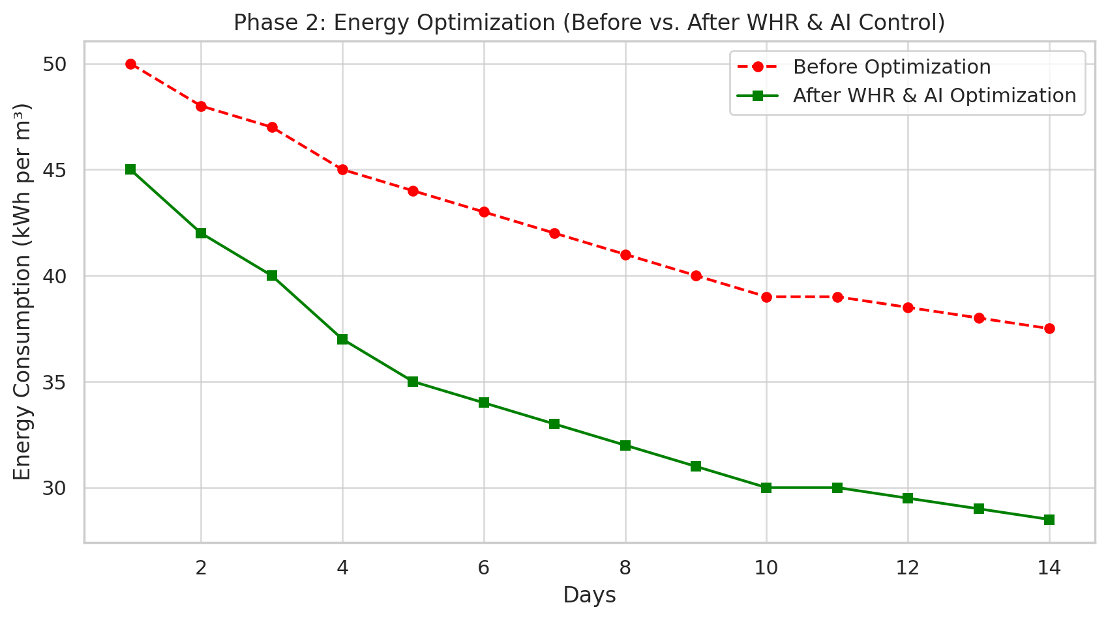
Graph 4 is showing energy consumption by the RO+MVR plant before and after WHR and AI control, which have greatly reduced operational cost and improves sustainability.

Slide 22
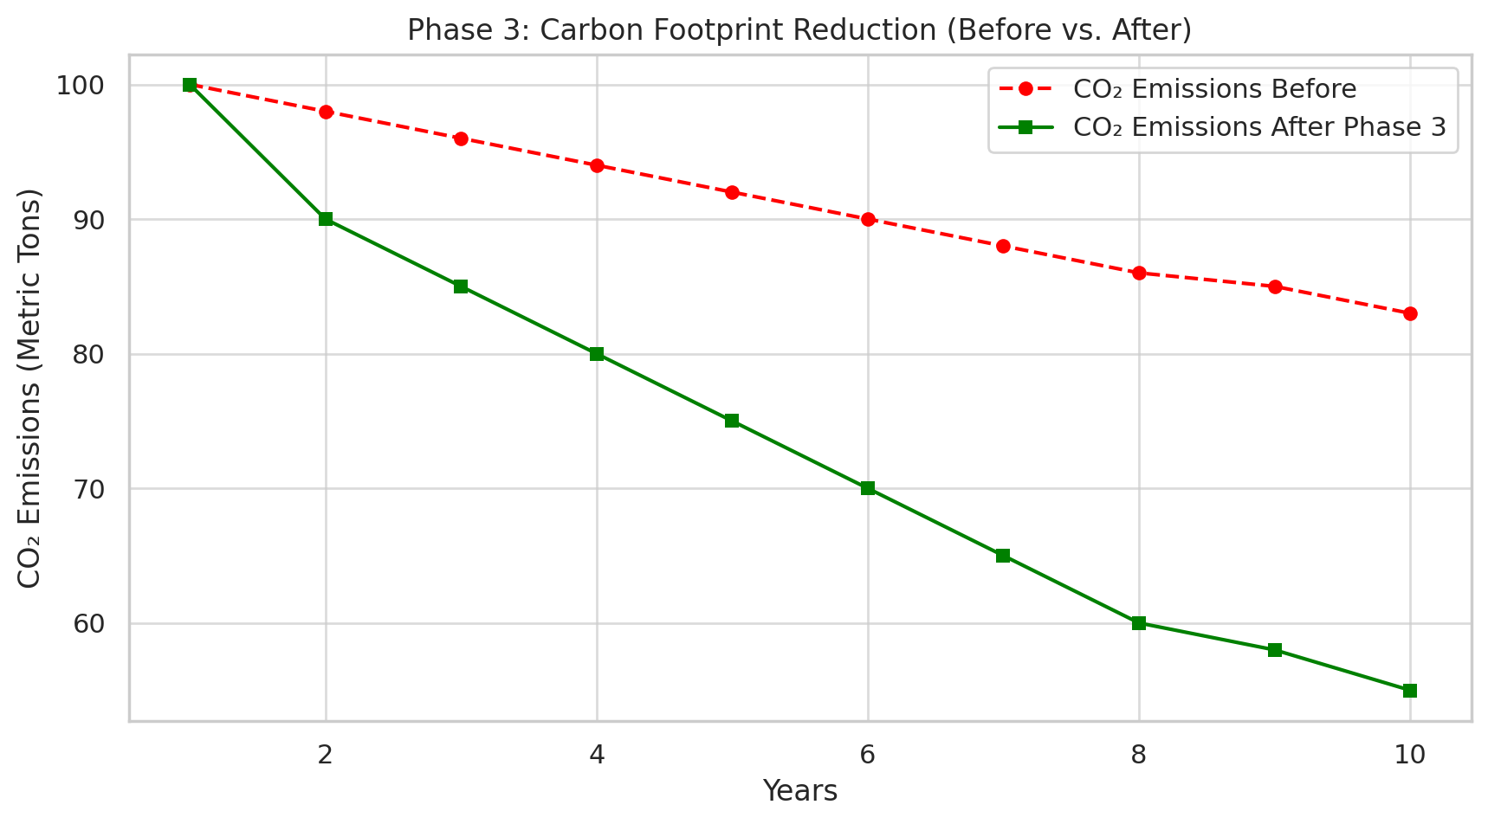
Phase 3 :
In This Phase, by implementing circular economy in our ZLD system, we achieve complete water reuse, resource and net-zero wastewater discharge. This ensures financial and environmental sustainability for long-term operations.
The forthcoming graphs just shows that:
The Graph shows reduction in Carbon Footprint over time.
With a projected reduction of 45 percent in carbon emissions.

Slide 23
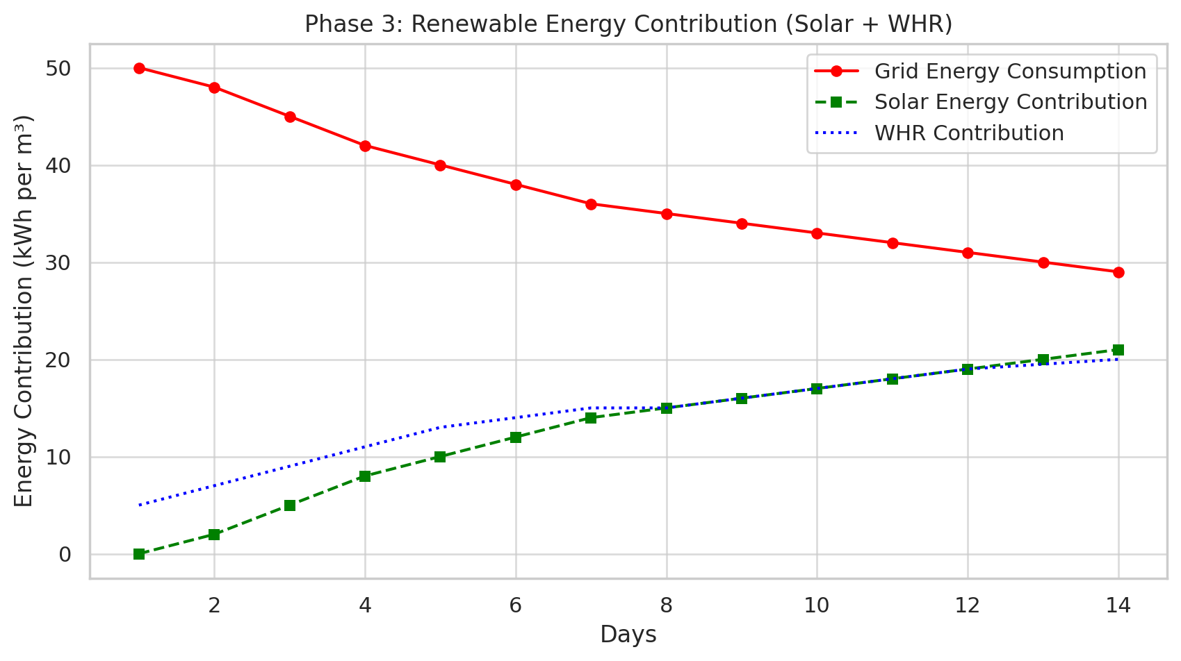
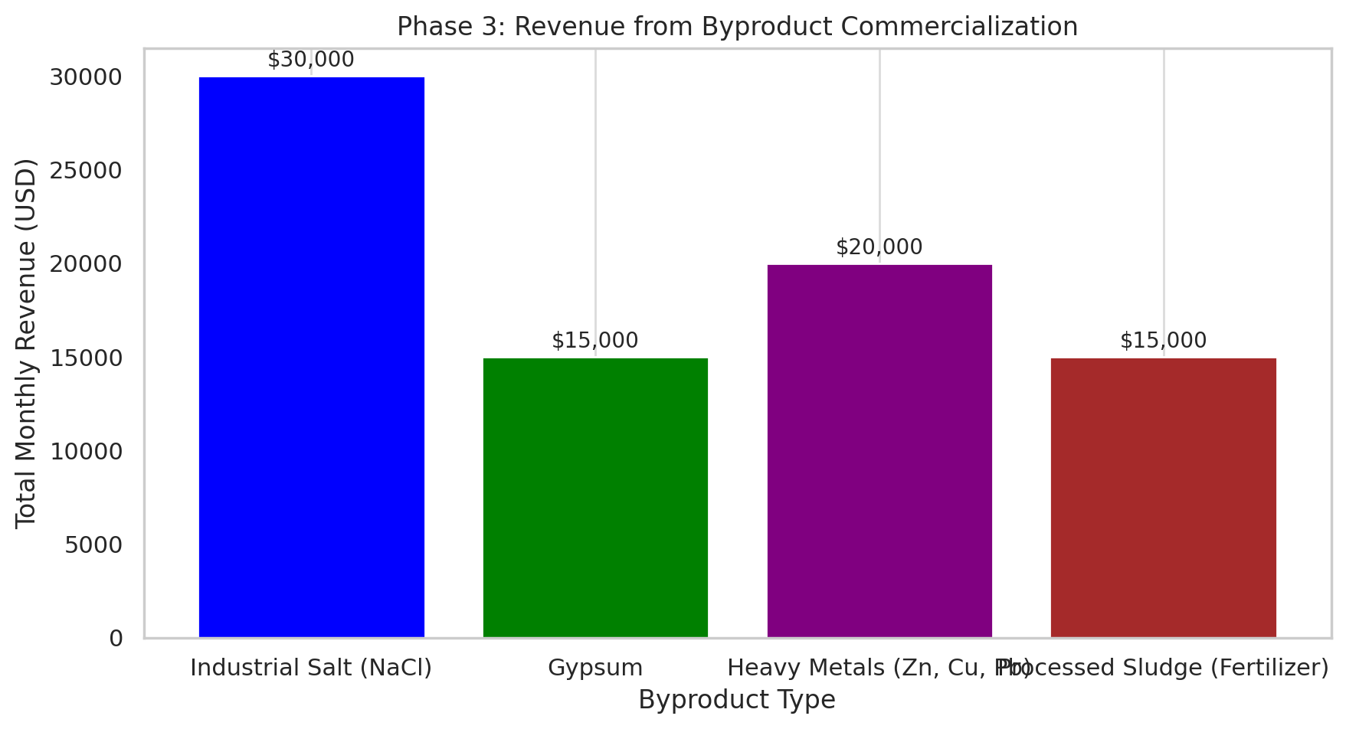
The Graph shows grid’s energy consumption decreasing overtime thus reducing reliance on fossil fuels,
WHR using refinery waste heat has improved carbon footprint
By optimizing energy efficiency through renewables, we achieve long term cost savings and sustainability.
The graph projects that plant will generate revenue through sell of byproduct obtained in ZLD process.
Making up to $80,000 per month .

Slide 24
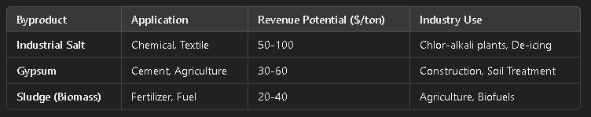
Brine Disposal & Byproduct Valorization
Key Strategies:
Brine Reduction : RO + MVR Hybrid from maximum water recovery
Byproduct recovery : Salt, Gypsum and Sludge Valorization
Sustainability: Circular economy model for industry reuse
Expected Outcomes:
Reduce disposal costs
Revenue from byproducts
Zero Waste & Sustainability Compliance

Slide 25
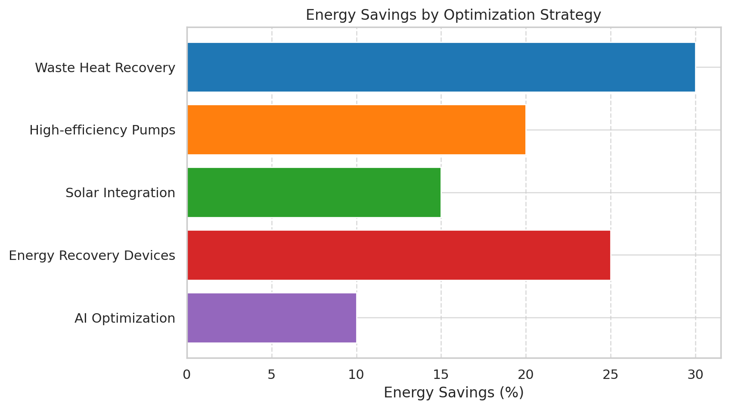
Energy Optimization Strategies

Slide 26
Risk Analysis and Mitigation Strategies
Risk analysis and mitigation
Cost Overruns &Inflation risk
Energy Prices Volatility
Regulatory Uncertainty
Cost Estimation & Buffering
Alternative supplying
Long term agreements
Adaptive policy

Slide 27
Justification and Summary
The Approaches selected for providing solution to the given problem are chosen on the basis of the constraints given to us. By using modelling and simulation techniques, we ran a cost-benefit analysis using minimization algorithms and differential evolution algorithms.
Our solution provides a clear cut pathway to a successful implementation of ZLD in BPL within the span of CPCB mandated deadline using RO+MVR plant.

