Slide 1
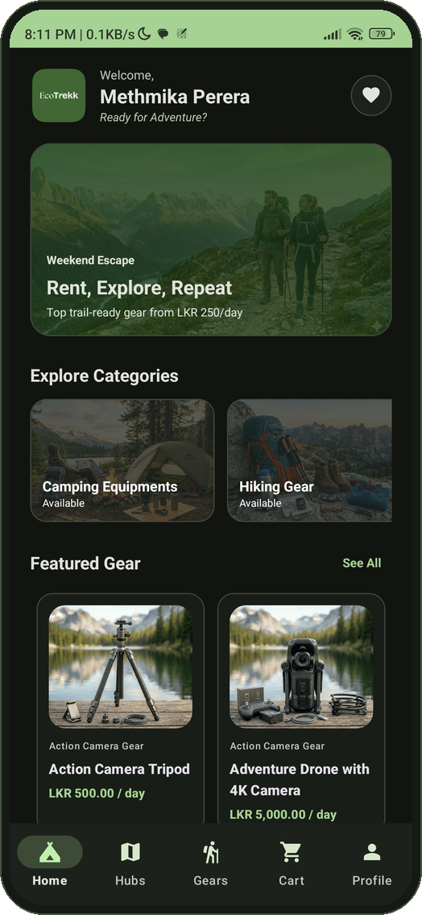

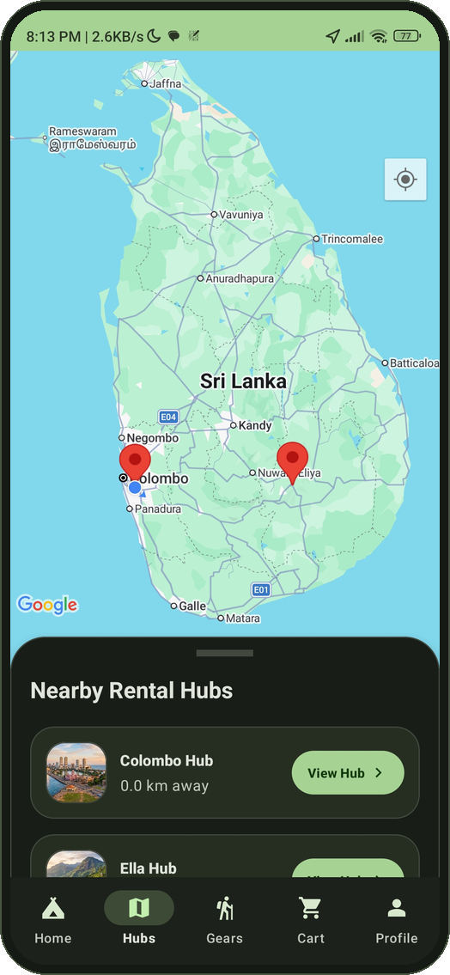
Camping Gear Rental Mobile Application
An M-commerce platform
(Android app, Spring Boot API and React admin dashboard)
Methmika Perera | 200421803135
Handheld Device Programming II
BSc (Hons) in Software Engineering
Notes:
Introduce yourself and the project. EcoTrekk is a camping gear rental platform with three parts: the Android app (the focus of this unit), a Spring Boot REST backend, and a React admin dashboard. About 25 minutes: problem, architecture, app walkthrough by feature, backend and admin, testing, next steps.

Slide 2






Problem & Solution
THE PROBLEM
THE ECOTREKK SOLUTION
Quality gear is costly to buy and hard to store
Find nearby rental hubs on a map
Bookings by phone, paper inventory, cash only
Reserve gear for a date range
Double-bookings and poor customer communication
Pay by card (Stripe) or cash at the hub
Android App
for customers
Spring Boot API
business logic and data
React Admin
for operators
Notes:
Camping gear is expensive and bulky, so many people would rather rent. But rental shops mostly work by phone, paper inventory and cash. That causes double-bookings, wrong stock counts and poor communication. EcoTrekk replaces this with one digital flow: find a hub, reserve by dates, pay, collect.

Slide 3
Android app
Java, Material 3, Retrofit, Room, WorkManager
Spring Boot REST API
MySQL
18 JPA entities
HTTPS + JSON
Java 17
Service layer with transactions
Firebase Admin token check
Stripe payment intents
STOMP WebSocket events
Cloudinary signed uploads
React admin
TypeScript, MUI, Recharts, Axios
External services
HTTPS + WebSocket
Firebase (Auth, FCM)
Stripe
Google Maps
Cloudinary
Notes:
Two clients talk to one Spring Boot REST API over HTTPS and JSON. The API persists to MySQL. Four external services are used: Firebase for authentication and push messages, Stripe for card payments, Google Maps for the hub map, and Cloudinary for gear images. Real-time updates reach the admin dashboard through a STOMP WebSocket.

Slide 4
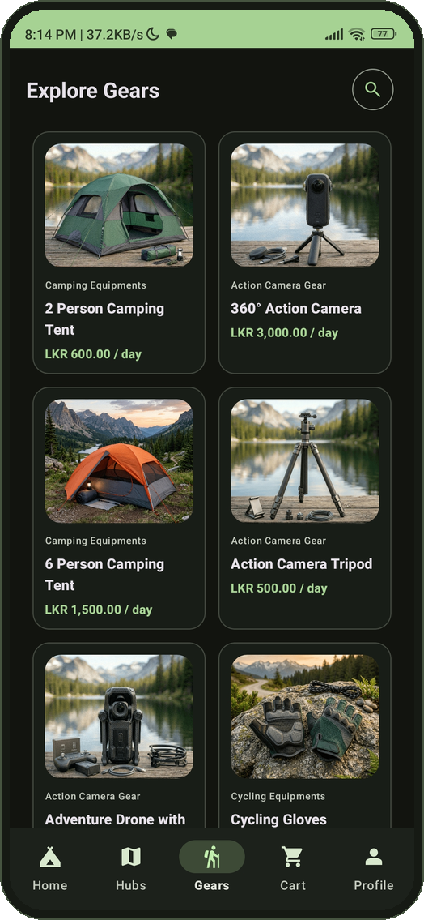
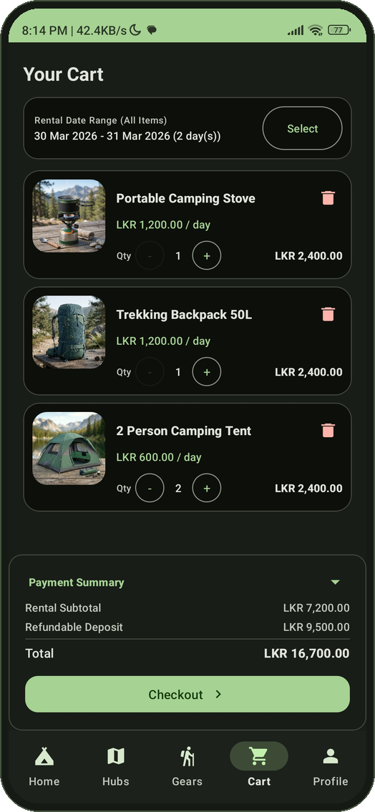
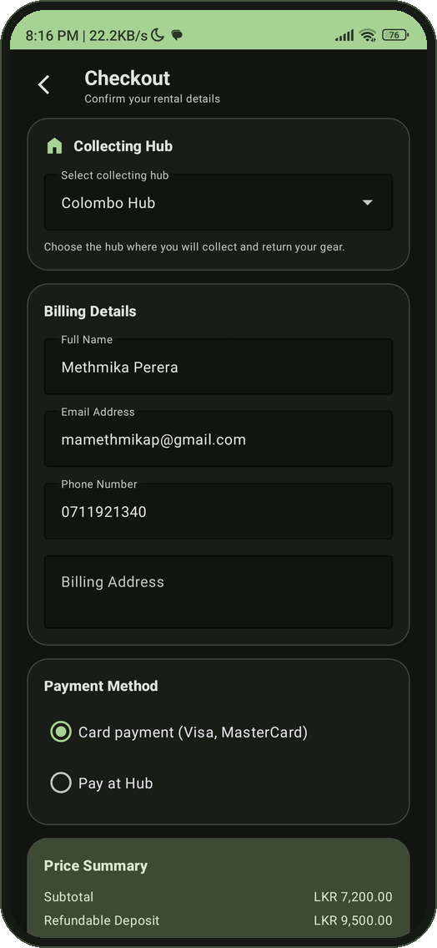
Customer App
Home
Categories, featured gear, wishlist
Hubs
Map markers and nearby sheet
Gears
Filters, shake to refresh, double-tap to save
Cart
Date range and quantities
Checkout
Hub, billing and payment
Notes:
Walk through five key screens quickly. Home shows categories, featured gear and wishlist. Hubs shows the Google Map with markers and a nearby-hubs bottom sheet. Gears has search, category and price filters, shake to refresh and double-tap to save to the wishlist. Cart has the date range and quantity steppers. Checkout picks the collection hub, billing details and payment method.

Slide 5






Process Flow
01
02
03
Sign in
Find a hub
Browse gear
Firebase email login or sign-up, session kept in SharedPreferences
Google Map with markers, distances and a nearby-hubs sheet
Chips, price slider, shake to refresh, double-tap to save
04
05
06
Cart and dates
Confirm and pay
Track the order
Date-range picker, quantity stepper, totals with deposit
Biometric prompt, then Stripe card payment or cash at the hub
Order history and details, push notification on approval
Notes:
This is the end-to-end customer journey and it touches most of the Android topics: Firebase sign-in, Google Maps, RecyclerView catalog with filters and a double-tap gesture, date-range picker and cart in Room, biometric confirmation plus Stripe, and push notifications with order history.

Slide 6






UI Designs And Navigation
13
Layouts
Constraint, Linear, Frame, Coordinator and NestedScroll layouts
Navigation
Bottom navigation swaps five fragments; Fragment Result API passes the category
Activities
5
Material 3 theme
Light and dark resources; the mode is saved in SharedPreferences
Dialogs and pickers
Date-range picker, custom-view alert dialog, photo source chooser, biometric prompt
Fragments
9
Rich widgets
Chips, range slider, FAB, bottom sheet, Snackbars, quantity stepper
Intents
Explicit screen navigation; implicit view, share, dial and call
RecyclerViews
Notes:
13 activities, 5 fragments hosted in HomeActivity and switched with a bottom navigation bar, and 9 RecyclerViews with their own adapters. Material 3 theme with light and dark resources. Layouts are mostly Constraint, Linear, Frame and Coordinator. Fragment-to-fragment communication uses the Fragment Result API when a category is tapped on Home.

Slide 7



Local Storage And Background Sync
Spring Boot API
cart and wishlist endpoints
WorkManager worker
every 6 h, or when back online
Room database
cart_items, favorites, users
LiveData observers
UI refreshes on change
Cart screen
local copy if server fails
SharedPreferences
Room (SQLite)
Sync policy
Private mode key-value storage
Session and customer id
Theme mode and FCM token
3 entities and 3 DAOs
Repository and helper classes
Singleton database instance
Periodic work every 6 hours, KEEP policy
One-time sync when back online
Retry when a sync run fails
Server to local refresh
Notes:
Two storage mechanisms. SharedPreferences holds small private values: the session, the theme mode and the FCM token. Room holds structured data: cart items, favourites and users. A periodic WorkManager job runs every six hours when the network is connected and refreshes the cart and wishlist from the server into Room. When the connection comes back, the connectivity receiver also triggers a one-time sync straight away. The cart screen observes LiveData, and falls back to the Room copy when the server is unreachable. Sync is server to local; offline changes are not queued yet.

Slide 8

Network, Cloud And Payments
23
Firebase Authentication
Email sign-in. Sign-up uses a custom token issued by the backend, and the ID token is exchanged with the backend at login.
REST endpoints through Retrofit and Gson
Firebase Cloud Messaging
The device token is stored and synced to the backend, which sends push messages the app shows as notifications.
GET, POST and DELETE
Cart, wishlist, orders, profile, hubs, gears
Async enqueue() callbacks
JSON mapped to DTO classes
Stripe PaymentSheet
The backend creates the PaymentIntent. The app only receives a client secret, so card data never touches it.
Notes:
All data goes through Retrofit with the Gson converter: 23 endpoints covering create, read and delete on the cart and wishlist, order history, profile update and payment. Calls use enqueue so they never block the UI thread. Firebase Authentication handles sign-in; sign-up goes through the backend which returns a custom token. FCM delivers push messages. Stripe PaymentSheet handles the card so card data never touches the app or my server.

Slide 9
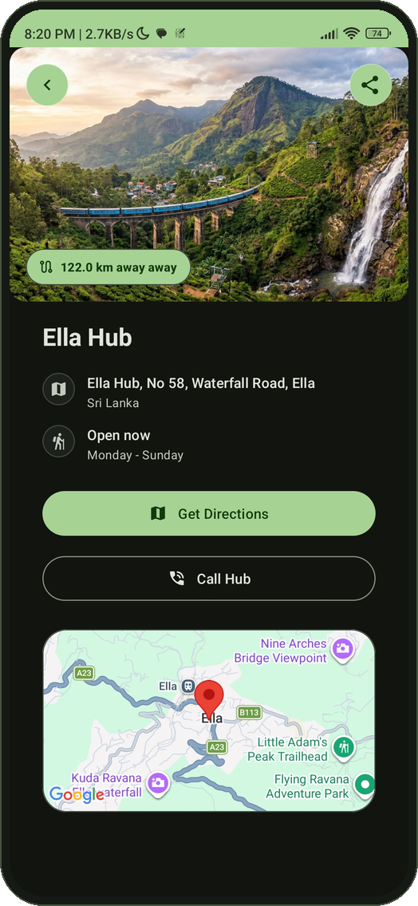
Maps, Location And Phone Features
Google Maps SDK
Marker and info window per hub
Custom map style, my-location layer
Animated camera and nearby-hubs bottom sheet
Location
Last known GPS or network location
Distance with Location.distanceBetween
Permission requested at runtime, graceful fallback
Phone integration
Call hub: ACTION_CALL, dialer fallback
Get Directions: implicit intent to Google Maps
Share hub through a chooser
Notes:
The Hubs tab embeds a Google Map fragment with a marker per hub, a custom map style, my-location layer and animated camera. A bottom sheet lists nearby hubs with distances worked out from the last known location. The hub detail screen has a map preview, Get Directions through an implicit intent, Call Hub with the call permission and a dialer fallback, and a share chooser.

Slide 10


Sensors, Biometrics And Permissions
Shake to refresh
Biometric checkout
Runtime permissions
Accelerometer through SensorManager
Magnitude change with low-cut filter
Threshold 12, 2-second debounce
Registered onResume, released onPause
AndroidX BiometricPrompt before every order
Fingerprint, face or device credential
Success continues to payment
Failure or cancel shows a Snackbar
Location for the map and distances
Notifications on Android 13 and above
Call phone for hub calls
Denial handled without a crash
Notes:
Shake to refresh: the accelerometer gives x, y and z. I take the magnitude, track the change, apply a low-cut filter, and when the value passes 12 with a two-second debounce I reload the catalog. The listener is registered in onResume and released in onPause. Biometric: BiometricPrompt appears before any order is placed. Permissions: location, notifications on Android 13 and above, and call phone, each requested at runtime and handled when denied.

Slide 11



Camera For The Profile Photo
Tap the pencil
choose a photo source
System camera
saves to cache through a FileProvider
uCrop
1:1 crop, at most 1024 px
Upload
multipart JPEG to the API
Avatar updates
Glide shows the new image
System camera app
FileProvider
Small, safe uploads
TakePicture contract opens the camera
No CAMERA permission needed
Camera hardware is optional; gallery still works
Shares one cache file as a content URI
No storage permission, no file path leaks
Capture deleted after cropping
Result capped at 1024 x 1024 px
JPEG quality 85, a few hundred KB
Capture path survives an activity restart
Notes:
On the Personal Information screen the pencil button opens a small chooser: take a photo or pick one from the gallery. Taking a photo uses ActivityResultContracts.TakePicture, which opens the phone's own camera app. The app gives it a content URI from a FileProvider that points to a file in the app's private cache folder, so no CAMERA permission is needed and no storage permission either. The captured photo then goes through the same uCrop step as gallery photos, one to one, limited to 1024 pixels so the upload stays small, and is uploaded as multipart to the backend. The server accepts up to 5 MB, but the phone sends a few hundred kilobytes. The capture file is deleted after cropping, and its path is saved so it survives the activity being restarted while the camera app is open. This covers taking pictures; I did not implement video or an in-app camera preview.

Slide 12






Offline Banner And Double-tap Gesture
Offline banner
Double-tap to save
No internet connection
2 Person Camping Tent
LKR 600.00 / day
Double-tap
Back online
BroadcastReceiver for CONNECTIVITY_ACTION
Registered once in the Application class
Lifecycle callbacks add the pill to every screen
Back online triggers a one-time data sync
GestureDetector on every gear card
Single tap opens details, double tap adds
Add-only; blocked while offline
Heart badge with a pop animation
Notes:
Two recent additions. First, a BroadcastReceiver listens for connectivity changes. It is registered once in the Application class, and activity lifecycle callbacks add a small pill to whichever screen is open, so no activity needed changes. It shows No internet connection while offline and Back online for a moment when the connection returns, and then triggers a one-time sync. CONNECTIVITY_ACTION is deprecated since Android 9 but is still delivered to receivers registered in code; the modern alternative is NetworkCallback. Second, a GestureDetector on each gear card: a single tap opens the details after a short delay, a double tap adds the gear to the wishlist. It is add-only, shows a heart badge with a pop animation, and is blocked when offline because the app has no offline write queue yet.

Slide 13


Push Notifications And Multitasking
NOTIFICATION FLOW
Admin approves the order
Spring Boot
Firebase Admin sends the push
FCM
delivers to the device
App service
onMessageReceived
Notification
channel, PendingIntent
Tap
Splash, Home, Order History
THREADS AND BACKGROUND WORK
Retrofit enqueue()
ExecutorService
WorkManager
Network calls run off the main thread and callbacks return to the UI thread.
Room reads and checkout work run on a background executor, then runOnUiThread.
Periodic sync survives app restarts and runs only when the network is connected.
Notes:
When an admin approves an order, the backend sends a push through Firebase Admin. FCM delivers it to the app's messaging service, which builds a NotificationCompat notification on a high-importance channel with a PendingIntent. Tapping it opens Splash, which forwards a target-screen extra to Home, which opens Order History. For multitasking, Retrofit enqueue runs network calls off the main thread, an ExecutorService handles Room reads with runOnUiThread, and WorkManager runs the periodic sync.

Slide 14


Spring Boot Backend And Mysql
18
18
3
MySQL
JPA entities
REST controllers
Roles: customer, hub manager, admin
Relational database
Identity and security
Rental domain
Real-time and media
Firebase Admin verifies ID tokens at login
Customer, hub manager and admin accounts
Stripe secret key stays on the server
Gear, categories, hub inventory
Cart, wishlist, invoices and items
Transactional order and stock services
Order and payment status enums
STOMP WebSocket broadcasts
Dashboard updates without a refresh
Cloudinary signed image uploads
Push notification service
Notes:
The backend is Spring Boot 4 on Java 17 with 18 JPA entities and 18 controllers. Firebase Admin verifies the ID token at login. The domain covers gear, categories and hub inventory, plus cart, wishlist and invoices with payment status. Services are transactional. A STOMP WebSocket publishes events on /topic so the admin dashboard updates without a refresh. Cloudinary handles signed image uploads.

Slide 15
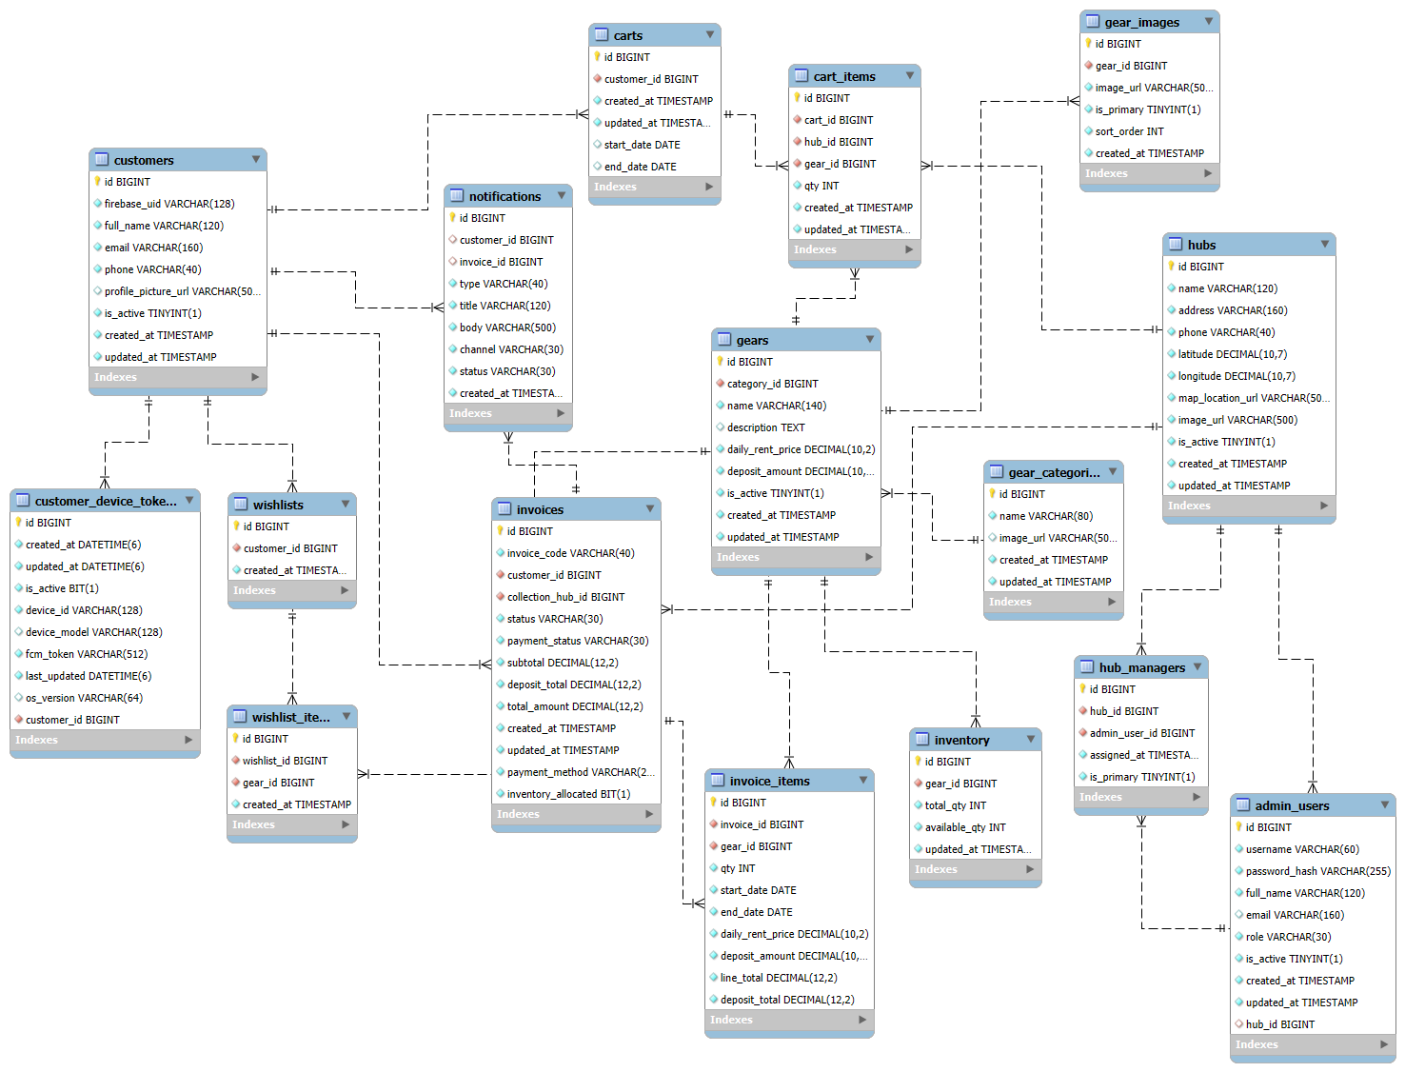

Slide 16
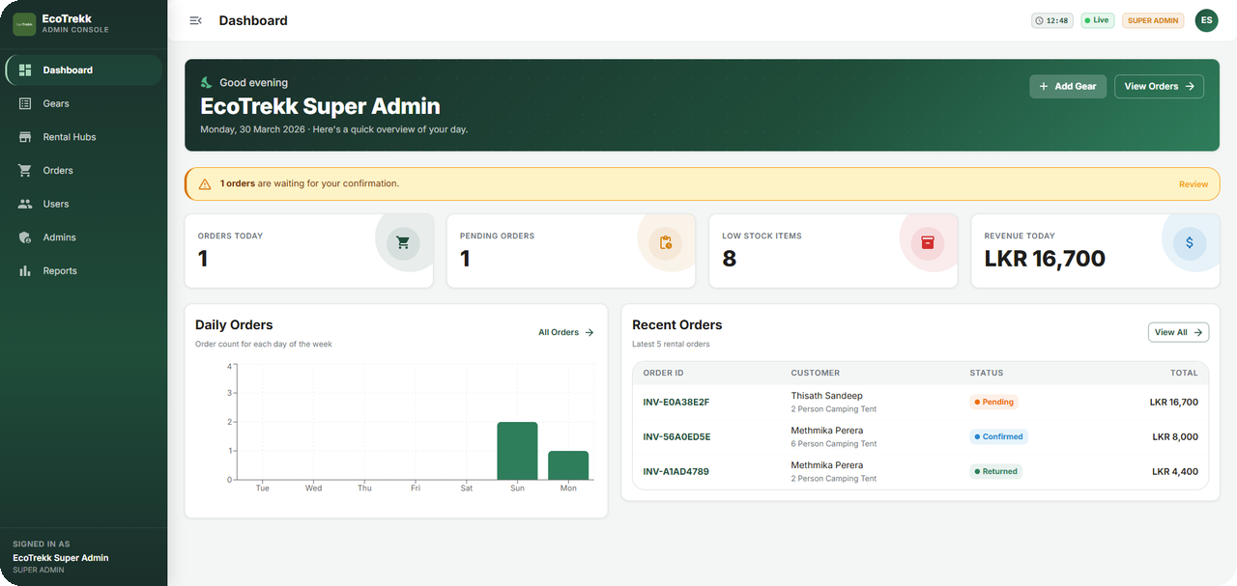
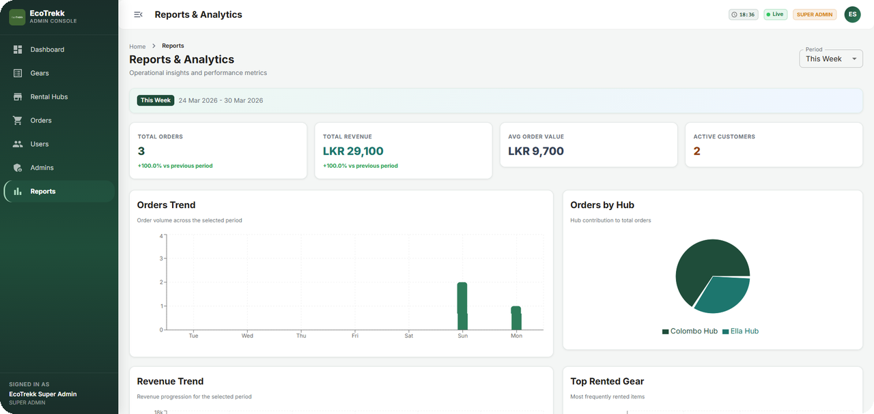
React Admin Dashboard
Dashboard
Orders today, pending approvals, low stock, revenue
Reports and analytics
Orders and revenue trends, orders by hub, top rented gear
React 19
TypeScript
MUI 7
Vite
Axios
Recharts
WebSocket
Pages: dashboard, users, admins, rental hubs, inventory, orders, reports, profile
Notes:
Operators manage the business from a React and TypeScript dashboard built with MUI and Vite. It has users, admins, rental hubs, inventory, orders, profile and a reports page with charts: orders trend, revenue trend, orders by hub and top rented gear. It also receives live updates over the WebSocket.

Slide 17
Testing And Results
INVENTORY LIFECYCLE TESTS
Shake to refresh
Tested on a physical device: a shake over the threshold reloads the catalog.
Test case | Outcome
Single order, sufficient stock | PASS: stock reduced
Single order, insufficient stock | PASS: error, stock unchanged
Order rejected | PASS: stock restored
Order returned | PASS: stock restored
Biometric checkout
Valid fingerprint continues; wrong fingerprint and cancel are both handled.
4 of 4
lifecycle cases passed in manual end-to-end testing
Real-time update
Dashboard stock row changed about 1 to 2 seconds after a phone checkout.
Notes:
Inventory lifecycle was tested end to end: an order with enough stock reduces stock, an order with too little stock returns an error and leaves stock unchanged, and rejected or returned orders restore stock. Shake-to-refresh and biometric checkout were tested on a physical phone. For real-time updates I completed a checkout on the phone while watching the dashboard and the stock row changed in about one to two seconds.

Slide 18




Limitations And Next Steps
Future Implementation Goals
Planned app improvements
AI-assisted inventory
Predict demand and plan stock per hub
Email sending and chat option
In-app route polylines with the Directions API
Spending charts in the mobile app
In-app CameraX preview and video capture
Long-press and swipe gestures in the cart
ViewModel, landscape layouts and automated tests
Multi-tenant hubs
Separate operators on one platform
Cross-platform client
Reach iOS users from one codebase
Notes:
Be upfront. The app syncs server to local only, so an offline write queue is the first improvement; for now the wishlist double-tap is blocked while offline instead of being queued. I would also add in-app route polylines with the Directions API, spending charts, an in-app CameraX preview with video (today the camera uses the system camera app and takes pictures only) and long-press or swipe gestures in the cart. The report's roadmap covers predictive inventory with AI, multi-tenant hubs and a cross-platform client. Attaching the Firebase ID token with an OkHttp interceptor and automated tests are the main hardening items.

Slide 19
Thank you
Methmika Perera | 200421803135
Handheld Device Programming II
Notes:
Close by thanking the examiner and offering to demo. Have the app on a physical phone with the backend and ngrok tunnel running. Suggested demo extras: toggle airplane mode to show the offline banner, and double-tap a gear to save it.

