Slide 1
Methods 3: Multilevel Statistical Modeling and Machine Learning
Week 02: Multilevel linear regression
September 10, 2024

Slide 2
The course plan
Week 1: Introduction
Instructor sessions: Setting up R and Python and recollection of the general linear model
Week 2: Multilevel linear regression
Instructor sessions: Modelling subject level effects – and how do they differ from group level effects?
Week 3: Link functions and fitting generalised linear multilevel models
Instructor sessions: What to do when the response variable is not continuous?
Week 4: Evaluating Generalised linear mixed models
Instructor sessions: How do we assess how models compare to one another?
Week 5: Explanation and Prediction
Instructor sessions: Code review
Week 6: Mid-way evaluation and Machine Learning Intro
Instructor sessions: Getting Python Running
Week 7: Linear regression revisited (machine learning)
Instructor sessions: How to constrain our models to make them more predictive
Week 8: Logistic regression revisited (machine learning)
Instructor sessions: Categorizing responses based on informed guesses
Week 9: Dimensionality Reduction, Principled Component Analysis (PCA)
Instructor sessions: What to do with very rich data?
Week 10: Outlook, unsupervised classification and neural networks
Instructor sessions: Data with no labels and networks
Week 11: Organising and preprocessing messy data
Instructor sessions: Code review
Week 12: Final evaluation and wrap-up of course
Instructor sessions: Ask anything!
<nummer>

Slide 3
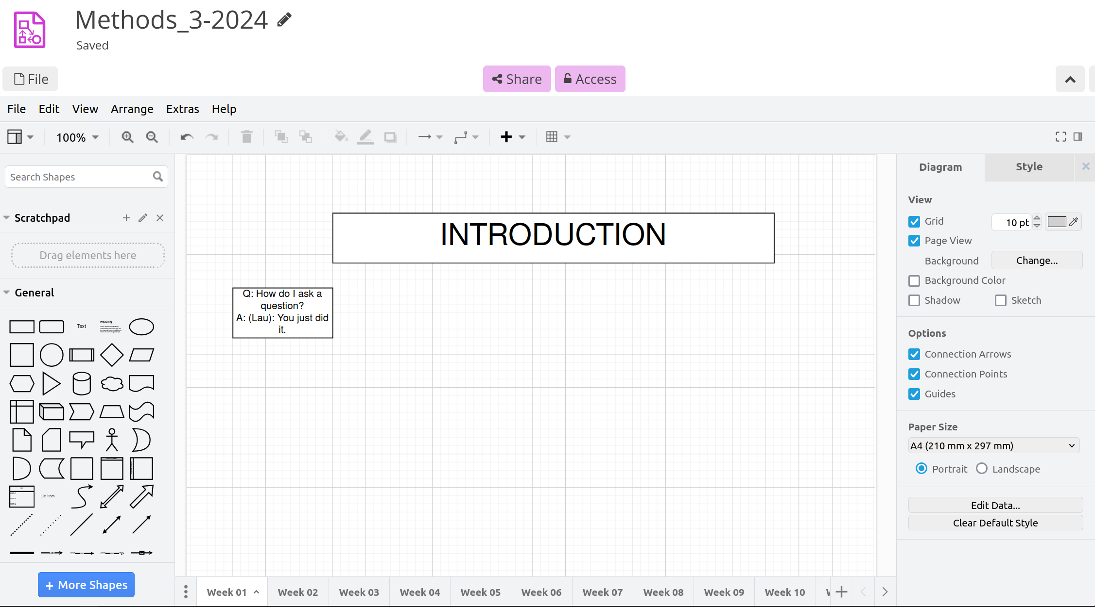
CryptPad https://cryptpad.fr/diagram/#/2/diagram/edit/e2J7ywc5mVeuAmudDDsnkR7U/

Slide 4
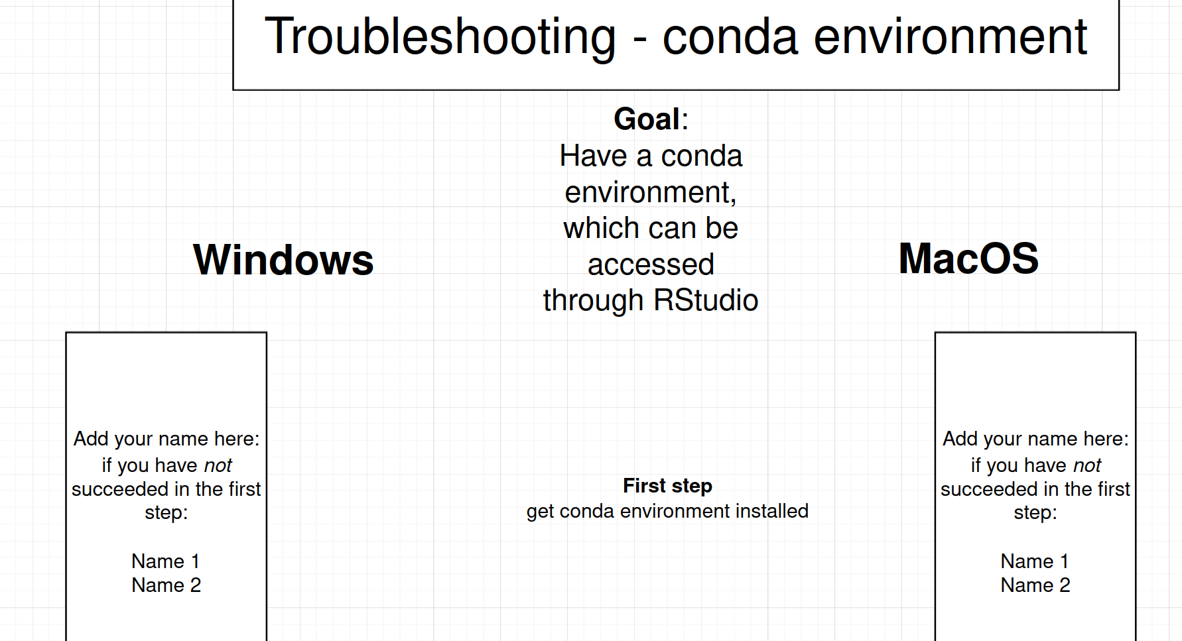
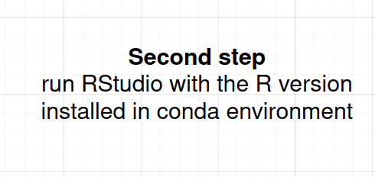
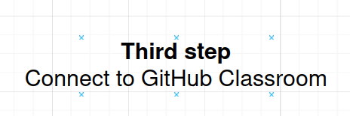
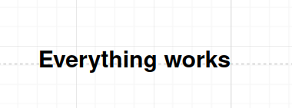
Troubleshooting
CONDA ENVIRONMENTS

Slide 5
Learning goals and outline
Multilevel linear regression
Understanding the motivations for doing multilevel modelling
  Using all the data
  Respecting the data distribution
Understanding the basics of multilevel modelling
  Different kinds of design matrices, X and Z
  Variance-covariance matrices
  Pooling: complete pooling, no pooling and partial pooling

Slide 6
Overall motivation
We want to use all the information in the data while respecting the data distributions the data is generated from

Slide 7
The four classical levels of variables
Nominal
  examples: true/false, correct/incorrect, female/male, dog/cat, apples/pear, also called categorical
  they are names of categories, but it does not make sense to order them
Ordinal
  examples: senior/junior, adult/child 1/2/3
  they are also names of categories, but there is an explicit or implicit ordering, i.e. one is greater than another
Interval
  examples: the year 1984 AD; the temperature 100 °C
  they are can be continuous, and there is ordering, e.g. 100 °C > 90 °C. And intervals can be compared, e.g. the interval from 80 °C to 100 °C is as long as the one from 40 °C to 60 °C
  crucially, there is no real 0; the year before 1 AD is not characterised by absence of time; and 0 °C is not characterised by the absence of temperature This means that we cannot say that, say, 40 °C is twice as high a temperature as 20 °C
Ratio
  examples: the temperature 273 K, the reaction time of a subject
  they are can be continuous, there is ordering and there is a real 0.
  Thus we can say that 200 K is twice the temperature of 100 K, as 0 K is the absence of temperature; and we can say that subject 2, 400 ms, is twice as fast as subject 1, 200 ms, because 0 ms is the time when the event happened
SLIDE UPDATED 2024_10_03

Slide 8
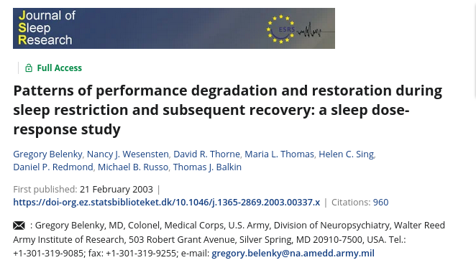
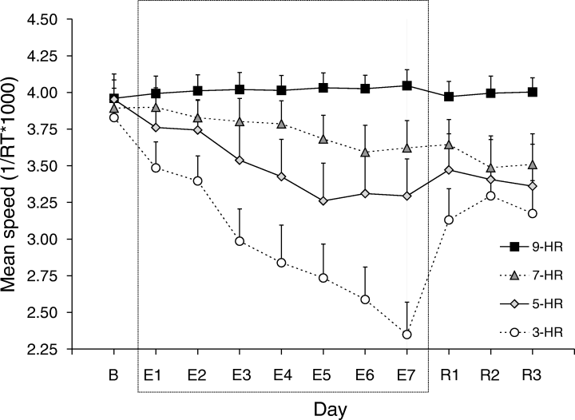
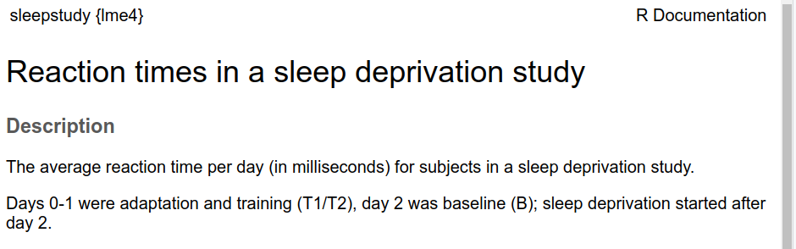
Sub-optimal practices
TREATING VARIABLES AS ANOTHER LEVEL THAN THEY ARE
Q: judging from the figure: what kind of predictor is Day modelled as?
And should it have been modelled otherwise?

Slide 9
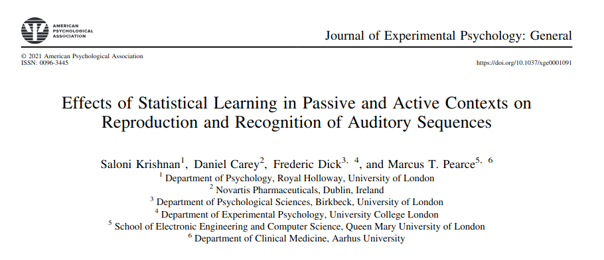
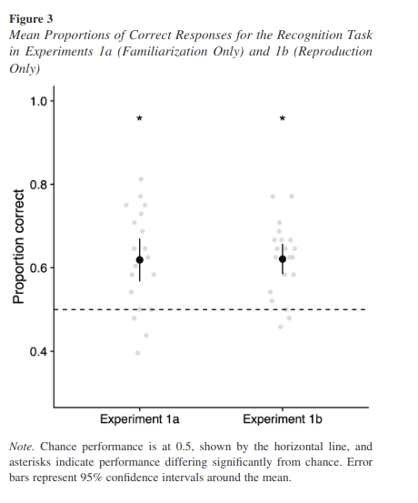
Sub-optimal practices
AGGREGATION – part 1
Q’s:
What do each of the grey dots represent?
What kind of response data is present at the single-trial level?
  And how is the response data categorised here?
Within a single-subject level framework, what would be the appropriate model to fit?
Can confidence intervals extend beyond proportion correct 1 or 0 with the approach used here?

Slide 10

Sub-optimal practices
AGGREGATION – part 2
“Three factorial ANOVA's were calculated for hits and correct rejections [...]. For these [electrode] sites, data were averaged separately for the left and right hemisphere but only for those 1 s intervals of an epoch which represent the first 1000 ms after presentation onset of the memory set and frame.” section 2.4.5
“The percentage of epochs that were excluded from data analysis (due to artifacts) for hits and correct rejections ranged from 28% to 42% in the four experimental conditions.” section 2.4.2
Q: What may be a problem when data is aggregated like that?

Slide 11
When all you have is a hammer, everything looks like a nail
General Linear Model
Normally distributed variable
(an interval or ratio variable)

Slide 12
W02_live_coding

Slide 13
Understanding the basics of multilevel modelling

Slide 14
Design matrices

Slide 15
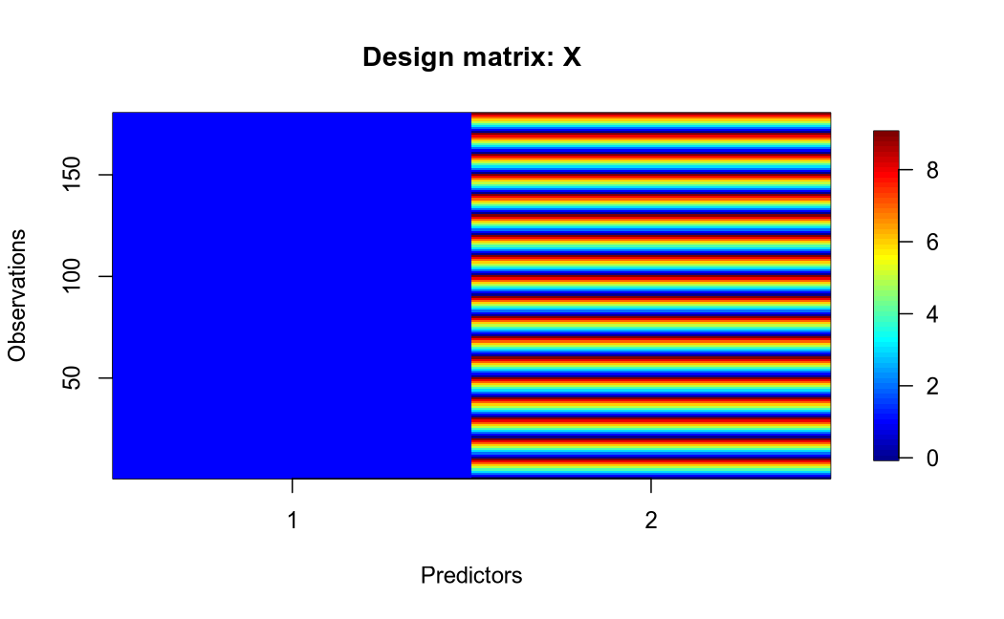
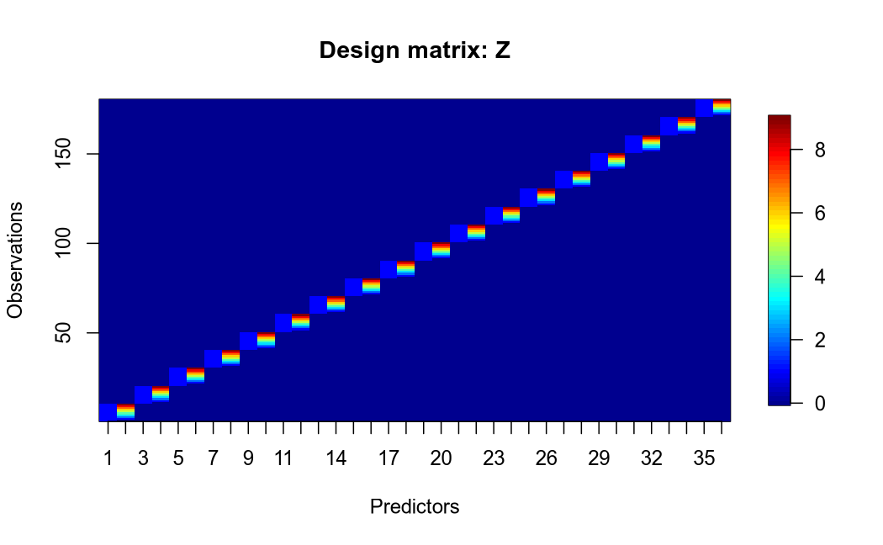
Level 1
Level 2
Fixed effects
Random effects

Slide 16
Linear mixed model fit by REML ['lmerMod']
Formula: Reaction ~ Days + (Days | Subject)
Data: sleepstudy
REML criterion at convergence: 1743.628
Random effects:
Groups Name Std.Dev. Corr
Subject (Intercept) 24.741
Days 5.922 0.07
Residual 25.592
Number of obs: 180, groups: Subject, 18
Fixed Effects:
(Intercept) Days
251.41 10.47

Slide 17
  Variance-covariance matrices

Slide 18
Linear mixed model fit by REML ['lmerMod']
Formula: Reaction ~ Days + (Days | Subject)
Data: sleepstudy
REML criterion at convergence: 1743.628
Random effects:
Groups Name Std.Dev. Corr
Subject (Intercept) 24.741
Days 5.922 0.07
Residual 25.592
Number of obs: 180, groups: Subject, 18
Fixed Effects:
(Intercept) Days
251.41 10.47
$Subject
(Intercept) Days
308 2.2585509 9.1989758
309 -40.3987381 -8.6196806
310 -38.9604090 -5.4488565
330 23.6906196 -4.8143503
331 22.2603126 -3.0699116
332 9.0395679 -0.2721770
333 16.8405086 -0.2236361
334 -7.2326151 1.0745816
335 -0.3336684 -10.7521652
337 34.8904868 8.6282652
349 -25.2102286 1.1734322
350 -13.0700342 6.6142178
351 4.5778642 -3.0152621
352 20.8636782 3.5360011
369 3.2754656 0.8722149
370 -25.6129993 4.8224850
371 0.8070461 -0.9881562
372 12.3145921 1.2840221
with conditional variances for “Subject”
Q: What are the means of these columns?

Slide 19
Variance-covariance matrix
Bates D, Mächler M, Bolker B, Walker S (2015) Fitting Linear Mixed-Effects Models Using lme4. Journal of Statistical Software 67:1–48. https://doi.org/10.18637/jss.v067.i01
Subject.(Intercept) Subject.Days.(Intercept) Subject.Days
0.96674177 0.01516906 0.23090995

Slide 20
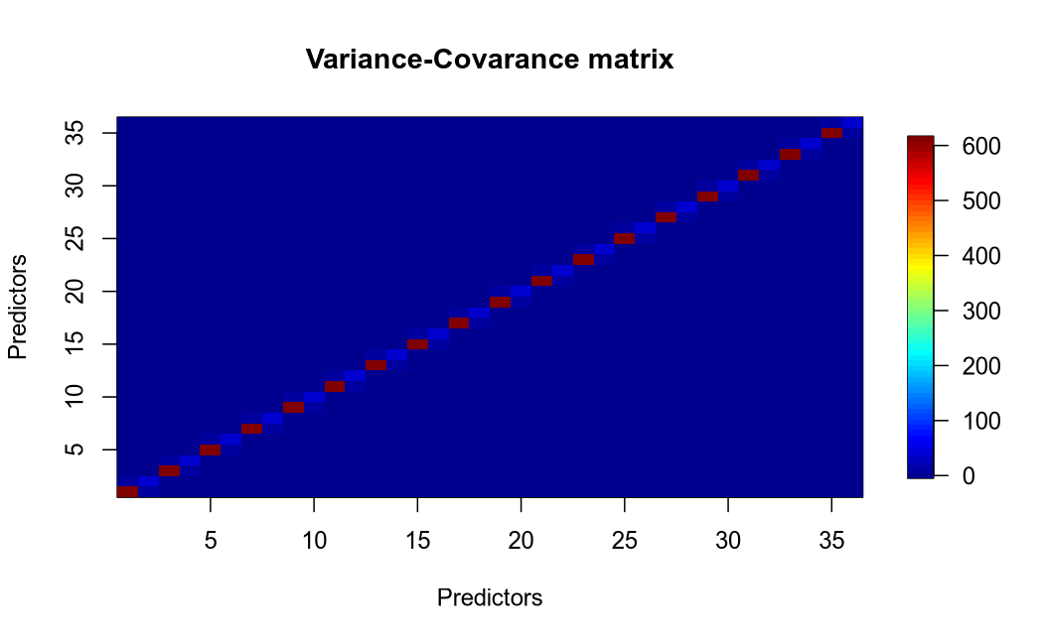
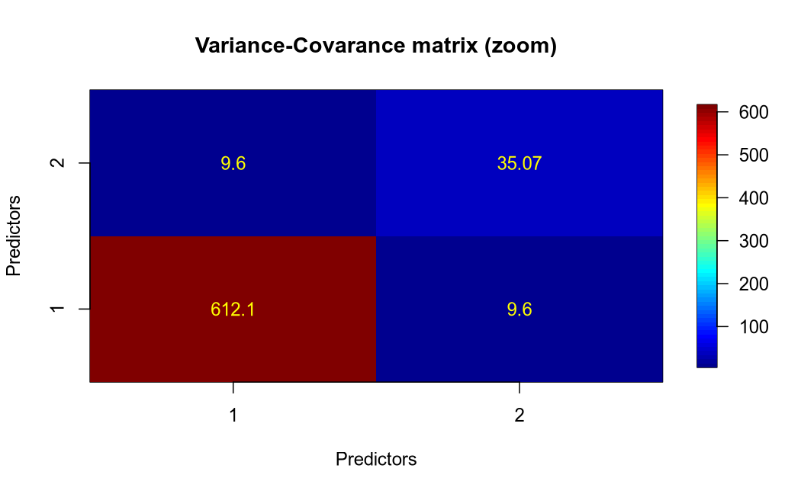
Q: What would the plot look like if there was no covariance between predictors?

Slide 21
Why do we care about covariance?
Too much covariance between predictors, and your model doesn’t converge ...
... and even in you get convergence, the estimated coefficients may be sensitive to small changes in input

Slide 22
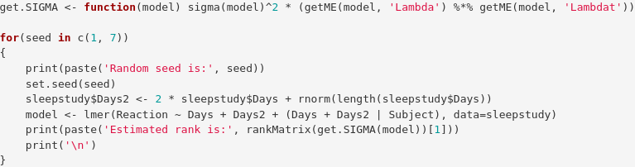
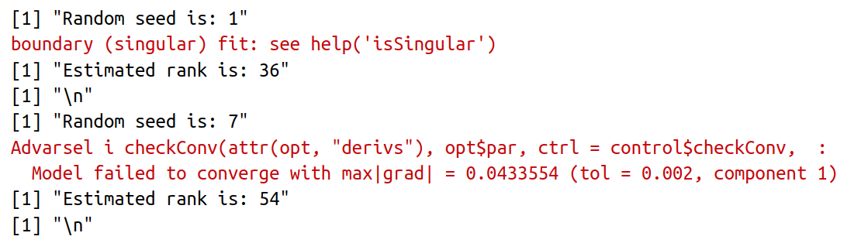

Slide 23
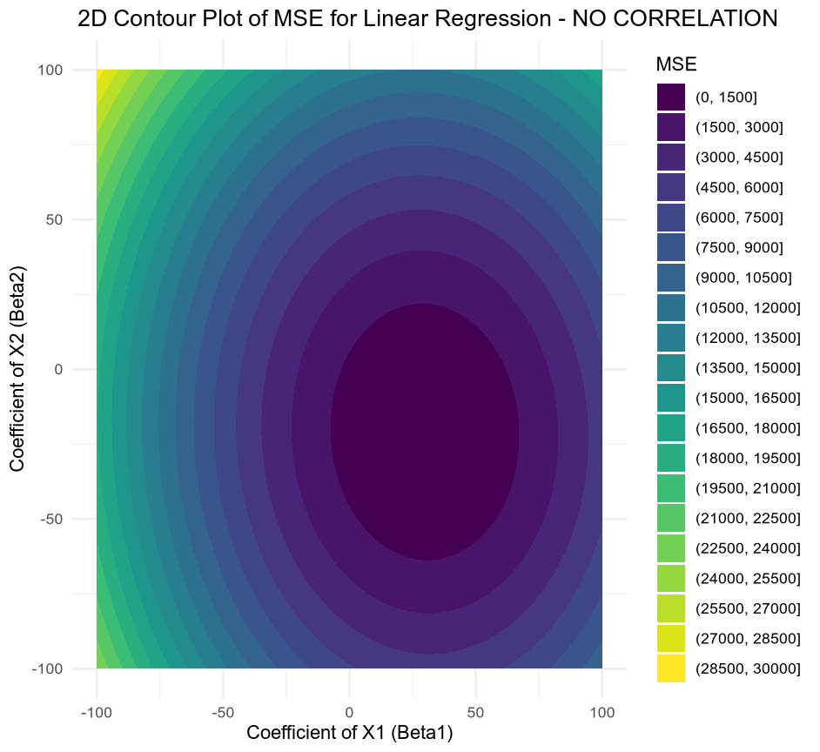
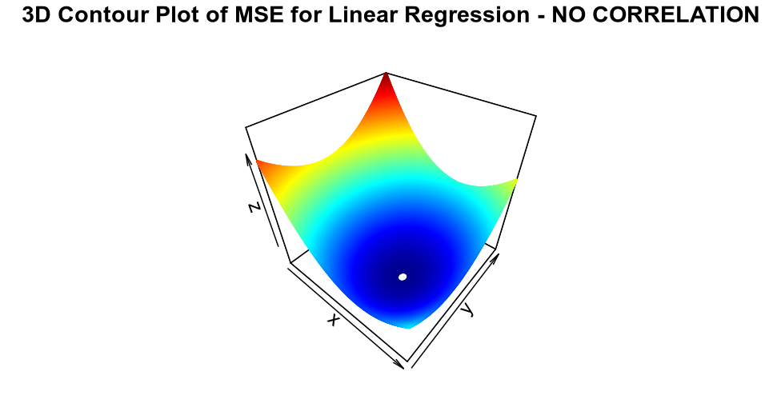
Full rank

Slide 24
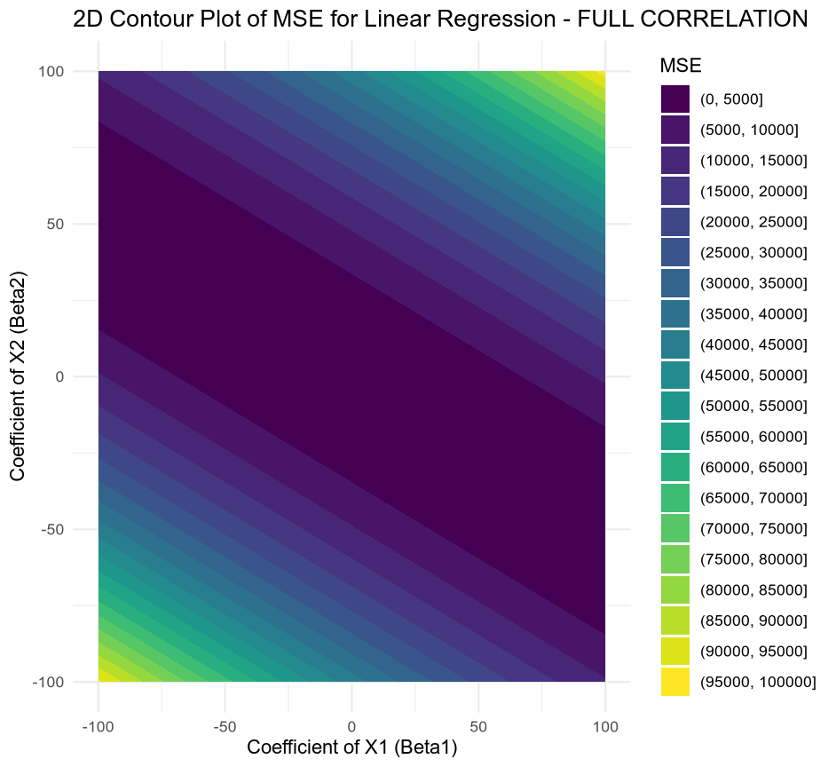
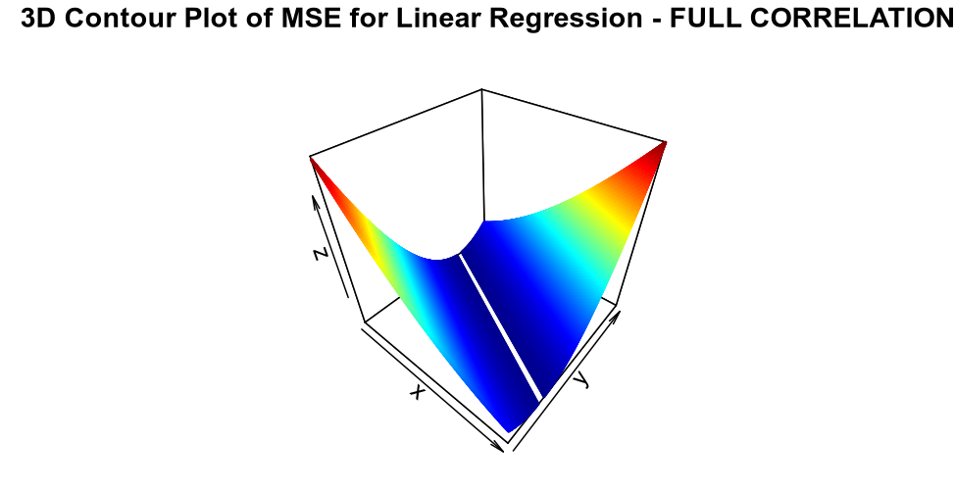
Singular

Slide 25
Hint for the future
With “big data”, the variance-covariance matrices will matter a lot
(machine learning)

Slide 26
Pooling

Slide 27
Overview – pooling
Complete pooling
  Ignores the categorical predictor, e.g. Subject, altogether
  lm(Reaction ~ Days)
No pooling
  Overfits the categorical predictor, e.g. Subject, i.e. overstates the variation among Subjects
  lm(Reaction ~ Days * Subject – 1); models slopes and intercepts for each subject
  lm(Reaction ~ Days + Subject – 1); models intercepts for each subject
Partial pooling
  A compromise between the two extremes a
SLIDE UPDATED 2024_10_03

Slide 28
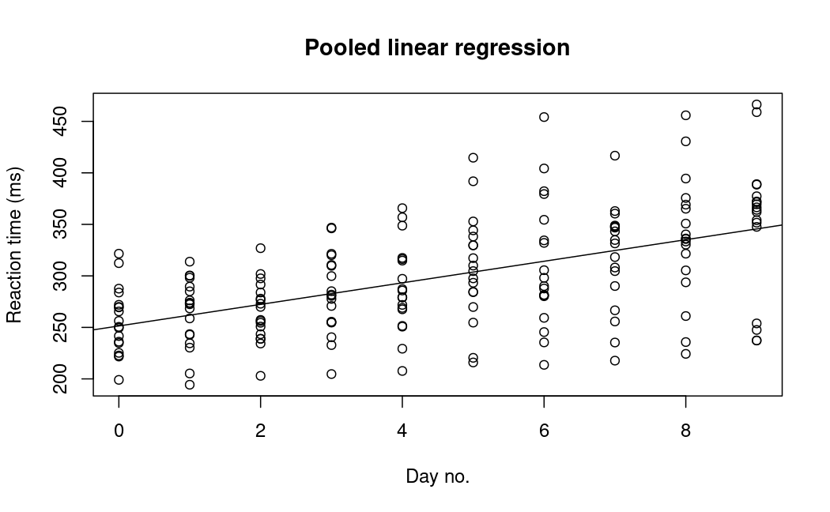
Complete pooling

Slide 29
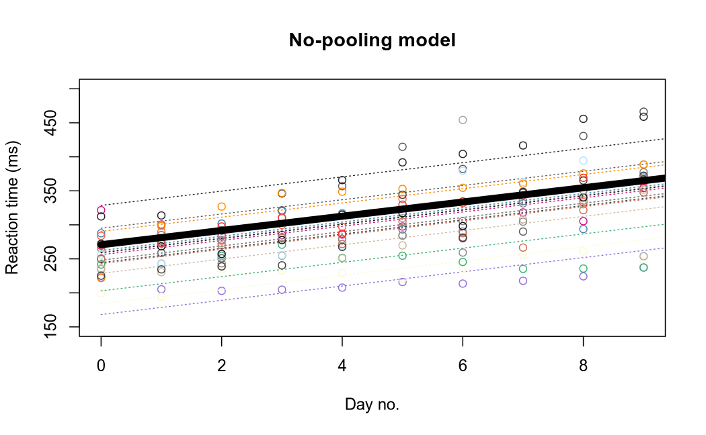
No pooling

Slide 30
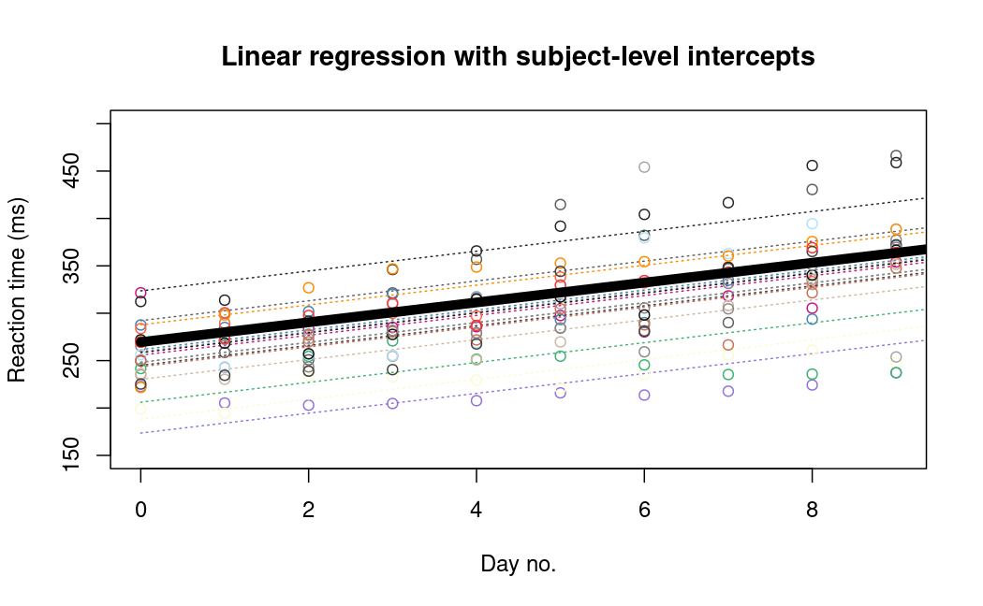
Partial pooling

Slide 31
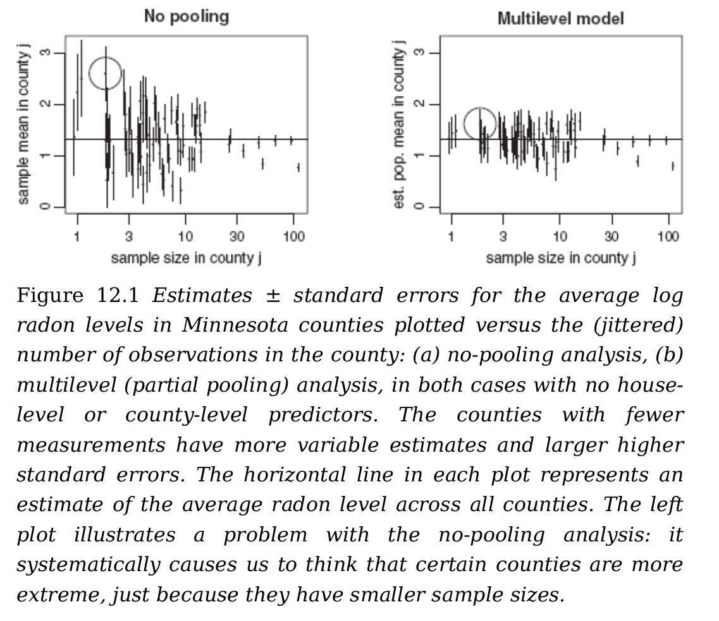
Gelman A, Hill J (2006) Data Analysis Using Regression and Multilevel/Hierarchical Models. Cambridge University Press

Slide 32
How is shrinking done?
HOW IS BIAS ADDED?
Bates D, Mächler M, Bolker B, Walker S (2015) Fitting Linear Mixed-Effects Models Using lme4. Journal of Statistical Software 67:1–48. https://doi.org/10.18637/jss.v067.i01

Slide 33
Another way to look at shrinking
OR HOW TO ADD BIAS
Q’s:
What happens to the estimated α_{j}, when respectively n_{j}, σy, or σα:
increases?
decreases?
is 0?
goes towards infinity?
Gelman A, Hill J (2006) Data Analysis Using Regression and Multilevel/Hierarchical Models. Cambridge University Press
Notes:
In plain words:
More observations per group equal that subject estimate is weighted higher
Higher within-group variance equals that group estimate is weighted higher
Higher between-group variance equals that subject estimate is weighted higher

Slide 34
Linear mixed model fit by REML ['lmerMod']
Formula: Reaction ~ Days + (1 | Subject)
Data: sleepstudy
REML criterion at convergence: 1786.465
Random effects:
Groups Name Std.Dev.
Subject (Intercept) 37.12
Residual 30.99
Number of obs: 180, groups: Subject, 18
Fixed Effects:
(Intercept) Days
251.41 10.47
Call:
lm(formula = Reaction ~ Days, data = sleepstudy)
Coefficients:
(Intercept) Days
251.41 10.47
Call:
lm(formula = Reaction ~ Days + Subject - 1, data = sleepstudy)
Coefficients:
Days Subject308 Subject309 ...
10.47 295.03 168.13 ...

Slide 35
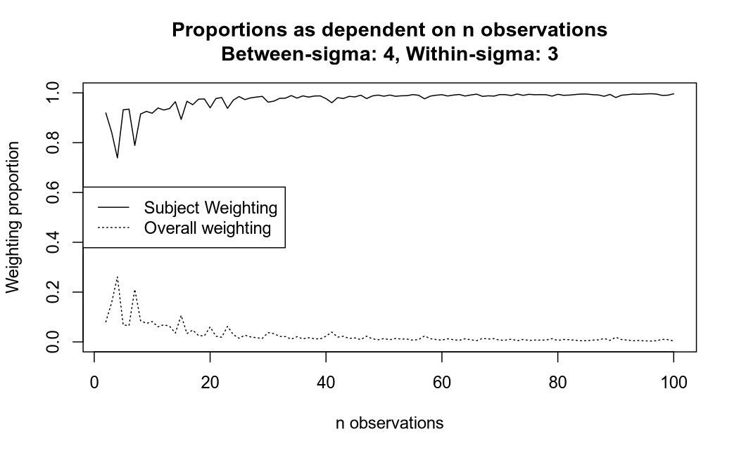
When σα > σy
100 SIMULATIONS

Slide 36
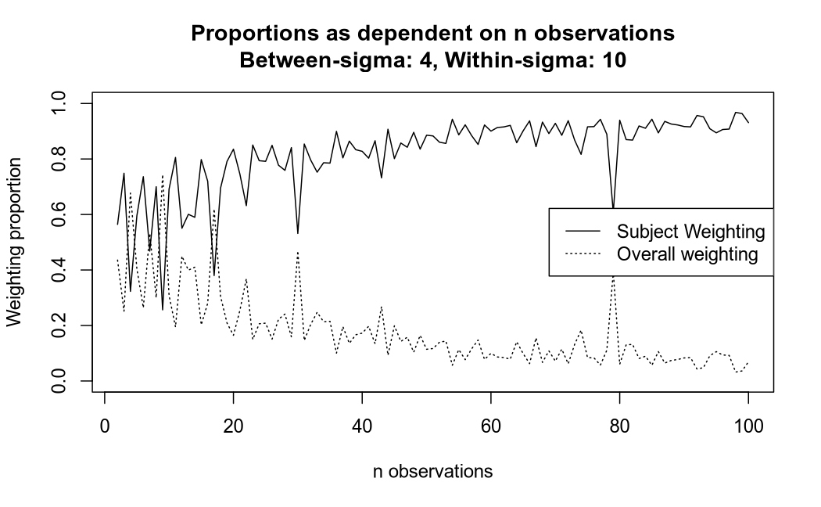
When σα < σy
100 SIMULATIONS

Slide 37
The course plan
Week 1: Introduction
Instructor sessions: Setting up R and Python and recollection of the general linear model
Week 2: Multilevel linear regression
Instructor sessions: Modelling subject level effects – and how do they differ from group level effects?
Week 3: Link functions and fitting generalised linear multilevel models
Instructor sessions: What to do when the response variable is not continuous?
Week 4: Evaluating Generalised linear mixed models
Instructor sessions: How do we assess how models compare to one another?
Week 5: Explanation and Prediction
Instructor sessions: Code review
Week 6: Mid-way evaluation and Machine Learning Intro
Instructor sessions: Getting Python Running
Week 7: Linear regression revisited (machine learning)
Instructor sessions: How to constrain our models to make them more predictive
Week 8: Logistic regression revisited (machine learning)
Instructor sessions: Categorizing responses based on informed guesses
Week 9: Dimensionality Reduction, Principled Component Analysis (PCA)
Instructor sessions: What to do with very rich data?
Week 10: Outlook, unsupervised classification and neural networks
Instructor sessions: Data with no labels and networks
Week 11: Organising and preprocessing messy data
Instructor sessions: Code review
Week 12: Final evaluation and wrap-up of course
Instructor sessions: Ask anything!
<nummer>

Slide 38
Next time –
Link functions and fitting generalised linear multilevel models
Generalising general models
Link functions
  transforming from one scale to another
  inverse functions
Maximum likelihood estimation

Slide 39
Reading questions
Chapter 5, Gelman & Hill
  Why do we want to transform Xiβ using logit⁻¹?
  What is an odds ratio?
  How are logistic regression coefficients interpreted?
Sections 6.1 and 6.2 Gelman & Hill
  What is the parameter, θ, of the Poisson distribution?
  Why may overdispersion be an issue?

