Slide 1
Methods 3: Multilevel Statistical Modeling and Machine Learning
Week 03: Link functions and fitting generalised linear multilevel models
September 17, 2024

Slide 2
The course plan
Week 1: Introduction
Instructor sessions: Setting up R and Python and recollection of the general linear model
Week 2: Multilevel linear regression
Instructor sessions: Modelling subject level effects – and how do they differ from group level effects?
Week 3: Link functions and fitting generalised linear multilevel models
Instructor sessions: What to do when the response variable is not continuous?
Week 4: Evaluating Generalised linear mixed models
Instructor sessions: How do we assess how models compare to one another?
Week 5: Explanation and Prediction
Instructor sessions: Code review
Week 6: Mid-way evaluation and Machine Learning Intro
Instructor sessions: Getting Python Running
Week 7: Linear regression revisited (machine learning)
Instructor sessions: How to constrain our models to make them more predictive
Week 8: Logistic regression revisited (machine learning)
Instructor sessions: Categorizing responses based on informed guesses
Week 9: Dimensionality Reduction, Principled Component Analysis (PCA)
Instructor sessions: What to do with very rich data?
Week 10: Outlook, unsupervised classification and neural networks
Instructor sessions: Data with no labels and networks
Week 11: Organising and preprocessing messy data
Instructor sessions: Code review
Week 12: Final evaluation and wrap-up of course
Instructor sessions: Ask anything!

Slide 3
Recap – week 02
Design matrices
  reflect the choices we make in modelling
  sometimes, our choices cannot be fit
  the variance-covariance matrix will sometimes reveal why
Partial pooling
  allows for subject weighting or average weighting on a case-by-case basis, depending on the reliability of information available

Slide 4
Learning goals and outline
Link functions and fitting generalised linear multilevel models
Understanding that we can extend the scope of our general linear model by using appropriate link functions and data distributions
Understanding that we can extend this scope to multilevel modelling as well
Getting an understanding of maximum likelihood estimation

Slide 5
Extending the scope of the general linear model by using appropriate link functions and data distributions
With a focus on logistic regression (Booleans) and Poisson regression (counts)

Slide 6
Generalised linear model

Slide 7
At least four ingredients needed
Gelman A, Hill J (2006) Data Analysis Using Regression and Multilevel/Hierarchical Models. Cambridge University Press: Chapter 6

Slide 8

Logistic regression

Slide 9
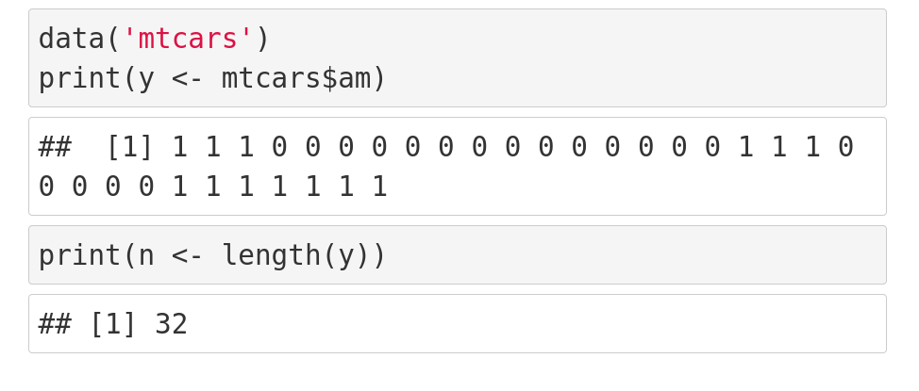

Slide 10
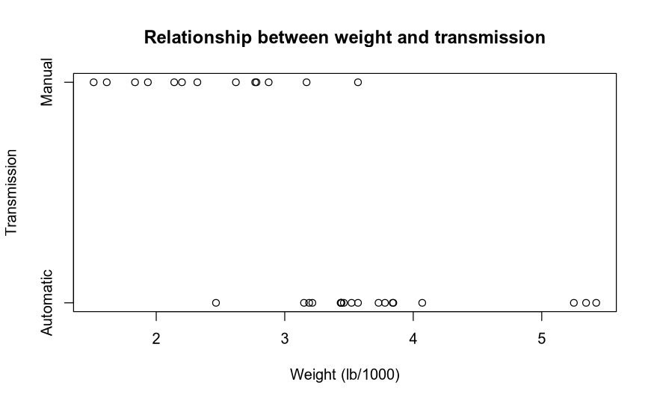

Slide 11
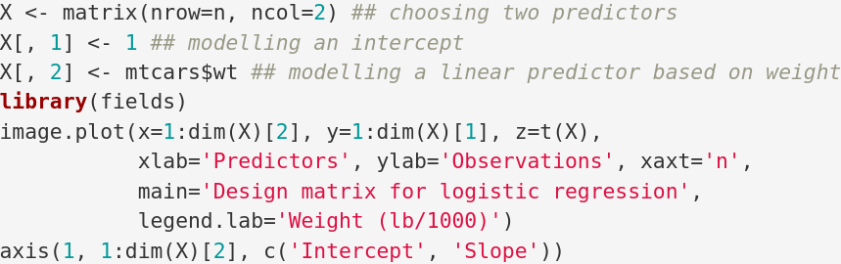
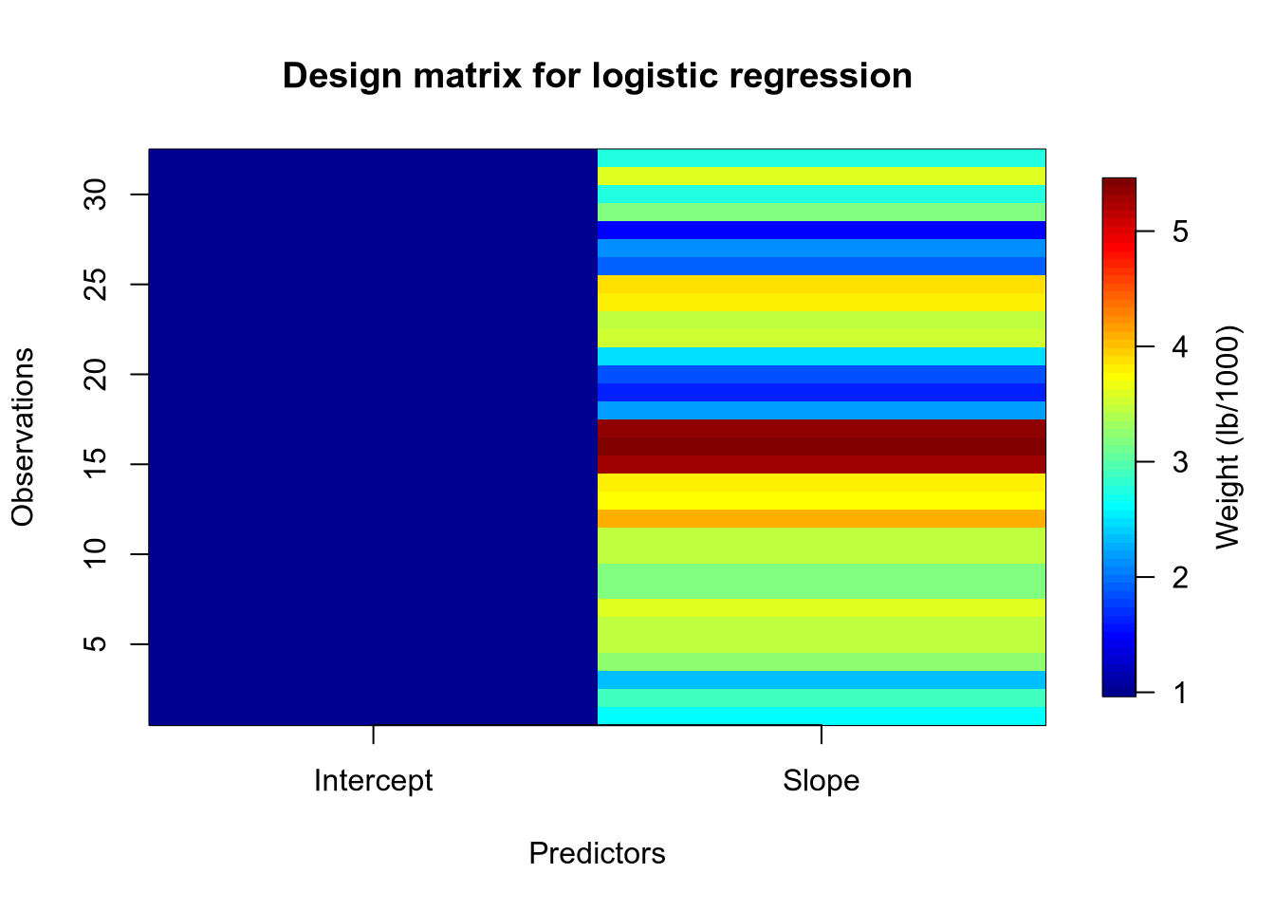

Slide 12
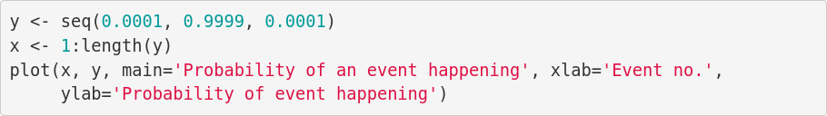
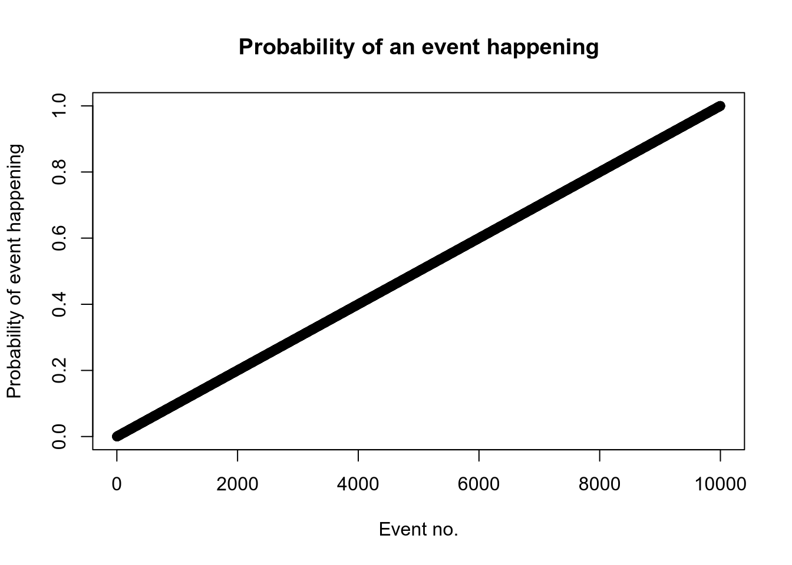

Slide 13
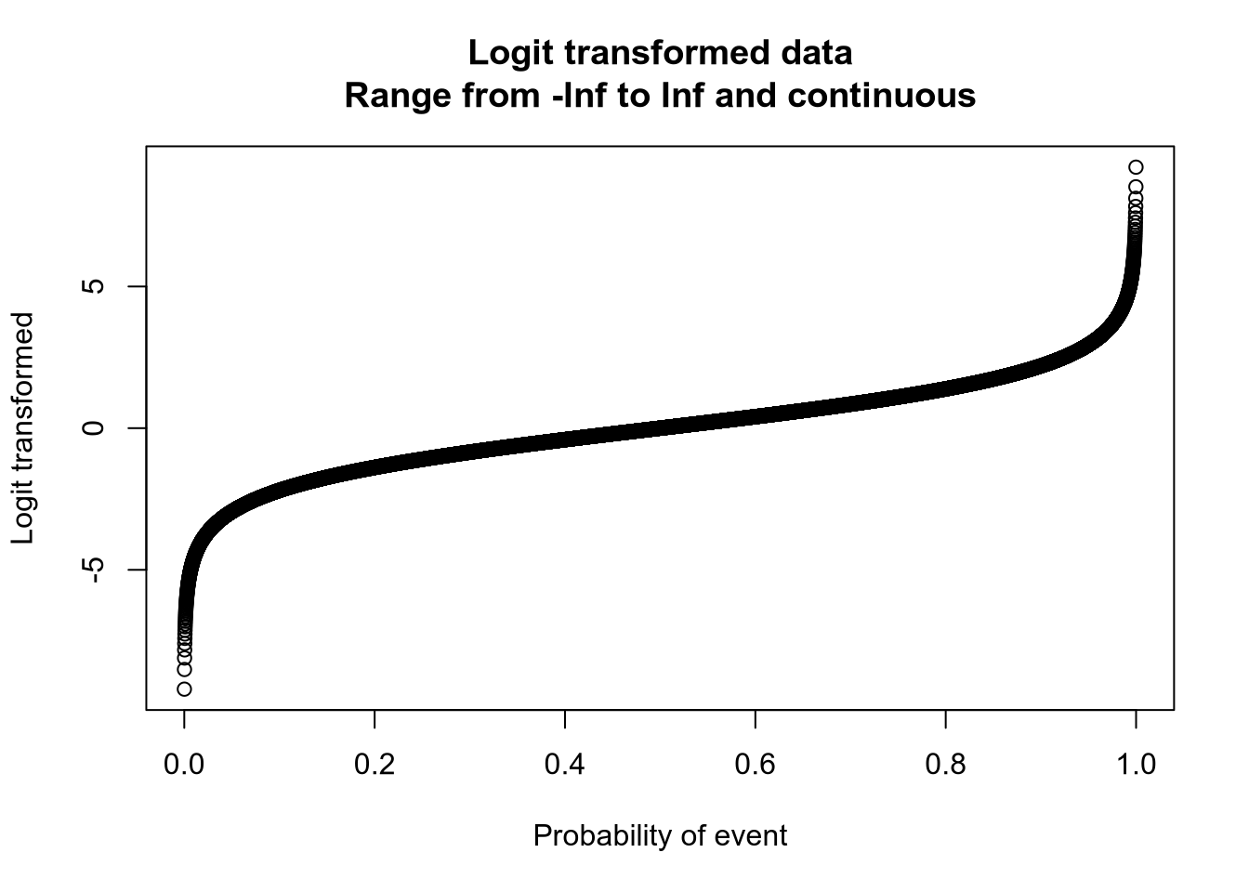

Slide 14
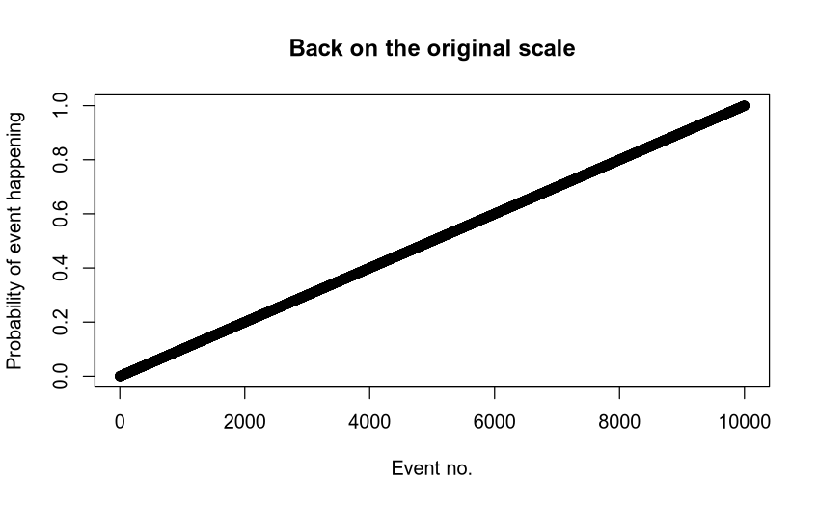

Slide 15
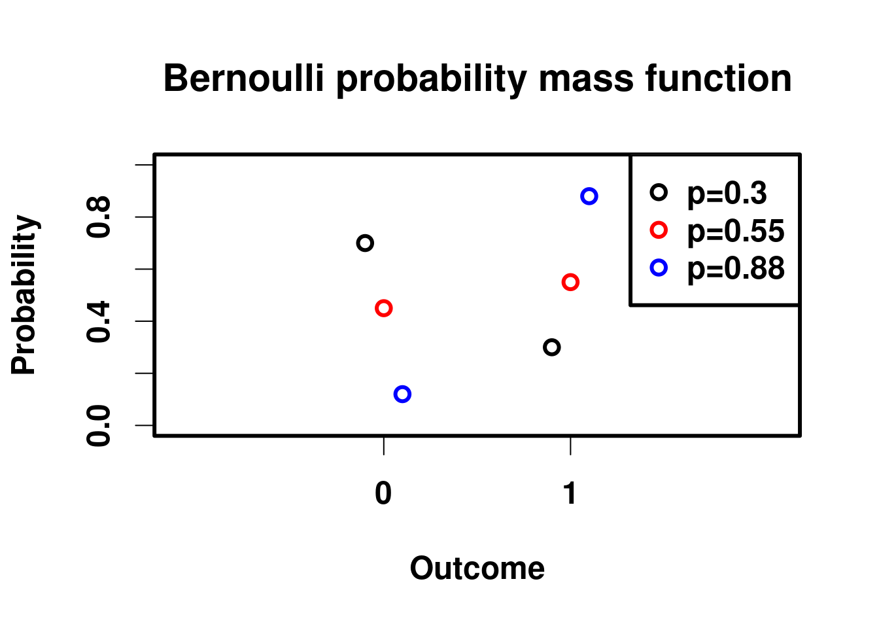
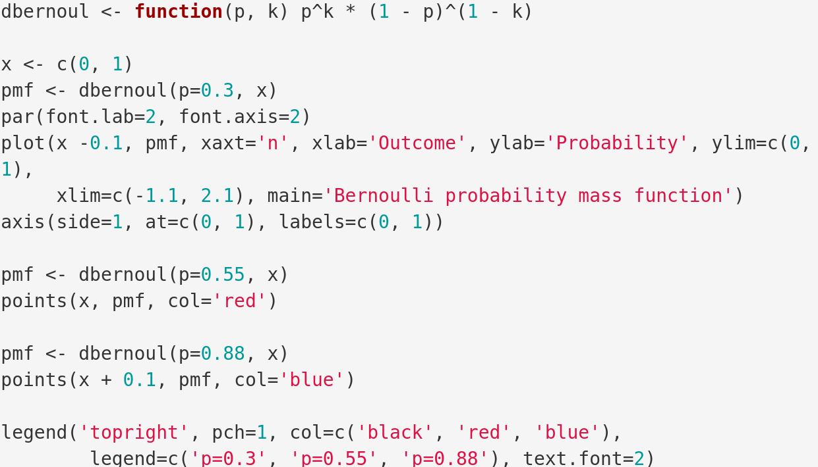

Slide 16
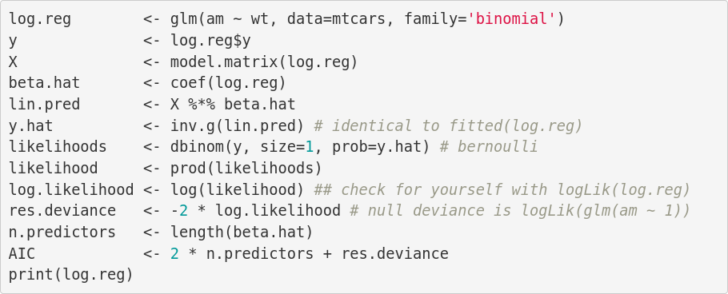
Bringing it all together
Call: glm(formula = am ~ wt, family = "binomial", data = mtcars)
Coefficients:
(Intercept) wt
12.040 -4.024
Degrees of Freedom: 31 Total (i.e. Null); 30 Residual
Null Deviance: 43.23
Residual Deviance: 19.18 AIC: 23.18
live coding

Slide 18
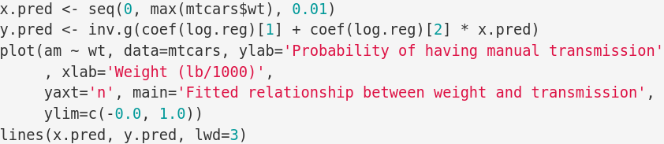
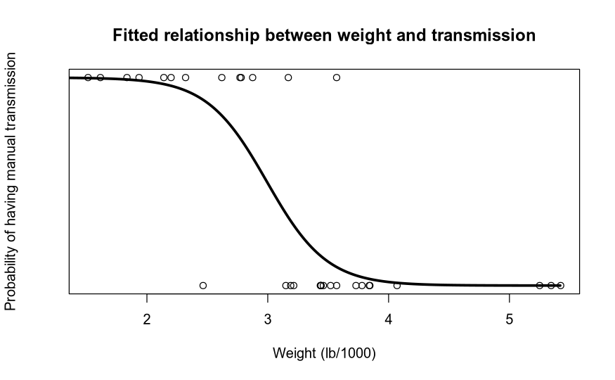

Slide 19

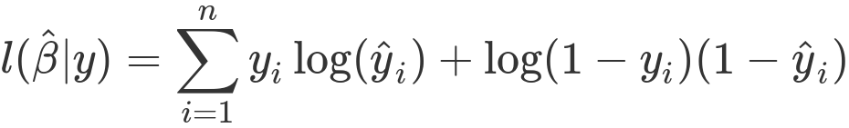
Why we need a data distribution
WE NEED A LIKELIHOOD TO MAXIMISE
Why is the log-likelihood preferred?

Slide 20
Poisson regression

Slide 21
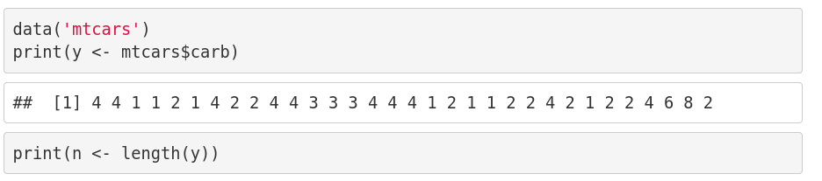
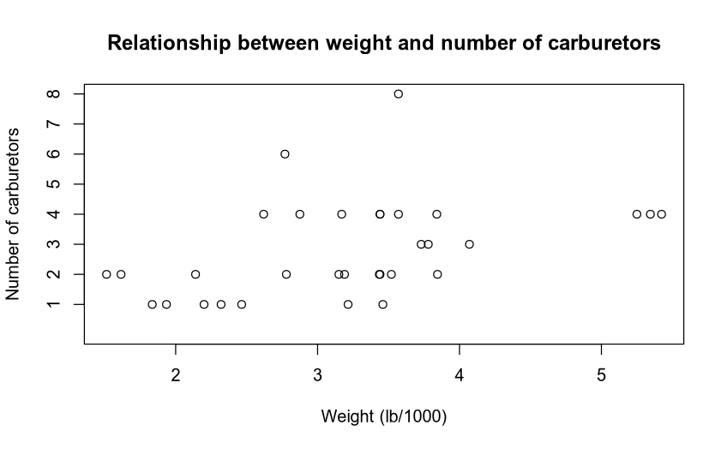

Slide 22
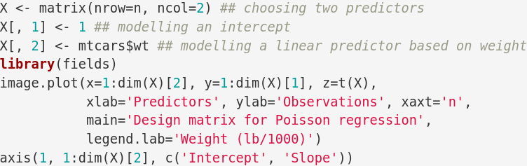


Slide 23
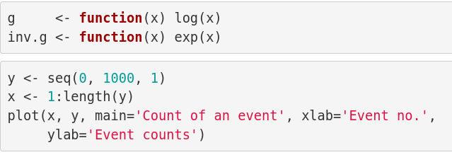
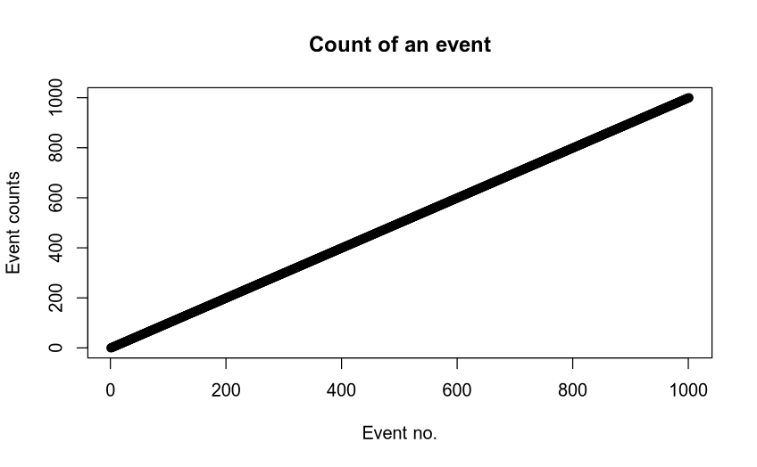

Slide 24
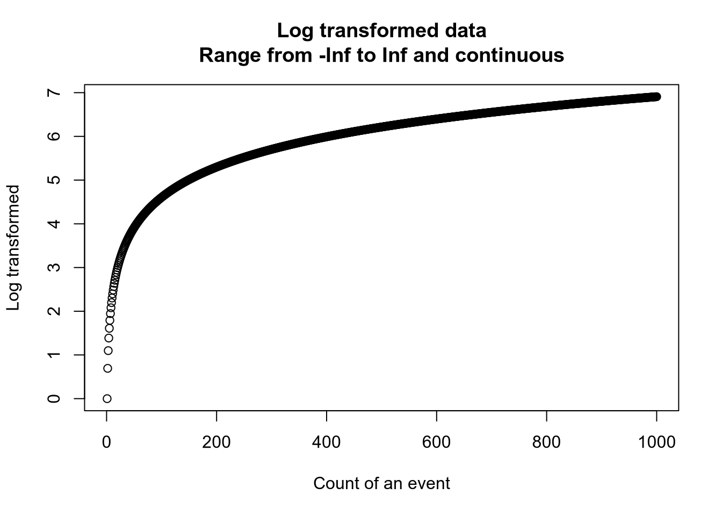

Slide 25
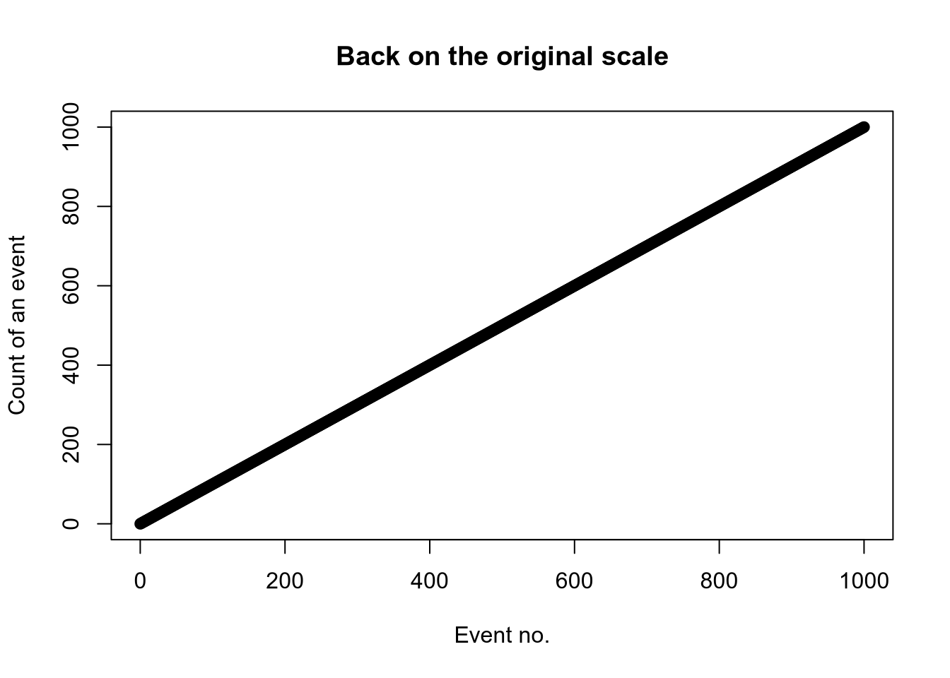

Slide 26
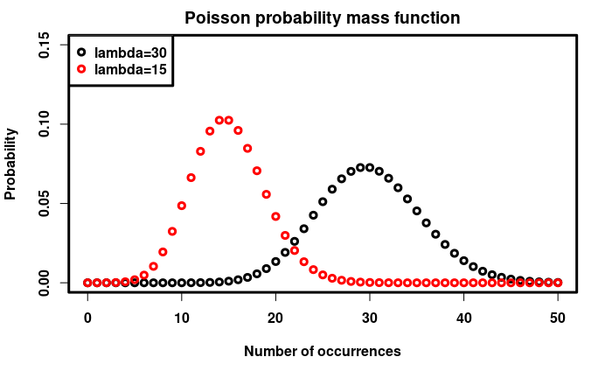

Slide 27
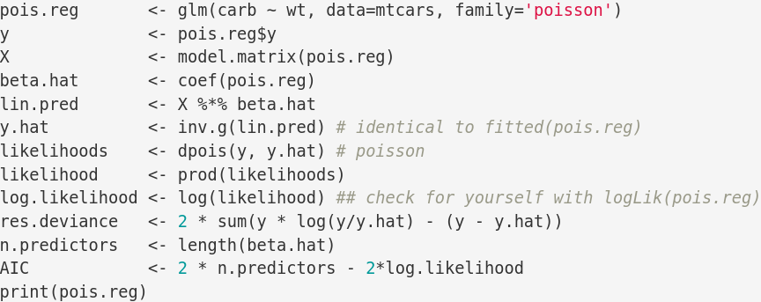
Bringing it all together
Call: glm(formula = carb ~ wt, family = "poisson", data = mtcars)
Coefficients:
(Intercept) wt
0.2391 0.2386
Degrees of Freedom: 31 Total (i.e. Null); 30 Residual
Null Deviance: 27.04
Residual Deviance: 21.96 AIC: 115.3
live coding

Slide 28
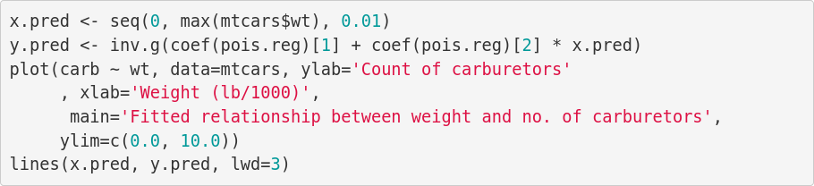
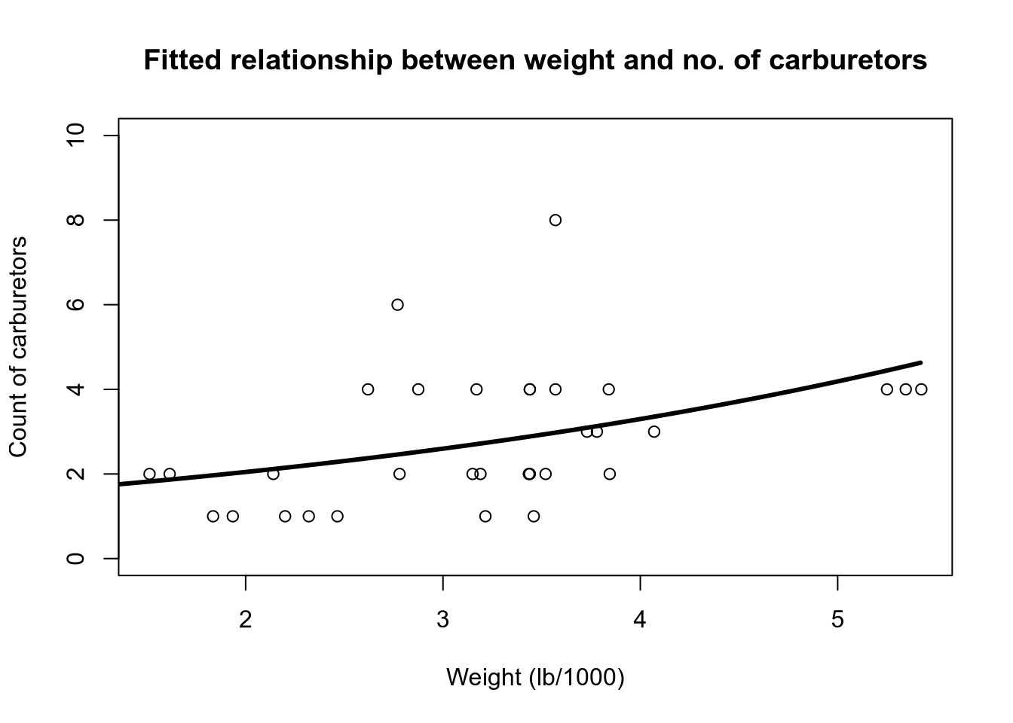

Slide 30
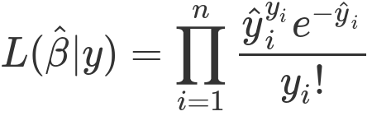
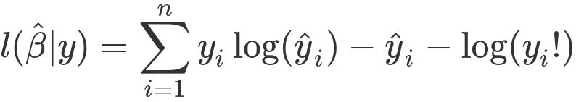
Why we need a data distribution
WE NEED A LIKELIHOOD TO MAXIMISE

Slide 31
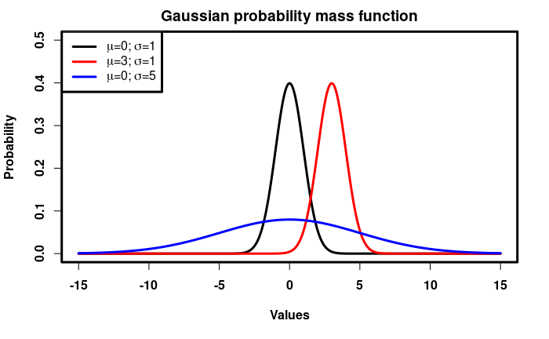
... the identity link
<nummer>
CC BY Licence 4.0: Lau Møller Andersen

Slide 32
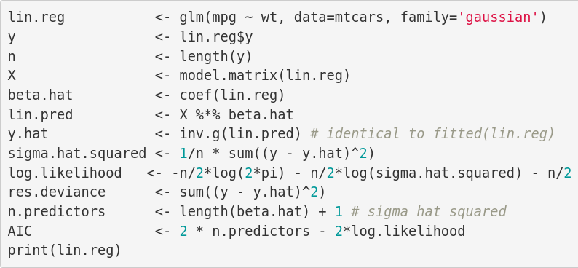
Bringing it all together
Call: glm(formula = mpg ~ wt, family = "gaussian", data = mtcars)
Coefficients:
(Intercept) wt
37.285 -5.344
Degrees of Freedom: 31 Total (i.e. Null); 30 Residual
Null Deviance: 1126
Residual Deviance: 278.3 AIC: 166

Slide 33




Slide 34
Summary
We can extend the General Linear Model to a Generalised Linear Model by ...
  choosing appropriate link functions
    we can define our own
  and using appropriate data distributions
    such that we have a likelihood function to maximise
This can be used to extend the General Linear Multilevel Model to the Generalised Linear Multilevel Model
  And we can get the benefits of partial pooling among other things

Slide 35
Maximising likelihood for multilevel models
Beyond the scope of the present course
Bates D, Mächler M, Bolker B, Walker S (2015) Fitting Linear Mixed-Effects Models Using lme4. Journal of Statistical Software 67:1–48. https://doi.org/10.18637/jss.v067.i01

Slide 36
Example of how to fit

Slide 37
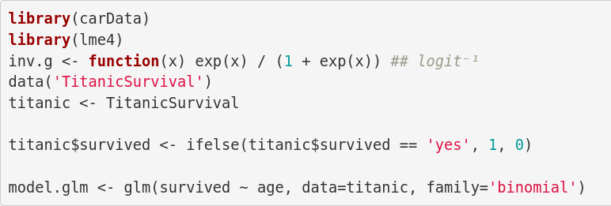
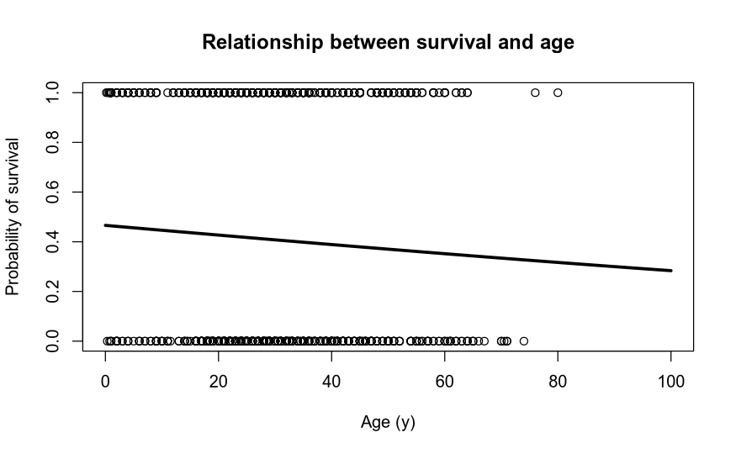

Slide 38
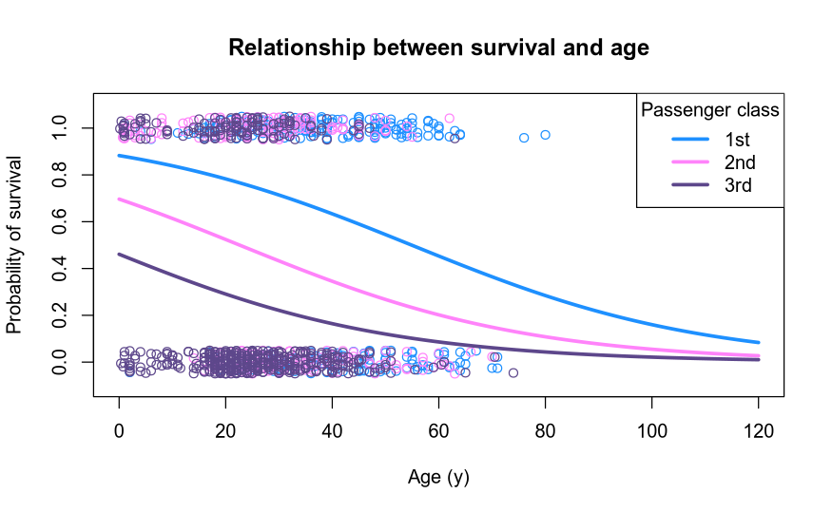

Slide 39
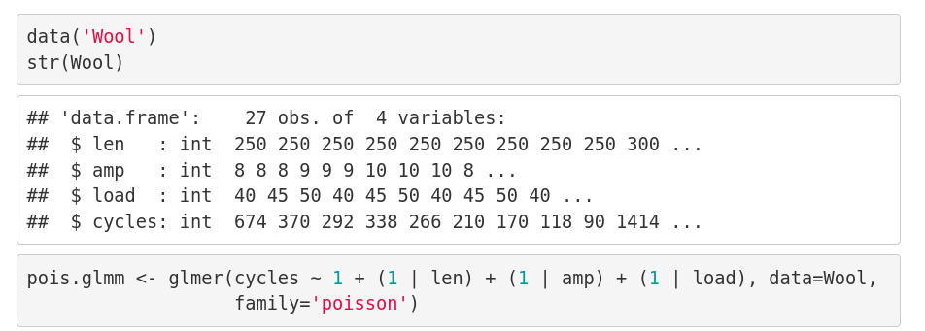
Poisson example

Slide 40
Learning goals and outline
Link functions and fitting generalised linear multilevel models
Understanding that we can extend the scope of our general linear model by using appropriate link functions and data distributions
Understanding that we can extend this scope to multilevel modelling as well
Getting an understanding of maximum likelihood estimation

Slide 41
The course plan
Week 1: Introduction
Instructor sessions: Setting up R and Python and recollection of the general linear model
Week 2: Multilevel linear regression
Instructor sessions: Modelling subject level effects – and how do they differ from group level effects?
Week 3: Link functions and fitting generalised linear multilevel models
Instructor sessions: What to do when the response variable is not continuous?
Week 4: Evaluating Generalised linear mixed models
Instructor sessions: How do we assess how models compare to one another?
Week 5: Explanation and Prediction
Instructor sessions: Code review
Week 6: Mid-way evaluation and Machine Learning Intro
Instructor sessions: Getting Python Running
Week 7: Linear regression revisited (machine learning)
Instructor sessions: How to constrain our models to make them more predictive
Week 8: Logistic regression revisited (machine learning)
Instructor sessions: Categorizing responses based on informed guesses
Week 9: Dimensionality Reduction, Principled Component Analysis (PCA)
Instructor sessions: What to do with very rich data?
Week 10: Outlook, unsupervised classification and neural networks
Instructor sessions: Data with no labels and networks
Week 11: Organising and preprocessing messy data
Instructor sessions: Code review
Week 12: Final evaluation and wrap-up of course
Instructor sessions: Ask anything!

Slide 42
Next time
Overdispersion and other link functions
Comparison of models
  R²
  Log-likelihood testing
  Akaike Information Criteria
  Regularisation

Slide 43
Reading questions
Chapter 14; focus on sections 14.1 and 14.2
  Read for examples of advanced multilevel models and what they can be good for
Chapter 15; focus on section 15.1
  What is overdispersion?
Suggestion: re-read pp. 31-42 of: Winter B (2013) Linear models and linear mixed effects models in R with linguistic applications. arXiv:13085499 [cs]

