Slide 1
Methods 3: Multilevel Statistical Modeling and Machine Learning
Class 03:
What to do when the response variable is not continuous?
September 19, 2024

Slide 2
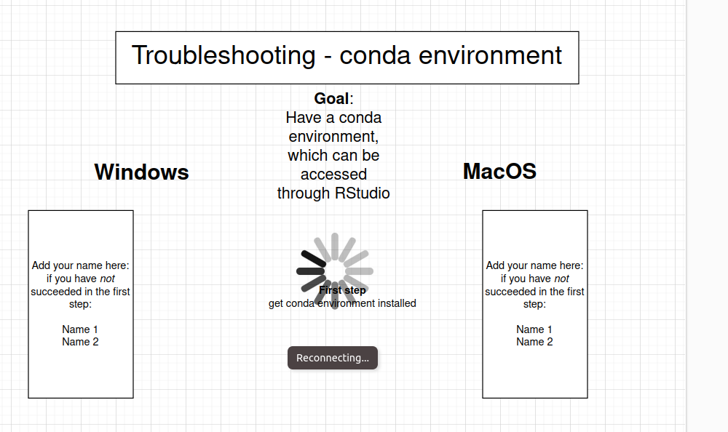

Slide 3
Assignment 2 – parts 1 and 2
Will count as one assignment for the purposes of the exam

Slide 4
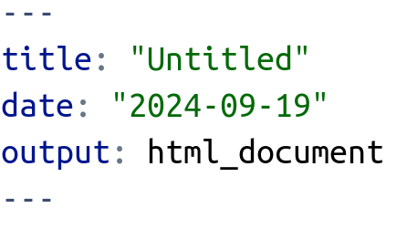
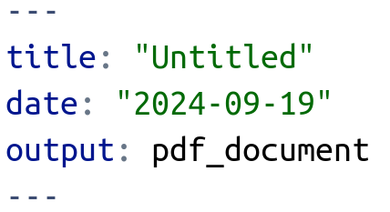
If you cannot knit a pdf, try html instead
(you can make it a pdf afterwards)

Slide 5
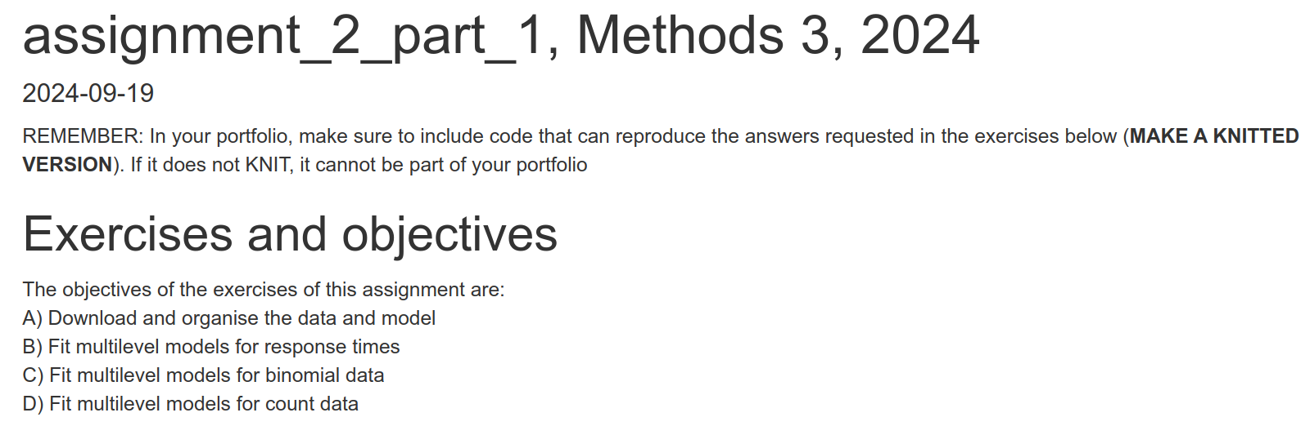

Slide 6
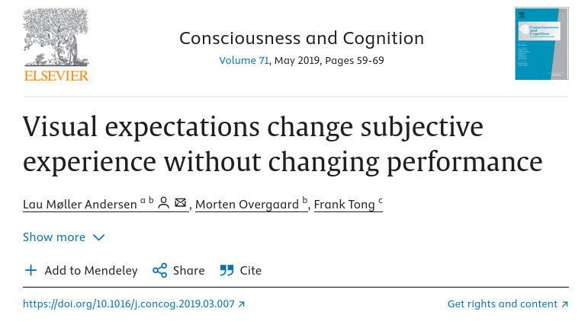
Introduction to experiment

Slide 7
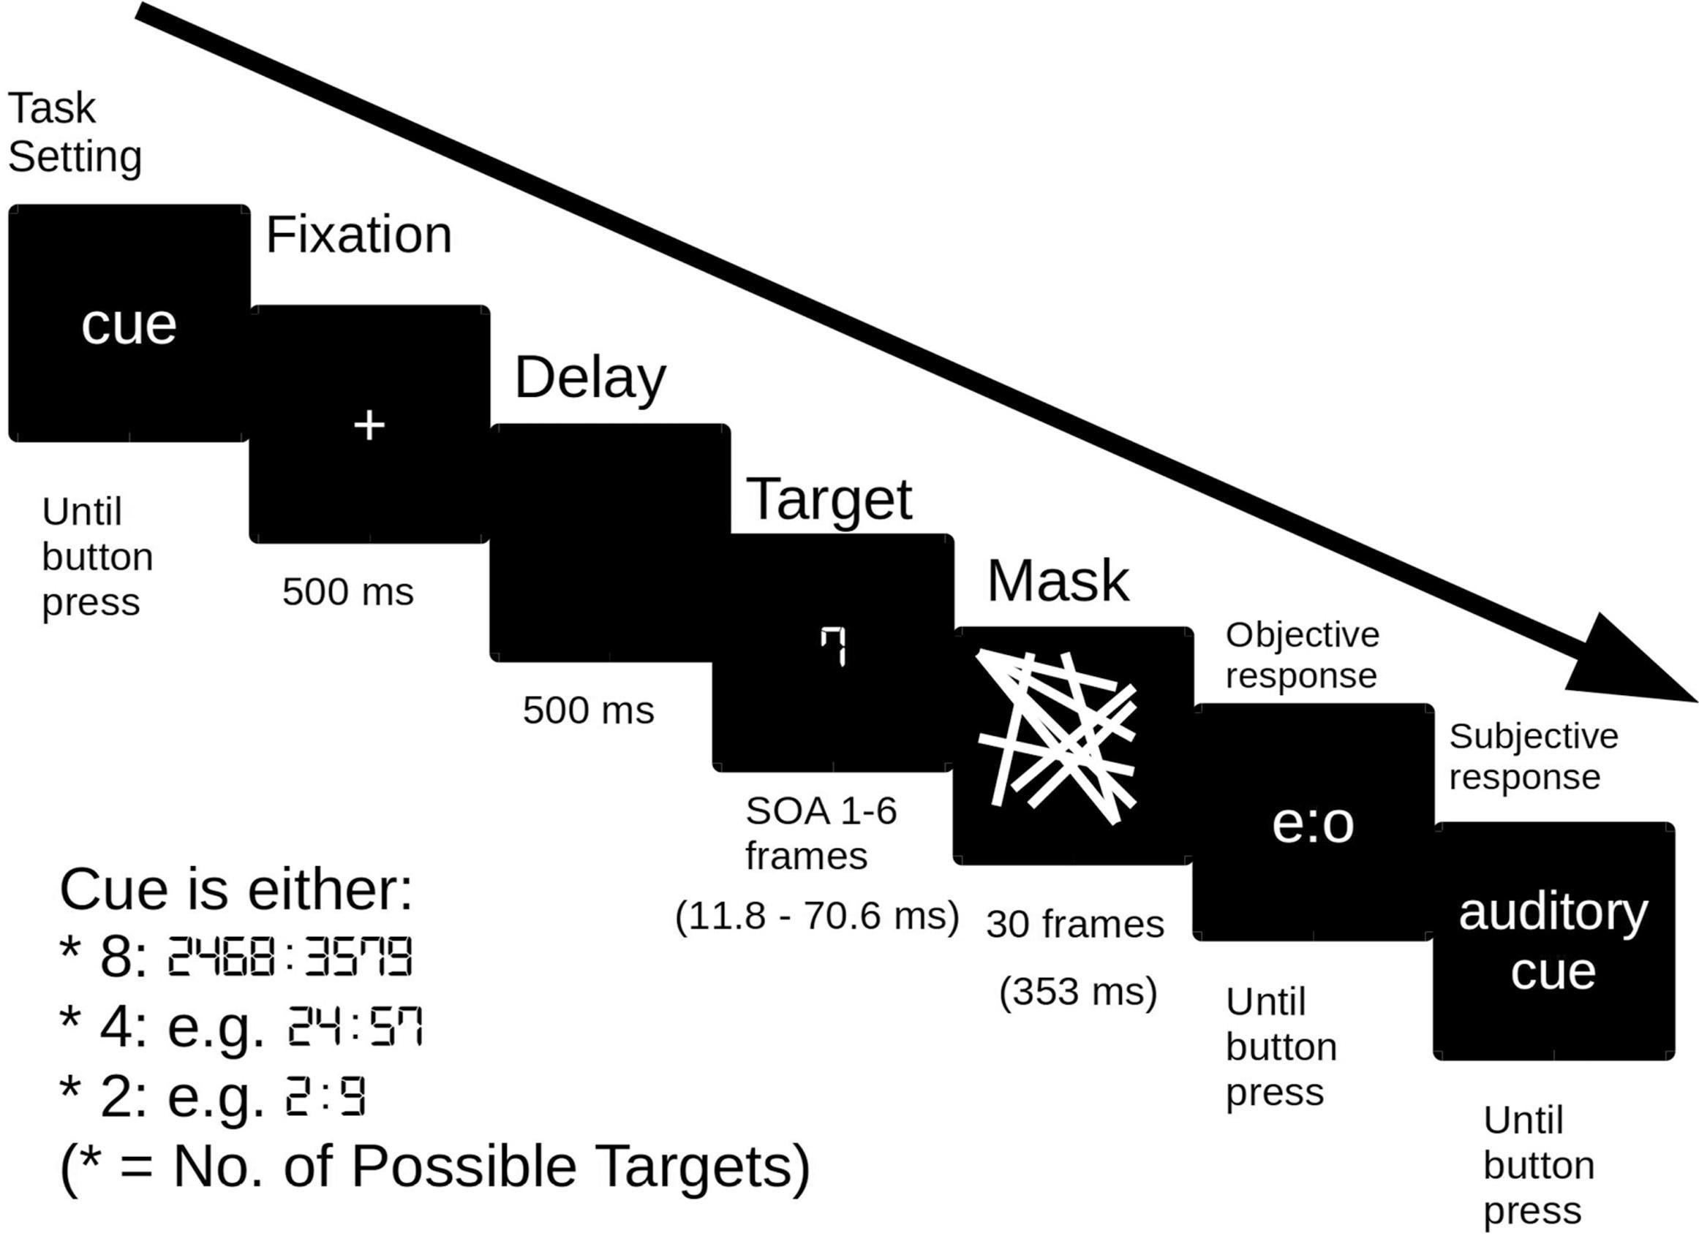
Introduction to experiment
Andersen LM, Overgaard M, Tong F (2019) Visual expectations change subjective experience without changing performance. Consciousness and Cognition 71:59–69. https://doi.org/10.1016/j.concog.2019.03.007

Slide 8
Introduction to experiment
We are looking at experiment 2,
where Stimulus Onset Asynchrony was always 3 frames, i.e. 35.3 ms
Andersen LM, Overgaard M, Tong F (2019) Visual expectations change subjective experience without changing performance. Consciousness and Cognition 71:59–69. https://doi.org/10.1016/j.concog.2019.03.007

Slide 9
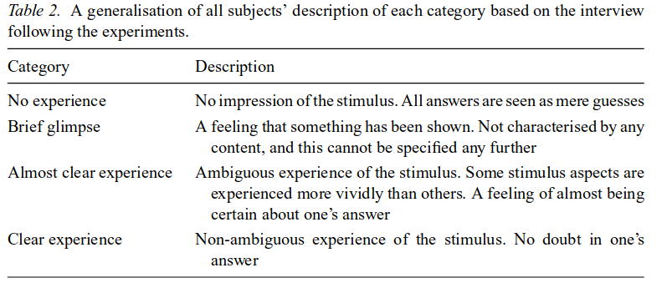
Perceptual Awareness Scale
PAS
1
2
3
4
Ramsøy TZ, Overgaard M (2004) Introspection and subliminal perception. Phenomenology and the Cognitive Sciences 3:1–23. https://doi.org/10.1023/B:PHEN.0000041900.30172.e8

Slide 10
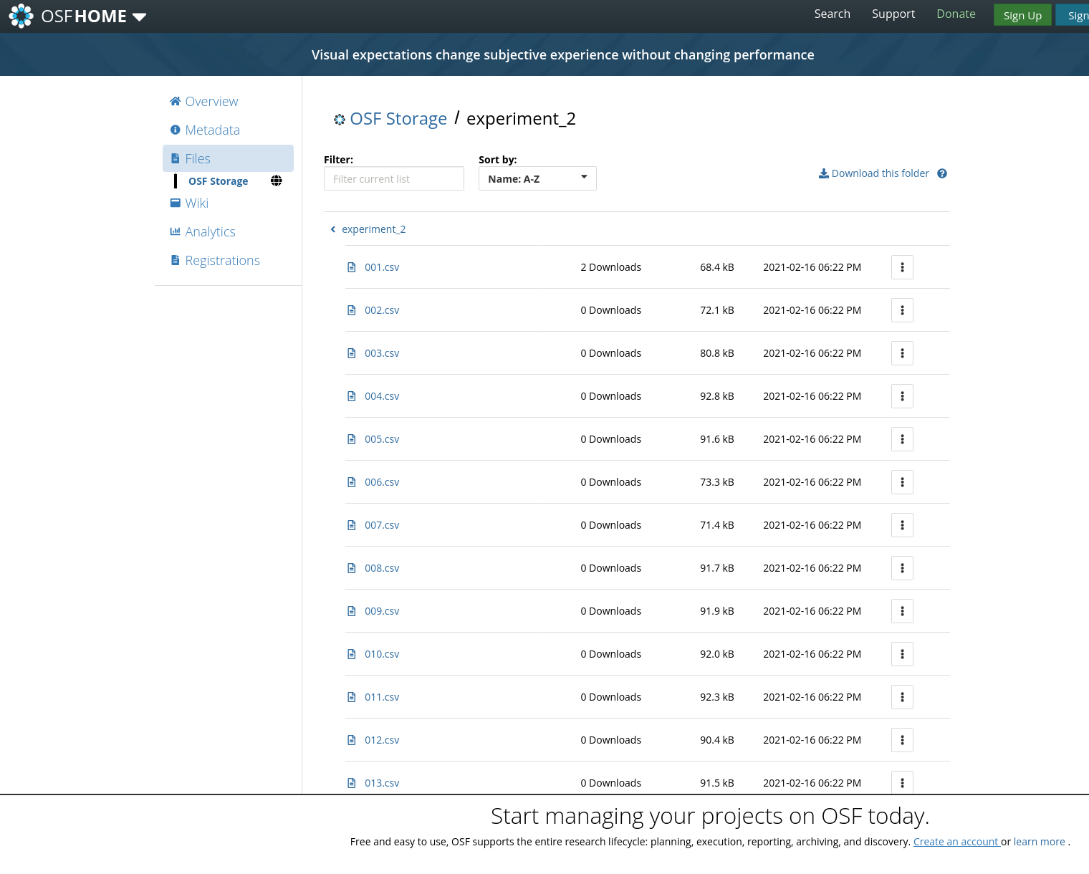
Data – Center for Open Science
https://osf.io/ecxsj/files/

Slide 11
Data contains
Response times
Accuracy
And counts of Perceptual Awareness Scale Ratings

Slide 12
Model comparisons
In part 1, you are asked to do model comparisons – on purpose, I ask you to do this before you have had the lecture on quantitative comparisons
  Model comparisons can also be done without appealing to statistical significance
If you prefer, you may come back to part 1 in your exam and use the quantitative methods you will learn about performing model comparisons, but it is not a requirement

Slide 13
Now let’s get to it!

