Slide 1
Methods 3: Multilevel Statistical Modeling and Machine Learning
Week 04: Evaluating Generalised linear mixed models:
September 24, 2024

Slide 2
The course plan
Week 1: Introduction
Instructor sessions: Setting up R and Python and recollection of the general linear model
Week 2: Multilevel linear regression
Instructor sessions: Modelling subject level effects – and how do they differ from group level effects?
Week 3: Link functions and fitting generalised linear multilevel models
Instructor sessions: What to do when the response variable is not continuous?
Week 4: Evaluating Generalised linear mixed models
Instructor sessions: How do we assess how models compare to one another?
Week 5: Explanation and Prediction
Instructor sessions: Code review
Week 6: Mid-way evaluation and Machine Learning Intro
Instructor sessions: Getting Python Running
Week 7: Linear regression revisited (machine learning)
Instructor sessions: How to constrain our models to make them more predictive
Week 8: Logistic regression revisited (machine learning)
Instructor sessions: Categorizing responses based on informed guesses
Week 9: Dimensionality Reduction, Principled Component Analysis (PCA)
Instructor sessions: What to do with very rich data?
Week 10: Outlook, unsupervised classification and neural networks
Instructor sessions: Data with no labels and networks
Week 11: Organising and preprocessing messy data
Instructor sessions: Code review
Week 12: Final evaluation and wrap-up of course
Instructor sessions: Ask anything!

Slide 3

Recap
Lydia’s question – what about log 0
  it’s the linear predictor, Xβ, that is transformed
0⁰:
  https://en.wikipedia.org/wiki/Zero_to_the_power_of_zero
  “The choice whether to define 0⁰ is based on convenience, not on correctness. If we refrain from defining 0⁰, then certain assertions become unnecessarily awkward. ... The consensus is to use the definition 0⁰ = 1, although there are textbooks that refrain from defining 0⁰ ”
Benson DC (1999) The Moment of Proof: Mathematical Epiphanies. Oxford University Press

Slide 4
Recap – 0⁰ = 1

Slide 5
Recap – generalised modelling
At least four ingredients needed
Gelman A, Hill J (2006) Data Analysis Using Regression and Multilevel/Hierarchical Models. Cambridge University Press: Chapter 6

Slide 6
Learning goals and outline
Evaluating Generalised linear mixed models
Learning tools for comparing models
  Variance explained
  Likelihood ratio tests
  Information criteria
Bridging to out-of-sample
  Introducing regularisation

Slide 7
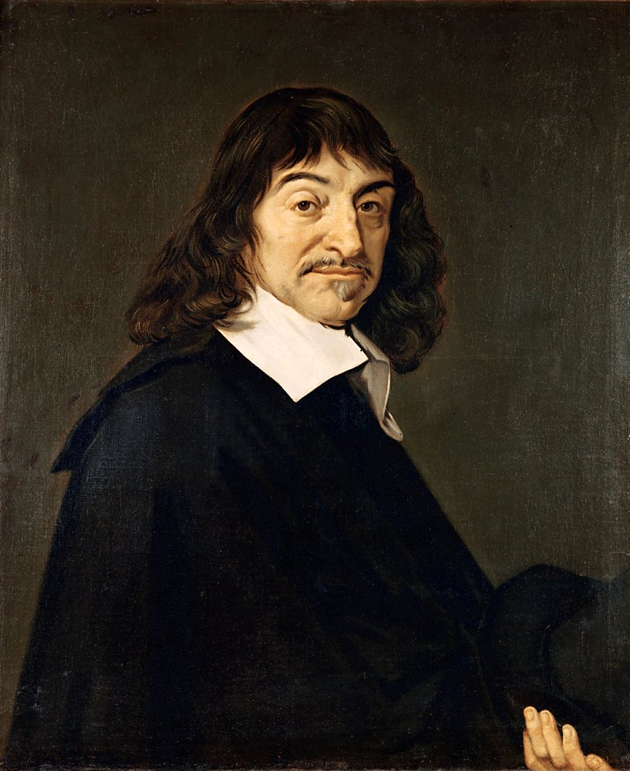
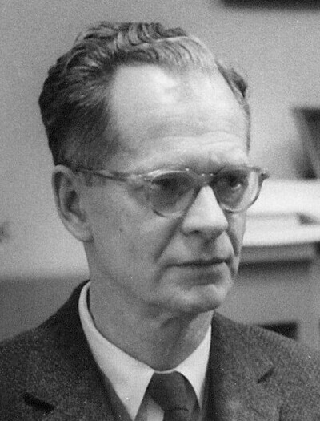
Why are we modelling?
To be able to understand the world
To be able to predict and control the world
By Silly rabbit - self-made (by User:Silly rabbit).
Updated in the Gimp by User:Michaelrayw2.,
CC BY 3.0, https://commons.wikimedia.org/w/index.php?curid=115478248
EXPLANATION
PREDICTION/CONTROL
<nummer>

Slide 8

Why are we modelling?
To be able to understand the world
To be able to predict and control the world
EXPLANATION
PREDICTION /CONTROL

Slide 9
What constitutes a good model?
Accurate estimation of the underlying parameters of the population distribution
Generalisation to new data
EXPLANATION
PREDICTION/CONTROL

Slide 10
Within an explanatory framework, how can we assess whether we have done a good job?

Slide 11
1) Variance explained

Slide 12
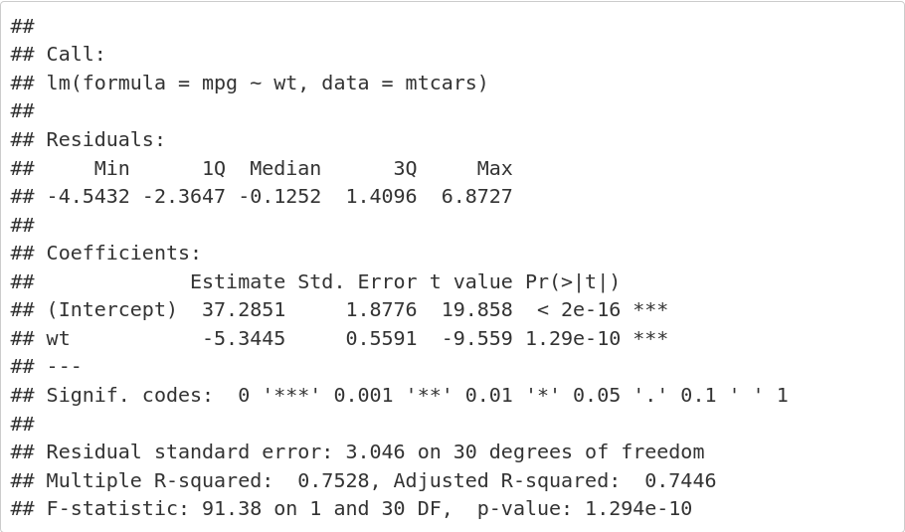
R summary

Slide 13
R² (coefficient of determination)

Slide 14
R²; adjusted

Slide 15
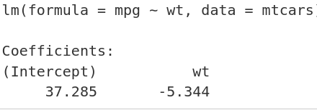
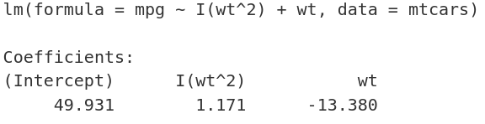


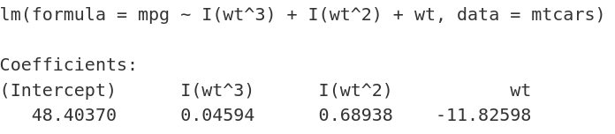
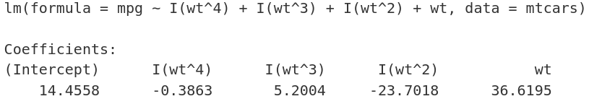



Slide 16
R² – multilevel models
Nakagawa S, Schielzeth H (2013) A general and simple method for obtaining R2 from generalized linear mixed-effects models. Methods in Ecology and Evolution 4:133–142. https://doi.org/10.1111/j.2041-210x.2012.00261.x

Slide 17
R² – multilevel models
Linear mixed model fit by REML ['lmerMod']
Formula: Reaction ~ Days + (1 | Subject)
Data: sleepstudy
REML criterion at convergence: 1786.465
Random effects:
Groups Name Std.Dev.
Subject (Intercept) 37.12
Residual 30.99
Number of obs: 180, groups: Subject, 18
Fixed Effects:
(Intercept) Days
251.41 10.47

Slide 18
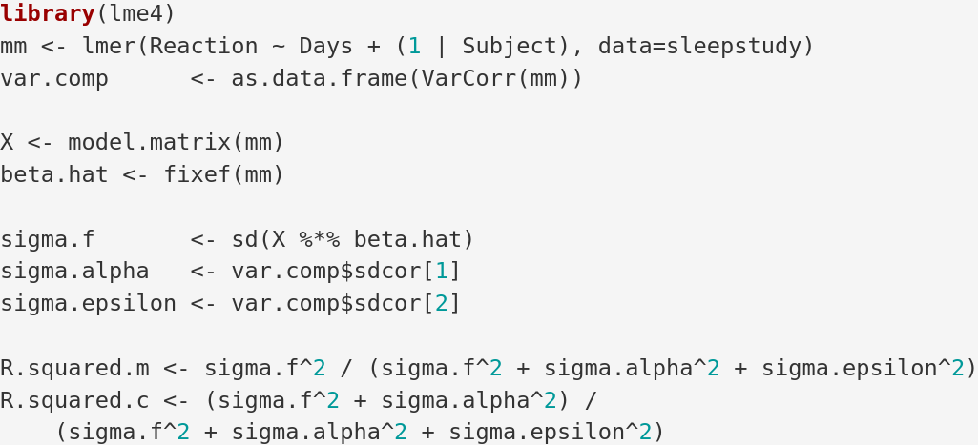
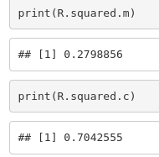

Slide 19
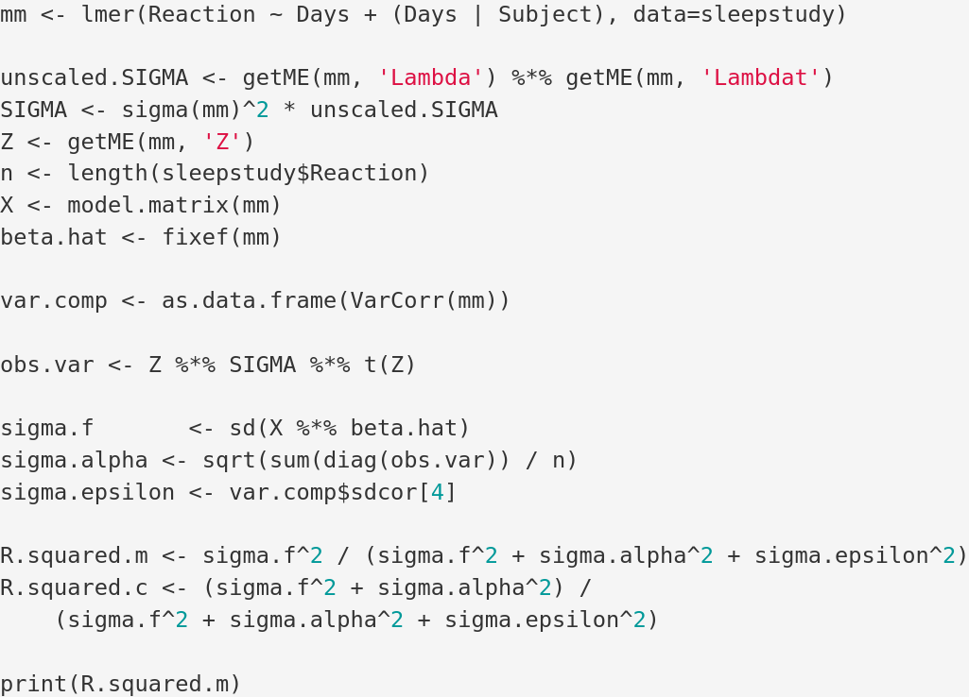
With slopes...
Johnson PCD (2014) Extension of Nakagawa & Schielzeth’s R2GLMM to random slopes models. Methods in Ecology and Evolution 5:944–946. https://doi.org/10.1111/2041-210X.12225

Slide 20
Linear mixed model fit by REML ['lmerMod']
Formula: Reaction ~ Days + (Days | Subject)
Data: sleepstudy
REML criterion at convergence: 1743.628
Random effects:
Groups Name Std.Dev. Corr
Subject (Intercept) 24.741
Days 5.922 0.07
Residual 25.592
Number of obs: 180, groups: Subject, 18
Fixed Effects:
(Intercept) Days
251.41 10.47

Slide 21
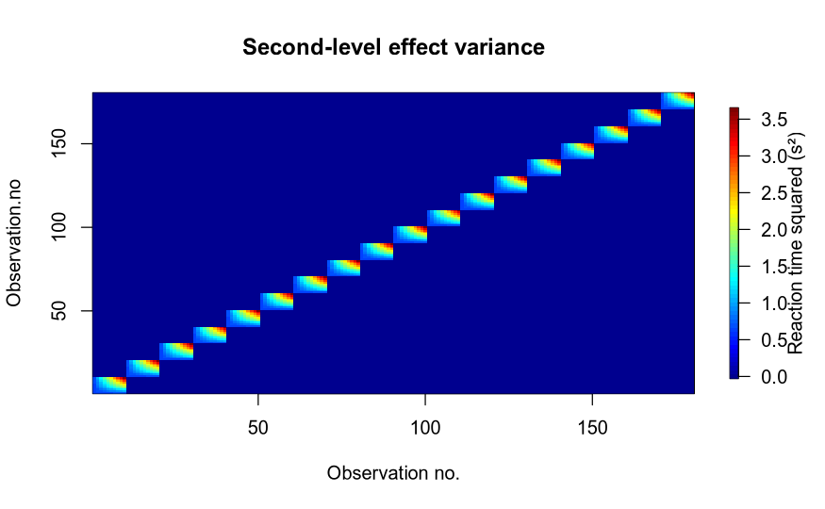
Johnson PCD (2014) Extension of Nakagawa & Schielzeth’s R2GLMM to random slopes models. Methods in Ecology and Evolution 5:944–946. https://doi.org/10.1111/2041-210X.12225

Slide 22
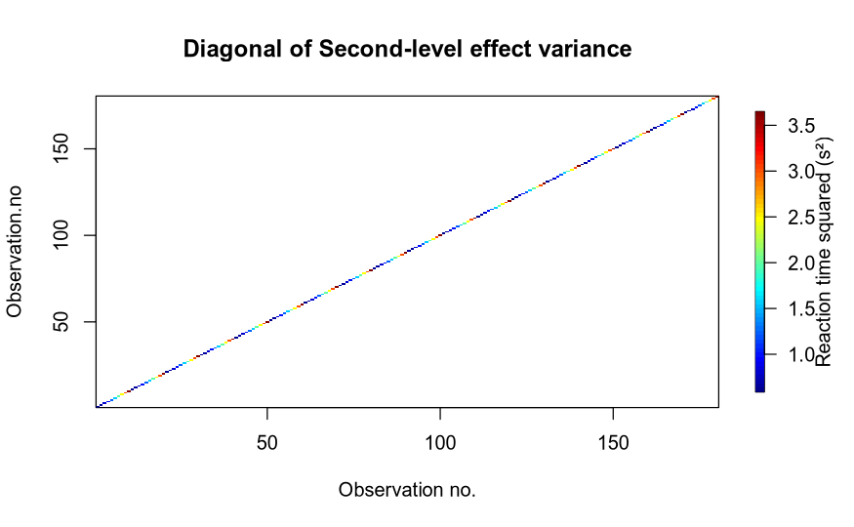
Johnson PCD (2014) Extension of Nakagawa & Schielzeth’s R2GLMM to random slopes models. Methods in Ecology and Evolution 5:944–946. https://doi.org/10.1111/2041-210X.12225

Slide 23
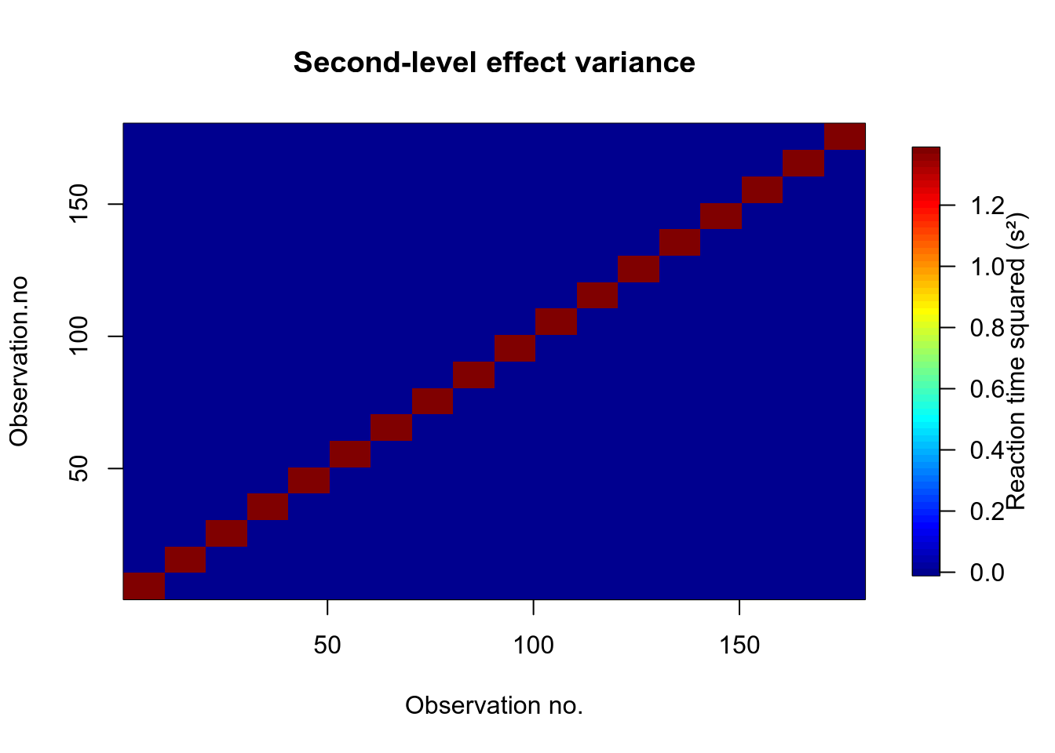
Discuss: what Z is behind this matrix?

Slide 24
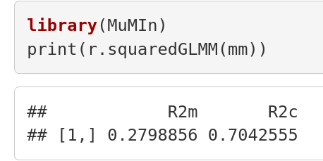
MuMIn
MULTI-MODEL INFERENCE

Slide 25
Variance explained
Pros
  R² is intuitive
Cons
  More complex models will always explain more variance
  Hard to interpret in the case of collinearity
  R² may not give us what we want

Slide 26


Yarkoni T, Westfall J (2017) Choosing Prediction Over Explanation in Psychology: Lessons From Machine Learning. Perspect Psychol Sci 12:1100–1122. https://doi.org/10.1177/1745691617693393
(1)
Correct interpretation:
“if one fits a model with the form of equation 1 in each new sample – each time estimating new values of b₀, b₁, and b₂ – what will be the average proportional reduction in the sum of squared errors?” (Yarkoni and Westfall 2017)
Tempting interpretation: the parameter estimates are likely to be true, because R² is large

Slide 27
2) Likelihood ratios

Slide 28
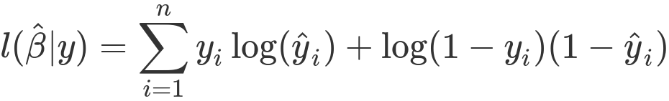
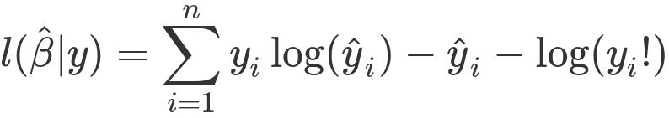
Log-likelihoods

Slide 29
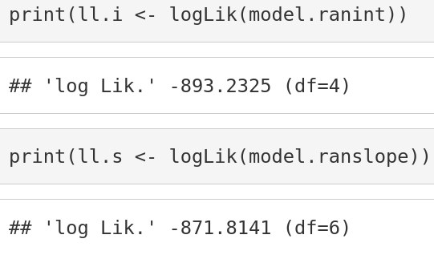
Is the gain in log-likelihood worth the parameters we spend, and why is df increased by 2?

Slide 30
Likelihood-ratio test
refitting model(s) with ML (instead of REML)
Data: sleepstudy
Models:
model.ranint: Reaction ~ Days + (1 | Subject)
model.ranslope: Reaction ~ Days + (Days | Subject)
npar AIC BIC logLik deviance Chisq Df Pr(>Chisq)
model.ranint 4 1802.1 1814.8 -897.04 1794.1
model.ranslope 6 1763.9 1783.1 -875.97 1751.9 42.139 2 7.072e-10 ***
---
Signif. codes: 0 ‘***’ 0.001 ‘**’ 0.01 ‘*’ 0.05 ‘.’ 0.1 ‘ ’ 1

Slide 31
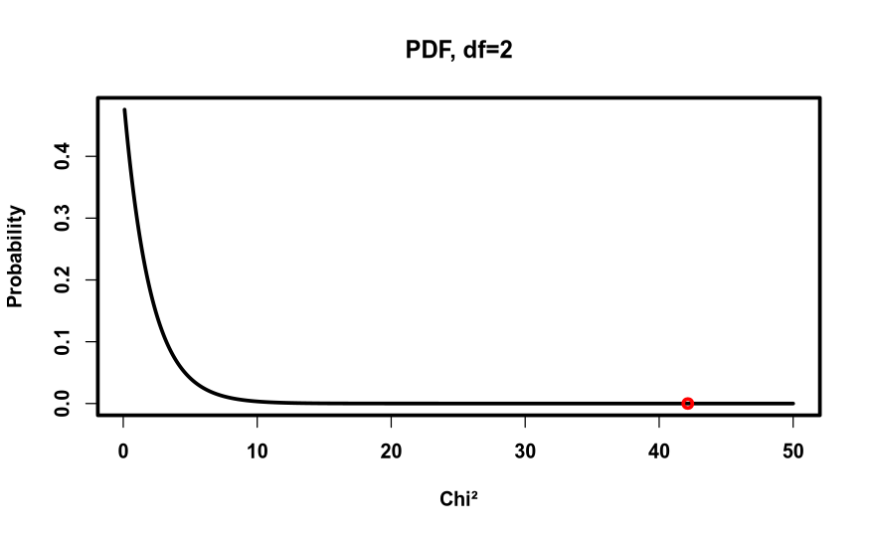
Pr(>Chisq)
7.072e-10

Slide 32
When is it valid?
“The LR test is only adequate for testing fixed effects when both the ratio of the total sample size to the number of fixed-effect levels being tested and the number of random-effect levels (blocks) are large. We have found little guidance and no concrete rules of thumb in the literature [...]” (my highlights, Bolker et al., 2009)
Bolker BM, Brooks ME, Clark CJ, et al (2009) Generalized linear mixed models: a practical guide for ecology and evolution. Trends in Ecology & Evolution 24:127–135. https://doi.org/10.1016/j.tree.2008.10.008

Slide 33
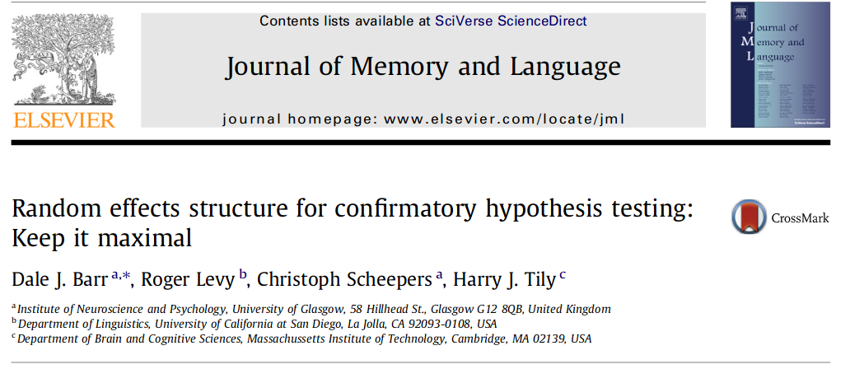

Slide 34
“Through theoretical arguments and Monte Carlo simulation, we show that LMEMs generalize best when they include the maximal random effects structure justified by the design. [...] Maximal LMEMs should be the ‘gold standard’ for confirmatory hypothesis testing in psycholinguistics and beyond. (my highlight)”
Barr DJ, Levy R, Scheepers C, Tily HJ (2013) Random effects structure for confirmatory hypothesis testing: Keep it maximal. Journal of Memory and Language 68:255–278. https://doi.org/10.1016/j.jml.2012.11.001
Discuss: what does this mean?

Slide 35
Likelihood ratio
Pros
  Models can be compared in a principled way by reference to a theoretical distribution, χ². (In the single level case, F can be calculated)
Cons
  Models have to be nested in one another
  Maximum likelihood fitting may be biased for complex models
  Requires large sample sizes
  Be careful if collinearity is high

Slide 36
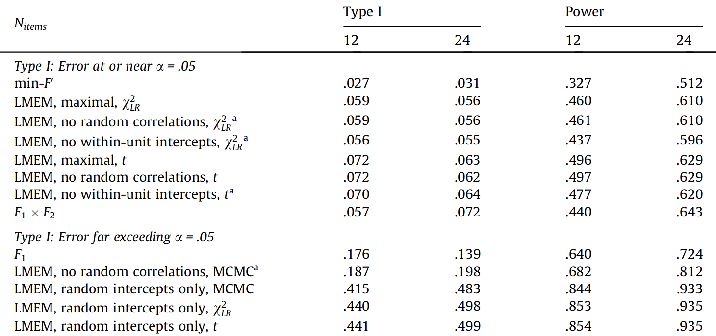
Barr DJ, Levy R, Scheepers C, Tily HJ (2013) Random effects structure for confirmatory hypothesis testing: Keep it maximal. Journal of Memory and Language 68:255–278. https://doi.org/10.1016/j.jml.2012.11.001

Slide 37
3) Information criteria

Slide 38
Information criteria
When we add k predictors that are pure noise, deviance is reduced by an amount corresponding to a χ² distribution with k degrees of freedom.
“On average, a predictor needs to reduce the deviance by 2 to in order to improve the fit to new data”
(Gelman and Hill, 2006)
(Gelman and Hill, 2006, p. 525)

Slide 39
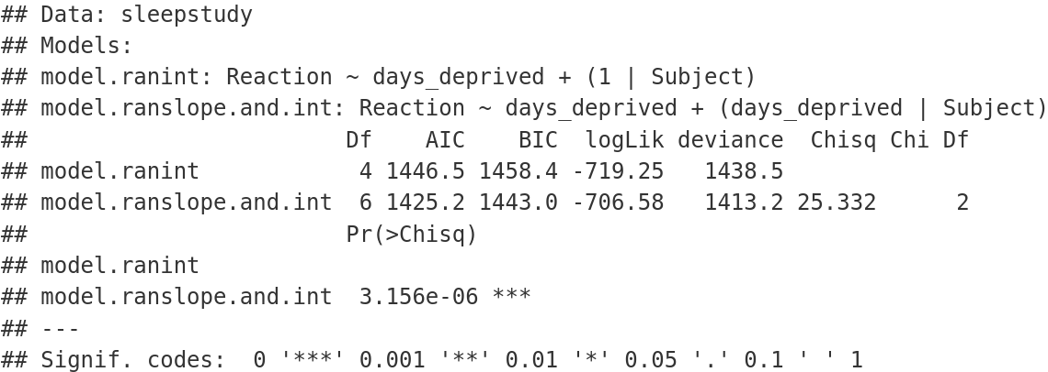

Slide 40
How to estimate k?

Slide 41
With J parameters
Complete pooling
  all J parameters collapsed into 1 parameter, (k = 1)
No pooling
  each of the J parameters is estimated, (k = J)
Partial pooling
  the number of effective parameters may be estimated by sampling and the Deviance Information Criterion can be estimated (beyond this course)
  the number of parameters, loosely speaking, depend on whether the parameters are estimated mostly by the group average or the individual’s own average (k = ?)

Slide 42
Information criteria
Pros
  Models can be compared even though one is not nested within the other (response data has to be the same though)
Cons
  Number of effective parameters not well defined for multilevel models
  Maximum likelihood fitting may be biased for complex models
  Be careful if collinearity is high

Slide 43
Interim summary
Our different ways of comparing models seem to rely on estimating the number of effective parameters, on which there is no clear consensus
Collinearity is a problem for all methods we have covered
  Collinearity leads to unstable models
    What can we do about it?

Slide 44
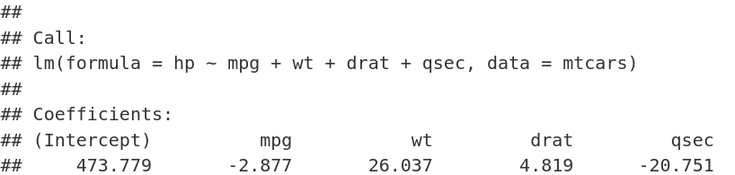
Collinearity
Assuming no collinearity, what is the interpretation of the coefficients?
With collinearity, is that interpretation possible?

Slide 45
Stability of a model:
Feeding new data or adding new predictor variables will not change the parameter estimates a lot
Seems to be a good ingredient for a model that generalises well

Slide 46
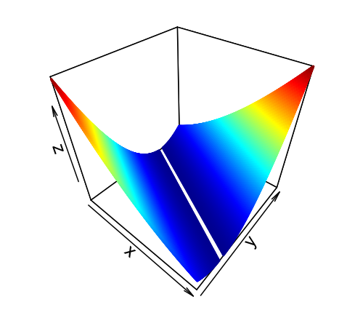
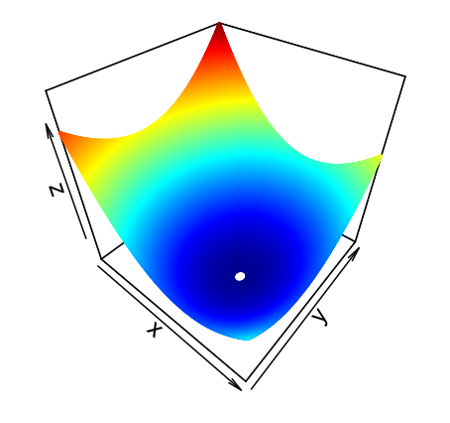
Stability of a model
Here you see the gradient descent profiles for two models.
Which of these models is the most stable?

Slide 47
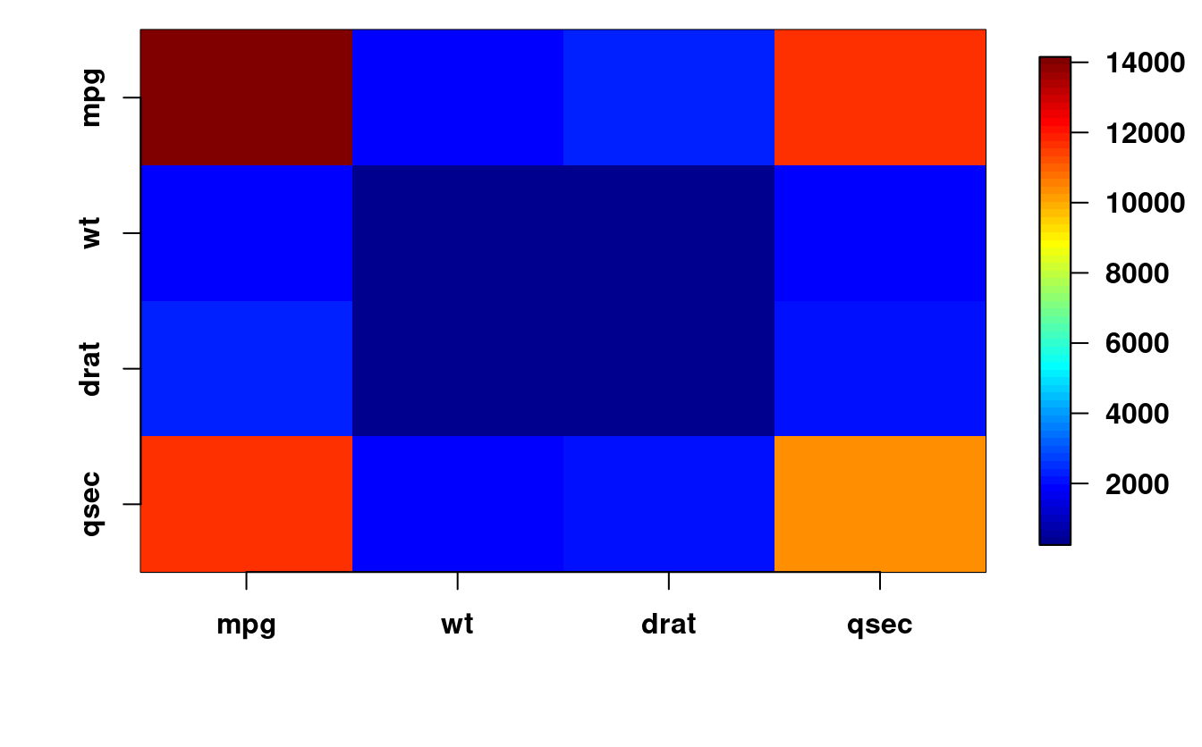
The fact that the off-diagonal > 0, indicates that there is collinearity

Slide 48
How can we make a model stable?

Slide 49
Regularisation

Slide 51
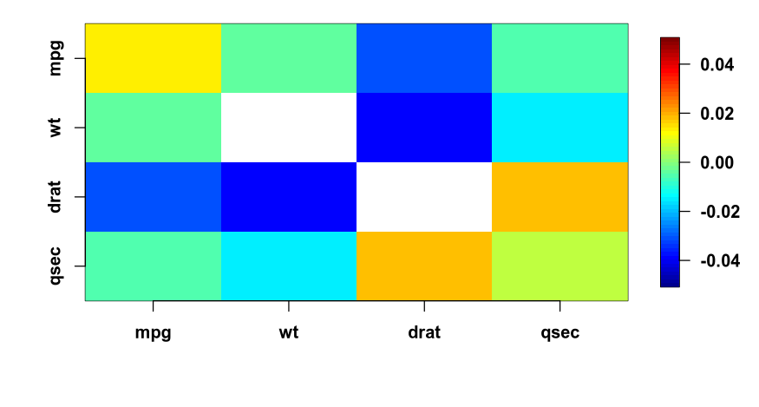

Slide 52
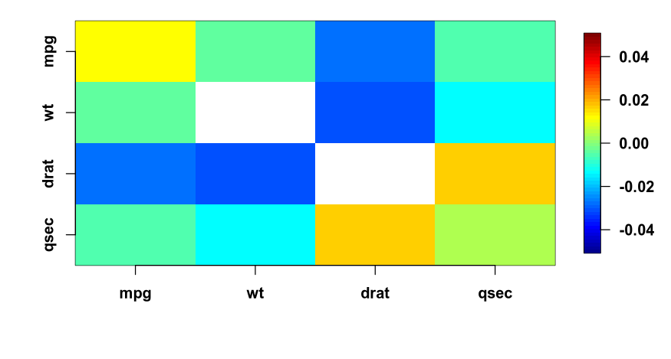

Slide 53
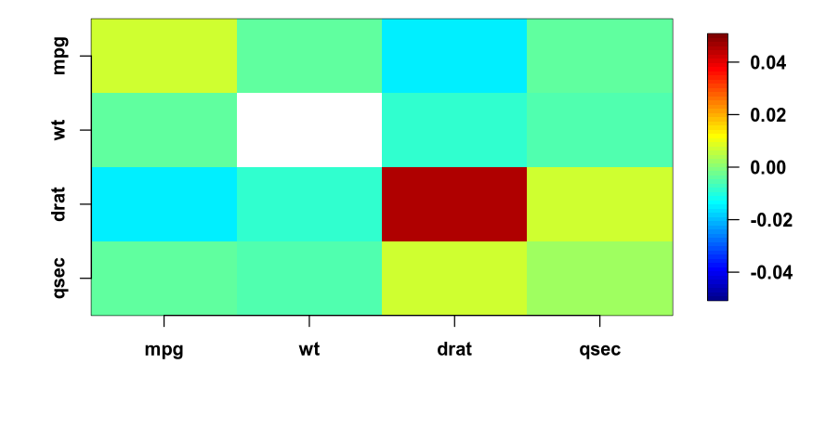

Slide 54
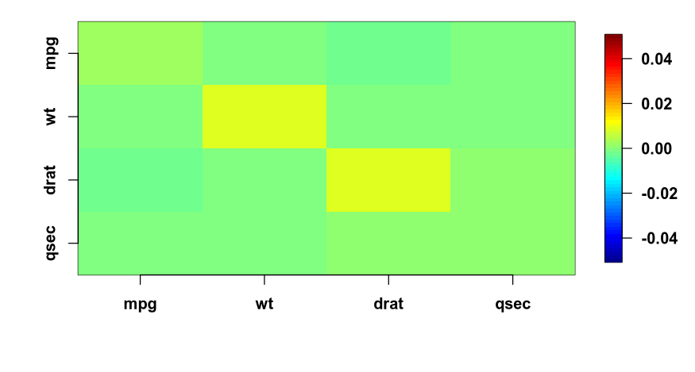

Slide 55
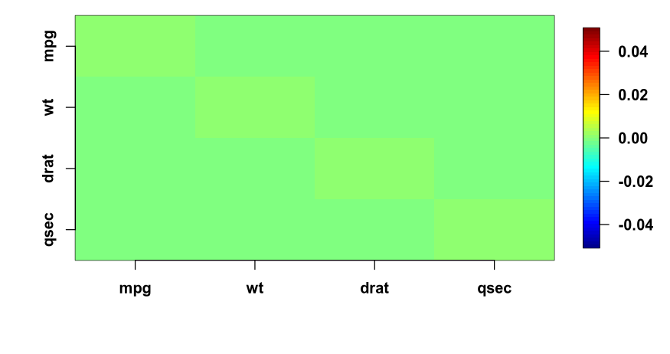

Slide 56
Regularisation decreases collinearity, but at what price?
I.e. what increases instead?
Notes:
By introducing bias

Slide 57
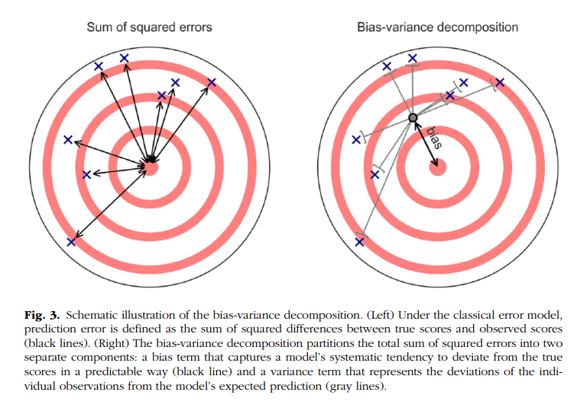
(Yarkoni and Westfall, 2017)
<nummer>
CC BY Licence 4.0: Lau Møller Andersen

Slide 58
Summary
R², AIC and log-likelihood tests can all be adapted to multilevel models
  However, some debate exists around what are the number of effective parameters
  And none of them handle collinearity explicitly
Regularisation gives a handle on collinearity
  at the cost of introducing bias

Slide 59
Learning goals and outline
Evaluating Generalised linear mixed models
Learning tools for comparing models
  Variance explained
  Likelihood ratio tests
  Information criteria
Bridging to out-of-sample
  Introducing regularisation

Slide 60
The course plan
Week 1: Introduction
Instructor sessions: Setting up R and Python and recollection of the general linear model
Week 2: Multilevel linear regression
Instructor sessions: Modelling subject level effects – and how do they differ from group level effects?
Week 3: Link functions and fitting generalised linear multilevel models
Instructor sessions: What to do when the response variable is not continuous?
Week 4: Evaluating Generalised linear mixed models
Instructor sessions: How do we assess how models compare to one another?
Week 5: Explanation and Prediction
Instructor sessions: Code review
Week 6: Mid-way evaluation and Machine Learning Intro
Instructor sessions: Getting Python Running
Week 7: Linear regression revisited (machine learning)
Instructor sessions: How to constrain our models to make them more predictive
Week 8: Logistic regression revisited (machine learning)
Instructor sessions: Categorizing responses based on informed guesses
Week 9: Dimensionality Reduction, Principled Component Analysis (PCA)
Instructor sessions: What to do with very rich data?
Week 10: Outlook, unsupervised classification and neural networks
Instructor sessions: Data with no labels and networks
Week 11: Organising and preprocessing messy data
Instructor sessions: Code review
Week 12: Final evaluation and wrap-up of course
Instructor sessions: Ask anything!

Slide 61
Next time
Penalised regression
  Ridge and lasso regression
Doing out-of-sample testing
  Finding optimal lambda
Bias variance decomposition
  Increasing one, reduces the other

Slide 62
Reading questions
Yarkoni and Westfall
  What is overfitting?
  What are training and test errors?
  How is p-hacking and overfitting related?
  How may big data guard against overfitting?
Breimann
  What are the Data and Algorithmic Modeling Cultures?
  What is the Rashomon effect?
  What is the Occam dilemma?

