Slide 1
Methods 3: Multilevel Statistical Modeling and Machine Learning
Week 05: Explanation and Prediction
October 2, 2024

Slide 2
The course plan
Week 1: Introduction
Instructor sessions: Setting up R and Python and recollection of the general linear model
Week 2: Multilevel linear regression
Instructor sessions: Modelling subject level effects – and how do they differ from group level effects?
Week 3: Link functions and fitting generalised linear multilevel models
Instructor sessions: What to do when the response variable is not continuous?
Week 4: Evaluating Generalised linear mixed models
Instructor sessions: How do we assess how models compare to one another?
Week 5: Explanation and Prediction
Instructor sessions: Code review
Week 6: Mid-way evaluation and Machine Learning Intro
Instructor sessions: Getting Python Running
Week 7: Linear regression revisited (machine learning)
Instructor sessions: How to constrain our models to make them more predictive
Week 8: Logistic regression revisited (machine learning)
Instructor sessions: Categorizing responses based on informed guesses
Week 9: Dimensionality Reduction, Principled Component Analysis (PCA)
Instructor sessions: What to do with very rich data?
Week 10: Outlook, unsupervised classification and neural networks
Instructor sessions: Data with no labels and networks
Week 11: Organising and preprocessing messy data
Instructor sessions: Code review
Week 12: Final evaluation and wrap-up of course
Instructor sessions: Ask anything!

Slide 3
Recap
Our ways of evaluating models using an explanatory framework are limited when
  we have no good way of estimating effective parameters
  we have high degrees of collinearity
  we have small sample sizes
    the latter two can lead to unstable models
Regularisation can improve the stability of a model
  which comes at the cost of adding bias to the model

Slide 4
Learning goals and outline
Explanation and prediction
Understanding how error can be decomposed into bias and variance
Understanding when penalised regression may be helpful
Understanding how models can be evaluated by out-of-sample testing

Slide 5
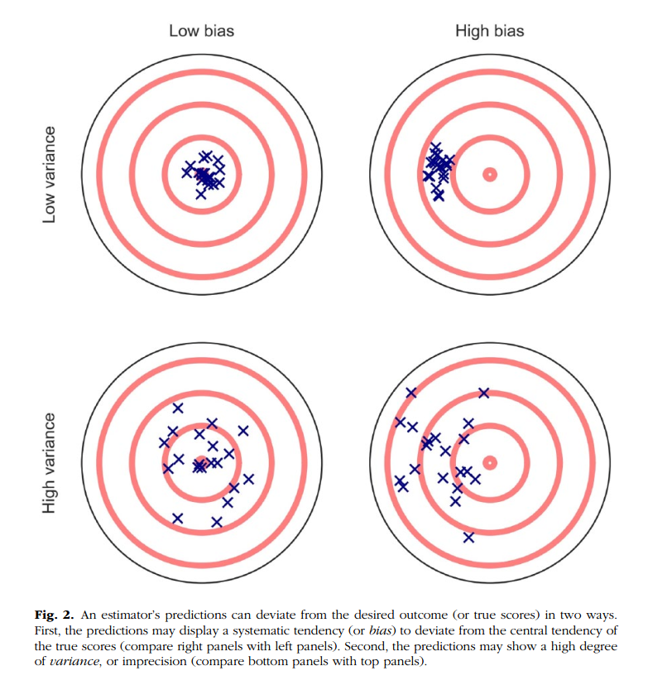
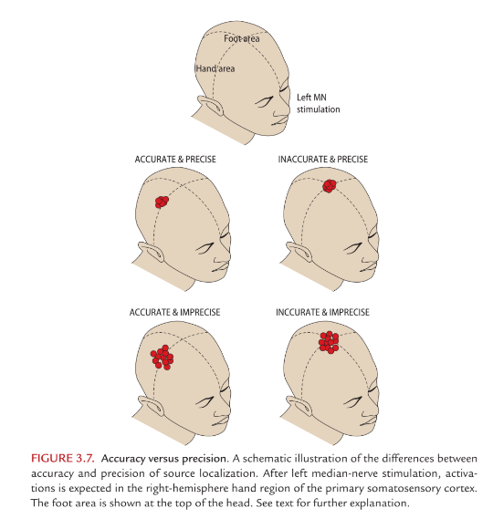
Hari R, Puce A (2017) MEG-EEG Primer. Oxford University Press, New York, NY, US
Yarkoni T, Westfall J (2017) Choosing Prediction Over Explanation in Psychology: Lessons From Machine Learning. Perspect Psychol Sci 12:1100–1122. https://doi.org/10.1177/1745691617693393

Slide 6
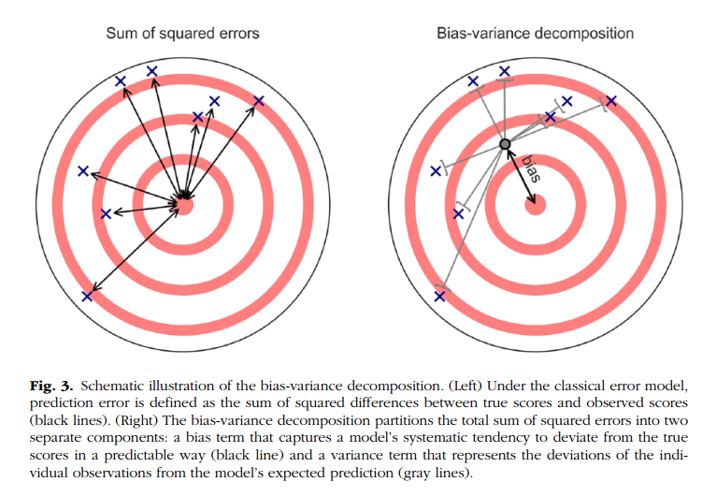
Yarkoni T, Westfall J (2017) Choosing Prediction Over Explanation in Psychology: Lessons From Machine Learning. Perspect Psychol Sci 12:1100–1122. https://doi.org/10.1177/1745691617693393

Slide 7
Bias-variance decomposition

Slide 8
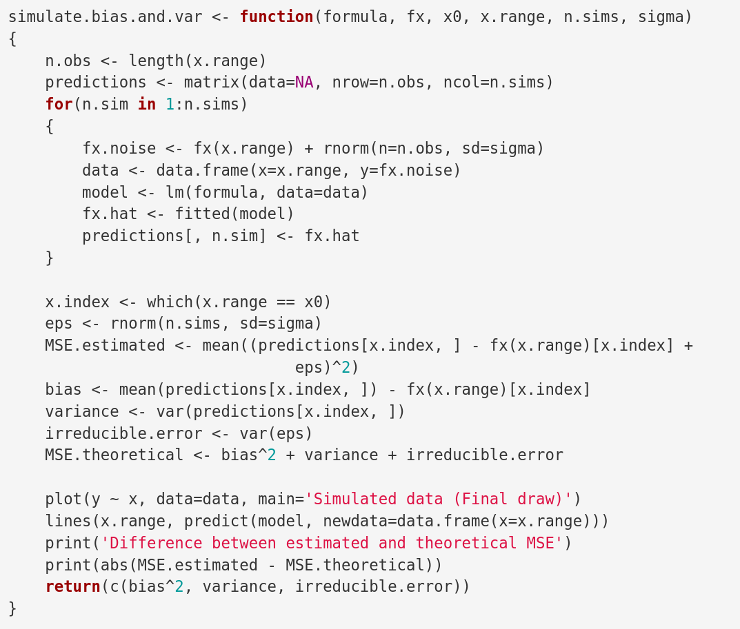

Slide 9
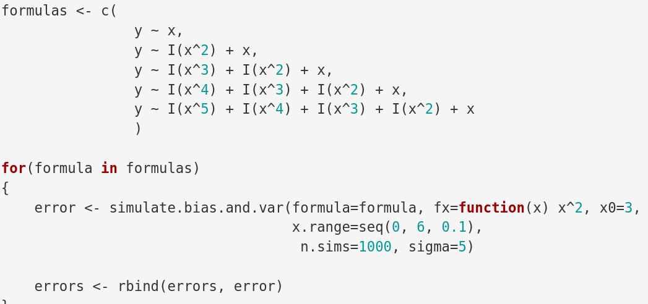

Slide 10
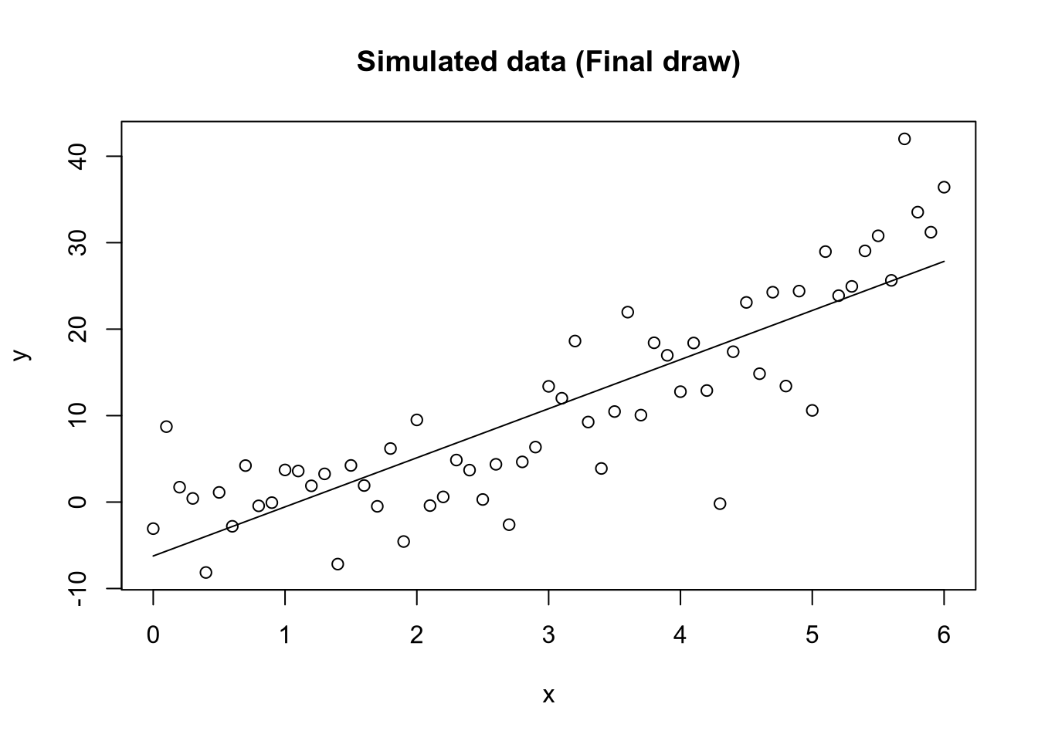
y ~ x

Slide 11
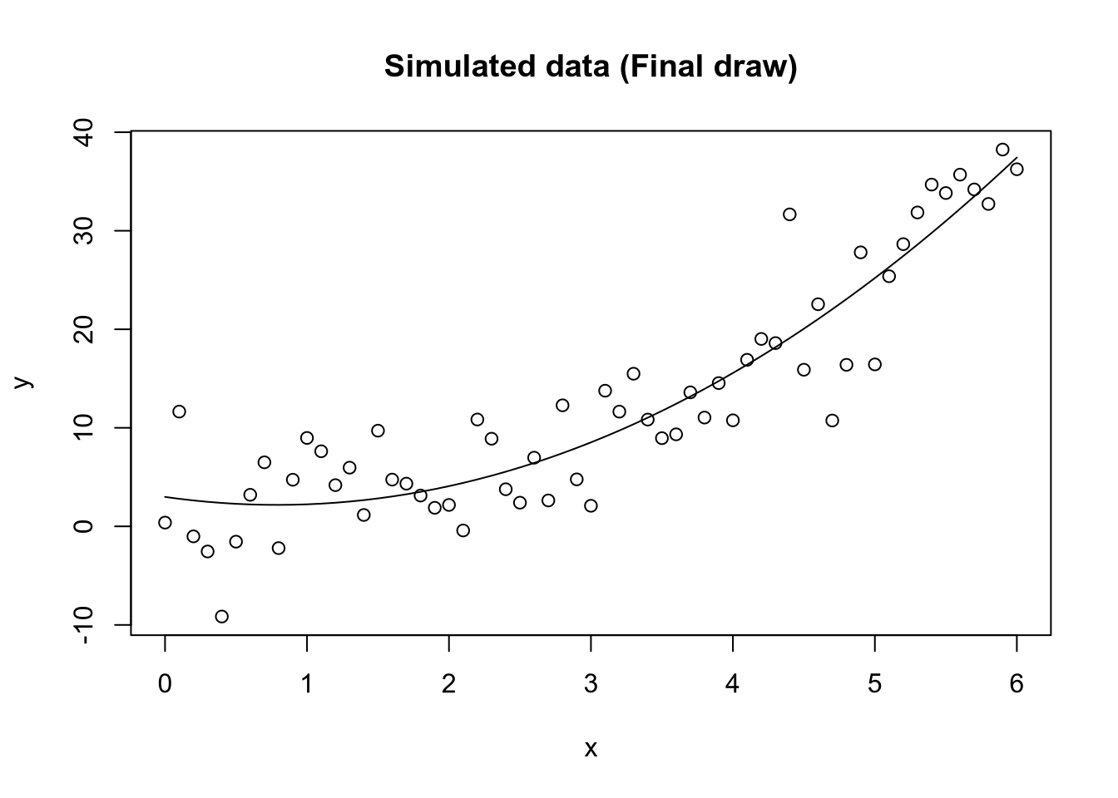
y ~ x² + x

Slide 12
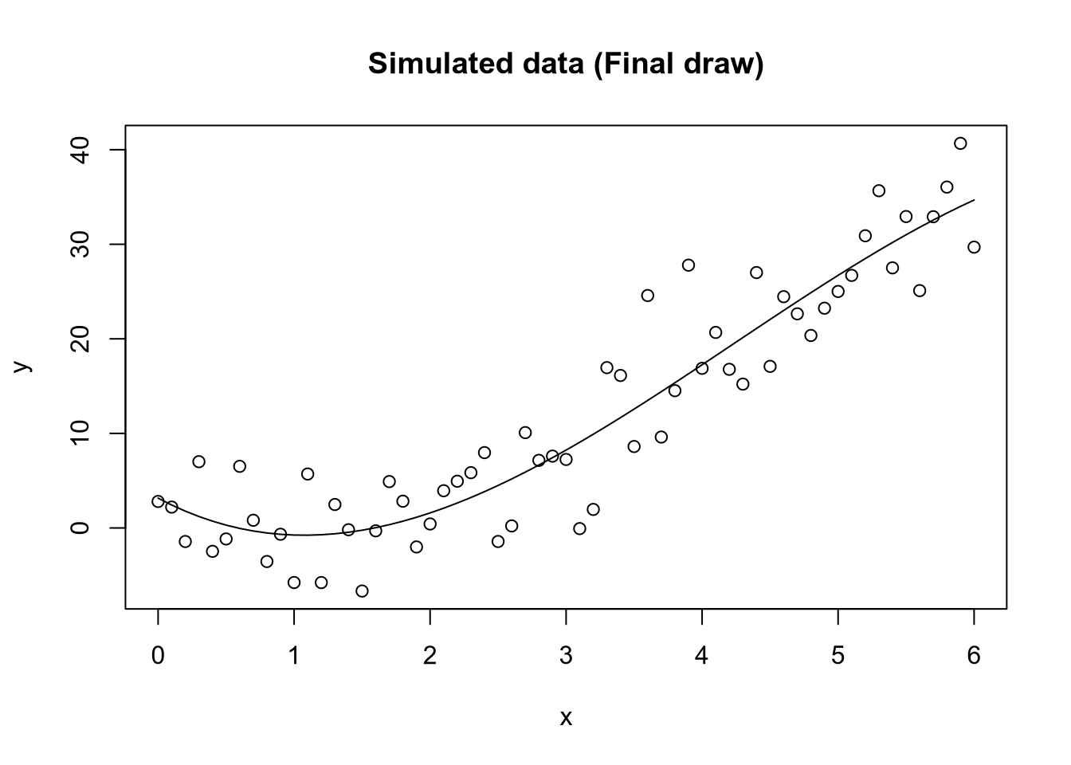
y ~ x³ + x² + x

Slide 13
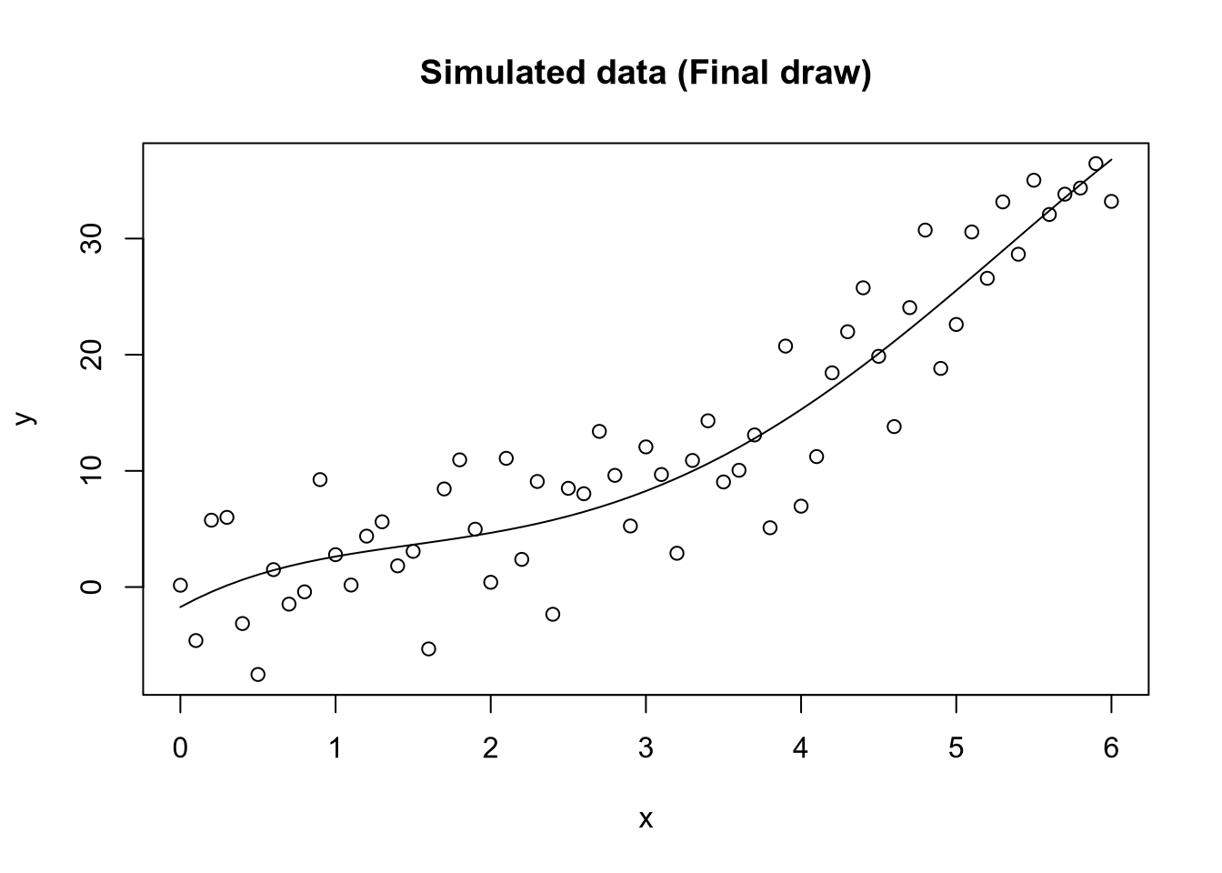
y ~ x⁴ + x³ + x² + x

Slide 14
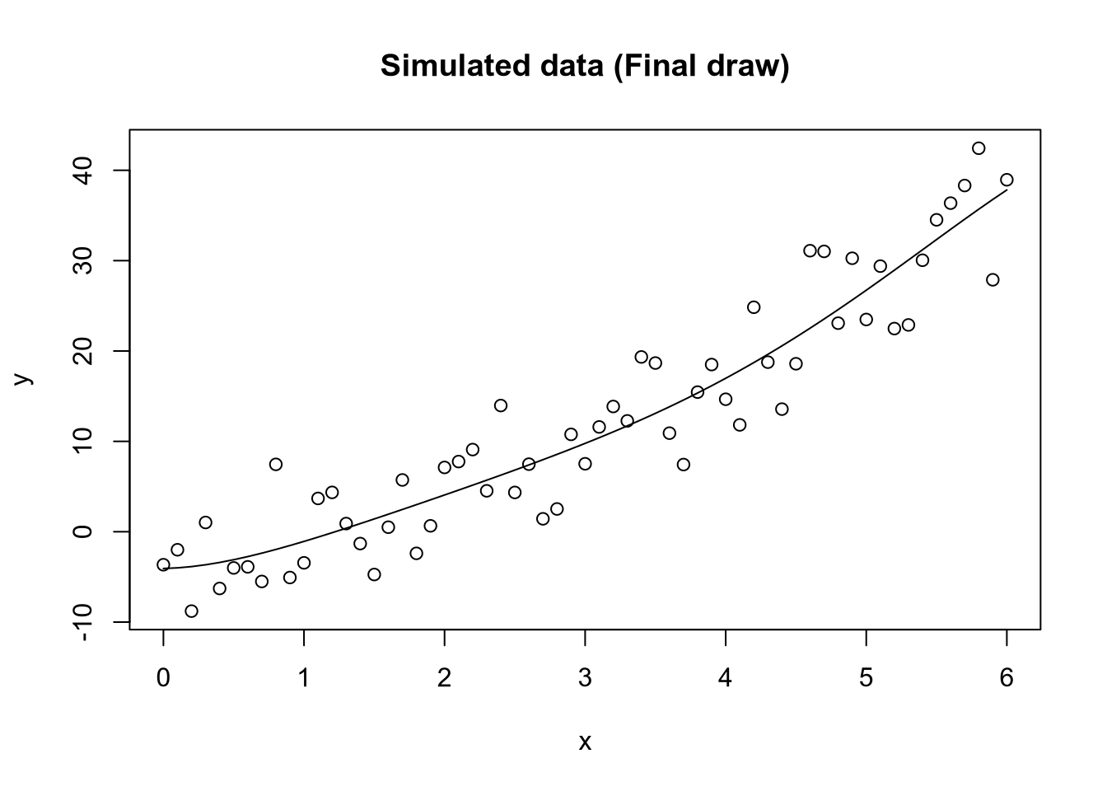
y ~ x⁵ + x⁴ + x³ + x² + x

Slide 15
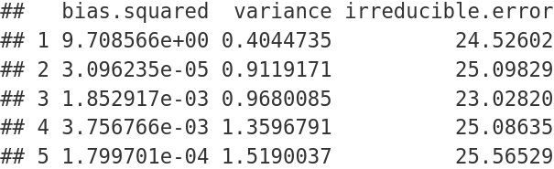
x0 = 3
y ~ x
y ~ x² ...
y ~ x³ ...
y ~ x⁴ ...
y ~ x⁵ ...

Slide 16
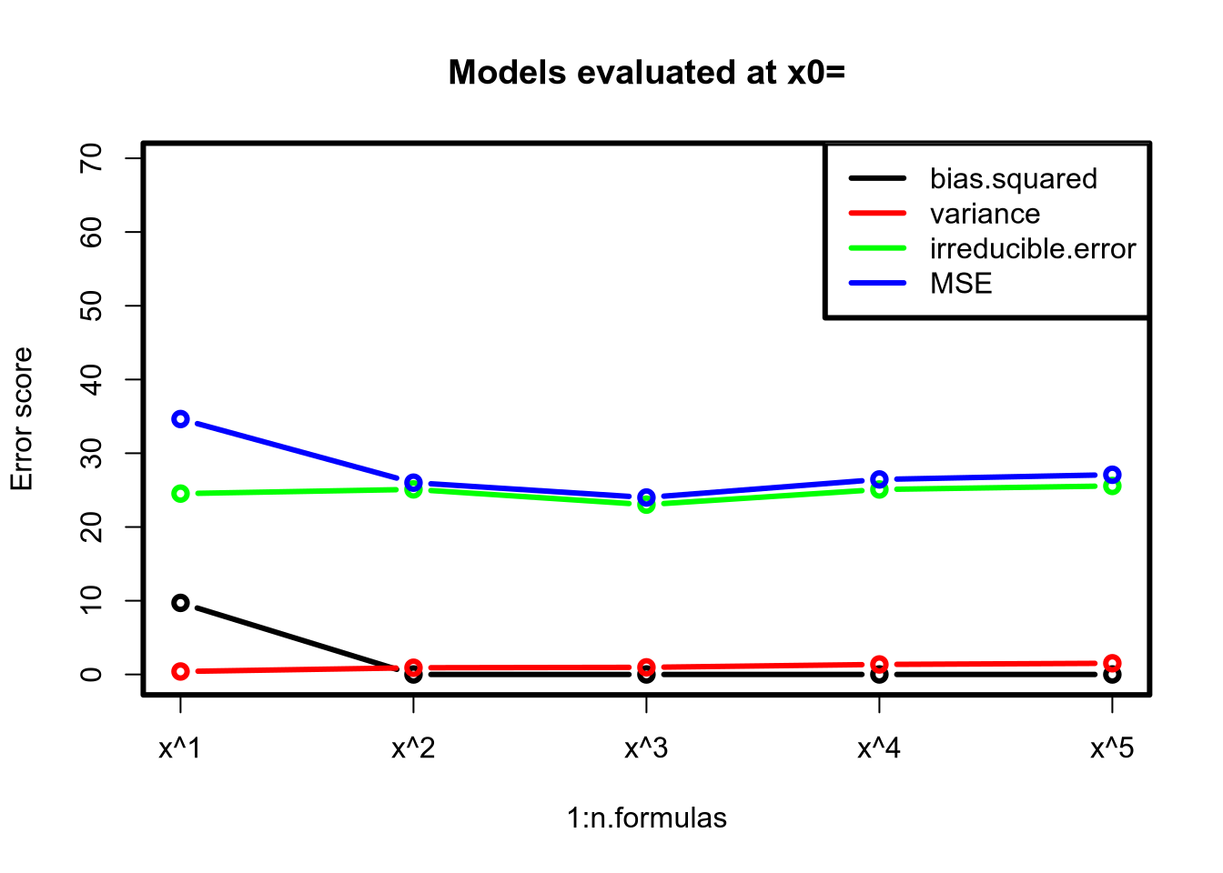
3

Slide 17
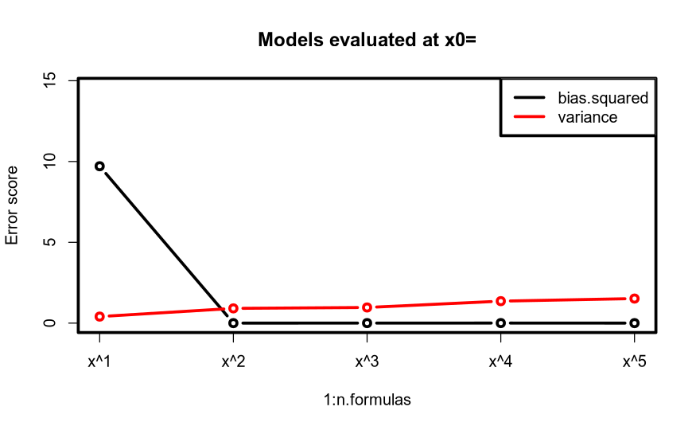
3

Slide 18
Discussion points:
What happens to variance when x0 is increased? (say to 6)
What happens to variance when x0 is decreased? (say to 1)

Slide 19
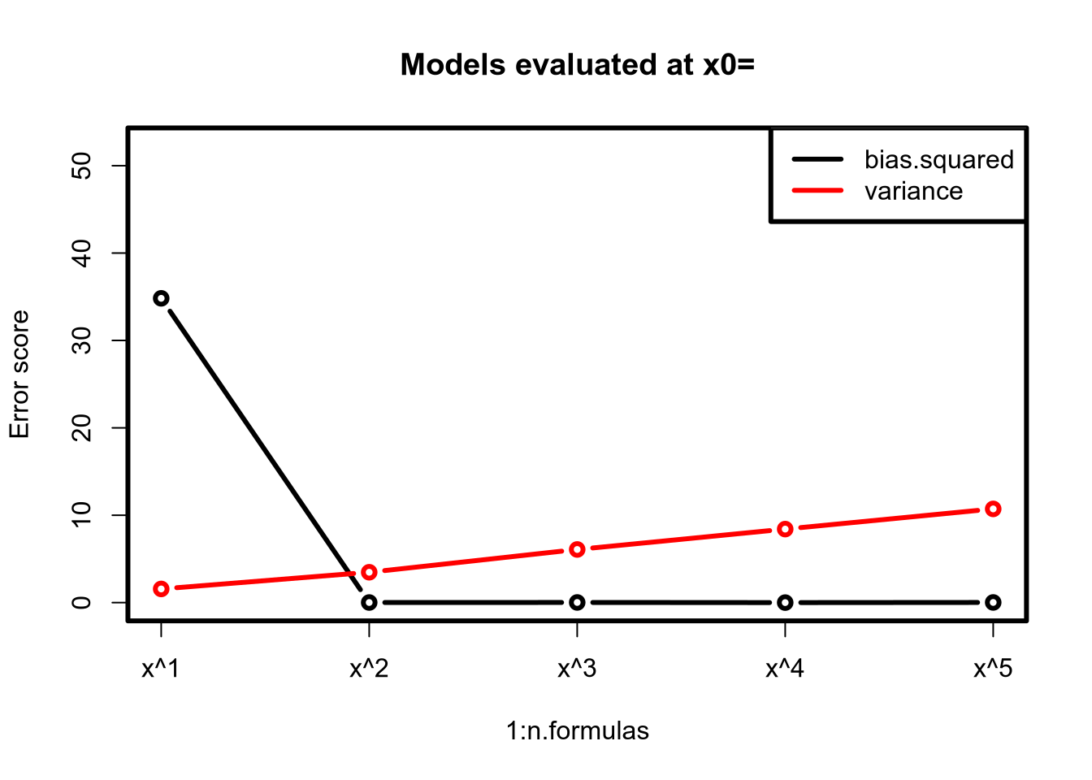
6

Slide 20
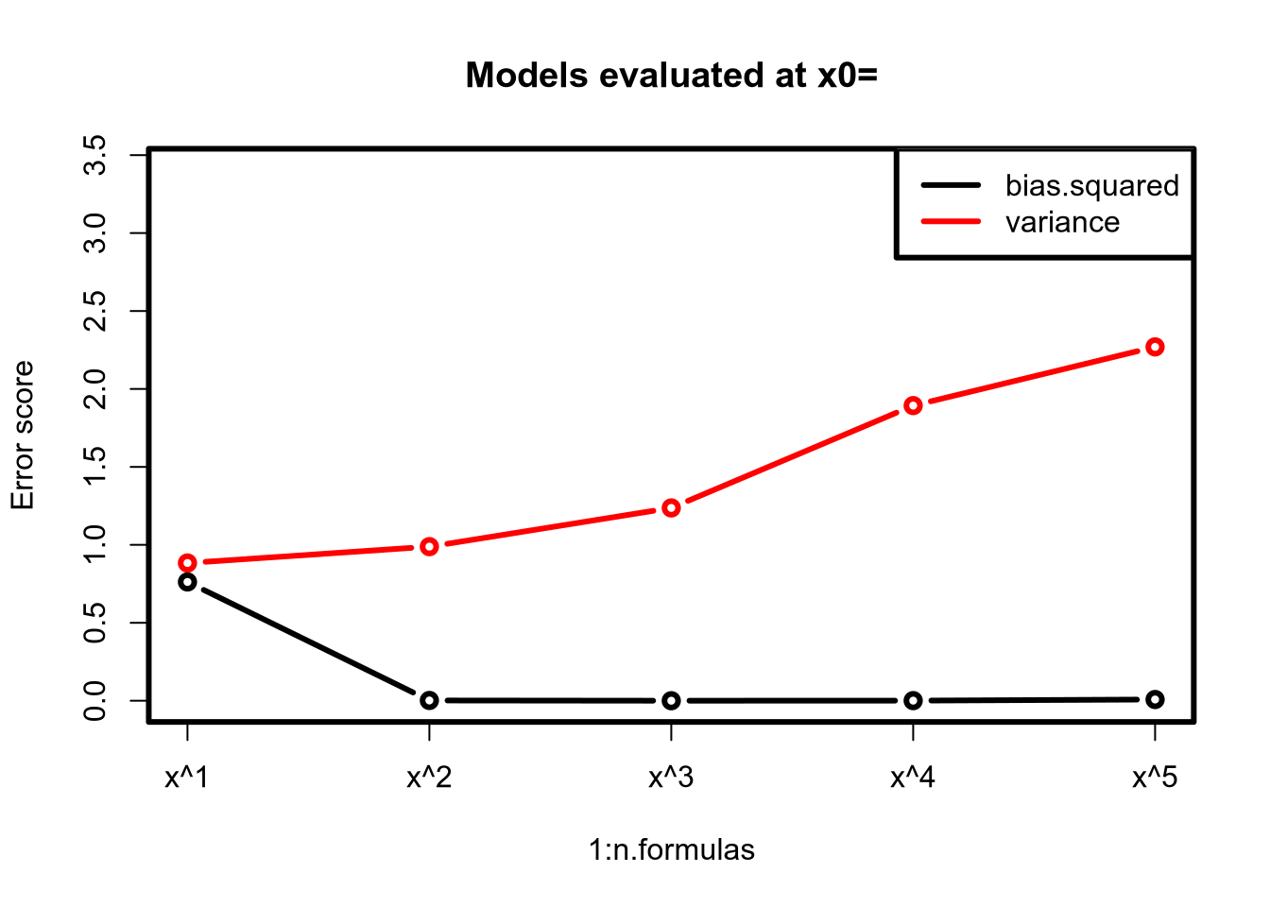
1

Slide 21
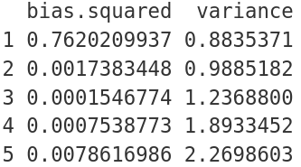
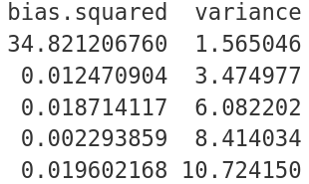
x0 = 1
x0 = 3
x0 = 6

Slide 22
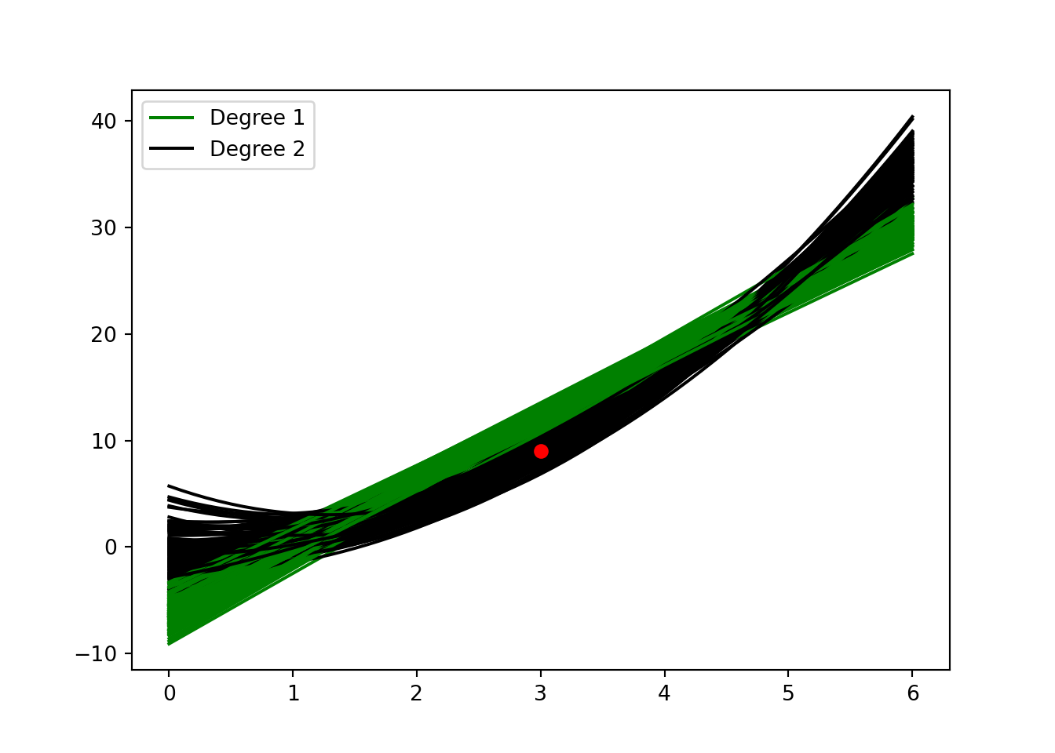
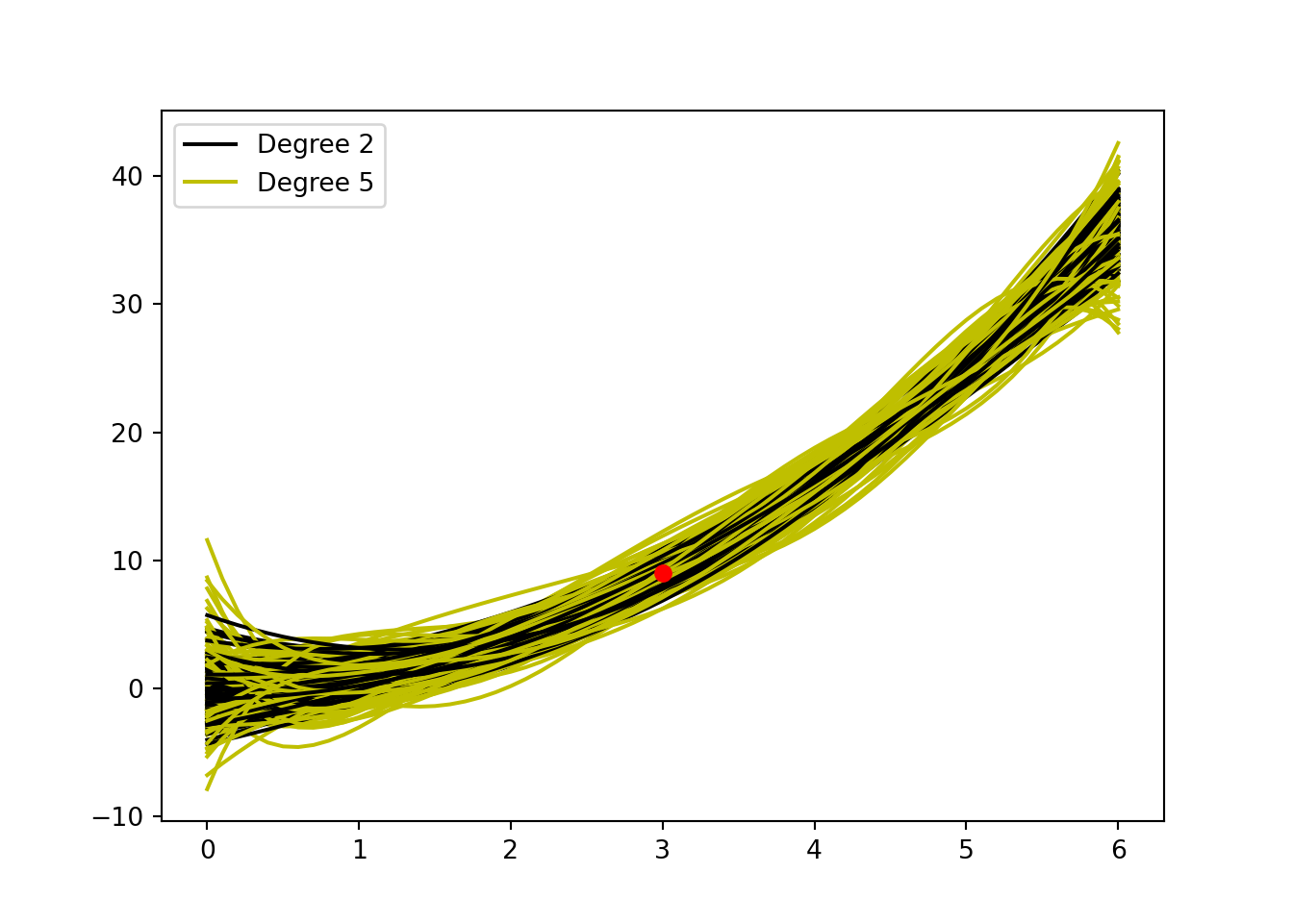
Simulations for polynomials of degree 1, 2 and 5 at x0 = 3

Slide 23
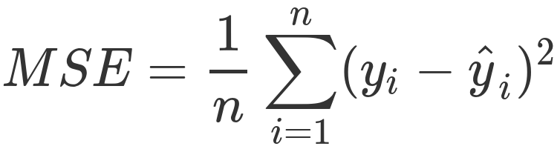
OUT OF SAMPLE TESTING
as a way of evaluating models
Using mean squared error as a measure of predictive power

Slide 24
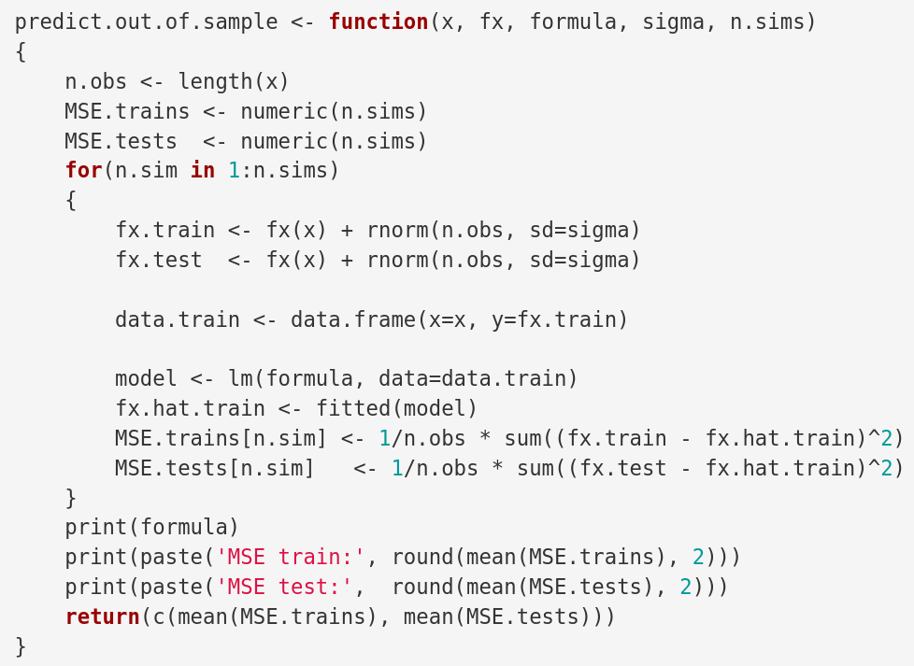

Slide 25
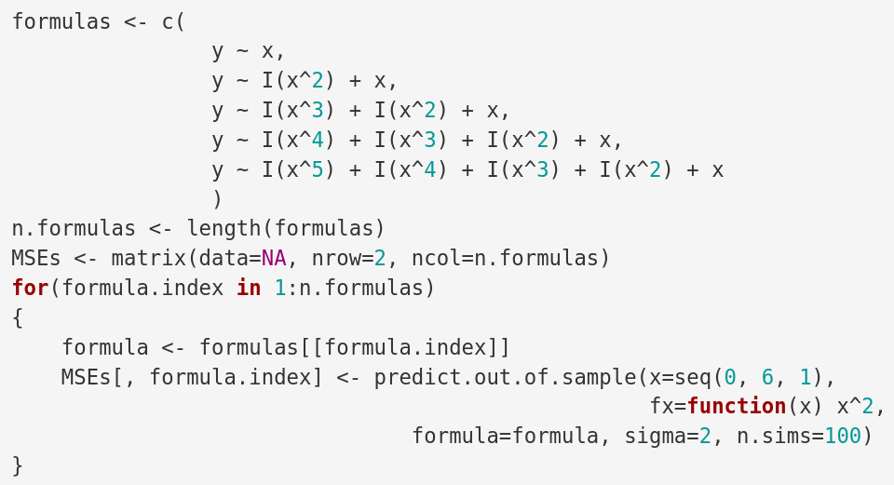

Slide 26
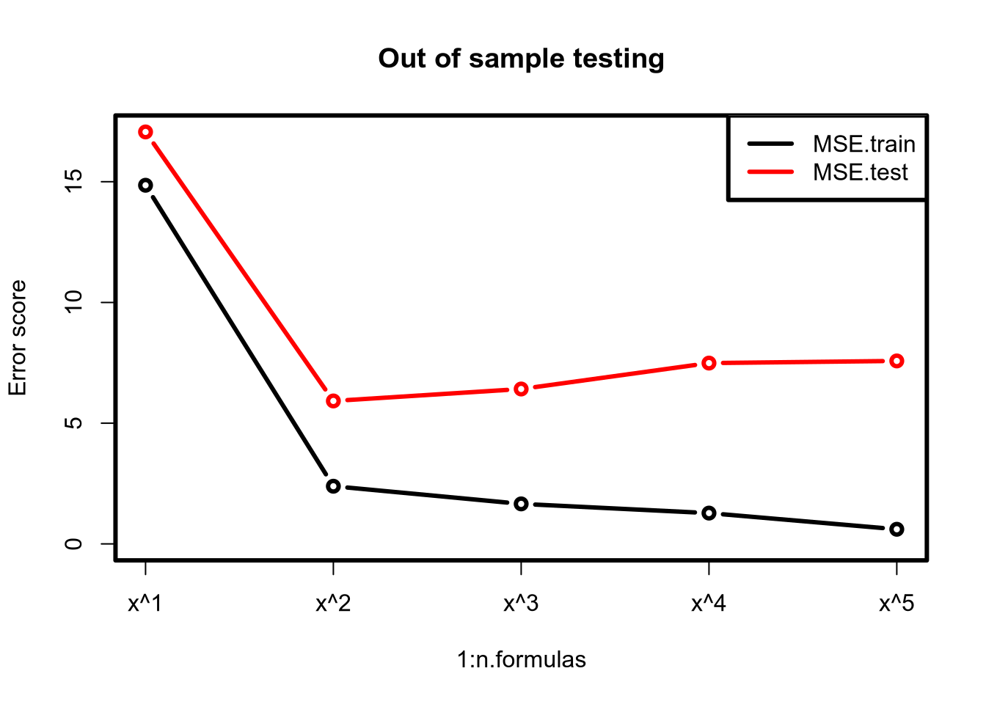

Slide 27
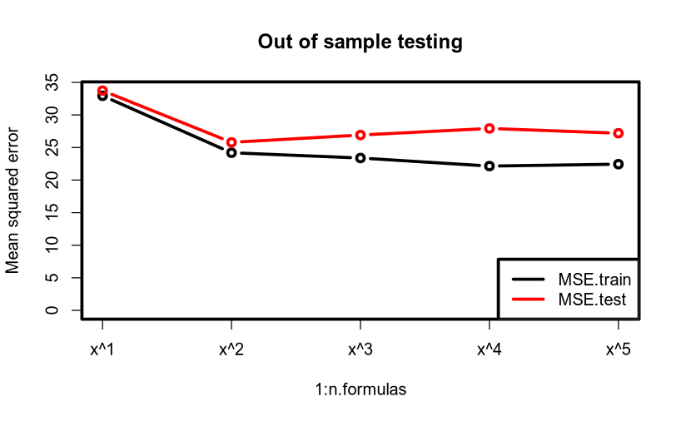

Slide 28
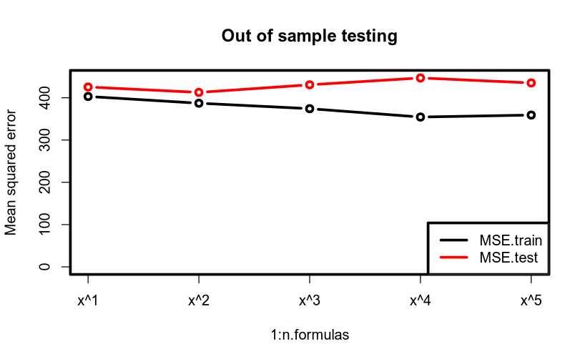

Slide 29
Interim summary
So if greater variance is detrimental to prediction, we may be able improve prediction by introducing bias (and thereby reducing variance)

Slide 30
Penalised regression
Group discussion
In each case: what happens when?
1. λ increases?
2. λ decreases?
3. λ is 0?
4. λ goes towards infinity?

Slide 31
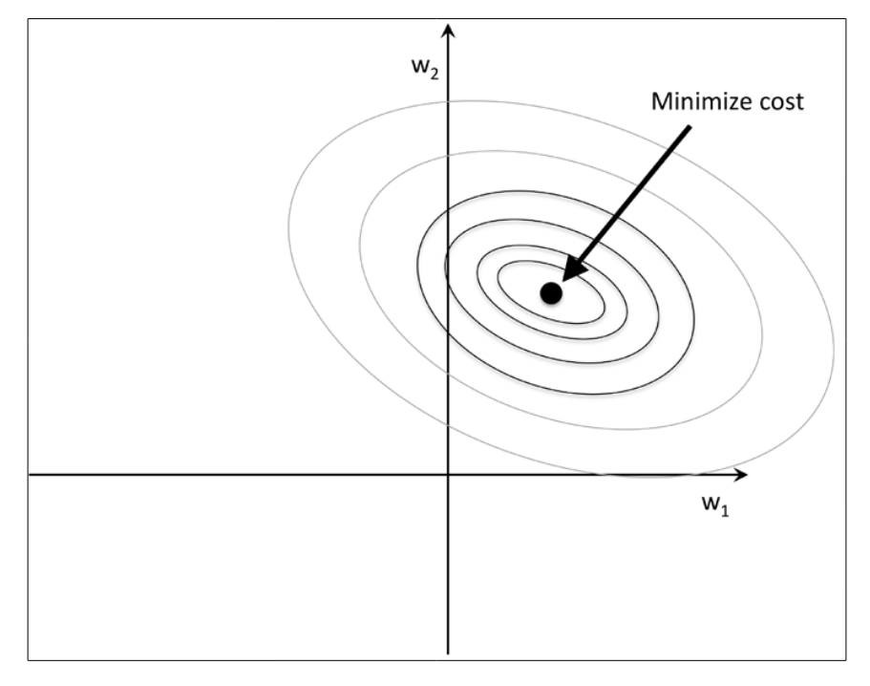
Least squares
p. 113; Raschka S (2015) Python Machine Learning. Packt Publishing Ltd

Slide 32
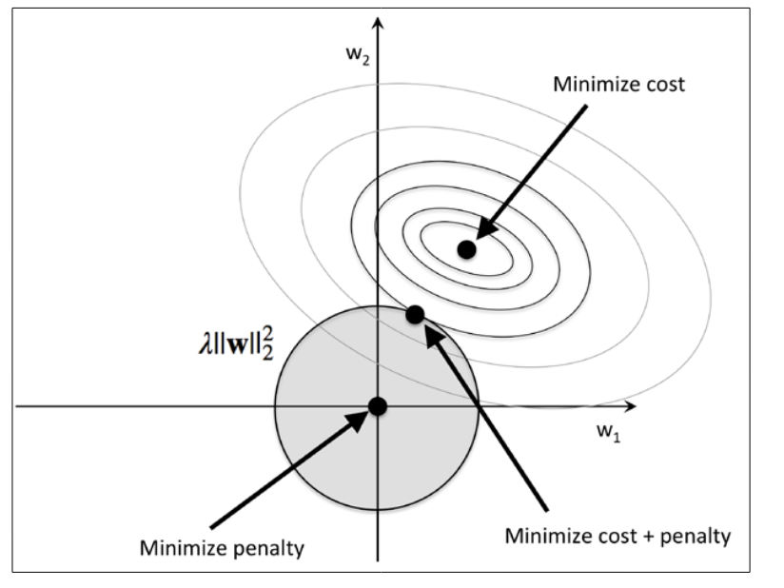

L2 regularization, ridge
p. 114; Raschka S (2015) Python Machine Learning. Packt Publishing Ltd
Why is the budget round?
Budget
(p. 114: Raschka, 2015)

Slide 33
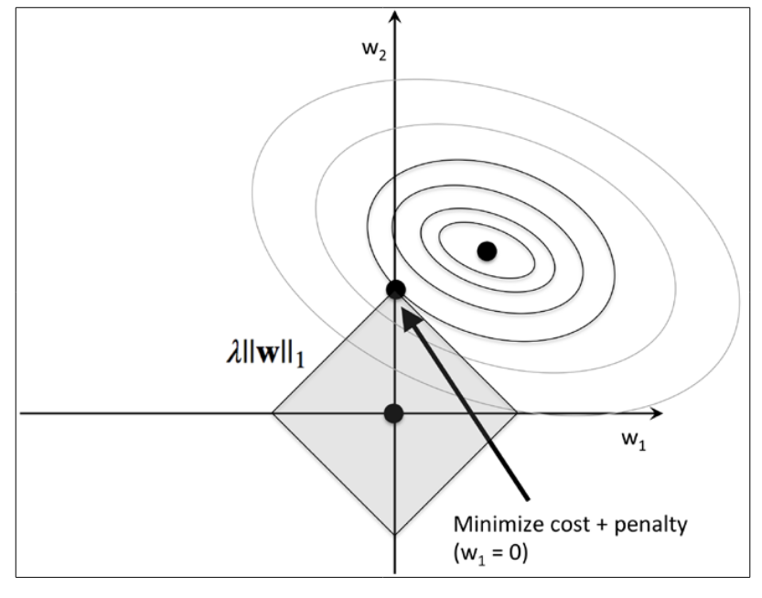

L1 regularization, lasso
p. 115; Raschka S (2015) Python Machine Learning. Packt Publishing Ltd
Why is the budget square?
Budget
(p. 115: Raschka, 2015)

Slide 34


Out-of-sample as validity check

Slide 35
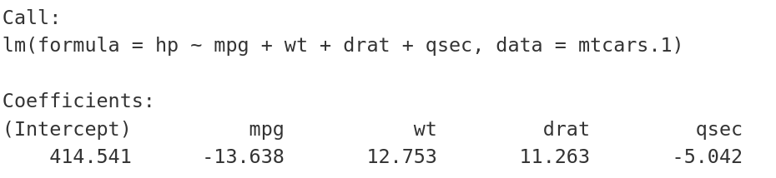
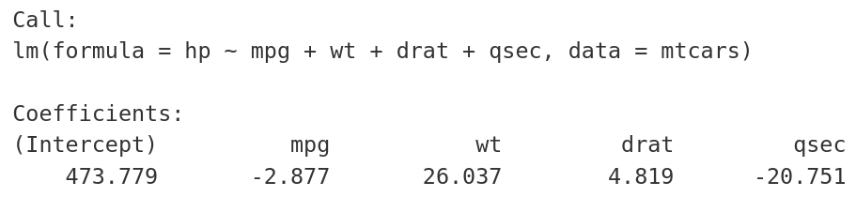
Out-of-sample as validity check

Slide 36
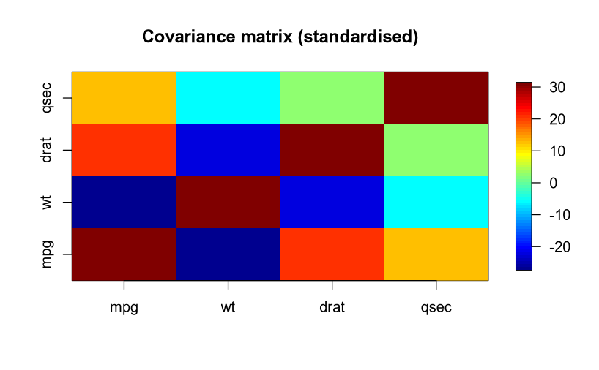
Collinearity
MTCARS

Slide 37

Suddenly, someone shows up with
Let’s check our model

Slide 38
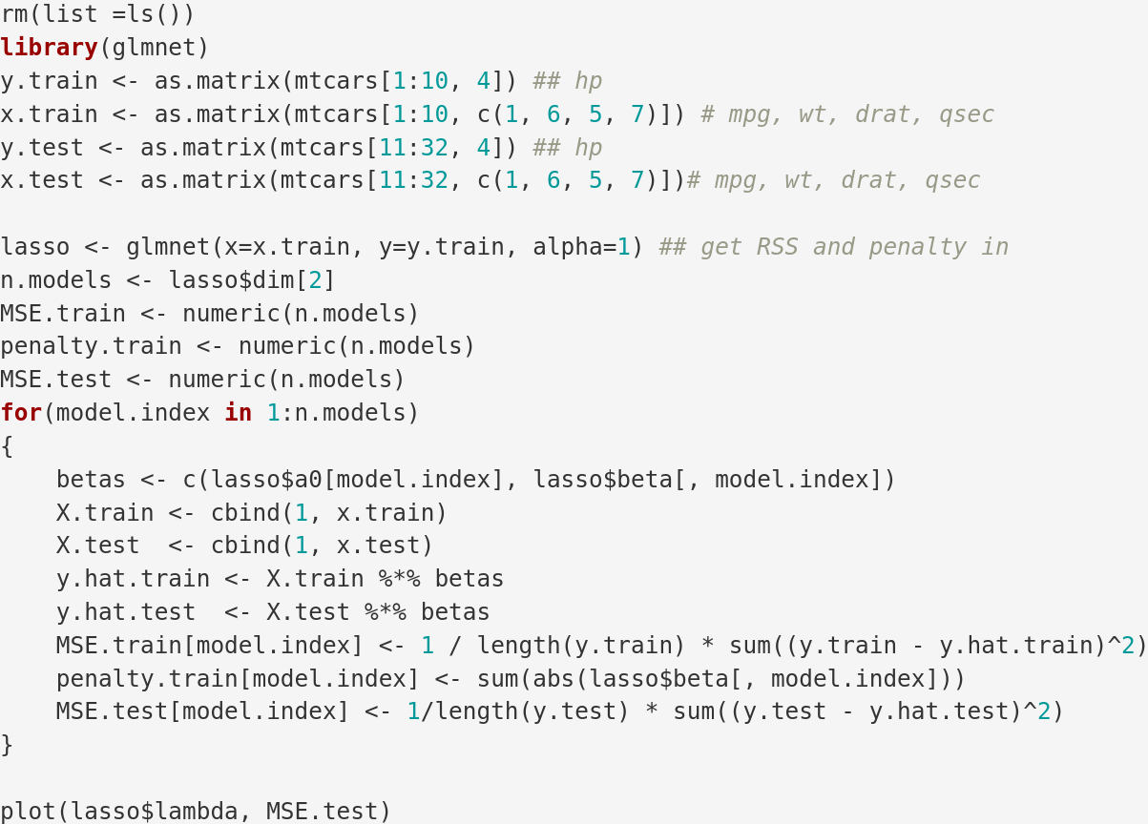

Slide 39
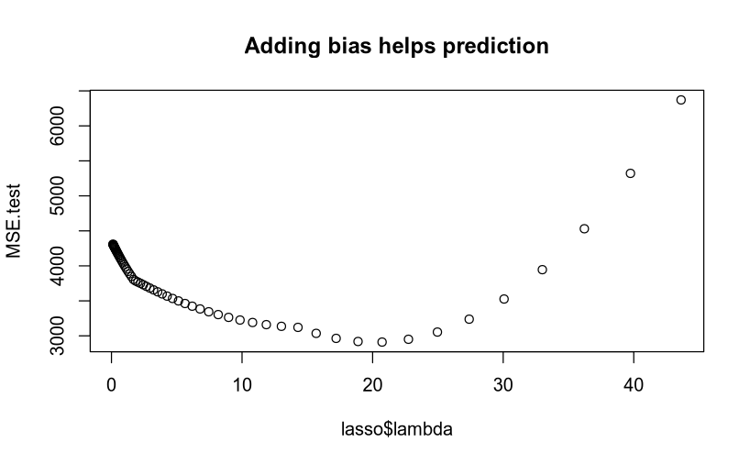

Slide 40
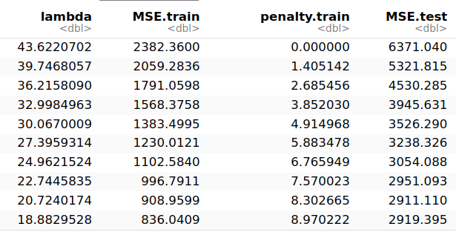

Slide 41
glmnet(x = x.train, y = y.train, alpha = 1)
s8 mpg wt drat qsec
291.925294 -8.302665 0.000000 0.000000 0.000000
Call:
lm(formula = hp ~ mpg + wt + drat + qsec + 1, data = mtcars[1:10, ])
Coefficients:
(Intercept) mpg wt drat qsec
414.541 -13.638 12.753 11.263 -5.042

Slide 42
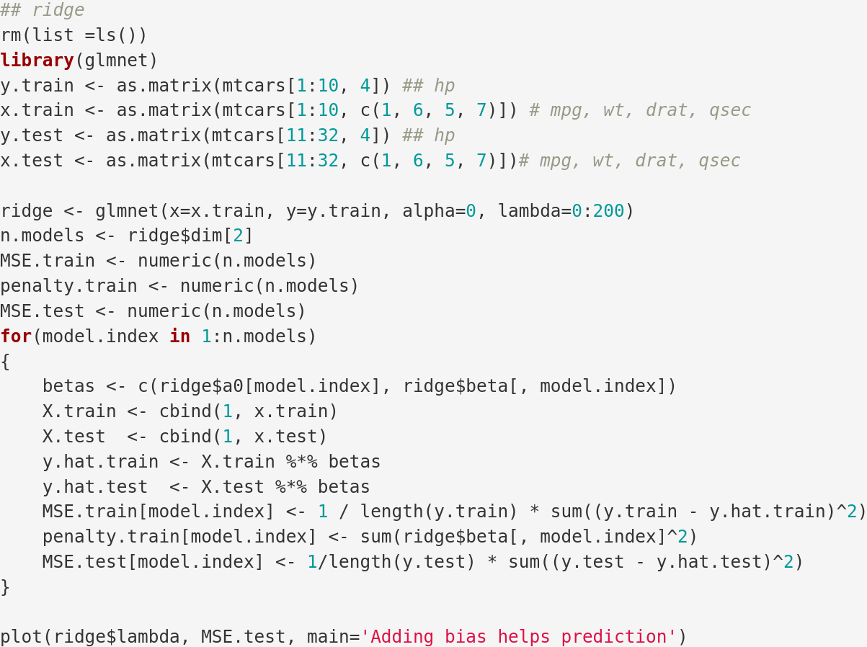

Slide 43
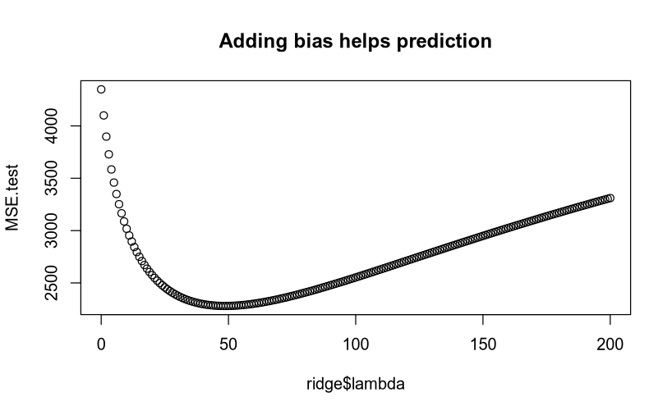

Slide 44
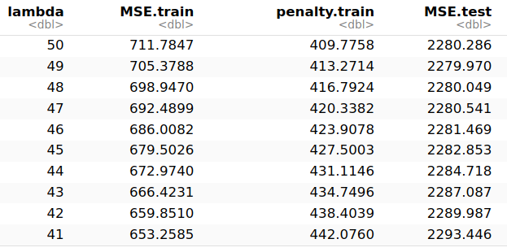

Slide 45
glmnet(x = x.train, y = y.train, alpha = 0, lambda = 0:200)
s151 mpg wt drat qsec
312.148253 -5.788459 17.325500 -7.093469 -5.410624
Call:
lm(formula = hp ~ mpg + wt + drat + qsec + 1, data = mtcars[1:10, ])
Coefficients:
(Intercept) mpg wt drat qsec
414.541 -13.638 12.753 11.263 -5.042

Slide 46
Adding bias to a model can increase stability of the model and can in turn increase prediction capability
Remember in linear regression MSE is a metric for prediction error

Slide 47
Least squares
p. 113; Raschka S (2015) Python Machine Learning. Packt Publishing Ltd

Slide 48
L2 regularization, ridge
p. 114; Raschka S (2015) Python Machine Learning. Packt Publishing Ltd
Why is the budget round?
Budget
(p. 114: Raschka, 2015)

Slide 49
L1 regularization, lasso
p. 115; Raschka S (2015) Python Machine Learning. Packt Publishing Ltd
Why is the budget square?
Budget
(p. 115: Raschka, 2015)

Slide 50
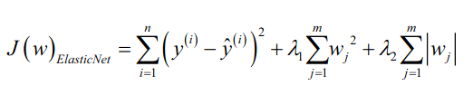
We can combine L1 and L2
JUST FOR COMPLETION

Slide 51
Summary
Bias can be added in ways that improve prediction
  it does this by removing collinearity
  thereby making the model stable
  and more generalisable
This is one backbone of machine learning

Slide 52
Learning goals and outline
Explanation and prediction
Understanding how error can be decomposed into bias and variance
Understanding when penalised regression may be helpful
Understanding how models can be evaluated by out-of-sample testing

Slide 53
The course plan
Week 1: Introduction
Instructor sessions: Setting up R and Python and recollection of the general linear model
Week 2: Multilevel linear regression
Instructor sessions: Modelling subject level effects – and how do they differ from group level effects?
Week 3: Link functions and fitting generalised linear multilevel models
Instructor sessions: What to do when the response variable is not continuous?
Week 4: Evaluating Generalised linear mixed models
Instructor sessions: How do we assess how models compare to one another?
Week 5: Explanation and Prediction
Instructor sessions: Code review
Week 6: Mid-way evaluation and Machine Learning Intro
Instructor sessions: Getting Python Running
Week 7: Linear regression revisited (machine learning)
Instructor sessions: How to constrain our models to make them more predictive
Week 8: Logistic regression revisited (machine learning)
Instructor sessions: Categorizing responses based on informed guesses
Week 9: Dimensionality Reduction, Principled Component Analysis (PCA)
Instructor sessions: What to do with very rich data?
Week 10: Outlook, unsupervised classification and neural networks
Instructor sessions: Data with no labels and networks
Week 11: Organising and preprocessing messy data
Instructor sessions: Code review
Week 12: Final evaluation and wrap-up of course
Instructor sessions: Ask anything!

Slide 54
Next time
Introduction to classification
  The Perceptron
  ADAline
Linear regression in machine learning
  Looking at big(ger) scale data

Slide 55
Reading questions
Chapter 1
  What are the differences between supervised, unsupervised and reinforcement learning?
  What is the difference between classification and regression?
  What is dimensionality reduction?
    Is it similar to regularisation?
Chapter 2
  How does the w vector and x matrix relation to what we know as X and β?
  What is the difference between a training data set and a test data set?
  What is gradient descent?
  What is a quantizer?

