Slide 1
Methods 3: Multilevel Statistical Modeling and Machine Learning
Week 06: Mid-way evaluation and Machine Learning Intro:
October 8, 2024

Slide 2
The course plan
Week 1: Introduction
Instructor sessions: Setting up R and Python and recollection of the general linear model
Week 2: Multilevel linear regression
Instructor sessions: Modelling subject level effects – and how do they differ from group level effects?
Week 3: Link functions and fitting generalised linear multilevel models
Instructor sessions: What to do when the response variable is not continuous?
Week 4: Evaluating Generalised linear mixed models
Instructor sessions: How do we assess how models compare to one another?
Week 5: Explanation and Prediction
Instructor sessions: Code review
Week 6: Mid-way evaluation and Machine Learning Intro
Instructor sessions: Getting Python Running
Week 7: Linear regression revisited (machine learning)
Instructor sessions: How to constrain our models to make them more predictive
Week 8: Logistic regression revisited (machine learning)
Instructor sessions: Categorizing responses based on informed guesses
Week 9: Dimensionality Reduction, Principled Component Analysis (PCA)
Instructor sessions: What to do with very rich data?
Week 10: Outlook, unsupervised classification and neural networks
Instructor sessions: Data with no labels and networks
Week 11: Organising and preprocessing messy data
Instructor sessions: Code review
Week 12: Final evaluation and wrap-up of course
Instructor sessions: Ask anything!

Slide 3
The four classical levels of variables
Nominal
  examples: true/false, correct/incorrect, female/male, dog/cat, apples/pear, also called categorical
  they are names of categories, but it does not make sense to order them
Ordinal
  examples: senior/junior, adult/child 1/2/3
  they are also names of categories, but there is an explicit or implicit ordering, i.e. one is greater than another
Interval
  examples: the year 1984 AD; the temperature 100 °C
  they are can be continuous, and there is ordering, e.g. 100 °C > 90 °C. And intervals can be compared, e.g. the interval from 80 °C to 100 °C is as long as the one from 40 °C to 60 °C
  crucially, there is no real 0; the year before 1 AD is not characterised by absence of time; and 0 °C is not characterised by the absence of temperature This means that we cannot say that, say, 40 °C is twice as high a temperature as 20 °C
Ratio
  examples: the temperature 273 K, the reaction time of a subject
  they are can be continuous, there is ordering and there is a real 0.
  Thus we can say that 200 K is twice the temperature of 100 K, as 0 K is the absence of temperature; and we can say that subject 2, 400 ms, is twice as fast as subject 1, 200 ms, because 0 ms is the time when the event happened
SLIDE UPDATED 2024_10_03

Slide 4
Overview – pooling
Complete pooling
  Ignores the categorical predictor, e.g. Subject, altogether
  lm(Reaction ~ Days)
No pooling
  Overfits the categorical predictor, e.g. Subject, i.e. overstates the variation among Subjects
  lm(Reaction ~ Days * Subject – 1); models slopes and intercepts for each subject
  lm(Reaction ~ Days + Subject – 1); models intercepts for each subject
Partial pooling
  A compromise between the two extremes above. If a group, e.g. Subject, has few observations (high variance), it will be shrunk towards the overall mean. If Subject has many observations (low variance), it will be shrunk less towards the overall mean
  lmer(Reaction ~ Days + (Days | Subject) # models slopes and intercepts for each subject
  lmer(Reaction ~ Days + (1 | Subject) # models intercepts for each subject
SLIDE UPDATED 2024_10_03

Slide 5
Recap?
Bias can be added in ways that improve prediction
  it does this by removing collinearity
  thereby making the model stable
  and more generalisable

Slide 6
Learning goals and outline
Mid-way evaluation and Machine Learning Intro
Learning some early classification methods
  Perceptron and ADAline
  Classification depends on having a quantiser function
Learning how linear regression (with biasing penalties) can be constructed and cross-validated

Slide 7
Mid-way evaluation
~10 min
Write something you liked about the course so far
Write something you did not like about the course so far
What would you change?

Slide 8
I’ll summarise the feedback on the three points, and what we’ll change for next time

Slide 9
The Perceptron
Raschka S (2015) Python Machine Learning. Packt Publishing Ltd

Slide 10
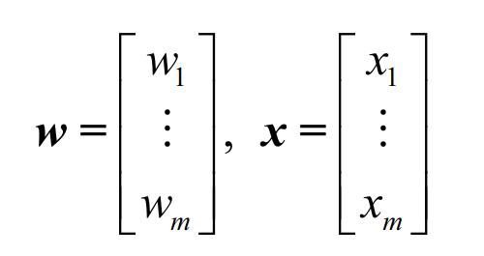
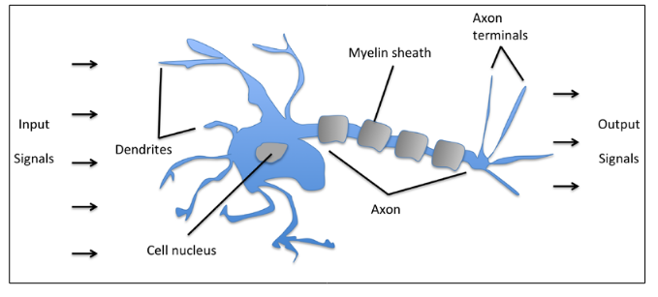

Black box idea
Question: what do x, w and z correspond to in the above picture of the Perceptron?
(p. 18: Raschka, 2015)

Slide 11
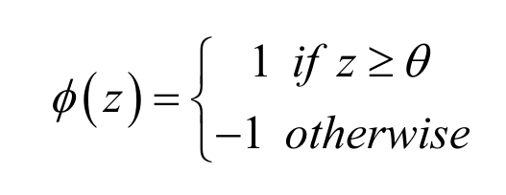
Prediction/classification rule
Perceptron fires
Perceptron doesn’t fire
θ is a pre-specified threshold
(p. 18: Raschka, 2015)

Slide 12

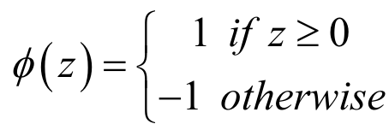
Prediction/classification rule
Perceptron fires
Perceptron doesn’t fire
(p. 18: Raschka, 2015)

Slide 13
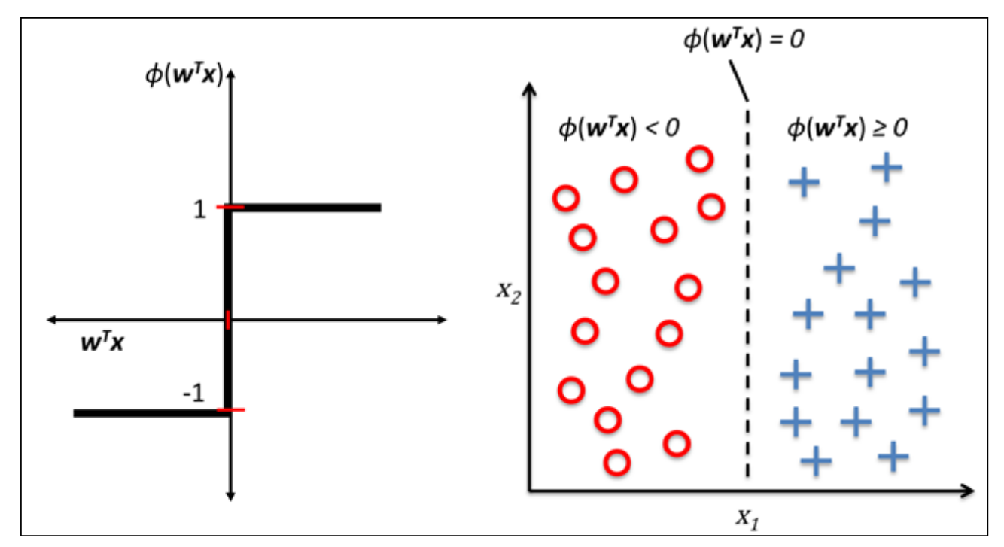
Perceptron classification
We want to find w^{T}x that achieves this separation
(p. 21: Raschka, 2015)

Slide 14
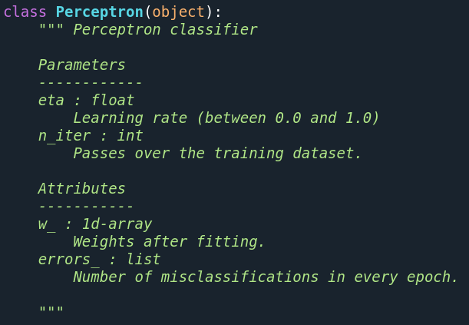
In Python (in 2021)

Slide 15

Special definition that indicates what the object (Perceptron) can be initialised with

Slide 16
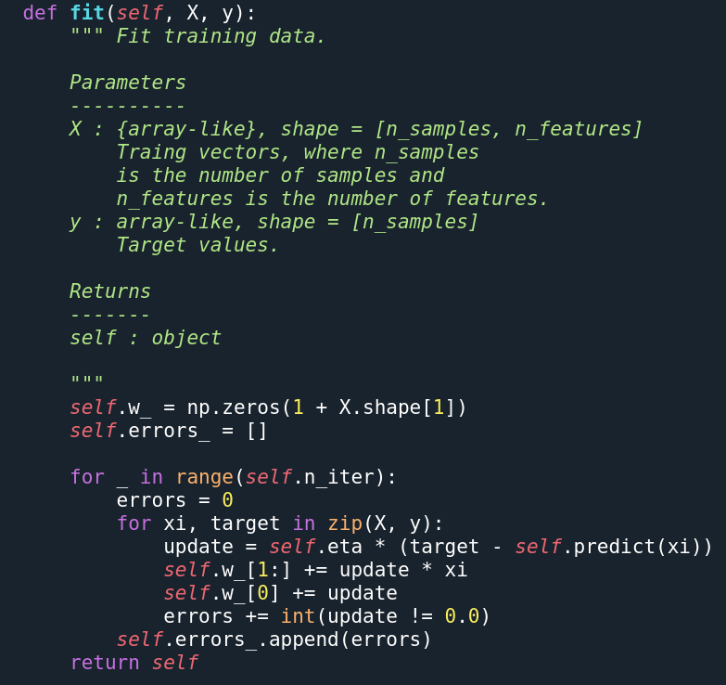
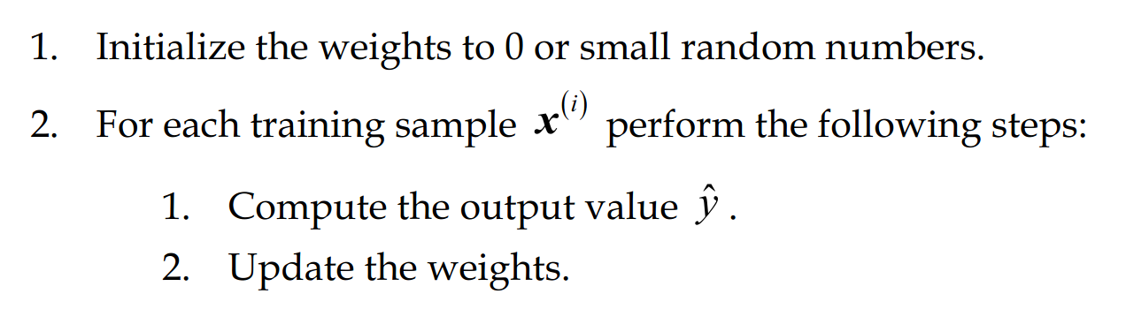
Specifying methods of Perceptron

Slide 17
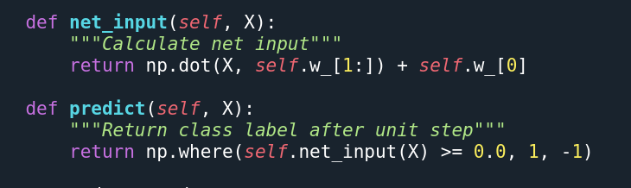

Slide 18
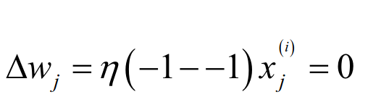
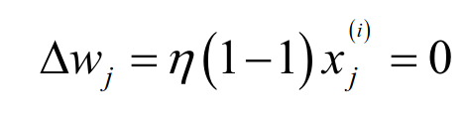
When we are right
real label
predicted label
real label
predicted label

Slide 19
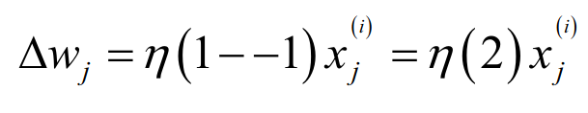
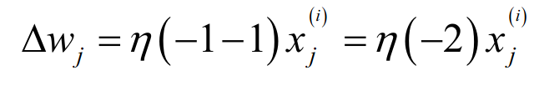
When we are wrong
real label
predicted label
real label
predicted label

Slide 20
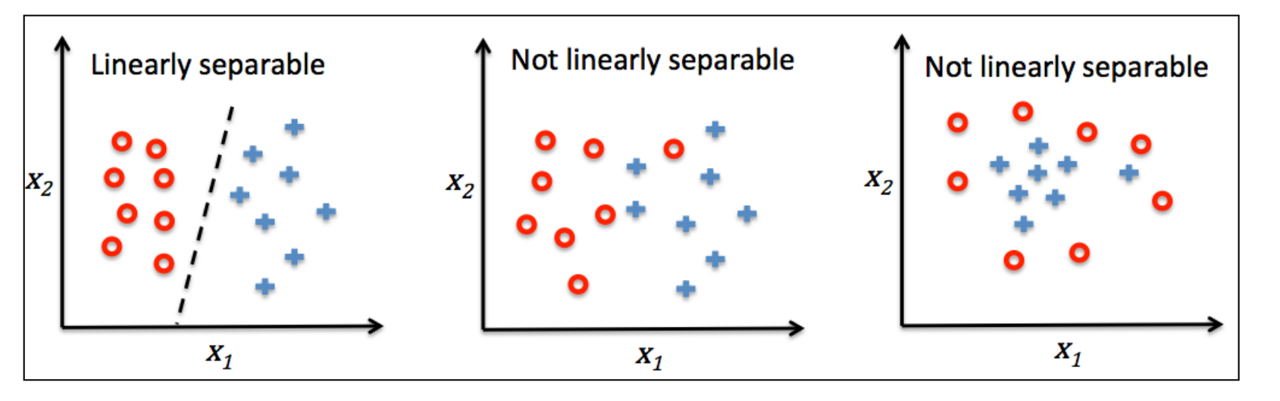
Convergence only possible when linearly separable
(p. 23: Raschka, 2015)

Slide 21
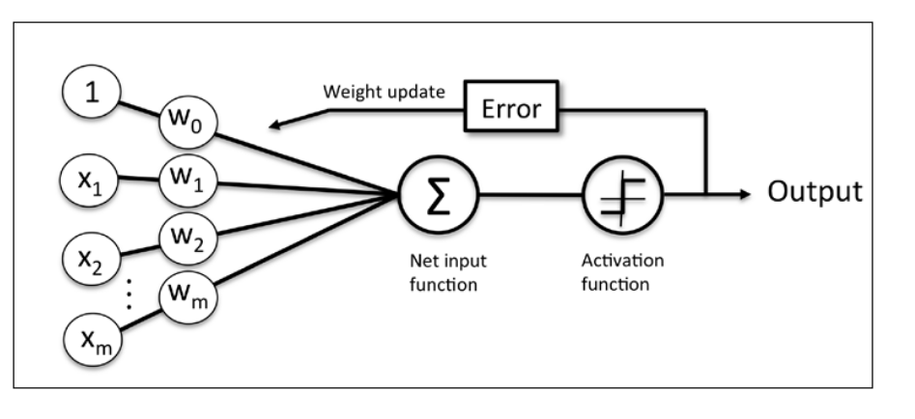
Perceptron: Graphical summary
(p. 24: Raschka, 2015)

Slide 22
An example

Slide 23
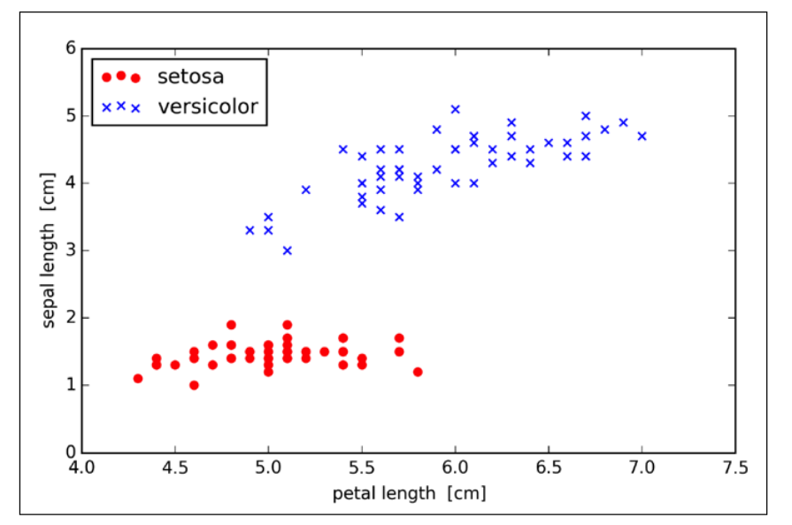
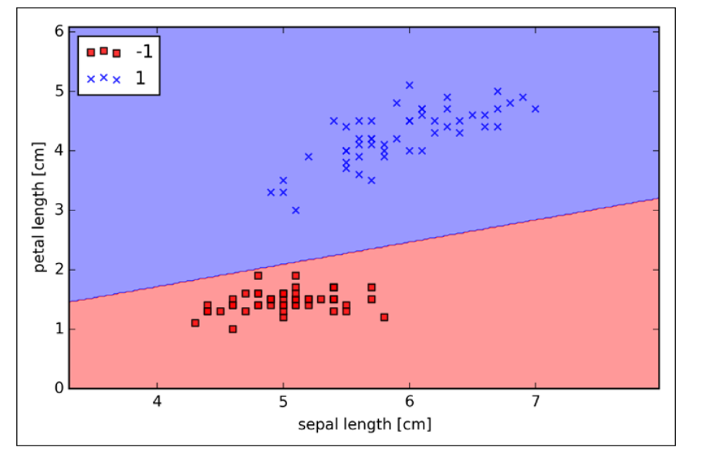



(p. 29 & p. 32: Raschka, 2015)

Slide 24
Perceptron: Graphical summary
(p. 24: Raschka, 2015)

Slide 25
ADALINE
Raschka S (2015) Python Machine Learning. Packt Publishing Ltd

Slide 26
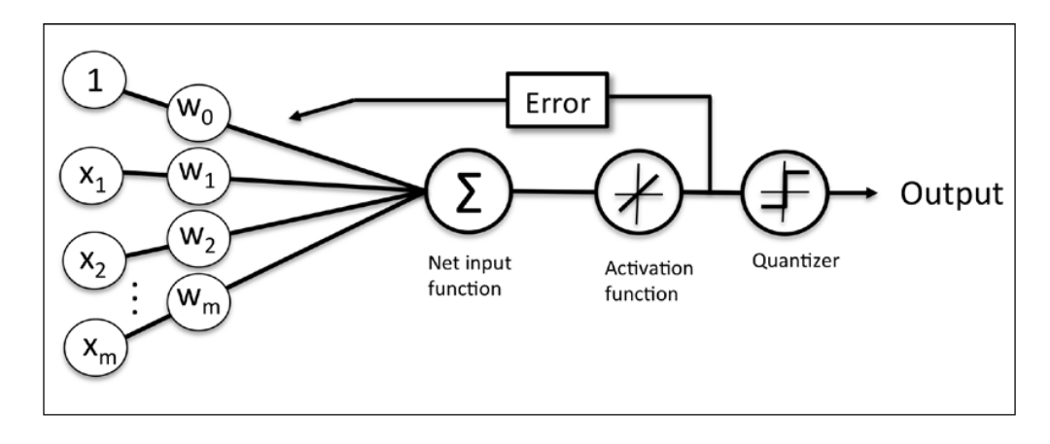
ADAptive LInear NEuron (ADALINE)
(p. 33: Raschka, 2015)

Slide 27
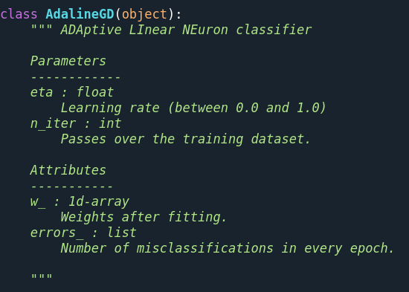

ADALINE Gradient descent

Slide 28
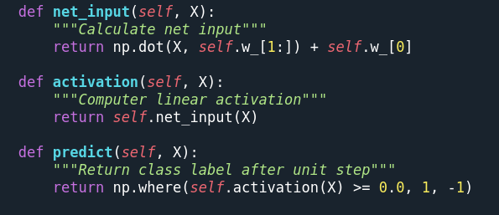
Methods

Slide 29
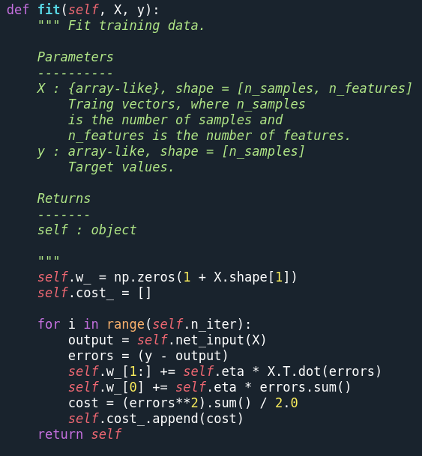
The fit method

Slide 30
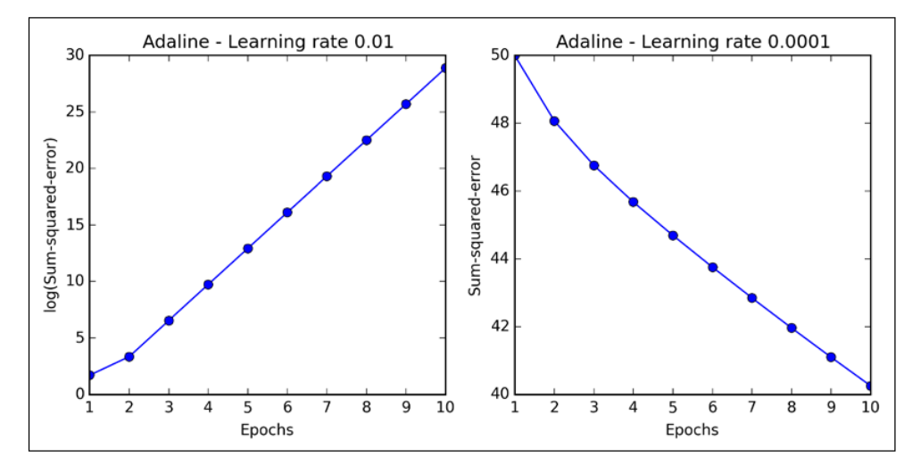
Learning rate
Overshooting the global minimum
Slow stepping down
Always check whether it converges
(p. 40: Raschka, 2015)

Slide 31
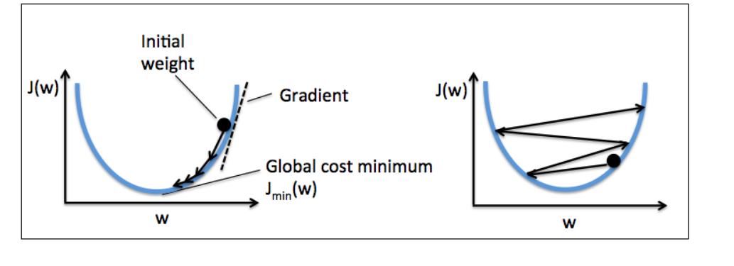
Gradient descent
Slow stepping down
Overshooting the global minimum
(p. 40: Raschka, 2015)

Slide 32
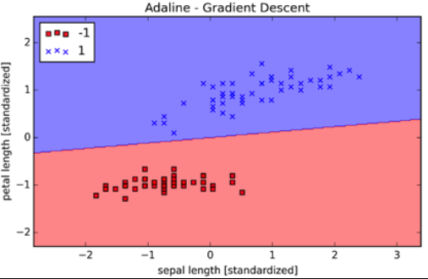


(p. 42: Raschka, 2015)

Slide 33
‘
How does this relate to linear regression?
From ADALINE

Slide 34
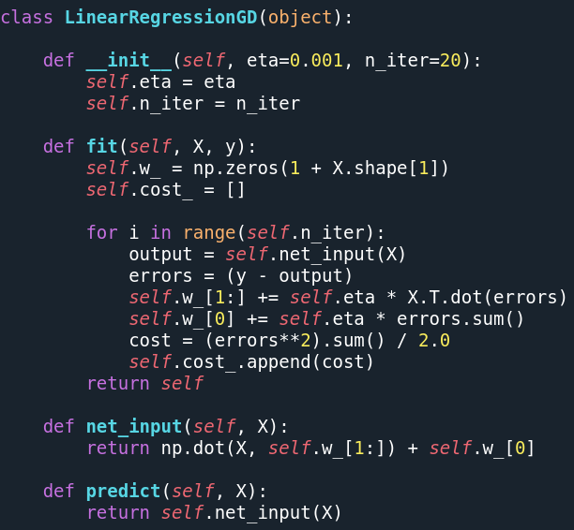
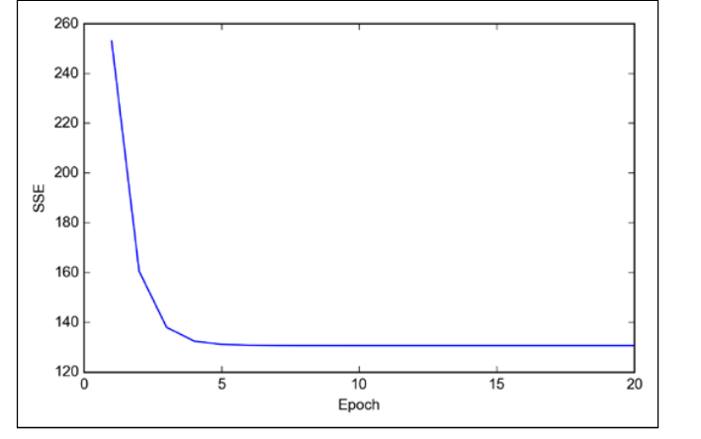
Very similar to ADALINE
and when converged will be virtually identical to the ordinary least squares solution
Convergence

Slide 35
ADALINE

Slide 36
LINEAR REGRESSION

Slide 37
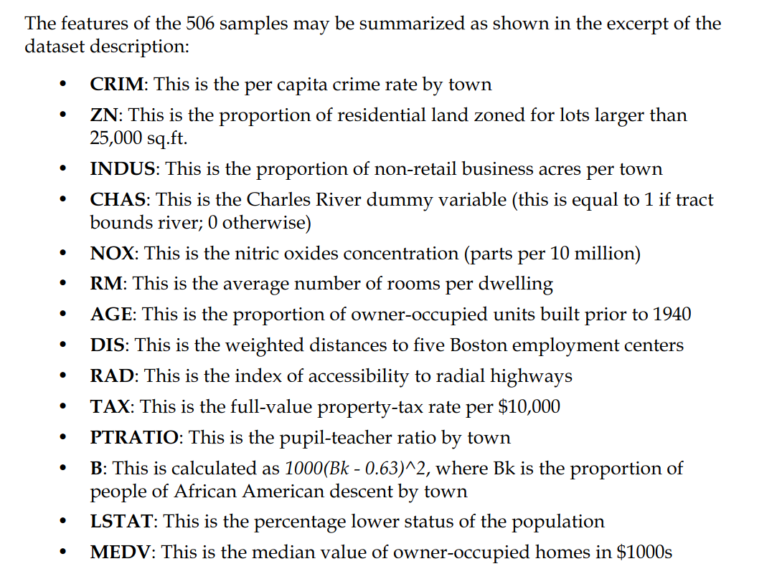
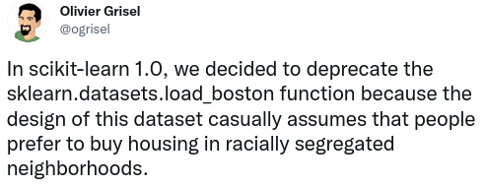
(p. 229: Raschka, 2015)

Slide 38
California Housing Dataset
X
MedInc: median income in block group
HouseAge: median house age in block group
AveRooms: average number of rooms per household
AveBedrms: average number of bedrooms per household
Population: block group population
AveOccup: average number of household members
Latitude: block group latitude
Longitude: block group longitude
y
MedHouseVal: The median house value for California districts, expressed in hundreds of thousands of dollars ($100,000)

Slide 39
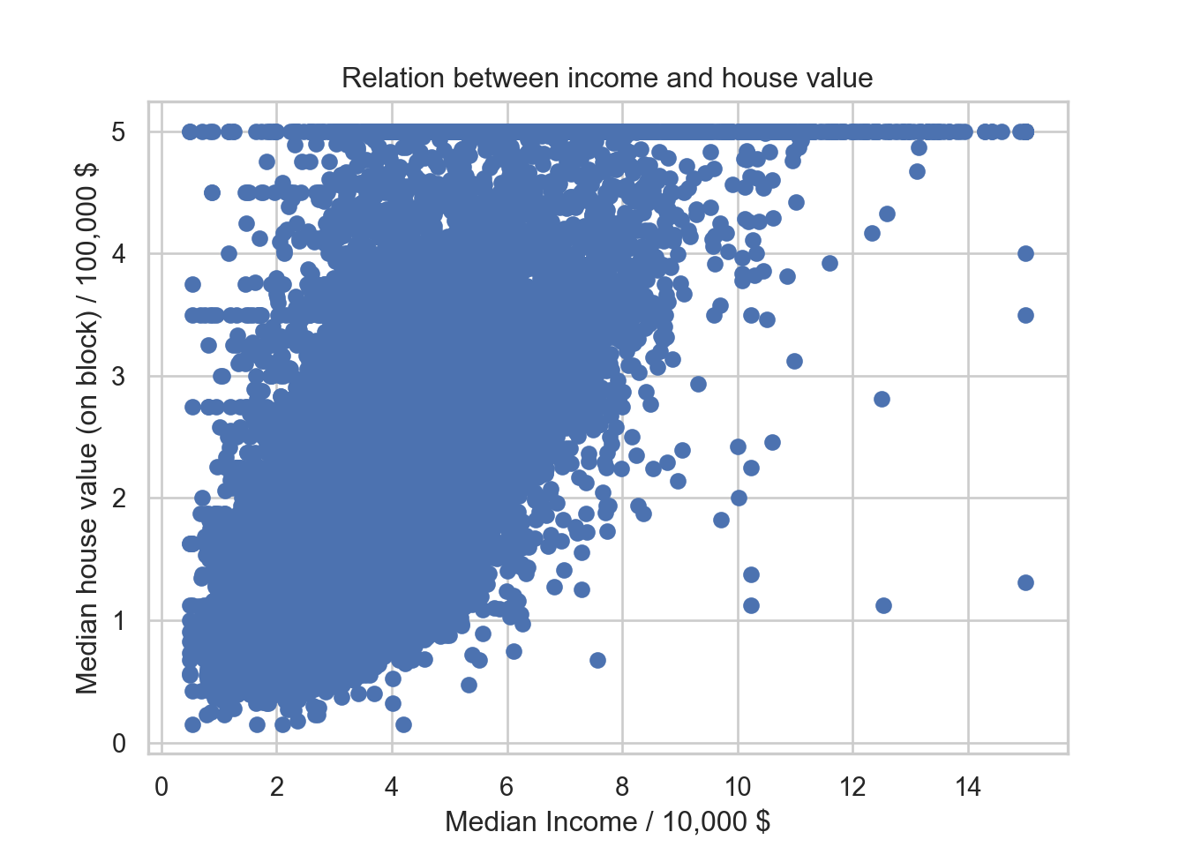
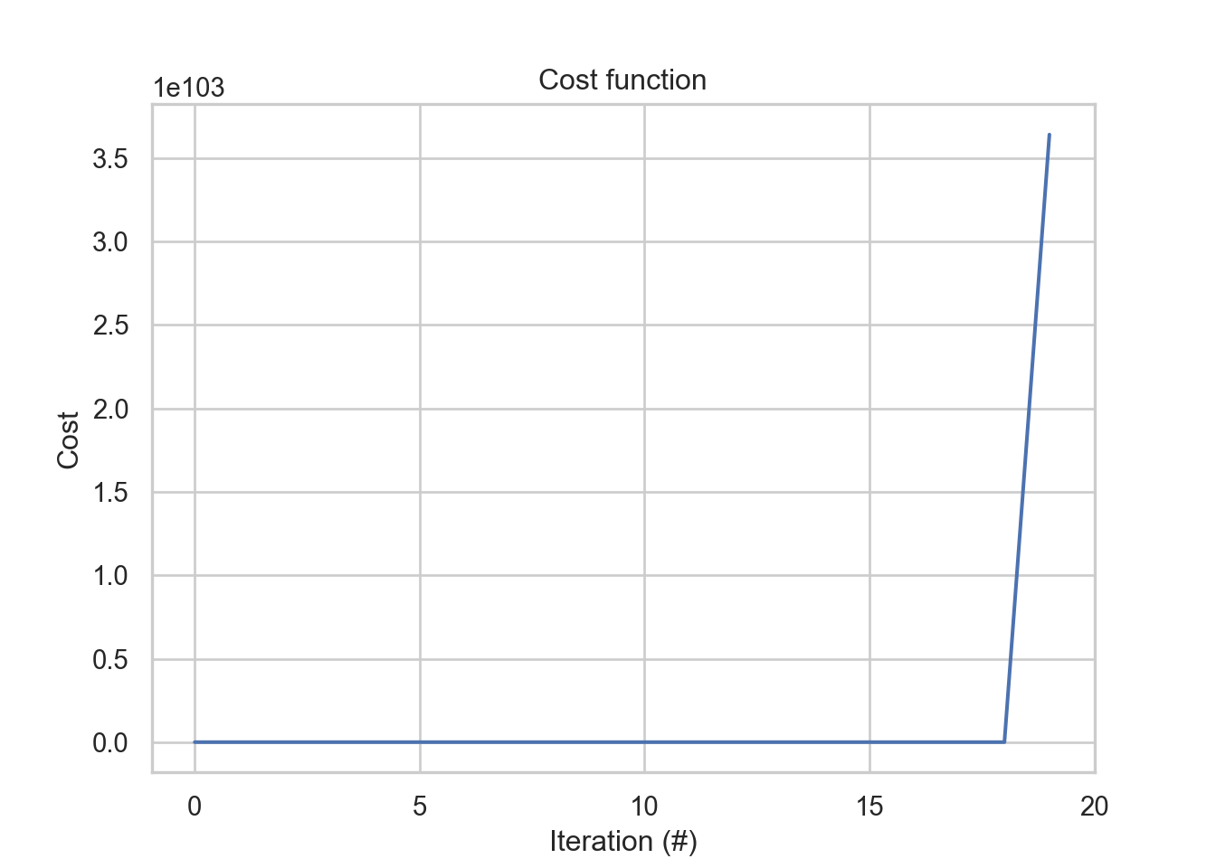
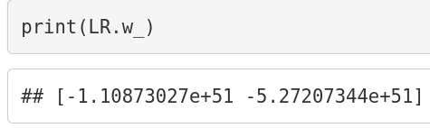
!

Slide 40
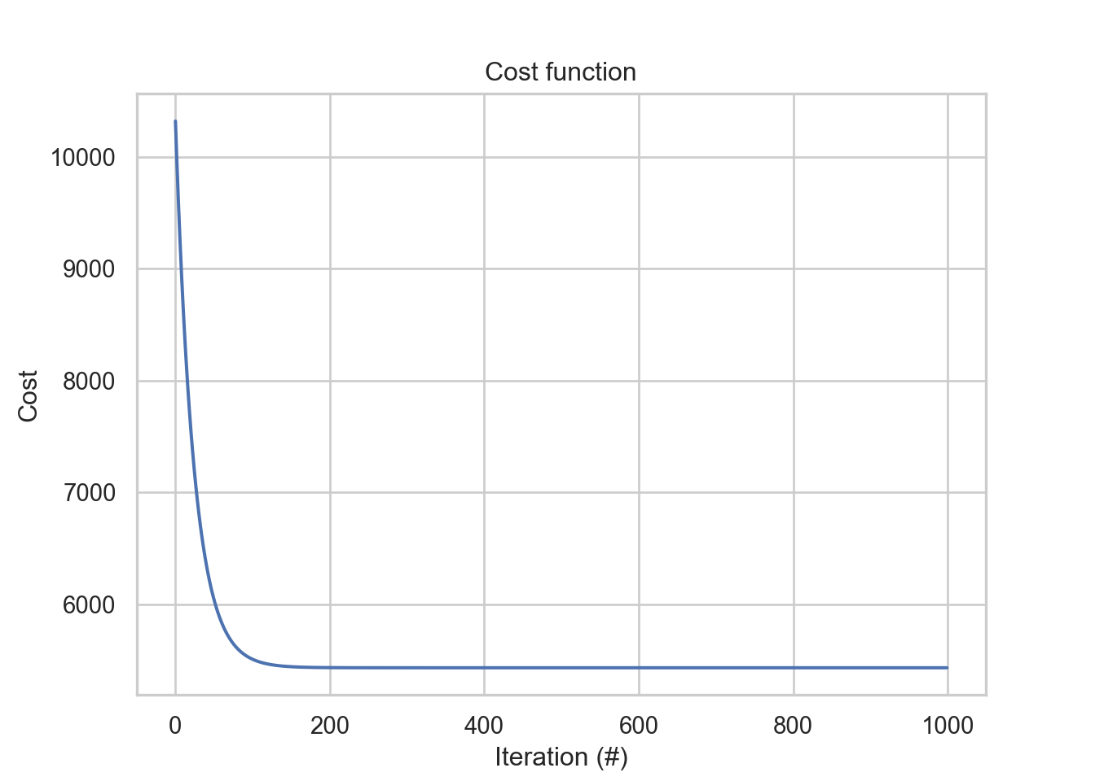
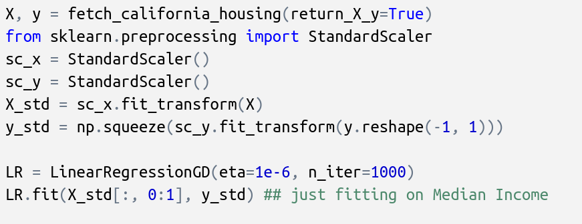
Check for convergence!

Slide 41
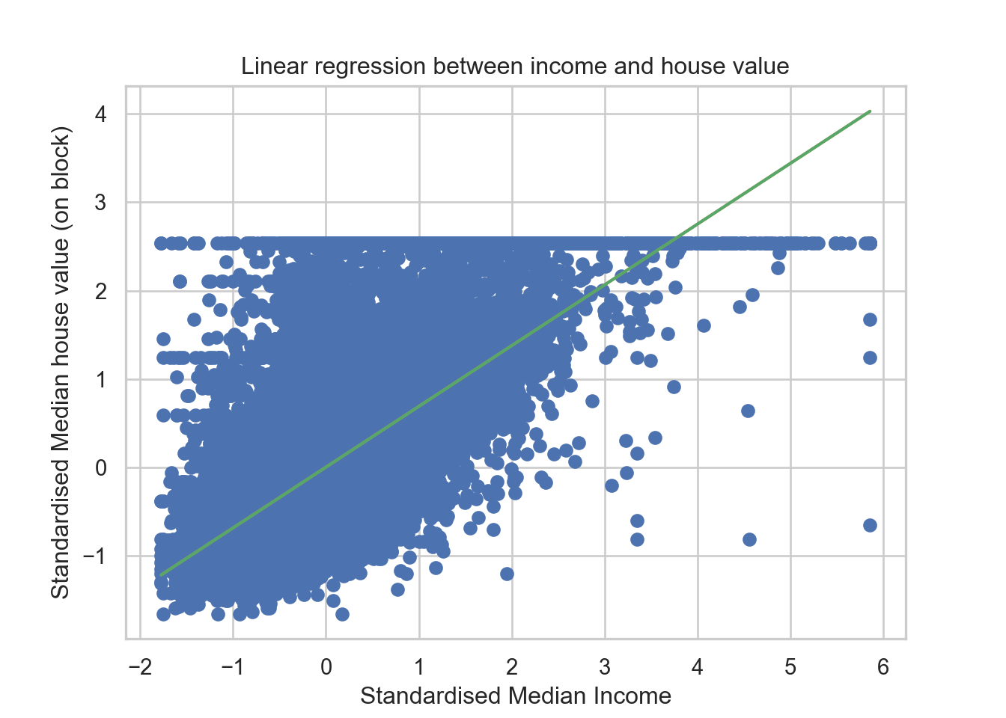
Standardisation
Brings data onto a normal distribution with with μ=0 and σ=1

Slide 42
Multiple linear regression

Slide 43
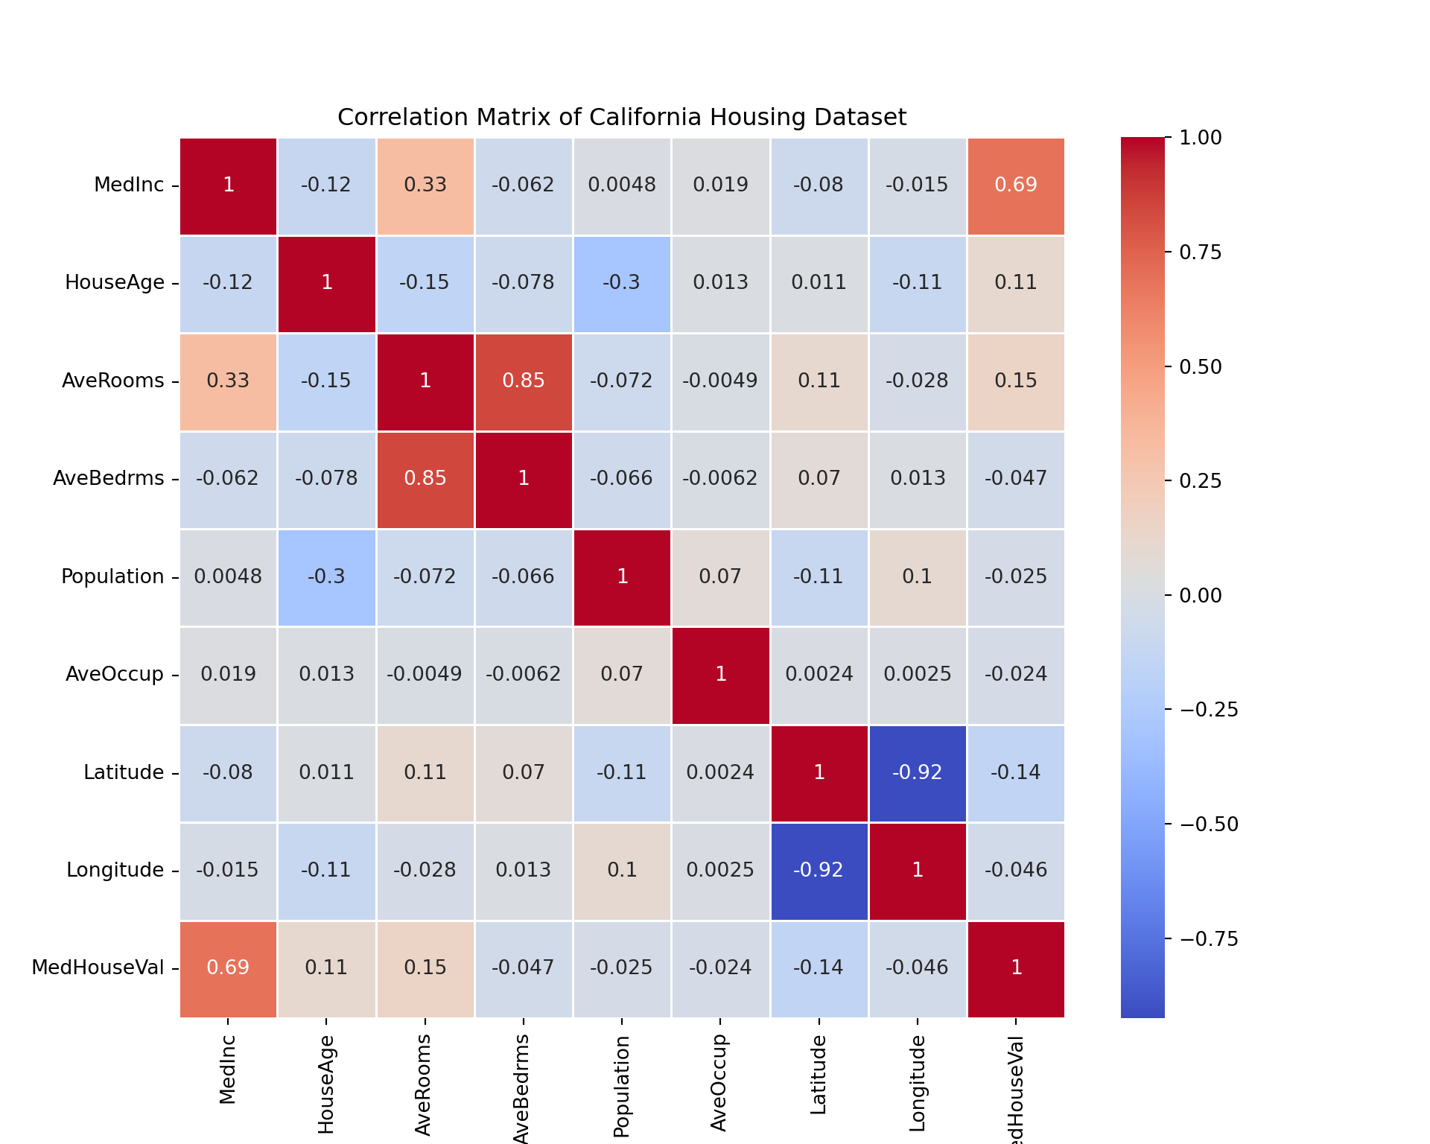

Slide 44
Because of the collinearity, we know we are prone to overfitting, so we do out-of-sample prediction instead of validating our model with traditional measures like R² and maximum likelihood

Slide 45
How to choose the out-of-sample dataset?

Slide 46
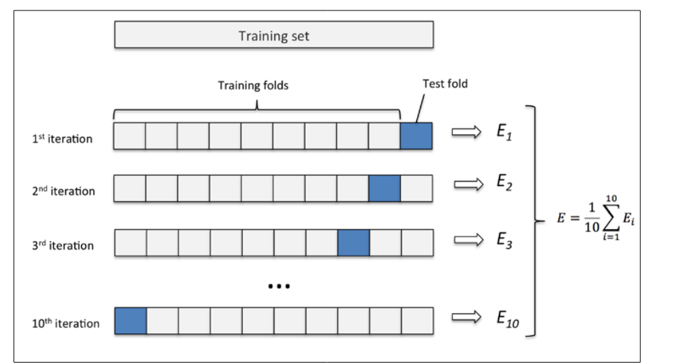
Cross-validation
(p. 176: Raschka, 2015)

Slide 47
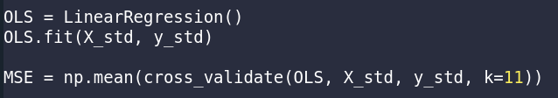
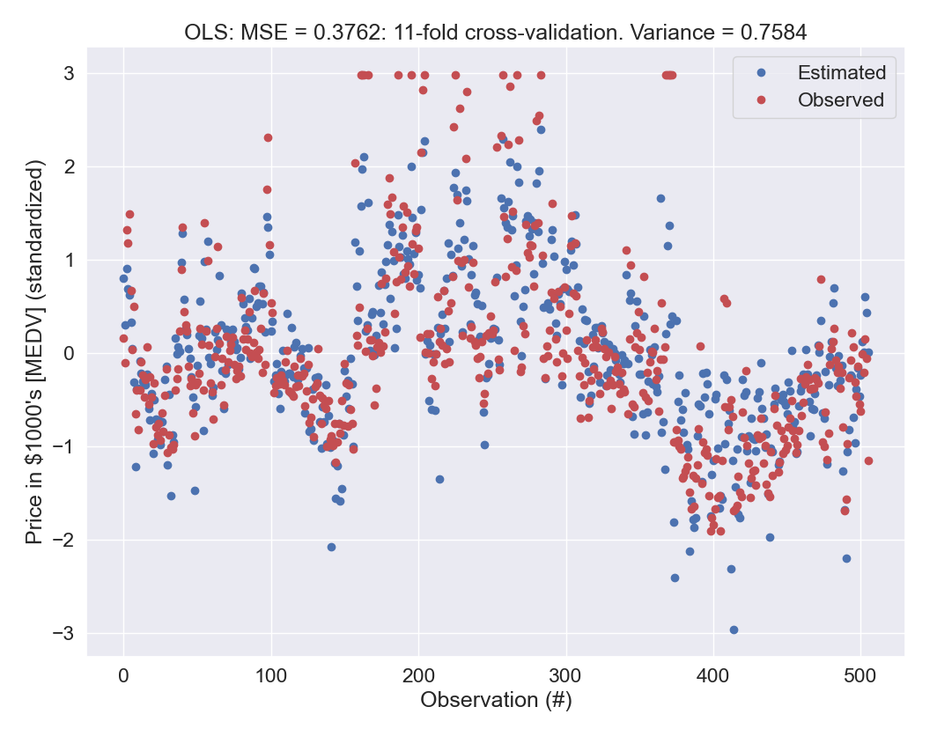

Slide 48

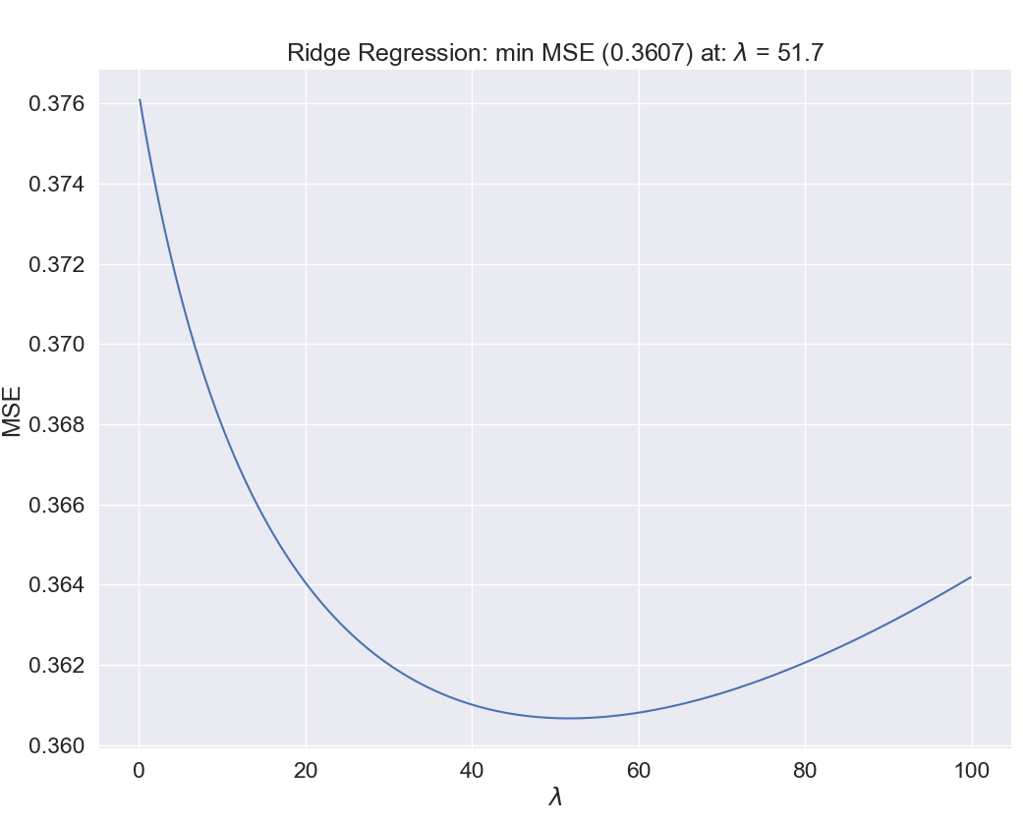
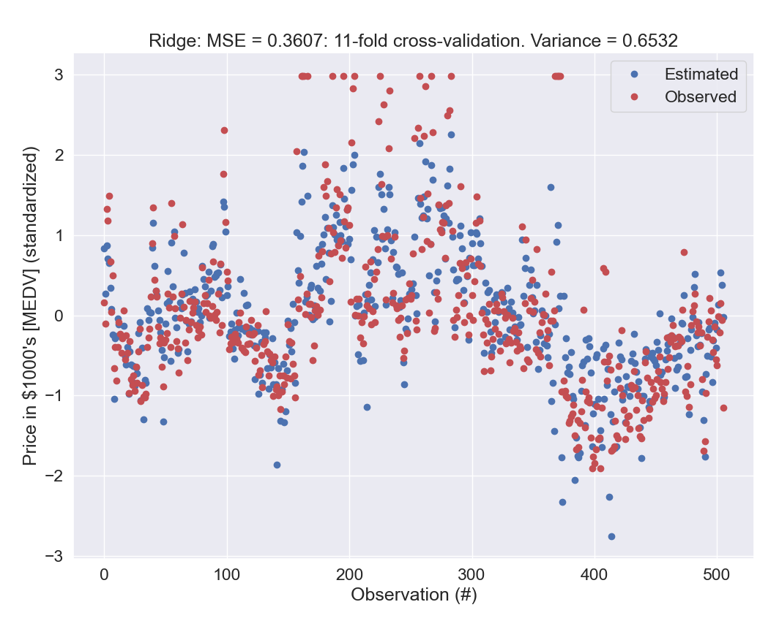
We can impose penalties
(but not on the intercept)

Slide 49

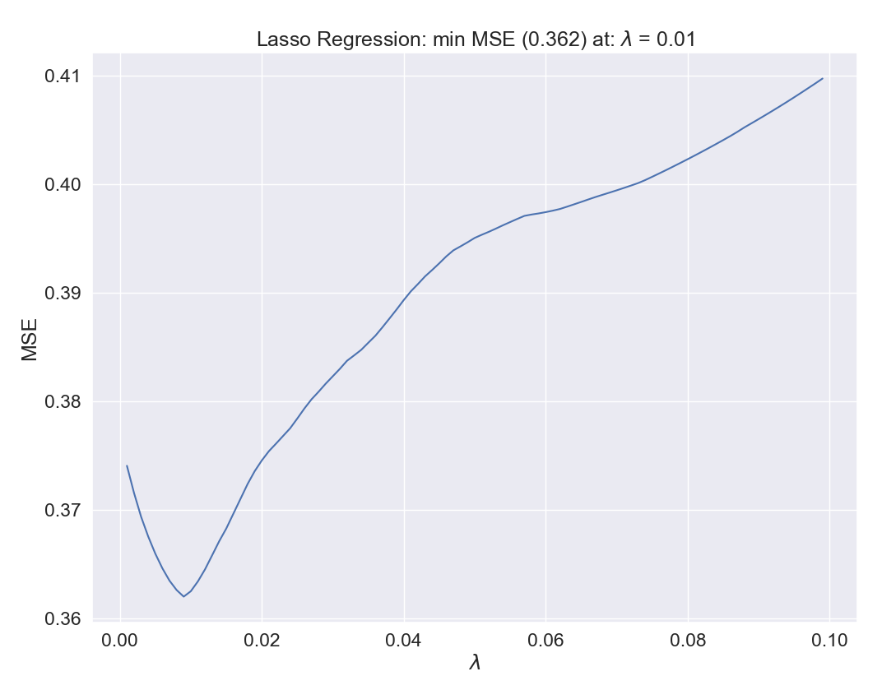
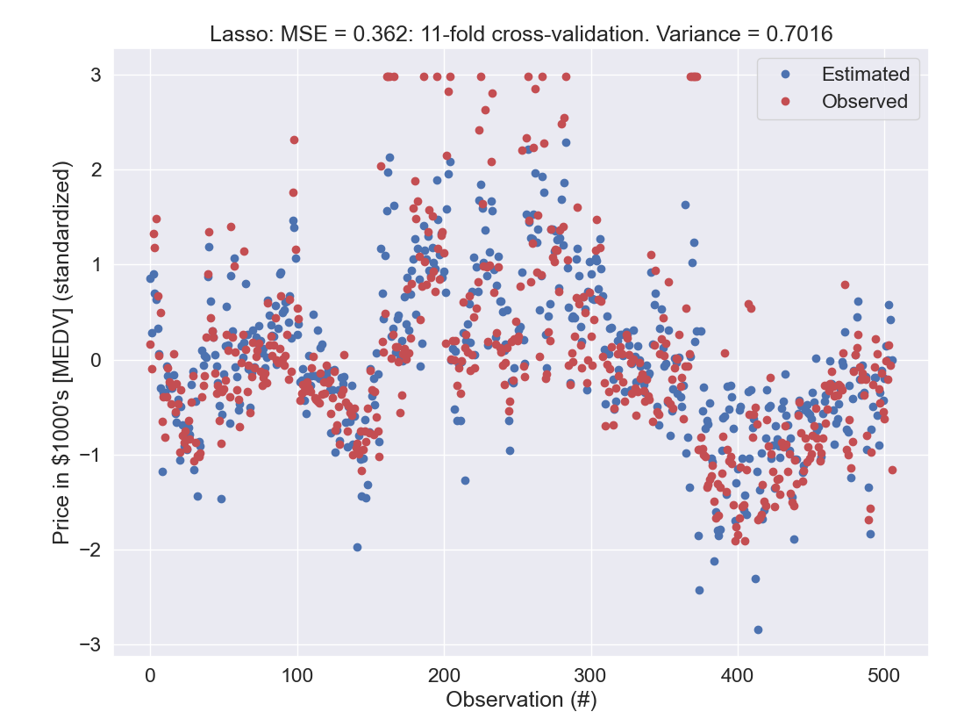
We can impose penalties
(but not on the intercept)

Slide 50
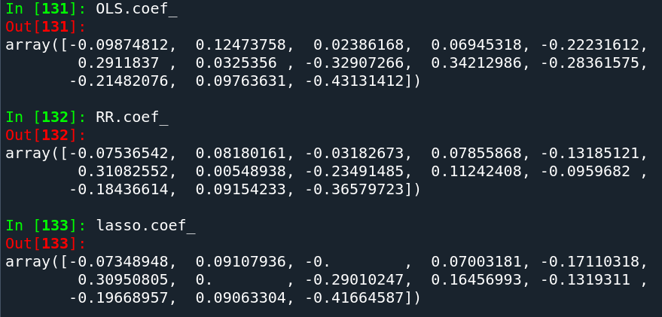
Coefficients are shrunk

Slide 51
Summary
We can build simple classification tools using scikit-learn
  These can give us decision boundaries
  That we can apply to new data (we haven’t done that yet)
We need to define cost functions
  These can be conceptually separated from prediction functions (remember ADALINE)
We can use linear regression to do continuous predictions

Slide 52
The course plan
Week 1: Introduction
Instructor sessions: Setting up R and Python and recollection of the general linear model
Week 2: Multilevel linear regression
Instructor sessions: Modelling subject level effects – and how do they differ from group level effects?
Week 3: Link functions and fitting generalised linear multilevel models
Instructor sessions: What to do when the response variable is not continuous?
Week 4: Evaluating Generalised linear mixed models
Instructor sessions: How do we assess how models compare to one another?
Week 5: Explanation and Prediction
Instructor sessions: Code review
Week 6: Mid-way evaluation and Machine Learning Intro
Instructor sessions: Getting Python Running
Week 7: Linear regression revisited (machine learning)
Instructor sessions: How to constrain our models to make them more predictive
Week 8: Logistic regression revisited (machine learning)
Instructor sessions: Categorizing responses based on informed guesses
Week 9: Dimensionality Reduction, Principled Component Analysis (PCA)
Instructor sessions: What to do with very rich data?
Week 10: Outlook, unsupervised classification and neural networks
Instructor sessions: Data with no labels and networks
Week 11: Organising and preprocessing messy data
Instructor sessions: Code review
Week 12: Final evaluation and wrap-up of course
Instructor sessions: Ask anything!

Slide 53
Learning goals and outline
Mid-way evaluation and Machine Learning Intro
Learning some early classification methods
  Perceptron and ADAline
  Classification depends on having a quantiser function
Learning how linear regression (with biasing penalties) can be constructed and cross-validated

Slide 54
Next time
We will do logistic regression and linear regression together
  but we will skip an assignment and put in a code review instead
    P7
      Assignment 3: How to constrain our models to make them more predictive
      Assignment 4: Using logistic regression to classify subjective experience from brain data
    P8
      code review
I’ll update the syllabus accordingly

Slide 55
Reading questions
Chapter 10
  What is lasso and ridge regression?
  What is standardisation?
Chapter 3
  What is the cost function of logistic regression?
  What is overfitting and underfitting?
  What is a support vector?

