Slide 1
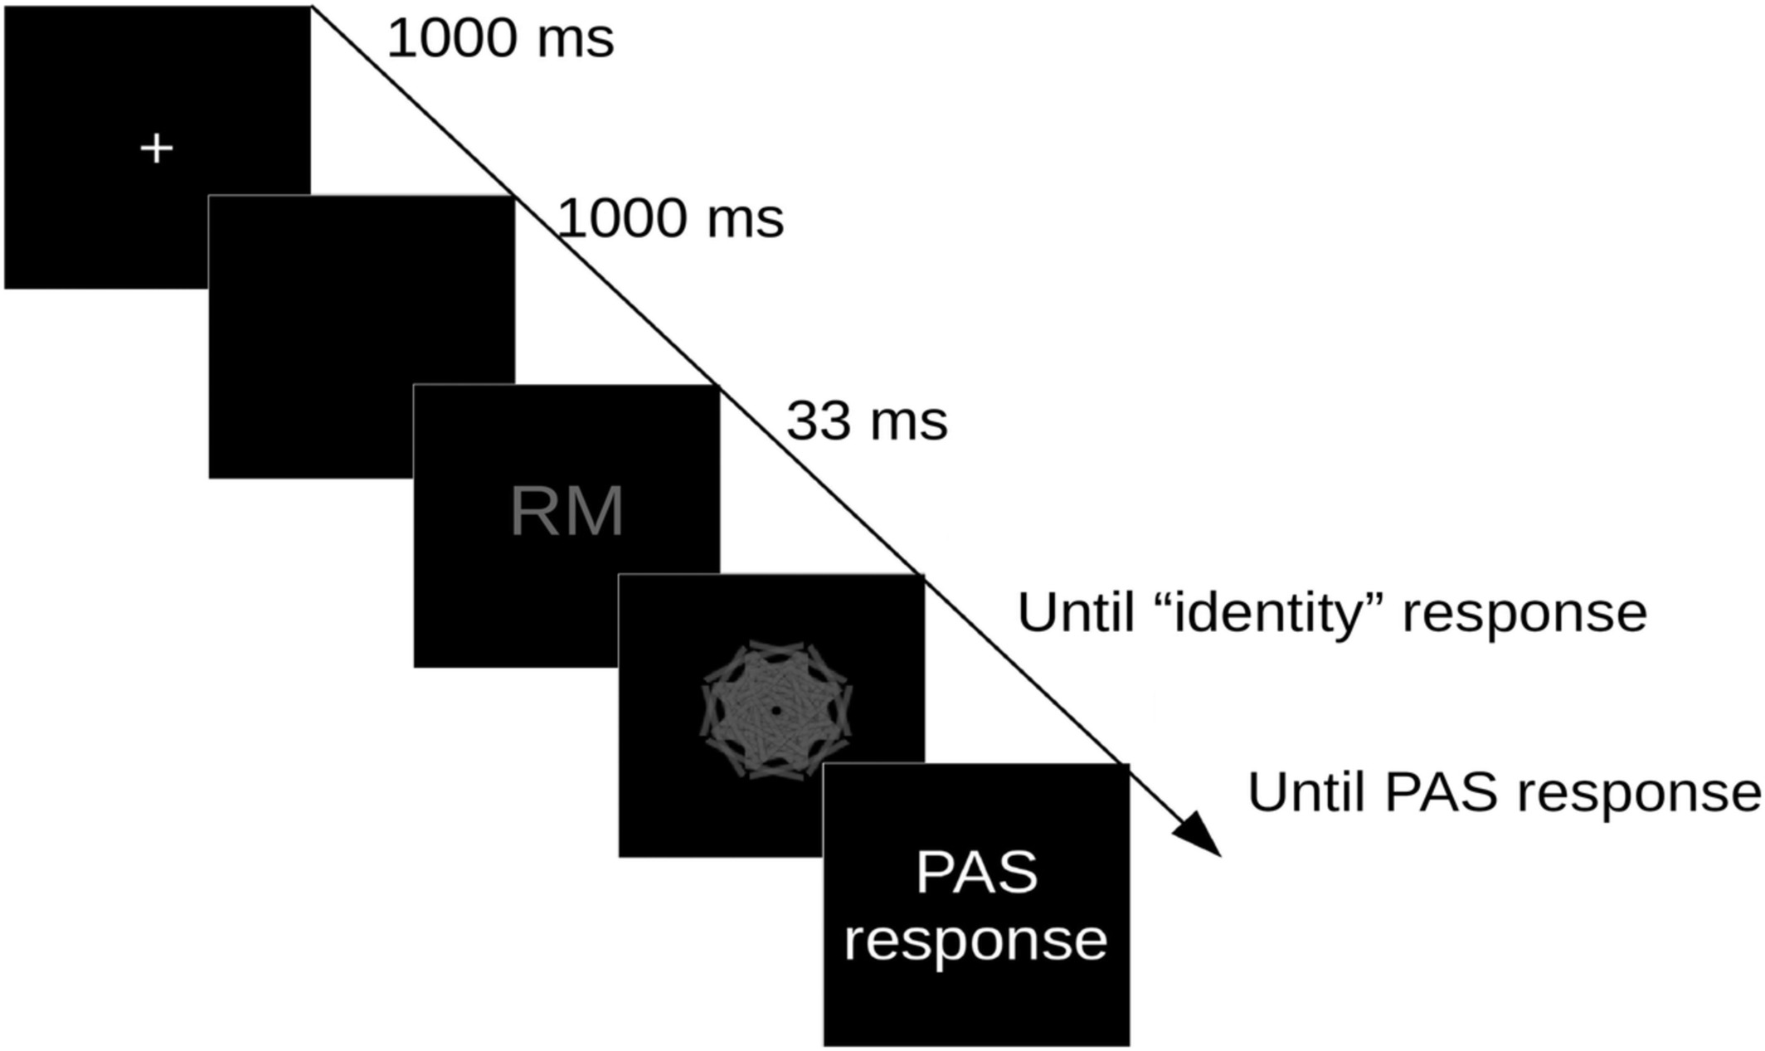
Paradigm – 800 repetitions

Slide 2
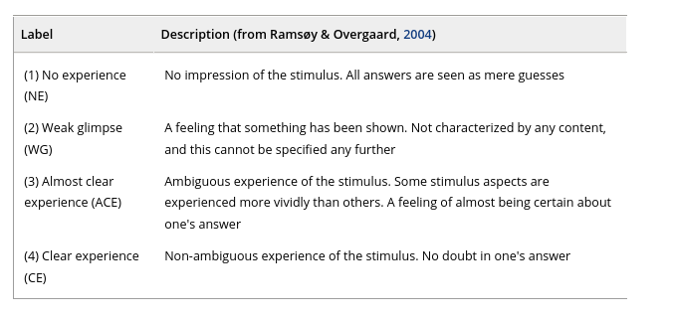

Slide 3
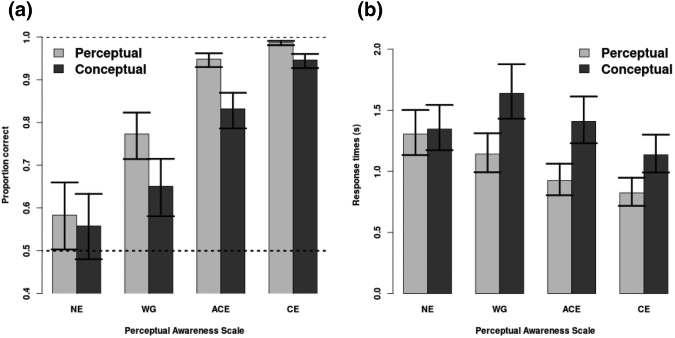
Behavioural results

Slide 4
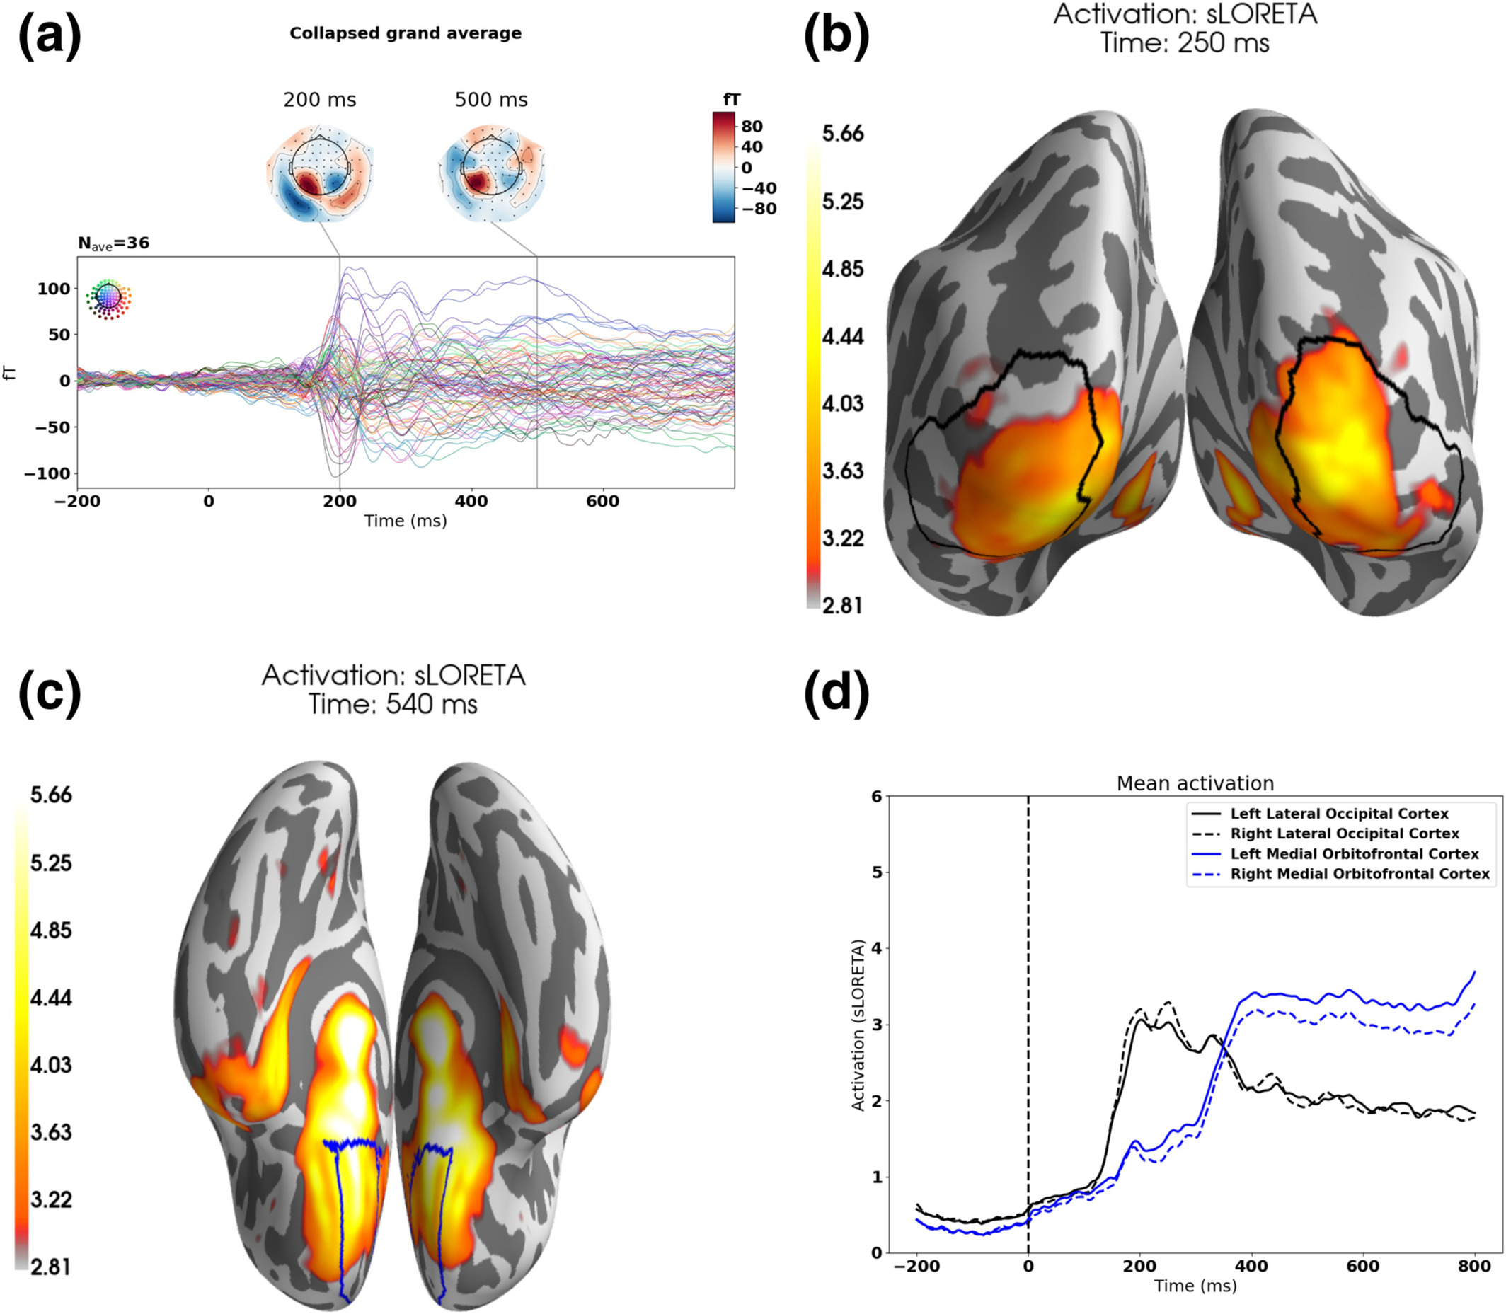
Average over
(36 subjects x
800 trials x)
102 sensors x
251 time points
you will be looking at
1 subject x
682 trials x
102 sensors x
251 time points

Slide 5
Also check out Emil Trencker Jessen’s slides
(In GitHub Classroom)

