Slide 1
Methods 3: Multilevel Statistical Modeling and Machine Learning
Week 07: Linear and logistic regression revisited (machine learning) October 22, 2024

Slide 2
The course plan
Week 1: Introduction
Instructor sessions: Setting up R and Python and recollection of the general linear model
Week 2: Multilevel linear regression
Instructor sessions: Modelling subject level effects – and how do they differ from group level effects?
Week 3: Link functions and fitting generalised linear multilevel models
Instructor sessions: What to do when the response variable is not continuous?
Week 4: Evaluating Generalised linear mixed models
Instructor sessions: How do we assess how models compare to one another?
Week 5: Explanation and Prediction
Instructor sessions: Code review
Week 6: Mid-way evaluation and Machine Learning Intro
Instructor sessions: Getting Python Running
Week 7: Linear and logistic regression revisited (machine learning)
Instructor sessions: Categorizing responses based on informed guesses
Week 8: Model evaluation and hyperparameter tuning
Instructor sessions: Code review
Week 9: Dimensionality Reduction, Principled Component Analysis (PCA)
Instructor sessions: What to do with very rich data?
Week 10: Outlook, unsupervised classification and neural networks
Instructor sessions: Data with no labels and networks
Week 11: Organising and preprocessing messy data
Instructor sessions: Code review
Week 12: Final evaluation and wrap-up of course
Instructor sessions: Ask anything!

Slide 3
Mid-way evaluation
TOTAL ANSWERS = 51

Slide 4
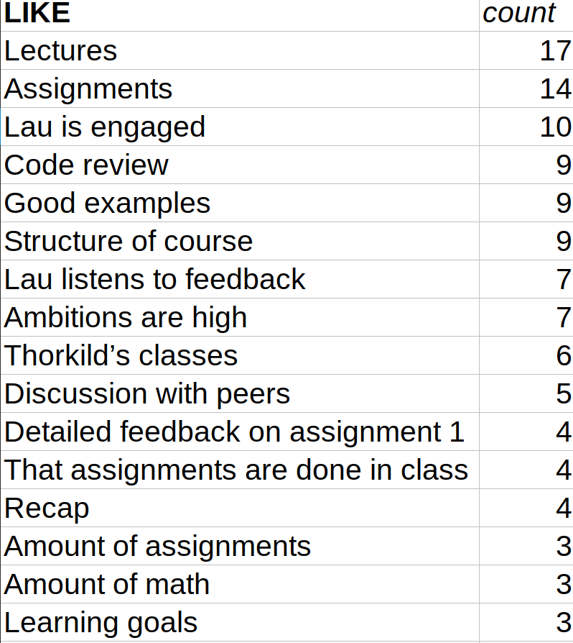
n≥3

Slide 5
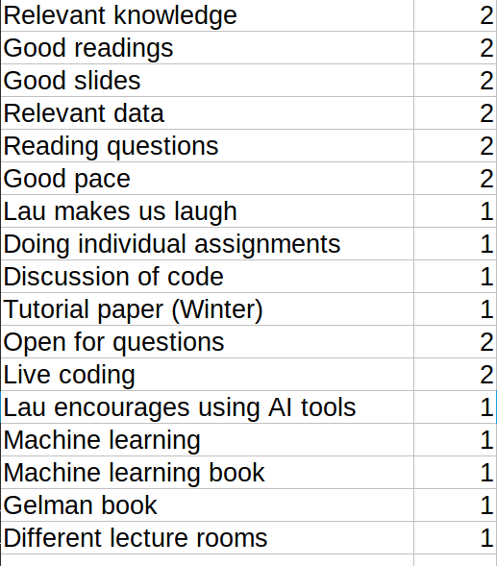
n<3

Slide 6
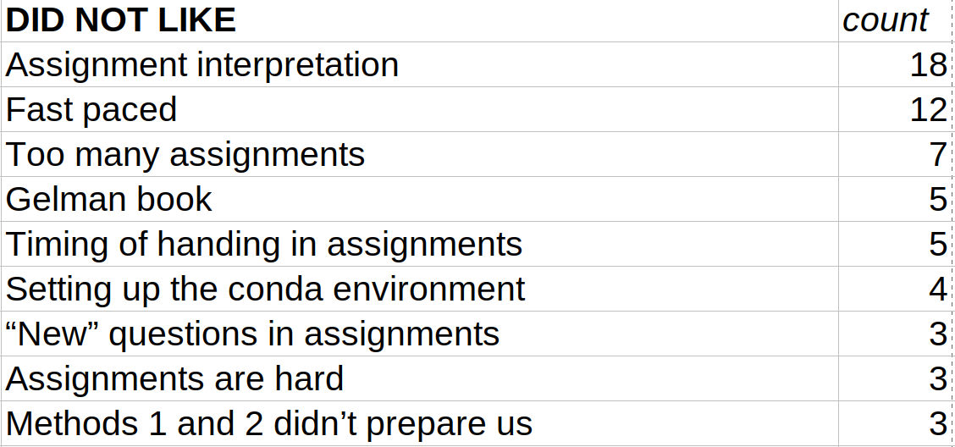
n≥3

Slide 7
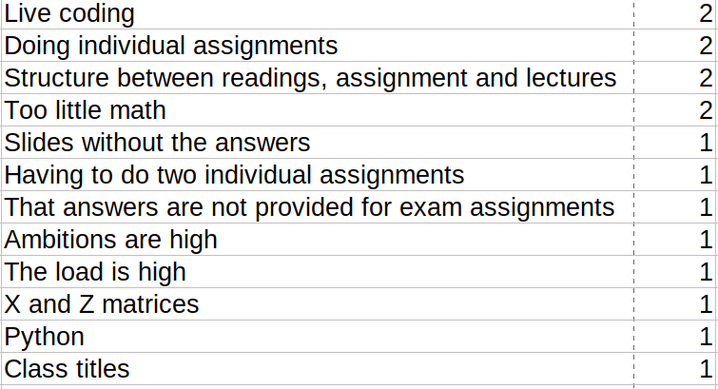
n<3

Slide 8
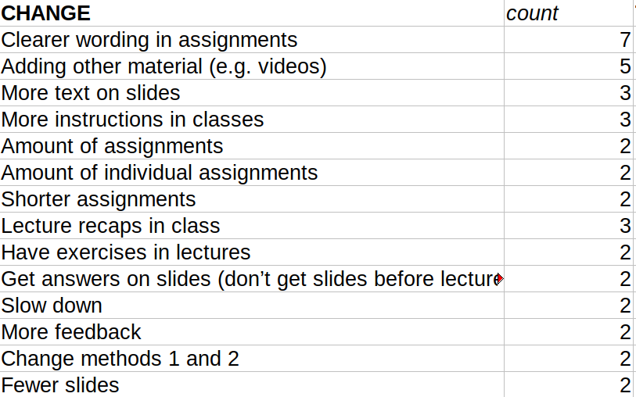
n≥2

Slide 9
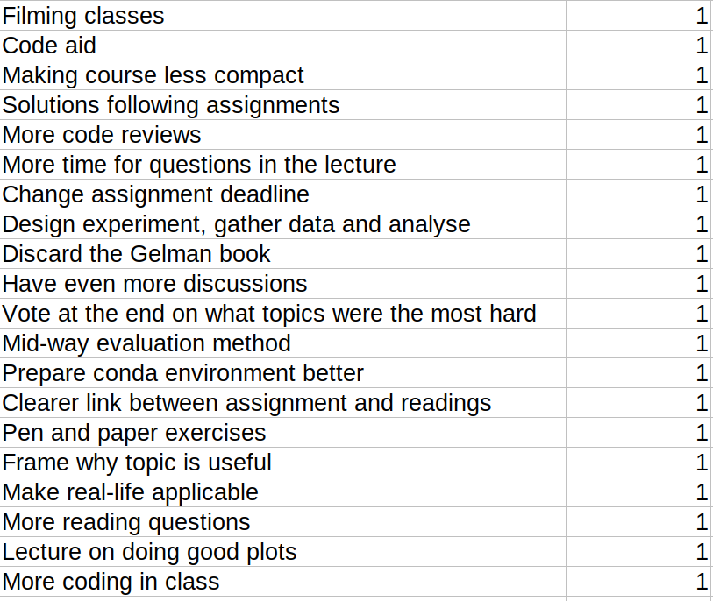
n<2

Slide 10
Summary – what we promise to change
I will be very careful and aim at writing questions that are easy to understand
Thorkild will add some good videos

Slide 11
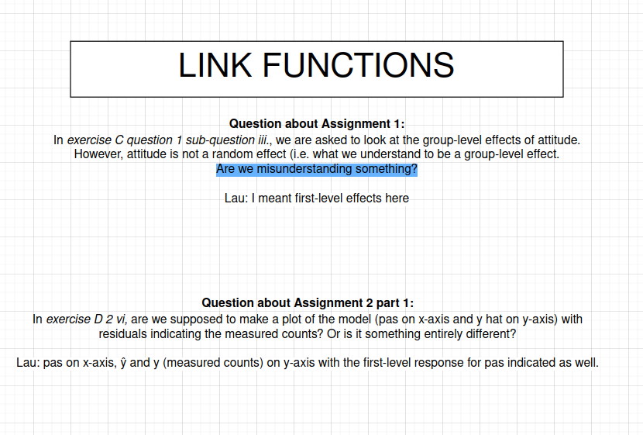
What you should change – start asking questions!

Slide 12
Next year – conda installation
I will be able to borrow a Windows computer and a Mac computer to test the setup

Slide 13
Recap
We have feature vectors, x^{(i)}, for which we try to find the optimal weights, w.
  Similar to Xβ
The optimal w’s for the are the ones that minimise the error
  Two kinds of error:
    Perceptron
      training data error: n misclassifications on training data
      test data error: n misclassifications when generalised to test data
    ADALINE
      training data error: sum of squared errors on training data
      test data error: n misclassifications when generalised to test data
    Linear regression
      training data error: sum of squared errors on training data
      test data error: mean of squared errors when generalised to test data
Our primary outcome is the test data error

Slide 14
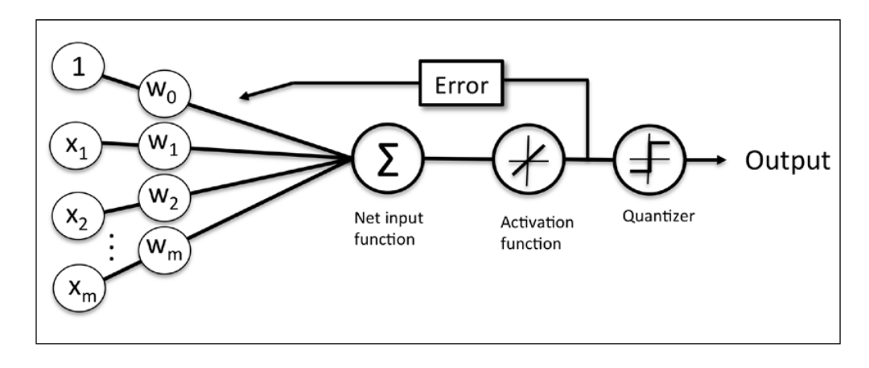
Recap
training data error
basis for test data error
Features
Weights
adapted from (p. 33: Raschka, 2015)

Slide 15
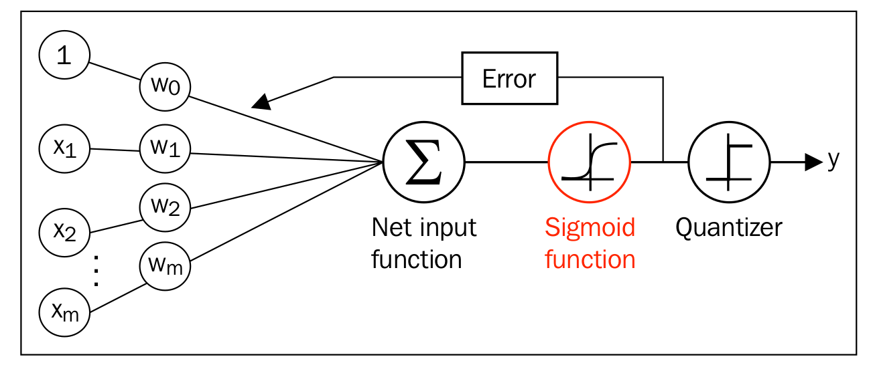
Moving to logistic regression
(p. 33: Raschka, 2015)
(p. 58: Raschka, 2015)

Slide 16
Learning goals and outline
Linear and logistic regression revisited (machine learning)
Understanding how linear and logistic regression can be adapted to a classification framework
Understanding how gradient descent can provide a common framework across regression fits
Getting acquainted with Support Vector Machines

Slide 17
WHY LOGISTIC REGRESSION?

Slide 18
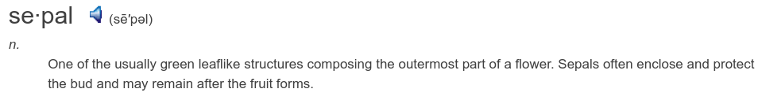
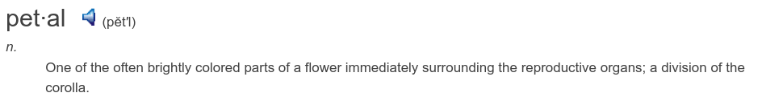

Let’s have a look at an iris flower
https://i.ytimg.com/vi/E8Nrl9QLNq8/maxresdefault.jpg

Slide 19
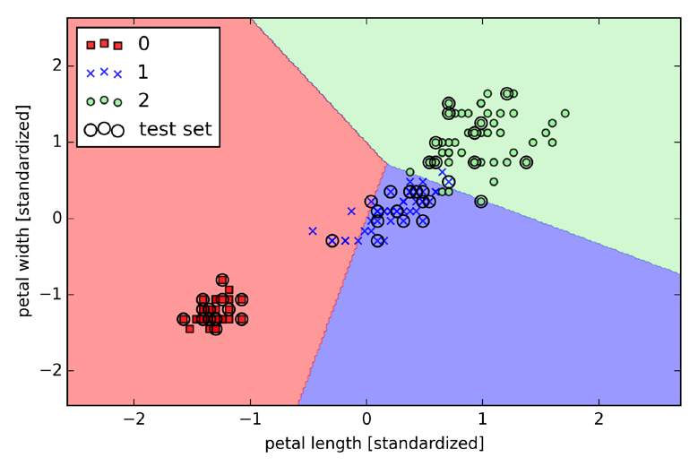
The problem (Perceptron)
Not linearly separable →never converges
(p. 55: Raschka, 2015)

Slide 20
WANTED: an algorithm that converges with linearly separable regions that minimise the number of errors made

Slide 21
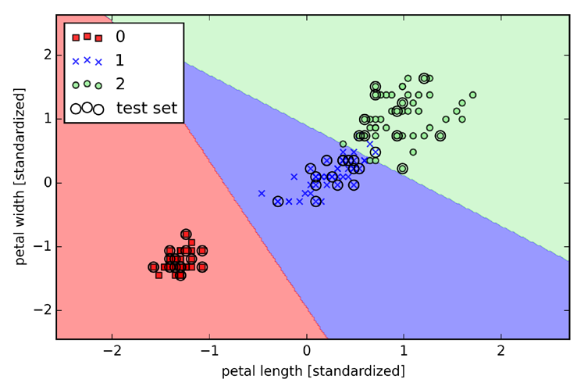
Something like this
LOGISTIC REGRESSION
(p. 63: Raschka, 2015)
Separates flowers, while keeping errors at a minimum

Slide 22
What’s our cost function, J(w)?
i.e. how do we calculate this?

Slide 23
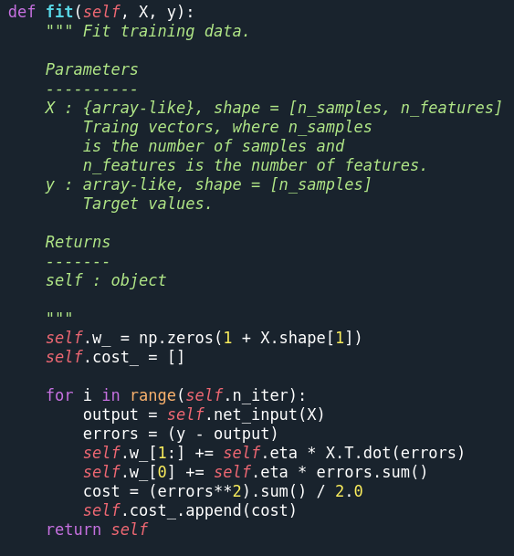
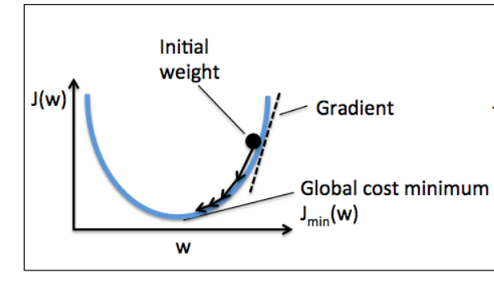
Updating weights
ADALINE fit
Where have you seen this before?
(p. 40: Raschka, 2015)

Slide 24
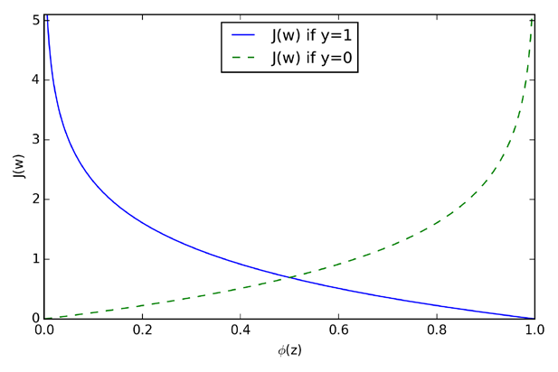
Cost function for one instance
(p. 61: Raschka, 2015)

Slide 25
L1 and L2 regularisation
NB! Regularisation in sklearn.linear_model.LogisticRegression is controlled by C

Slide 26
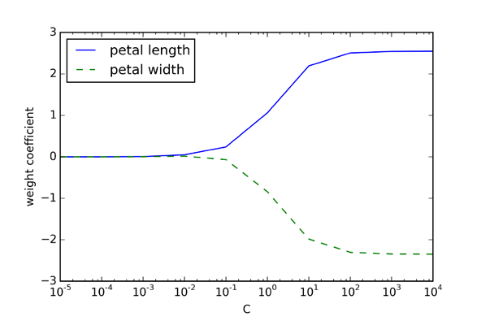
L2 regularisation
(p. 68: Raschka, 2015)

Slide 27
Updating weights – the general case
proof on p. 64
ADALINE fit
(p. 40: Raschka, 2015)

Slide 28
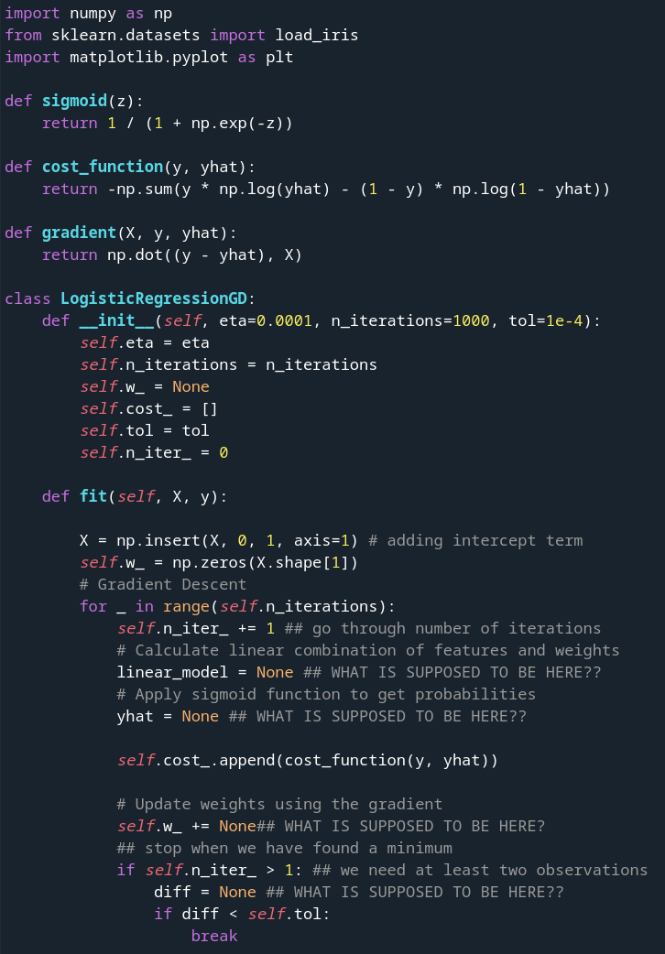
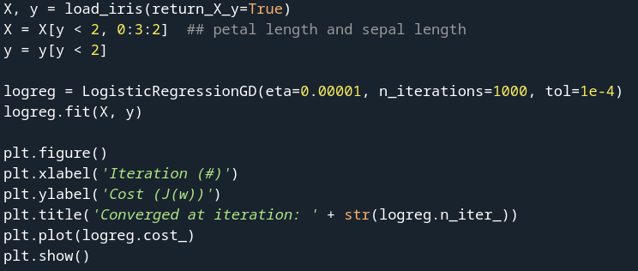
Exercise in class
Find code on Brightspace

Slide 29
Interim summary
Gradient descent can be put into a common framework
  we would thus also be able to do Poisson machine learning (not covered here), and any other transformation that would be meaningful
Now, we need to move beyond fitting and test

Slide 30
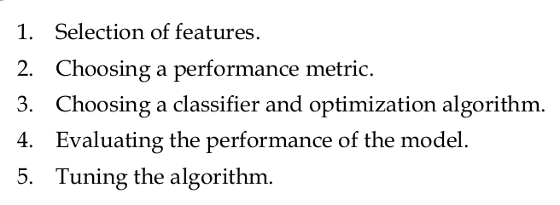
Steps of machine learning analysis
(p. 50: Raschka, 2015)

Slide 31
1. Selection of features, i.e. X
https://i.ytimg.com/vi/E8Nrl9QLNq8/maxresdefault.jpg
It is a good idea to standardise these

Slide 32
2. Choosing a performance metric
E.g. Accuracy of classification or Reduction of error

Slide 33
3. Choosing a classifier and an optimization algorithm
Logistic regression and gradient descent
Linear regression and gradient descent

Slide 34
4. Evaluating the performance of the model
Perform out-of-sample testing
Do this in a cross-validated manner where the data, several times, is partitioned into training and test data sets, to minimise bias.

Slide 35
5. Tuning our model
If our model performs better on the training data than on the test data, we are likely to be overfitting. Regularisation could be a solution. We can do e.g. grid search or randomised search (next week) to find the optimal C-values in logistic and linear regression
We could also try to reduced the number of features in the model and only retain the ones explaining the most variance, thereby reducing the risk of overfitting, e.g. by using Principled component analysis (in two weeks)

Slide 36
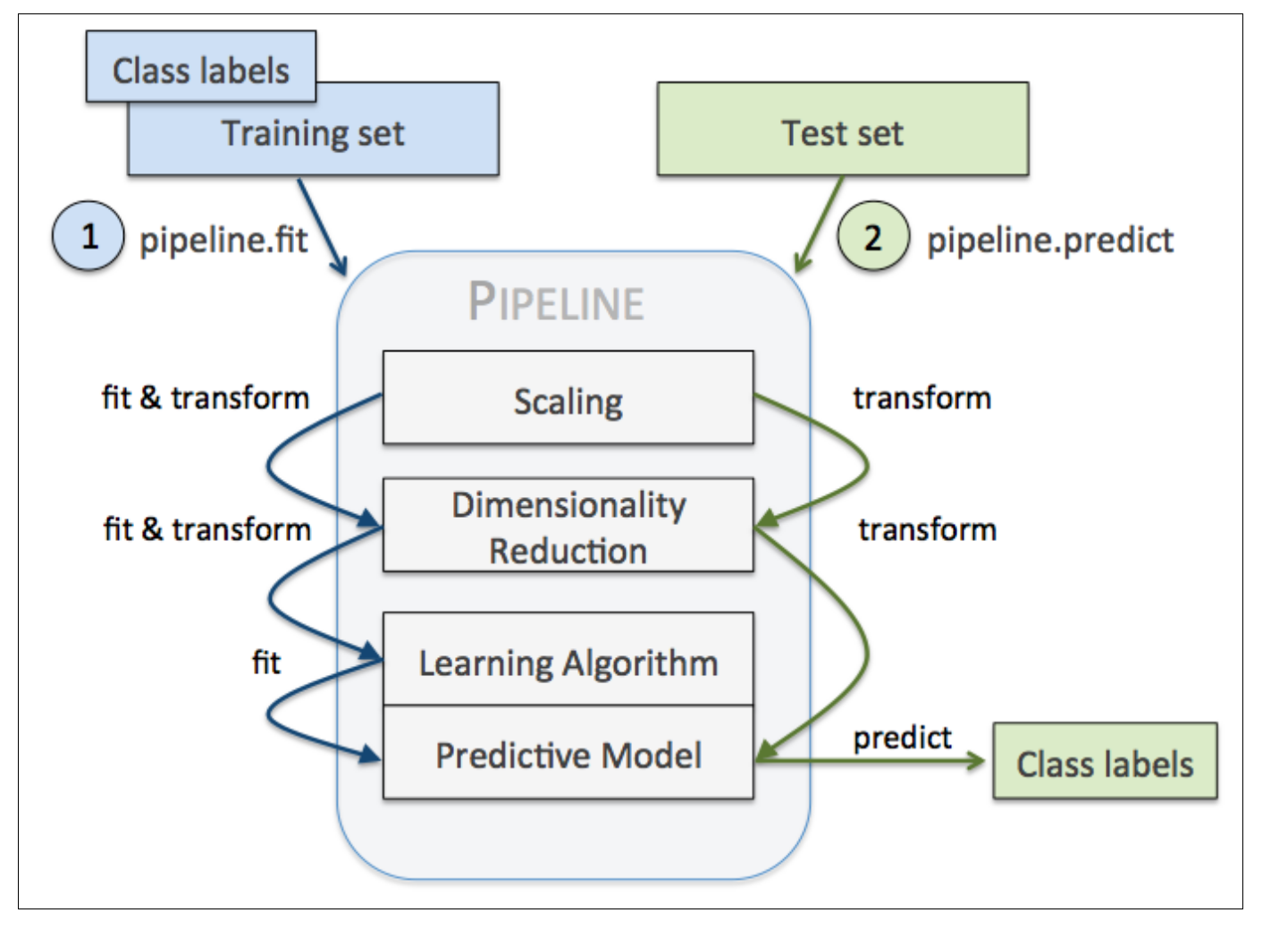

General structure
(p. 172: Raschka, 2015)
Can be implemented in scikit-learn (in four weeks)
‘
https://scikit-learn.org/stable/auto_examples/compose/plot_digits_pipe.html#sphx-glr-auto-examples-compose-plot-digits-pipe-py

Slide 37
Live coding
RUNNING LOGISTIC REGRESSION

Slide 38
SUPPORT VECTOR MACHINES

Slide 39
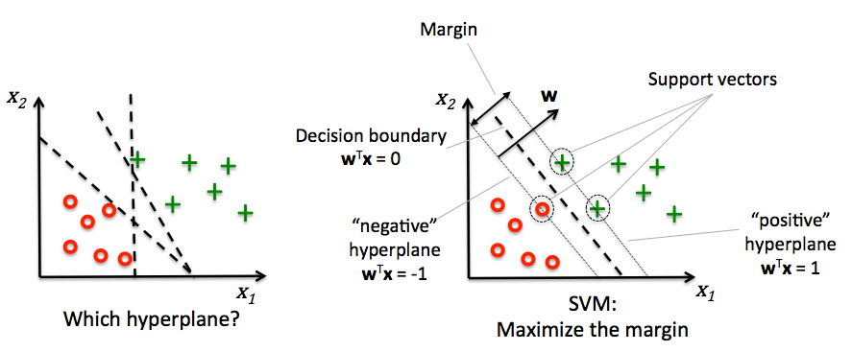
(p. 69: Raschka, 2015)

Slide 40
(p. 69: Raschka, 2015)
QUESTION: What is the subtraction of equation (2) from equation (1) equal to on the figure?

Slide 41
Subtraction

Slide 42
This will optimise the width of the margin
(p. 69: Raschka, 2015)

Slide 43
This faces a problem that the Perceptron also faces
Which?

Slide 44
SOLUTION: introducing a slack variable ξ (xi)

Slide 45
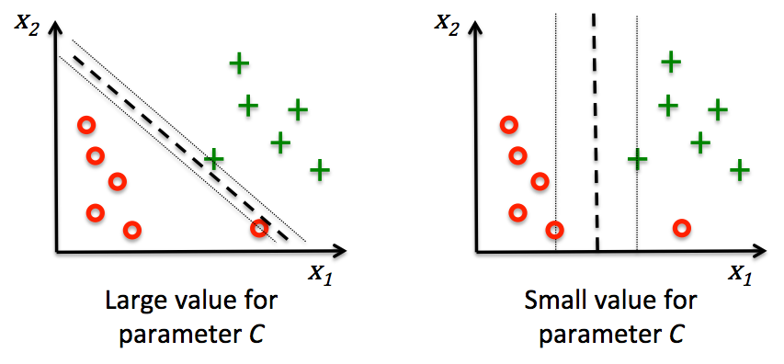
Introducing ξ
(p. 72: Raschka, 2015)
Large C: narrow margin – penalises errors harshly
Small C: wide margin – penalises errors mildly

Slide 46
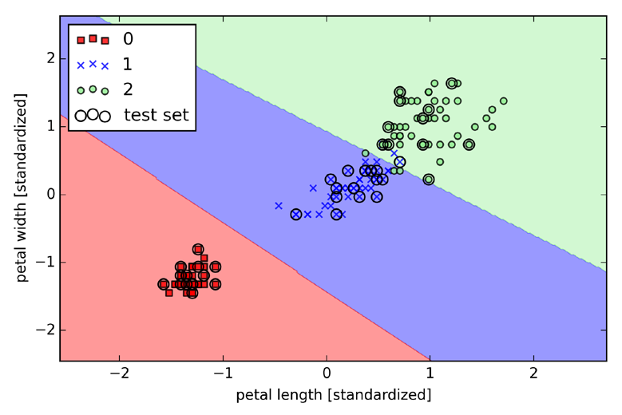
Comparison to logistic regression
Support Vector Machine (p.73,
Raschka 2015)
Logistic regression (p. 63,
Raschka 2015)

Slide 47
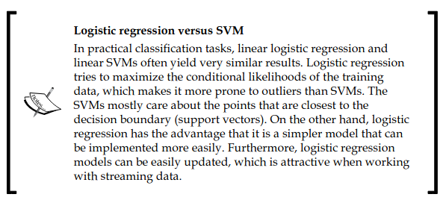
(p. 74: Raschka, 2015)

Slide 48
Summary
Our standard regression methods can be set up for prediction
Scikit-learn can help us set the whole pipeline for classification
Support Vector Machines are very similar to logistic regression, but may generalise better

Slide 49
Learning goals and outline
Linear and logistic regression revisited (machine learning)
Understanding how linear and logistic regression can be adapted to a classification framework
Understanding how gradient descent can provide a common framework across regression fits
Getting acquainted with Support Vector Machines

Slide 50
The course plan
Week 1: Introduction
Instructor sessions: Setting up R and Python and recollection of the general linear model
Week 2: Multilevel linear regression
Instructor sessions: Modelling subject level effects – and how do they differ from group level effects?
Week 3: Link functions and fitting generalised linear multilevel models
Instructor sessions: What to do when the response variable is not continuous?
Week 4: Evaluating Generalised linear mixed models
Instructor sessions: How do we assess how models compare to one another?
Week 5: Explanation and Prediction
Instructor sessions: Code review
Week 6: Mid-way evaluation and Machine Learning Intro
Instructor sessions: Getting Python Running
Week 7: Linear and logistic regression revisited (machine learning)
Instructor sessions: Categorizing responses based on informed guesses
Week 8: Model evaluation and hyperparameter tuning
Instructor sessions: Code review
Week 9: Dimensionality Reduction, Principled Component Analysis (PCA)
Instructor sessions: What to do with very rich data?
Week 10: Outlook, unsupervised classification and neural networks
Instructor sessions: Data with no labels and networks
Week 11: Organising and preprocessing messy data
Instructor sessions: Code review
Week 12: Final evaluation and wrap-up of course
Instructor sessions: Ask anything!

Slide 51
Next time
Doing search for the best hyperparameters
Confusion matrices
Validation Accuracy

Slide 52
Extra slides on non-linear SVM’s

Slide 53
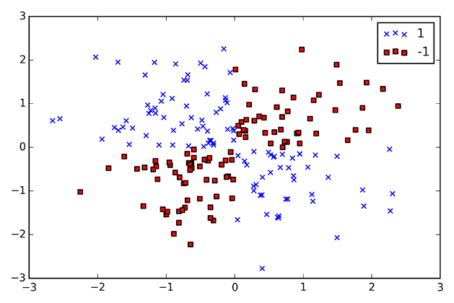
A brief look at a non-linear problem
(p. 75: Raschka, 2015)

Slide 54
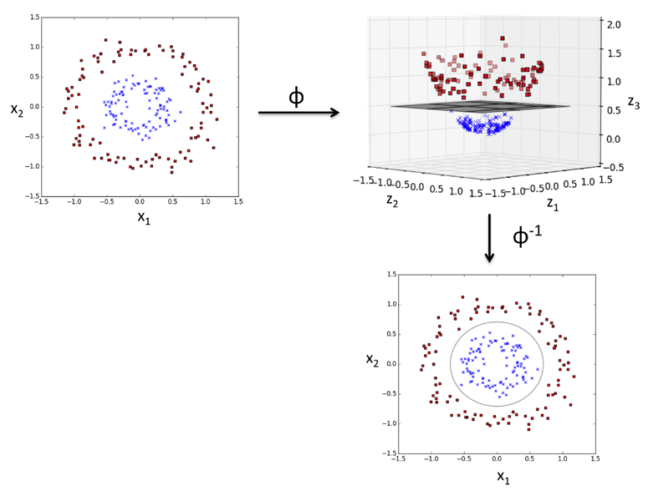
Map onto higher-dimensional space
Note that a linear solution is made

Slide 55
Creating the higher dimensions can be computationally expensive

Slide 56
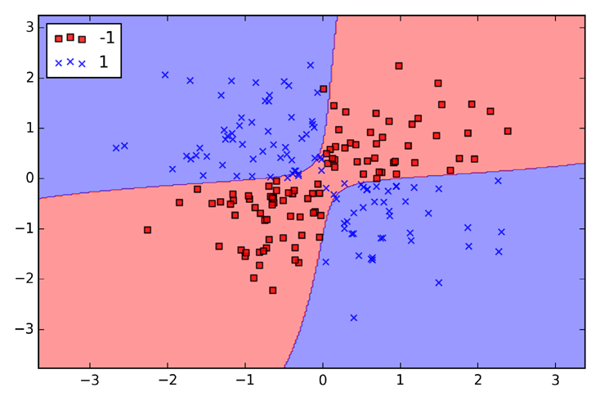
Non-linear decision boundaries
(p. 78: Raschka, 2015)

Slide 57
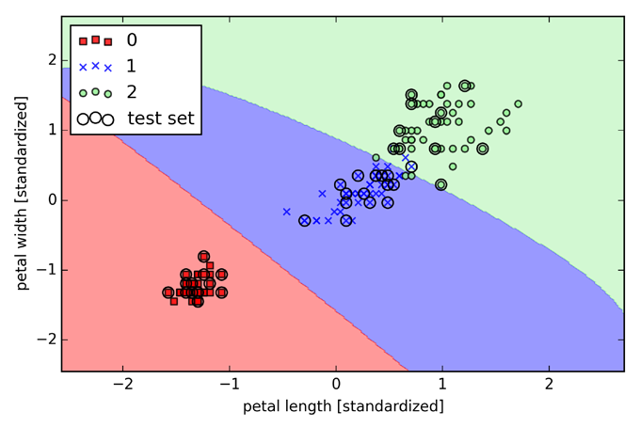
(p. 79: Raschka, 2015)

Slide 58
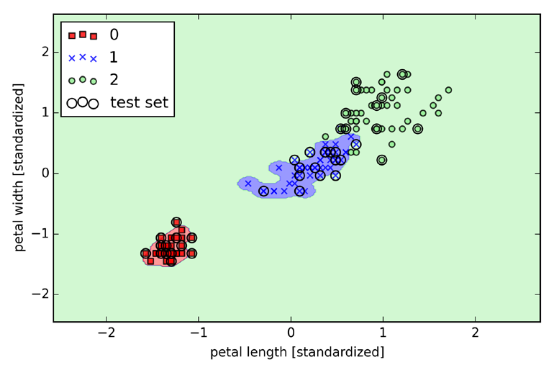
(p. 80: Raschka, 2015)

