Slide 1
Methods 3: Multilevel Statistical Modeling and Machine Learning
Week 8: Model evaluation and hyperparameter tuning
October 29, 2024

Slide 2
Structure of lecture
Me talking
  Understanding the data
Discussion points
Live coding
In-lecture exercises
  At least one

Slide 3
The course plan
Week 1: Introduction
Instructor sessions: Setting up R and Python and recollection of the general linear model
Week 2: Multilevel linear regression
Instructor sessions: Modelling subject level effects – and how do they differ from group level effects?
Week 3: Link functions and fitting generalised linear multilevel models
Instructor sessions: What to do when the response variable is not continuous?
Week 4: Evaluating Generalised linear mixed models
Instructor sessions: How do we assess how models compare to one another?
Week 5: Explanation and Prediction
Instructor sessions: Code review
Week 6: Mid-way evaluation and Machine Learning Intro
Instructor sessions: Getting Python Running
Week 7: Linear and logistic regression revisited (machine learning)
Instructor sessions: Categorizing responses based on informed guesses
Week 8: Model evaluation and hyperparameter tuning
Instructor sessions: Code review
Week 9: Dimensionality Reduction, Principled Component Analysis (PCA)
Instructor sessions: What to do with very rich data?
Week 10: Outlook, unsupervised classification and neural networks
Instructor sessions: Data with no labels and networks
Week 11: Organising and preprocessing messy data
Instructor sessions: Code review
Week 12: Final evaluation and wrap-up of course
Instructor sessions: Ask anything!

Slide 4
Recap
We saw how gradient descent provides a common framework for fitting several kinds of models
We saw a need to test the effects of hyperparameters in a consistent way
We were introduced to Support Vector Machines

Slide 5
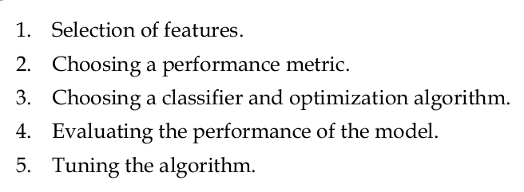
Recap
STEPS OF MACHINE LEARNING ANALYSIS
Next time, PCA
Next time, PCA
Today
Today
(p. 50: Raschka, 2015)

Slide 6
Learning goals and outline
Model evaluation and hyperparameter tuning
Understanding how cross-validation can improve validity
Understanding and being able to apply Pipeline from scikit-learn
Being able to run an analysis optimising the hyperparameters

Slide 7
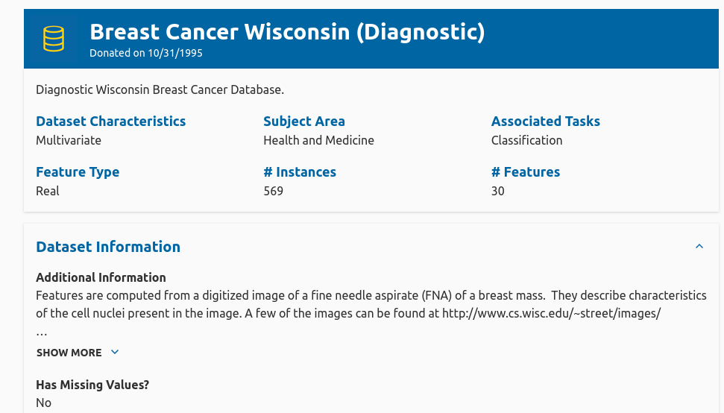
Breast Cancer Wisconsin
https://archive.ics.uci.edu/dataset/17/breast+cancer+wisconsin+diagnostic

Slide 8
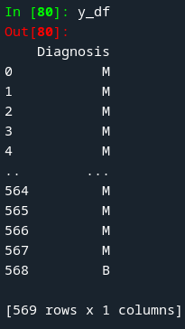
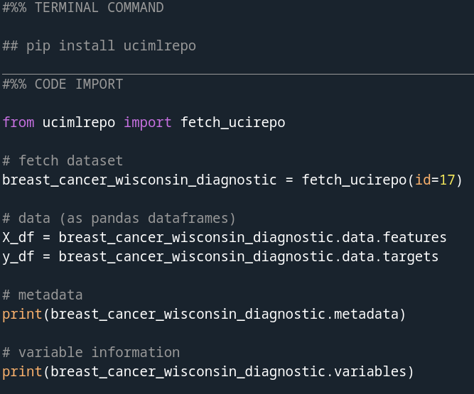
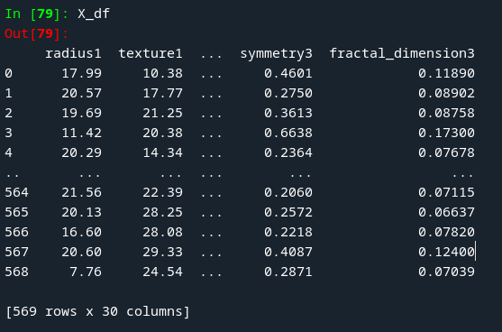
The data

Slide 9
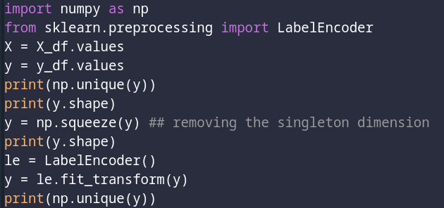

Label encoding

Slide 10
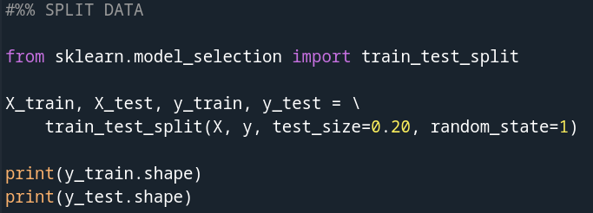

Training and test data split
ALSO CALLED HOLDOUT METHOD

Slide 11
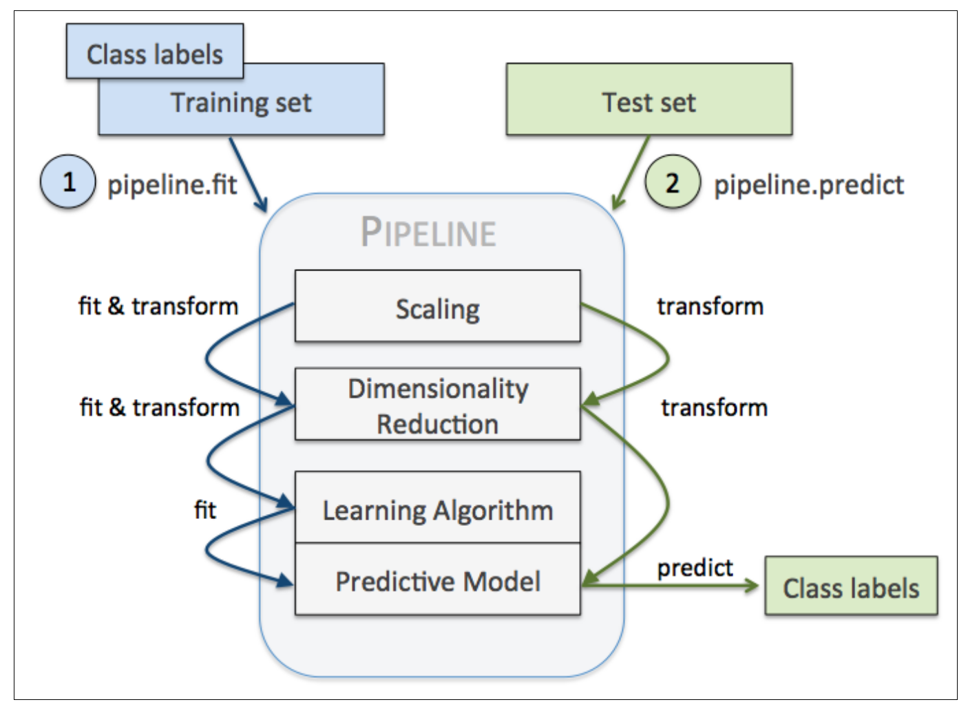
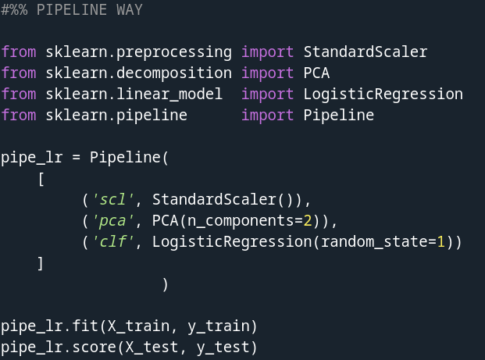
Pipeline
(p. 172: Raschka, 2015)

Slide 12
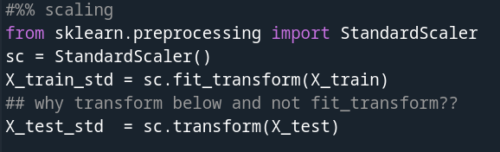
What does the pipeline do?
SCALING

Slide 13
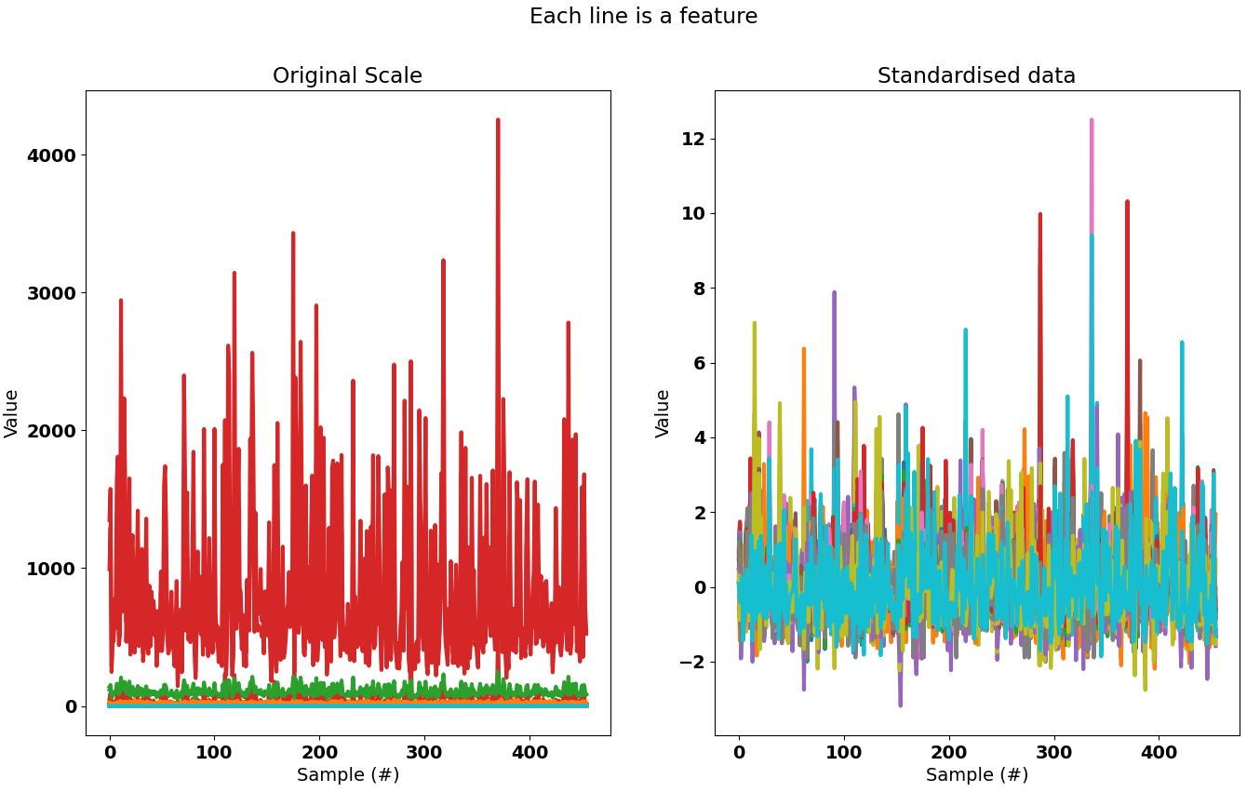
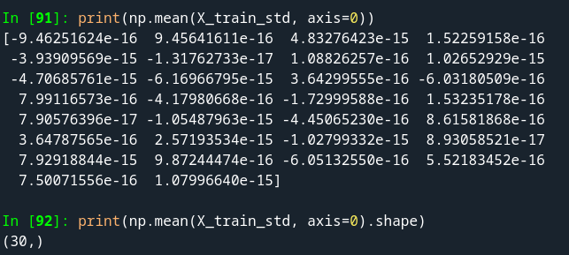

What does the pipeline do?
SCALING
µ ≈ 0; σ ≈ 1

Slide 14
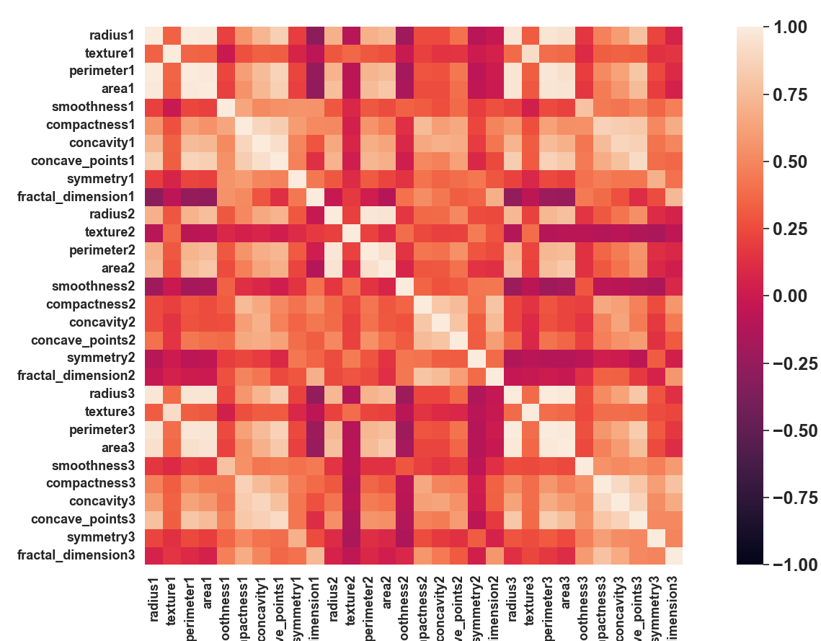
Normalised covariance matrix

Slide 15
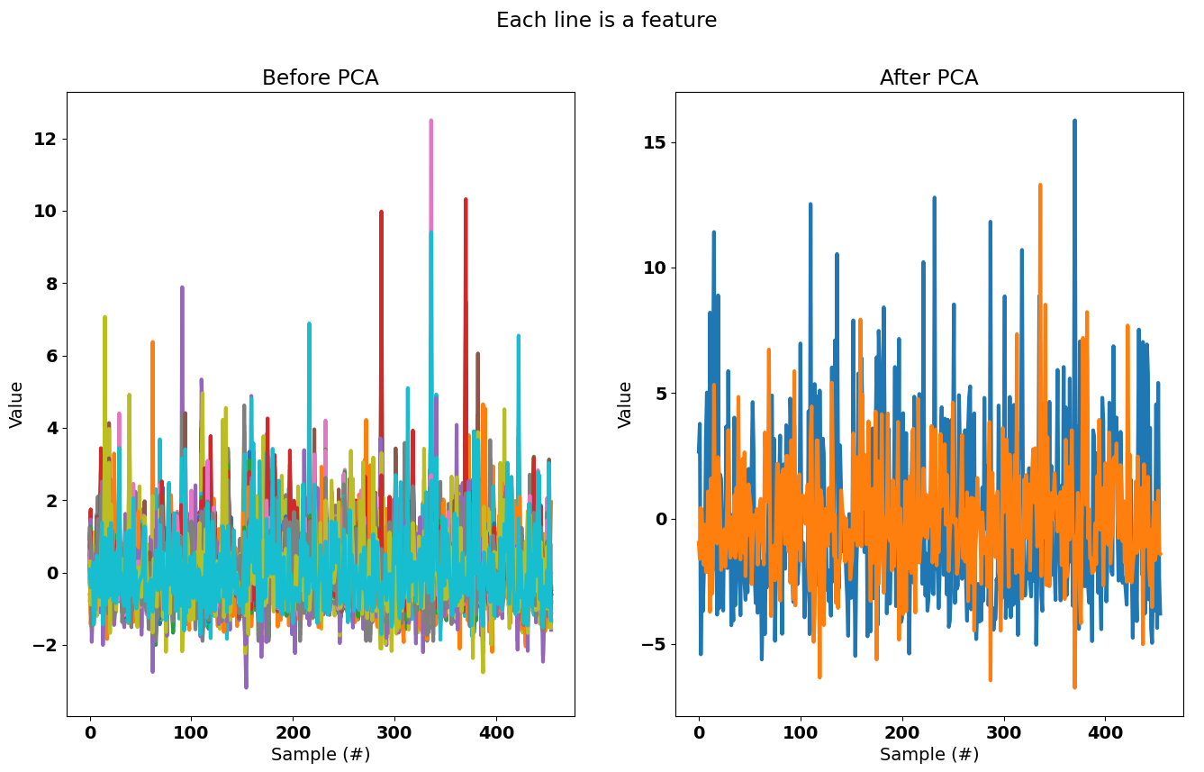
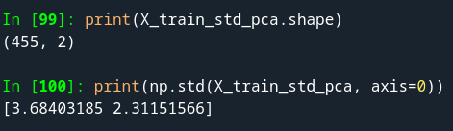

What does the pipeline do?
PCA

Slide 16
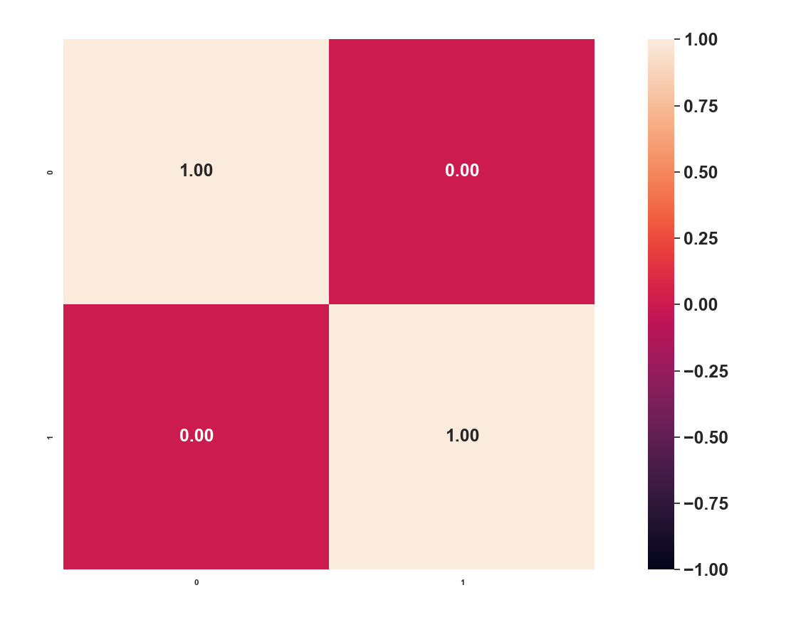
Normalised covariance matrix
PCA: 2 FEATURES

Slide 17

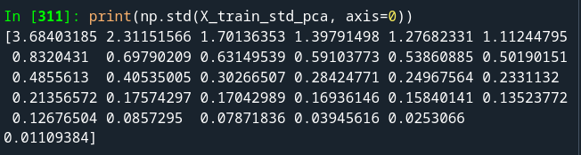
Normalised covariance matrix
PCA: 30 FEATURES

Slide 18
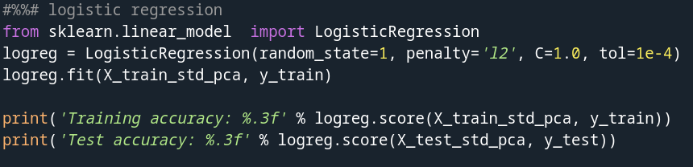

What does the pipeline do?
LOGISTIC REGRESSION

Slide 19
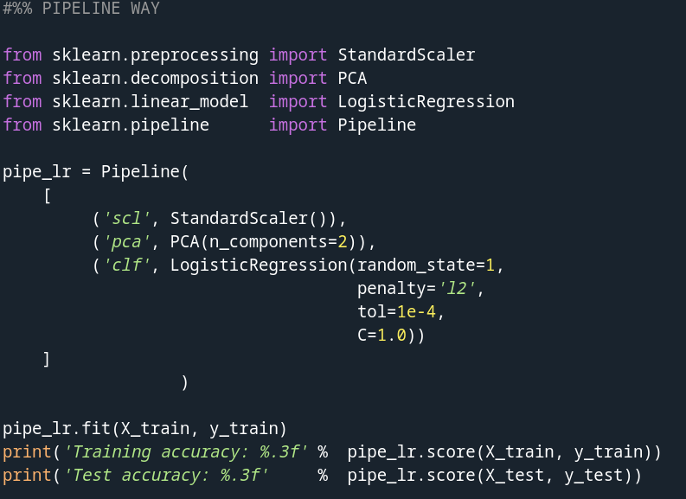
What does the pipeline do?
ALL TOGETHER

Slide 20
DISCUSSION POINT
1. Which are the hyperparameters here?
2. Using the holdout method, train_test_split, what may be a disadvantage if we want to find the optimal set of hyperparameters?

Slide 21
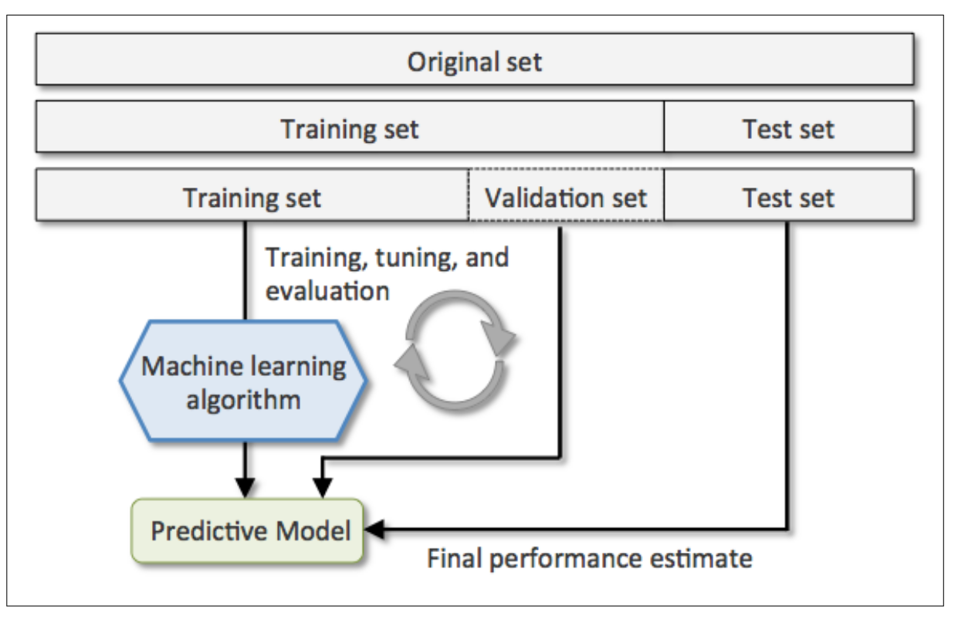
Validation set
(p. 174: Raschka, 2015)

Slide 22
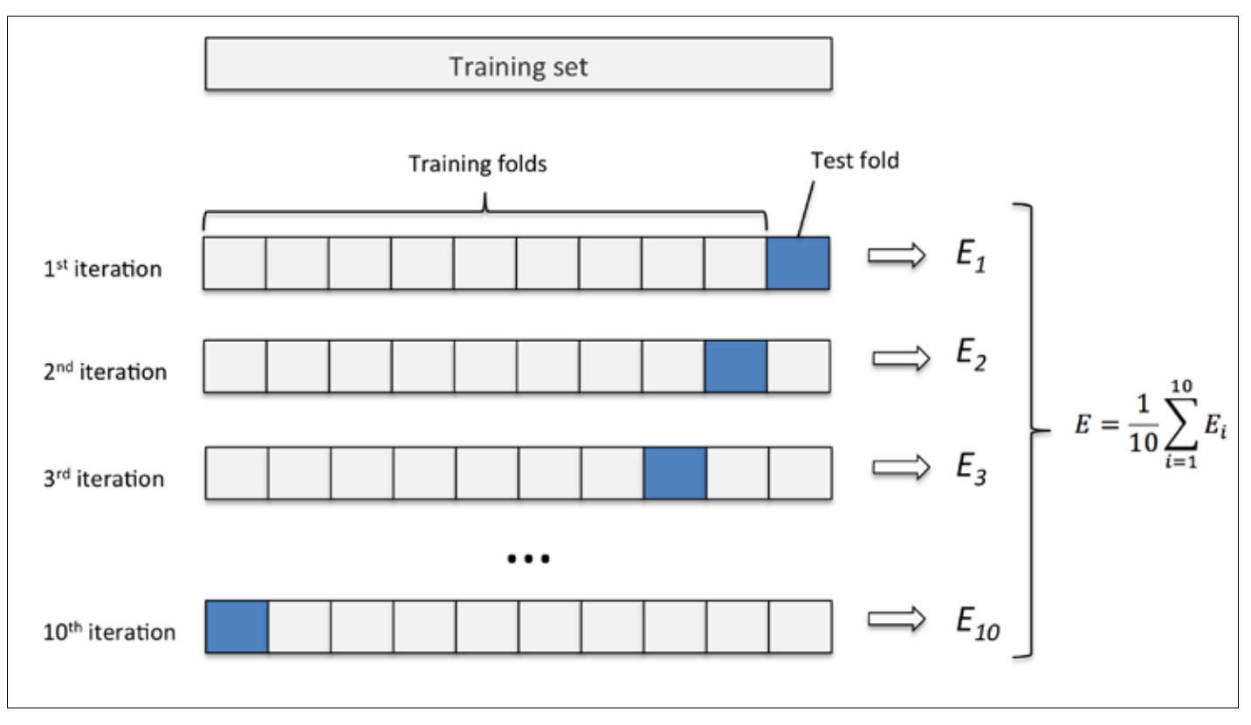
K-fold cross validation
(p. 176: Raschka, 2015)

Slide 23
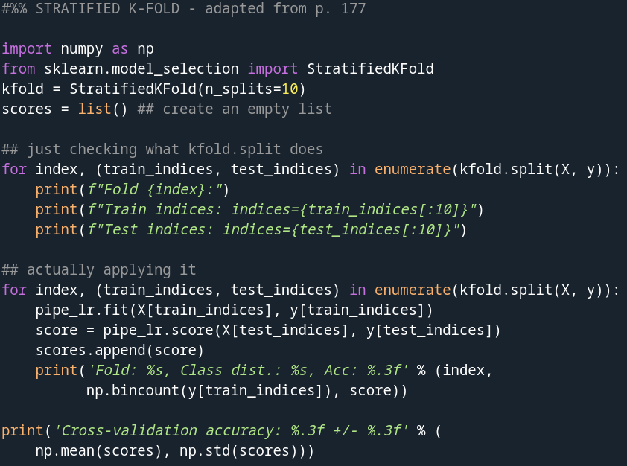
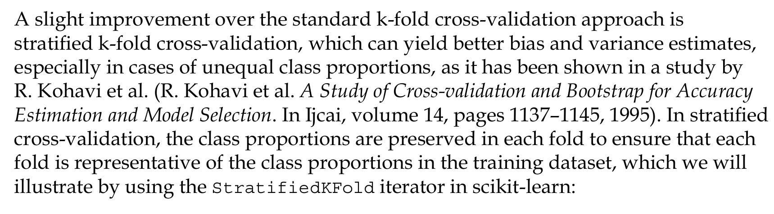
Stratified K-fold validation
Stratified – making sure that there is an equal count of each category for each split – check the output of np.bincount
(p. 176: Raschka, 2015)

Slide 24
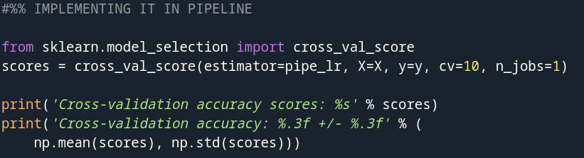
for cv_index in range(cv):
What does n_jobs do?
(p. 172: Raschka, 2015)

Slide 25
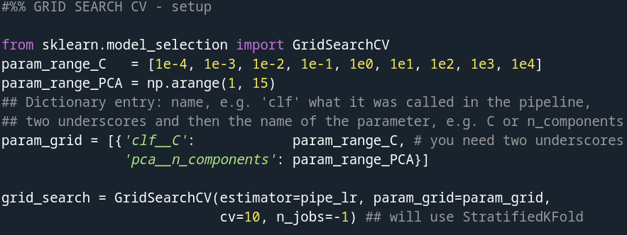
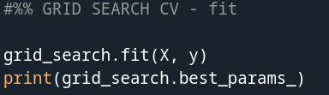

Grid Search

Slide 26
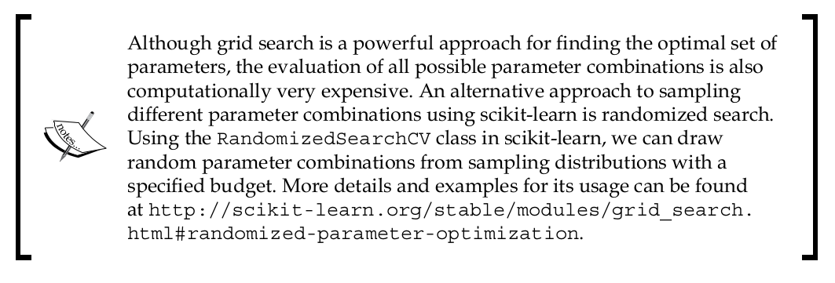
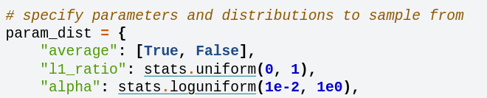
Randomised grid search
https://scikit-learn.org/stable/auto_examples/model_selection/plot_randomized_search.html#sphx-glr-auto-examples-model-selection-plot-randomized-search-py

Slide 27
Interim summary
Standardisation
  Makes linear and logistic regression fit more easily using gradient descent
Feature extraction
  PCA
    Reduces the number of dimensions and thus the risk of overfitting
Search of parameter space and cross-validation
  Allows one to find the best hyperparameters

Slide 28
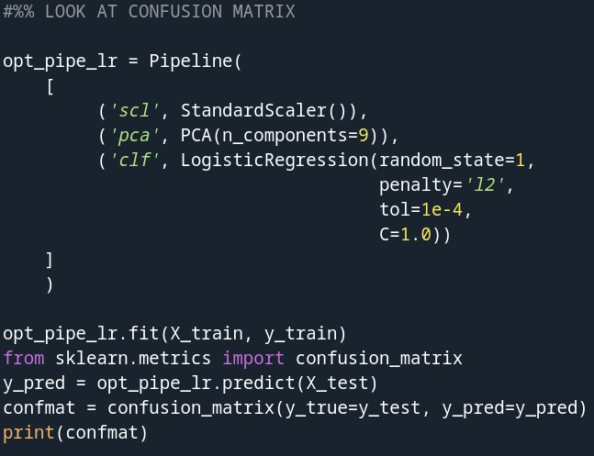
Confusion matrix

Slide 29
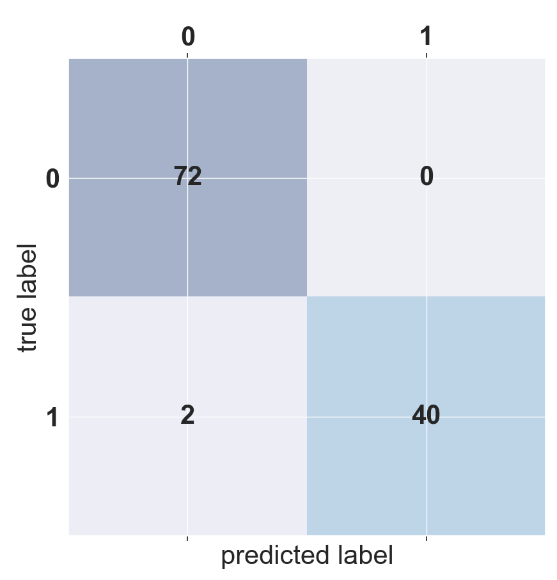
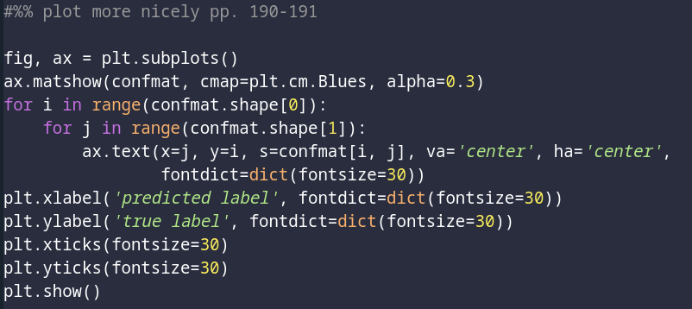
Confusion matrix
Discussion point:
What do each of the four squares represent?
0: Benign
1: Malignant

Slide 30
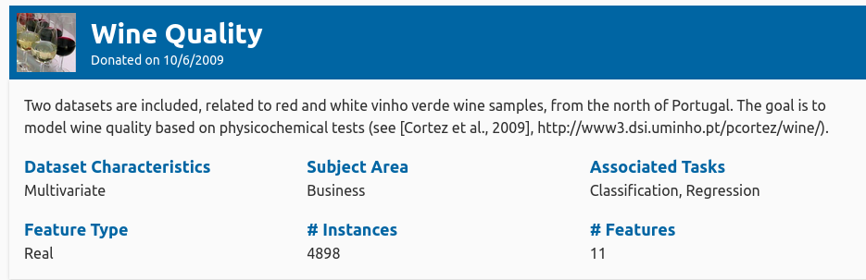
Exercise in lecture
WINE DATASET
https://archive.ics.uci.edu/dataset/17/breast+cancer+wisconsin+diagnostic

Slide 31
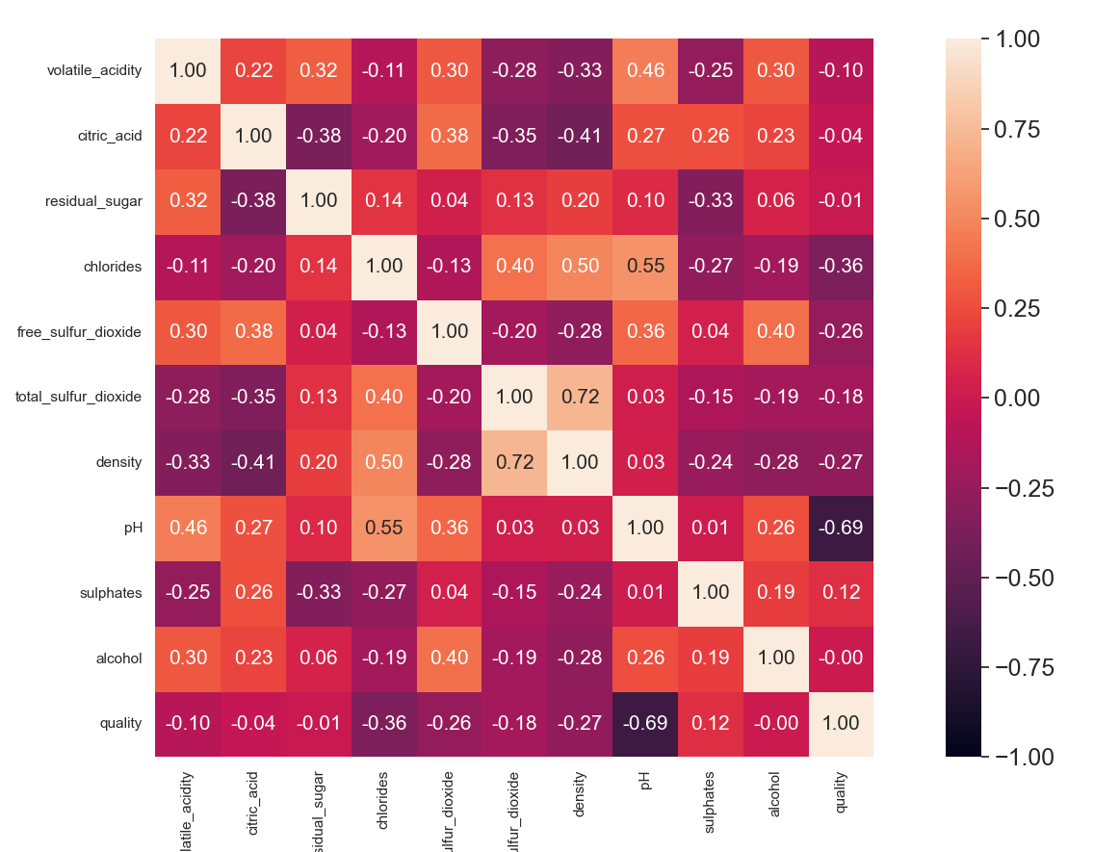
Normalised covariance matrix

Slide 32

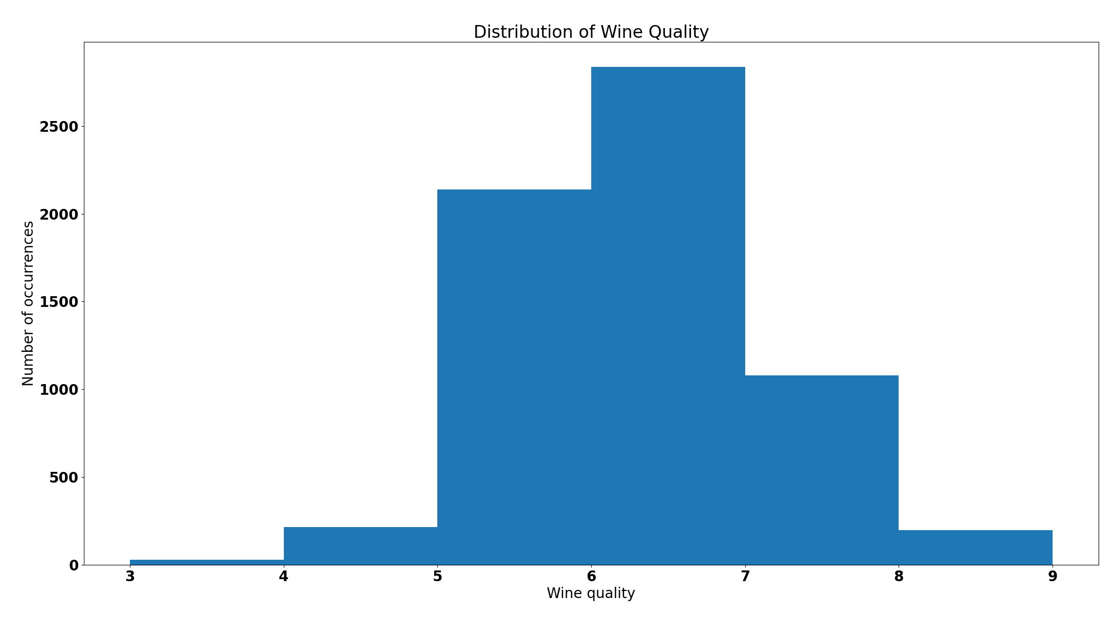
y-values

Slide 33
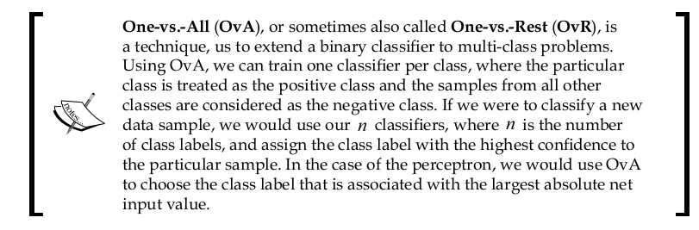
Binary vs. multiclass classification
ONE-VS-ALL
(p. 28: Raschka, 2015)

Slide 34
Binary vs. multiclass classification
MULTINOMIAL CLASSIFICATION
Example
pk: predicted probability for class k
zk: net value for class k
K: number of classes

Slide 35
Exercise in lecture
Overall aim: get the best classification in terms of accuracy, on a test set using logistic regression
There is a prize for the best classification found
Work in pairs or triplets
OPTIONAL: can you reach an even better score with SVM?

Slide 36
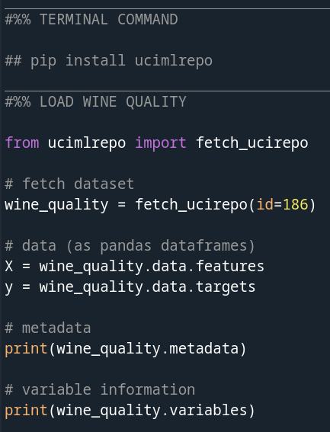
Load the data

Slide 37
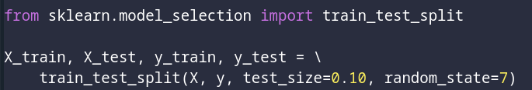
Split you must start with
Thus the final test will be on X_test and y_test as defined here using clf.score(X_test, y_test)
NB! This is different from how I did it

Slide 38
Suggested operations in no particular order
test penalisers: L1, L2 or elastic net
test different number of features in PCA space
make sure to use cross-validation appropriately
scale variables
try different solvers (check the solver argument of LogisticRegression)
try multinomial or OvR classification
make

Slide 39
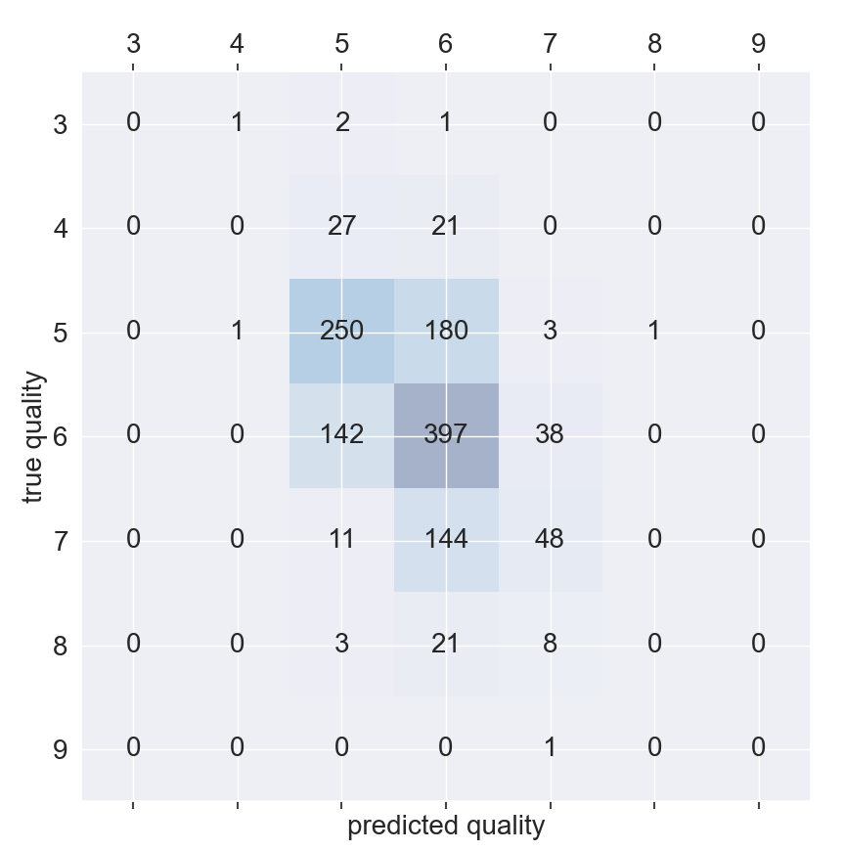
Also show your confusion matrix

Slide 40
Discuss
Name some characteristics of this data that makes it hard to reach “high” classification rate
Name some important steps in improving classification
Did multinomial or OvR perform better?

Slide 41
Summary
The space of hyperparameters can be quite large
  Therefore we need consistent ways of exploring them
Using a Pipeline is a good way to control things at a conceptual level within getting lost in the nitty-gritty
  But do visit the nitty-gritty every now and then to make sure you understand what is going on

Slide 42
Learning goals and outline
Model evaluation and hyperparameter tuning
Understanding how cross-validation can improve validity
Understanding and being able to apply Pipeline from scikit-learn
Being able to run an analysis optimising the hyperparameters

Slide 43
The course plan
Week 1: Introduction
Instructor sessions: Setting up R and Python and recollection of the general linear model
Week 2: Multilevel linear regression
Instructor sessions: Modelling subject level effects – and how do they differ from group level effects?
Week 3: Link functions and fitting generalised linear multilevel models
Instructor sessions: What to do when the response variable is not continuous?
Week 4: Evaluating Generalised linear mixed models
Instructor sessions: How do we assess how models compare to one another?
Week 5: Explanation and Prediction
Instructor sessions: Code review
Week 6: Mid-way evaluation and Machine Learning Intro
Instructor sessions: Getting Python Running
Week 7: Linear and logistic regression revisited (machine learning)
Instructor sessions: Categorizing responses based on informed guesses
Week 8: Model evaluation and hyperparameter tuning
Instructor sessions: Code review
Week 9: Dimensionality Reduction, Principled Component Analysis (PCA)
Instructor sessions: What to do with very rich data?
Week 10: Outlook, unsupervised classification and neural networks
Instructor sessions: Data with no labels and networks
Week 11: Organising and preprocessing messy data
Instructor sessions: Code review
Week 12: Final evaluation and wrap-up of course
Instructor sessions: Ask anything!

Slide 44
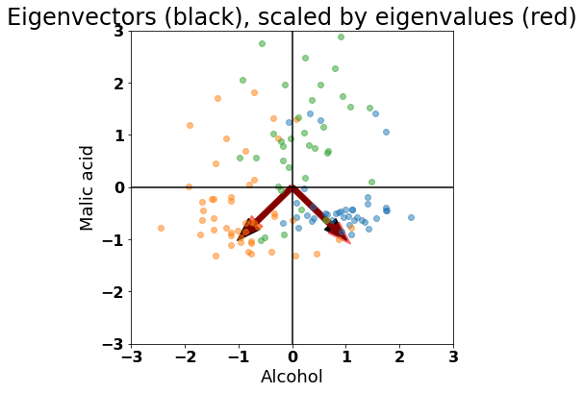
Next time
Learning how we can extract the features that explain the most variance
Understanding how that can improve classification
Get acquainted with the concept of a eigenvector

Slide 45
Reading questions
What is an eigenvalue?
  https://www.youtube.com/watch?v=PFDu9oVAE-g
How can multiplying by a matrix be seen as transformation of coordinate systems?
  https://www.youtube.com/watch?v=kYB8IZa5AuE
How would you find the optimal amount of principled components to keep?

