Slide 1
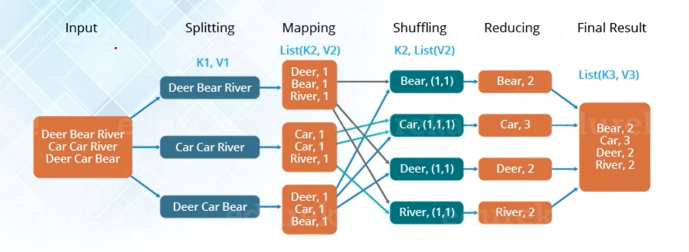
MapReduce

Slide 2
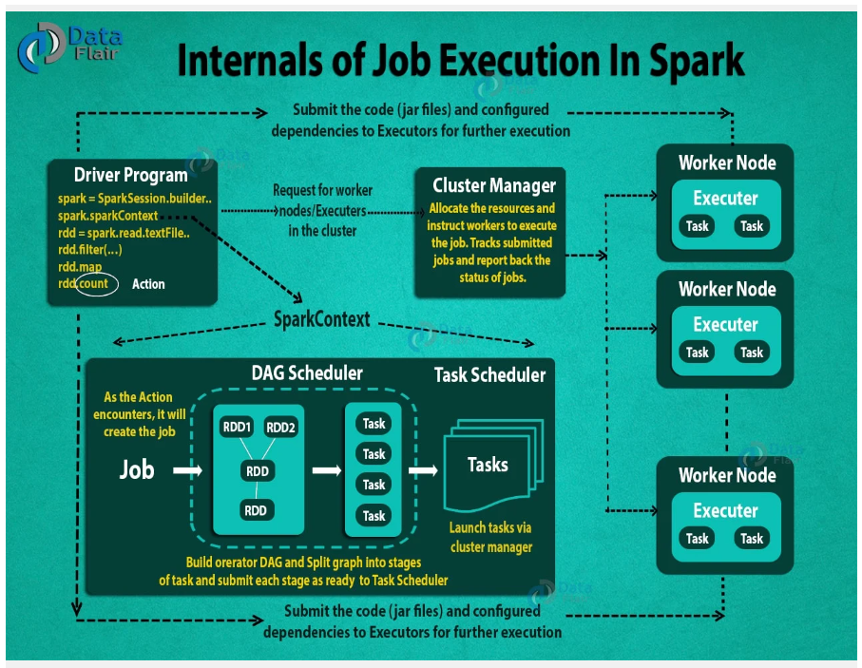
Apache Spark

Slide 3
Comparison of query running time

Slide 4
Time taken by query( in sec) | HiveQL | Spark-SQL
Carrier delay query | 7.6366 | 4.2338
NAS dealy query | 5.4844 | 3.104
Weather delay query | 1.2705 | 0.72725
Late aircraft delay query | 3.1885 | 0.7875
Security delay query | 1.10775 | 0.8615

Slide 5
MapReduce VS Apache Spark
Attributes | MapReduce | Apache Spark
Fast Process/ Performance | Faster then traditional system | Spark is 10-100 times faster
Ease of Use | Lengthy and Complex Framework | Simple and user-friendly system
Cost | Low | High
Use | Batch Processing | Real-time Processing
Language | Written in Java | Written in Scala

Slide 6
Conclusion
Apache Spark is potentially 100 times faster than Hadoop MapReduce.
Apache Spark utilizes RAM and isn’t tied to Hadoop’s two-stage paradigm.
Apache Spark works well for smaller data sets that can all fit into a server's RAM.
Hadoop is more cost-effective for processing massive data sets.
Apache Spark is now more popular than Hadoop MapReduce.

Slide 7
Thank You!

