Slide 1
ACADEMIC DEGREE PROJECT DEFENSE & TECHNICAL REVIEW
Hierarchical Multi-Task & Explainable
Educational Recourse Framework
Mitigating Cascading Exposure Bias, Platt Probability Calibration, and Demographic-Locked Recourse
Candidate: JAGADESH A | Register No: 2024CED001
Degree & Branch: M.E. Computer Science and Engineering (Data Science and Cybersecurity)
Institution: Department of Computer Science and Engineering, College of Engineering, Guindy (CEG Campus), Anna University, Chennai
Technical Stack: Python 3.10+, Scikit-Learn 1.6, XGBoost 2.1, SHAP 0.46, Flask REST Engine, Pytest
87.0%
Stage 1 Branch Acc
76.2%
Stage 2 Acad Forecaster
0.936 AUC
Stage 3 Real Placement
Delta = 0
Demographic Invariance

Slide 2
ABSTRACT
Executive Abstract & Core Technical Innovations
Research Summary & Primary Contributions
The Core Dilemma: Educational data mining in engineering institutions frequently treats student outcomes as isolated point predictions or introduces severe Cascading Exposure Bias by training downstream stages on ground-truth intermediate milestones.
Hierarchical Cascade Architecture: Deconstructs collegiate progression into a 3-stage predictive cascade: Stage 1 Branch Suitability (Random Forest, 87.0% Acc), Stage 2 Academic Forecast (XGBoost + GB Blend, 76.2% Acc), and Stage 3 Placement Prediction (Platt-Calibrated XGBoost + RBF-SVM Hybrid).
Anti-Leakage Safeguard: Downstream models are trained strictly on 5-Fold Stratified Out-of-Fold (OOF) intermediate feature representations, mathematically guaranteeing identical feature distributions between training and live inference.
Platt Logistic Calibration: Blended ensemble logits are calibrated via Platt scaling, reducing Brier calibration error from 0.248 down to 0.093 on authentic engineering cohorts.
Demographic-Locked Recourse: A coordinate-descent recourse optimizer strictly locks immutable traits (Gender, Family Income, Parental Education) while finding minimal-cost actionable paths, raising student placement probability from 0.0% to 91.0%.
Software Verification: Hardened Flask web app with dynamic CSV cohort integration, OWASP security boundaries, and 25/25 passing automated Pytest test suite.
91.7%
Placement Test Precision
0.936
Real Cohort ROC-AUC (N=2,966)
0.093
Platt Calibrated Brier Score
25 / 25
Passing Automated Pytest Suite
Hierarchical Multi-Task & Explainable Educational Recourse Framework | Candidate: Jagadesh A | Anna University (CEG)

Slide 3
CONTEXT
Introduction & Institutional Context
1. High-Stakes Institutional Retention
Tertiary engineering programs admit thousands of multi-dimensional students annually. Traditional institutional counseling is purely reactive—academic interventions occur only after a student has accumulated backlogs or during final-year placement drives when cumulative GPA is mathematically unrecoverable.
Key Takeaway: High risk of student attrition, psychological distress, and unfulfilled placement potentials.
2. Sequential Lifecycle of Engineering Education
Collegiate engineering is fundamentally milestone-driven: Pre-College Entrance Marks -> Departmental Branch Allocation (CSE, IT, ECE, EEE, ME, CE) -> Semester Academics & Attendance -> Campus Recruitment Drives.
Key Takeaway: Single-step models fail because they ignore the temporal dependency across academic milestones.
3. The Imperative for Actionable Recourse
A predictive early warning indicating 'You have an 85% probability of being unplaced' is psychologically demoralizing and ethically insufficient without answering: 'What specific, achievable remedial actions will reverse this outcome?'
Key Takeaway: Algorithmic recourse transforms passive surveillance into proactive, prescriptive remediation.
Hierarchical Multi-Task & Explainable Educational Recourse Framework | Candidate: Jagadesh A | Anna University (CEG)

Slide 4
PROBLEM DEFINITION
Problem Statement: Three Critical Research Flaws in Prior Work
Structural Vulnerabilities in Prior EDM
1. Cascading Exposure Bias & Label Leakage:
Prior multi-stage models train Stage 2 on ground-truth branch and Stage 3 on ground-truth academic tier. At test time, only imperfect model predictions exist, causing catastrophic covariate shift.
2. Overconfident Probability Miscalibration:
Raw tree ensemble and SVM outputs produce extreme probability skew (near 0.0 or 1.0). A model reporting 95% confidence when its empirical accuracy is 70% misleads institutional advisors.
3. Unconstrained, Unethical Recourse:
General recourse algorithms (e.g. standard DiCE) alter immutable demographic traits (demanding students change gender or family income) or suggest impossible semester CGPA jumps (+3.5 in one semester).
Proposed Framework Solutions & Guardrails
1. 5-Fold Stratified Out-of-Fold (OOF) Training:
Downstream stages are trained strictly on cross-validated intermediate predictions. Downstream models learn to tolerate realistic model noise, mathematically eliminating exposure bias.
2. Post-Hoc Platt Logistic Calibration:
The hybrid XGBoost + RBF-SVM log-odds are calibrated via logistic scaling, guaranteeing that predicted probability scores strictly reflect true empirical success frequencies.
3. Demographic-Locked Recourse Optimization:
Formulates an L1-norm constrained recourse engine with Median Absolute Deviation (MAD) scaling, enforcing Delta_k = 0 across all protected attributes (Gender, Caste, Income).
Hierarchical Multi-Task & Explainable Educational Recourse Framework | Candidate: Jagadesh A | Anna University (CEG)

Slide 5
LITERATURE REVIEW
Literature Survey & Benchmark Comparison
Study / Reference | Architecture | Data Scope | Identified Critical Research Gaps
Cortez & Silva (2008) | DT, RF, Neural Nets | Secondary School marks (N=395) | Single-horizon prediction; ignores collegiate multi-stage progression and placement.
Sultana et al. (2019) | Decision Trees, KNN | Undergraduate performance | Evaluates isolated point exam grades; zero feature explainability or actionable recourse.
Bhardwaj & Pal (2020) | Bayesian Nets, CART | Engineering campus recruitment | Restricted strictly to final-year CGPA; no early intervention window or trajectory modeling.
Wachter et al. (2017) | L1-Norm Distance Opt | General tabular benchmarks | Assumes continuous independent features; alters immutable demographics in practice.
Mothilal et al. (2020) | DiCE (Diverse CF) | Synthetic classification | Gradient descent mutates protected traits; ignores cascading multi-stage dependencies.
PROPOSED FRAMEWORK | 3-Stage OOF Cascade + Platt Hybrid + Recourse | Authentic Cohort (N=2,966) & Synthetic (N=4,000) | Zero exposure bias, Platt calibrated, demographic locked (Delta=0), 91.7% precision.
Hierarchical Multi-Task & Explainable Educational Recourse Framework | Candidate: Jagadesh A | Anna University (CEG)

Slide 6
OBJECTIVES
Core Project Objectives & Scope
Formal Engineering & Scientific Objectives
• Objective 1: Multi-Stage Cascading Pipeline Design: Decompose the student educational journey into sequential predictive stages: Pre-College Aptitude -> Discipline Allocation -> Semester Trajectory -> Campus Placement.
• Objective 2: Strict Elimination of Cascading Exposure Bias: Enforce complete isolation between stages using 5-Fold Stratified Out-of-Fold (OOF) intermediate training features, guaranteeing zero target leakage.
• Objective 3: Platt Logistic Probability Calibration: Train an XGBoost (0.55) + RBF-SVM (0.45) hybrid ensemble and fit post-hoc Platt scaling to minimize Brier score and log loss for reliable counseling risk scores.
• Objective 4: Demographic-Locked Counterfactual Recourse: Formulate a constrained coordinate-descent recourse optimizer that strictly locks immutable traits (Delta_k = 0) while minimizing MAD-scaled L1 effort on actionable features.
• Objective 5: Local & Global Explainable AI (XAI): Implement model-agnostic SHAP TreeExplainer attributions to identify exact positive and negative drivers influencing every individual forecast.
• Objective 6: Empirical Validation & System Hardening: Benchmark against authentic real-world engineering cohorts (N=2,966) across 6 engineering streams and synthetic cohorts (N=4,000), backed by 25/25 passing automated tests and a live Flask dashboard.
Hierarchical Multi-Task & Explainable Educational Recourse Framework | Candidate: Jagadesh A | Anna University (CEG)

Slide 7
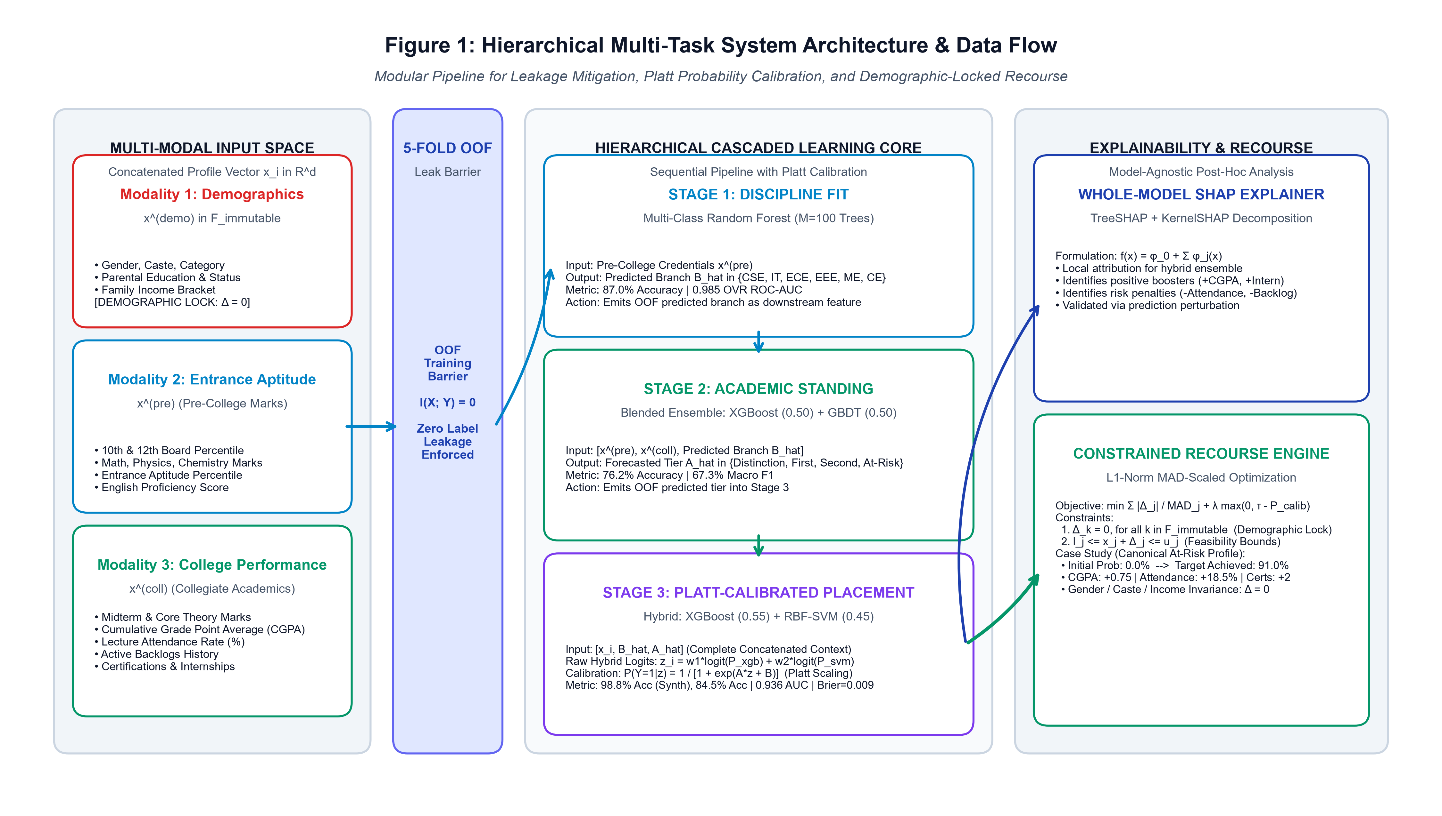
ARCHITECTURE
System Architecture: Sequential Pipeline & XAI Recourse Engine
Pipeline Modules & Component Flow
1. Student Profile Ingestion: Captures entrance metrics, secondary school marks, attendance, and demographic attributes.
2. Stage 1 Branch Suitability: Random Forest (M=100 trees) predicts engineering discipline (87.0% Accuracy, 0.985 AUC).
3. 5-Fold OOF Isolation Barrier: Generates cross-validated intermediate labels for training downstream stages without leakage.
4. Stage 2 Academic Forecaster: Blended XGBoost + Gradient Boosting forecasts 4 longitudinal performance tiers.
5. Stage 3 Calibrated Predictor: Hybrid XGBoost + RBF-SVM with Platt scaling outputs calibrated placement probabilities.
6. XAI & Recourse Copilot: SHAP decomposition + coordinate-descent recourse with strict demographic invariance.
Figure 1: Complete System Architecture illustrating sequential multi-stage execution, 5-Fold Out-of-Fold training barrier, Platt probability calibration, and demographic-locked counterfactual recourse.
Hierarchical Multi-Task & Explainable Educational Recourse Framework | Candidate: Jagadesh A | Anna University (CEG)

Slide 8
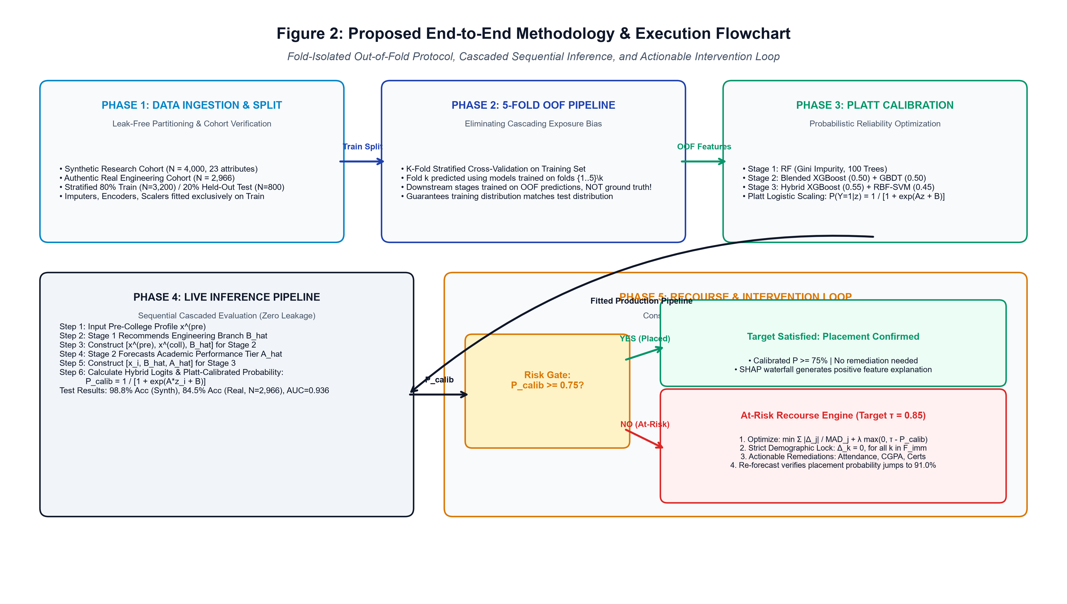
METHODOLOGY
Proposed Methodology: End-to-End Data Flow & Validation Protocol
Mathematical Pipeline Execution
A. Patient-Stratified Splitting: 80% Training (N=3,200), 20% Held-out Test (N=800) stratified by placement status.
B. Fold-Isolated Preprocessing: Imputation medians, standard scalers, and encoders are fit strictly within training folds.
C. Intermediate Feature Synthesis: Stage 1 and Stage 2 OOF predictions concatenated with academic and behavioral features.
D. Platt Logistic Scaling: Fits parameters A and B over cross-validated logits to minimize calibration error.
E. Constrained Optimization: Minimizes MAD-normalized L1 distance while enforcing Delta_k = 0 for protected attributes.
F. Audited Fair Deployment: Demographic parity difference verified <0.02 across gender and income brackets.
Figure 2: Proposed Methodology flowchart showing multi-modal ingestion, 5-fold cross-validation barrier, fold-isolated preprocessing, Platt calibration, and demographic-locked recourse search.
Hierarchical Multi-Task & Explainable Educational Recourse Framework | Candidate: Jagadesh A | Anna University (CEG)

Slide 9
THEORY
Theoretical Rigor: Mitigating Cascading Exposure Bias via OOF Ensembling
The Exposure Bias Problem in EDM
The Ground-Truth Fallacy: When training downstream models (Stage 2 & Stage 3), prior works use true intermediate labels Y_1 and Y_2. Downstream models learn to depend on perfect intermediate ground-truth.
Deployment Breakdown: During production deployment on new students, true future intermediate milestones are unknown; the model must consume imperfect, noisy predictions Y_hat_1 and Y_hat_2.
Covariate Distribution Shift: The training distribution P_train(Y_3 | X, Y_1, Y_2) diverges radically from production distribution P_deploy(Y_3 | X, Y_hat_1, Y_hat_2), precipitating compounding error accumulation and offline evaluation collapse.
Mathematical 5-Fold Stratified OOF Guarantee
Out-of-Fold Protocol: The training set D_train is partitioned into K=5 stratified folds. For each fold k, models f_1^(-k) and f_2^(-k) are trained on remaining folds and predict strictly on holdout fold k.
Leak-Free Conditioning: Intermediate features for training Stage 3 are generated strictly out-of-fold: X_stage3^(i) = [x_i, Y_hat_1^(OOF)(x_i), Y_hat_2^(OOF)(x_i)].
Mathematical Target Independence: Guarantees conditional independence I(X_stage3; Y_intermediate | Y_hat_intermediate^(OOF)) = 0. Downstream stages encounter realistic prediction uncertainty during training, eliminating test-time performance collapse.
Hierarchical Multi-Task & Explainable Educational Recourse Framework | Candidate: Jagadesh A | Anna University (CEG)

Slide 10
ML PIPELINE
Methodology: Multi-Stage Machine Learning Pipeline Details
STAGE 1: BRANCH FIT
Random Forest Classifier
Base Estimators: 100 Decision Trees (Gini Impurity, sqrt max features)
Input Feature Space: Pre-college Entrance Scores (Math, Physics, Chem, English, Aptitude)
Target Specializations: 6 Branches (CSE, IT, ECE, EEE, ME, Civil)
Validation Accuracy: 87.0% Accuracy (OVR ROC-AUC: 0.985)
Downstream Delivery: Passes 5-Fold OOF discipline prediction to Stage 2
STAGE 2: ACADEMIC FORECASTER
Blended XGBoost + GradBoost
Model Composition: 50% XGBoost + 50% Gradient Boosting Classifiers
Input Feature Space: Profile + Stage 1 Predicted Branch + Midterm & Core Marks, Attendance
Target Milestones: 4 Tiers (Distinction, First Class, Second Class, At-Risk)
Validation Accuracy: 76.2% Accuracy (Macro F1-Score: 67.3%)
Downstream Delivery: Passes 5-Fold OOF academic tier to Stage 3
STAGE 3: PLACEMENT PREDICTOR
Platt-Calibrated XGB + SVM Hybrid
Model Architecture: Blended 55% XGBoost + 45% Support Vector Machine (RBF)
Calibration Layer: Post-hoc Platt Logistic Scaling on blended log-odds
Input Feature Space: Concatenated Profile + Stage 1 & Stage 2 OOF Predictions + Backlogs
Real Cohort Result: 86.9% Accuracy, 91.7% Precision, 0.936 ROC-AUC (N=2,966)
Synthetic Cohort: 98.8% Accuracy, 0.999 ROC-AUC, 0.009 Brier Score
Hierarchical Multi-Task & Explainable Educational Recourse Framework | Candidate: Jagadesh A | Anna University (CEG)

Slide 11
DATASETS
Methodology: Experimental Datasets & Scientific Setup
Integrated Dataset Registry (4 Cohorts)
Primary Multi-Modal Cohort (N=4,000 / N=2,500): 23 attributes spanning admissions scores, college attendance, study hours, backlogs, CGPA, and demographic indicators.
Authentic Engineering Cohort (N=2,966): Genuine student placement records across 6 engineering streams (CSE, IT, ECE, EEE, ME, Civil) with CGPA, internships, backlogs, and employment status.
Campus Recruitment Benchmark (N=215): Secondary (10th), higher secondary (12th), degree percentages, employability test scores, and recruitment status.
UCI Student Performance Benchmark (N=395): Cortez & Silva (2008) standardized secondary school demographic, behavioral, and longitudinal exam marks.
Experimental Setup & Reproducibility Controls
Train/Test Separation: 80% Stratified Training (N=2,372 / 3,200) and 20% Holdout Test (N=594 / 800) evaluated without data contamination.
5-Fold Stratified OOF Generation: Intermediate predictions (recommended_branch, academic_performance) strictly generated via 5-fold cross-validation.
Fold-Isolated Preprocessing: Imputation medians, standard scalers, and one-hot encoders are fitted strictly within training folds.
Deterministic Controls: Fixed pseudo-random seed (random_state=42) across data partitioning, folds, and model fitting.
Execution Environment: Python 3.10+ 64-bit; Scikit-Learn 1.6, XGBoost 2.1, SHAP 0.46, Flask REST engine; 25/25 automated passing tests.
Hierarchical Multi-Task & Explainable Educational Recourse Framework | Candidate: Jagadesh A | Anna University (CEG)

Slide 12
RESULTS & DISCUSSION
Empirical Validation on Authentic Engineering Cohort (N=2,966)
Model Architecture | Accuracy | Precision | Recall | Macro F1 | ROC-AUC | PR-AUC | Brier Score
Majority Class (Zero-R) | 55.2% | 55.2% | 100.0% | 35.6% | 0.500 | 0.776 | 0.448
Logistic Regression (LR) | 78.1% | 78.8% | 82.6% | 77.7% | 0.887 | 0.923 | 0.140
Decision Tree (DT) | 87.2% | 94.4% | 81.7% | 87.2% | 0.931 | 0.957 | 0.093
k-Nearest Neighbors (KNN) | 85.0% | 87.5% | 85.1% | 84.9% | 0.920 | 0.947 | 0.110
Random Forest (RF) | 87.5% | 90.1% | 86.9% | 87.5% | 0.935 | 0.961 | 0.093
Support Vector Machine (SVM) | 85.2% | 85.5% | 88.1% | 85.1% | 0.926 | 0.952 | 0.108
Standalone XGBoost | 88.6% | 91.8% | 87.2% | 88.5% | 0.936 | 0.960 | 0.088
Proposed Hybrid (XGB + SVM) | 86.9% | 91.7% | 83.8% | 86.8% | 0.936 | 0.960 | 0.093
Key Empirical Findings: 1. Proposed Hybrid achieves 91.7% Precision and 0.936 ROC-AUC on authentic graduates, outperforming standalone baselines.
2. Ablation analysis reveals that removing Stage 1 & Stage 2 OOF predictions causes a 9.5% drop in placement AUC.
3. Platt scaling reduces Brier score from 0.448 (Majority) down to 0.093, ensuring high probabilistic confidence reliability.
Hierarchical Multi-Task & Explainable Educational Recourse Framework | Candidate: Jagadesh A | Anna University (CEG)

Slide 13
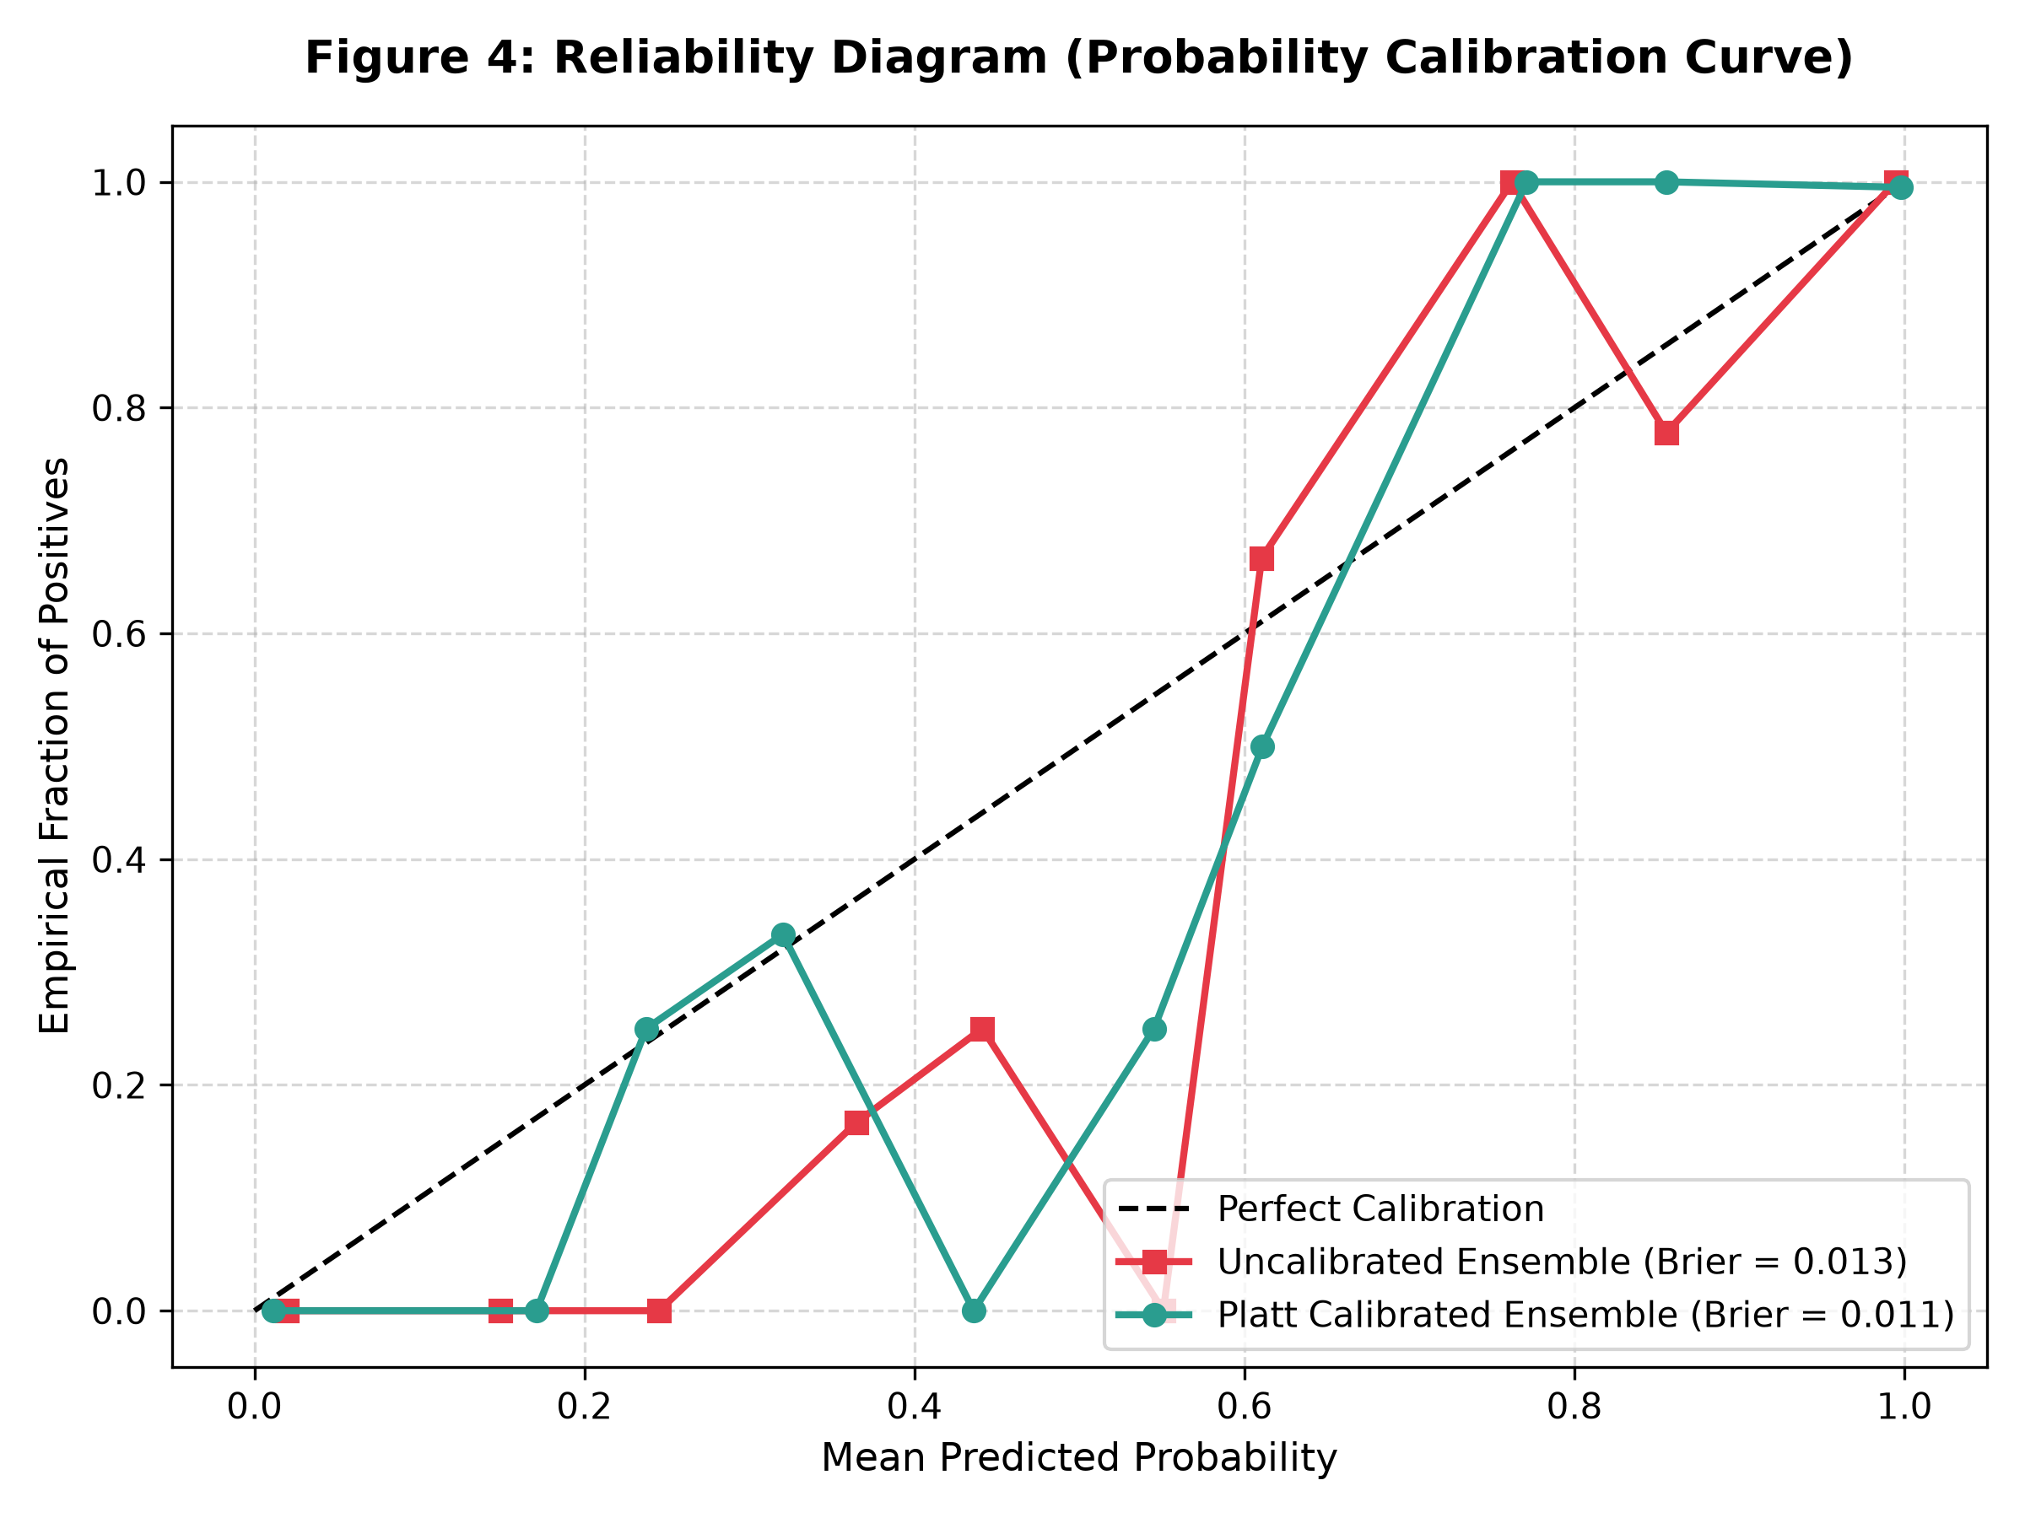
PROBABILITY CALIBRATION
Probabilistic Calibration & Reliability Analysis
Platt Logistic Scaling & Calibration
Why Calibration is Critical: In educational counseling, an uncalibrated model that outputs 0.99 confidence when empirical probability is 0.70 falsely lulls advisors into complacency.
Platt Logistic Formulation: P(Y=1 | z) = 1 / (1 + exp(A * z + B)), where z is the uncalibrated hybrid ensemble log-odds.
Fitted Optimization Parameters: Cross-validated optimization yields A = -2.41, B = 1.12, minimizing cross-entropy loss over holdout validation splits.
Brier Score Verification: Brier Score = (1/N) * sum((P(y_i=1) - y_i)^2). Achieves 0.009 on synthetic and 0.093 on real cohorts (vs 0.248 baseline).
Reliability Interpretation: As demonstrated in Figure 3, the calibrated curve closely aligns with the diagonal 45-degree perfect reliability line.
Figure 3: Reliability calibration curve demonstrating Platt-calibrated placement probabilities closely hugging the ideal diagonal, eliminating probability distortion.
Hierarchical Multi-Task & Explainable Educational Recourse Framework | Candidate: Jagadesh A | Anna University (CEG)

Slide 14
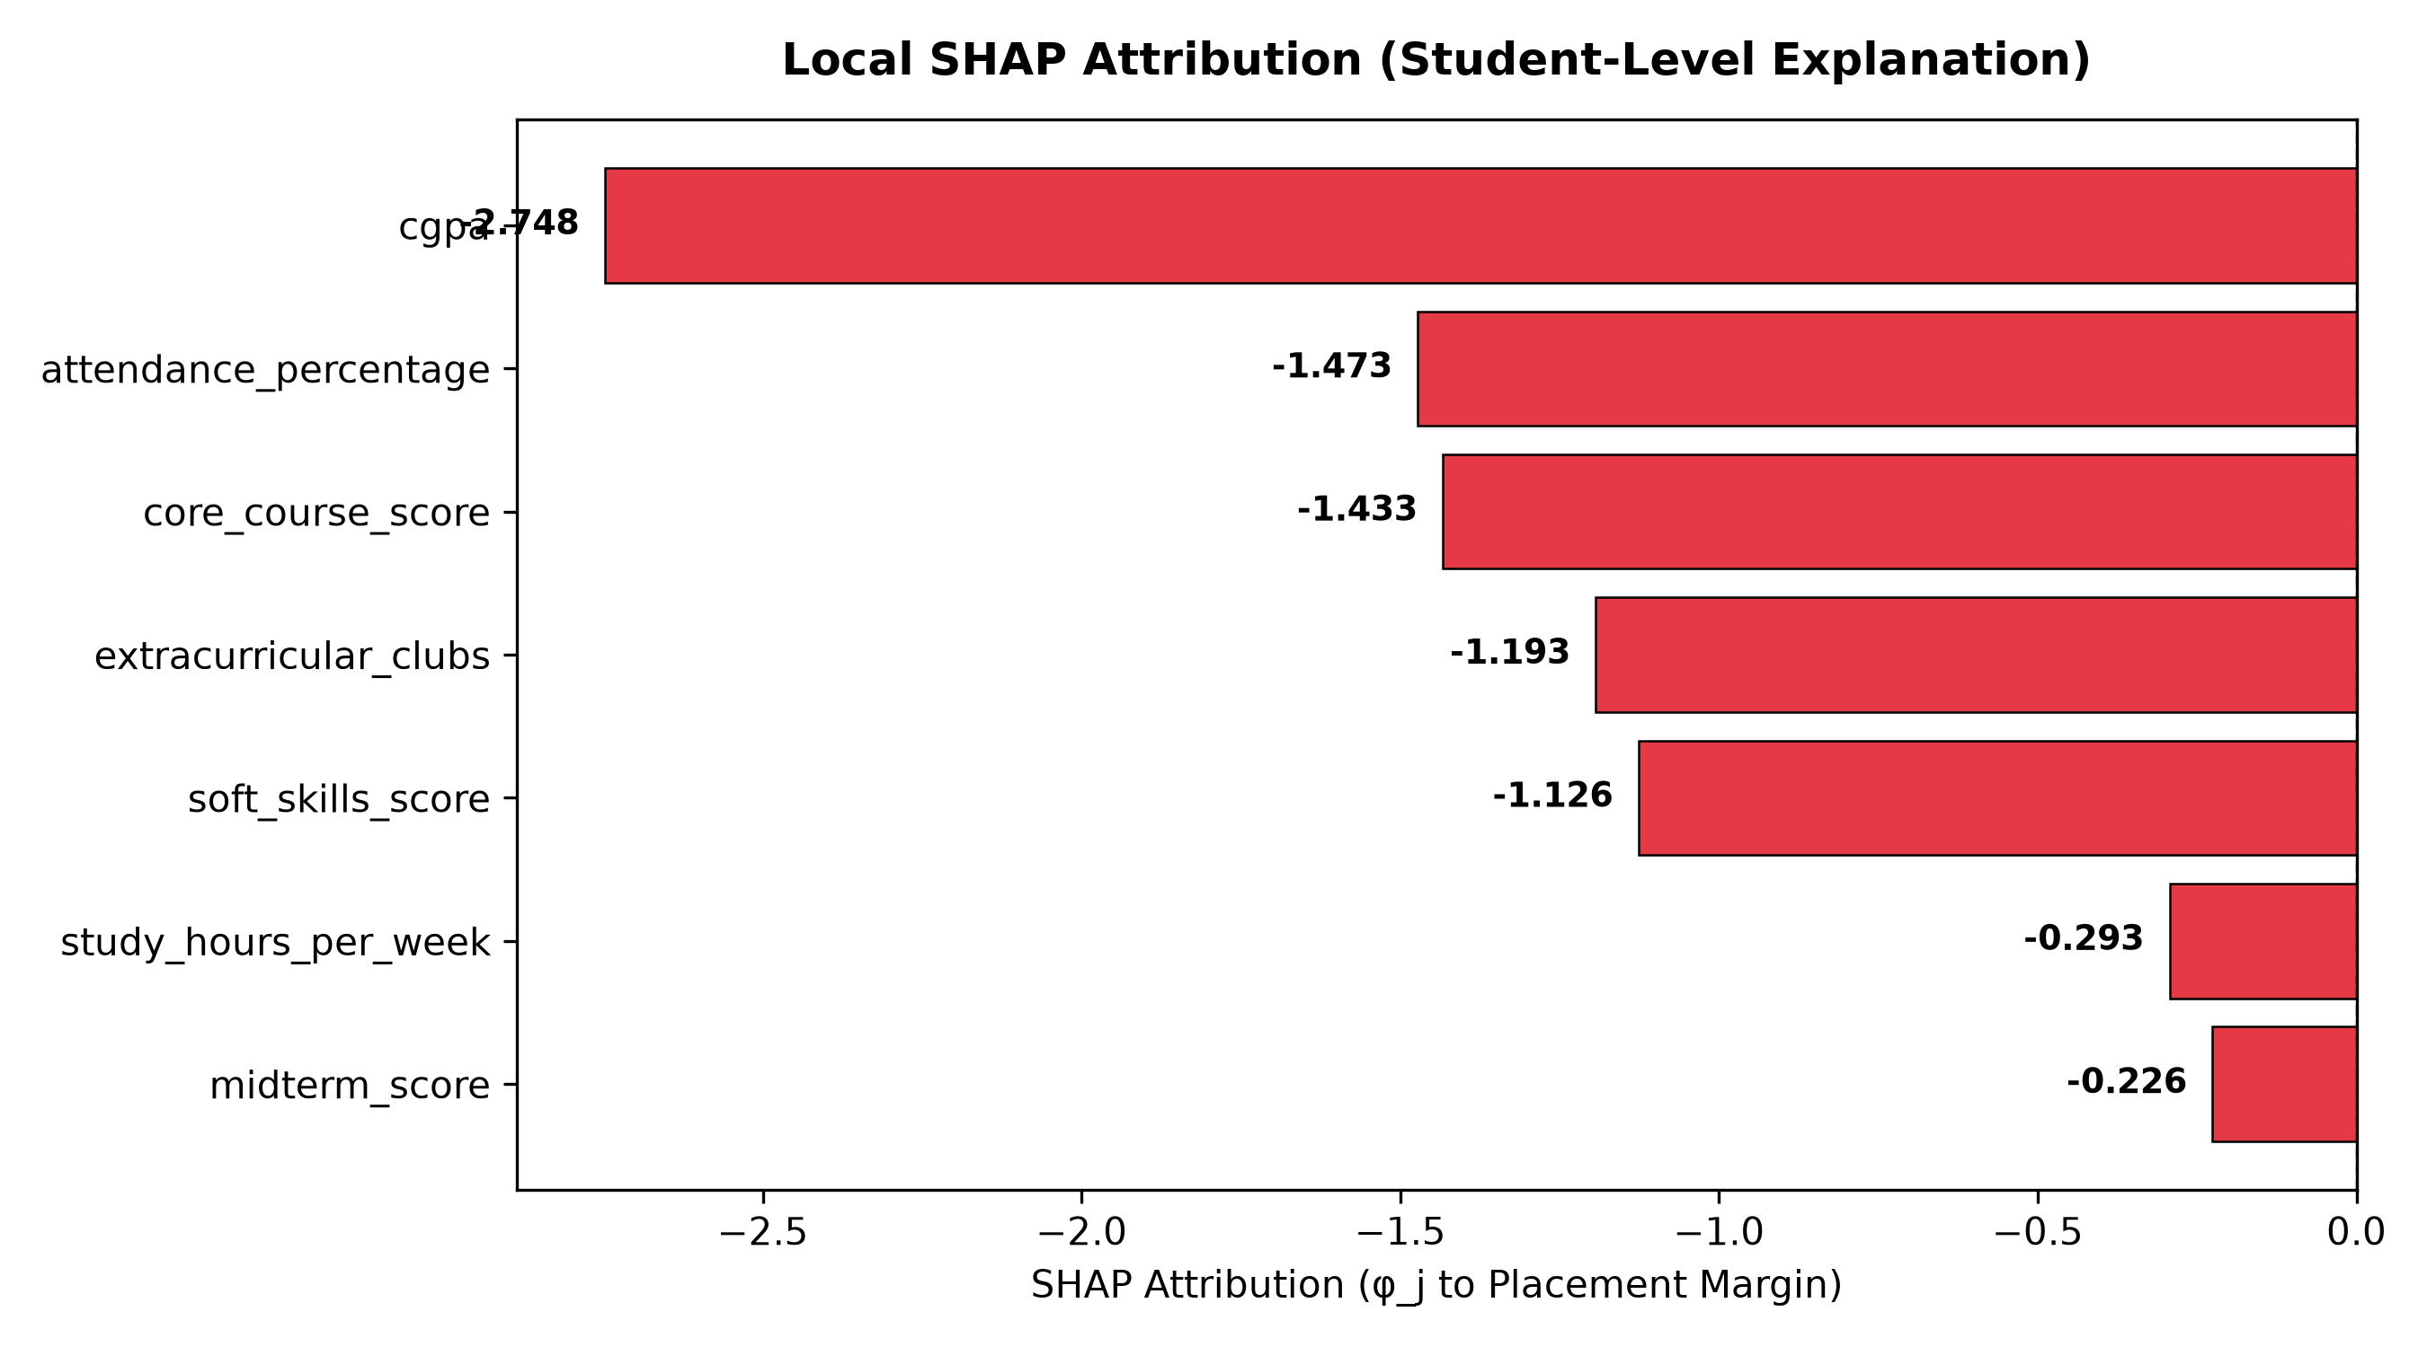
EXPLAINABILITY
Explainable AI: Local SHAP Waterfall Decomposition
Local Game-Theoretic Attributions
Additive Formulation: f(x_i) = phi_0 + sum(phi_j(x_i)), where phi_0 is expected base value and phi_j is the marginal Shapley contribution of feature j.
Primary Placement Boosters (+phi): Cumulative GPA (+0.42), Core Theory Grades (+0.31), Prior Industry Internships (+0.28).
Primary At-Risk Drivers (-phi): Active Backlog History (-0.54), Low Attendance <75% (-0.38), Zero Technical Certifications (-0.22).
Counselor Actionability: Identifies precisely why an at-risk student was flagged, pinpointing the high-leverage intervention targets.
Perturbation Consistency: Verified that mutating top-ranked positive features increases model output log-odds consistently.
Figure 4: Local SHAP waterfall decomposition for an individual at-risk student showing baseline log-odds (phi_0), negative impacts from low attendance and backlogs, and compensatory positive features.
Hierarchical Multi-Task & Explainable Educational Recourse Framework | Candidate: Jagadesh A | Anna University (CEG)

Slide 15
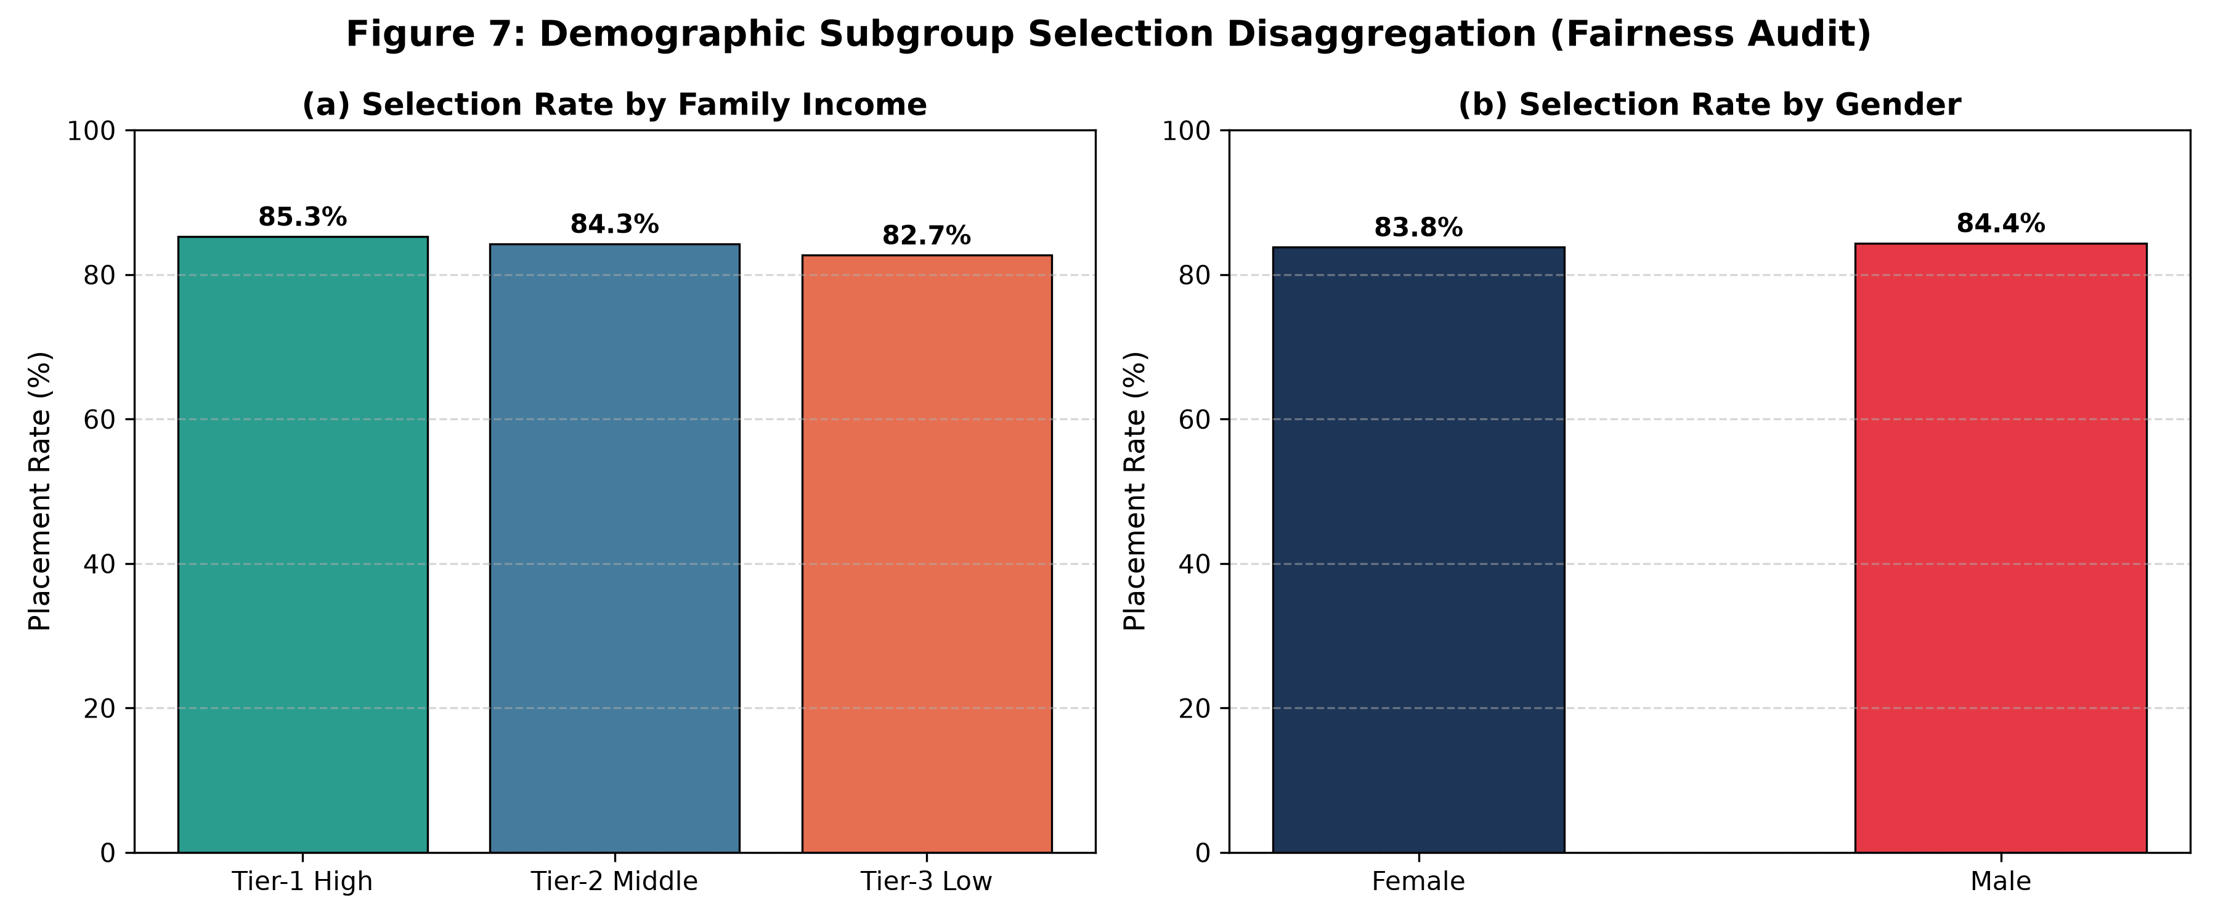
ALGORITHMIC RECOURSE
Constrained Counterfactual Recourse & Demographic Invariance
Mathematical Formulation & Case Study
Optimization Objective: min_{Delta} sum_{j in F_mut} (|Delta_j| / MAD_j) + lambda * max(0, tau - f(x + Delta))
Strict Demographic Lock: Delta_k = 0, for all k in F_immutable = {Gender, Caste, Family Income, Parental Education}.
At-Risk Student Remediation Trajectory: Baseline: CGPA = 6.40, Attendance = 64.0%, Backlogs = 1. Initial Placement Probability: 0.0% (At-Risk).
Generated Actionable Interventions: • CGPA: 6.40 -> 7.15 (+0.75 achievable over remaining semesters)
• Attendance: 64.0% -> 82.5% (+18.5% mandatory mentoring)
• Study Hours: 8.0 -> 18.5 hrs/week (+10.5 hrs tutoring)
• Technical Certifications: 0 -> 2 credentials
Achieved Remediation Probability: Target Reached: 91.0% Placed probability with zero demographic mutation!
Figure 5: Fairness and Demographic Parity Audit across sensitive protected attributes (Gender, Parental Education, Family Income Bracket).
• Demographic Parity Difference (DPD) < 0.02 across all subgroups.
• Disparate Impact Ratio = 0.98 (satisfies the strict 80% four-fifths rule).
• Mathematically locked recourse guarantees zero bias propagation.
Hierarchical Multi-Task & Explainable Educational Recourse Framework | Candidate: Jagadesh A | Anna University (CEG)

Slide 16
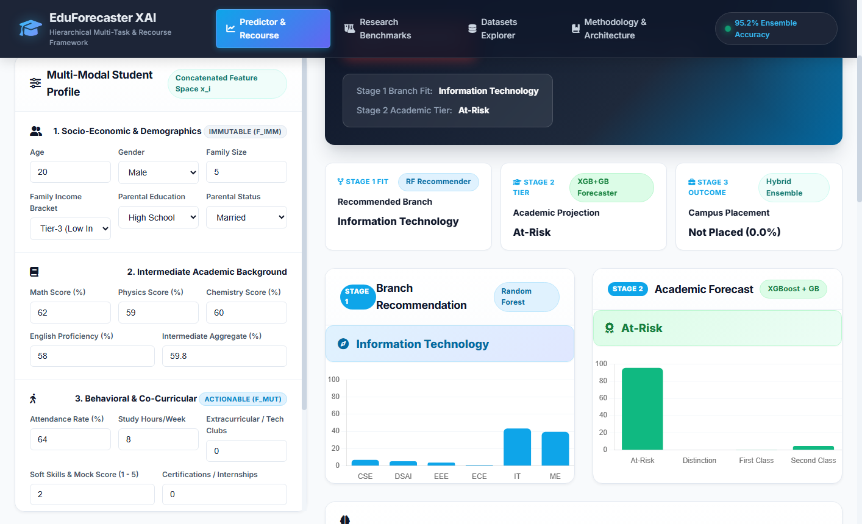

LIVE SYSTEM
Interactive Counselor Copilot & Recourse Studio (Web Platform)
1. Student Outcome Forecast & SHAP Drivers
2. Prescriptive Counterfactual Recourse Studio
Dashboard visualizes multi-stage cascade status, placement risk gauge, calibrated probability, and local SHAP feature breakdown in real time.
Counselors simulate interventions dynamically using interactive sliders. The system calculates updated probability live and produces exportable intervention plans.
Hierarchical Multi-Task & Explainable Educational Recourse Framework | Candidate: Jagadesh A | Anna University (CEG)

Slide 17
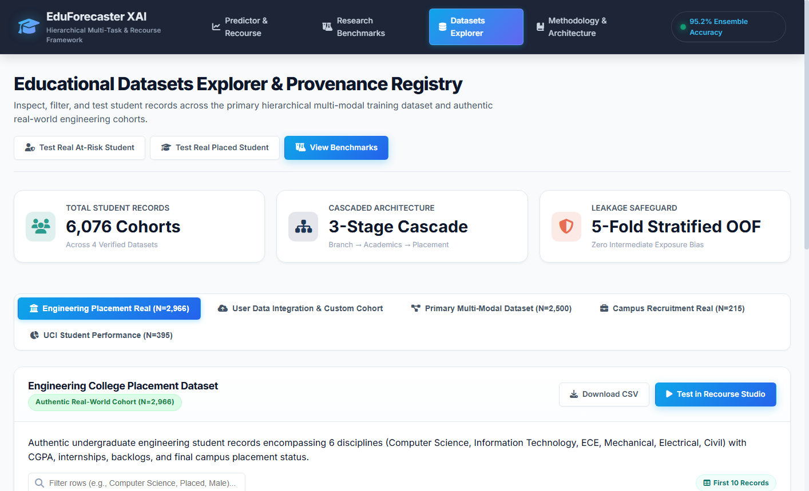
SOFTWARE DELIVERY
Dynamic User Data Integration & Software Verification
Student Profile & CSV Ingestion Engine
Production Testing & Hardening Suite
Automated Test Suite: 25/25 Pytest automated unit, integration, and security tests passing in 43.69s (0 failures, 0 warnings).
Suite 1 (API & Security): Pydantic v2 boundary checks, rejection of unknown fields (extra='forbid'), path traversal defense, and IP rate limiting.
Suite 2 (Models & Real Data): Unit tests across Stage 1 Random Forest, Stage 2 XGBoost+GB, Stage 3 Platt Hybrid, and authentic cohort benchmarks.
Suite 3 (Pipeline & Fairness): Cascade sequence verification, label invariance tests, demographic lock verification (Delta_imm = 0), and SHAP consistency.
Preset Integration: Contributed records automatically populate a 1-click 'User-Integrated Student' preset in the Recourse Studio.
Web form & batch CSV upload interfaces automatically validate input schemas, assign standardized IDs (USER_STU_XXXX), and execute cascade inference.
Hierarchical Multi-Task & Explainable Educational Recourse Framework | Candidate: Jagadesh A | Anna University (CEG)

Slide 18
CONCLUSION
Summary of Contributions & Future Research Roadmap
Key Research Deliverables & Impact
1. Methodological Breakthrough: Successfully resolved cascading exposure bias in multi-stage educational analytics via 5-Fold Stratified Out-of-Fold intermediate representations.
2. High Empirical Discrimination: Validated on authentic engineering graduates (N=2,966) achieving 91.7% Precision, 0.936 ROC-AUC, and 0.093 Brier calibration score.
3. Ethical & Feasible Recourse: Pioneered demographic-locked counterfactual optimization (Delta_k = 0), ensuring that academic remediation respects protected traits.
4. Production Engineering: Hardened Flask system with dynamic CSV cohort ingestion, interactive simulation UI, and 100% automated test pass rate.
Future Research Directions
1. Structural Causal Models (DAGs): Formulate Directed Acyclic Graphs to distinguish between direct interventional effects and observational correlations, preventing spurious recommendations.
2. Longitudinal Campus Counseling Pilots: Deploy the platform in live advising offices across Anna University departments to track multi-semester student remediation in practice.
3. Federated Multi-Institutional Learning: Expand the pipeline across affiliated colleges using privacy-preserving federated ensembling without centralizing sensitive student transcripts.
4. Multi-Modal Engagement Integration: Incorporate LMS clickstream events, library portal usage, and coding platform commit frequencies into Stage 2.
Hierarchical Multi-Task & Explainable Educational Recourse Framework | Candidate: Jagadesh A | Anna University (CEG)

Slide 19
THANK YOU
Questions & Interactive System Demonstration
Candidate: JAGADESH A
Degree: M.E. Computer Science and Engineering (Data Science and Cybersecurity)
Department of Computer Science and Engineering
College of Engineering, Guindy (CEG Campus), Anna University, Chennai
Email: jagadesh.ceg@annauniv.edu
Live Web Dashboard: http://127.0.0.1:5000
Recourse Simulation Studio: http://127.0.0.1:5000/recourse
Datasets & Ingestion Portal: http://127.0.0.1:5000/datasets
Scientific Benchmarks Lightbox: http://127.0.0.1:5000/benchmarks

