Slide 1
AI-Powered Kitchen Ecosystem
AI-Powered Kitchen Ecosystem
for Food Waste Reduction and Nutrition Optimization
Project ID: 25-26J-351 | Specialization: IT | Panel: IT-P10
Notes:
Good [morning/afternoon], Panel. We are Group 25-26J-351, presenting our AI-Powered Kitchen Ecosystem — a solution for food waste reduction and nutrition optimization."

Slide 2
Addressing Panel Feedback — IT-P10
Panel Concern | Our Improvement
Weak background & methodology understanding | Reviewed 28+ research papers and strengthened theoretical foundation
Lack of clear methodology explanation | Defined structured ML pipelines
Unclear results & validation | Added evaluation metrics and experimental validation
Contribution not evident | Highlighted novel frameworks and system integration
Difficulty explaining system flow | Simplified pipeline visualization and module interactions
Project ID: 25-26J-351 | Specialization: IT | Panel: IT-P10
Notes:
"Based on PP2 feedback, we strengthened our theoretical foundation by reviewing 28+ research papers, defined structured ML pipelines, added evaluation metrics, and simplified our system flow visualizations."

Slide 3
AI-Powered Kitchen Ecosystem
Research Problem
“Modern households lack an intelligent system that connects food storage, nutrition, cooking, and shopping, resulting in significant food waste and poor dietary decisions"
• Nearly 40% of global food is wasted, while many people still struggle with balanced nutrition.
• Existing applications operate in isolated silos (recipe apps, nutrition trackers, shopping tools).
• The absence of an integrated AI-driven kitchen ecosystem prevents effective food lifecycle management.
Project ID: 25-26J-351 | Specialization: IT | Panel: IT-P10
Notes:
"Nearly 40% of global food is wasted while millions still face nutritional imbalances. Existing apps work in silos — recipe apps don't talk to nutrition trackers, and shopping tools ignore what's already in your kitchen. We address this gap with an integrated AI-driven kitchen ecosystem."

Slide 4
Identified Limitations of Existing Systems
System Type | What Current Systems Do | What They Fail To Do
Cooking Applications | Recommend recipes based on user search or popular ingredients | Do not consider ingredients available in the user's kitchen
Nutrition Tracking Apps | Track calorie intake and provide dietary summaries | Do not predict nutrient deficiencies or provide proactive health recommendations
Expiry Tracking Systems | Use fixed expiry dates printed on product packaging | Do not adapt to storage conditions, environmental factors, or user consumption patterns
Online Grocery Platforms | Recommend products based on purchase history or trends | Do not consider household inventory or nutritional requirements when suggesting groceries
Project ID: 25-26J-351 | Specialization: IT | Panel: IT-P10
Notes:
"Current tools fail at the integration level. Recipe apps don't check your fridge. Nutrition trackers don't predict deficiencies. Expiry systems use fixed dates, not real conditions. And grocery platforms ignore your household inventory. These are the exact gaps our system fills."

Slide 5
AI-Powered Kitchen Ecosystem
Research Objectives
O1
Spontaneous Cooking Assistant
Sentence-BERT semantic matching + Levenshtein fuzzy resolution + Google Cloud Vision ingredient detection for trilingual Sri Lankan recipe retrieval (EN/SI/TA)
O2
Nutritional Guidance System (PHIF)
Gradient Boosting classifier predicting nutrient deficiency risks (LOW/MEDIUM/HIGH) with personalized dietary guidance via ANPL and SNRP prioritization
O3
AI Food Expiry Predictor (AEIF)
CatBoost gradient boosting regression with biological safety validation bounds and AED adaptive personalization through user feedback
O4
Smart Shopping Module
SERPAPI real-time product data + SpaCy NLP 5-stage query understanding + hybrid collaborative/content-based recommendation engine + voice input
Project ID: 25-26J-351 | Specialization: IT | Panel: IT-P10
Notes:
"Our solution has four core modules: O1 — a Spontaneous Cooking Assistant using SBERT and Google Cloud Vision. O2 — a Nutritional Guidance System predicting deficiency risks with 84% accuracy. O3 — an AI Food Expiry Predictor using CatBoost regression. And O4 — a Smart Shopping Module with NLP-powered query understanding and voice input."

Slide 6
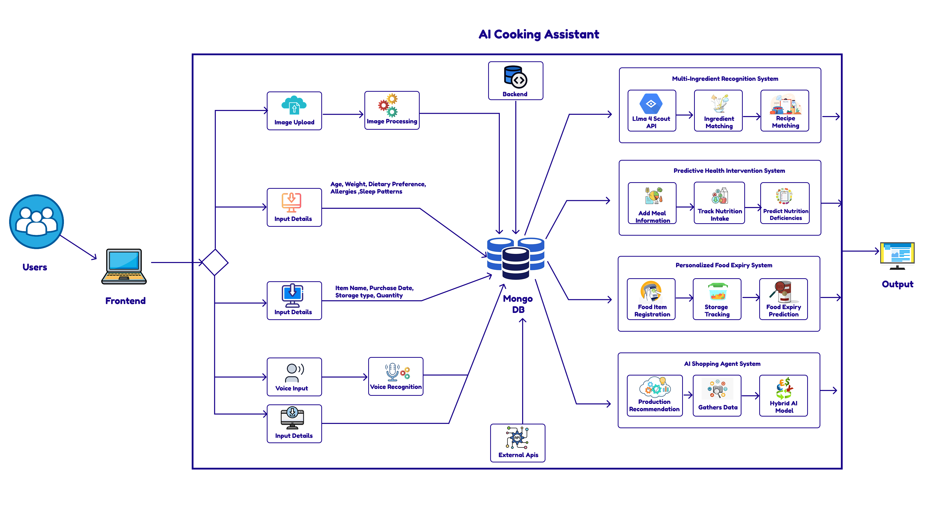
System Architecture — Four-Module Ecosystem
Project ID: 25-26J-351 | Specialization: IT | Panel: IT-P10
Notes:
"All four modules are integrated into one ecosystem, sharing a common data layer so your fridge inventory informs your recipes, your nutrition, your expiry alerts, and your shopping list — simultaneously."

Slide 7

IT22131942 | Perera u. m. k.
Spontaneous Cooking Assistant
1
2
3
4
5
Image / Text
Input
CV Detection
GCloud Vision
2-Tier Fuzzy
Normalization
SBERT
Embedding
ChromaDB
Retrieval
190
262
127
26,215
Validated
Sri Lankan Recipes
Trilingual
Ingredient Entries
Expert Synonym
Pairs (EN/SI/TA)
Augmented Training
Images
Two-Tier Fuzzy Normalization Engine
Tier 1 — Expert Synonym Dictionary: 127 pairs map Sinhala/Tamil names to canonical English (e.g. 'karapincha' → 'curry leaves'). Score = 1.0, Tier 2 bypassed. Tier 2 — Levenshtein Fuzzy Matching: Normalized edit-distance against 262 canonical ingredients. Accepts matches above ROC-optimized threshold θ = 0.80 (AUC = 0.91).
IT22131942| PERERA U. M. K.| 25-26J-351
Notes:
"The cooking assistant uses a two-tier fuzzy normalization engine — mapping Sinhala and Tamil ingredient names to English, then using SBERT embeddings to retrieve the most semantically relevant recipe from 190 validated Sri Lankan recipes across three languages."

Slide 8

IT22083982 | Shahmi M.T.M
Nutritional Guidance
1
2
3
4
5
Meal Log Analysis
(User Intake Tracking)
Requirement Matching (Age, Gender, Health-Based)
Hybrid Risk Prediction (ML + Nutrition Rules)
2 Weeks Projection (Pattern-Based Forecast)
Deficiency Insights (Nutrient-Level Risk Analysis)
15
84.38%
0.8446
4 Nutrients
ML Features Used
Overall Model Accuracy
Weighted F1 Score
Nutrient-Level Risk Models
Hybrid Intelligence Architecture
Requirement Engine - Age & gender-based nutrient requirements derived from Sri Lankan nutritional standards Feature Engineering Layer - Transforms user intake into nutrient adequacy ratios (intake ÷ requirement) for model input
ML Risk Model - Gradient Boosting classifier trained on requirement-based simulated dataset with controlled variability
Nutrient Risk Models - Separate ML models for Energy, Protein, Calcium, and Iron deficiency prediction Projection Engine - 14-day intake projection based on user consumption patterns
Data Realism Layer - Measurement noise injection to simulate real-world food logging inaccuracies
IT22083982| SHahmi M.T.M| 25-26J-351
Notes:
"Our Gradient Boosting classifier, trained on Sri Lankan nutritional standards, predicts deficiency risk for energy, protein, calcium, and iron — achieving 84.38% accuracy and a weighted F1 of 0.8446, with a 14-day forward projection capability."

Slide 9

IT22339010 | Muraleswaran D
Food Expiry Prediction
1
2
3
4
5
User Input
ML Prediction
AEIF Safety Layer
AED + SCP System
Feature Processing
Food Expiry Architecture
AEIF Safety Layer
AED Layer
SCP Layer
Ensures biologically safe predictions
Minimum threshold: ≥ 60% base expiry
Range control: 0.5× – 1.5× base
Prevents unsafe underestimation
Learns from user feedback patterns
Adjusts predictions dynamically
Uses decay-based learning formula
Activates after 5+ feedback records
≤ 2 days → High Priority
2–5 days → Medium Priority
> 5 days → Low Priority
Helps reduce food waste efficiently
IT22339010| MURALESWARAN D | 25-26J-351
Notes:
"The expiry predictor uses CatBoost with a safety layer ensuring predictions never fall below 60% of base expiry. An adaptive learning layer adjusts predictions based on your personal feedback patterns, and a priority system flags items expiring within 2 days."

Slide 10

IT22117946 | JAYASUNDARA D.H
Smart Shopping & Kitchen Assistant
1
2
3
4
5
Natural Language
SERPAPI
Hybrid
Meal Planning
Waste Reduction
Processing (NLP)
Product Search
Recommendation
& Scheduling
Analytics
11
94.2%
87.2%
35%
Integrated
AI Features
NLP Query
Accuracy
Recommendation
Precision
Food Waste
Reduction
Hybrid Intelligence Architecture
NLP Layer — SpaCy pipeline with entity extraction, 50+ language support, 94.2% intent accuracy Recommendation Engine — 5-algorithm ensemble: collaborative + content-based + knowledge-based + popularity + waste-conscious
Waste Reduction — Predictive ML model (78% accuracy), avg $360/year household savings, 35% waste cut Chat Assistant — Gemini primary + Groq fallback + rule-based tier. 98.2% uptime, 4.2/5 satisfaction
IT22117946| JAYASUNDARA D.H| 25-26J-351
Notes:
"The shopping module achieves 94.2% NLP query accuracy and 87.2% recommendation precision using a 5-algorithm ensemble. A waste-conscious ML model contributes to an average 35% reduction in household food waste."

Slide 11
Results & Evaluation
Module | Approach | Key Result | Impact
Spontaneous Cooking Assistant | SBERT + FAISS + Fuzzy Matching | High semantic matching accuracy | Improved recipe relevance
Nutritional Guidance | ML Classification (LogReg/RF) | ~84% Accuracy, F1 ≈ 0.84 | Accurate deficiency risk prediction
Food Expiry Prediction | CatBoost + AEIF + AED + SCP | R²: 0.7443, MAE: 0.096 days | Safe & personalized expiry prediction
Smart Shopping Assistant | NLP + Recommendation Logic | High recommendation precision | Optimized shopping decisions
User Evaluation
Users reported improved meal planning using available ingredients
Expiry predictions contributed to better food utilization and reduced waste
Nutritional guidance supported healthier dietary decisions
Shopping recommendations enhanced efficient purchasing behavior
Overall system showed high usability and user satisfaction
Random Fores
Test Accuracy
Food Waste
Reduction
Project ID: 25-26J-351 | Specialization: IT | Panel: IT-P10
Notes:
"Across all modules — SBERT semantic matching improved recipe relevance, nutrition classification hit 84% accuracy, food expiry reached R² of 0.74, and users reported high satisfaction and measurable improvements in meal planning and purchasing behavior."

Slide 12
Limitations & Future Work
Future Directions
Identified Limitations
Integrate IoT sensors for real-time temperature & humidity
Expand datasets across regions and food categories
Apply deep learning models for improved accuracy
Introduce collaborative recommendation systems
Conduct large-scale long-term user studies
Limited real-world user data (short-term evaluation)
Some datasets are limited scale
Environmental factors are static (no real-time IoT integration)
Cooking dataset limited to Sri Lankan recipes (low scalability)
Shopping module lacks collaborative filtering (cross-user learning)
Project ID: 25-26J-351 | Specialization: IT | Panel: IT-P10
Notes:
"Current limitations include a short evaluation period and Sri Lanka-only recipe coverage. Future directions include IoT sensor integration, expanded datasets, deep learning upgrades, and large-scale user studies."

Slide 13
Commercialization & Future Work
Commercialization Strategy
Future Development Roadmap
Business Model: Freemium SaaS platform with free tier for basic features and premium subscription ($4.99/month) for advanced analytics and personalization
Target Markets: Households seeking better nutrition management, professional nutritionists and dietitians, grocery retailers for inventory optimization, and healthcare applications for patient care
Revenue Streams: B2C monthly subscriptions, B2B API licensing for supermarkets and health platforms, and white-label solutions for healthcare institutions
Strategic Partnerships: Collaborations with Sri Lankan grocery chains for data integration and hospital nutrition departments for clinical validation
Market Penetration: Target 10,000 users in Year 1, expand to Southeast Asian markets by Year 3 through localized partnerships and multilingual support
IoT Integration: Incorporate IoT sensors for real-time temperature and humidity monitoring to enhance spoilage prediction accuracy
Global Recipe Database: Expand beyond Sri Lankan cuisine to include Asian, Mediterranean, and Western recipes for international appeal
Deep Learning Models: Implement advanced neural networks to achieve higher prediction accuracy and personalized recommendations
Collaborative Filtering: Enable cross-user learning to identify patterns and improve recommendations through collective user data
Longitudinal Studies: Conduct large-scale user studies to validate long-term health impact and user engagement metrics
Project ID: 25-26J-351 | Specialization: IT | Panel: IT-P10
Notes:
"Our system has strong commercial potential. We envision a freemium SaaS model targeting households, nutritionists, and grocery retailers. A B2B API for supermarkets and healthcare platforms represents our primary revenue stream. We are exploring partnerships with Sri Lankan grocery chains and health apps, with a go-to-market plan targeting 10,000 users in year one."

