Slide 1
Software Testing
Advanced Concepts

Slide 2
Agenda
Fundamentals of Testing
Testing Through Software Lifecycle
Static Techniques
Test Design Techniques
Test Management
Tools for Testing

Slide 3
Fundamentals of Testing

Slide 4

Why is Software Testing Necessary?
In today’s world computer technology is becoming more ubiquitous…
… and software is the engine that runs, manages and controls the operation of these technologies that are increasingly intertwined with all aspects of our daily lives.

Slide 5

What causes software to fail?
Software failures are caused by defects
A defect is any error, flaw or fault, which when executed causes the software to behave in an unexpected manner, potentially resulting in failure or unintended results.
Software defects are often referred to as bugs

Slide 6
Need for Software Testing
To detect the presence of defects such that they can be remedied
To reduce the risk of problems occurring once software is put into operation
To provide confidence in the overall quality of the software under test
And potentially meet standards, contractual and/or legal requirements

Slide 7
Seven Testing Principles
Testing shows presence of defects
Exhaustive testing is impossible
Early Testing
Defect Clustering
Pesticide Paradox
Testing is context dependent
Absence-of-errors fallacy

Slide 8
Testing shows presence of defects
Testing can show the presence of defects in software but it can not confirm the absence of any defects
When testing is conducted the probability of undiscovered defects is reduced
Even if no defects are found, there is no way to conclusively prove that none exist (correctness)

Slide 9
Exhaustive testing is impossible
Testing all possible permutations of inputs and preconditions is impossible
Example: Exhaustively testing that a webpage displays in an acceptable manner for every user that views it. This would require testing every possible web enabled device, with every combination of every version of operating system and browser.
Even testing a majority of possibilities is likely to be technically or cost prohibitive

Slide 10
Early Testing
It is generally accepted in software testing that the cost of a defect found earlier will cost less to fix.
Known as Boehm’s curve, created in the early 1980’s
Cost
Time

Slide 11
Defect Clustering
Generally it has been observed in most software development projects, that most of the defects found tend to occur in a small number of modules (groupings of code)
As such, testing effort is most effectively utilized when focussed on areas with the greater defect density

Slide 12
Pesticide Paradox
Repeated execution of the same test cases will eventually result in no new defects being found
Similar to the use of pesticides, sooner or later, repeated usage of the same pesticide will not kill any more bugs
To deal with this issue, test cases need to be reviewed and potentially revised or replace in order to potentially detect new defects not caught by previous tests

Slide 13
Testing is Context Dependent
Different environments or contexts requires testing to be done differently.
The focus of testing, types and levels of testing may need to differ substantially.
Example: Testing for software that operates an aircraft’s flight systems versus a smartphone game.

Slide 14
Absence of Error’s Fallacy
States that just because errors are not found, it does not necessarily ensure that:
the users needs will be met by the system or that…
there are no errors
the software is high quality

Slide 15
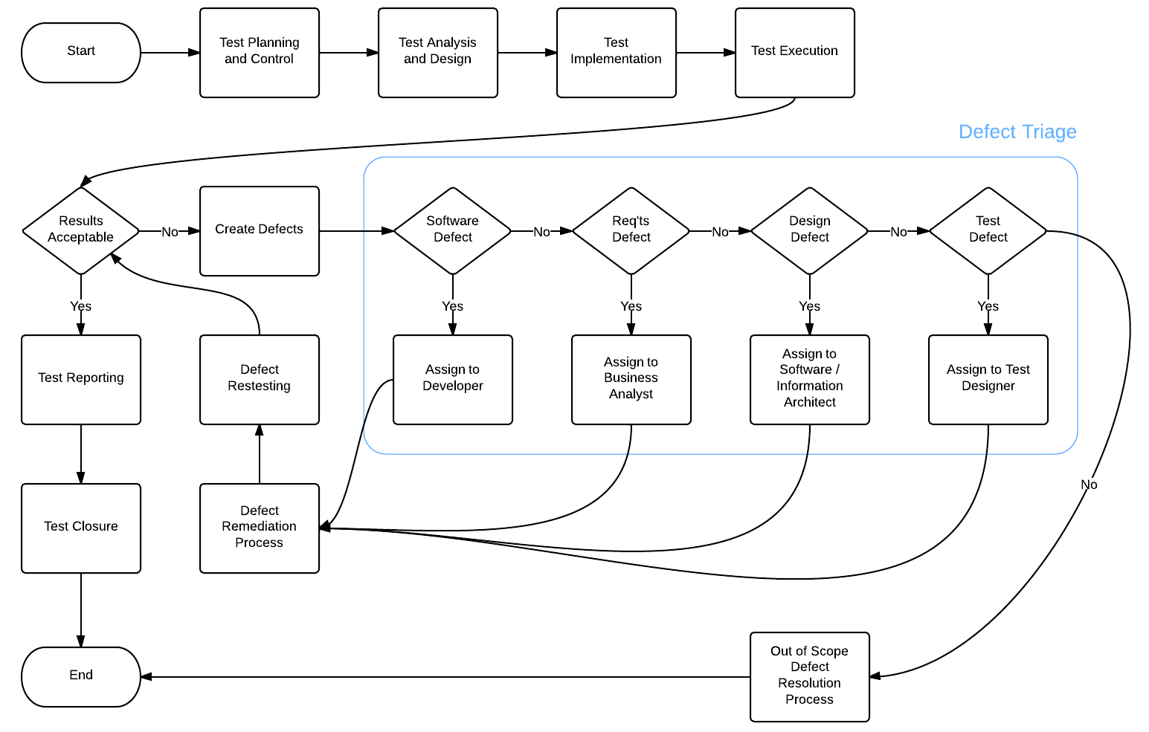
Fundamental Test Process

Slide 16
Fundamental Test Process
Test Planning and Control
Master Test Plan
Test Analysis and Design
Test Cases
Test Implementation
Setting up test environments, test scripts, and test data
Test Execution (and Defect Management)
Test Exit Criteria and Reporting
Test Closure

Slide 17
Testing Documentation
The ISTQB uses the IEEE Standard 829-2008 as a reference standard for all software testing documentation and includes:
Master and Level Test Plans
Level Test Design Specifications
Level Test Cases
Level Test Procedures
Level Test Logs
Incident (Defect) Reports
Master and Level Test Reports

Slide 18

Test Planning and Control
Test Planning:
An activity where the objectives of testing with respect to the overall goals of the project are defined
Activities in planning include the creation of a Master Test Plan and Level Test Plans
Test Control:
An ongoing activity of comparing actual progress against the plan and reporting status and deviations from the plan
Notes:
Test planning is usually but not always an ongoing activity that takes feedback from the monitoring and control activities.

Slide 19
Test Plans
A test plan is a document that describes the overall approach or strategy that will be used to ensure that the software under test meets its requirements and design specifications
The master test plan contains all of the high level test planning and also as sub-plans, all of the level testing plans and includes:
An introduction including a mission statement and objectives
Resources required (personnel, HW, SW, tools, environments)
Testing scope (what is and is not in scope for testing)
Work products and deliverables
Risk and contingency planning
Expected Results and Success Criteria

Slide 20
Test Analysis and Design
Involves taking test objectives defined in test planning and defining test conditions and test cases to achieve those objectives. Activities in this phase include:
Reviewing and understanding the test basis (including requirements, test plans, architectural models, and other relevant software development project documentation
Evaluating feasibility of the test objectives
Designing and prioritizing high-level test cases
Identifying test data requirements
Identifying test environment requirements
Creating bi-directional traceability between test basis and test cases

Slide 21
Test Implementation
A set of activities needed to prepare for test execution. Activities include:
Finalizing, implementing and prioritizing test cases
Developing test scripts and test procedures for test cases
Preparing test data and test environments (test harnesses)
Organizing test cases into test suites (collections of test cases, usually representing a test scenario)
Updating bi-directional traceability between test basis and test cases

Slide 22
Test Execution
In this phase the actual testing is conducted by executing test suites (either manually or using automated tools). Activities include:
Executing test suites
Logging test information and outcomes
Comparing actual results with expected results
Reporting discrepancies as incidents (a.k.a issues, defects, bugs) and doing any cursory analysis to assist in determining their cause
Repeating testing as a result of actions to remedy incidents

Slide 23
Test Exit Criteria and Reporting
In this phase, the results of test execution are assessed against the testing objectives at each of the test levels.
Check test log results against planned exit criteria
Determine if additional testing is required or if exit criteria needs modifying
Write a test summary report for stakeholders that includes information such as pass/fail and defect raised statistics

Slide 24
Test Closure
In the final phase of the test process, the test team close out testing activities, collect any data or metrics from the test process, document any lessons learned for future test engagements, and ensure all of the outputs (work products) of the testing process are in a completed state.
These activities occur at project milestones, such as when a major project objective is achieved, the finalized software system is released, or the project is completed (or cancelled).

Slide 25
Exercise 1
Create a Master Test Plan
A client is building a software application and has provided Meticulon with a Request For Proposal (RFP) document that highlights the main features of the software being developed. A contract is expected to be signed and Meticulon’s Test Manager has asked you to come up with a draft Master Test Plan.
In groups of 2, decide upon some information that should be included in each section of the draft Master Test Plan (a template has been provided)
You will have up to an hour to fill out the draft Master Test Plan after which we will as a team create a final Master Test Plan based on input from each of the groups

Slide 26
Agenda
Fundamentals of Testing
Testing Through Software Lifecycle
Static Techniques
Test Design Techniques
Test Management
Tools for Testing

Slide 27
Testing Through Software Lifecycle

Slide 28
Software Development Life Cycle
The software development life cycle is a process that describes the different phases of software development and their order.
There are a number different models that implement the SDLC methodology, including:
Waterfall
V-Model
Rapid Application Prototyping
Iterative
Agile

Slide 29
Waterfall Model
A traditional sequential software development method
Requirements
Design
Development
(Implementation)
Testing
(Verification)
Maintenance
(and Operations)

Slide 30
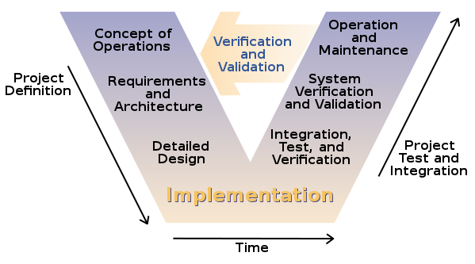
V-Model
considered to be an extension of the waterfall model
By Leon Osborne, Jeffrey Brummond, Robert Hart, Mohsen (Moe) Zarean Ph.D., P.E, Steven Conger ; Redrawn by User:Slashme. [Public domain], via Wikimedia Commons

Slide 31
Agile Model
A modern incremental software development method where software is developed in short cycles (sprints)
Initial Planning
Requirements
Planning
Analysis & Design
Evaluation
Implementation
Testing
Deployment

Slide 32
Software Development Team
Most software developed on projects in teams
The Project Management Institute defines a project as “a temporary group activity designed to produce a unique product, service or result”
Roles on a software development project team include:
Project Manager
Business Analysts
Software Architect
Information Architect / User Interface Designer
Developer / Programmer
Tester

Slide 33
Software Development Phases
SDLC models usually share most of the same phases (or their underlying activities)
Planning
Requirements
Analyze and Design
Implementation
Test
Evaluation

Slide 34
Planning
Major responsibility of the project manager
Project management includes:
Major considerations are cost, schedule (time), scope (requirements) and quality
Scope Management
Schedule Management
Cost Management
Risk Management
Stakeholder Management
Quality Management
Scope
Quality
Time
Cost

Slide 35
Requirements
What … does the software do?
But really starts with… Why?
Business Need
Provided by Stakeholders (any person, organization or entity that is interested in a project)
Conducted by Business Analysts

Slide 36
Requirements
Activities:
Elicitation – discovering and gathering
Analysis – logically breaking down and organizing
Specification – representing requirements in a way that easily understood
Validation – ensuring that requirements are correct and are actually implemented in the solution

Slide 37
Requirements Traceability
One method of ensuring that requirements are implemented is through traceability
Traceability links requirements:
Back to the business problem / needs
To project objectives / desired outcomes
To solution design and implementation
To test cases and test scripts

Slide 38
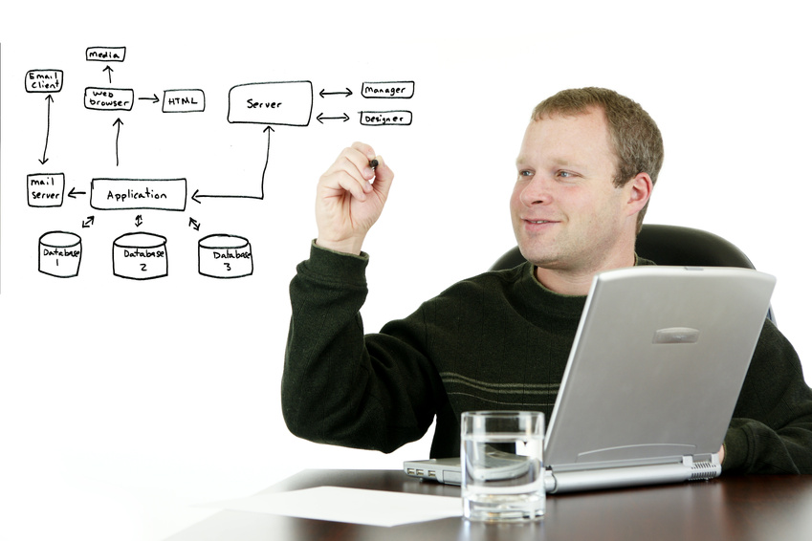
Analysis and Design
Software Architecture
Conceptualization
Modeling
Prototyping
Done by software architects
User Interface
Wire-framing
Usability
Accessibility
Storyboarding
Done by Information Architects or UI Designers

Slide 39
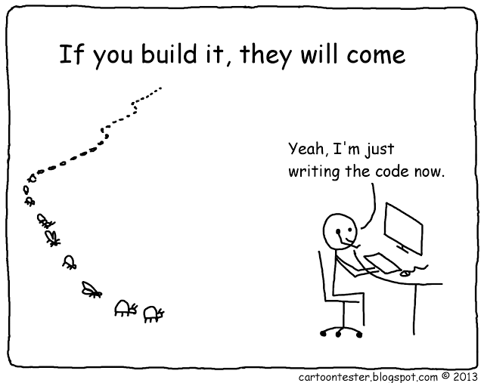
Implementation
The actual development of the software code to meet the requirements
Done by programmers (software developers)
Code is released in groups called “Builds”
Initially testing should be done by the programmers
Cartoon by Andy Glover, used with permission from cartoontest.blogspot.com

Slide 40
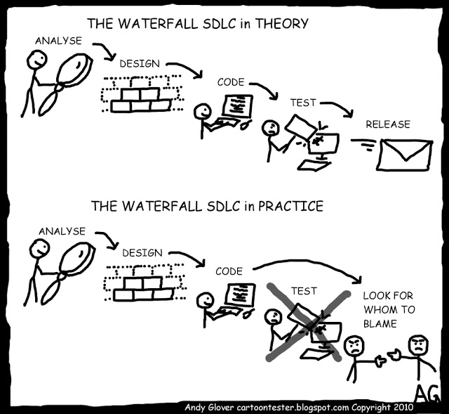
Testing
As the last phase before stakeholder evaluation, testing often is done haphazardly to meet budget or schedule constraints
New agile methodologies attempt to introduce testing throughout the process to avoid the situation illustrated here…
Cartoon by Andy Glover, used with permission from cartoontest.blogspot.com

Slide 41
Evaluation
Evaluation measures the overall effectiveness of the application developed
Stakeholders review the application to determine how closely it meets the original need (and any needed changes)
May involve ensuring contractual criteria were met
May also involve looking at potential enhancements for future development
Acceptance testing usually forms a part of evaluation

Slide 42


Software Testing Methods
Static testing
Dynamic testing
Reviewing documentation or code
Prevent errors from happening
Executing developed software
Identify defects in the software
Can be manual or automated
Can be white, black or grey box

Slide 43
Software Testing Methods (cont.)
Manual Testing – a tester manually follows the steps in a test case and records the results
Automated Testing – testers write code-based tests, which when run, automatically execute the test case steps (even going so far as to mimic actor interactions) and checks for expected result conditions.

Slide 44
Software Testing Methods (cont.)
White (Clear) Box Testing – a tester (or programmer) tests the internal workings of a program (usually at the and can selectively choose inputs to test specific parts of the code.
Black Box Testing – a tester treats the program as a “black box” for which they have no knowledge of the inner workings. The tester only knows the function of the program and what results are expected given a set of inputs.
Grey Box Testing – a combination of white and black box testing

Slide 45
Software Testing Levels
There are a number of different levels of software testing including:|
Unit (Component) Testing – testing of a specific piece of code, usually performed by software developers on a single functional unit
Integration Testing – testing that involves interactions between separate components via interfaces
System Testing – end to end testing of entire system to verify it meets overall requirements
Acceptance Testing – testing done by actual users to ensure it meets their needs

Slide 46
Software Testing Types
There are a number of different types of software testing including:
Functional Testing – verifying that a specific function of the code works as expected
Non-Functional Testing – testing of aspects not directly related to the functionality of the program, such as scalability, reliability or performance
Regression Testing – is done by running previously passed test cases to ensure that new modifications do not have side effects
Structural Testing
Smoke Testing
Usability Testing
Accessibility Testing

Slide 47
Exercise 2
Create High Level Test Cases
The client has signed a contract with Meticulon to provide test services. Development is already in progress and the client expects to put out its initial build of software in the coming days. An updated requirements list has been provided by the client. In order to start testing as soon as possible Meticulon’s Test Manager has asked you to come up with a draft set of high level test cases for the positive flows
In groups of 2, create a set of high level test cases (an Excel template has been provided).
You will have up to an hour to fill out the high level test cases. The high level test cases will be reviewed as a group in a future exercise.

Slide 48
Agenda
Fundamentals of Testing
Testing Through Software Lifecycle
Static Techniques
Test Design Techniques
Test Management
Tools for Testing

Slide 49
Static Techniques

Slide 50
Reviews
An activity where software or other work product is looked at in order to meet one or more objectives
Objectives include gaining understanding, ensuring conformance to standards or specifications, identifying defects
Can be conducted as a demonstration, meeting, or individual review (e.g. reading a document) with diverse audiences (i.e. peers, stakeholders, subject matter experts, etc.)
Can be formal or informal
An example of a formal review is a moderated meeting with external reviewers with a set agenda and actions
An example of an informal review is two people working on the same task (pair programming)

Slide 51
Types of Reviews
Informal Review
An unstructured review that may or may not be documented.
Walkthrough
A demonstration by the author to promote understanding (can be formal or informal depending on the audience)
Technical Review
A review involving technical experts to ensuring quality and conformance to planned work (can be formal or informal)
Inspection
A formal (usually moderated) review that is primarily looking for defects or non-conformance

Slide 52
Exercise 3
Software Demo / Revisit High Level Test Cases
The client recently gave the Meticulon Test Manager a demonstration of the most recent build of the software. The Test Manager is going to do a walkthrough of the software and has asked you to take notes so that you can update your High Level Test Cases.
In groups of 2, create a set of high level test cases (an Excel template has been provided).
You will have 30 minutes to update the high level test cases after which we will as a team we will build a final set of High Level Test cases using input from the group

Slide 53
Agenda
Fundamentals of Testing
Testing Through Software Lifecycle
Static Techniques
Test Design Techniques
Test Management
Tools for Testing

Slide 54
Test Design Techniques

Slide 55
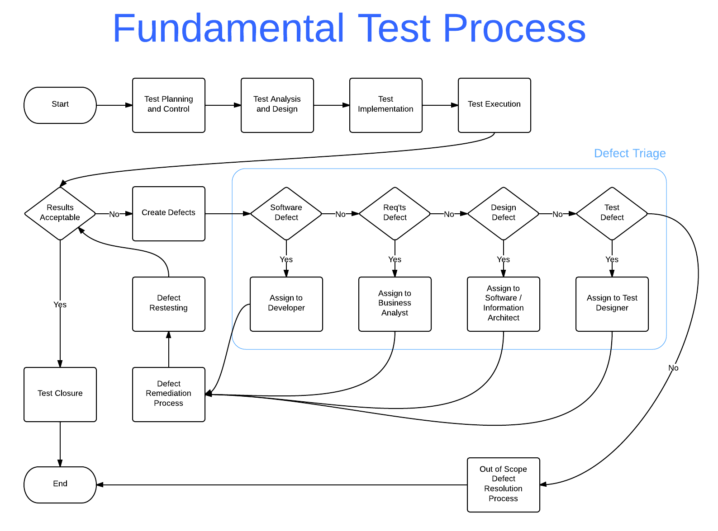

Slide 56
Test Design Techniques
Test Development Process
Categories of Test Design Techniques
Specification-Based Techniques (Black-Box)
Structure-Based Techniques (White-Box)
Experience-Based Techniques
Choosing Test Techniques

Slide 57
Test Development Process
Identifying test conditions through test basis analysis
Establish traceability from test conditions to requirements
Determine detailed test approach (based on risks)
Design tests (test cases, test data)
Includes input values, preconditions, and expected results (outputs, data & state changes)

Slide 58
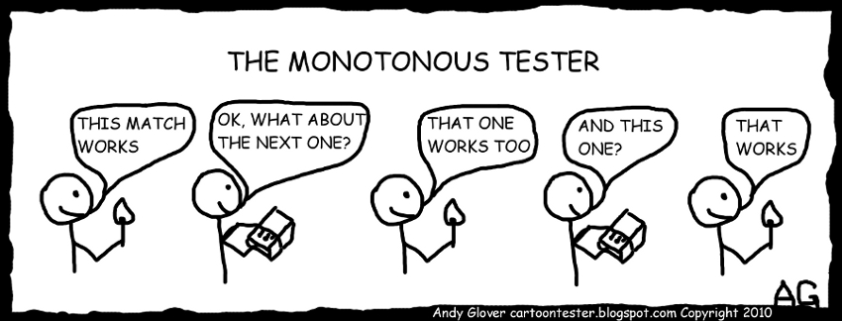
Test Development Process
Implement, prioritize and organize test cases into test procedure specification
Cartoon by Andy Glover, used with permission from cartoontest.blogspot.com

Slide 59
Categories of Test Design Techniques
Specification-Based Techniques (Black Box)
Test cases derived from models (formal or informal) which specify the problem to be solved
Structure-Based Techniques (White Box)
Code and detailed design information used to derive test cases
Test case coverage of software can be measured
Experience-Based Techniques
Knowledge and experience of people used to derive test cases
Uses knowledge of stakeholders about software, its usage and environment
Defects and their distribution also can influence test case design

Slide 60
Specification-Based Techniques
Specification-Based Techniques (Black-Box) include:
Equivalence Partitioning
Boundary Value Analysis
Decision Table Testing
State Transition Testing
Use Case Testing

Slide 61
Equivalence Partitioning
Also called Equivalence Class Partitioning
a technique where input data is divided into partitions (classes) of equivalent data
Test cases are then designed to ensure that each partition is tested at least once.
The goal is to reduce the number of overall test cases but still ensure high coverage of inputs to test for defects

Slide 62
Equivalence Partitioning
Input can be divided into groups of valid data and invalid data by the characteristics of the data itself
To divide data into equivalence partitions we use an equivalence relation
Equivalence testing can be used at all levels of testing

Slide 63
Equivalence Partitioning Examples
A simple equivalence relation – is a given number even?
We can easily see that this type of relation can create an operating flow decision in the following code :
If (x % 2 == 0) then
Print “X is even”
Else
Print “X is odd”
In this case we have 2 equivalence classes, one containing even numbers and one containing odd numbers

Slide 64
Equivalence Partitioning Examples
A more complex example might be determining the equivalence classes for determining the amount of income tax a person should pay
We may know there are different tax brackets that need to be tested (hopefully they have been specified if we are doing black-box testing)
In this case, incomes that fall within each tax bracket range will be members of the same equivalence classes

Slide 65
Exercise 4
Equivalence Partitioning
A potential client is building an app that allows users to create a shopping list for a grocery store. The app allows users to add products to a list with the following product information: name, brand, price, weight, and quantity
As part of the RFP response, they have asked for summary equivalence testing partitions. The Meticulon Test Manager has asked you to create a list of equivalence classes to be included
In groups of two, create a list of equivalence relations and resulting classes for potential inputs for products. You have 20 minutes after which we will discuss as a group

Slide 66
Boundary Value Analysis
Considered to be an extension of Equivalence Partitioning
Using values that are on the edge of a equivalence partition are more likely to yield defects than values within the partition
Generally want to use the minimum and maximum values within an equivalence partition

Slide 67
Boundary Value Analysis
Boundaries can be tested for valid partitions and invalid partitions
When designing test cases, a test for each boundary value should be done
Detailed specifications, including business requirements, are a good source for determining boundary values.
Boundary Value Analysis can be used at all levels of testing

Slide 68
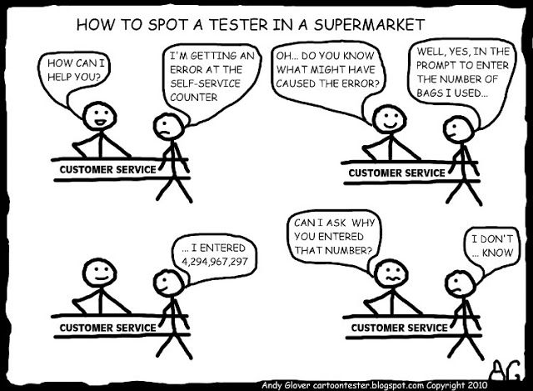
Boundary Value Analysis
Cartoon by Andy Glover, used with permission from cartoontest.blogspot.com

Slide 69
Exercise 5
Boundary Value Analysis
Take a look at the list of equivalence partitions created in Exercise 4 and identify what some interesting boundary values might be.
In your previous groups of two, update your list of equivalence partitions to include boundary values when they make sense. You have 20 minutes after which we will discuss as a group

Slide 70
Decision Table Testing
Useful for testing logical conditions and complex business rules of software under test.
To create a decision table, the specifications are analyzed to determine the conditions and resultant actions
Usually the conditions are stated such that they can be evaluated as Boolean statements for an equivalence class (i.e. True or False)

Slide 71
Decision Table Testing
A table is created that contains all of the true and false permutations for each of the input conditions
 | Permutations
 | 1 | 2 | 3 | 4 | 5 | 6 | 7 | 8
Condition A | T | T | T | T | F | F | F | F
Condition B | T | T | F | F | T | T | F | F
Condition C | T | F | T | F | T | F | T | F
Action A | X |  |  |  | X
Action B | X | X |  |  |  |  | X | X
Action C |  | X |  | X |  | X |  | X

Slide 72
Decision Table Testing
A test case should be developed for each combination of possible condition outputs (i.e. each column in the decision table)
Using decision tables ensures that all possible logical combinations of business rules are covered during testing

Slide 73
Exercise 6
Decision Table Testing
A client has asked Meticulon to test its web based stock trading platform. As a part of the effort to build test cases, the Meticulon Test Manager has asked you to build a decision table for calculating the account trading commissions. The business rules for calculating commissions are:
New accounts receive 10 free trades
For accounts with over $50,000 dollars in assets, trades cost $10
For high frequency trading accounts (over 50 trades in the last 30 days), trades cost $8
The regular commission for trades is $18
In groups of 2, build a decision table including the conditions and actions. You have 30 minutes.

Slide 74
State Transition Testing
A system may exhibit different behaviours or responses depending on the current conditions or previous history
A system (or portion thereof) that can be described by a finite set of states is a good candidate for State Transition Testing.
This type of system is often called a finite state system (or finite state machine)

Slide 75
State Transition Testing
Any system where a specific input can result in different outputs based on the state can be categorized as a finite state system
This type of context specific behaviour can be modelled using a state diagram and / or a state transition table
State transition diagrams can be as abstract or as detailed as needed.

Slide 76
State Transition Testing
The four key characteristics of a state diagram are:
The states that the system can be in
The transitions that occur to move between different states
The events (inputs) that cause transitions
And the actions (outputs) that result from a transition of state

Slide 77
State Transition Testing
A state diagram can be used to design test cases that follow specific desired sequences of states and transitions
Coverage of software under test may include:
ensuring that each state is reached
each transition is exercised
that specific sequences are tested
that invalid transitions are not achievable

Slide 78
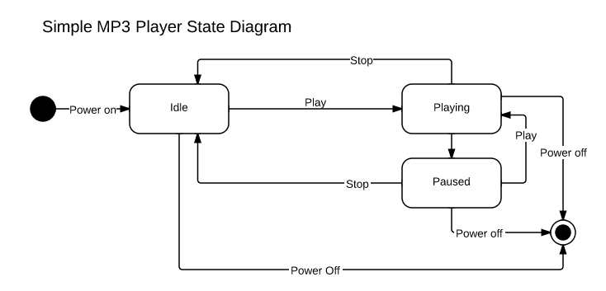
State Transition Testing

Slide 79
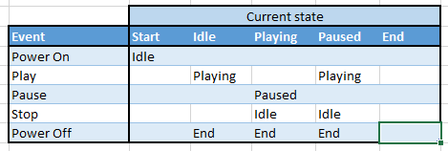
State Transition Testing
The state transition table for the MP3 Player state diagram could be drawn as follows:

Slide 80
Exercise 7
State Transition Testing
A client is about to contract Meticulon to test its elevator control system for a building with 3 floors.
In an attempt to get a head start on building test cases, the Meticulon test manager has asked you to create a state diagram and a state transition table for the elevator system
You have 30 minutes to create the diagram and table using Word or Excel

Slide 81
Use Case Testing
Use case testing involves deriving tests from use cases.
Use cases describe process flows through a system, where users of the system interact with the system to produce results that provide value
Test cases developed from use cases are useful in:
Uncovering defects that may occur as a part of real-world activities of the users of the software
Designing acceptance tests
Uncovering integration defects caused by the interaction of different components and systems

Slide 82
Test Design Techniques
Test Development Process
Categories of Test Design Techniques
Specification-Based Techniques (Black-Box)
Structure-Based Techniques (White-Box)
Experience-Based Techniques
Choosing Test Techniques

Slide 83
Structured-Based Techniques
Structure-Based Techniques (White Box) utilizes knowledge of the underlying structure of the software to develop tests
Structure-Based Techniques include:
Statement Testing and Coverage
Decision Testing and Coverage
Other Structure Based Techniques

Slide 84
Structured-Based Techniques
Why these techniques are important?
User requirements
Developers
Code
Statements
Decisions (Boolean)
Multiple Decisions
Repetitive Statements
Exception Handle Statements
Tester’s skills, intuition & experience (Apps, technologies, etc.)
User requirements
Test Cases
Testers
Black-Box Technique

Slide 85
Agenda
Fundamentals of Testing
Testing Through Software Lifecycle
Static Techniques
Test Design Techniques
Test Management
Tools for Testing

Slide 86
Test Management

Slide 87
Test Management
Test Organization
Test Planning and Estimation
Test Progress Monitoring and Control
Configuration Management
Risk and Testing
Incident Management

Slide 88
Test Organization
Test Independence
Effectiveness of testing can be improved by using independent testers
No bias and ability to see other and different defects
Different levels of test independence include:
The developer test themselves
Other developers from the team tests
Independent testers from the same organization
Independent testers from users / business group
Test specialists for specific testing types
External testers (from outside the organization)

Slide 89
Test Organization
Roles include Test Leader and Tester
Testers may specialize based on competency in specific areas
Test Leader (aka Manager / Coordinator)
Develops test strategy
Develops and executes test plan
Manages the design, implementation and execution of testing
Reporting

Slide 90
Test Organization
Tester
Review and contribute to test planning
Create test specifications
Set up test environments
Prepare test data
Design and implement test cases
Implement and execute tests, log and evaluate results and report incidents (defects)
Use testing tools and defect management tools
Automate testing

Slide 91
Test Planning and Estimation
Test Planning
Test Planning Activities
Entry Criteria
Exit Criteria
Test Estimation
Test Strategy, Test Approach

Slide 92
Test Estimation
The Oxford English dictionary defines Estimation as:
A rough calculation of the value, number, quantity, or extent of something
The ISTQB defines test estimation as:
“The calculated approximation of a result related to various aspects of testing (e.g. effort spent, completion date, costs involved, number of test cases, etc.) which is usable even if input data may be incomplete, uncertain, or noisy.”

Slide 93
Test Estimation
In software testing, a test leader and testers estimate the effort required for testing in order to identified the needed resources and to develop a schedule

Slide 94
Test Estimation
Two approaches for test estimation are:
Metric-based estimation which uses metrics (measurements of results) from previous projects or benchmarks to approximate the testing effort
Expert-based estimation which uses experience of the people who will actually do the tasks to generate estimates

Slide 95
Test Estimation
Overall testing effort (and the estimation thereof) will be influenced by:
Quality / Completeness of the test basis
Complexity of problem and its solution
Requirements including quality, security, reliability and documentation
Skills, capability and experience levels of the organization, project and test team

Slide 96
Test Strategy, Test Approach
The test approach is the implementation of a test strategy. Some typical and complementary approaches include:
Analytical approaches (testing areas of greatest risk)
Model-based approaches (i.e. based on statistical models)
Methodical approaches (failure-based, experience based, checklist based)
Process or standards compliant approaches
Dynamic (Modifying test approach based on results)
Regression-Averse (Using automation to reduce regression efforts)

Slide 97
Test Cases Revisited
Wikipedia defines a Test Case as:
a set of conditions or variables under which a tester will determine whether an application, software system or one of its features is working as it was originally established for it to do
A test case nominally consists of ...
an identifier
the name of the test case
a description of what is tested by the test case
a list of actions to perform
an expected result for each action
a column where the tester can write the actual result

Slide 98
Sample Test Case
TC ID: | TC_1285
TC Name: | Shopping Cart Checkout
Description: | This test describes the process of an online shopper checking out (purchasing) the goods that they have in their shopping cart
Flow: | Basic
Pre-conditions: | The user (customer) must have already logged on to the web site with an account that has associated credit card, shipping address and billing address information. The user must have atleast one product added to his cart and is on the shopping cart web page.
Inputs: | None required
Environment: | Chrome browser (latest release)
Result:
Step # | Action | Expected result | Actual result | Comments
1 | Click the 'Proceed to Checkout' button | The user is directed to the 'Select a shipping address' web page
2 | Click the 'Ship to this address' button | The user is directed to the 'Choose your shipping options' web page
3 | Select the 'Standard shipping' radio button. | The standard shipping option is highlighted
4 | Click the 'Continue' button | The 'Select a Payment Method' web page is displayed. The item(s) that were originally in the cart are shown. A total price including shipping and taxes is shown.
5 | Click the 'Place your order' button | The 'Thank you, your order has been placed' web page is shown. The order number is displayed in bold.

Slide 99
Exercise 8
Detailed Test Cases
The client recently deployed its most recent alpha build to the test environment. The Meticulon Test Manager has created user ids for the test team on the test environment and will demo how to use it. The test manager would like the team to split up the high level test cases and build detailed test cases.
Using the provided detailed test case template and the current test basis, including the business requirements document and the newly provisioned test environment, individually create your selected detailed test cases.
We will take 90 minutes to start building test cases. Afterwards we will review them as a group.

