Slide 1
MANGO LEAF CLASSIFIER
Image Recognation with
Neural Network

Slide 2
Aim
01
Training and Results of Model
02
Steps Taken to Reach the Final
Content List
03
Limits of Model
04
The dataset and the objective of the model
The final used model, explanation of results
History of tested models before the final mode.
Discussion of limitation and areas to improve the model further

Slide 3
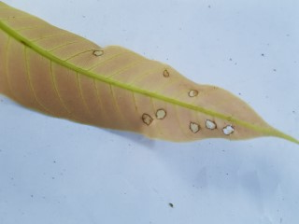
Aim
01
Mango Leaf Disease Dataset
Kaggle: Mango Leaf Disease Dataset (kaggle.com)
Contains 240x320 mango leaf images.
Desired model should be able to have high accuracy in identifying the classification of given images of leaves.

Slide 4
Information Dataset
Number of Images
4000 images
1800 are of distinct leaves,
rest are prepared by zooming and rotating where deemed necessary,
500 images for each class
Number of classes
8 classes
Anthracnose
Bacterial Canker
Cutting Weevil
Die Back
Gall Midge
Healthy
Powdery Mildew
Sooty Mould

Slide 5
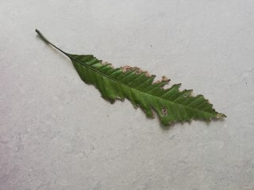
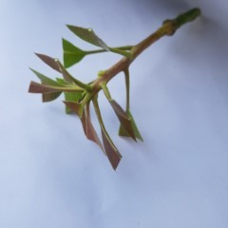
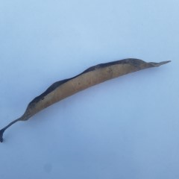
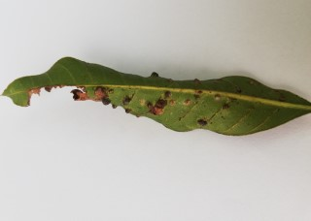
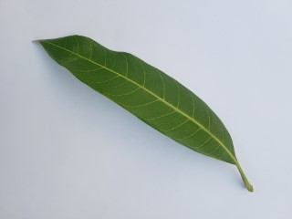
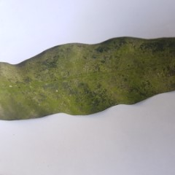
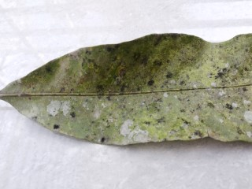
Anthracnose | Bacterial Canker | Cutting Weevil | Die Back
Gall Midge | Healthy | Powdery Mildew | Sooty Mould

Slide 6
Training and Results of Model
Training Preparations
02
^{Set computation to GPU}
Load and read data (In batches)
^{Scale data}
Split data (Train, validation, test)
¹ wiki.ros.org/ROS/Introduction sayfasından çevrilmiş bilgilerdir

Slide 7
Model Information
Pre-trained Model Xception:
Normalizing
Added Layers:
We load an existing image classifier model with prompt “include_top=False” to only take gained information but not the information on classes.
This positioning means the outputs from base_model are normalized before being passed to the dense layers, helping to ensure the inputs to these dense layers are standardized
We add an extra layer with density of 256 and a final output layer with 8 nodes for 8 classes, activation at ‘softmax’

Slide 8
Model Summary
Model: "sequential_1"
_________________________________________________________________
Layer (type) Output Shape Param #
=================================================================
xception (Functional) (None, 2048) 20861480
batch_normalization_5 (Batc (None, 2048) 8192
hNormalization)
dense_2 (Dense) (None, 256) 524544
dropout_1 (Dropout) (None, 256) 0
dense_3 (Dense) (None, 8) 2056
=================================================================
Total params: 21,396,272
Trainable params: 21,337,648
Non-trainable params: 58,624
_________________________________________________________________

Slide 9
Compile And Train Details:
model.compile(optimizer='adam', loss='sparse_categorical_crossentropy', metrics=['accuracy’])
logdir='logs’
tensorboard_callback = tf.keras.callbacks.TensorBoard(log_dir=logdir)
hist = model.fit(train, epochs=8, validation_data=validation, callbacks=[tensorboard_callback])
We use sparse categorical crossentropy for loss function since we have multiclassed dataset.
We use tensorboards logging method to gather information of training.

Slide 10
The Result
Train Accuracy : 0.9932
Validation Accuracy : 0.9862
Test Accuracy : 0.9875

Slide 11
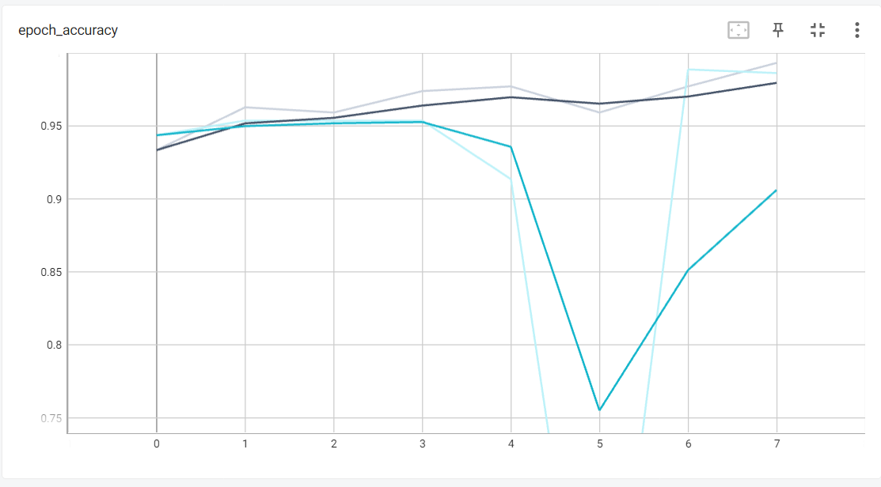
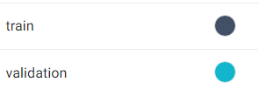
The solid lines are smoothed lines, while transparent lines are actual measurement for the given step.
Results are taken from tensorboard logdir

Slide 12
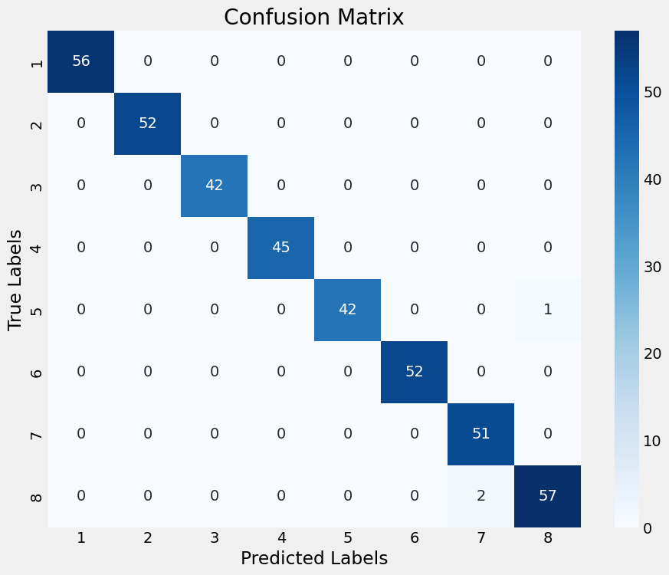

Slide 13
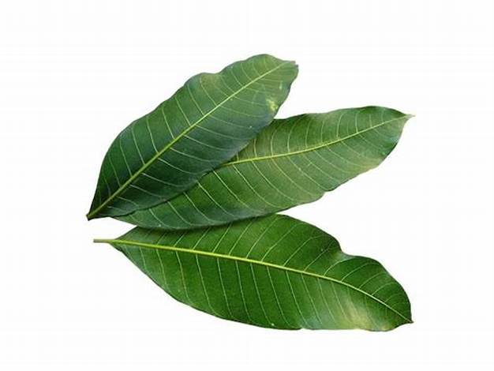
Test on Online Images
True Class : Healthy Prediction : Healthy
To test the model in completely new data, new images found and tested

Slide 14
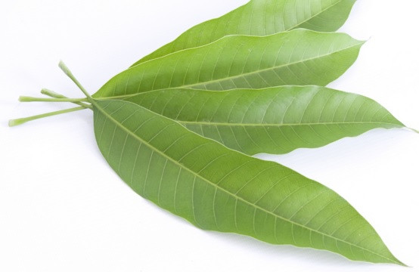
Test on Online Images
True Class : Healthy Prediction : Healthy
To test the model in completely new data, new images found and tested

Slide 15
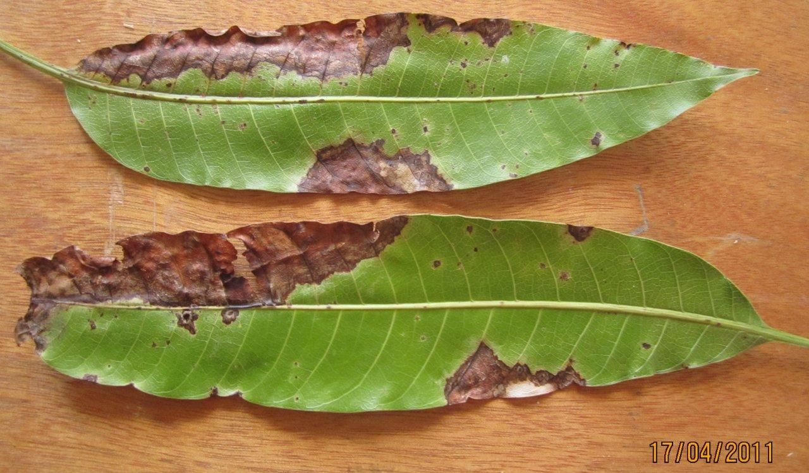
Test on Online Images
True Class : Anthracnose Prediction : Bacterial Canker
To test the model in completely new data, new images found and tested

Slide 16
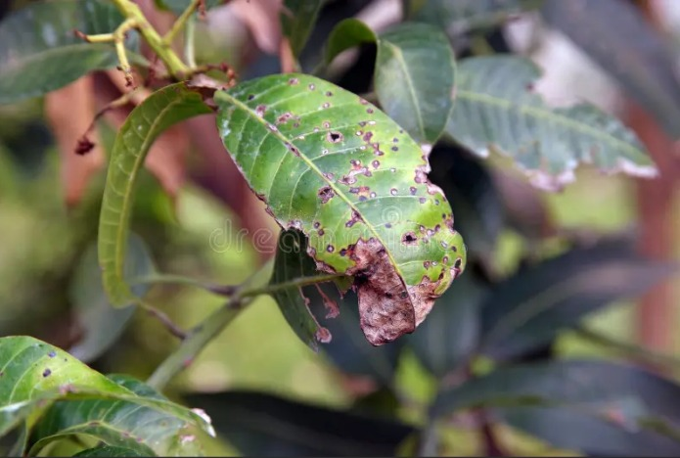
Test on Online Images
True Class : Anthracnose Prediction : Gall Midge
To test the model in completely new data, new images found and tested

Slide 17
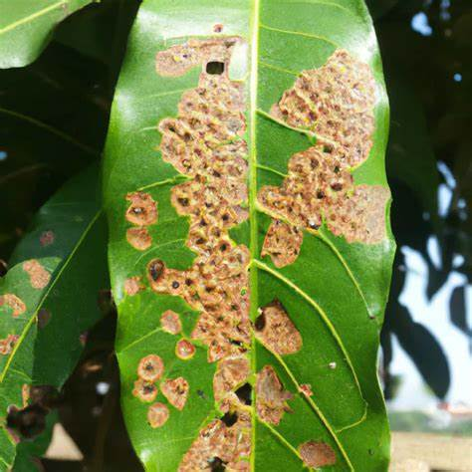
Test on Online Images
True Class : Bacterial Canker Prediction : Gall Midge
To test the model in completely new data, new images found and tested

Slide 18
Steps Taken to Reach the Final
Initial Model
1
Pretrained EfficientNetB0
2
Pretrained MobileNetV2
3
03
Pretrained Xception
4

Slide 19

 | Initial Model | EfficientNetB0 | MobileNetV2 | Xception
Trainable params | 34,079,240 | 4,340,100 | 2,556,424 | 21,337,648
Non-trainable params | 2,496 | 44,583 | 36,672 | 58,624
Batch Size | 32 | 32 | 32 | 16
Epoch | 20 | 4 | 4 | 8
Train Accuracy | 0.9907 | 0.9928 | 0.9975 | 0.9932
Validation Accuracy | 0.4013 (Intermediate epoch accuracy 0.954) | 0.9962 | 0.2313 | 0.9862
Observation | ^{Volatile Validation accuracy} ^{Low reliability} | ^{High Accuracy} ^{High Reliability} Non-compatible with build-in Tensorflow, causing error on saving | ^{Low Accuracy} Small build, accuracy may be increased with increase epoch. | ^{High Accuracy} Reliable (Still Less Then EffficientNetB0) Big build, required decreased batch count to prevent Out Of Memory (OOM) Saved, suitable with built-in TensorFlow Version

Slide 20
Model: "sequential_1"
_________________________________________________________________
Layer (type) Output Shape Param #
=================================================================
conv2d_3 (Conv2D) (None, 256, 256, 32) 896
batch_normalization (BatchN (None, 256, 256, 32) 128
ormalization)
activation (Activation) (None, 256, 256, 32) 0
max_pooling2d_3 (MaxPooling (None, 128, 128, 32) 0
2D)
conv2d_4 (Conv2D) (None, 128, 128, 64) 18496
batch_normalization_1 (Batc (None, 128, 128, 64) 256
hNormalization)
activation_1 (Activation) (None, 128, 128, 64) 0
max_pooling2d_4 (MaxPooling (None, 64, 64, 64) 0
2D)
conv2d_5 (Conv2D) (None, 64, 64, 128) 73856
batch_normalization_2 (Batc (None, 64, 64, 128) 512
hNormalization)
activation_2 (Activation) (None, 64, 64, 128) 0
max_pooling2d_5 (MaxPooling (None, 32, 32, 128) 0
2D)
conv2d_6 (Conv2D) (None, 32, 32, 256) 295168
batch_normalization_3 (Batc (None, 32, 32, 256) 1024
hNormalization)
activation_3 (Activation) (None, 32, 32, 256) 0
max_pooling2d_6 (MaxPooling (None, 16, 16, 256) 0
2D)
flatten_1 (Flatten) (None, 65536) 0
dense_2 (Dense) (None, 512) 33554944
batch_normalization_4 (Batc (None, 512) 2048
hNormalization)
activation_4 (Activation) (None, 512) 0
dropout (Dropout) (None, 512) 0
dense_3 (Dense) (None, 256) 131328
batch_normalization_5 (Batc (None, 256) 1024
hNormalization)
activation_5 (Activation) (None, 256) 0
dropout_1 (Dropout) (None, 256) 0
dense_4 (Dense) (None, 8) 2056
=================================================================
Total params: 34,081,736
Trainable params: 34,079,240
Non-trainable params: 2,496
_________________________________________________________________
1
^{Initial Model}
^{Batch: 32}
^{Epoch: 20}

Slide 21
^{Training Information}
Epoch 16/20
accuracy: 0.9723 - val_accuracy: 0.8725
Epoch 17/20
accuracy: 0.9856 - val_accuracy: 0.9538
Epoch 18/20
accuracy: 0.9749 - val_accuracy: 0.8125
Epoch 19/20
accuracy: 0.9881 - val_accuracy: 0.7387
Epoch 20/20:
accuracy: 0.9907 - val_accuracy: 0.4013
1
^{Initial Model}
^{Batch: 32}
^{Epoch: 20}
^{Results:}
^{Volatile Validation accuracy}
^{Low reliability}

Slide 22
Model: "sequential_5"
_________________________________________________________________
Layer (type) Output Shape Param #
=================================================================
efficientnetb0 (Functional) (None, 1280) 4049571
batch_normalization_5 (Batc (None, 1280) 5120
hNormalization)
dense_10 (Dense) (None, 256) 327936
dropout_5 (Dropout) (None, 256) 0
dense_11 (Dense) (None, 8) 2056
=================================================================
Total params: 4,384,683
Trainable params: 4,340,100
Non-trainable params: 44,583
_________________________________________________________________
2
^{Pretrained} ^{EfficientNetB0}
^{Batch: 32}
^{Epoch: 4}

Slide 23
^{Training Information}
Epoch 1/4
accuracy: 0.9964 - val_accuracy: 0.9987
Epoch 2/4
accuracy: 0.9957 - val_accuracy: 0.9925
Epoch 3/4
accuracy: 0.9917 - val_accuracy: 0.9912
Epoch 4/4
accuracy: 0.9928 - val_accuracy: 0.9962
2
^{Pretrained} ^{EfficientNetB0}
^{Batch: 32}
^{Epoch: 4}
^{Results:}
^{High Accuracy}
^{High Reliability}
Non-compatible with build-in Tensorflow, causing error on saving

Slide 24
Model: "sequential"
_________________________________________________________________
Layer (type) Output Shape Param #
=================================================================
mobilenetv2_1.00_224 (Funct (None, 1280) 2257984
ional)
batch_normalization (BatchN (None, 1280) 5120
ormalization)
dense (Dense) (None, 256) 327936
dropout (Dropout) (None, 256) 0
dense_1 (Dense) (None, 8) 2056
=================================================================
Total params: 2,593,096
Trainable params: 2,556,424
Non-trainable params: 36,672
_________________________________________________________________
3
^{Pretrained} ^{MobileNetV2}
^{Batch: 32}
^{Epoch: 4}

Slide 25
^{Training Information}
Epoch 1/4
accuracy: 0.9019 - val_accuracy: 0.2250
Epoch 2/4
accuracy: 0.9842 - val_accuracy: 0.2338
Epoch 3/4
accuracy: 0.9932 - val_accuracy: 0.1425
Epoch 4/4
accuracy: 0.9975 - val_accuracy: 0.2313
3
^{Pretrained} ^{MobileNetV2}
^{Batch: 32}
^{Epoch: 4}
^{Results:}
^{Low Accuracy}
Small build, accuracy may be increased with increase epoch.

Slide 26
Model: "sequential_1"
_________________________________________________________________
Layer (type) Output Shape Param #
=================================================================
xception (Functional) (None, 2048) 20861480
batch_normalization_5 (Batc (None, 2048) 8192
hNormalization)
dense_2 (Dense) (None, 256) 524544
dropout_1 (Dropout) (None, 256) 0
dense_3 (Dense) (None, 8) 2056
=================================================================
Total params: 21,396,272
Trainable params: 21,337,648
Non-trainable params: 58,624
_________________________________________________________________
4
^{Pretrained} ^{Xception}
^{Batch: 16}
^{Epoch: 8}

Slide 27
^{Training Information}
Epoch 4/8
accuracy: 0.9739 - val_accuracy: 0.9538
Epoch 5/8
accuracy: 0.9771 - val_accuracy: 0.9137
Epoch 6/8
accuracy: 0.9593 - val_accuracy: 0.5063
Epoch 7/8
accuracy: 0.9771 - val_accuracy: 0.9887
Epoch 8/8
accuracy: 0.9932 - val_accuracy: 0.9862
4
^{Pretrained} ^{Xception}
^{Batch: 16}
^{Epoch: 8}
^{Results:}
^{High Accuracy}
Reliable (Still Less Then EffficientNetB0)
Big build, required decreased batch count to prevent Out Of Memory (OOM)
Saved, suitable with built-in TensorFlow Version

Slide 28
04
Limits of Model
Discussion of limitation and areas to
improve the model further

Slide 29
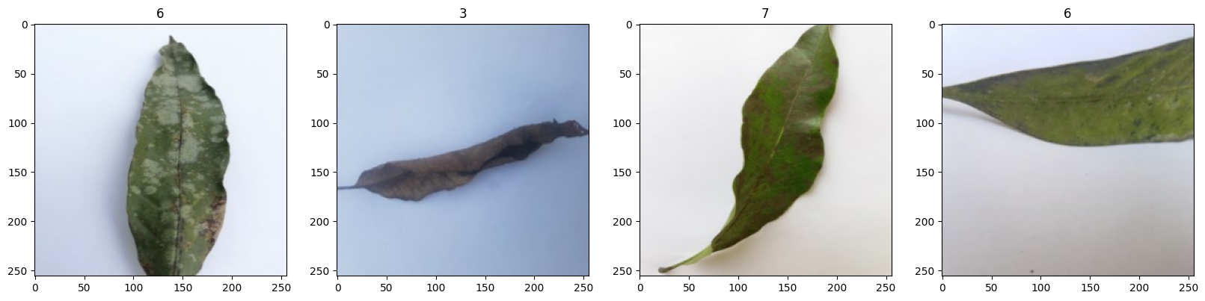
Limits
Lab Environment Dataset
The images are taken in same place with same equipment, creating similar features for image detection. The model created works accurately heavily on images with similar images.
Dataset can be improved by finding images that are taken in different environment with different equipment

Slide 30
Limits
Variability in Lighting and Angles
While the images include variability in lighting and angles, it is hard to assume it covers every possibility in real world application. The dataset images are mostly singular leaves while in real life use case, it is possible most be tempted to use on photos including mulptile leaves where the trained model may experience difficulty.

Slide 31
Limits
Limited Diversity in Disease Manifestation
The disease in mango leaves can manifest in different manner and shows different sings overtime. While 500 images is good starting point per class, it might not be enough to capture the full spectrum of disease manifestation.

Slide 32
Limits
Transfer Learning Limitations:
Limitation caused by using Pre-trained model includes risk of domain shift, feature relevance, over-reliance on Pre-trained features.
Overfitting:
The image dataset of 4000 is not great number of data and includes the risk of overfitting.
Model Interpretability and Explainability:
Using Pre-trained models, especially on complex models like Xception, can be seen as “black boxes”, meaning the feature importance for model is hard to define, limiting the insight in how to make predictions.

Slide 33
Areas to Improve
Increasing environment difference
Increasing variability
Dataset Expansion
Different Architectures for Trial
Fine-Tuning on Pre-training or no Pre-trained model
Model Explanability

Slide 34
Conclusion
The limits are defined and areas to improve mainly focus on how the limits can be addressed. The final model achieved can be used with high accuracy in lab environment, even automated for mango leaf disease detection given a functional pipe-line is created.

Slide 35
Thank You!
metinunlu97@gmail.com

