Slide 1
DNS Analysis & Troubleshooting
Using Wireshark
Graded Lab Project
Ubuntu & Wireshark

Slide 2
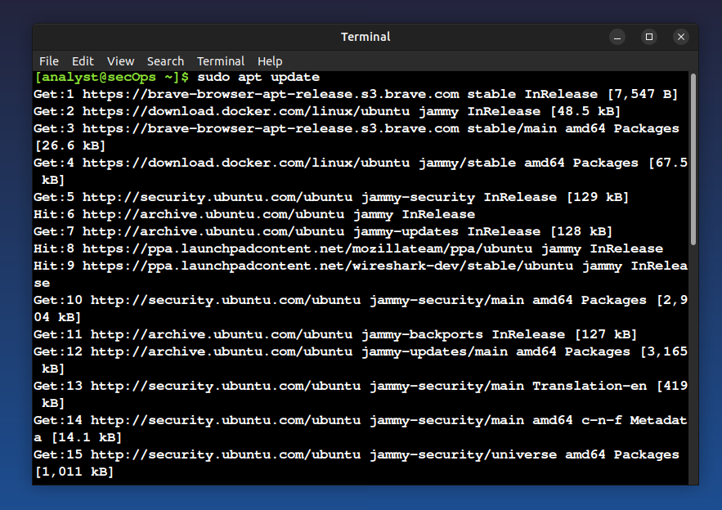
Step 1
Command: sudo apt update
Explanation: Updates the package list and checks for available software updates.

Slide 3
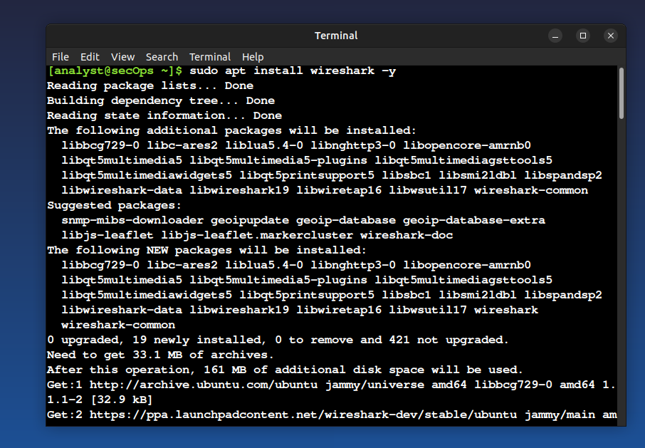
Step 2
Command: sudo apt install wireshark -y
Explanation: Installs Wireshark on the Ubuntu system.

Slide 4
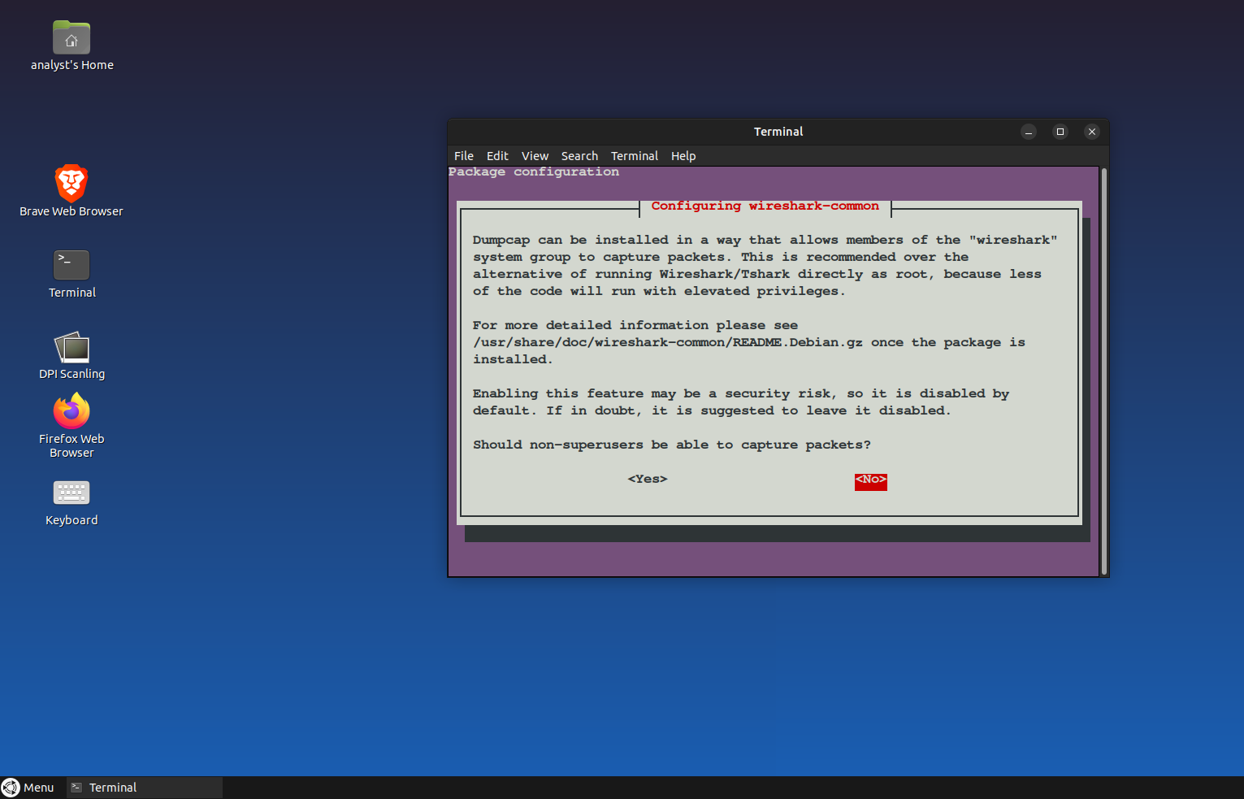
Step 3
Command: Wireshark configuration prompt
Explanation: Allows non-root users to capture packets by selecting Yes.

Slide 5
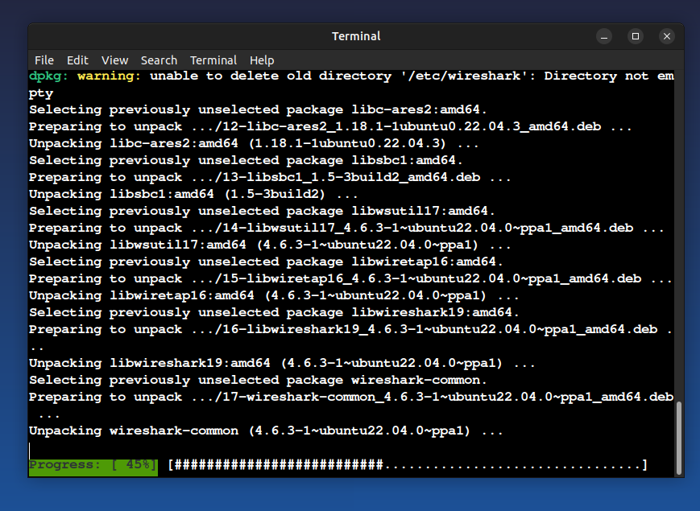
Step 4
Command: Installing dependencies
Explanation: Wireshark and required libraries are being installed.

Slide 6
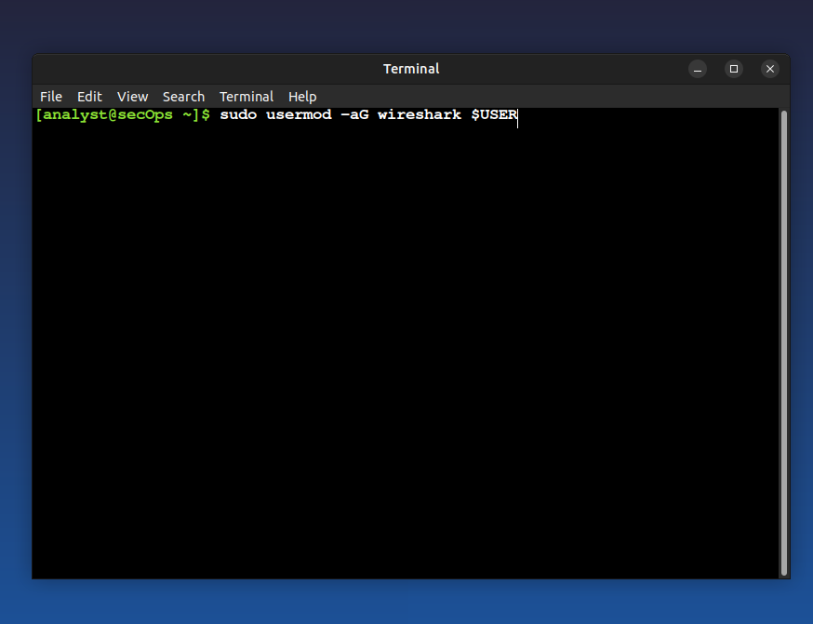
Step 5
Command: sudo usermod -aG wireshark $USER
Explanation: Adds the current user to the wireshark group.

Slide 7
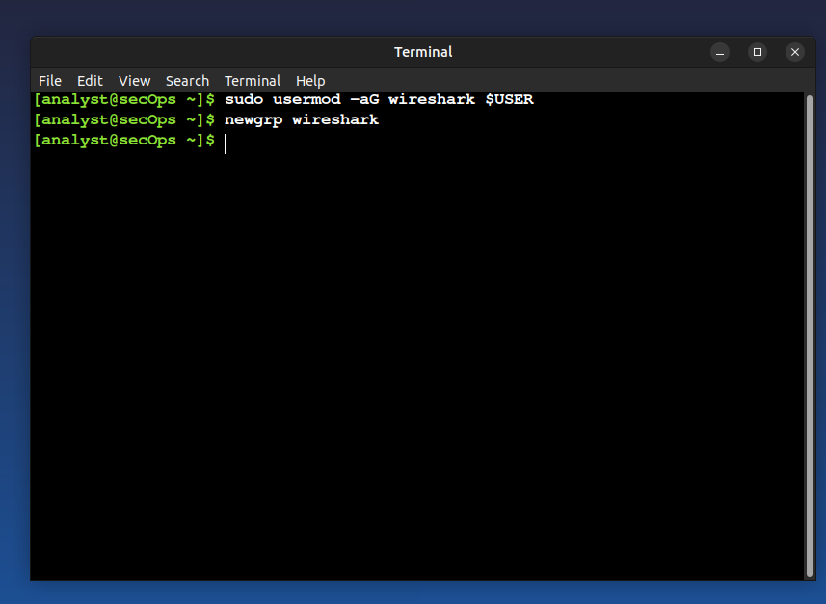
Step 6
Command: newgrp wireshark
Explanation: Applies the group change without logging out.

Slide 8
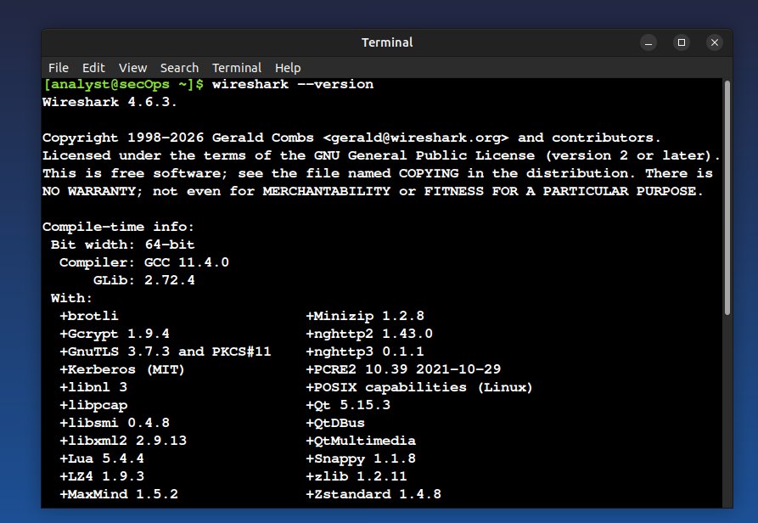
Step 7
Command: wireshark --version
Explanation: Verifies that Wireshark is installed correctly.

Slide 9
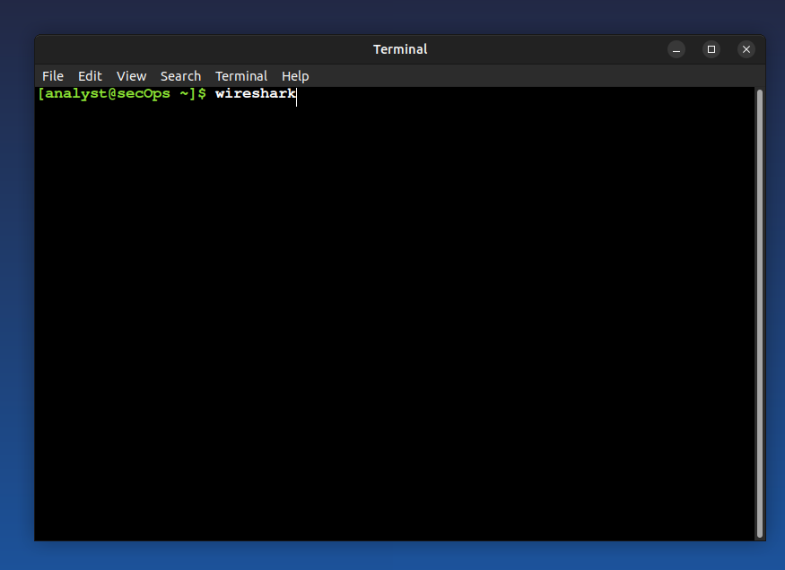
Step 8
Command: wireshark
Explanation: Launches the Wireshark application.

Slide 10
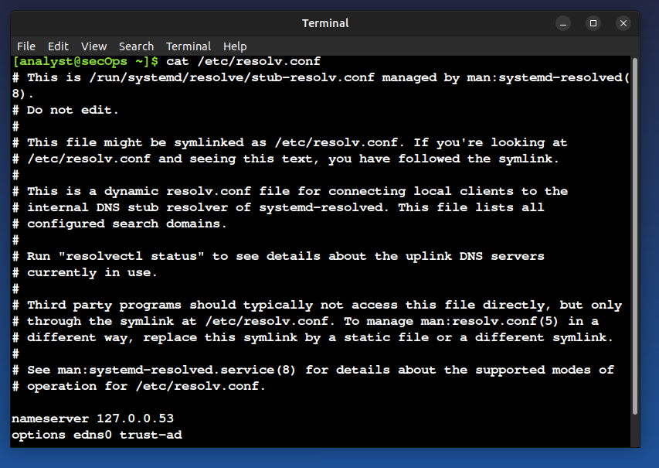
Step 9
Command: cat /etc/resolv.conf
Explanation: Shows the current DNS configuration used by the system.

Slide 11
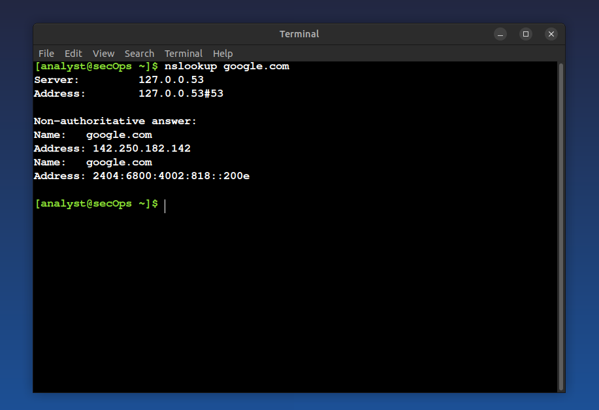
Step 10
Command: nslookup google.com
Explanation: Tests DNS resolution for a valid domain.

Slide 12
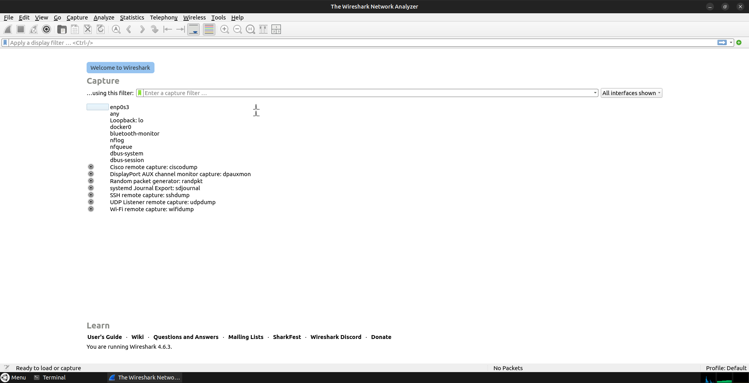
Step 11
Command: Open Wireshark
Explanation: Wireshark interface is opened for packet capture.

Slide 13
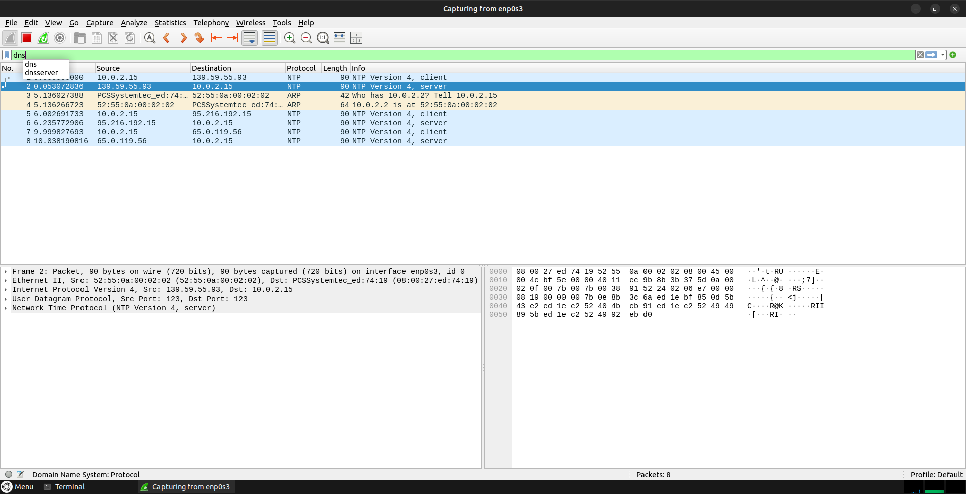
Step 12
Command: Apply dns filter
Explanation: Filters only DNS packets in Wireshark.

Slide 14
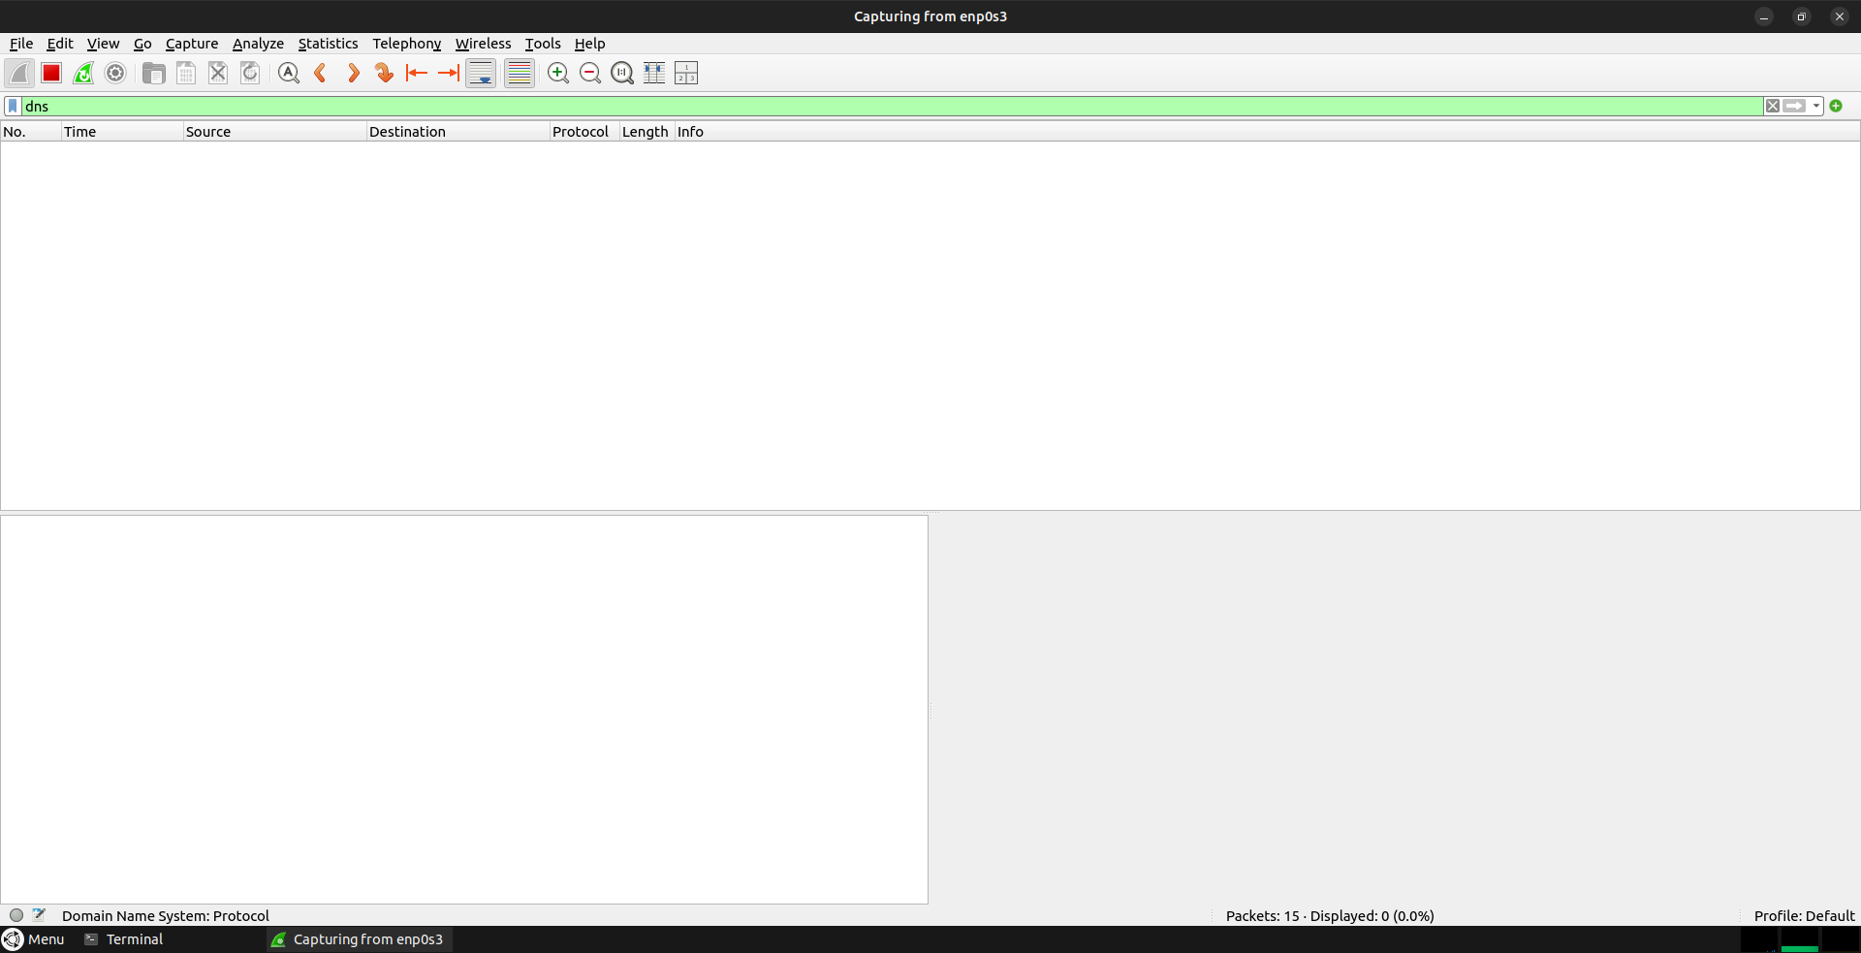
Step 13
Command: Start capture
Explanation: Wireshark starts capturing DNS traffic.

Slide 15
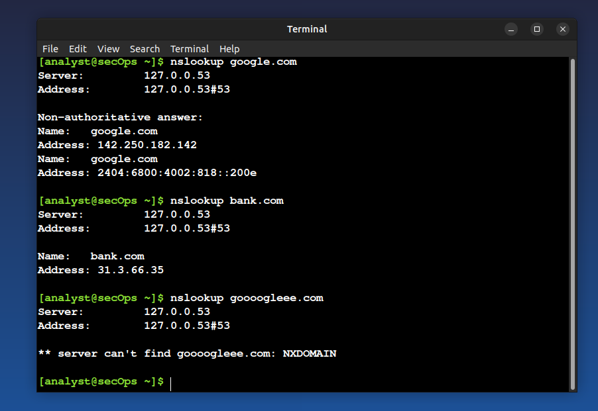
Step 14
Command: Generate DNS traffic
Explanation: DNS queries are generated using nslookup.

Slide 16
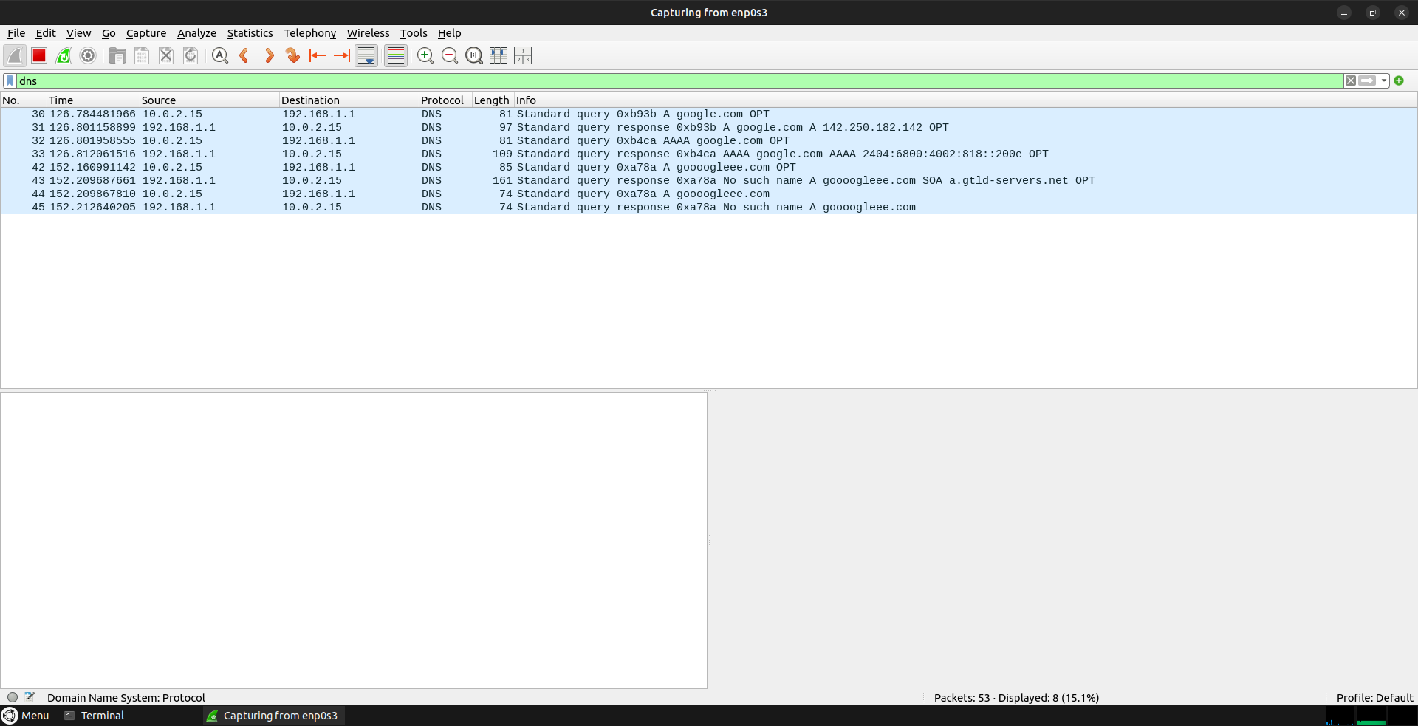
Step 15
Command: Analyze DNS packets
Explanation: DNS requests and responses are visible in Wireshark.

Slide 17
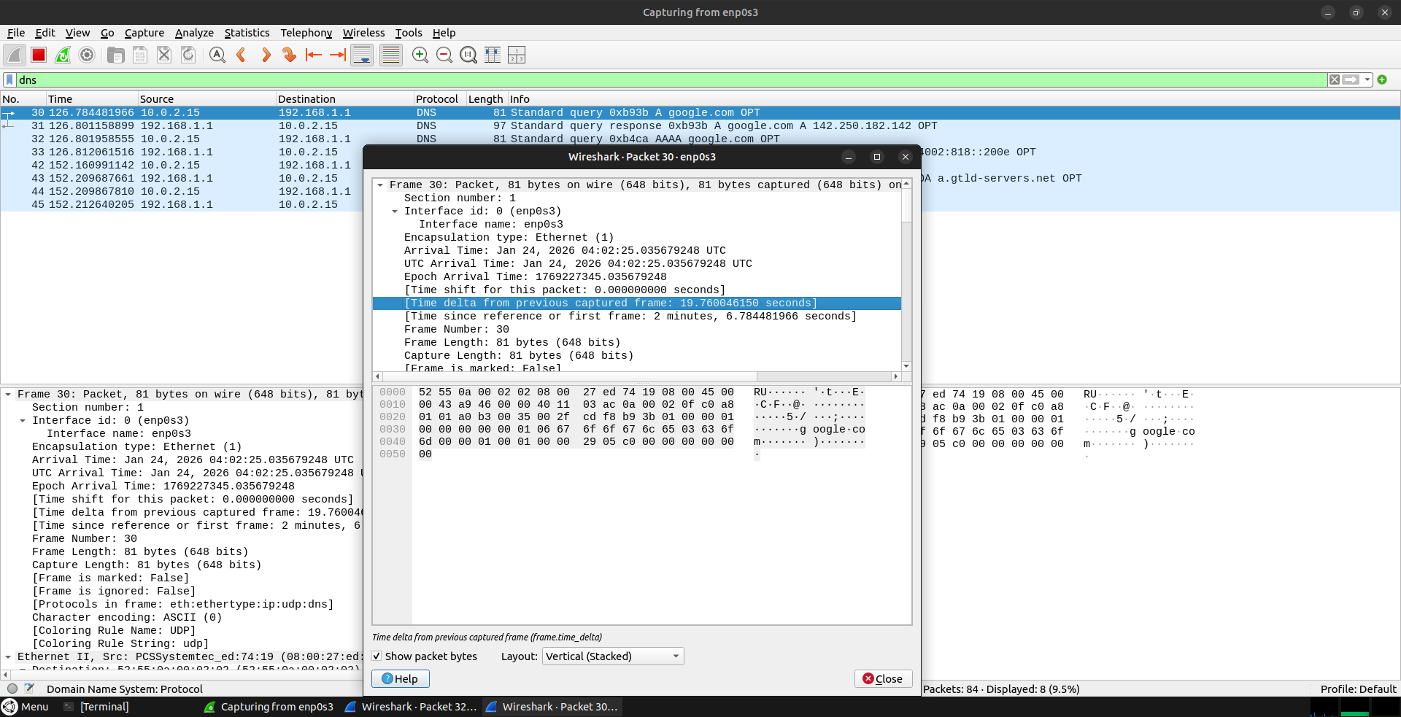
Step 16
Command: Check response time (google.com)
Explanation: DNS response is fast due to reachable DNS server.

Slide 18
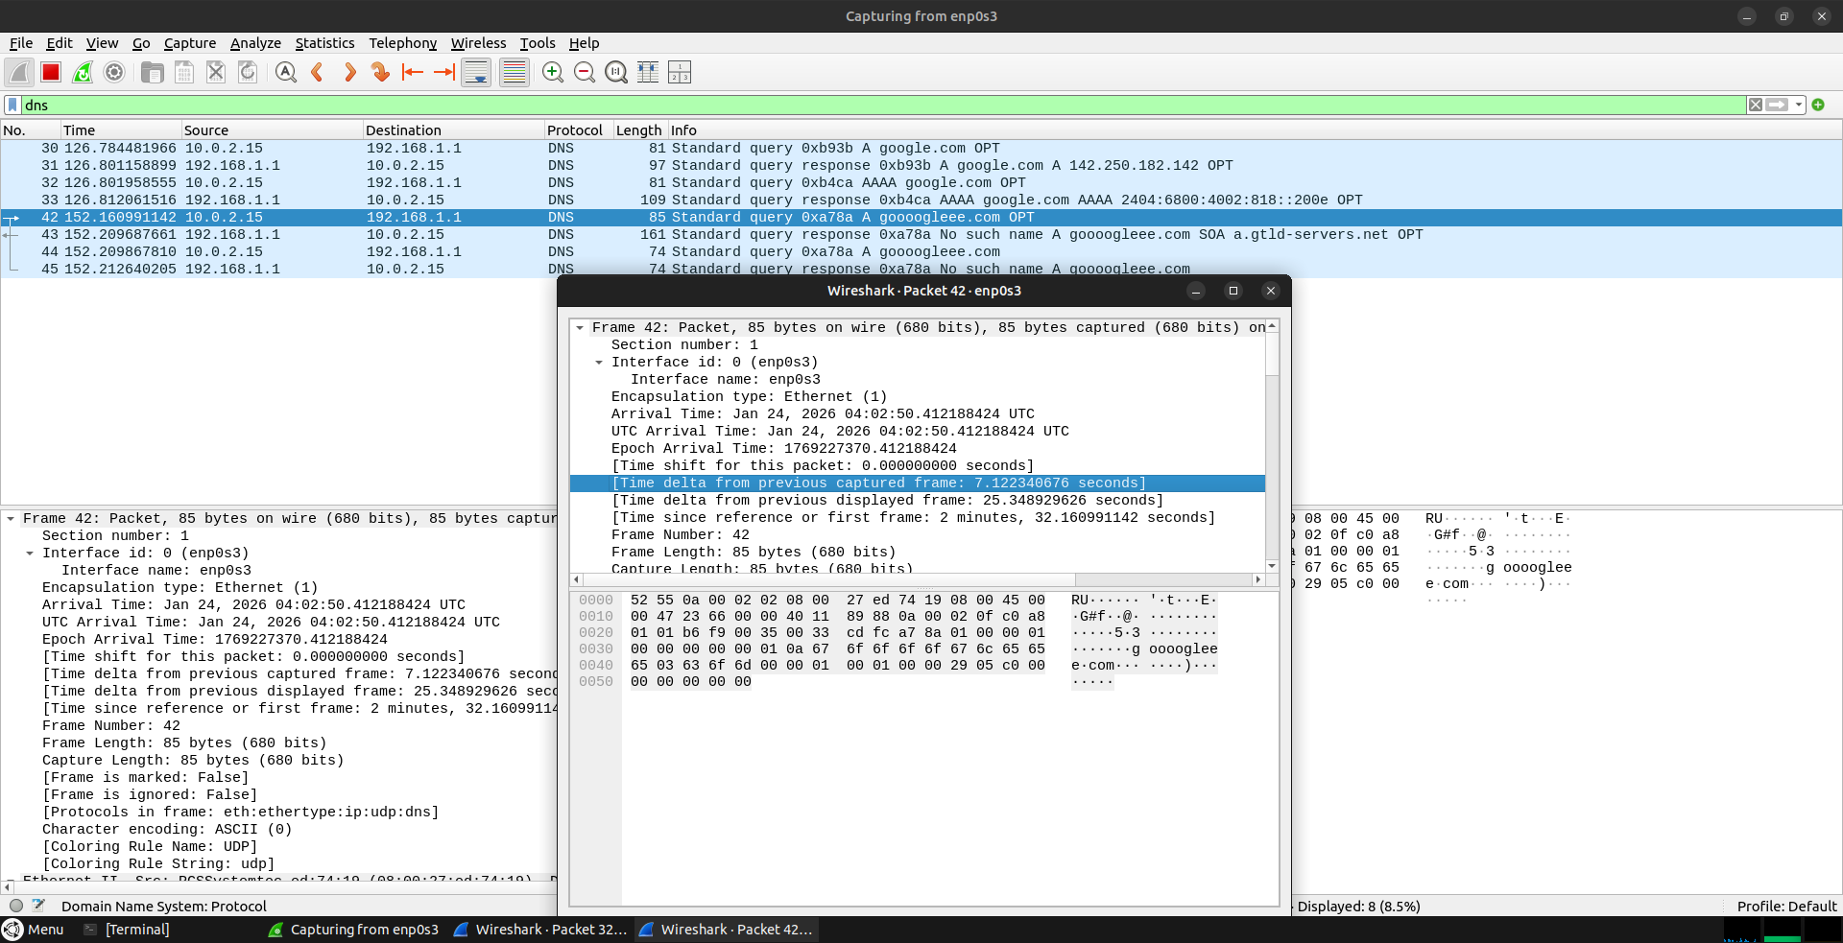
Step 17
Command: Check NXDOMAIN
Explanation: Invalid domain returns NXDOMAIN response.

Slide 19
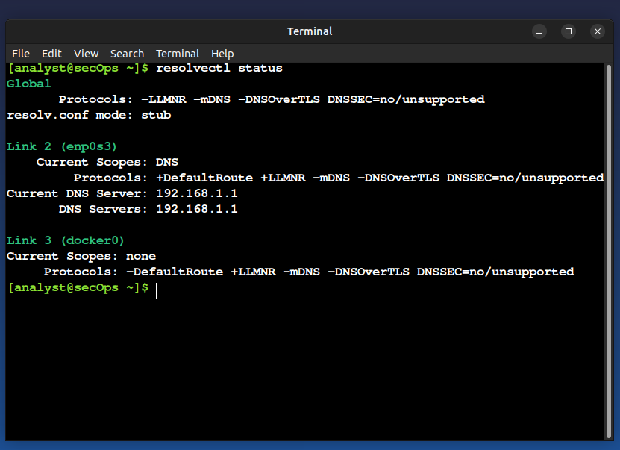
Step 18
Command: resolvectl status
Explanation: Shows current DNS server configuration.

Slide 20
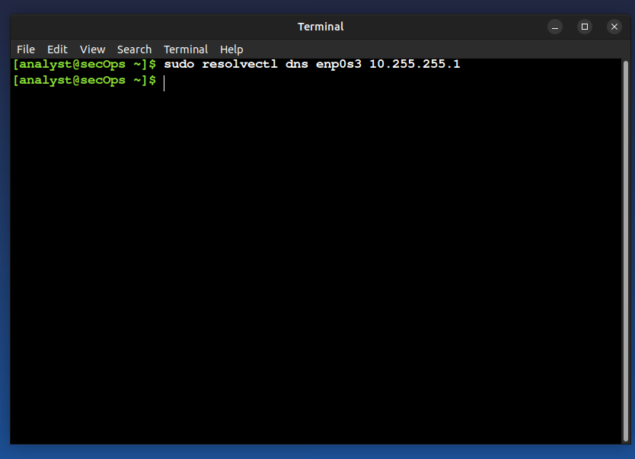
Step 19
Command: Set bad DNS (10.255.255.1)
Explanation: System DNS is changed to an unreachable server.

Slide 21
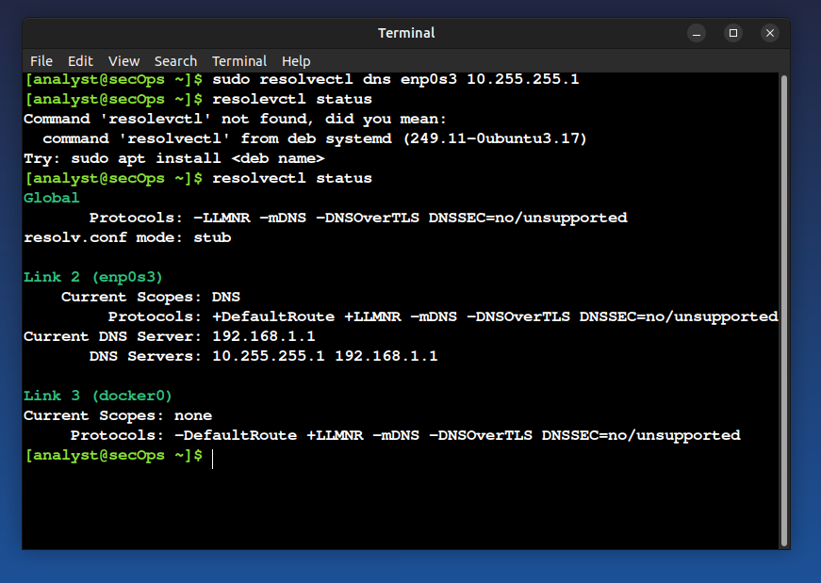
Step 20
Test DNS again. Command: resolvectl status
Explanation: DNS resolution becomes slow due to timeout.

Slide 22
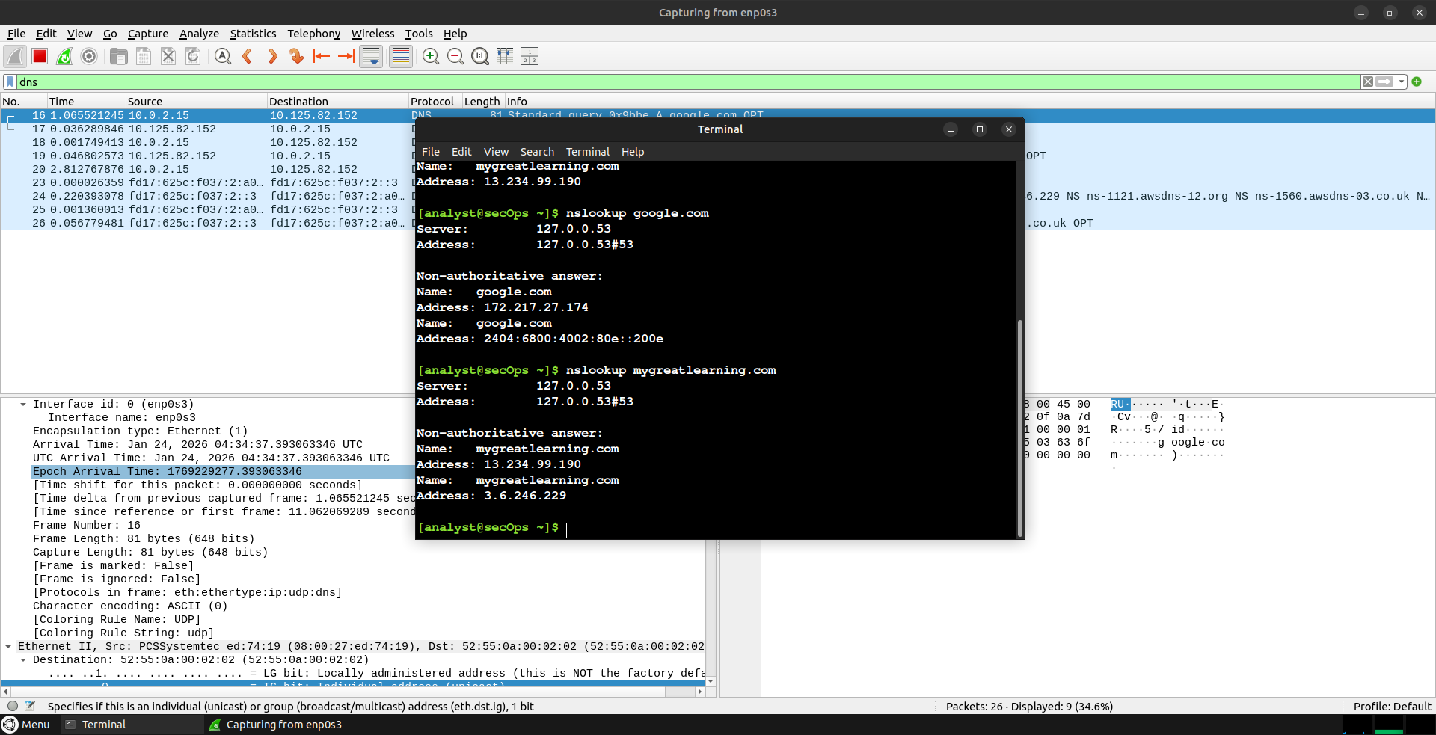
Step 21
Observe delay
Explanation: Wireshark shows delayed DNS response.
In my ubuntu lab I noticed that the nslookup google.com took 2 seconds in terminal to show
details and nslookup mygreatlearning.com took 4 to 5 seconds to show details in terminal.

Slide 23
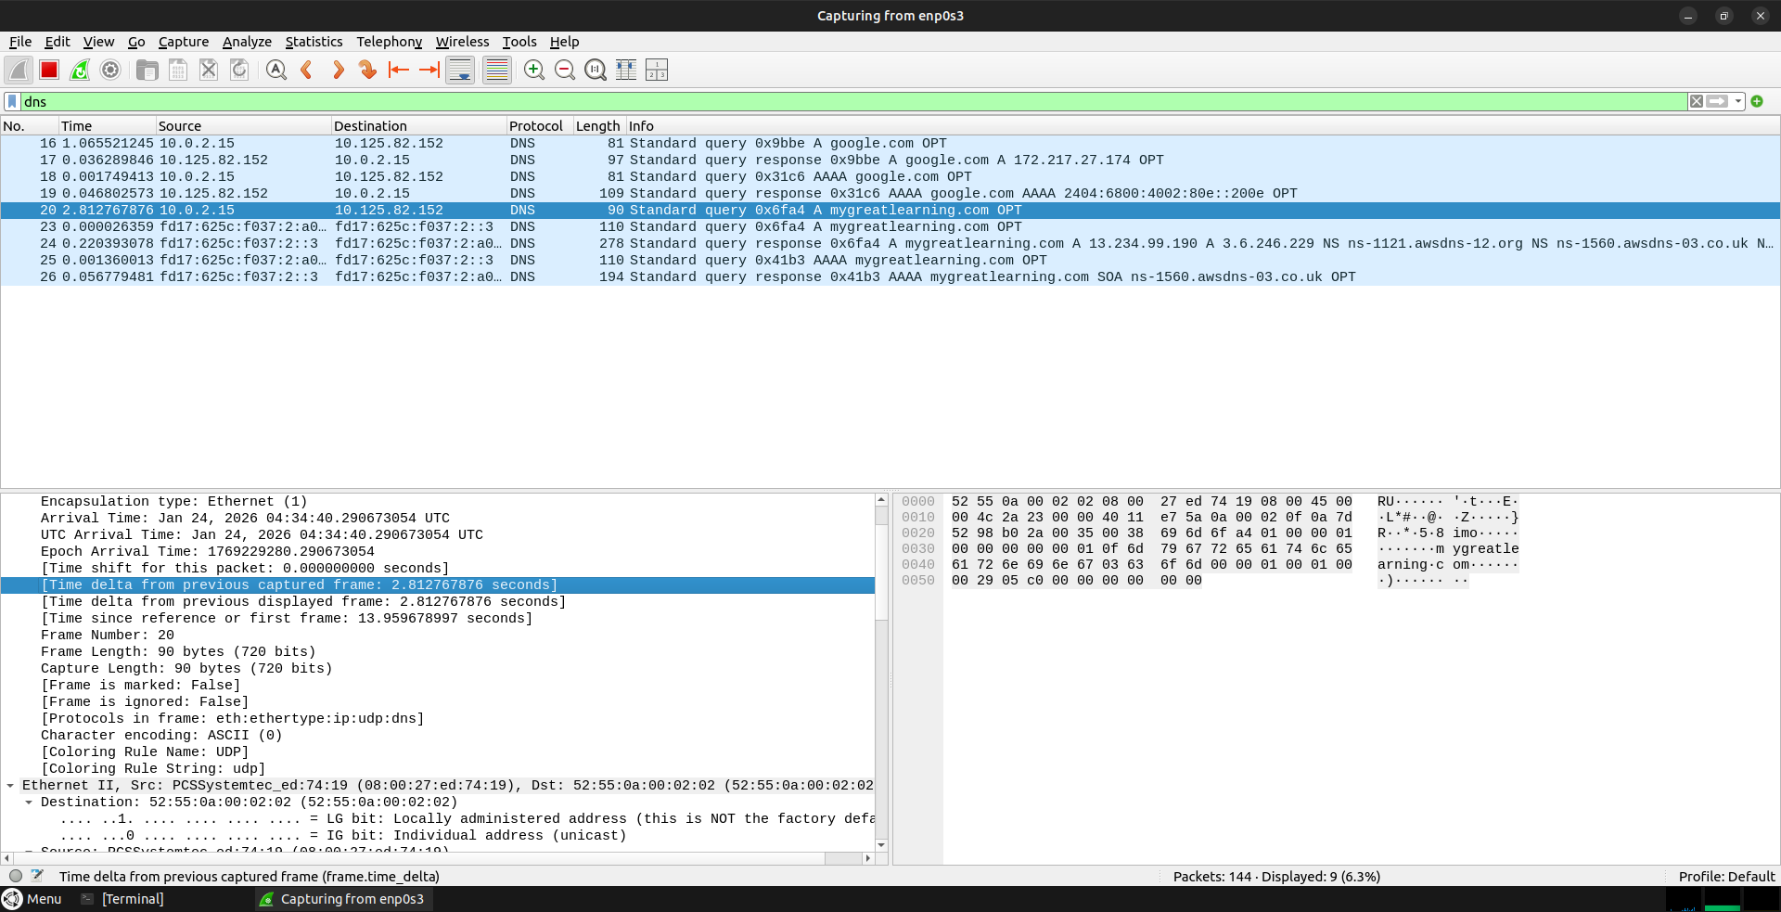
Step 22
DNS request failed
Explanation: Initial DNS server does not respond.
First it tried with 10.255.255.1 and it waited for aprox. 5 seconds and then again tried with
original DNS server i:e 192.168.1.1

Slide 24
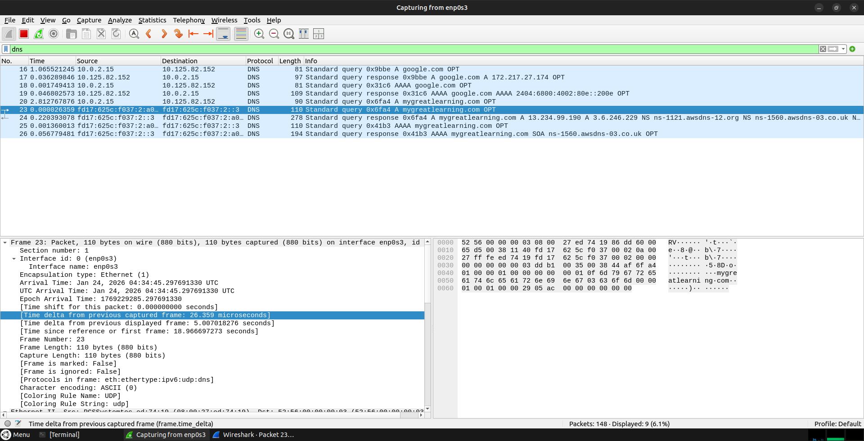
Step 23
Retry with original DNS
Explanation: System retries using secondary DNS server i:e 192.168.1.1

Slide 25
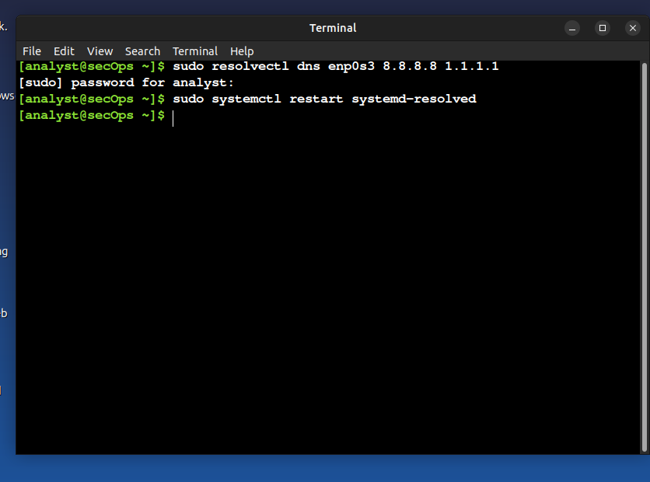
Step 24
Command: sudo resolvectl dns enp0s3 8.8.8.8 1.1.1.1
Explanation: DNS is changed to public servers (8.8.8.8, 1.1.1.1).
Google = 8.8.8.8 and cloudfare = 1.1.1.1

Slide 26
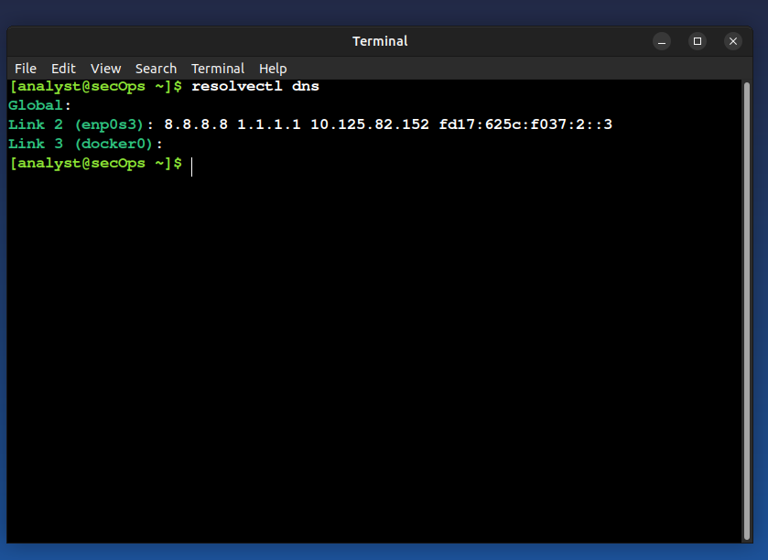
Step 25
Command: Restart systemd-resolved
Explanation: Applies the DNS configuration changes.

Slide 27
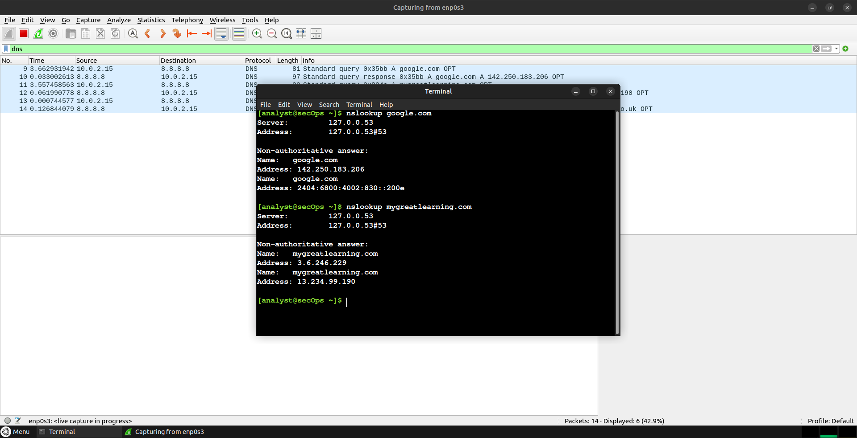
Step 26
Test DNS after fix
Explanation: DNS resolution becomes fast again.

Slide 28
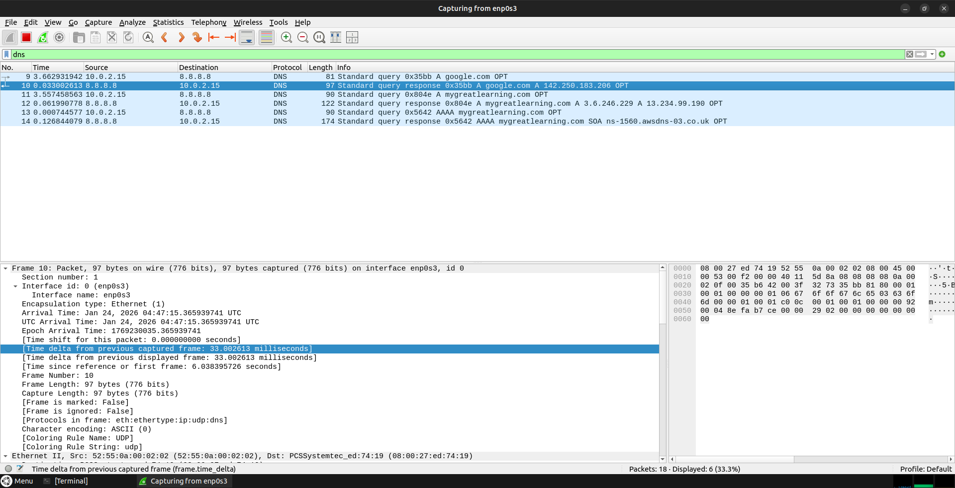
Step 27
Verify timing
Explanation: Wireshark confirms normal DNS response time.

