Slide 1

Token Economy Institute
Dec 2018

Slide 2
Background
No widely accepted definition of “Token Economy” for now.
People may talk about “Token Economy”, but they have no idea of what is the connotation and denotation of this concept, and why it is so important.
For many Blockchain projects, it seems that Blockchain=smart contract, but the fact is far beyond that.
How to design an effective token economy model?
What is role of DAC playing in token economy?
How do Stable coin and STO help with the token economy model design?

Slide 3
Why Token Economy matters a lot?
Paradigm Shift.
A good and efficient model design will unleash the power of Blockchain, while a bad design will only ruin the overall business.
Technology is only a tool, in the end, it is the economy force to decide how far a project could go.

Slide 4
Vision
To be the TIER ONE decentralized research institute and advocate in token economy theory, practice, models and successful cases in North America and globally.

Slide 5
How does TEI work?
TEI | Traditional Research Institute
DAC(Decentralized Autonomous Company) and community | Centralized
From and For the Community who have interest in Token Economy | Limited members with a high entrance fee
Open to all capable community members to collaborate | Closed
Cross-functional with public chain, universities, industry experts, powerhouses, 3rd party service partners(lawyers, auditors, compliance officers, etc.) | Only limited to its research crews and consultants.
Sharing the copyrights/benefits with participating partners | Solely owned
Community members gain incentives for participating and contributing | Paid service

Slide 6
Overall Structure
DAC
Public Chain
University
Powerhouses
3rd party service
Investors
TEI
BUMO
Exchange
Media
Consultant
Lawyer
Accountants
Compliance Officers
Projects
University of Toronto
Events
Research Report
Temp Tasks
Token Economy Experts
ET Fund
Traditional VC
BlockX Labs
CodingFly

Slide 7
What TEI will do? Promote the application and practice of Token Economy into real life business scenarios.
Manage the token economy community
Guide the direction of research and activities
Publish the white paper and research report
Provide token economy model design consultation
Collaborate strategic resource
Hold events and activities

Slide 8
Deliverables
White paper/Research reports(Token Economy 101, User Cases Analysis and etc.)
Token Economy Models Design Consultation Service
Events Organization

Slide 9
Milestones
Stage | Deliverables | Events | Benefits to DAC members
1 | Token Economy White Paper | Publish/Speech/Panel/Interview | Copyright sharing Reputation building
2 | Token Economy Institute launch | Panel/Interview | Reputation building
3 | TEI Token Economy Design Workshop or Hackathon | Workshop or Hackathon | Reputation building
4 | The 1st Global Token Economy Summit | Conference | Reputation building

Slide 10
Incentive Model of TEI(initiating period)
Donations
Contributors
Token Funds

Slide 11
How to Collaborate
BUMO Foundation | U of T
Real life user cases Industry experience Token Economy research whitepaper Initial Funding | Research crew Networking

Slide 12
In the long run…
TEI Global Community + TEI Token
Token Economy + STO
Short-Middle Term
Long Term

Slide 13
Some ideas from the models and practice of token economy white paper

Slide 14
What is Token Economy?
The design of economic systems based on Blockchain technology.

Slide 15
DAC vs. DAO
DAO: It is an entity that lives on the internet and exists autonomously, but also heavily relies on hiring individuals to perform certain tasks that the automaton itself cannot do. DAO contains some kind of internal property that is valuable in some way, and it has the ability to use that property as a mechanism for rewarding certain activities. A DAO is non-profit.
DAC: Decentralized autonomous corporations/companies are a smaller topic, because they are basically a subclass of DAOs. There is a concept of shares in a DAC which are purchasable and tradeable in some fashion, and those shares potentially entitle their holders to continual receipts based on the DAC’s success. A DAC pays dividends.
*From Vitalik.

Slide 16
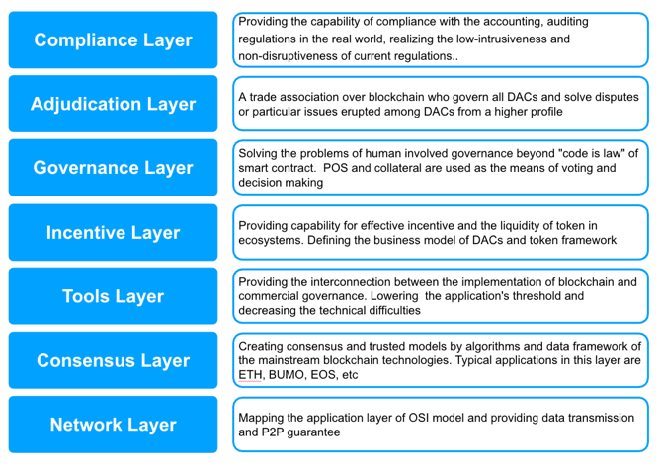
What are included in Token Economy?
Token Economy
Blockchain Infrastructure
*From BAO whitepaper.

Slide 17
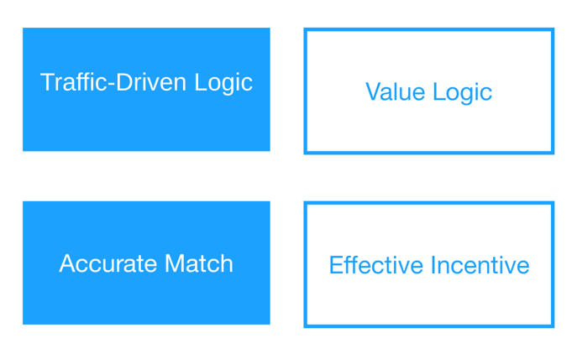
From Internet economy to Token Economy
Internet Economy
Token Economy

Slide 18
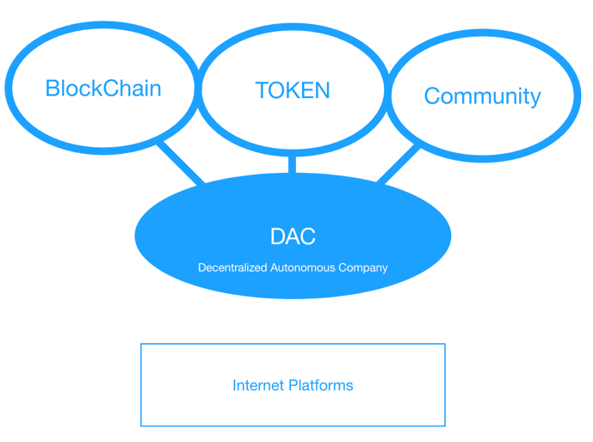
DAC & Token Economy

Slide 19
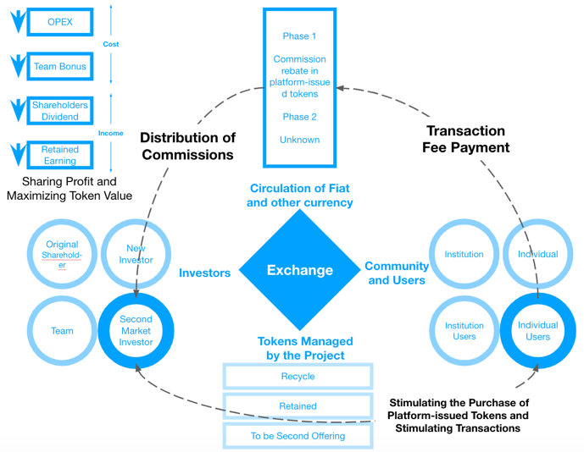
Example of Devils -the death of Fcoin

Slide 20
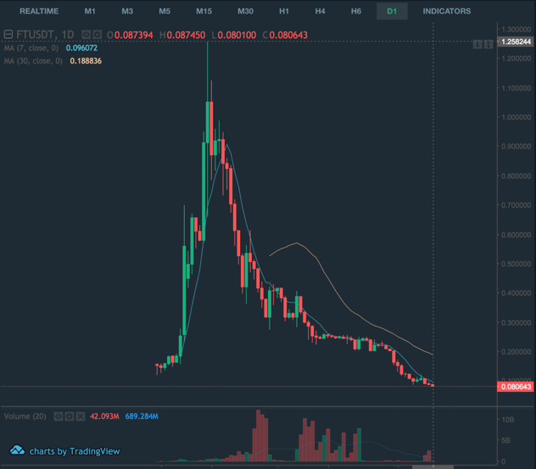
Dramatic ending
In USD | High | Low | % change
Price | 1.258244 | 0.080643 | -93.59%
Transaction Volume | 17B (June 26) | 0.16B (Aug 12) | -99.06%

Slide 21
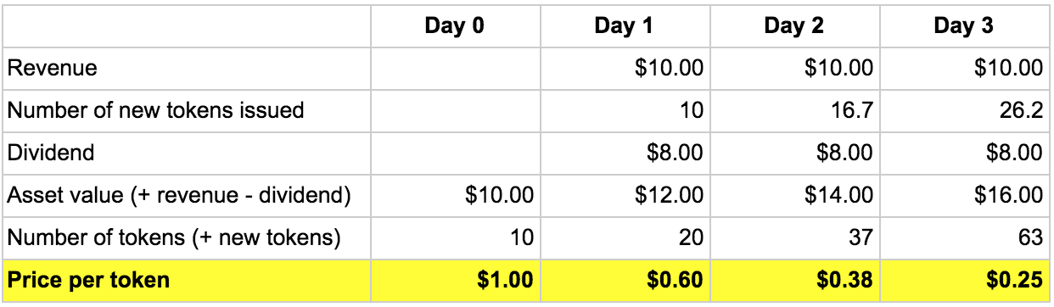
Why?
80% Revenue Distribution — FCoin’s Fundamental Token Design Flaw
Paying dividends won’t incentivize token holders to hold FT tokens. This is because paying dividends causes the token price to drop and creates a market perception that the token is losing value, and creates incentives for traders to sell immediately instead of holding FT tokens.
*hypothesis analysis model

Slide 22
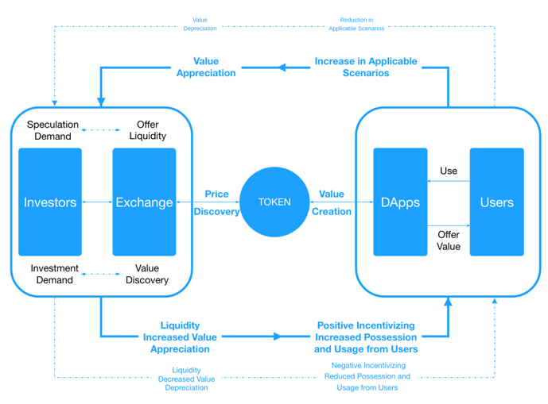
The big circle

Slide 23
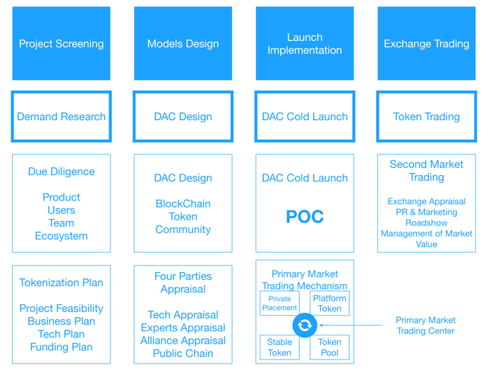
How to do?

Slide 24
Token Economy Institute
World No.1 Decentralized Token Economy Think Tank

