Slide 1
Unit Test – Definition
A unit test is a piece of code written by a developer that exercises a very small, specific area of functionality of the code being tested.
“Program testing can be used to show the presence of bugs, but never to show their absence!”
Edsger Dijkstra, [1972]

Slide 2

Manual Testing
You have already done unit testing
Manually, by hand
Manual tests are less efficient
Not structured
Not repeatable
Not on all your code
Not easy to do as it should be

Slide 3
Unit Testing – Some Facts
Tests are specific pieces of code
In most cases unit tests are written by developers, not by QA engineers
Unit tests are released into the code repository (TFS / SVN / Git) along with the code they test
Unit testing framework is needed
Visual Studio Team Test (VSTT)
NUnit, MbUnit, Gallio, etc.

Slide 4
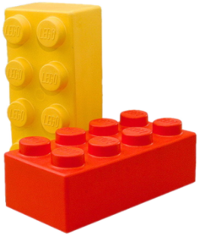
Unit Testing – More Facts
All classes should be tested
All methods should be tested
Trivial code may be omitted
E.g. property getters and setters
Private methods can be omitted
Some gurus recommend to never test private methods → this can be debatable
Ideally all unit tests should pass before check-in into the source control repository

Slide 5

Why Unit Tests?
Unit tests dramatically decrease the number of defects in the code
Unit tests improve design
Unit tests are good documentation
Unit tests reduce the cost of change
Unit tests allow refactoring
Unit tests decrease the defect-injection rate due to refactoring / changes

Slide 6

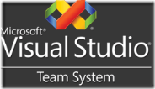
Unit Testing Frameworks
JUnit
The first popular unit testing framework
Based on Java, written by Kent Beck & Co.
Similar frameworks have been developed for a broad range of computer languages
NUnit – for C# and all .NET languages
cppUnit, jsUnit, PhpUnit, PerlUnit, ...
Visual Studio Team Test (VSTT)
Developed by Microsoft, integrated in VS

Slide 7
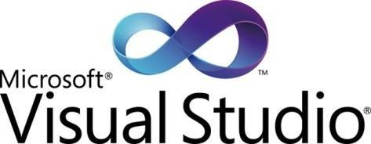
Visual Studio Team Test – Features
Team Test (VSTT) is very well integrated with Visual Studio
Create test projects and unit tests
Execute unit tests
View execution results
View code coverage
Located in the assembly Microsoft.VisualStudio.QualityTools. UnitTestFramework.dll

Slide 8
Visual Studio Team Test – Attributes
Test code is annotated using custom attributes:
[TestClass] – denotes a class holding unit tests
[TestMethod] – denotes a unit test method
[ExpectedException] – test causes an exception
[Timeout] – sets a timeout for test execution
[Ignore] – temporary ignored test case
[ClassInitialize], [ClassCleanup] – setup / cleanup logic for the testing class
[TestInitialize], [TestCleanup] – setup / cleanup logic for each test case

Slide 9
Assertions
Predicate is a true / false statement
Assertion is a predicate placed in a program code (check for some condition)
Developers expect the predicate is always true at that place
If an assertion fails, the method call does not return and an error is reported
Example of VSTT assertion:
Assert.AreEqual(
expectedValue, actualValue, "Error message.");

Slide 10
VSTT – Assertions
Assertions check a condition
Throw exception if the condition is not satisfied
Comparing values for equality
Comparing objects (by reference)
Checking for null value
AreEqual(expected_value, actual_value [,message])
AreSame(expected_object, actual_object [,message])
IsNull(object [,message])
IsNotNull(object [,message])

Slide 11
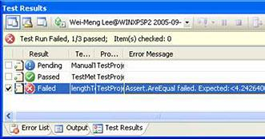
VSTT – Assertions (2)
IsTrue(condition)
Checking conditions
Forced test fail
IsFalse(condition)
Fail(message)

Slide 12
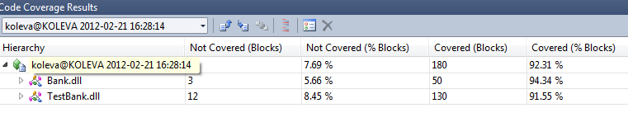
Code Coverage
Code coverage
Shows what percent of the code we’ve covered
High code coverage means less untested code
We may have pointless unit tests that are calculated in the code coverage
70-80% coverage is excellent

