Slide 1
Near the Jamming Transition of Elastic Active Cells: A Sharp-Interface Approach
PHYS9805
Steven Silber

Slide 2
Free Energy
Cell model originally conceived as “Phase-field model” (not restated here)
Phase-field model → sharp interface model
×
×
×
×
×
→
×
×
×
×
×
×
×
×
×
×
×

Slide 3
Sharp Interface Model
Time evolution of the individual cell:
Spherical shape (R0) with a preferred cell area (μ)

Slide 4
Cell Stiffness & Jamming
In a system of “hard” cells vs “soft” cells → mechanisms of migration?
Soft cells push through channels → behaviour is easily observed in this model
Motility: “strength” of cellular motion

Slide 5
Cell Stiffness & Jamming
Jamming: cell interface “jams”
  Cells do not exchange neighbours
  Cells do not travel around the system in general
Relevance? Blocks migration

Slide 6
Implications
Cancer cell migration
Microbial growth
Unjamming in wounds
Relationship of cell behaviour to the “glass transition”

Slide 7
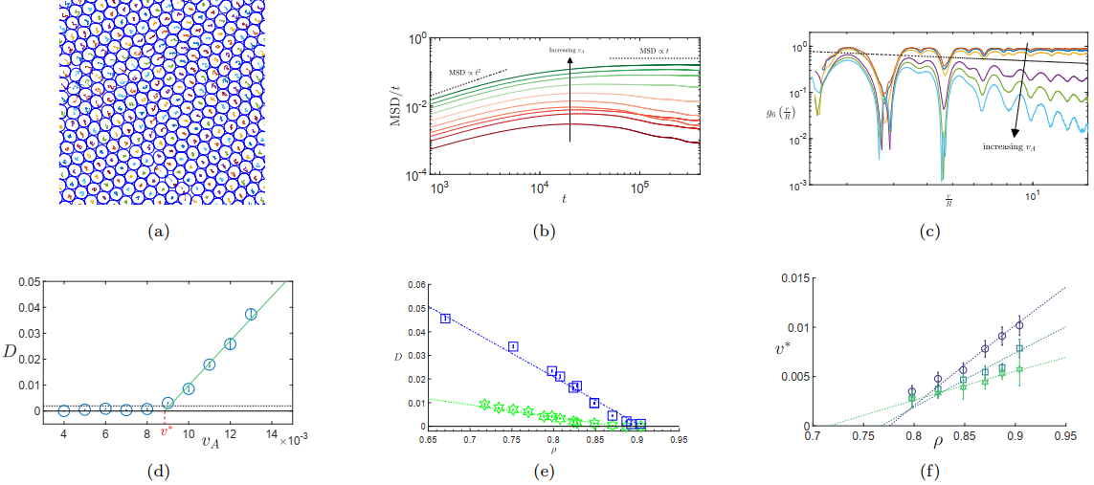
“Signatures of Jamming”

Slide 8
“Signatures of Jamming”

Slide 9
“Signatures of Jamming”

Slide 10
“Signatures of Jamming”

Slide 11
“Signatures of Jamming”

Slide 12
“Signatures of Jamming”

Slide 13
Conclusions
Proposed form of jamming velocity:
Elastic cell model reproduces both liquid and hexatic phase
  A transition between these phases is also observed (and consistent with KT theory)

