Slide 1
Analyzing Polarization in Social Media:
Method and Application to Tweets on 21 Mass shootings
Author: Demszky et al, 2019
Presenter: Zhaoran Ma

Slide 2
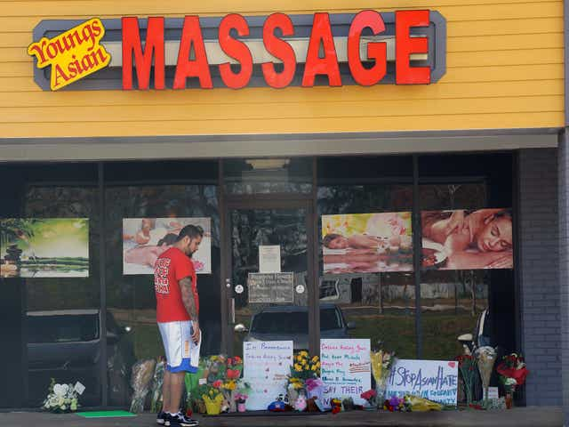
Motivation & Background
Atlanta Massage Shooting, 03/16/2021

Slide 3
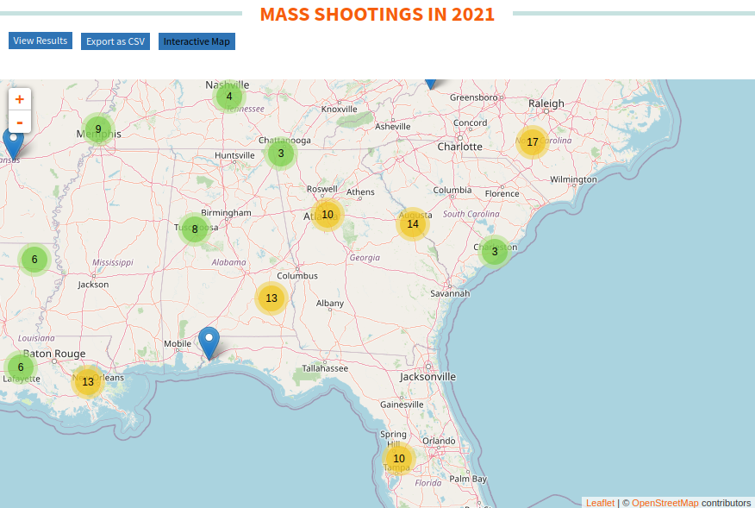
Motivation & Background

Slide 4
What are we talking about on Twitter?
San Francisco police responding to reports of a shooting at a UPS facility.
Synagogue shooting in Pittsburgh: what we know
Who is surprised that the San Bernardino shooters were radicalized Muslims?
Waffle House gunman’s father facing charges for GIVING him gun used to kill four
I will not just #prayforsutherlandsprings, today I vote for @PhilMurphyNJ and stronger gun control laws in NJ #ElectionDay #GunControlNow
My heart goes out to the friends and family of the victims in that parkland shooting :-(
Photo: US flag flying at half-staff at White House for victims of Roseburg, Ore., school shooting
News:
Victim & Location:
Shooter’s identity & ideology:
Investigation: Waffle House gunman’s father facing charges for GIVING him gun used to kill four
Laws & Policy: I will not just #prayforsutherlandsprings, today I vote for @PhilMurphyNJ and stronger gun control laws in NJ #Election Day #Uncontrollably
Solidarity: My heart goes out to the friends and family of the victims in that parkland shooting :-(
Remembrance: Photo: US flag flying at half-staff at White House for victims of Roseburg, Ore., school shooting

Slide 5
Quantifying Overall Polarization
Topic and Framing
Specific Framing Devices
Affect
Modality and Illocutionary Force

Slide 6
Data Collection
Partisian Assignment
Data Retrieved from a Stanford lab’s archive on Twitter firehouse based on a list of mass shooting between 2015 to 2018
To label a user either Democrat or Republican, check if they follow more Democrat or Republican
Notes:
Partisanship is
defined as the expected posterior probability that
an observer with a neutral prior would assign to a
tweeter’s true party after observing a single token
drawn at random from the tweets produced by the
tweeter.

Slide 7

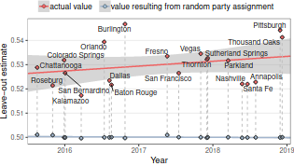
Quantifying Overall Polarization

Slide 8
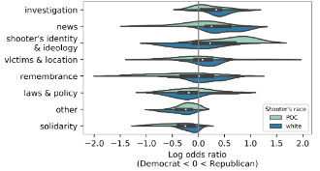
Topic and Framing
MALLET and BTM (biterm topic model)
Train GloVe embedding on vocabs from extracted tweets

Slide 9
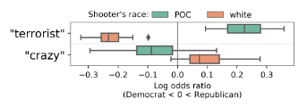
Specific Framing Devices

Slide 10
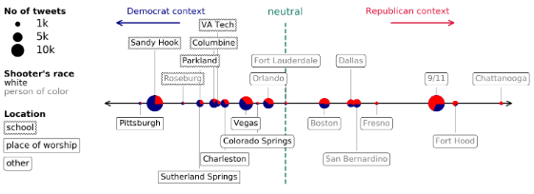
Specific Framing Devices

Slide 11
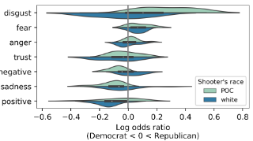
Affect
NRC Emotional Lexicon

Slide 12
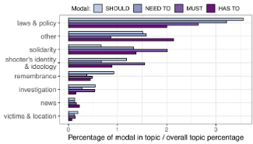
Modality and Illocutionary Force

Slide 13
Interesting findings & Future Steps
Ziems and Yang, 2021, To Protect and To Serve? Analyzing Entity-Centric Framing of Police Violence

