Slide 1
Intro to data science
Ladies Of Code workshop
May 16th, 2017

Slide 2
Basic prediction problem
dataset: features + a quantity depending on them
How to get the price of a new house knowing its features ?
case number | house surface | nbr of rooms | garden | construction date | price
1 | 100m² | 4 | no | 1975 | 400 000 euros
2 | 200m² | 6 | yes | 2003 | 900 000 euros
3 | 80m² | 3 | no | 1990 | 300 000 euros
4 | 150m² | 4 | yes | 2010 | ?
training set
test
set

Slide 3
Types of problems
Supervised learning
regression
predict a numeric value knowing the features (example: linear regression)
classification
predict a category knowing the features (example: logistic regression)
Unsupervised learning
find structure in the data (example: clustering)

Slide 4
Modeling
choose a type of model (linear regression, decision tree …)
“training/learning”: find the model parameters by minimizing a cost function on the training set
prediction: use the model to calculate expected values on the test set

Slide 5
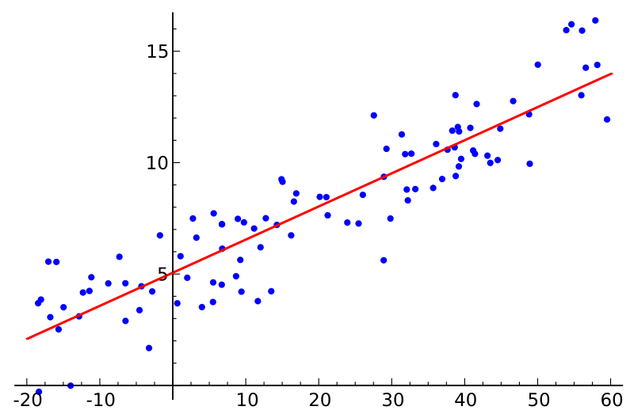

Model example: linear regression
price = a0 + a1*surface + a2*nbr_rooms + a3*construction_date
cost function:
training = find the a0, a1, a2, a3 that minimise the cost function, which is the distance between the model prediction and the actual value

Slide 6
Categorical variables
variable has unordered levels (ex: house heating = “electric” or “fuel” or “solar”)
can be transformed into several numeric variable using one-hot encoding:
heating = (1,0,0) for electric
(0,1,0) for fuel
(0, 0, 1) for solar

Slide 7
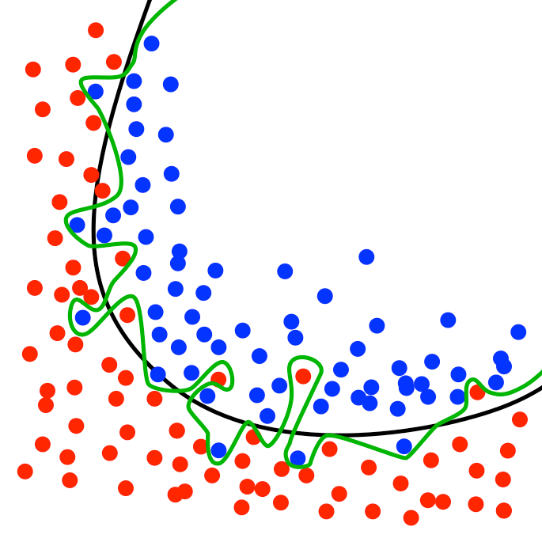
Overfitting
When the model is complex enough to follow the training data very closely, it will not be able to generalise to new data
Can happen when there are too many features compared to the size of the training dataset

Slide 8
training, cross-validation, test
To avoid overfitting, we have to check the performance of the model on data that was not used for training: we split our data into training and test sets
When looking for the best model parameters, we will compare the results with different parameters on the test set and choose the best; but then the final model has already used the test data !
When looking at parameters, we use a cross-validation set, and keep the test set for the final performance estimation
case 1 | train
case 2 | train
case 3 | train
case 4 | train
case 5 | cv
case 6 | cv
case 7 | cv
case 8 | cv
case 9 | test
case 10 | test

Slide 9
Regularization
Force a penalty on the cost function to keep the model parameters small
TODO add formula reg lin

Slide 10
normalization
example: surface >> number of rooms so surface terms will contribute more heavily to the cost function
normalize the inputs to avoid this artificial weight of naturally large variables
usually done by default in machine learning librairies (check the documentation !)

Slide 11
feature engineering
find new features that can help prediction:
external features: distance of house to train station
calculated features: average surface of rooms

Slide 12
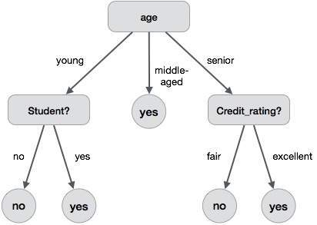
Model example: random forest
better model:
- « forest »
build several decision trees on differents subsets of the data, final result = average of each tree result
« random »
at each tree level, choose a smaller random set of features that will be used to make a decision to decorrelate the trees
1 decision tree

Slide 13

Ressources
Online lecture: “Probability and Statistics” by Khan Academy
Book: “An introduction to Statistical Learning” by Gareth James, Daniela Witten, Trevor Hastie and Robert Tibshirani (pdf is free)

