Slide 1

Why An App Like This?
There's a real need for an app that would allow people to easily connect with others to participate in healthy, peer-driven activities.

Slide 2
How did we do it?
                Flask
                SQLAlchemy
                Flask-Restless
                AngulasJS
                UI-Router
                Bootstrap

Slide 3
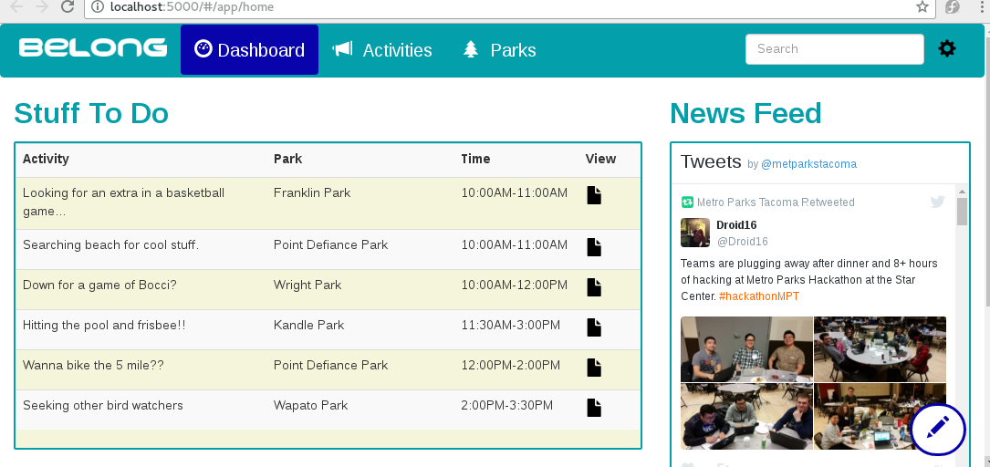
What does it look like?

Slide 4
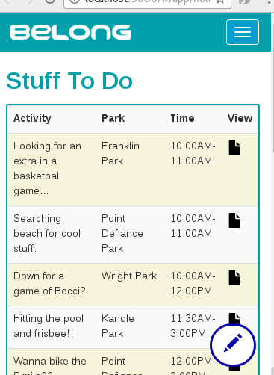
On Mobile...

Slide 5
What does it offer MPT?
A way to encourage use of parks.
Provides routing to reservations for resources that support activities and structured programs.
Would provide data regarding usage of park resources.
Platform to promote upcoming events.

Slide 6
Obstacles/Recommendations
Data and its accessibility.
Interaction with existing services.

Slide 7
Thanks!
We very much enjoyed ourselves and are grateful to all those that made this event possible.
We are looking forward to the next one!

