Slide 1
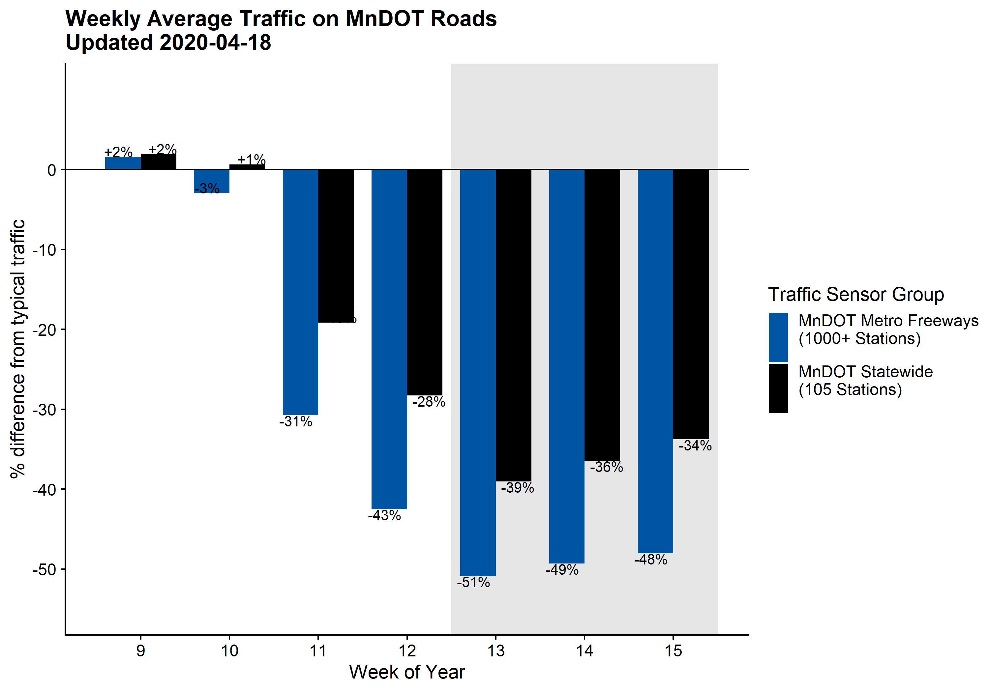
Weekday traffic continues to be about 50% lower than typical on Metro Freeways, and about 34-39% lower across the ~100 MnDOT roads with automated traffic recorders (ATRs) across the state.
There have been slight week-over-week increases in weekday traffic during the stay-at-home order, but traffic remains lower than the week prior to #StayHomeMN.
Stay-at-home order
March
2-6
March
9-13
March
16-20
March
23-27
Mar 30-
April 3
April
6-10
April
13-18

