Slide 1
Kepler
Static Typing and Submitting Code with Git
Gene Olafsen

Slide 2
Language and Typing
Designed as a dynamically-typed language.
That means you declare variables without giving them a specific data type. Types are automatically assigned based on how the variables are used.
band = "Pink Floyd"
quantity = 45
Statically-typed languages require the variable type to be declared explicitly.
string band = "Pink Floyd"
int quantity = 45

Slide 3
Methods and Types
Typing extends to program function and methods. The sample code below is unambiguous regarding the types of the arguments and return value.
double GetRectangleArea(double width, double height)
{
double area = width * height;
return area;
}

Slide 4
Python Methods
# ----
# Determines if there is an error in the audit message collection.
# ----
def IsAuditError(self) -> bool:
audit = [x for x in self.GetAudit() if x.level == 'Error']
if len(audit) > 0:
return True
return False

Slide 5
Dataclass
Data classes are just regular classes that are geared towards storing state, rather than containing a lot of logic. Every time you create a class that mostly consists of attributes, you make a data class.
The dataclasses module does is to make it easier to create data classes. It takes care of a lot of boilerplate for you.

Slide 6
Contributing to Kepler
The code is quickly reaching a point where each method is documented- a perfect time for anyone to submit an enhancement!
The following slides walk you through the process of creating a branch and submitting changes to Git.

Slide 7
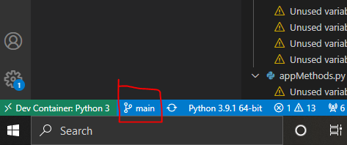
Start From 'Main'
Make sure you are on the "Main" branch to start.

Slide 8
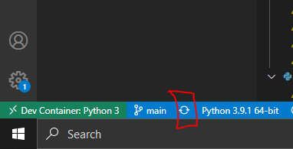
Work with Latest
Make sure to pull the latest commits.
If your code is 'behind' you will see additional information when you hover over this button.

Slide 9
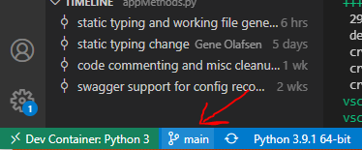
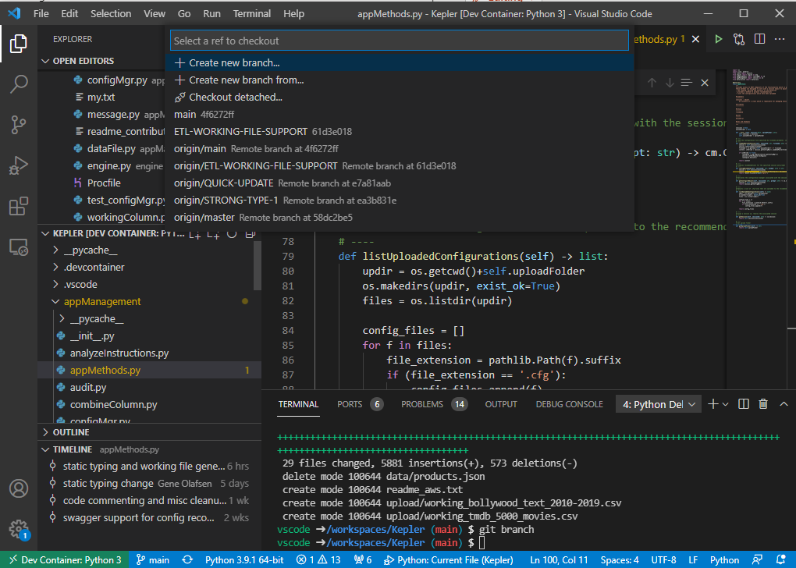
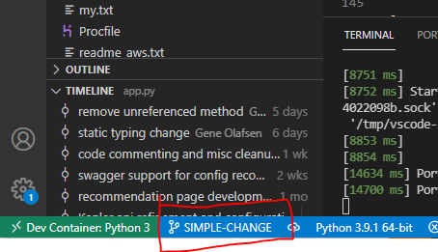
Create a Branch
Start with "Main".
Click on the branch button.
Enter the name of the branch to create.

Slide 10
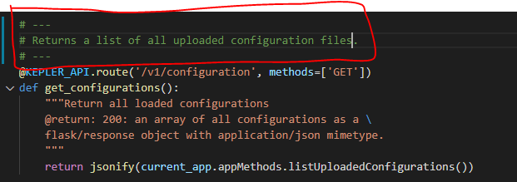
Edit the Code
Make changes as necessary.
In this case, a comment block is added to the top of a routing method.

Slide 11
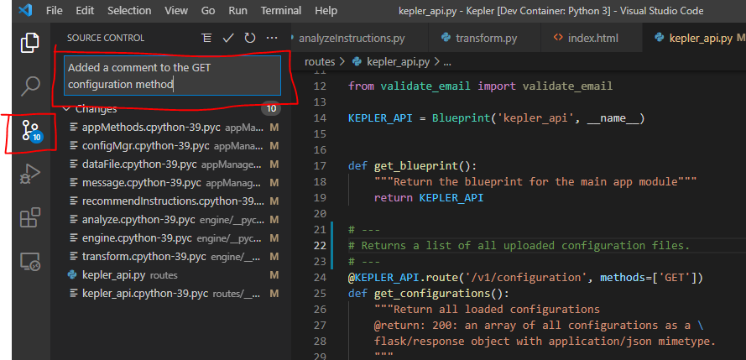
Provide a Branch Comment
Switch to the Source Control panel.
Enter a comment.

Slide 12
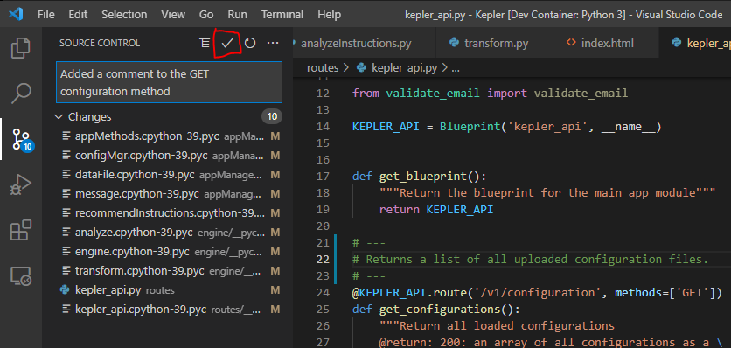
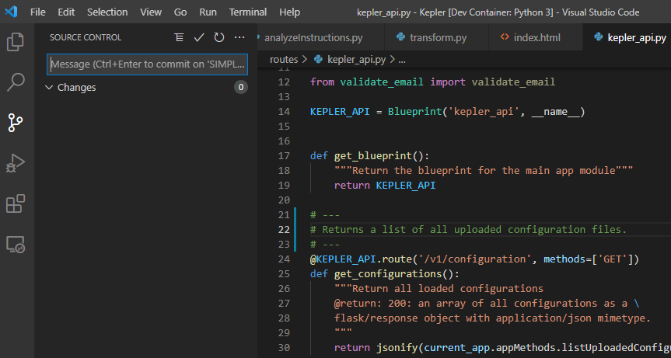
Commit Changes
Commit your changes by clicking the 'checkmark' button in the Source Control panel.

Slide 13
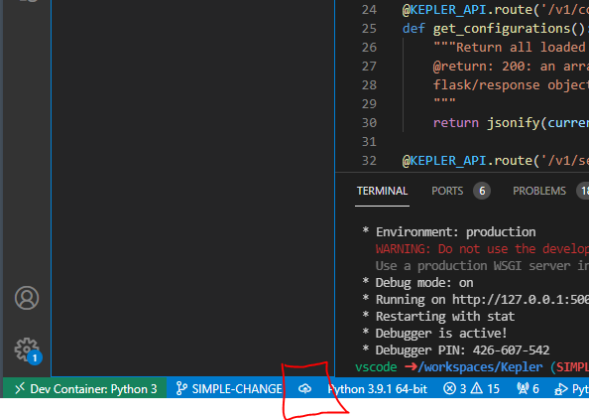
Publish Changes
The refresh button that we pushed before when we were on the Main branch to make sure we were up to date- is now an image pointing up to the cloud.
Click this button to push your changes up to the repository.

Slide 14
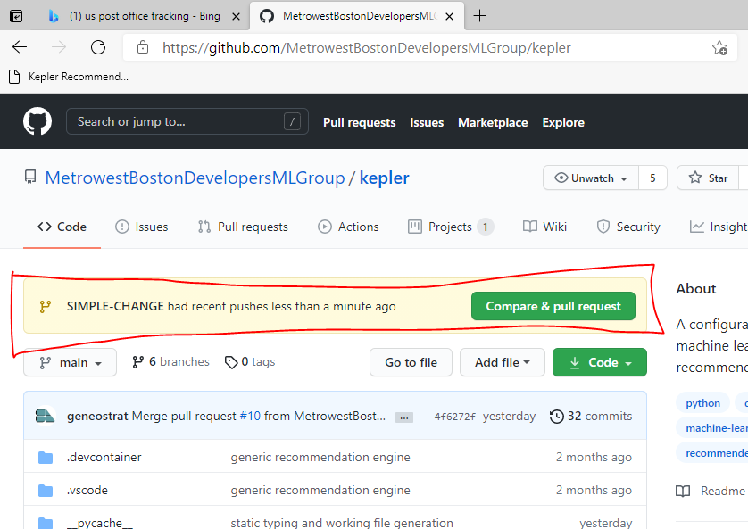
Git and Changes
Go to the Git repository.
It now shows that there is a branch that is available containing your changes.

Slide 15
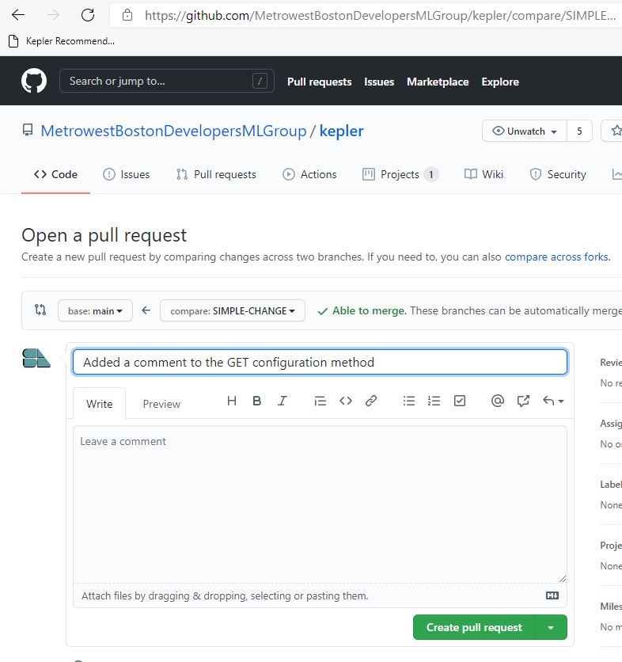
Add a Comment and Create a Pull Request
Pull requests let you tell others about changes you've pushed to a branch in a repository on GitHub.
Once a pull request is opened, you can discuss and review the potential changes with collaborators and add follow-up commits before your changes are merged into the base branch.

Slide 16
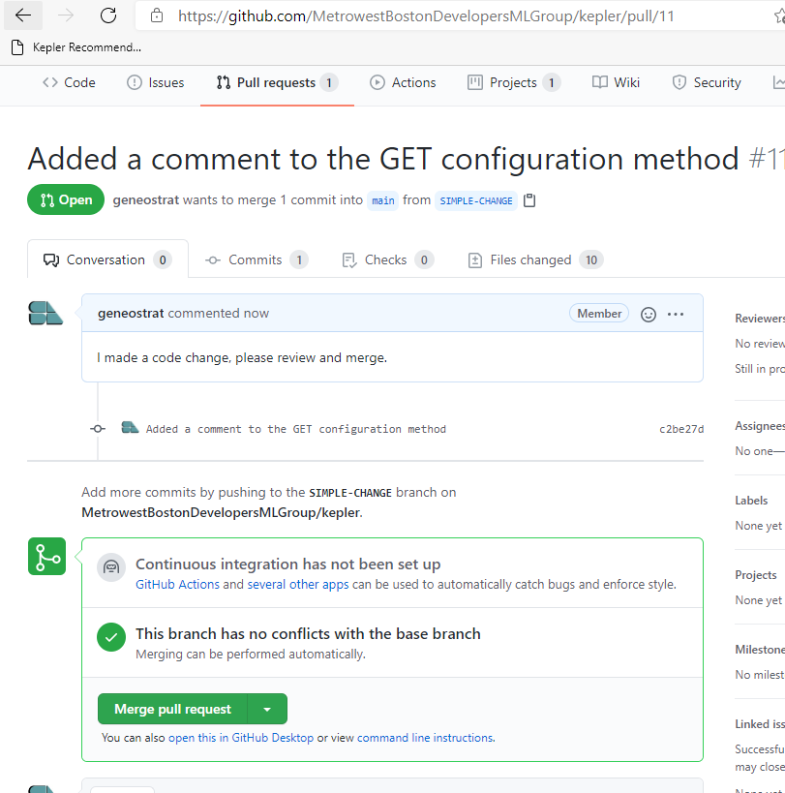
Merge Request
There are no conflicts- the changes can be merged.
The merge operation can only be performed by specific/permissioned users assigned to the repository.

Slide 17
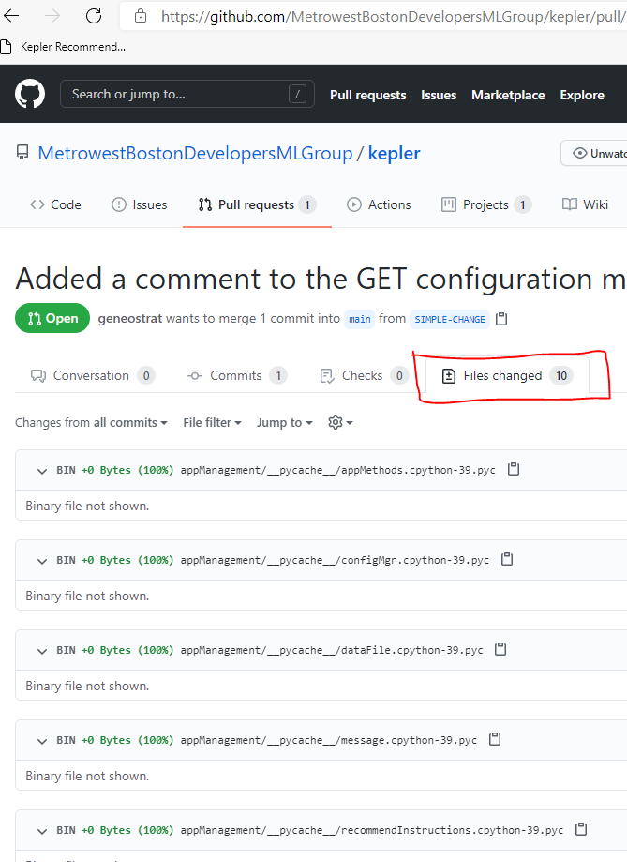
Review Changes
Change the 'tab' to review the changes associated with this commit.

Slide 18
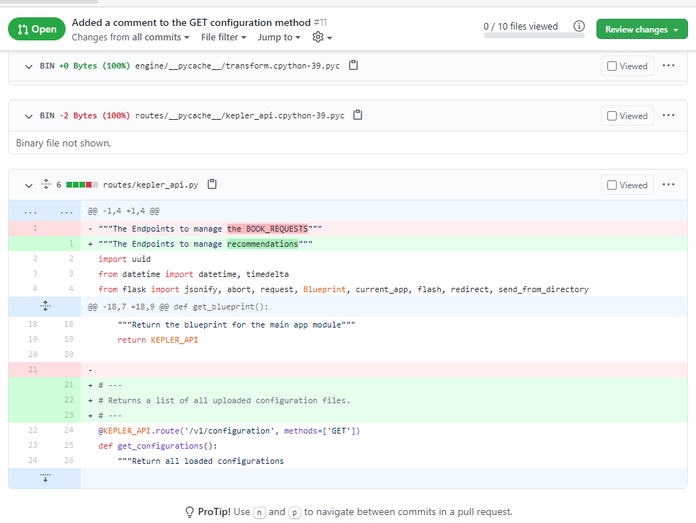
Review Changes (Cont)
Here are the changes that we made.

Slide 19
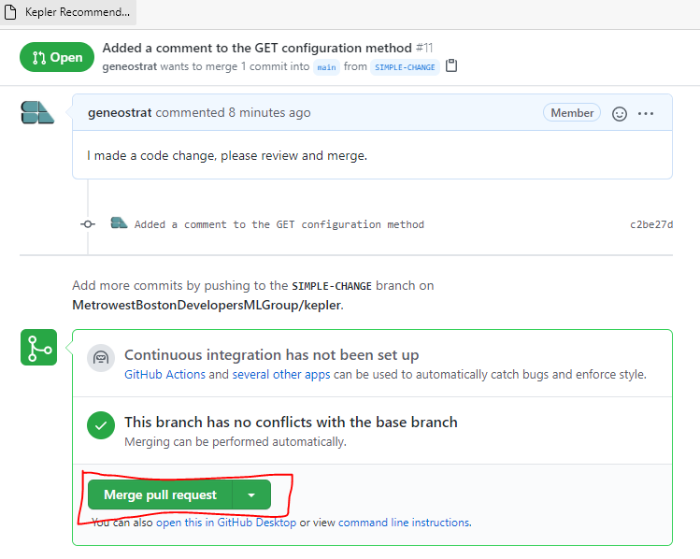
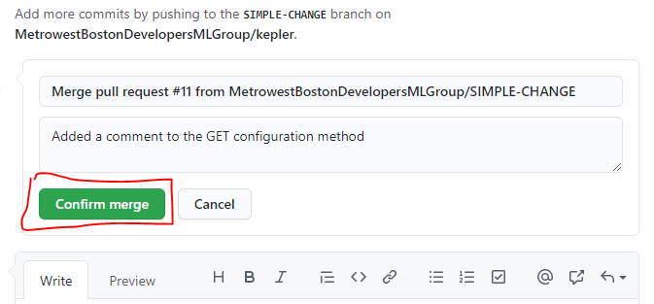
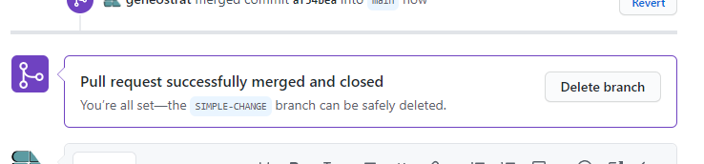
Merge
Merge the changes.
Confirm the Merge.
Success!

Slide 20
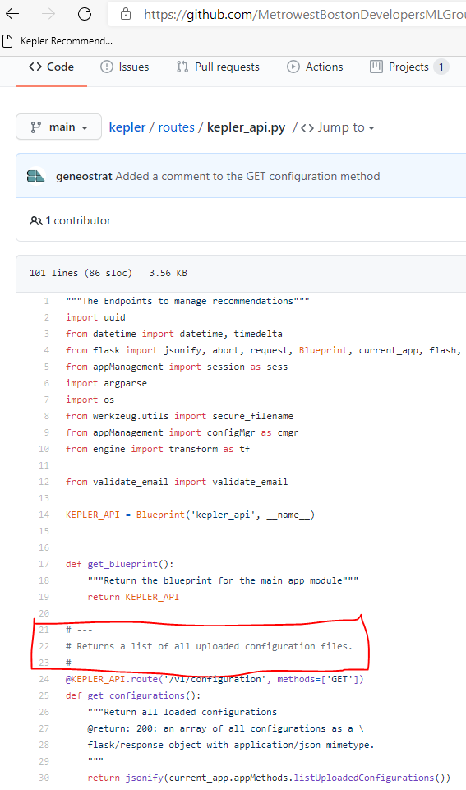
Confirm
Look at the main code branch.

Slide 21
Switch Back to "Main"
You are done with the branch now that everything is merged.
Switch back to the Main branch.

Slide 22
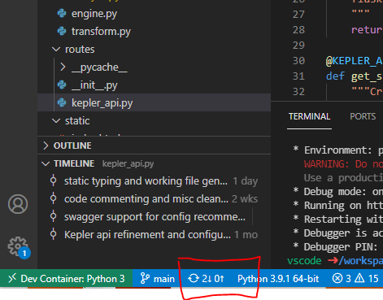
Pull Latest Commits
The Main branch is at least one commit behind...
Click the refresh icon button pull the latest code.

Slide 23
Next Steps...
I will enable the CI/CD pipeline in Git.
Continuous Integration / Continuous Deployment
Add issues to the project and associate checked-in branches with the issue it resolves.
Add unit tests to the project that are run during the merge process.

