Slide 1
Tri-Training
$$\text{A} \text{Review} \text{of} {\text{Zhou}\text{, }\text{Li}\text{ (2005)}}^{[1]}$$
Prepared for Metrowest Boston Machine Learning Meetup
Chris Winsor
5/15/2019
[1] Z. Zhou and M. Li, "Tri-Training: Exploiting Unlabeled Data Using Three Classifiers" in IEEE Transactions on Knowledge & Data Engineering, vol. 17, no. 11, pp. 1529-1541, 2005.

Slide 2
Tri-Training What is it? Why?
“Semi-Supervised Learning” (general class)
Prime models using Labeled Data
Then consume unlabeled data
Does require some labeled data (vs “unsupervised”)
Motivation:
Unlabeled data is easy to get. Labeled is expensive.
CNNs require a LOT of data and they’re popular
We want to use our unlabeled data!
Example:
Amazon wake-word - presented paper at ICASSP 2019 12-May-2019
Shi, Bowen & Sun, Ming & Kao, Chieh-Chi & Rozgic, Viktor & Matsoukas, Spyros & Wang, Chao. (2019). Semi-supervised Acoustic Event Detection based on tri-training

Slide 3
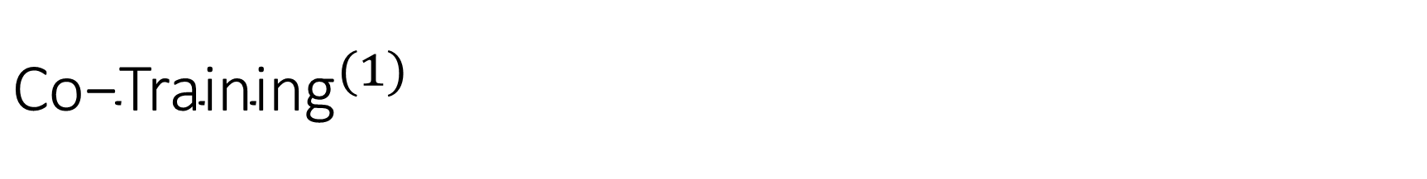
$${\text{Co}\text{−}\text{Training}}^{(1)}$$
The first Semi-Supervised Algorithm
Two classifiers
Attributes partitioned into two sets – each sufficient, and independent of one-another (“sufficient and redundant views”)
Classifiers trained using the labeled data and their chosen attributes
Using unlabeled data each classifier makes prediction using their attribute set
Each prediction is measured for confidence
“Confident” predictions are used to re-train the peer
Blum, A., Mitchell, T. Combining labeled and unlabeled data with co-training. COLT: Proceedings of the Workshop on Computational Learning Theory, Morgan Kaufmann, 1998, p. 92-100.
http://citeseerx.ist.psu.edu/viewdoc/download?doi=10.1.1.487.2431&rep=rep1&type=pdf

Slide 4
Co-Training
Attributes
Class
Subset the attributes
Attributes Subset A
Attributes Subset B
Labeled Data
2) Train two classifiers using Labeled Data
3) Use classifiers to predict class to be used by peer
Classifier 1
Classifier 2
Class
Class
4) Measure confidence of predictions. Select data instances based on confidence.
Unlabeled Data
5) Re-train using confident peer-labeled examples
Classifier 1
Classifier 2

Slide 5
Co-Training
Requires sufficient/independent attribute set
Not necessarily available
How to determine?
Assessing confidence
Can be computationally expensive

Slide 6
Tri-Training
Three classifiers
Split labeled data into 3 subsets (instance-based)
Train each using its labeled subset
Predict on unlabeled data → 3 sets of predictions
Majority vote. A 2/3 agreement results in new labeled instance for the “wrong” classifier
Re-train using new labeled data
Advantage:
Does not require attributes with “sufficient and redundant views”
No need to measure “confidence” of prediction

Slide 7
Tri-Training
Split Labeled Data L into 3 subsets S1,S2,S3
Labeled Data
S1
S2
S3
2) Train three classifiers
Classifiers
h1
h2
h3
Loop:
3) Predict class on all unlabeled data
Attributes
P1
P2
P3
Unlabeled Data
4) Majority Vote. Outlier gets new labeled instance
5) Add new labeled data from Step 4 to “L”. Re-train
Classifiers
h1
h2
h3

Slide 8
The bigger picture…
Tri-Training is NOT a machine learning algorithm.
It is not a peer to Bayes, CNN, Decision Trees
Rather:
Tri-Training re-purposes ML algorithms to allow use of unlabeled data!

Slide 9
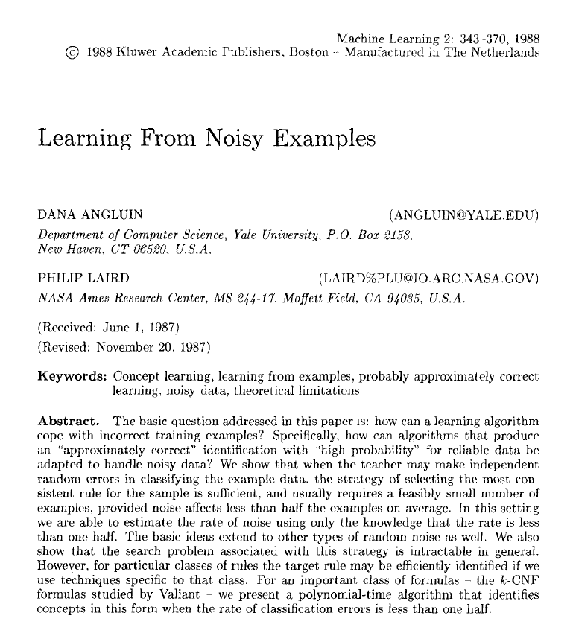
Angluin, Laird (1988)
How can a learning algorithm be adapted to handle noisy data?
Findings:
If “teacher” (i.e. data) has independent random errors
Then a strategy that will work is to select the most consistent rule for the sample
Notes:
It usually requires a feasibly small number of samples if the noise affects < ½ the samples
In general it is intractable, but shown to be polynomial for one rule type

Slide 10

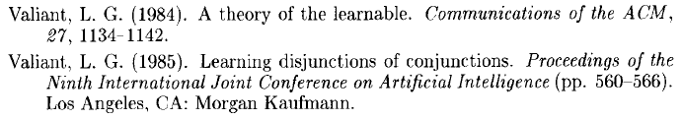
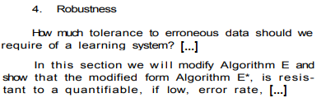
The basis for Semi-supervised Learning…
[1] Z. Zhou and M. Li, "Tri-Training: Exploiting Unlabeled Data Using Three Classifiers" in IEEE Transactions on Knowledge & Data Engineering, vol. 17, no. 11, pp. 1529-1541, 2005.
“A new co-training style semi-supervised learning algorithm is named tri-training is proposed.”
- PAC Learning -
“We give a methodology for studying [learning. It consists of an] information gathering mechanism, the learning protocol, […] and the class of concepts that can be learned”

Slide 11
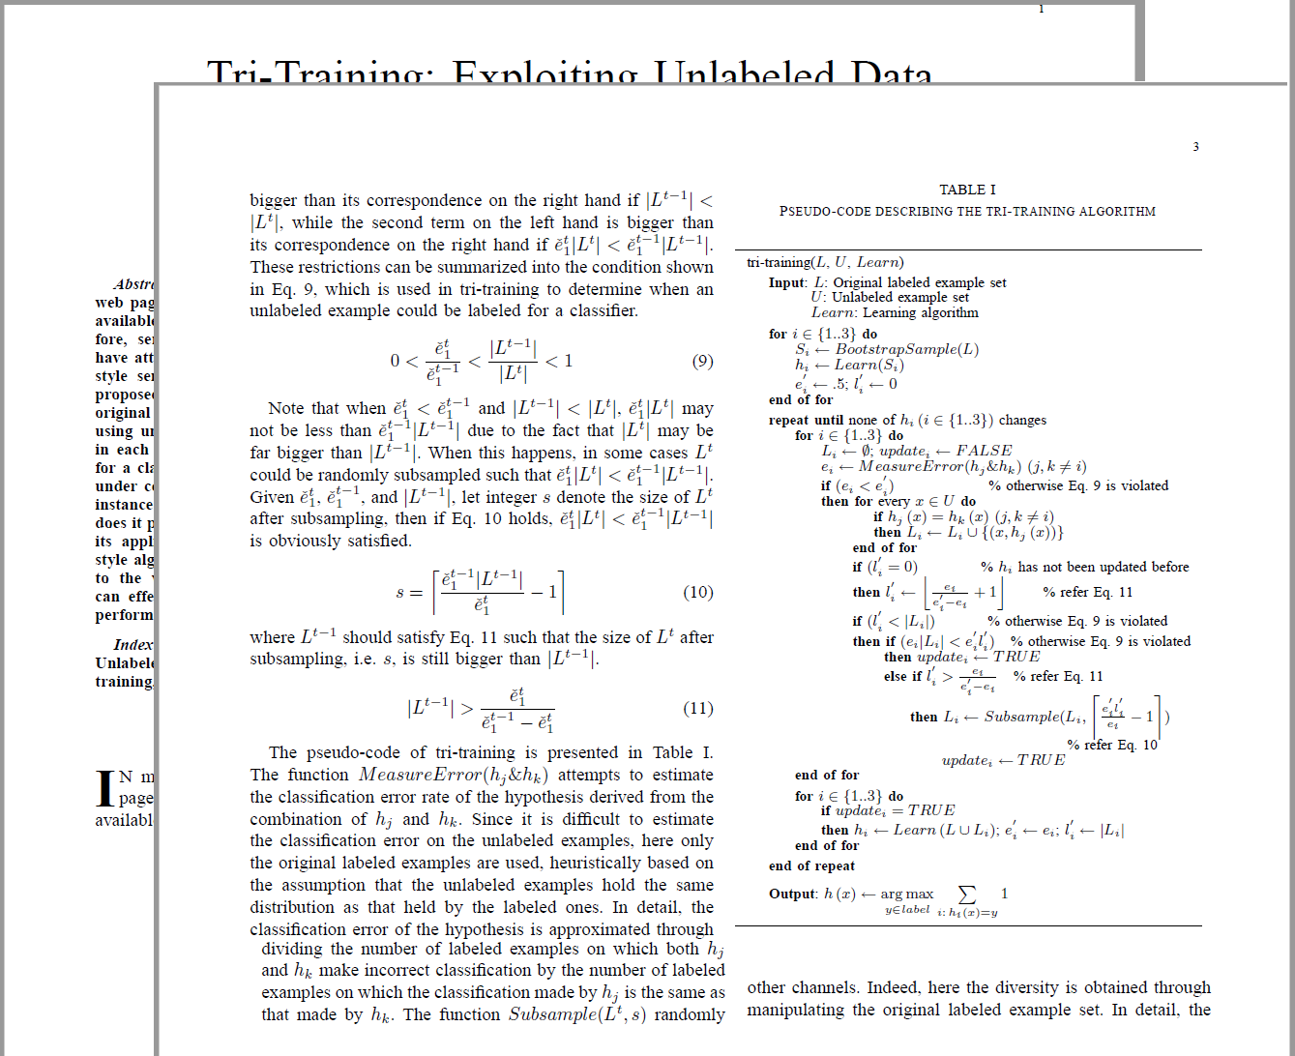
Equations 1.11 and Code Walk-through

Slide 12
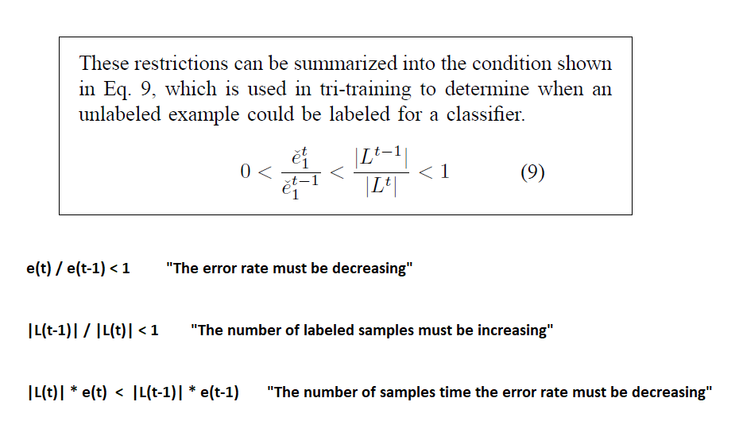
When can newly labeled examples be used?

Slide 13
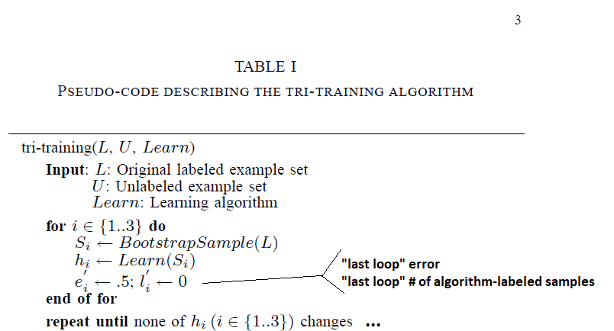
Tri-Training Pseudo-Code (priming section)

Slide 14
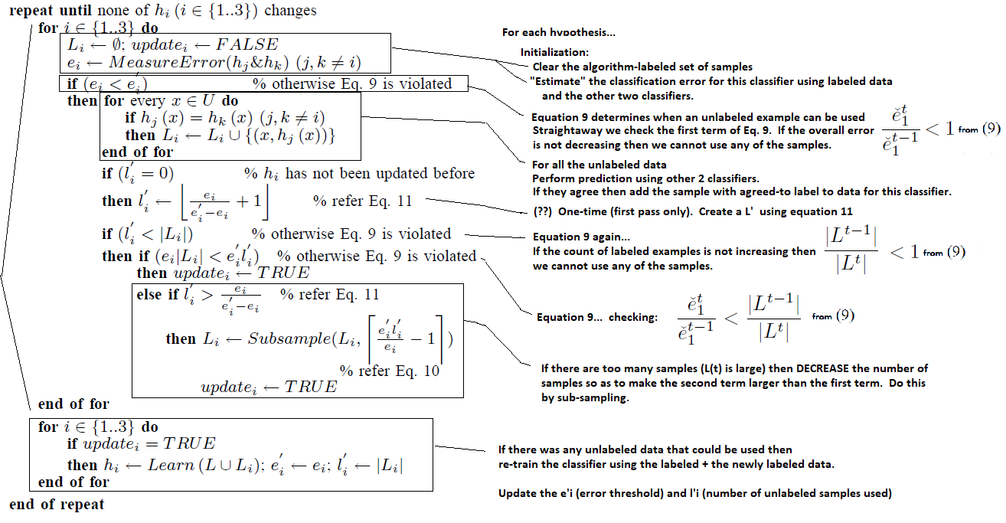
Tri-Training Pseudo-Code (updating section)

Slide 15
Testing and Rationale
Datasets <applicability>
(12) UCI, (1) Web Page Classification
“Unlabel Rate” <scalability>
20% to 80%
ML Algorithm <generality>
Decision Tree, NN, Naïve Bayes
Compare to other Semi-Supervised <compare to peers>
Co-training, Self-training1, Self-training2

Slide 16
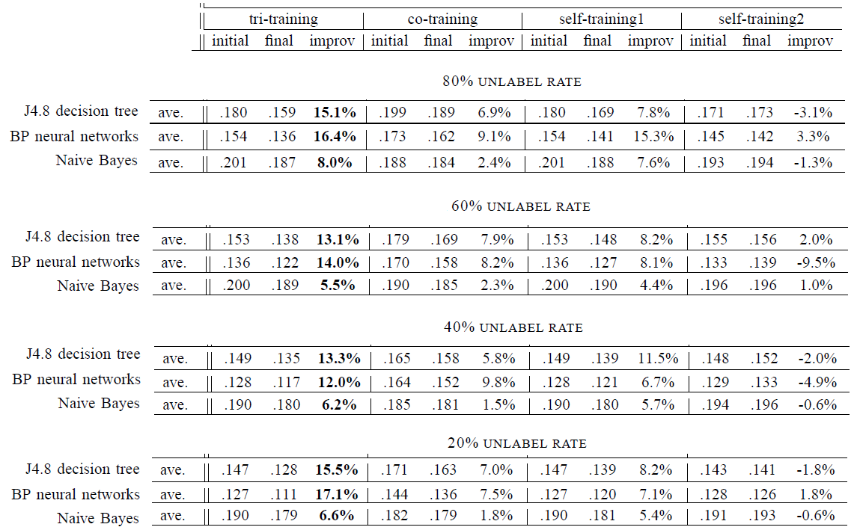
Results (avg on UCI datasets)

Slide 17
Conclusions
Good efficiency and generalizability because:
“gracefully”(?) choose examples to label
Use multiple classifiers to compose final hypothesis
Wide applicability
Does not require sufficient and redundant views
No constraint on learning algorithm
Algorithm is simple, but effectively exploited unlabeled examples

Slide 18
Future Research
Data Editing [18]
Help identify wrongly-labeled examples
Incorporating Data Editing into Tri-training
Active Learning [7]
Labels for selected unlabeled samples asked from user
Query by Committee [25]
Current implementation “incremental learning”
instead of full re-train each loop

Slide 19
Thank You

Slide 20
Angluin, Laird (1988) How to cope with incorrect training examples?
Reliable (Training) Data
Algorithm
“Approximately Correct”
Test Data
Model (h)
Strategy to “Adapt”
Noisy (training) Data
Algorithm’
Test Data

Slide 21
PAC (probably approximately correct) Learning (tutorial references…)
https://en.wikipedia.org/wiki/Probably_approximately_correct_learning
https://jeremykun.com/2014/01/02/probably-approximately-correct-a-formal-theory-of-learning/

