Slide 1
Knowledge Graphs and Embeddings
an overview prepared for
Metrowest Boston Developers Machine Learning Group
Chris Winsor
6/16/2021

Slide 2
Agenda
Overview
Survey Paper
Cai, Zheng, Chang “A Comprehensive Survey of Graph Embedding: Problems, Techniques and Applications”, Arxiv (2017)
Keras/Tensorflow Implementation
https://www.tensorflow.org/text/guide/word_embeddings

Slide 3
References:
https://towardsdatascience.com/an-introduction-to-knowledge-graphs-841bbc0e796e
Nickel, M., Murphy, K., Tresp, V., Gabrilovich, E. A Review of Relational Machine Learning for Knowledge Graphs. Proceedings of the IEEE (2015)
https://dl.acm.org/doi/abs/10.1145/2623330.2623623 (video + paper from 2014 – Kevin Murphy)
https://web.stanford.edu/class/cs520/2020/notes/What_is_a_Knowledge_Graph.html
Cai, H., Zheng, V. W. & Chang, K. C.-C. A Comprehensive Survey of Graph Embedding: Problems, Techniques and Applications. Arxiv (2017).
Maas, A., Daly, R., Pham, P., Huang, D., Ng, A., Potts, C. “Learning Word Vectors for Sentiment Analysis” Proceedings of the 49th Annual Meeting of the Association for Computational Linguistics: Human Language Technologies

Slide 4
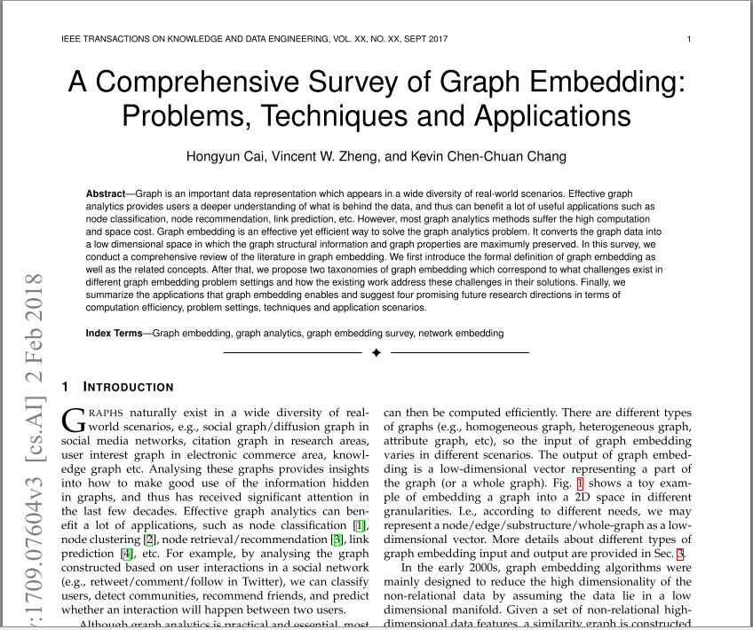

Slide 5
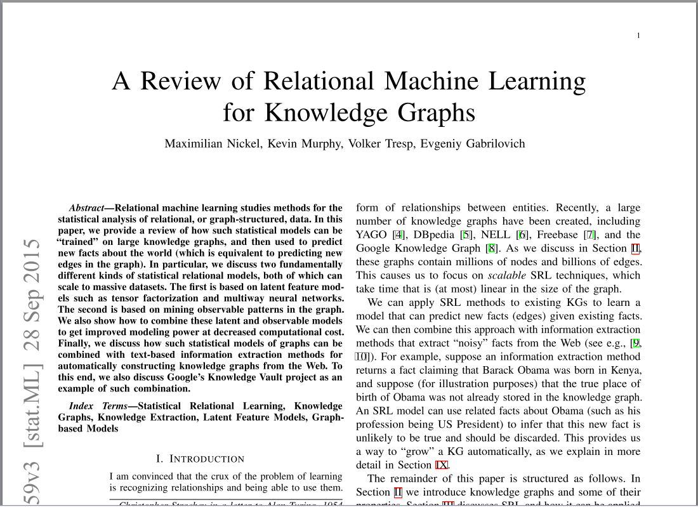

Slide 6
Knowledge Graph
A “graph structured knowledge base ... that stores factual information in (the) form of relationships between entities”.
Typically scraped from public internet sources (natural text, images)
Uses the Resource Description Framework (RDF) to represent facts as Subject-Predicate-Object (SPO) “triples”
[1] Nickel, M., Murphy, K., Tresp, V., Gabrilovich, E. A Review of Relational Machine Learning for Knowledge Graphs. Proceedings of the IEEE (2015)

Slide 7
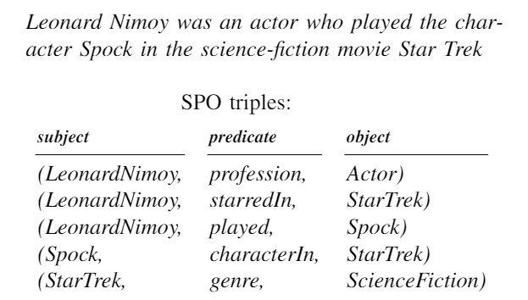
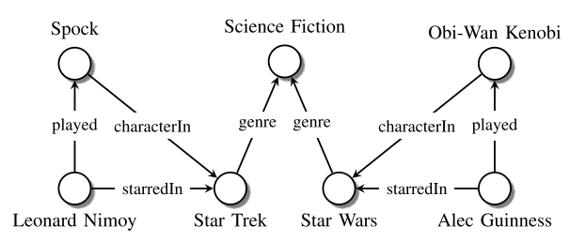
Example
Nickel, M., Murphy, K., Tresp, V., Gabrilovich, E. A Review of Relational Machine Learning for Knowledge Graphs. Proceedings of the IEEE (2015).

Slide 8
Why Knowledge Graph?
Highly scalable (can handle large quantities)
Ability to handle unstructured data
To establish a base for subsequent ML-based learning, insights, predictions
Example:
Troll Facebook movie reviews (unstructured text) into a standard format
Use that repository for movie recommendations, predict future academy awards, revenue prediction, etc.
KG is front end of (very large) data pipeline
https://aws.amazon.com/neptune/knowledge-graphs-on-aws/

Slide 9
Examples
Google | Knowledge Graph Acquired Freebase in 2010
Facebook | Graph API to Facebook Social Graph https://developers.facebook.com/docs/graph-api/
YAGO | Open source at Max Planck Institute for Computer Science in Saarbrücken Extracted from Wikipedia and other sources
DBpedia | https://www.dbpedia.org/ Maintained at University of Mannheim and Leipzig University Extracted from (and references to) Wikipedia.
Microsoft | (Teach-to-fish, give you fish) Graph API https://docs.microsoft.com/en-us/graph/overview Academic Knowledge Graph (MAKG) https://makg.org/ Knowledge Mining API (to Satori, Bing QnA, Enterprise Dictionary) https://www.microsoft.com/en-us/research/project/knowledge-mining-api/
Wikipedia | https://www.wikidata.org/wiki/Wikidata:Main_Page An open data source (welcomes responsible bots) and mined by all above WikiData is Wikipedia’s own KG
IBM | https://researcher.watson.ibm.com/researcher/view_group.php?id=7140
CMU NELL | Never Ending Language Learning http://rtw.ml.cmu.edu/rtw/kbbrowser/
In summary: Very active and early on. Positions being staked out. Implementations are still research-ey

Slide 10
DBpedia
Extracted from Wikipedia
2016-04 release = 6.0 million entities: 1.5M persons, 810k places, 135k music albums, 106k films, 20k video games, 275k organizations, 301k species and 5k diseases
9.5 billion RDF triples (1.3 billion from English edition Wikipedia and 5.0 billion from other language editions.
Reference: https://en.wikipedia.org/wiki/DBpedia

Slide 11
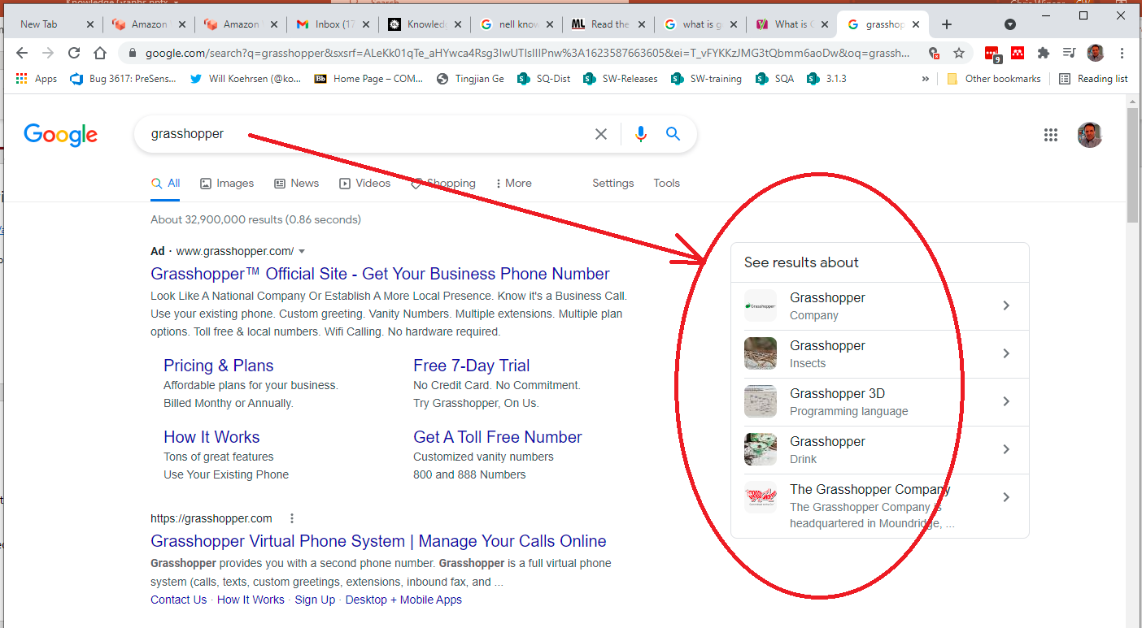

Slide 12


Slide 13
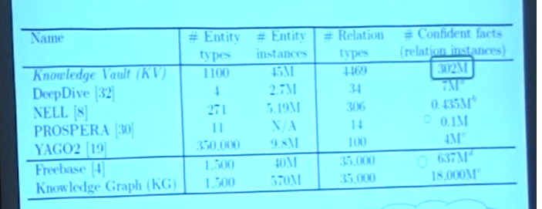
2014

Slide 14
Current Research Directions / Activity
Dynamic Knowledge Graphs (McKallum https://arxiv.org/abs/1810.05682)
Adding/changing entities or predicates (semantic structure) to existing KG (no re-training). Similar to “Dynamic KG” above.
“Graph stream processing”

Slide 15
Theory

Slide 16
Historical Context
Currently:
A means to aggregate and store knowledge scraped from internet
Historically:
W3C Semantic Web - intended as a standardized machine-friendly way to express meaning and relationships in websites and web data.
Schema.org (consortium establishing standardized ontology)
Webmasters did not code W3C so...
Google (et al) repurposed for use in KG
Knowledge Graphs leverage RDF (SPO, Schema Vocabulary, SPARQL) from W3C and (frequently) schema from schema.org

Slide 17
W3C RDF and SPO
SPO (Subject-predicate-object) A triple that defines a “fact”.
Subject and Object are Entities, Predicate is relationship.
RDF (Resource Description Framework) defines a directed labeled graph – a set of SPOs
RDF specification includes:
the SPARQL Query Language [SPARQL11-OVERVIEW];
the RDF Schema vocabulary [RDF11-SCHEMA].
A class hierarchy
https://www.w3.org/TR/rdf-schema/
https://www.w3.org/TR/rdf-sparql-query/

Slide 18
Fixed/Open Lexicon
Fixed Lexicon (schema-based)
Open Lexicon (schema free)
i.e. OpenIE (Stanford University) = NLP to SPO using “surface names”
https://nlp.stanford.edu/software/openie.html

Slide 19
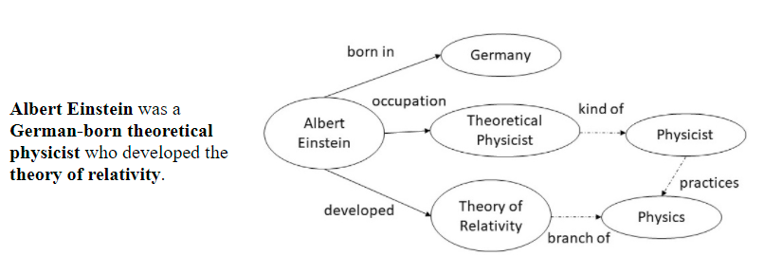
Example
Entity and relation extraction from natural text.
Reference: https://web.stanford.edu/class/cs520/2020/notes/What_is_a_Knowledge_Graph.html

Slide 20
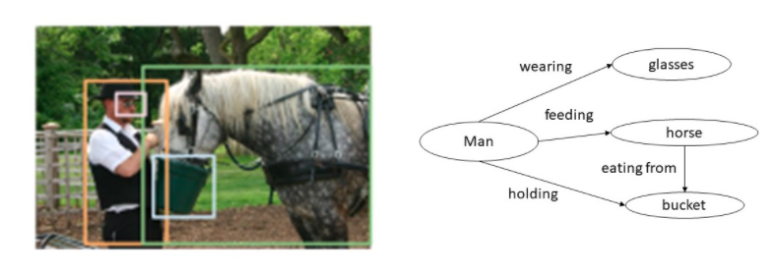
Example
Entities from object detector: (man, glasses, horse, bucket)
Relationships: (wearing, feeding, holding, eating from)
Reference: https://web.stanford.edu/class/cs520/2020/notes/What_is_a_Knowledge_Graph.html

Slide 21
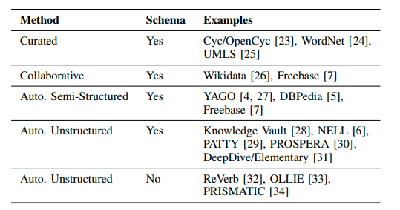
Quality and Means of Construction
Curated (manually built) and Collaborative (infoboxes) give highest quality
Unstructured text, automated classification give lower confidence facts

Slide 22
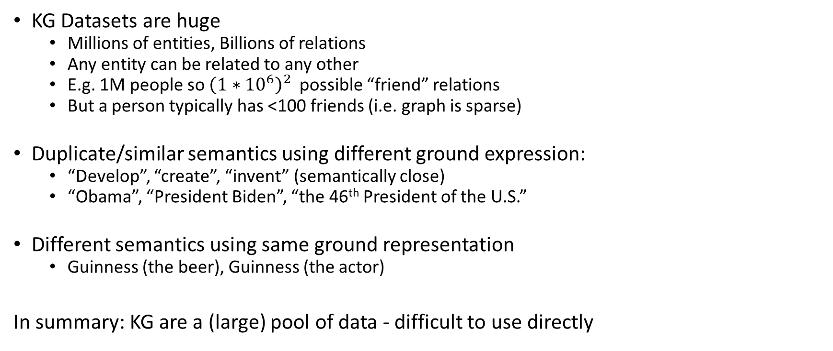
The Problem
KG Datasets are huge
Millions of entities, Billions of relations
Any entity can be related to any other
E.g. 1M people so ${\left(1∗{10}^{6}\right)}^{2}$ possible “friend” relations
But a person typically has <100 friends (i.e. graph is sparse)
Duplicate/similar semantics using different ground expression:
“Develop”, “create”, “invent” (semantically close)
“Obama”, “President Biden”, “the 46th President of the U.S.”
Different semantics using same ground representation
Guinness (the beer), Guinness (the actor)
In summary: KG are a (large) pool of data - difficult to use directly

Slide 23
SRL (Statistical Relational Learning)
“We ... assume that all the entities and (types of) relations in a knowledge graph are known. However, triples are assumed to be incomplete and noisy; entities and relation types may contain duplicates”.
My read: Like any Machine Learning method, the goal is to parameterize what we can glean from the data (the KG) and capture that as a Model. SRL is the process. Embeddings are the embodiment of our knowledge.

Slide 24
Graph Embedding Output
A set of low dimensional vectors representing (part of) a graph.
Node Embedding
Node-pair (Edge)
Subgraph
Whole graph
Driven by application
https://arxiv.org/abs/1709.07604

Slide 25
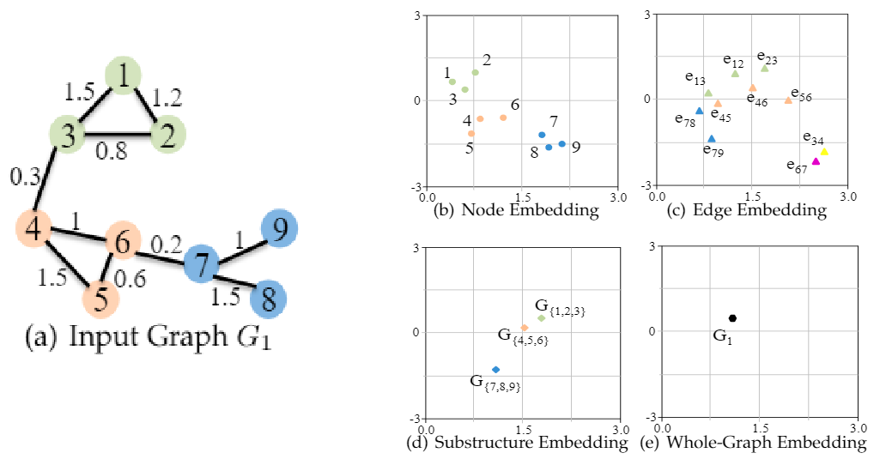
Graph Embedding Output
https://arxiv.org/abs/1709.07604

Slide 26
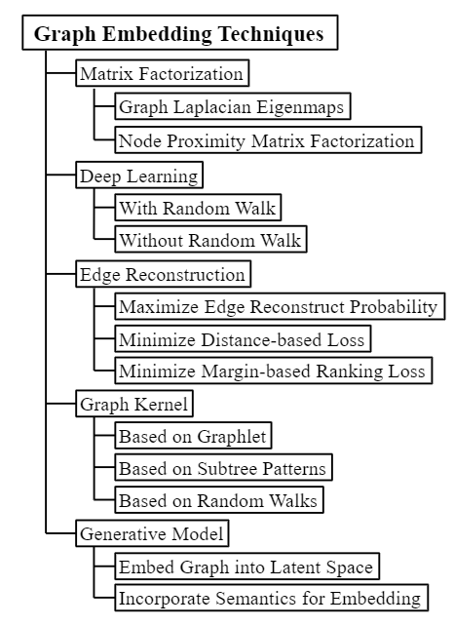
Techniques
https://arxiv.org/abs/1709.07604

Slide 27
Model Types
Latent Feature: explains triples through latent variables (triples are independent given a latent feature)
RESCAL
Multi-layer Perceptron
Latent Distance: relationship is based on distance
Structured embedding
Graph Feature: explains triples through features that are present
Path Ranking
much more here...
Nickel, M., Murphy, K., Tresp, V., Gabrilovich, E. A Review of Relational Machine Learning for Knowledge Graphs. Proceedings of the IEEE (2015)

Slide 28
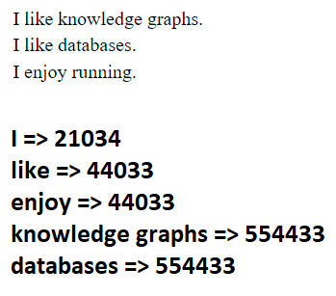
Embeddings...
Embedding maps low-level feature (word or object) to higher-level concept.
Neural networks operate on numeric, not nominal, values.
The number of embedding values is driven by need for detail (application dependent).

Slide 29
Next...

Slide 30
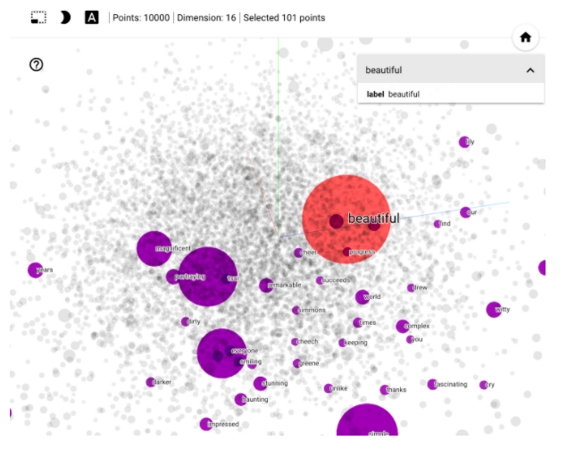
TensorFlow Implementation https://www.tensorflow.org/text/guide/word_embeddings
Introduction to word embeddings
Train Keras model for sentiment classification
Visualize using Embedding Projector

Slide 31
Requirements and Steps
Equipment:
Python with pip ($python –m pip --version)
TensorFlow
Jupyter Notebook
Procedure:
Download notebook https://storage.googleapis.com/tensorflow_docs/text/docs/guide/word_embeddings.ipynb
Modules (venv is recommended - see next slide) or...
python -m pip install tensorflow
Python –m pip install Jupyter
The notebook will download database, create embeddings

Slide 32
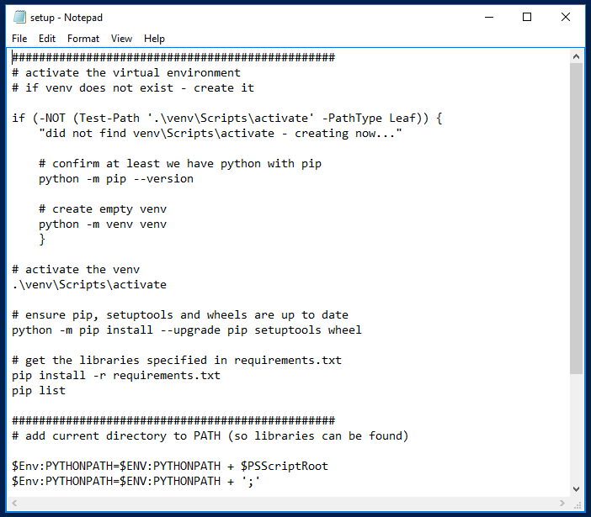
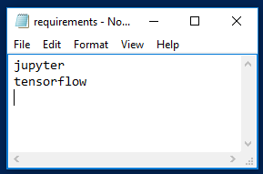
venv
setup.ps1
requirements.txt

Slide 33
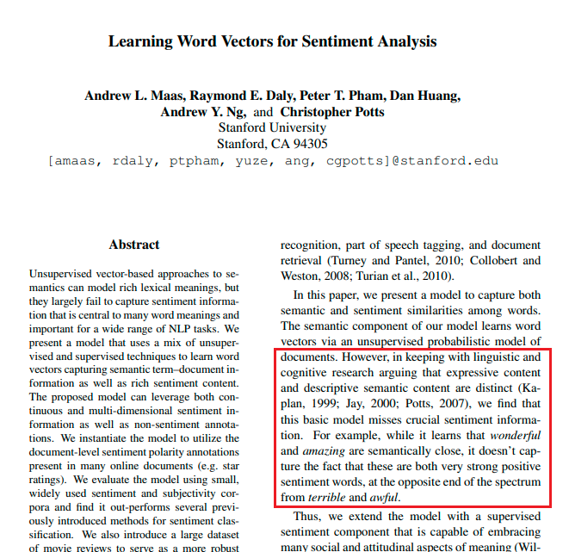
Large Movie Review (Dataset + Paper/Model) http://ai.stanford.edu/~amaas/data/sentiment/
Lexical meaning vs Sentiment
Meaning of the word vs feeling of the reader

Slide 34
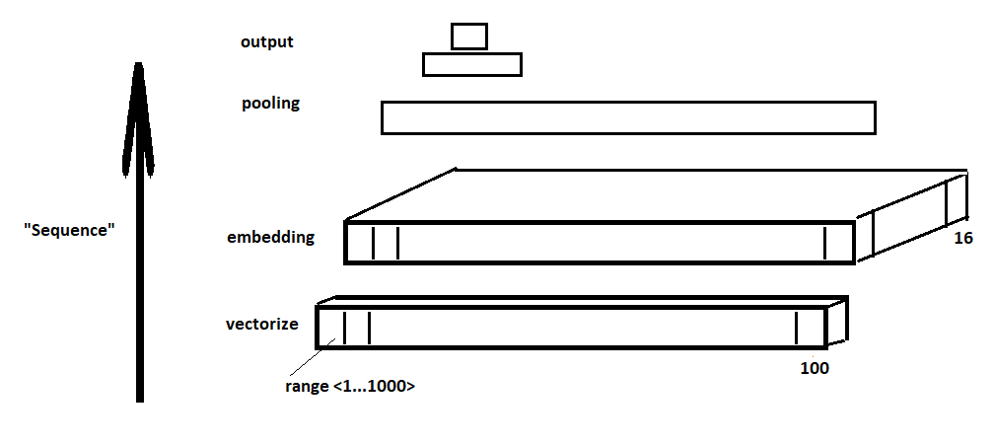
Tensorflow example

Slide 35
Go to the notebook
Review the database (files)
/pos /net
Readme
Walk the Jupyter notebook

Slide 36
Thank You

Slide 37
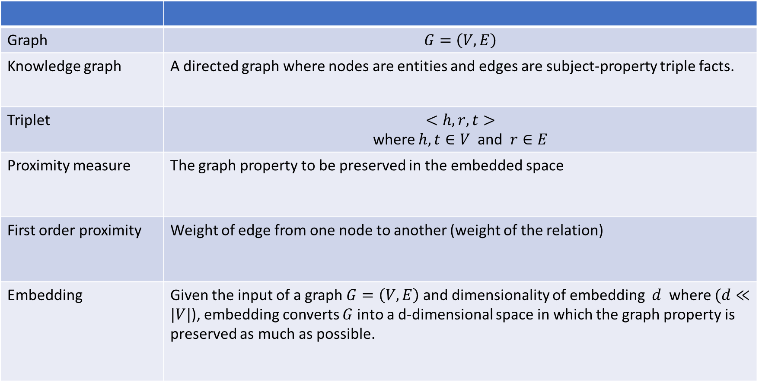
Notation and Definitions
Graph | $$G=\left(V,E\right)$$
Knowledge graph | A directed graph where nodes are entities and edges are subject-property triple facts.
Triplet | $<h, r, t>$ where $h, t∈V$ and $r∈E$
Proximity measure | The graph property to be preserved in the embedded space
First order proximity | Weight of edge from one node to another (weight of the relation)
Embedding | Given the input of a graph $G=\left(V,E\right)$ and dimensionality of embedding $d$ where $(d≪|V|$), embedding converts $G$ into a d-dimensional space in which the graph property is preserved as much as possible.
https://arxiv.org/abs/1709.07604

Slide 38
Factor Graph
A factor graph is a type of probabilistic graphical model. A factor graph has two types of nodes:
Random variable
Factor: used to evaluate relations between variables.
http://deepdive.stanford.edu/inference

Slide 39
Google Knowledge Graph vs Google Knowledge Vault
Knowledge Graph = product
Basis of google search
Knowledge Value = research.
focusing on certainty. Each fact associated with confidence score and provenance
Seen as a precision/recall problem

