Slide 1
Intentionally blank

Slide 3
Replacing QR Codes on Fliers: Exploiting Bystanders’ Trust
Aaron Thomas
Notes:
Audience participation: raise your phones
Keep your phone raised if you have a barcode scanning app. Make sure you have one, there will be QR codes to scan.

Slide 4

About the speaker
First year Undergraduate Student at PSU Berks
Security and Risk Analysis Major
Previously spoken at BloomCON

Slide 5
tl;dr
Bad people can steal fliers and put up modified copies of those fliers.

Slide 6
What to expect
QR Codes 101
Examine the Antiflier Attack
Security controls and policy
Notes:
Say WIIFM here:
After this talk is done you'll know more about QR codes than most people and have a good idea of what policy and controls can be used to mitigate an antiflier attack from affecting you.

Slide 7
Prepare your scanners
QR codes are coming
First QR code is two slides away

Slide 8
QR Code 101
2D Barcode
Extremely versatile

Slide 9
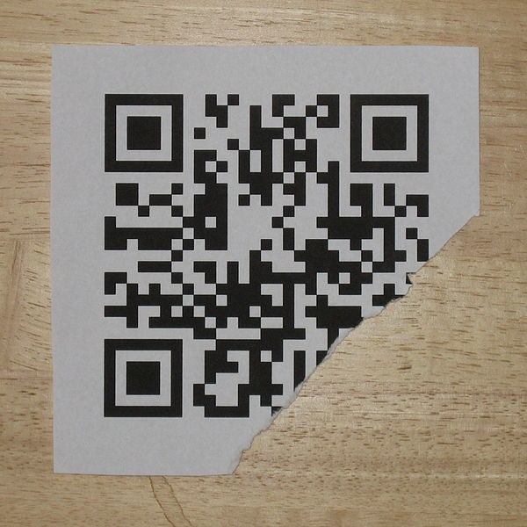
QR Codes 101
Notes:
-people familiar with links
-scan code, visit website
-this image demonstrates error correcting ability
-from wikipedia: licensed under creative commonns
-scan this

Slide 10
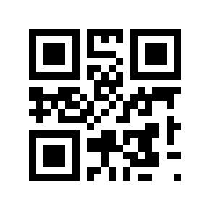
QR Codes 101
Notes:
-every qr code for rest of presentation I generated
-qr codes can contain a simple plaintext message
-scan this

Slide 11
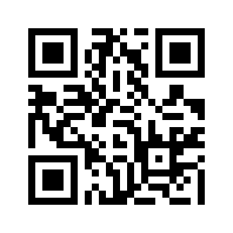
QR Codes 101
Notes:
-geographical data in a qr code
-this one is the location of where I go to college
-it’s finals week, many of my peers are taking those now
-thanks to my professors who let me schedule them so I can be here

Slide 12
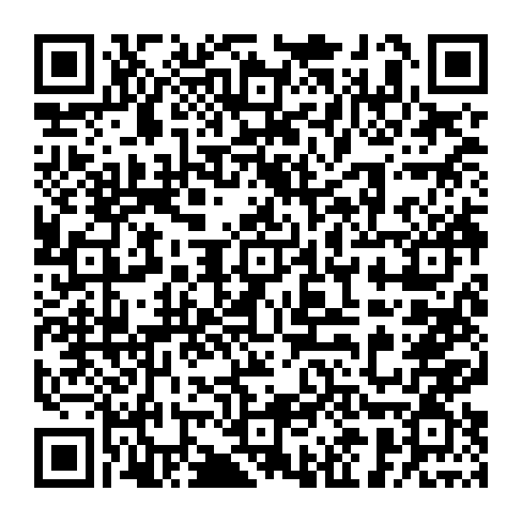
QR Codes 101
Notes:
-too much information can create difficult to scan qr codes
-this one contains a simple template of my contact information in vcard format
-no explain vcard, include link at end
-try scanning it

Slide 13
QR Codes on Fliers
Usually contain links
Probably trustworthy
Notes:
Let’s think about QR Codes on Fliers
-usually links
-rarely contain any other info
-often use url shorteners
-probably trustworthy
-most people trust a qr code
-attackers can exploit this

Slide 14
Antiflier Attack
Steal flier with QR code
Put up fake flier with new QR code

Slide 15
Hijacking QR Codes
Choose what website a user visits
Spread false contact info
Trick users into using wrong WiFi
Notes:
Website user visits:
-phishing
-stealthy javascript redirection
False contact info:
call a phone that goes to a lookalike voicemail every time, see what messages people leave
Wrong WiFi:
Users are now on attacker’s network, can do a man in the middle. Requires setting up a Wifi Network, this more advanced.

Slide 16
Phishing
Send user to lookalike website
Capture sensitive information

Slide 17
Stealthy Javascript
//do bad stuff
window.location(“example.com”);
Notes:
Lots of bad things that can be done with javascript, not going to go over those right now.
But what if they have javascript disabled?

Slide 18
What if javascript is disabled?
<noscript>
<meta http-equiv="refresh" content="0; url=http://www.example.com//>
</noscript>
Notes:
The noscript tag only does stuff when javascript is disabled
The meta tag can be used to redirect a user

Slide 19
Attacker Considerations
Bulletin board traffic
Does anyone care?
Physical access
Notes:
Traffic:
How often do people pass by the bulletin board? I
f someone sees it will theydo anything
Is it difficult to access the bulletin board

Slide 20
Simulated Attack
Probably illegal
Research experiment

Slide 21
Experiment Goals
Don’t interfere with normal use
Log every hit on an antiflier
Anonymously track repeat users

Slide 22
Solution: RedirectLogQ
Built on Python and MongoDB
Multiple redirect tokens per URL
Logs useful data for each hit
Does not store PII

Slide 23
Redirect Tokens
example.com/redirect?token=thing
Real URL
Base62 UUID Token
Location info

Slide 24
Hit Logs
On every redirect we keep
Time of redirect
Token used to redirect
UUID cookie

Slide 25
RedirectLogQ in Action
User gives a valid token
Find associated real URL
Do cookie stuff
Log the hit
Send a 302 response

Slide 26

Experiment Goals Revisited
Don’t interfere with normal use
Log every hit on an antiflier
Anonymously track repeat users

Slide 27
Experiment Pending
Lying to people is unethical
I’ll sort that out this summer

Slide 28
Preventing the Attack
Limit bulletin board access
Identify and remove antifliers
Allow users speak up

Slide 29
Limit Access
Put a case over the bulletin board
Lock that case up
Only allow certain individuals to add or remove fliers

Slide 30
Identify and Remove Antifliers
Scanning all the QR codes is a tedious and boring task
How do we make all QR codes with links look the same?

Slide 31
Identify and Remove Antifliers
Internal RedirectLogQ server
You control the existence of every redirection token
Users will easily see when something is amiss

Slide 32
Remaining Problem
Can’t verify non-URL QR codes
Don’t use them!
Print contact info and addresses on the flier.
Notes:
Most people are used to entering phone numbers and addresses by hand.

Slide 33
The End is nigh!
QR Codes 101
Examine the Antiflier Attack
Security controls and policy

Slide 34
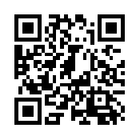
Helpful Info (coming soon)

