Slide 1
BigQueue A Big, Fast and Persistent Queue
- by William http://bulldog2011.github.com/

Slide 2
Feature Highlights
Fast
enqueue and dequeue are close to O(1) direct memory access.
Big
Only limited by available disk space.
Persistent
Data is persisted on disk and is crash resistant.
Reliable
OS will be responsible for message persistence even your process crashes.
Realtime
Produced messages will be immediately visible to consumers
Flexible Queue Semantics
Consume once queue, fanout queue, can even consume by index
Memory-efficient
Automatic pagging & swapping algorithm, only most recently accessed data is kept in memory.
Thread-safe
Multiple threads can concurrently enqueue and dequeue without data corruption.
Simple & Light-weight
Current library jar is less than 40K.

Slide 3
Performance Highlights
In concurrent producing and consuming case, average throughput is around 166MBps.
In sequential producing then consuming case, average throughput is around 333MBps.

Slide 4
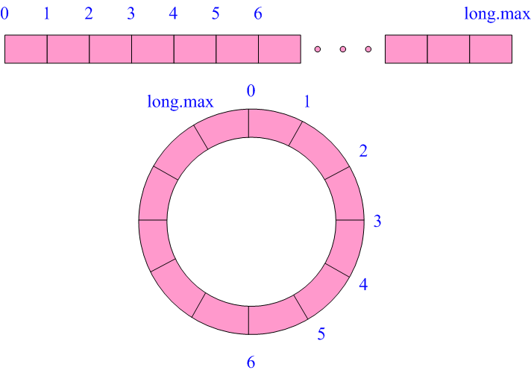
Design – Logical View
Looks just like a big array or a circular array

Slide 5
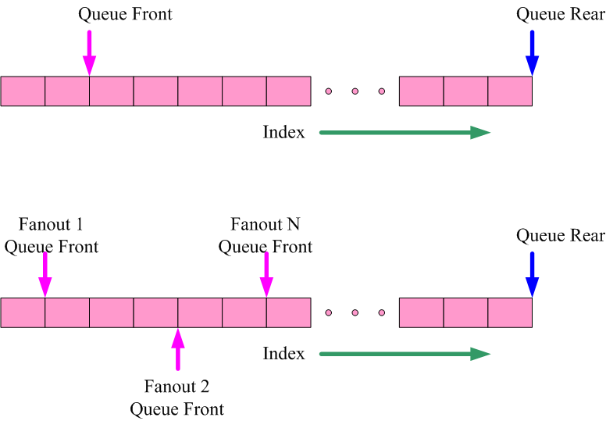
Design – Consume Once and Fanout Semantics Support

Slide 6
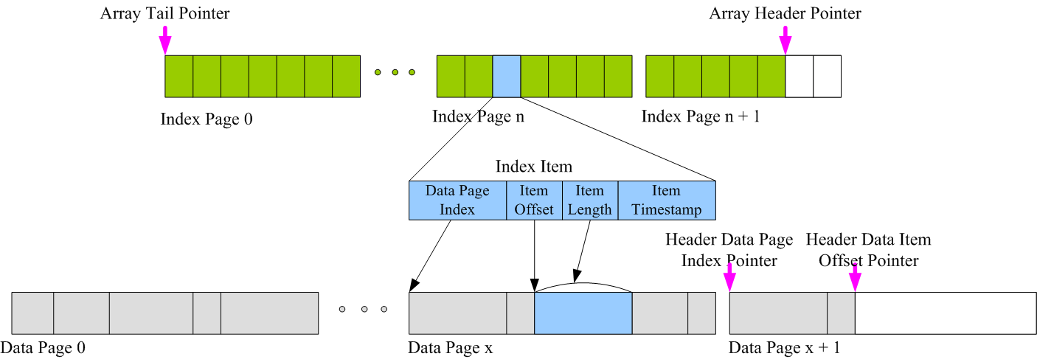
Design – Physical View : Paged Index + Data File

Slide 7
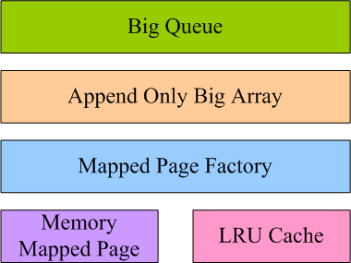
Design – Components View

Slide 8
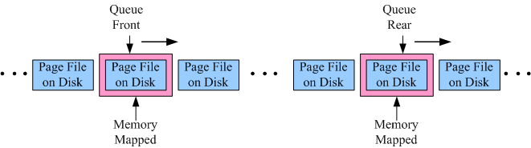
Design – Dynamic View : Memory Mapped Sliding Window

Slide 9
Concurrency
Produce(or append) is synchronized in the queue implementation
Consume(or read) is already thread-safe

Slide 10
Simple Interface
Creation IBigQueue bigQueue = new BigQueueImpl("d:/bigqueue/tutorial", "demo");
Enqueue for(int i = 0; i < 10; i++) {
String item = String.valueOf(i);
bigQueue.enqueue(item.getBytes());
}
Dequeue for(int i = 0; i < 5; i++) {
String item = new String(bigQueue.dequeue());
}
Peek
byte[] data = bigQueue.peek();

Slide 11
Fanout Queue
Creation IFanOutQueue foQueue = new FanOutQueueImpl("d:/tutorial/fanout-queue", "demo");
Enqueue for(int i = 0; i < 10; i++) {
String log = "log-" + i;
foQueue.enqueue(log.getBytes());
}
Fanout 1 Dequeue
String fanoutId1 = "realtime";
while(!foQueue.isEmpty(fanoutId1)) {
String item = new String(foQueue.dequeue(fanoutId1));
System.out.println(item);
}
Fanout 2 Dequeue
String fanoutId2 = "offline";
while(!foQueue.isEmpty(fanoutId2)) {
String item = new String(foQueue.dequeue(fanoutId2));
System.out.println(item);
}
Fanout 1 and Fanout 2 consuming are independent

Slide 12
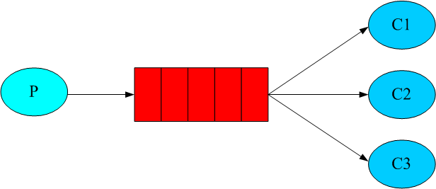
Fanout Queue Semantics

Slide 13
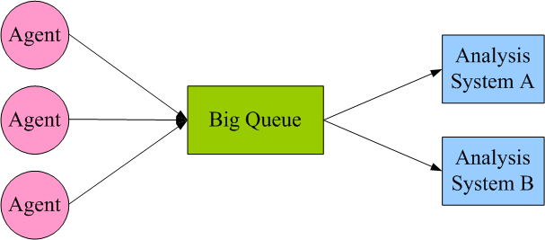
Use Case 1 : Log Collecting & Consuming

Slide 14
Use Case 2 : Big Data Sorting
Queue Only Algorithm:
Put all data into a source queue
Build a queueOfSortedQueues by dividing and sorting the source queue
Merge sort the queueOfSortedQueues
The last one left in the queueOfSortedQueues is the final sorted queue

Slide 15
Source, Samples, Docs and Tutorials
https://github.com/bulldog2011/bigqueue

Slide 16
Other Alternatives
Apache ActiveMQ
http://activemq.apache.org
RabbitMQ
http://www.rabbitmq.com/
ZeroMQ
http://www.zeromq.org
Kestrel
https://github.com/robey/kestrel
Apache Kafka
http://kafka.apache.org

