Slide 1
Building our website
The ✨aesthetic✨
Plan 🗺️
Priorities 🧭
Next tasks 👩‍💻
Ressources 📚

Slide 2
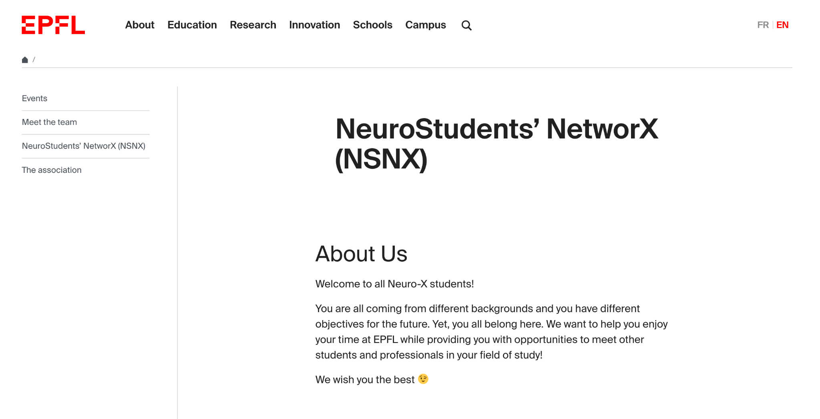
The ✨aesthetic✨
What we have:

Slide 3
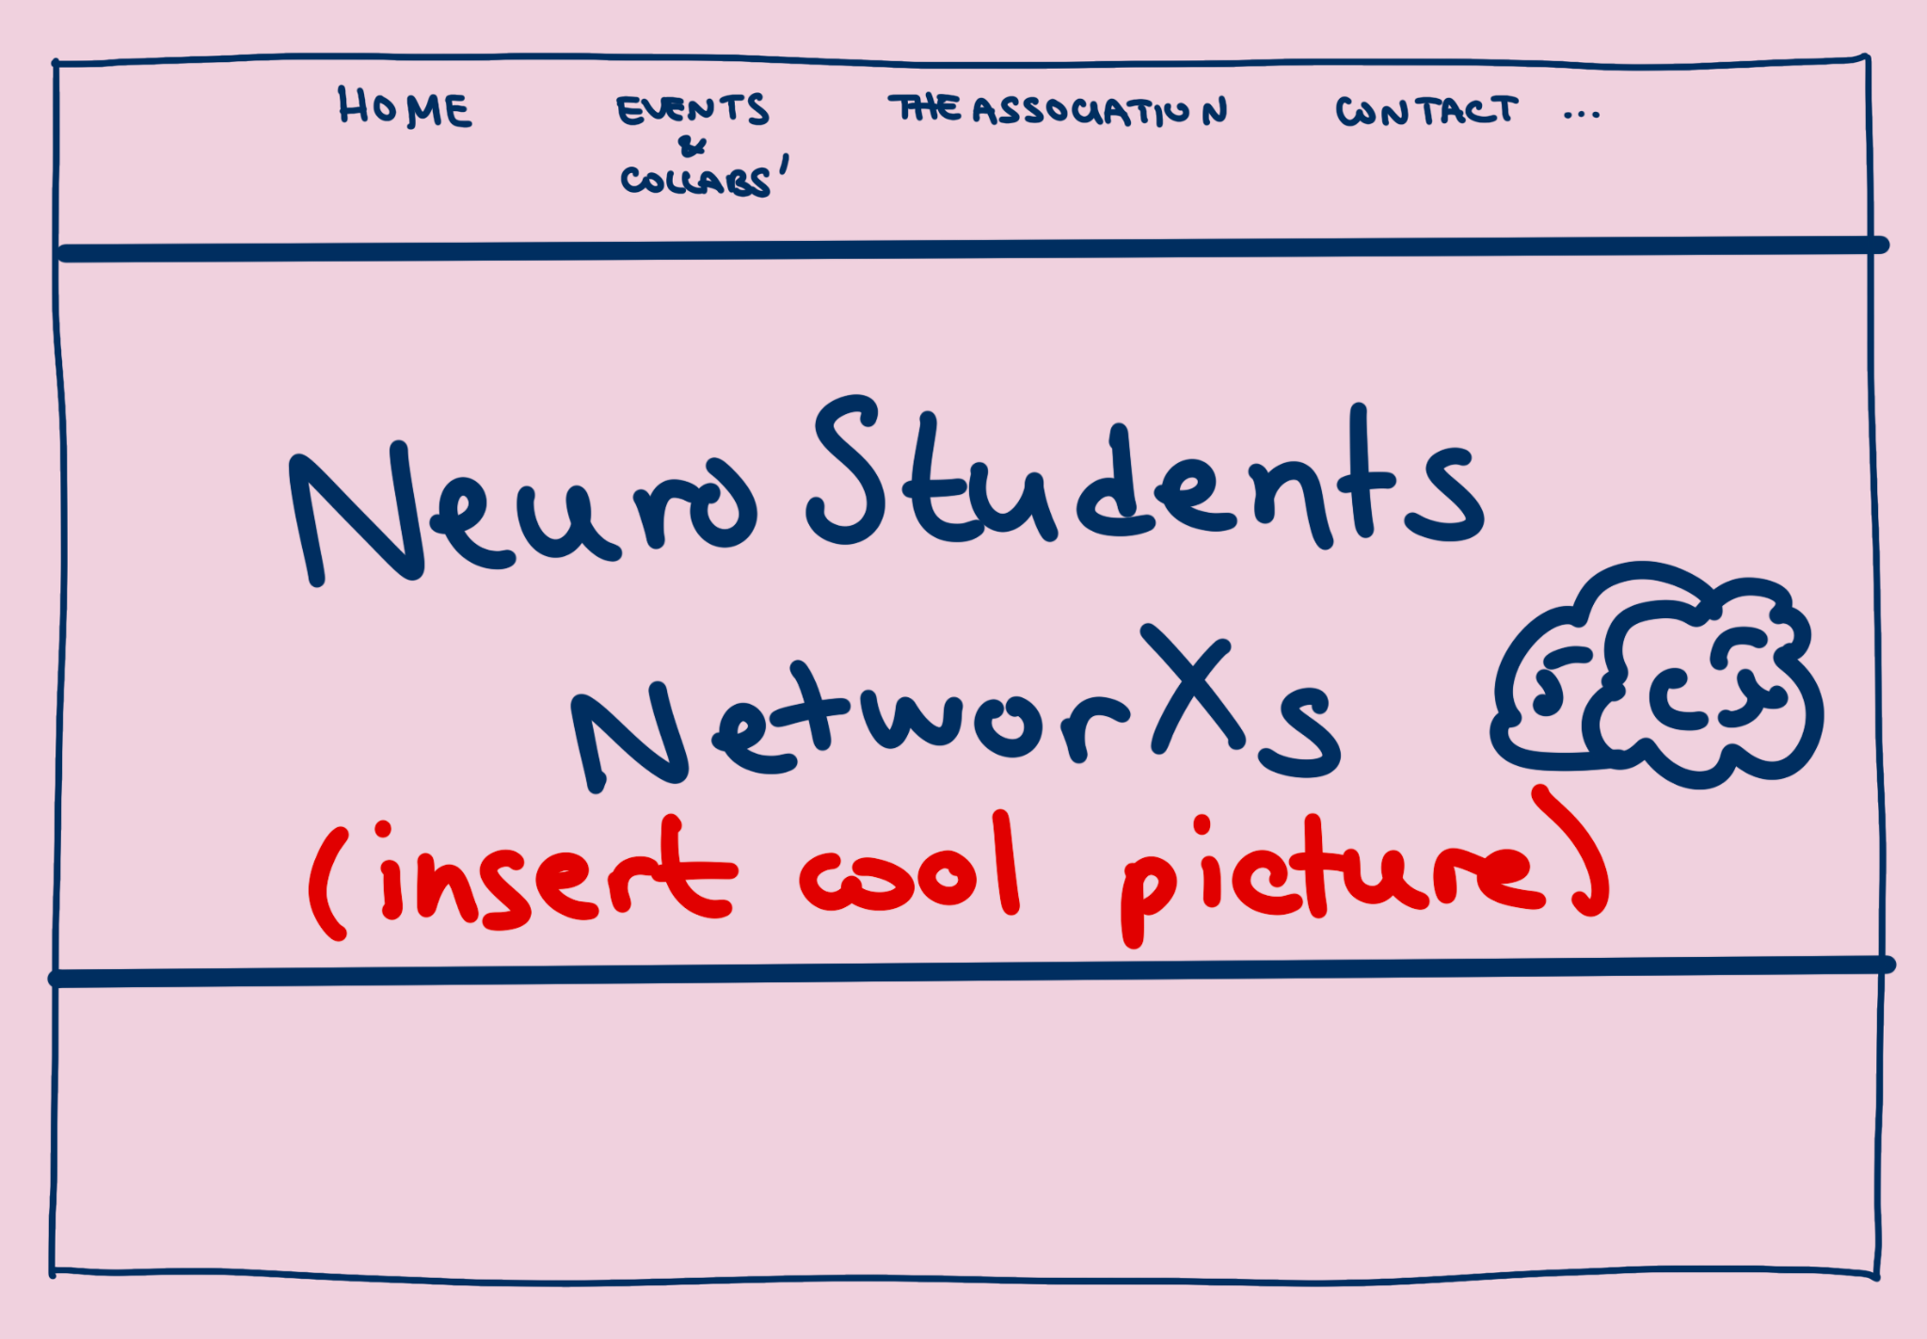
The ✨aesthetic✨
What I would’ve
liked to have:
dynamic
“real” website
Issue:
I would have to move out of WordPress
Time

Slide 4
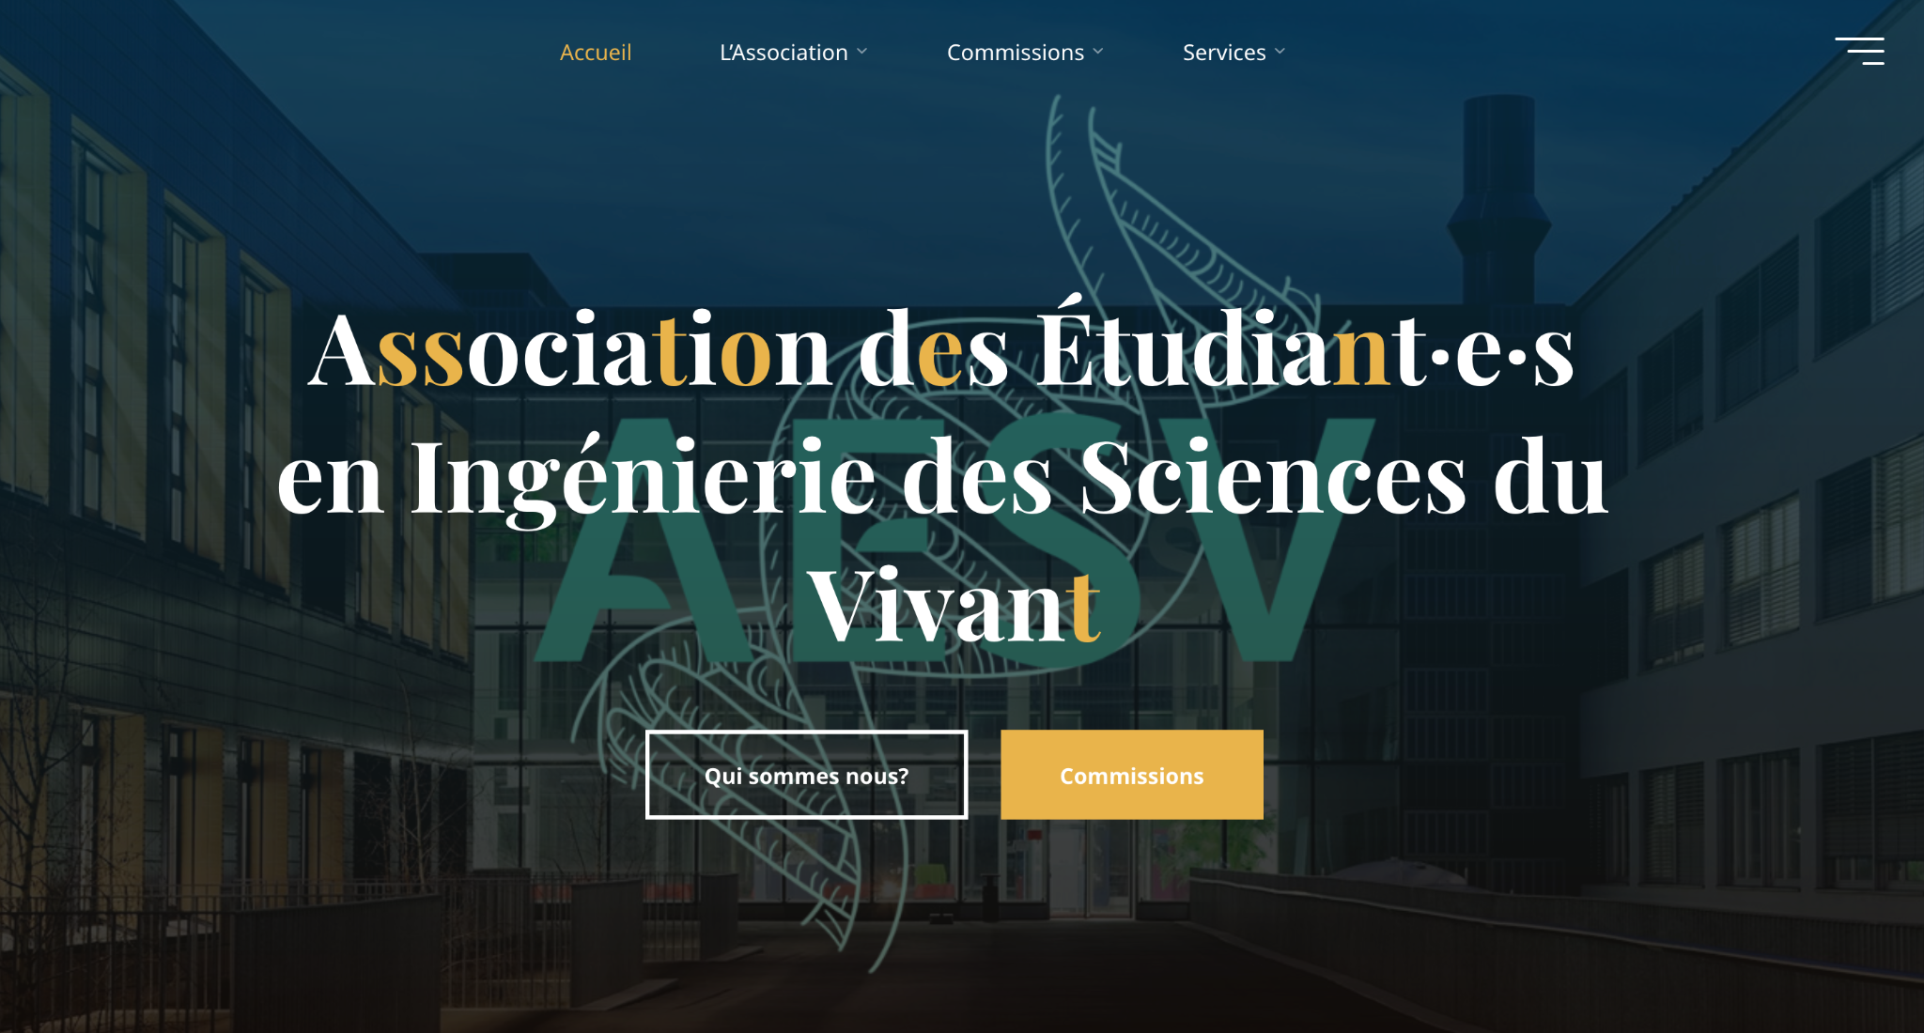
The ✨aesthetic✨
E.g. AESV’s website
What I would’ve
liked to have:
dynamic
“real” website
Issue:
I would have to move out of WordPress
Time

Slide 5
The plan 🗺️
As of now:
Events
Meet the team
NSNX
The association

Slide 6
The plan 🗺️
Detail:
What could be cool:
⇒ Past events
⇒ Upcomming events
timeline manner, with tags (company, lab, social…)
⇒ Want to collaborate?
(Home)
Events & collabs
The association
Hoodies & merch
Contact
Feeling lost
Newsletter
Students
Labs & companies

Slide 7
The plan 🗺️
Detail:
What could be cool:
⇒ About us:
What are we? About + history
Who are we? Detail association roles + join form
What do we do?
⇒ Committee:
Our faces + join form
⇒ Official Documents:
Statuses
(Home)
Events & collabs
The association
Hoodies & merch
Contact
Feeling lost
Newsletter
Students
Labs & companies

Slide 8
The plan 🗺️
Detail:
What could be cool:
⇒ Definitely not for this year, potentially cannot if we stay on EPFL’s website…
(Home)
Events & collabs
The association
Hoodies & merch
Contact
Feeling lost
Newsletter
Students
Labs & companies

Slide 9
The plan 🗺️
Detail:
What could be cool:
General info with email + social media + Klinke’s email + NeuroX page
(Home)
Events & collabs
The association
Hoodies & merch
Contact
Feeling lost
Newsletter
Students
Labs & companies

Slide 10
The plan 🗺️
Detail:
What could be cool:
⇒ Is NeuroX for me?
important ressourses (klinke’s mail, labs, nx page, epfl admission page, important ppl in the section)
students’ experiences (3 testimonies + link to reddit)
FAQ
⇒ Learning ressources
course detail (what each brings to NX students precisely)
Neuroscience 101
Microtechnics 101
Programming 101
(Home)
Events & collabs
The association
Hoodies & merch
Contact
Feeling lost
Newsletter
Students
Labs & companies

Slide 11
The plan 🗺️
Detail:
What could be cool:
⇒ X frequency, have a newsletter about the field and the school. Send it via mail + add it on the website. Cool to make people discover labs and companies
⇒ X frequency, have a newsletter about the field and the school. Send it via mail + add it on the website. Cool to make people discover labs and companies
idea of sections:
prof at epfl
prof in the world
company
founding paper summary
new discoveries
(Home)
Events & collabs
The association
Hoodies & merch
Contact
Feeling lost
Newsletter
Students
Labs & companies

Slide 12
The plan 🗺️
Detail:
What could be cool:
⇒ quick on website survey to know
where people are from (nationality, university, field)
where they want to go (accademia, industry)
how long they intend to stay at epfl
start date
⇒ Display results from survey, promote cohesion, if you’re from Portugal and you see that 5 people are to you might want to come to the events more!
(Home)
Events & collabs
The association
Hoodies & merch
Contact
Feeling lost
Newsletter
Students
Labs & companies

Slide 13
The plan 🗺️
Detail:
What could be cool:
⇒ List of labs at EPFL and detail on the field (tags)
⇒ List of labs in the europe and the world
⇒ Company list, with basic info about them, and potentially a testimony of someone who did a project there
⇒ Interviews of PIs
(Home)
Events & collabs
The association
Hoodies & merch
Contact
Feeling lost
Newsletter
Students
Labs & companies

Slide 14
The priorities 🧭
ASAP
Can wait next semester/year
(Home) might be unnecessary
Events & collabs
The association
Hoodies & merch
Contact
Feeling lost → Is NeuroX for me, when do registrations start?
Newsletter → can start next semester?
Students → can start in whatsapp?
Labs & companies

Slide 15
The next tasks 👩‍💻

