Slide 1

Work breakdown structure
Make your own Storyboard

Slide 2
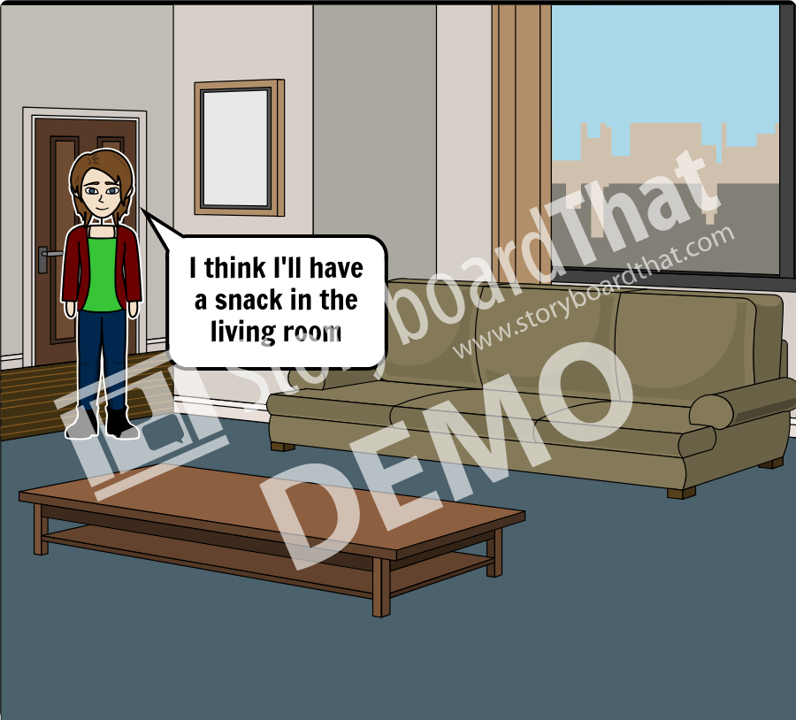
First slide

Slide 3
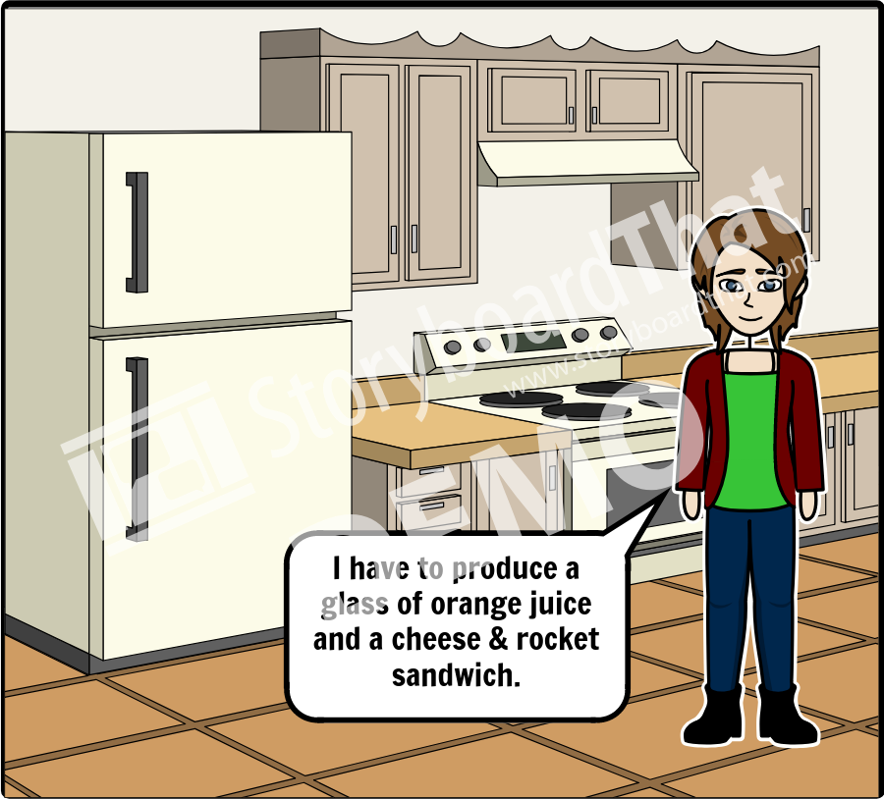
Second slide

Slide 4
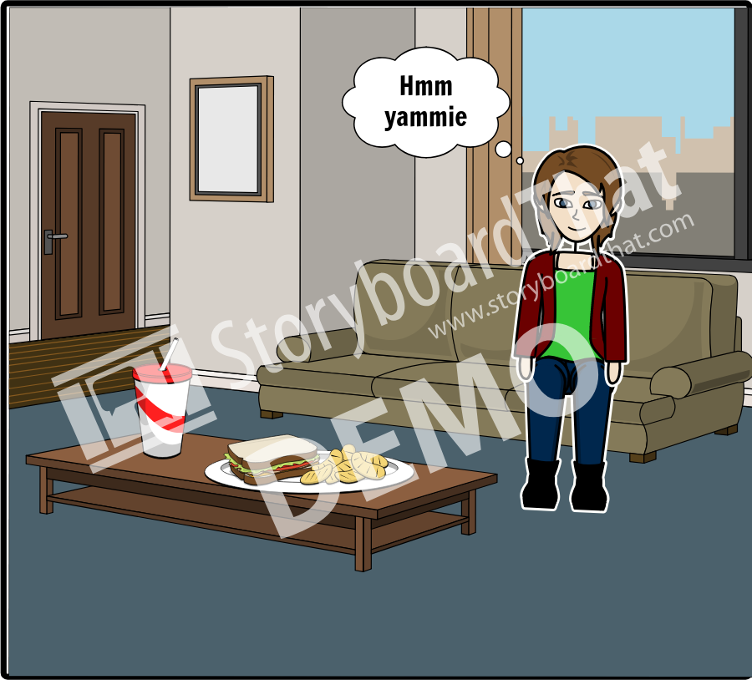
Last slide.

