Slide 1
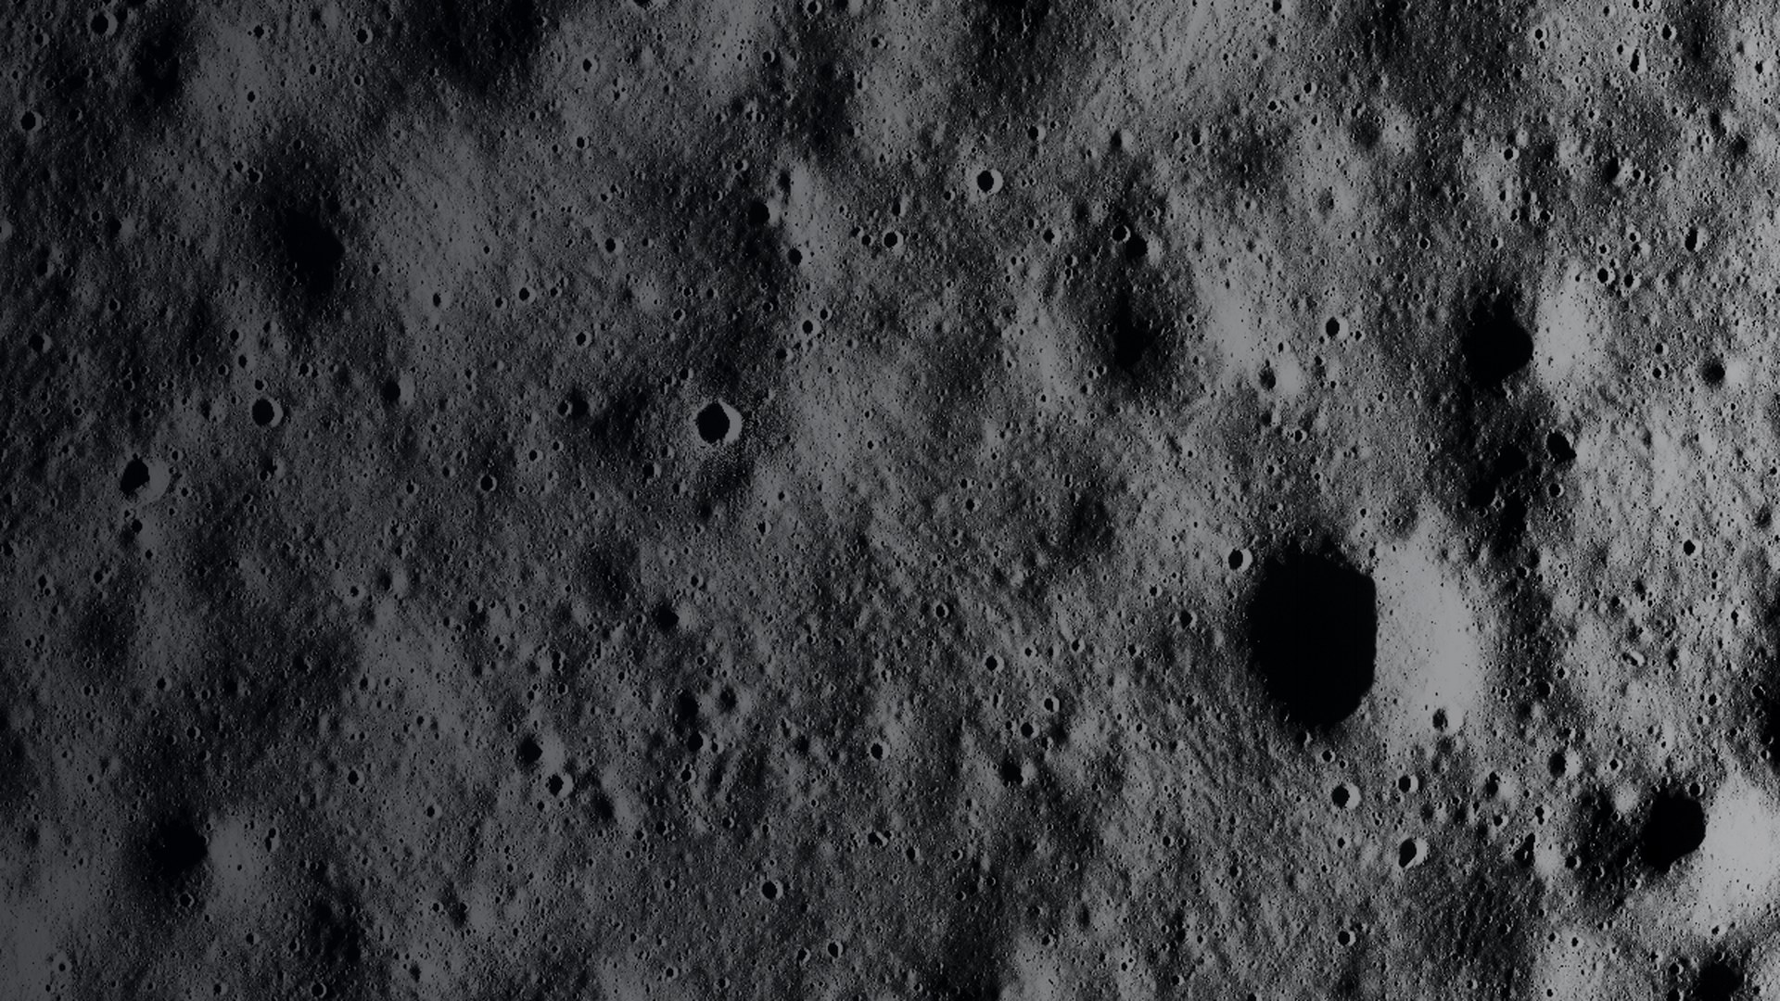
CHANDRAYAAN-2 · OHRC · LUNAR PSR
LunaPSR
A read-only enhancement and analysis system for the Moon’s darkest places.
It makes faint Chandrayaan-2 OHRC images easier to study — and shows exactly what each enhancement step added, without pretending to recover detail that is not in the data.
WHAT IT IS
WHAT IT DOES
WHY IT MATTERS
A software lab for real Chandrayaan-2 OHRC lunar images.
Enhances, compares, measures, and records every derived step.
Permanently shadowed regions are science-rich — but only a few DN above the noise.
For lunar scientists, image analysts, and reviewers who need to know what an enhancement changed.
HONEST BY DESIGN · All enhanced imagery is a derived representation. We do not claim recovered geology, measured SNR, or information the sensor did not collect.
6-slide overview
Notes:
One-sentence version: LunaPSR is a read-only lab that enhances faint Chandrayaan-2 OHRC lunar images and documents exactly what the enhancement added. The next two slides explain the problem and the features; slide 5 gives the honest benchmark.

Slide 2
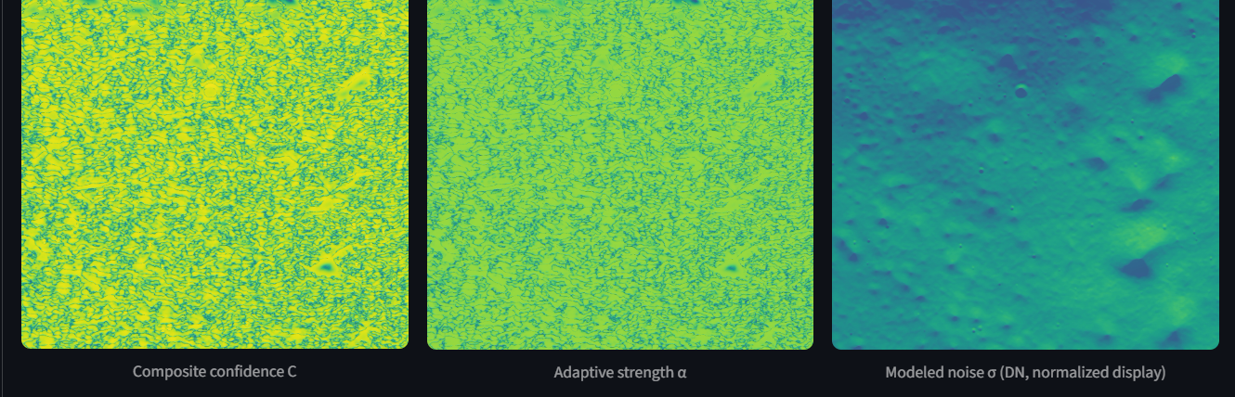
01 · THE PROBLEM IT SOLVES
LunaPSR · 2/6
The signal is barely above the noise.
Permanently Shadowed Regions (PSRs) near the Moon’s poles receive no direct sunlight. OHRC (the Orbiter High Resolution Camera) can image them, but the data are extremely faint — and very easy to over-enhance.
• Weak signal: pixel values rise only 1–5 DN above black in the studied region (mean 3.056). DN is the raw brightness unit.
• Noise: the Phase 4B physics model predicts about 0.511 DN of total noise — a model-based SNR of about 6, not a measured SNR.
• False detail: a global brightness stretch mostly reveals noise. Aggressive Retinex can create edges, textures, and isolated components that were not in the data.
• No audit trail: comparing methods on a 1.2-gigapixel product is slow, inconsistent, and hard to reproduce.
The real problem
An enhanced image can look better while becoming less trustworthy.
Model-based confidence, adaptive strength, and modeled noise — diagnostics, not measurements.
MODEL-BASED · NOT MEASURED
PROBLEMS IT SOLVES
Weak contrast
Noise amplification
False detail
No ground truth
No audit trail
Source: README §2, §12; docs/phase5a_ssr_investigation.md
AN ENHANCEMENT IS NOT EVIDENCE BY ITSELF
Notes:
Plain-language problem statement: the lunar surface here is almost black. A normal brightness stretch makes noise visible; a strong Retinex can invent structure. LunaPSR exists to enhance the data while keeping the evidence about what changed.

Slide 3
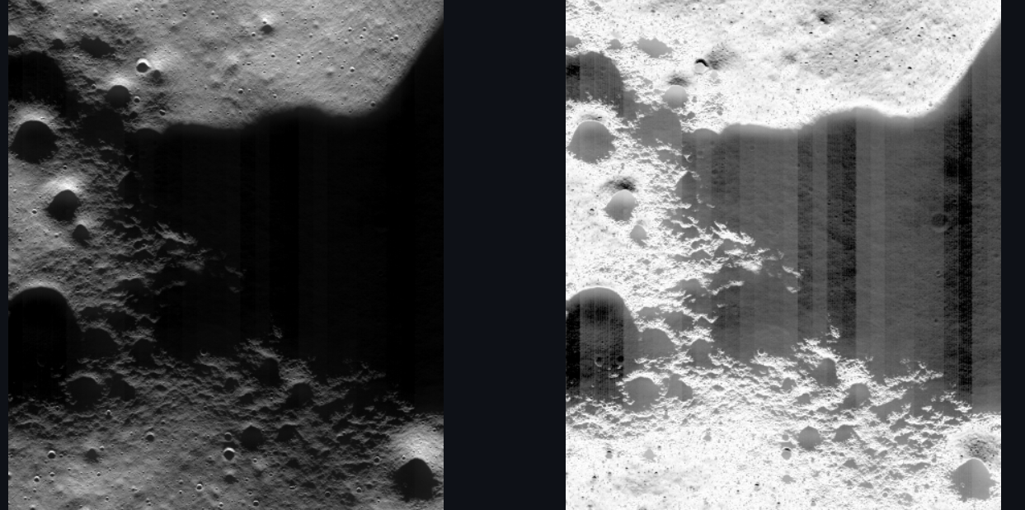
02 · WHAT IT DOES + FEATURES
LunaPSR · 3/6
One workflow: from raw pixels to evidence you can review.
LunaPSR is not a single filter. It is a complete lab for reading, enhancing, comparing, and documenting real lunar images — without modifying the source product.
Real OHRC product
→
Mask & normalize
→
Noise model
→
Enhance
→
Diagnostics & record
FEATURES THAT MATTER
READ-ONLY
NOISE-AWARE
1.2-gigapixel product, memory-mapped; source array never changed.
Model-based SNR and confidence, not ad-hoc contrast.
MULTI-METHOD
DIAGNOSTICS
Gamma, CLAHE, SSR, denoisers, LunaPSR, Adaptive Retinex.
Noise, confidence, structure, and edge-preservation maps.
AUDITABLE
USABLE
Metrics, processing history, JSON / CSV / PNG exports.
9-tab Streamlit lab; 304 tests keep the workflow honest.
The six cards are the practical capabilities — not separate products.
The lab: documented controls, Original / SSR / LunaPSR views, and headline diagnostics.
Every output is derived; every derived step has a record.
Source: README §4–§6; app.py; core/ohrc/
READ-ONLY SOURCE · DERIVED OUTPUTS
Notes:
This is the slide that answers 'what does the project do?' It runs one consistent workflow: read the real product, mask and normalize, model noise, enhance, then measure and save. The six feature cards are the practical capabilities.

Slide 4
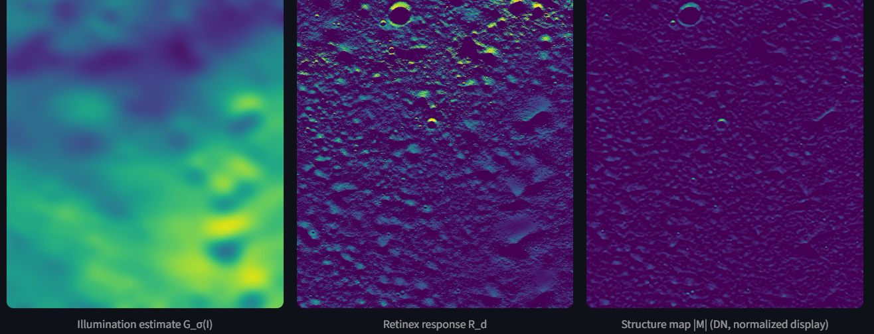
03 · HOW IT WORKS
LunaPSR · 4/6
Enhance only where the signal can support it.
A normal enhancement applies one curve everywhere. LunaPSR uses a physics-based noise model to decide how much enhancement each part of the image can justify.
Real OHRC product
→
Mask & normalize
→
Noise model
→
Adaptive enhancement
→
Diagnostics & record
• Noise is predicted, not guessed. The model combines shot noise, read noise, and quantization noise at each brightness level.
• Two-factor confidence. Is the local signal strong? Is local variation above the modeled noise? Both must agree before enhancement is released.
• Adaptive strength α. It stays conservative where the data look like noise, and increases only where real structure is supported.
• Adaptive Retinex. It separates illumination, robust response, and medium-scale structure instead of applying one global curve to the whole scene.
σ(DN) = √(DN/g + (σread/g)² + 1/12)
IN PLAIN TERMS
gain g is inferred from metadata — not an official calibration claim
The noise model is the gate, not a post-hoc excuse.
Illumination, robust Retinex response, and medium-scale structure used as variation evidence.
Phase 5B prototype — validation ongoing
MODEL-BASED SNR · NOT A MEASURED SNR
Source: docs/phase4b_noise_model.md; docs/phase5b_lunapsr_retinex.md
THE NOISE MODEL IS THE GATE
Notes:
The method in one sentence: estimate what the sensor noise should look like, then hold enhancement back wherever the image variation is consistent with that noise. The formula is shown for completeness; the audience only needs the idea of a gate.

Slide 5
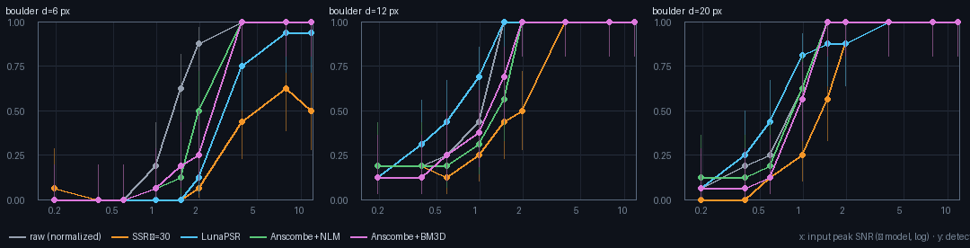
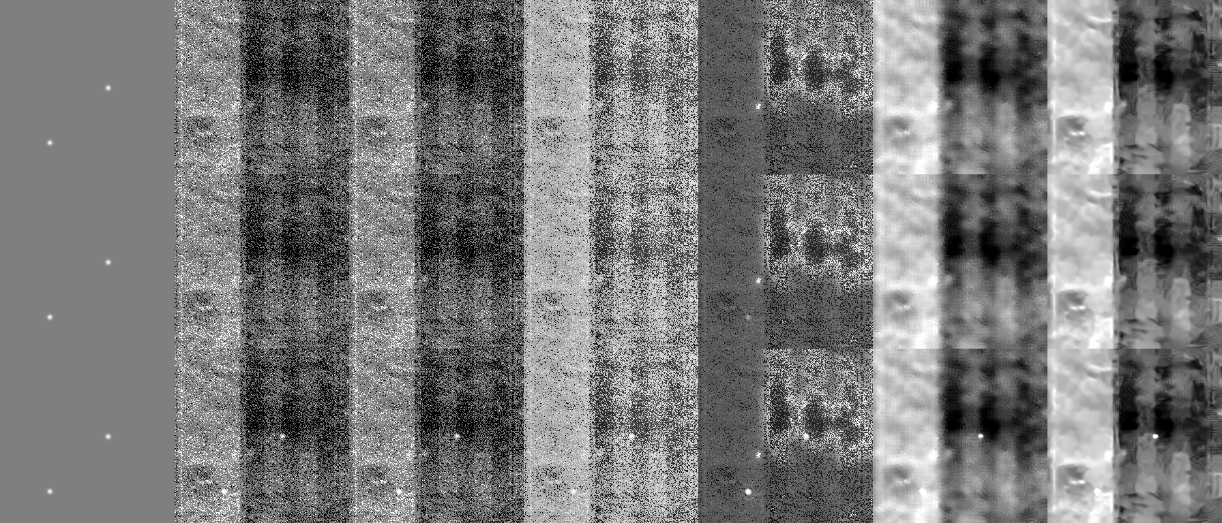
04 · EVIDENCE
LunaPSR · 5/6
We built ground truth — and report where it loses.
Phase 5C injects known craters and boulders into eight real 256×256 OHRC dark tiles. Five methods, one generic detector, per-tile 5% false-positive calibration.
0.882
0.868
0.704
0.638
Raw AUC — best overall
LunaPSR AUC
LunaPSR boulder AUC ≤ 0.5 DN
Raw boulder AUC ≤ 0.5 DN
• Raw wins overall. AUC 0.882 vs 0.868. Enhancement is not required to detect these features.
• LunaPSR has a narrow win. At ≤ 0.5 DN it ties raw overall (0.744 vs 0.742) and leads on faint 12–20 px boulders (0.704 vs 0.638; SSR 0.559).
• It also loses. LunaPSR is the worst method for 6 px boulders and less sensitive than raw for faint craters. SSR amplifies noise ~50×; LunaPSR ~14.5×.
Detection versus injected boulder contrast. The hard regime is low input SNR.
THE HONEST RESULT
A narrow, measurable win — not a clean sweep.
AUC measures how well a method separates real features from background: 0.5 is chance, 1.0 is perfect.
Injected boulders at 12 px: the visual task behind the curves.
Source: docs/phase5c_ground_truth_benchmark.md; outputs/phase5c/
PHASE 5C COMPLETE · 8 TILES · 5 METHODS · 5% FP
Notes:
The benchmark is deliberately adversarial to the project: raw data wins overall. LunaPSR's win is narrow and size-dependent. Say that clearly; it is more credible than claiming a clean sweep.

Slide 6
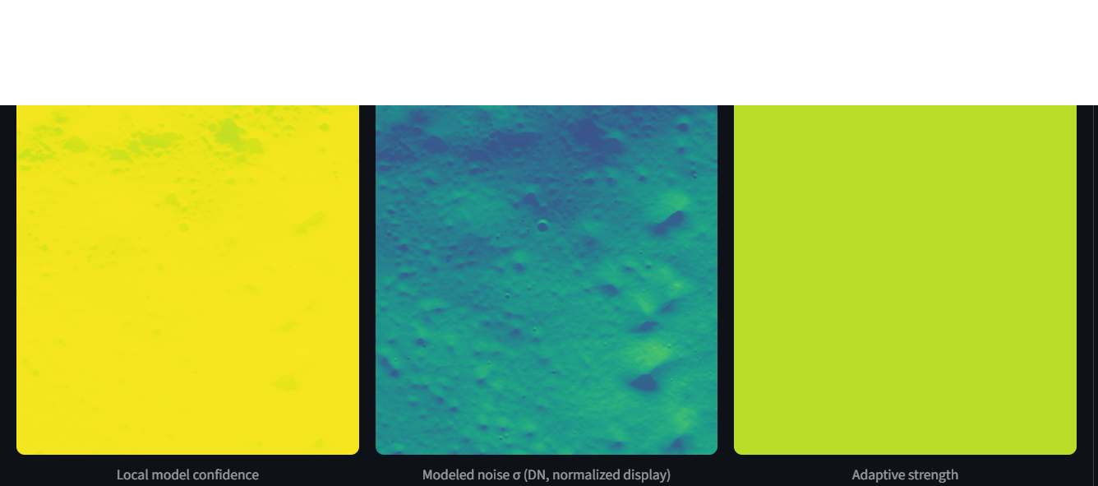
05 · USE IT
LunaPSR · 6/6
What you can do with LunaPSR.
Use it to inspect a real product, compare enhancement methods, and see exactly what each step changed — before you trust the result.
• Inspect a real OHRC product read-only.
• Compare gamma, CLAHE, SSR, denoisers, LunaPSR, and Adaptive Retinex side by side.
• See confidence, noise, structure, and edge diagnostics for every view.
• Export derived images, metrics, and a reproducible run record.
• Run the lab locally with the full 1.2 Gpx product; the cloud demo uses the bundled sample.
CURRENT STATUS
• Phase 5C benchmark: complete.
• Phase 5B Adaptive Retinex: prototype — validation ongoing.
• Live demo: private; the owner can make it public.
Diagnostic maps: local model-based confidence, modeled noise, and adaptive strength.
NEXT
The goal is not a prettier image. It is a more trustworthy analysis.
Validate across more regions · add downstream detection · publish one guided real-tile before/after.
github.com/Mevis-byte/LunaPSR · README §10, §14
DERIVED REPRESENTATION · NOT RECOVERED GEOLOGY
Notes:
Close on use and status. The project is not claiming a finished product: Phase 5C is complete, Phase 5B is still a prototype, and the live demo is private. The ask is to try it and report where it fails.

