Slide 1

AI-Powered Dashboard for Green Infrastructure Siting in South Florida
Ahmed S. Elshall, Ph.D.
Assistant Professor - Environmental Engineering
U.A. Whitaker College of Engineering
Joint Appointment with The Water School
Email: aelshall@fgcu.edu
Mewcha A. Gebremedhin, Ph.D.
Postdoctoral Research Scholar
U.A. Whitaker College of Engineering
Email: mgebremedhin@fgcu.edu
Notes:
Assisted Agents (Level 1): These are AI systems that support scientists in narrow, well-defined tasks.
Examples:
Literature search engines powered by LLMs.
Automated data cleaning or visualization tools.
Machine learning models for prediction (e.g., climate or groundwater models you might use in hydrology).
Key Feature: Human-in-the-loop is essential; the AI only assists.

Slide 2
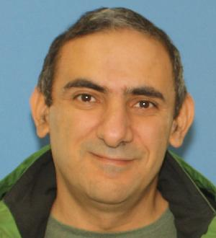
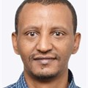
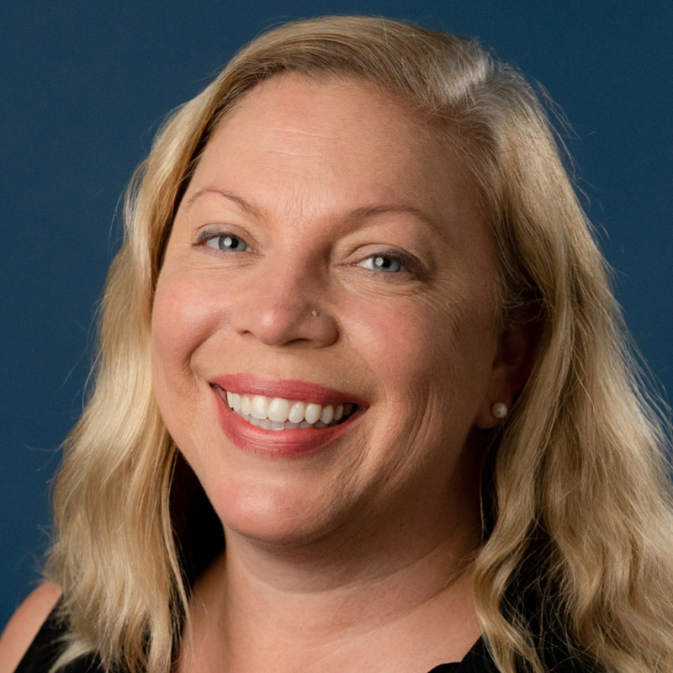
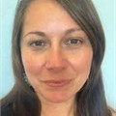

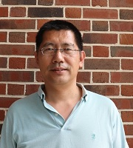



Nature-based Infrastructure for Enhancing Climate Resiliency of Groundwater Resources in South Florida
Ahmed Elshall, WCE and TWS
Mewcha Gebremedhin, WCE
Shelly Krueger, UF
Rachel Rotz, TWS
Seneshaw Tsegaye, WCE
Ming Ye, FSU
USGS Caribbean-Florida Water Science Center

Slide 3
Project Overview
Assess climate change impacts
Evaluate nature-based infrastructure for mitigation (local or regional)
Collaborative modeling
Web-based platform for data sharing
Groundwater education and outreach
Notes:
Quantifying the impacts of climate change on surface-groundwater interactions, groundwater resources, water quality in terms of salinity (undergoing). This is particularly related to the changing rainfall pattern and SLR rise under different scenarios
Collaborating with stakeholders to evaluate nature-based infrastructure for mitigation and adaptation solutions (Next step). This could be at local or regional scale (any suggestion on this would be also appreciated)
Conducting outreach campaigns to increase community awareness about the resilience of groundwater resources in South Florida (using different outlet medias).
Developing a user-friendly web-based platform to provide stakeholders with access to project data, supporting decision-making and community engagement. This helps to the goal of making data FAIR: Findable, Accessible, Interoperable, and Reusable

Slide 4
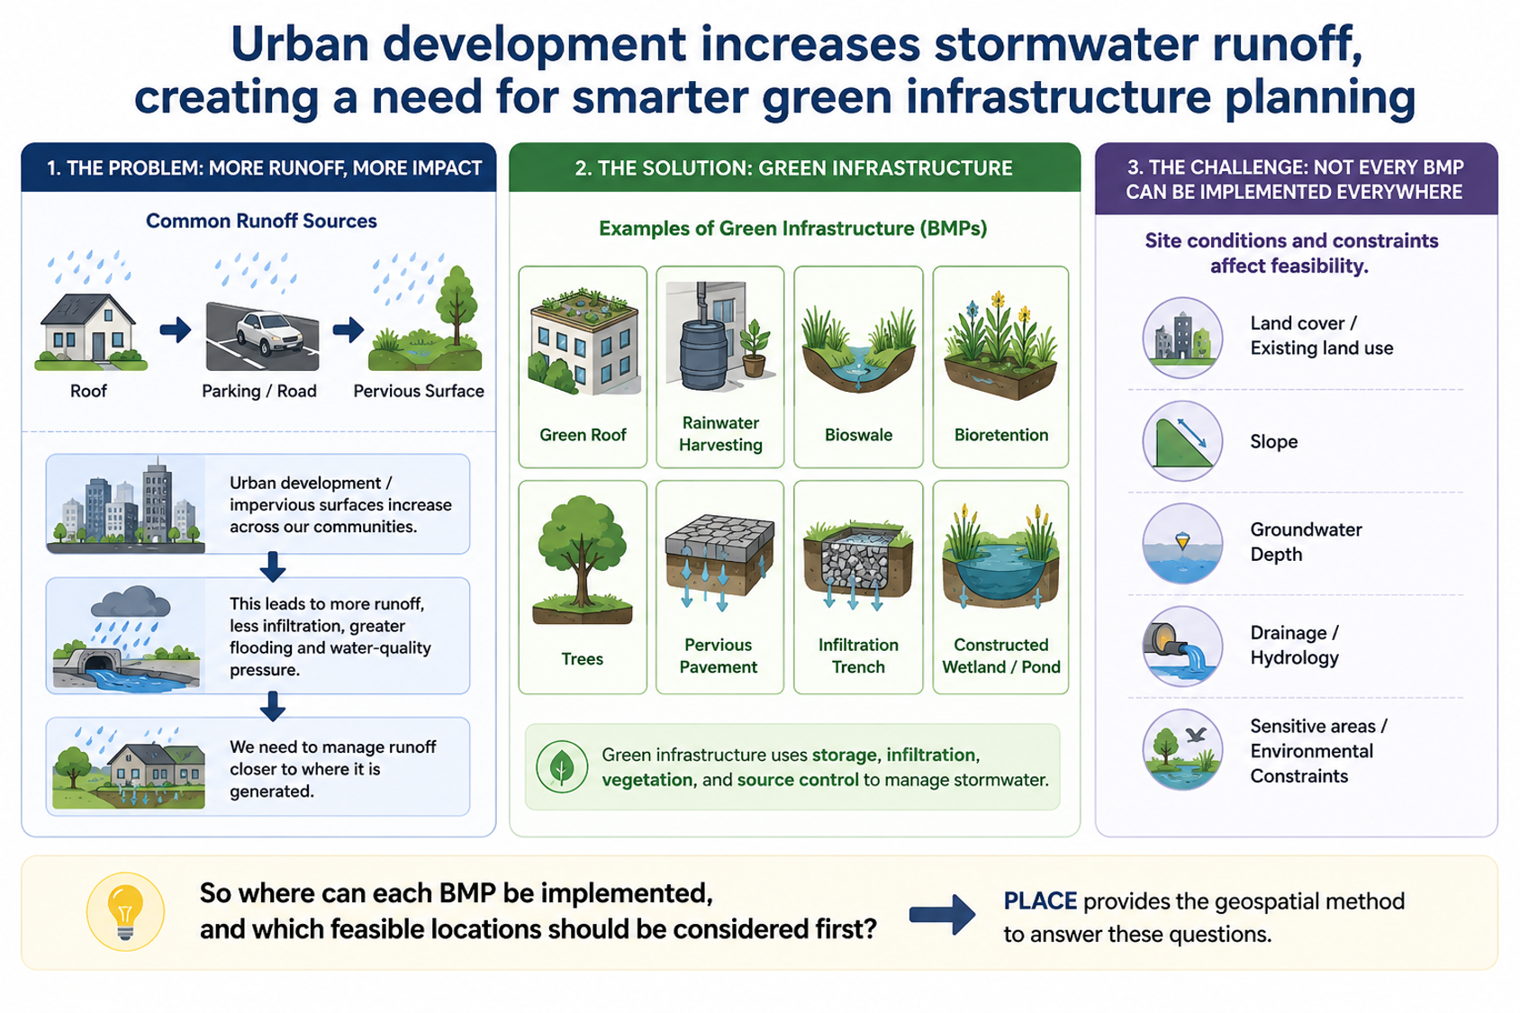


Urban development increases stormwater runoff creating a need for effective green infrastructure planning
Gray infrastructure
Green infrastructure
GI PLACE: Geospatial method for BMPs placement
ChatGPT generated icons
Notes:
Urban development-> impervious surface -> increased surface runoff
Gray infrastructure: Collect and drain (less infiltration, increased flooding, water quality issues)
Green infrastructure: Manage runoff closer to where it generated (nature-bases solution)
Green infrastructure use storage, infiltration, vegetation, and source control to manage stormwater
Not every BMP can be implemented everywhere:
Site conditions
Green infrastructure can reduce urban stormwater impacts, but effective implementation requires spatial planning
So where can each BMP be implemented, and which feasible locations should be considered first?
PLACE provides the geospatial method for answering these questions.

Slide 5
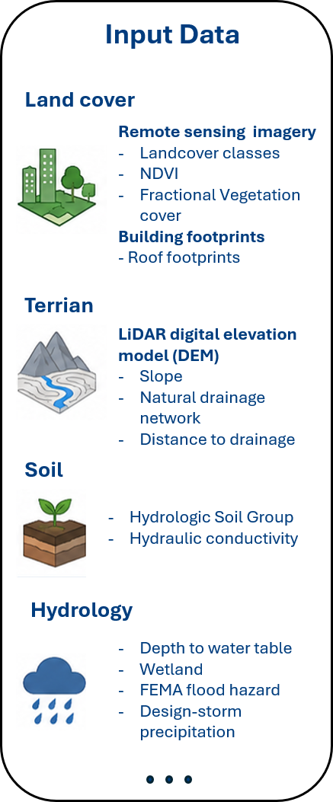
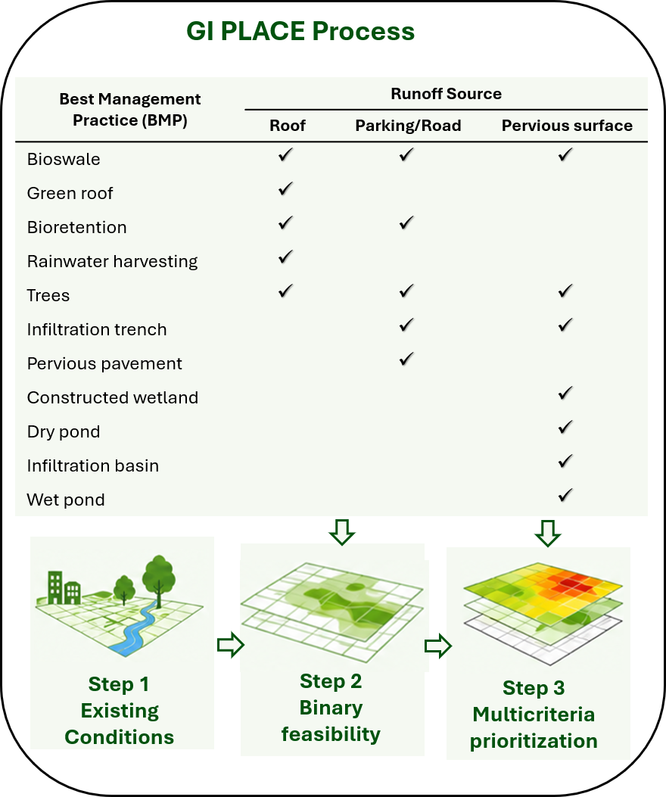
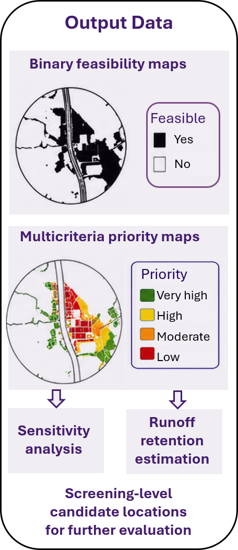
Turning GI PLACE to interactive green infrastructure planning dashboard

Slide 6
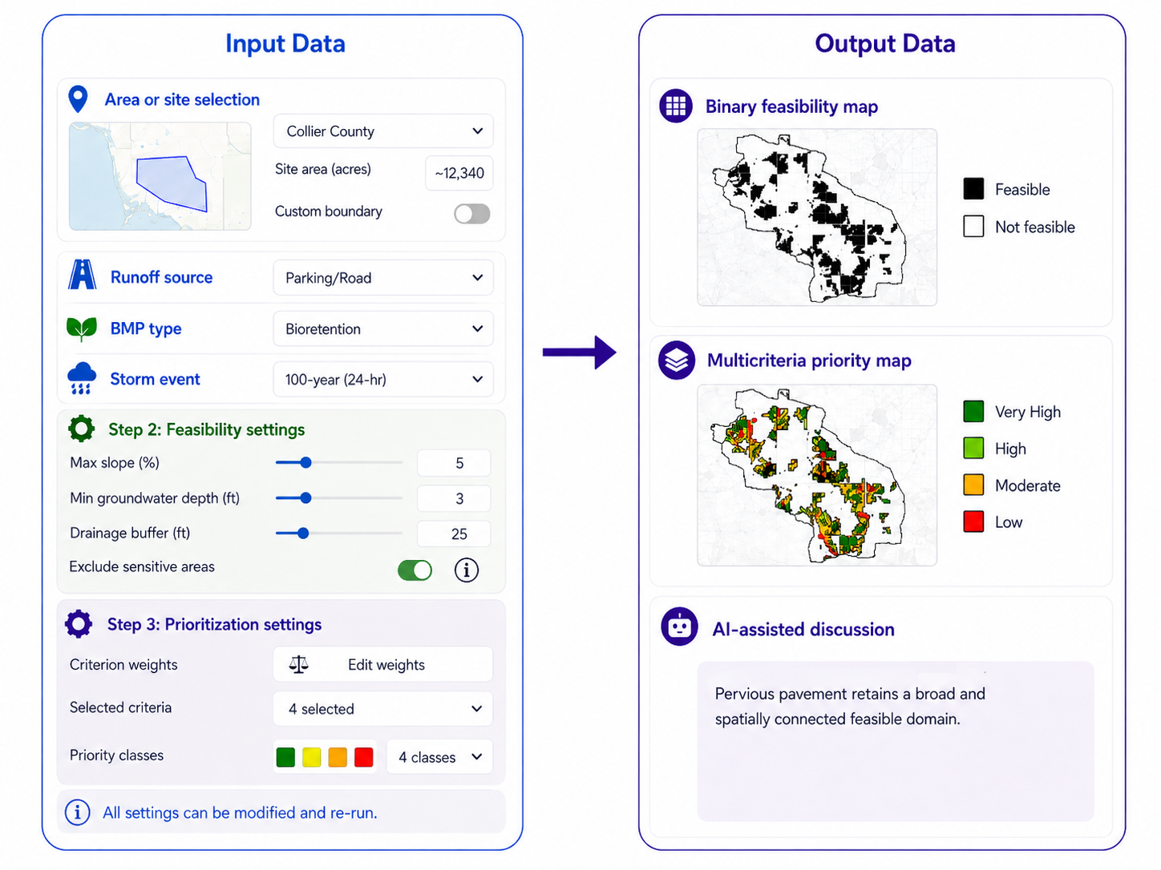
Interactive AI-powered dashboard: From user-defined setting to site-specific green infrastructure planning
Instructed ChatGPT generated image
Notes:
Interactive AI-powered dashboard for identifying and prioritizing green infrastructure locations for stormwater management

Slide 7
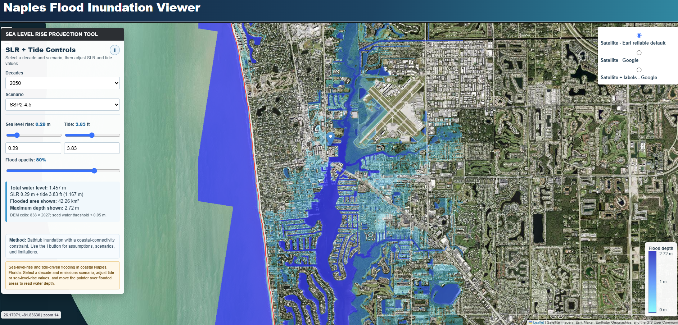
Project 2: Integrating bathtub inundation modeling and LLMs for coastal flood screening in South Florida

Slide 8
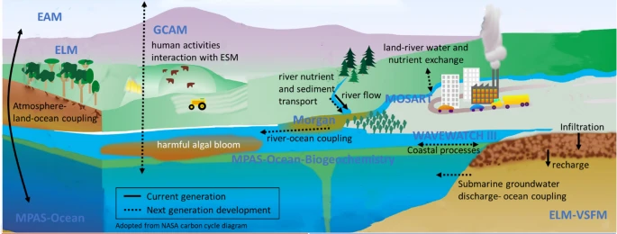

Project 3: Scenario analysis of nutrient loading mitigation to reduce red tide task using machine learning models
Notes:
Scenario Analysis of Nutrient Loading Mitigation to Reduce Red Tide Risk: Involves enhancing harmful algal bloom mitigation through advanced machine learning with feature analysis

Slide 9
Project support
Provide project datasets and guidance on Python packages
Assist with the design of browser-based UI
Manuscript mentorship for high-quality peer-reviewed publication
Cover open-access publication fees
Provide full travel support for 1 student (or 2 going together) to present at a national conference (e.g., AGU Fall Meeting, San Francisco)
Collaborative teamwork through the project
Service-learning hours
Notes:
Project datasets and workflows, plus guidance on required Python packages
Frontend guidance for a browser-based UI
Manuscript mentorship with the goal of a high-quality peer-reviewed publication (beyond a capstone report)
Open-access publication fees covered
Travel support for 1 student (or 2 going together) to present at a national conference (e.g., AGU Fall Meeting, San Francisco - One week).
Hands-on experience with geospatial big data
Graduate school preparation
Strong resume (working on an EPA funded grant and CMIP6 data)

Slide 10
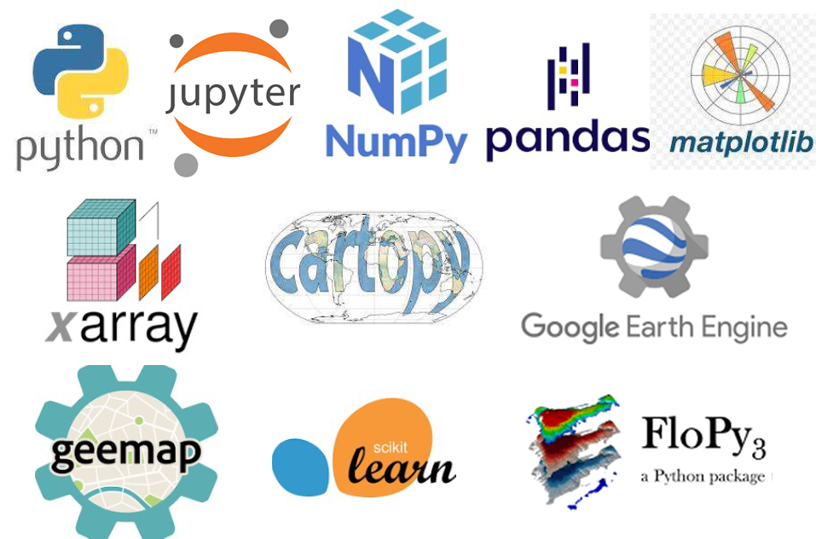

Scan for more Information and to apply
Advertisement: LA Position for Spring 2026
EGN 4930 / EGN 5932C
Environmental Data Science

Slide 11

Thank You
Questions?
https://aselshall.github.io/ads/ai
Scan for slides and more information

