Slide 1

Impact of Future Rainfall and Sea-Level Rise on Groundwater-Surface Water Interaction and Salinity in South Florida
Mewcha A. Gebremedhin, FGCU
Ahmed S. Elshall, FGCU
Ming Ye, FSU
Seneshaw Tsegaye, FGCU
Rachel Rotz, FGCU
Notes:
Groundwater–surface water interaction and salinity responses to projected rainfall and sea-level rise in South Florida

Slide 2


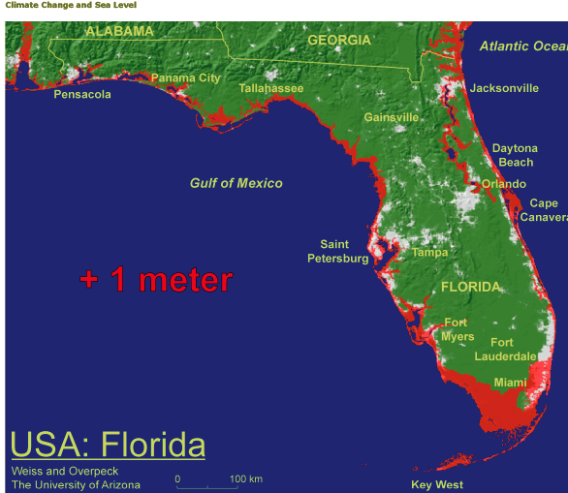
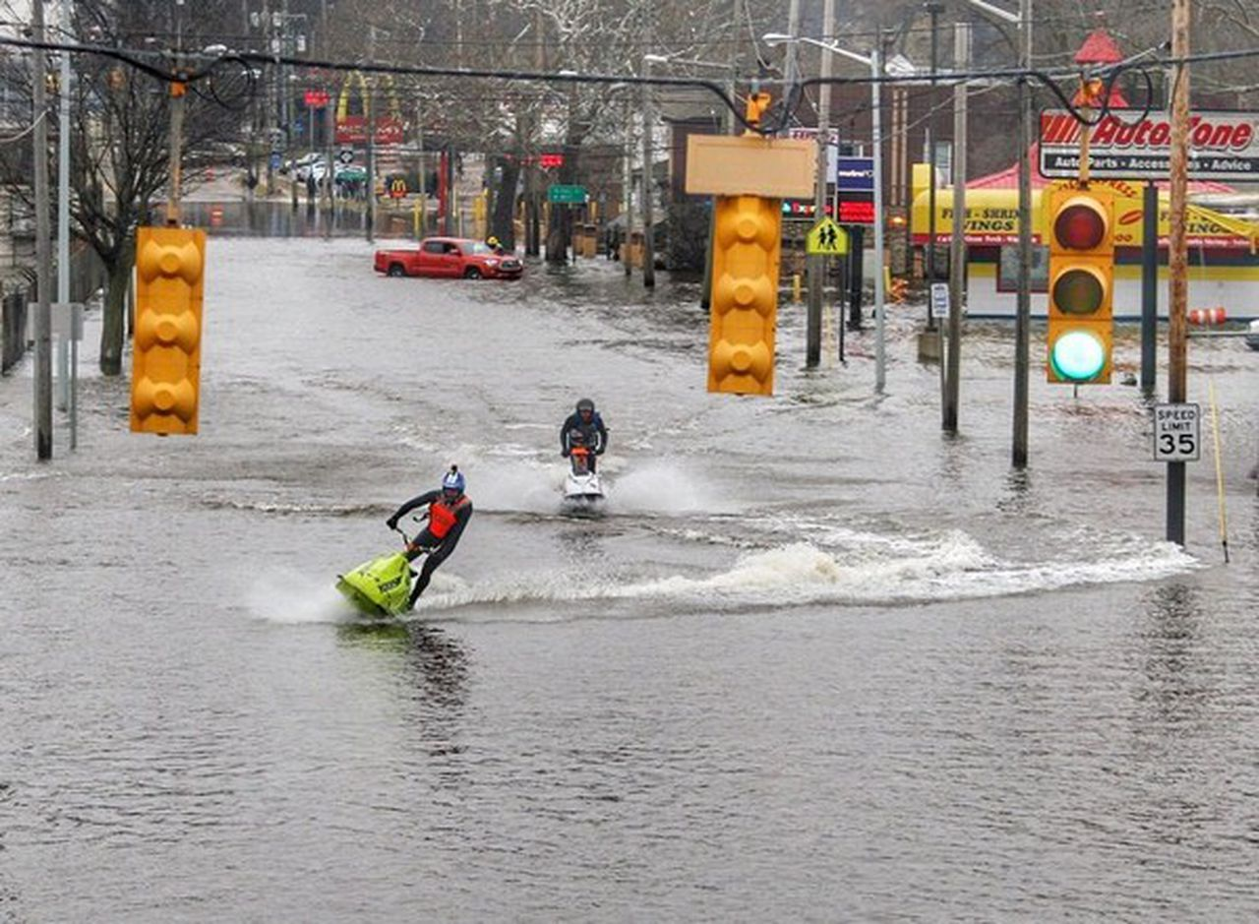
Climate change drives hydrologic system dynamics
Sea-level rise
Changing precipitation patterns
Credit: Brent Thomas
Notes:
South Florida hydrologic system is dynamic and complex, often called "ground-zero" for climate change impact.
These changes also affect the groundwater

Slide 3
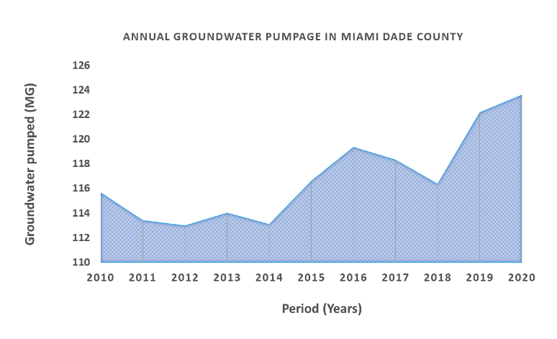
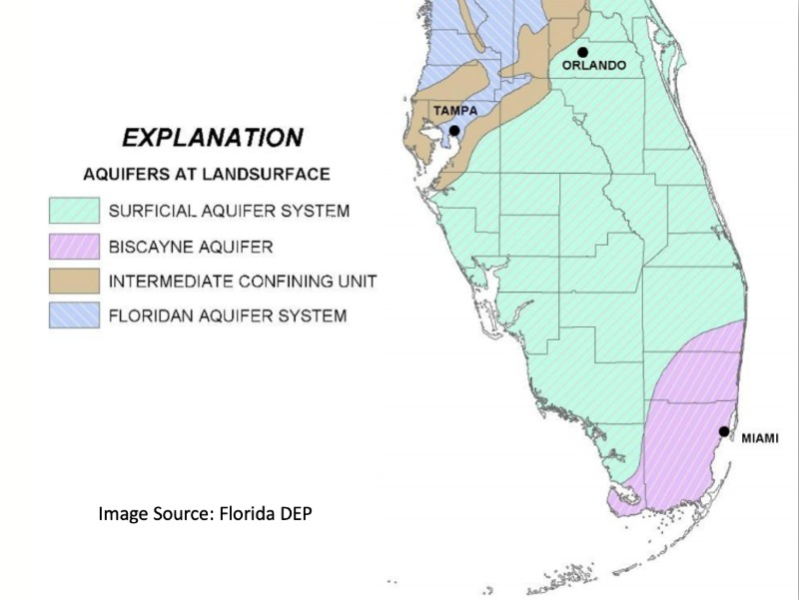


Groundwater is the main source of freshwater supply
10%
8%
https://www.evergladesfoundation.org/post/drinking-from-the-everglades
Notes:
Groundwater: agriculture, drinking, sanitation, ecology
Biscayne Aquifer: high permeability and direct connection to the sea

Slide 4
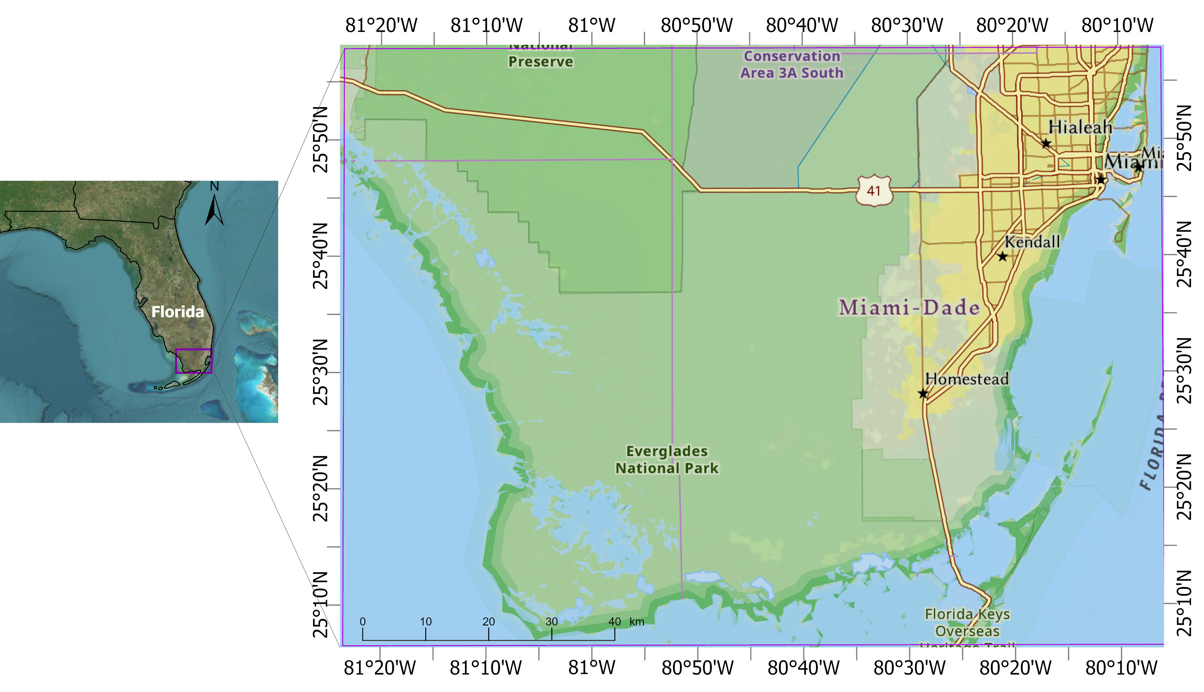
The study domain covers urban and wetland sub-areas

Slide 5
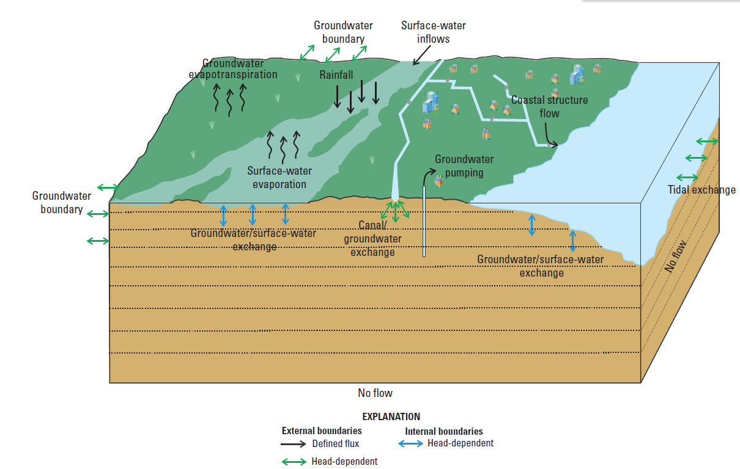
Density-dependent integrated hydrological model
CMIP6-based Multi-model Hydroclimate Projection over the Conterminous US (CONUS)
NASA Sea Level Projection Tool
Slough
GCM rainfall evaluation
Select best performing
BISECT model validation
Baseline (2011-2019)
Projection run
Near-future under SSP2-4.5 (2051-2059)
Near-future under SSP5-8.5 (2051-2059)
Far-future under SSP2-4.5 (2091-2099)
Far-future under SSP5-8.5 (2091-2099)
Implications of study
Conceptual model of the hydrologic system of the Biscayne and Southern Everglades Coastal Transport (BISECT) model (Swain et al., 20219)
Notes:
Overland flow receives water and solutes from canal are classified as external boundaries to the model, as they represent interactions with hydrology outside what is simulated.
Biscayne and Southern Everglades Coastal Transport (BISECT) Model is a combination of the Tides and Inflows to the Mangrove Everglades (TIME) and Biscayne models
BISECT assess the effects of sea-level rise, climate change, and human activities on water resources
BISECT simulates hydrodynamic SW-GW interaction flow in the surficial aquifer system of south Florida
State variables: surface-water stage, discharge (coastal streamflow ), head, salinity, surface-water-temperature (what is its implication for the future)
adjustments of frictional resistance in the wetlands: included some significant Manning’s n adjustments designed to promote additional marsh surface-water migration to Taylor Slough and create better agreement between simulated and measured flows.
Simulated variations in flow to the Everglades coastal streams are substantially affected by groundwater/surface-water interactions in the eastern urban areas.
interactions among water, ecology,human systems
The BISECT is well suited for simulating future conditions including sea-level rise with future rainfall and temperature data downscaled from global climate models.
Urbanization and human activities can modify surface roughness, influencing the assigned nnn.
Model Refinements: Several enhancements were made relative to the original models to better represent the hydrologic system . These include using more detailed topography, refining Manning’s n roughness coefficients, implementing spatially-variable surface albedo to improve evapotranspiration calculations, increasing the vertical resolution of the aquifer (more model layers) to capture the freshwater–saltwater interface, and extending model boundaries farther offshore

Slide 6
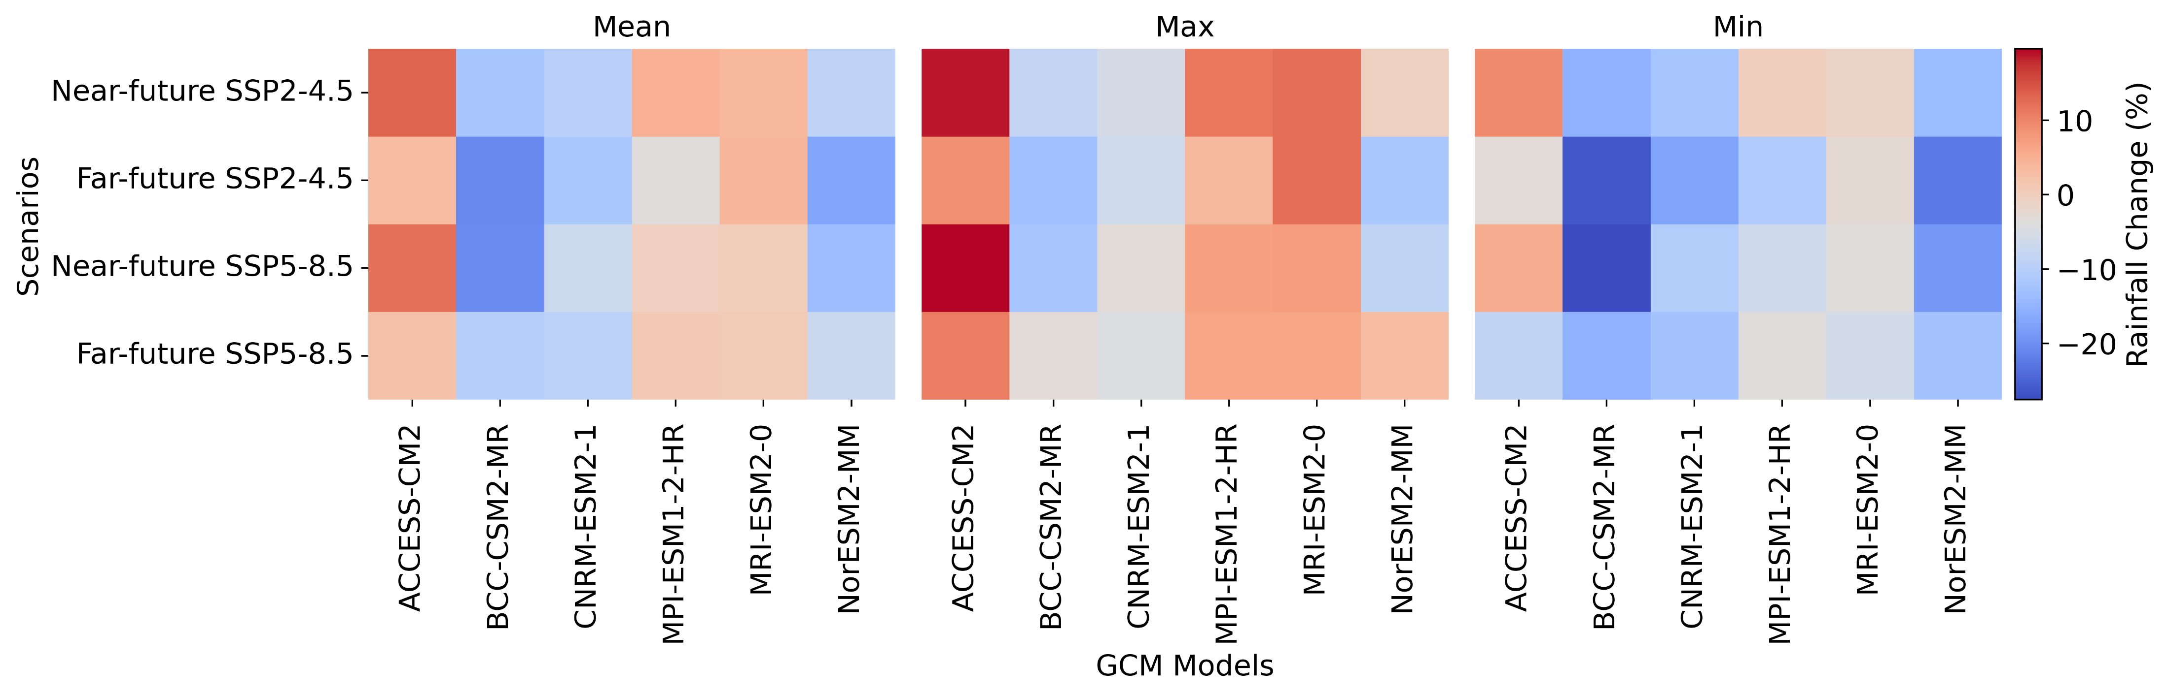
Evaluation of GCM rainfall projections revealed varying spatial patterns of rainfall
Relatively ACCESS-CM2 model perform better based different correlation and error metrics
Notes:
The downscaled data sources have been used in various regional scale hydro-climate risk assessment, including but not limited to evaluations of climate change impacts on hydrology, reservoir operations, hydropower generation, future energy demand and climate extreme events (Rastogi et al., 2022).

Slide 7
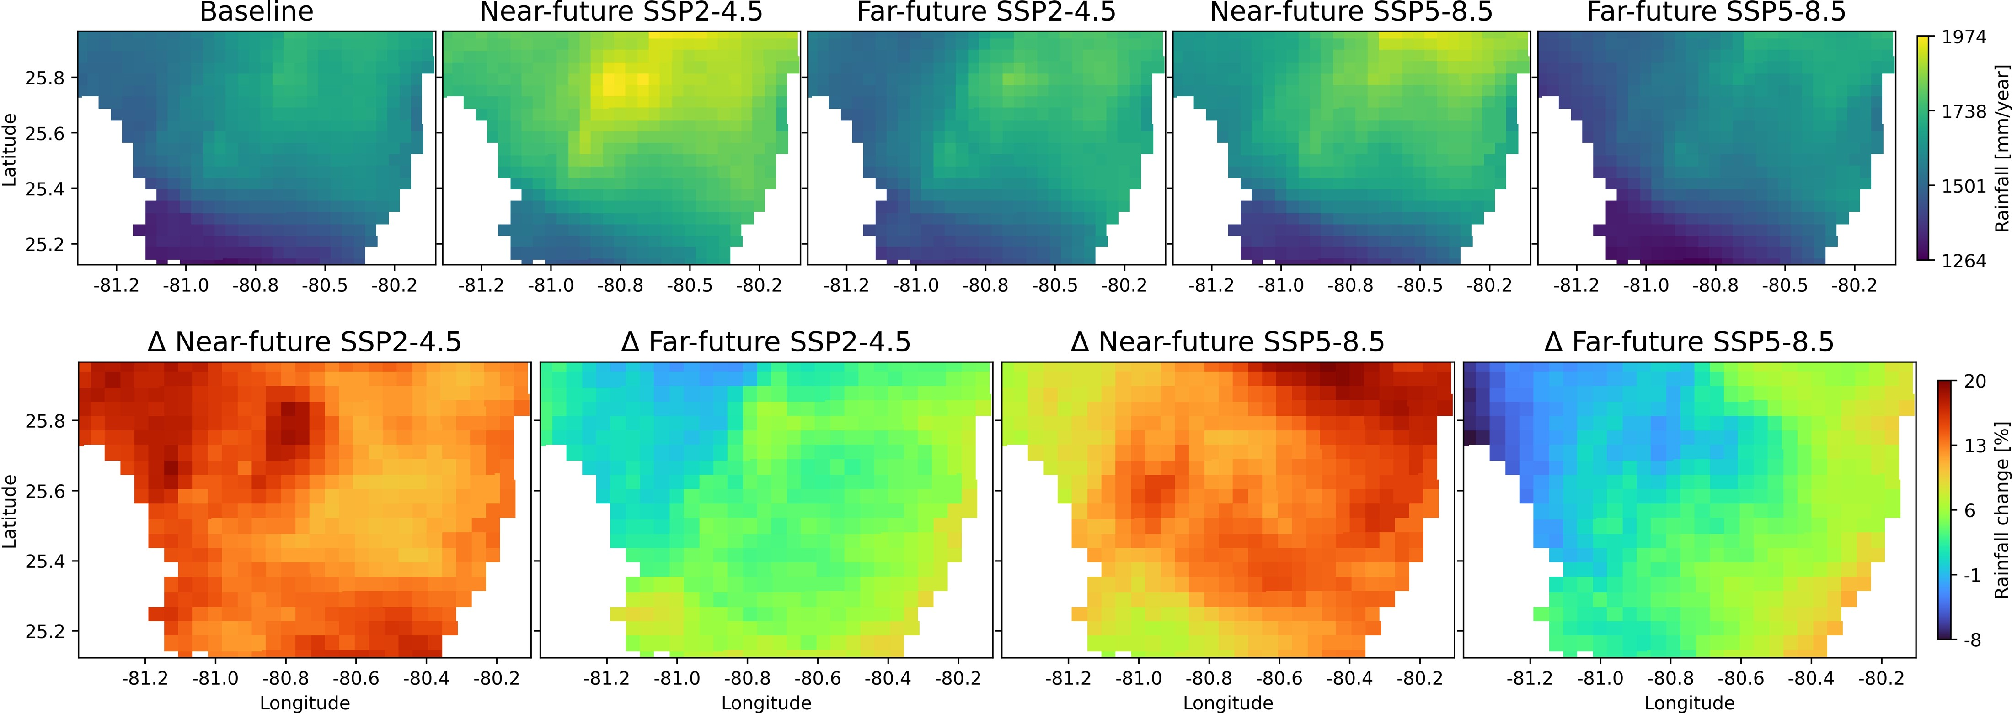
ACCESS-CM2 model projections presented increasing pattern
Mean
13.2%
3.4%
12.1%
2.4%
Notes:
These results highlighted that while moderate emissions scenarios may result in modest rainfall gains, continued high emissions could slightly decrease in rainfall across parts of the study area.

Slide 8
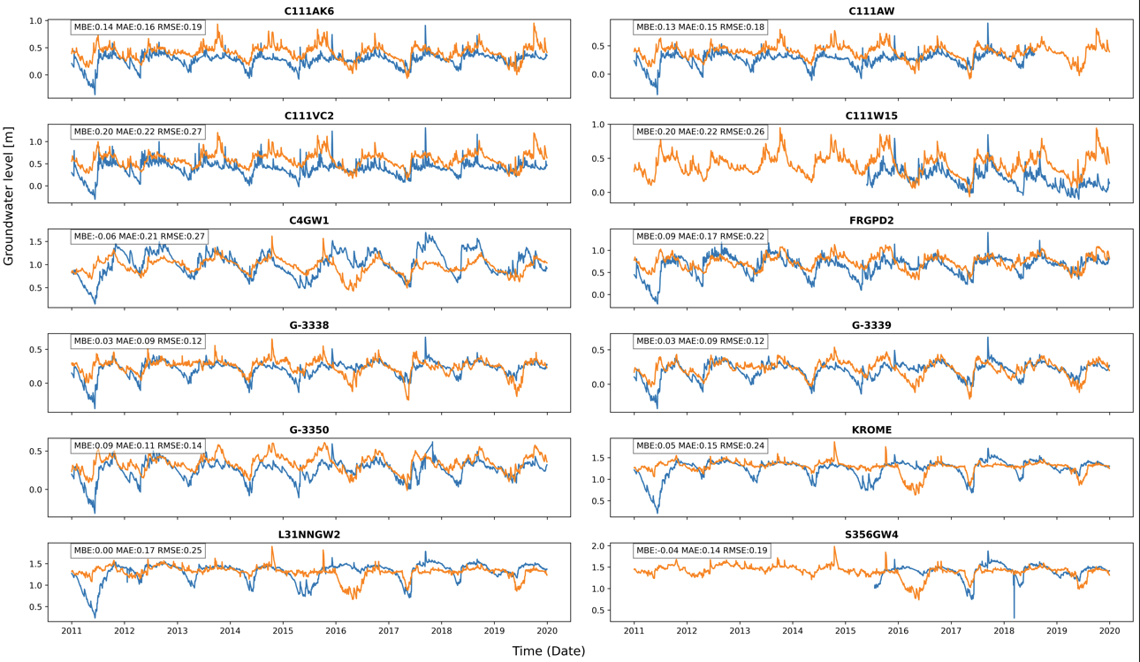
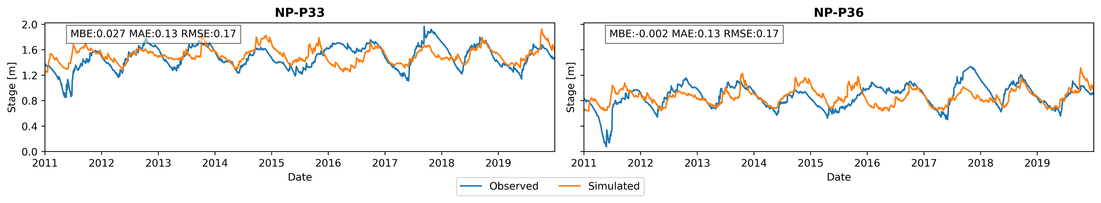
BISECT model validation captures the overall observed trend
Notes:
Variation in model performance across different well locations
Hydrogeological heterogeneity boundary conditions
nearby water bodies
pumping activities
spatial scale differences

Slide 9
Future surface salinity & temperature change
P1: G-3350 groundwater well in the Miami-Dade
P2 : Mahogany Hammock site within Everglades National Park
Notes:
Aquatic plants cannot tolerate this salinity level

Slide 10
Projected recharge exhibited spatio-temporal variability
Notes:
Sea level rise can elevate canal water levels even during dry periods, increasing hydraulic head and promoting greater recharge to the groundwater system. This can raise the groundwater table and heighten flood risk during subsequent heavy storm events.

Slide 11
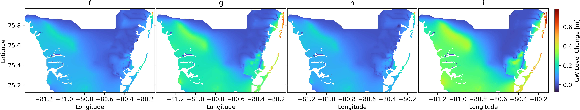
Groundwater water level projected to increase in the future
Higher rise is marked within Miami Beach to Bal Harbour (~1 m)
Notes:
Groundwater hydrologist may be happy with the groundwater level increase, but how about the water quality issue and flood.

Slide 12
Future scenarios indicate a pronounced reduction in groundwater evapotranspiration in the coastal areas
Notes:
This change indicated the change in SW-GW interactions

Slide 13
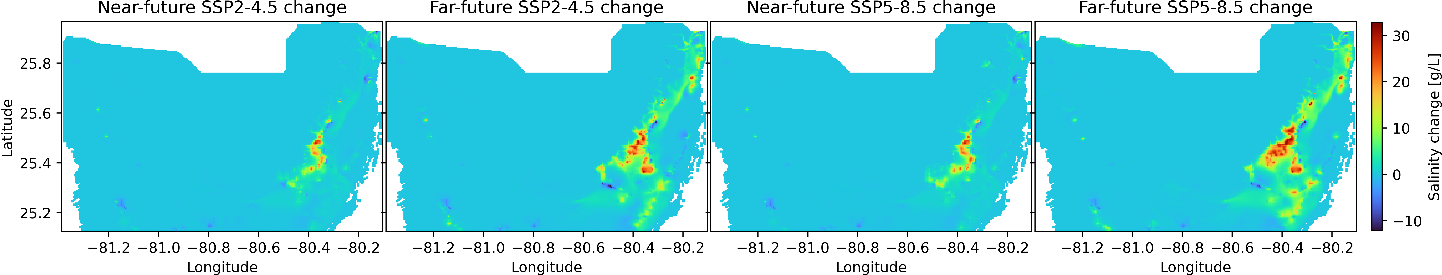
Projected groundwater salinity increases in the future
GW salinity at Layer 6

Slide 14
Modeling output implications
Water quality issues that may require expensive interventions
Flooding and infrastructure damage
Ecosystem change, including loss of habitats due hydrological changes like shifting surface-groundwater interactions
Nature-based tourism concern, tourism and other ecosystem services in South Florida are tied to the sustainable health of the Everglades and coastal environments
Notes:
desalination or relocation of wellfields

Slide 15



