Slide 1



Nature-based Infrastructure for Enhancing Climate Resiliency of Groundwater Resources in South Florida: An Integrated Modeling Approach ¹ Department of Bioengineering, Civil Engineering, and Environmental Engineering, U.A. Whitaker College of Engineering, Florida Gulf Coast University, Fort Myers, FL, USA ² Department of Earth, Ocean, and Atmospheric Science, Florida State University, Tallahassee, FL, USA ³ Environmental Geology Program, The Water School, Florida Gulf Coast University, Fort Myers, FL, USA
Mewcha Amha Gebremedhin¹, Ahmed S. Elshall¹, Ming Ye², Seneshaw Tsegaye¹, Rachel Rotz³
16 June 2025
Notes:
This project aligns with the call for proposal "Addressing Climate Resiliency through Nature Based
Infrastructure“
The project focuses on addressing the challenges of sea-level rise, changing precipitation patterns, and
rapid socioeconomic development, which pose threats to groundwater and community resilience in South
Florida

Slide 2
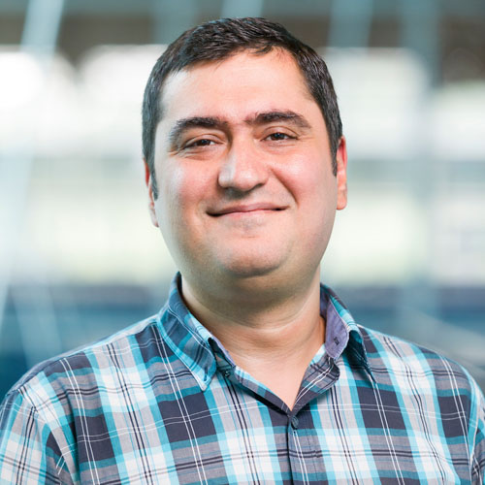


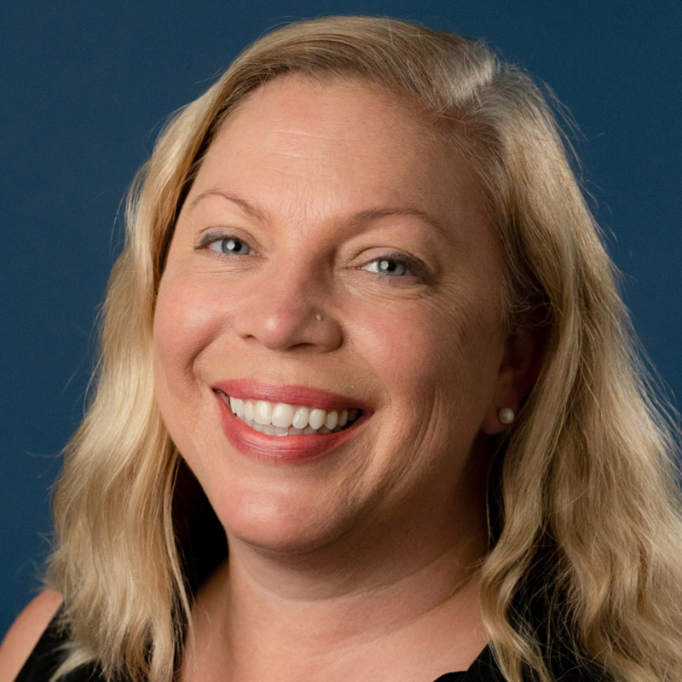










Team members
Ebrahim Ahmadisharaf|FSU
Ahmed Elshall|FGCU
Mewcha Gebremedhin|FGCU
Shelly Krueger|UF
Rachel Rotz|FGCU
Seneshaw Tsegaye|FGCU
Ming Ye|FSU

Slide 3
Project framework
Assess climate change impacts
Evaluate nature-based infrastructure for mitigation (local or regional)
Collaborative modeling
Web-based platform for data sharing
Groundwater education and outreach
Notes:
Quantifying the impacts of climate change on surface-groundwater interactions, groundwater resources, water quality in terms of salinity (undergoing). This is particularly related to the changing rainfall pattern and SLR rise under different scenarios
Collaborating with stakeholders to evaluate nature-based infrastructure for mitigation and adaptation solutions (Next step). This could be at local or regional scale (any suggestion on this would be also appreciated)
Conducting outreach campaigns to increase community awareness about the resilience of groundwater resources in South Florida (using different outlet medias).
Developing a user-friendly web-based platform to provide stakeholders with access to project data, supporting decision-making and community engagement. This helps to the goal of making data FAIR: Findable, Accessible, Interoperable, and Reusable

Slide 4
Future Climate Change Impacts on Surface-Groundwater Interactions and Salinization in South Florida

Slide 5
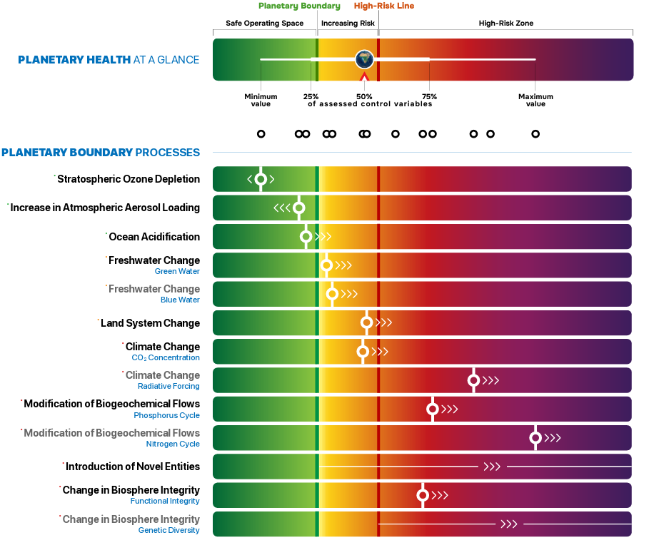
Planetary health
Planetary health
Source: Planetary Health Check 2024. Design: Globaia

Slide 6

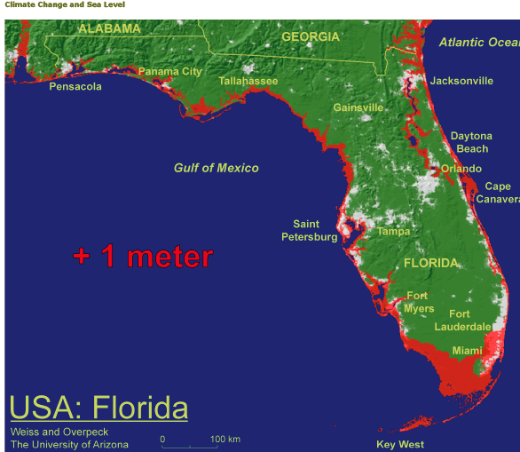
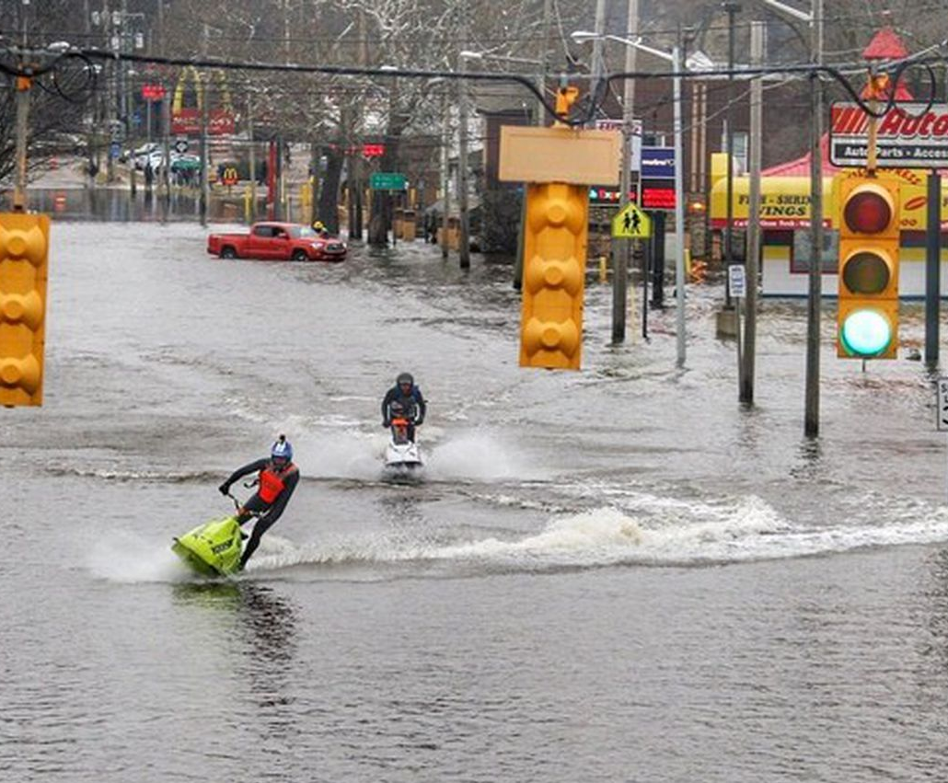
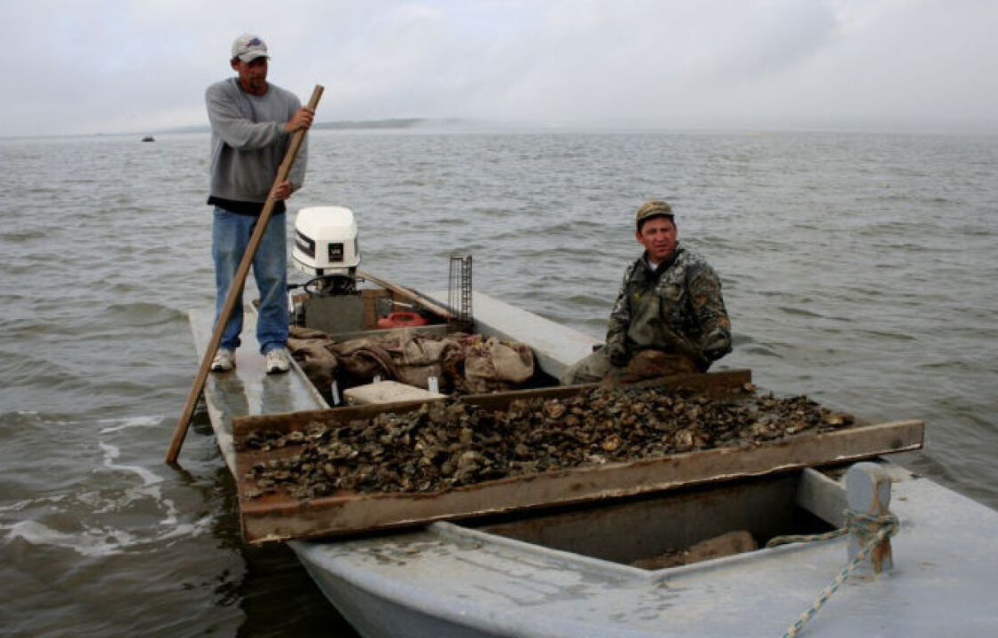
Climate change
South Florida hydrologic system is dynamic, complex and vulnerable to the climate change impacts
Sea-level rise
Changing precipitation patterns
Rapid socioeconomic development
Credit: Florida Fish and Wildlife Conservation Commission (FWC)
FWC approves plan in 2020 to suspend wild oyster harvest from Apalachicola Bay for 5 years
Credit: Brent Thomas

Slide 7
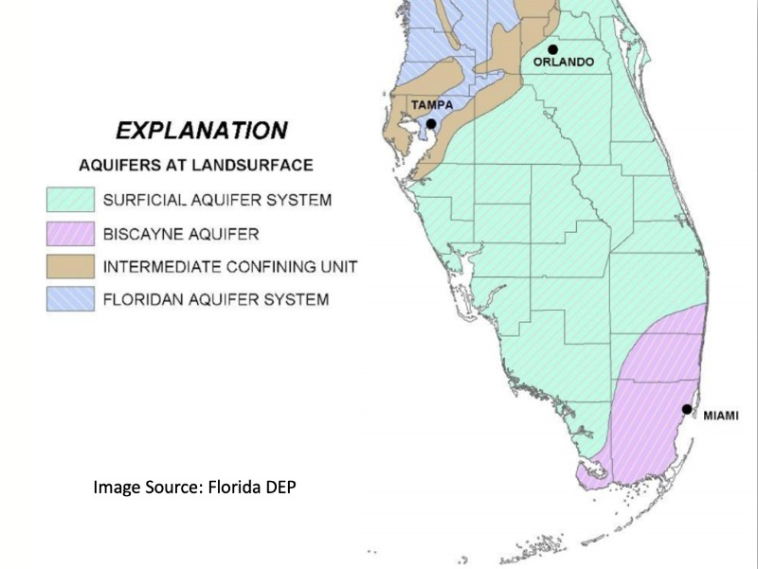
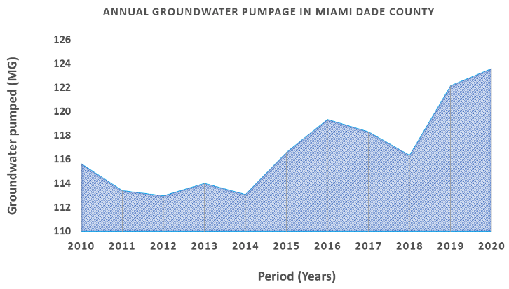


Freshwater
Groundwater is the main source of freshwater supply
10%
Changing precipitation patterns
8%
Sea-level rise
https://www.evergladesfoundation.org/post/drinking-from-the-everglades
Assessing the response of surface water-groundwater interactions and water quality to future climate change is crucial
Notes:
Groundwater: agriculture, drinking, sanitation, ecology
Biscayne Aquifer: high permeability and direct connection to the sea

Slide 8
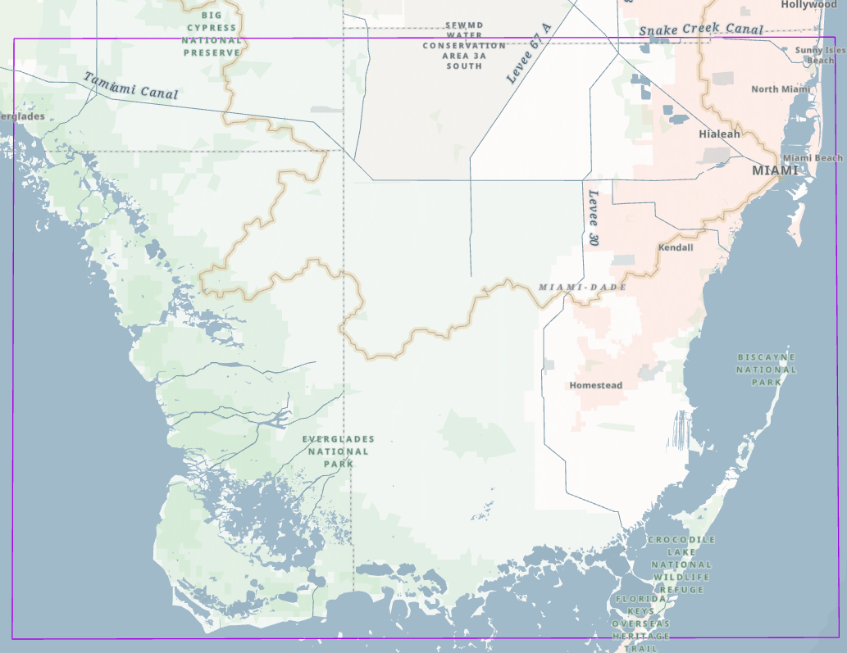
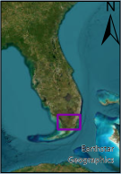
Study area
The same boundary to the Biscayne and Southern Everglades Coastal Transport (BISECT) domain
Complex hydrologic system
Near flat land
7,300 km² land area and 2,700 km² of surrounding marine waters
Grid resolution: 500m

Slide 9
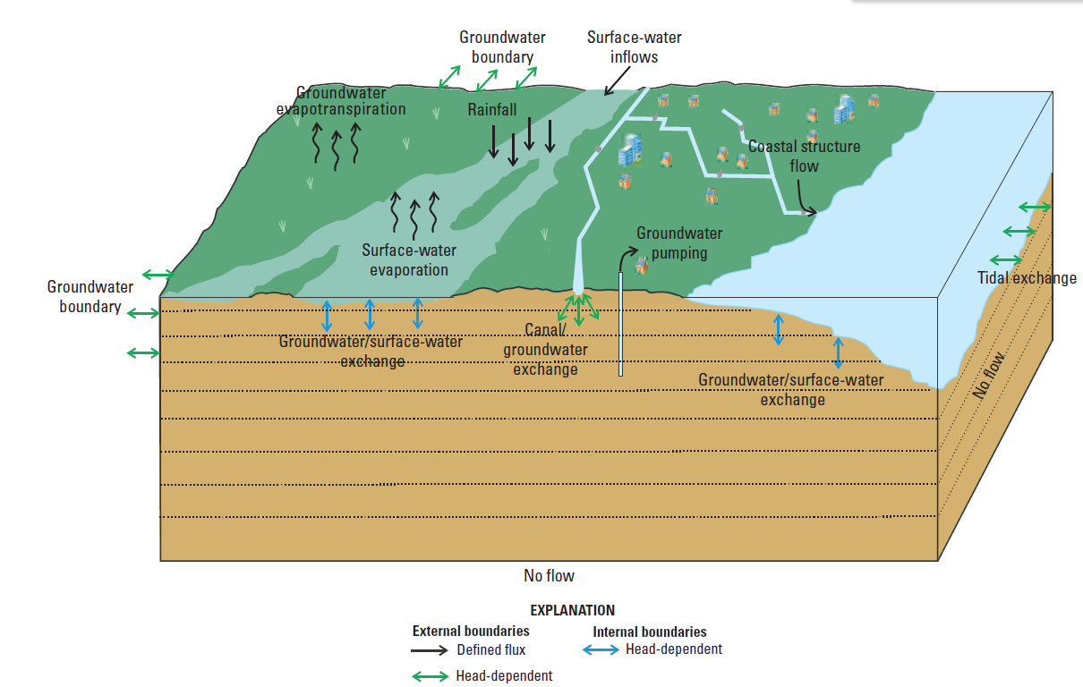
Approaches: Integrated hydrological model
CMIP6-based Multi-model Hydroclimate Projection over the Conterminous US (CONUS)
NASA Sea Level Projection Tool
GCM rainfall evaluation
Select best performing
Slough
BISECT model validation
Baseline (2011-2019)
Projection run
Near-future under SSP2-4.5 (2051-2059)
Near-future under SSP5-8.5 (2051-2059)
Far-future under SSP2-4.5 (2091-2099)
Far-future under SSP5-8.5 (2091-2099)
Implications of study
Conceptual model of the hydrologic system of the Biscayne and Southern Everglades Coastal Transport (BISECT) model (Swain et al., 20219)
Notes:
Overland flow receives water and solutes from canal are classified as external boundaries to the model, as they represent interactions with hydrology outside what is simulated.
Biscayne and Southern Everglades Coastal Transport (BISECT) Model is a combination of the Tides and Inflows to the Mangrove Everglades (TIME) and Biscayne models
BISECT assess the effects of sea-level rise, climate change, and human activities on water resources
BISECT simulates hydrodynamic SW-GW interaction flow in the surficial aquifer system of south Florida
State variables: surface-water stage, discharge (coastal streamflow ), head, salinity, surface-water-temperature (what is its implication for the future)
adjustments of frictional resistance in the wetlands: included some significant Manning’s n adjustments designed to promote additional marsh surface-water migration to Taylor Slough and create better agreement between simulated and measured flows.
Simulated variations in flow to the Everglades coastal streams are substantially affected by groundwater/surface-water interactions in the eastern urban areas.
interactions among water, ecology,human systems
The BISECT is well suited for simulating future conditions including sea-level rise with future rainfall and temperature data downscaled from global climate models.
Urbanization and human activities can modify surface roughness, influencing the assigned nnn.
Model Refinements: Several enhancements were made relative to the original models to better represent the hydrologic system . These include using more detailed topography, refining Manning’s n roughness coefficients, implementing spatially-variable surface albedo to improve evapotranspiration calculations, increasing the vertical resolution of the aquifer (more model layers) to capture the freshwater–saltwater interface, and extending model boundaries farther offshore

Slide 10
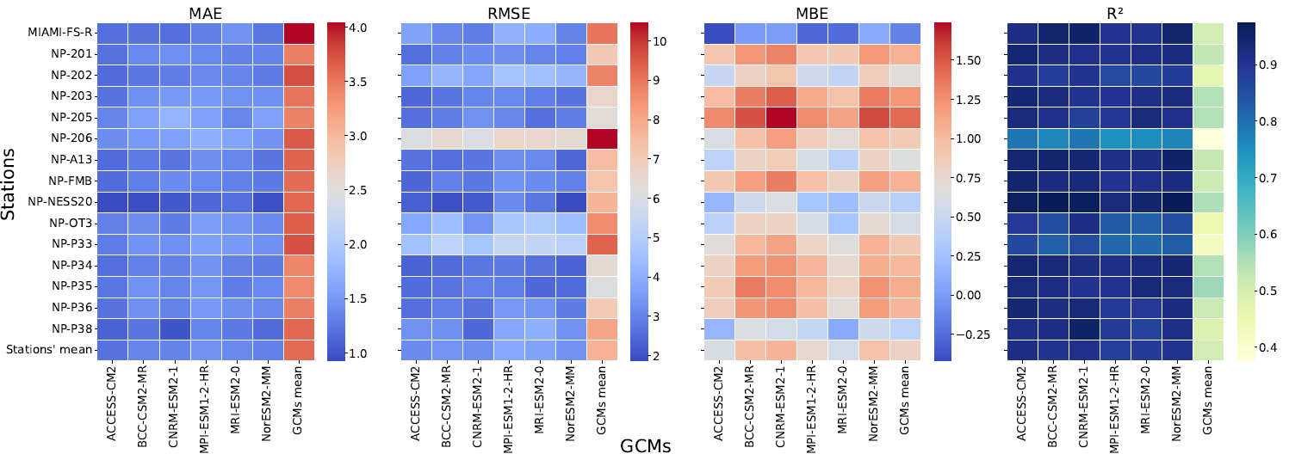
GCMs rainfall evaluation
Independent models' rainfall perform better than their average
Relatively ACCESS-CM2 model perform better
Notes:
The downscaled data sources have been used in various regional scale hydro-climate risk assessment, including but not limited to evaluations of climate change impacts on hydrology, reservoir operations, hydropower generation, future energy demand and climate extreme events (Rastogi et al., 2022).

Slide 11
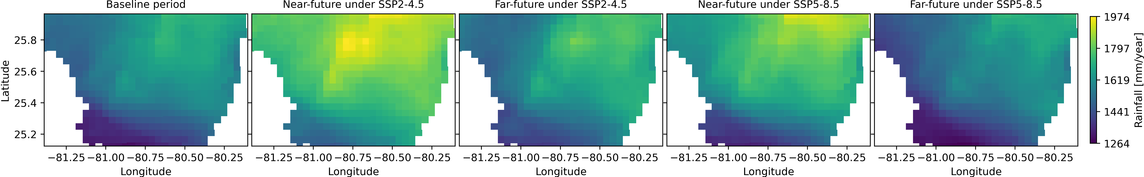
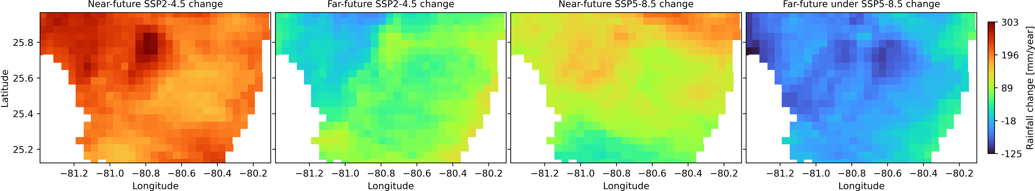
GCM rainfall projections
Mean
Max
13.2%
13.4%
3.4%
5.2%
7.3%
11.5%
2.2%
0.4%
Notes:
These results highlighted that while moderate emissions scenarios may result in modest rainfall gains, continued high emissions could slightly decrease in rainfall across parts of the study area.

Slide 12
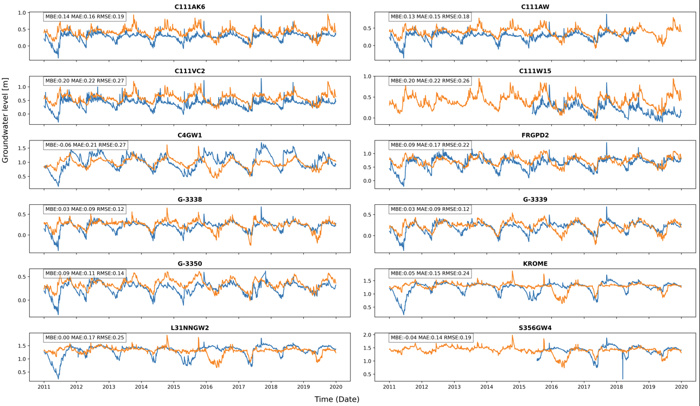
BISECT model validation
Groundwater levels
Notes:
Variation in model performance across different well locations
Hydrogeological heterogeneity boundary conditions
nearby water bodies
pumping activities
spatial scale differences

Slide 13
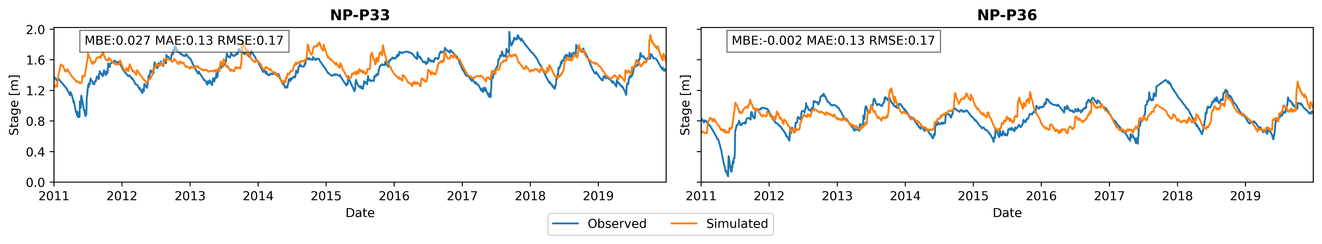
BISECT model validation
Surface water stage
Notes:
These results highlighted that while moderate emissions scenarios may result in modest rainfall gains, continued high emissions could slightly decrease in rainfall across parts of the study area.

Slide 14
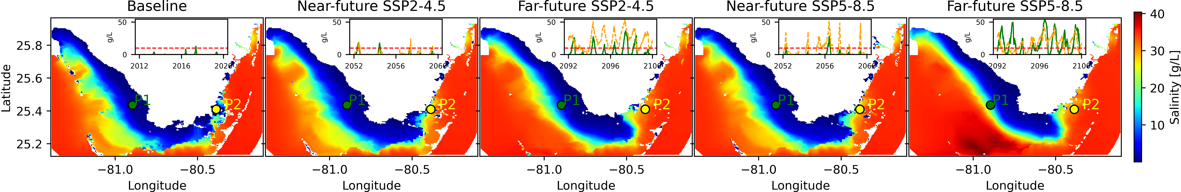
Surface water fluxes - Surface salinity & temp
Increasing surface salinity trend
Common freshwater macrophytes tolerate salinity levels of 5-10 g/L [Moreira et al., 2023]

Slide 15
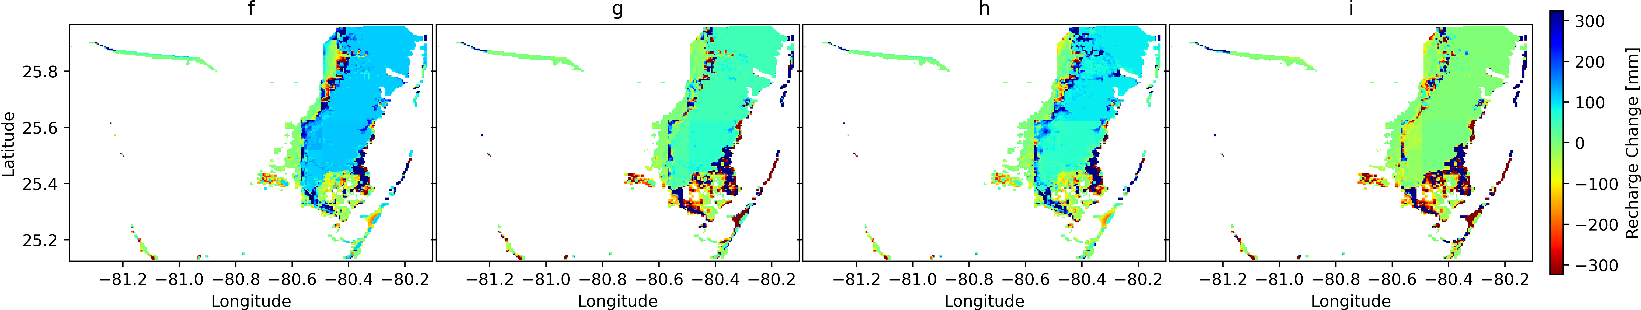
Groundwater fluxes - Recharge
It is highlighted moderate emissions mitigation in supporting sustainable groundwater resources compared to the projected decline in recharge under SSP5-8.5.
Notes:
90th percentile of the absolute differences was used to define a cutoff threshold

Slide 16
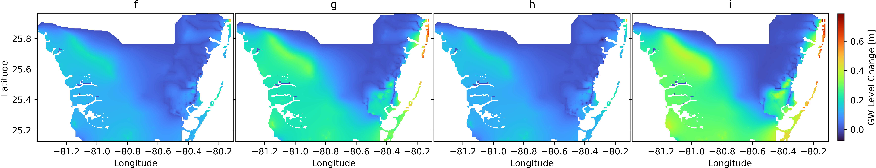
Groundwater fluxes - Water table
Groundwater heads projected to increase across much of the study area
Higher rise is marked within Miami Beach to Bal Harbour (~1 m)
Groundwater levels decrease in some small patches in the future, relatively in higher elevation and small recharge

Slide 17
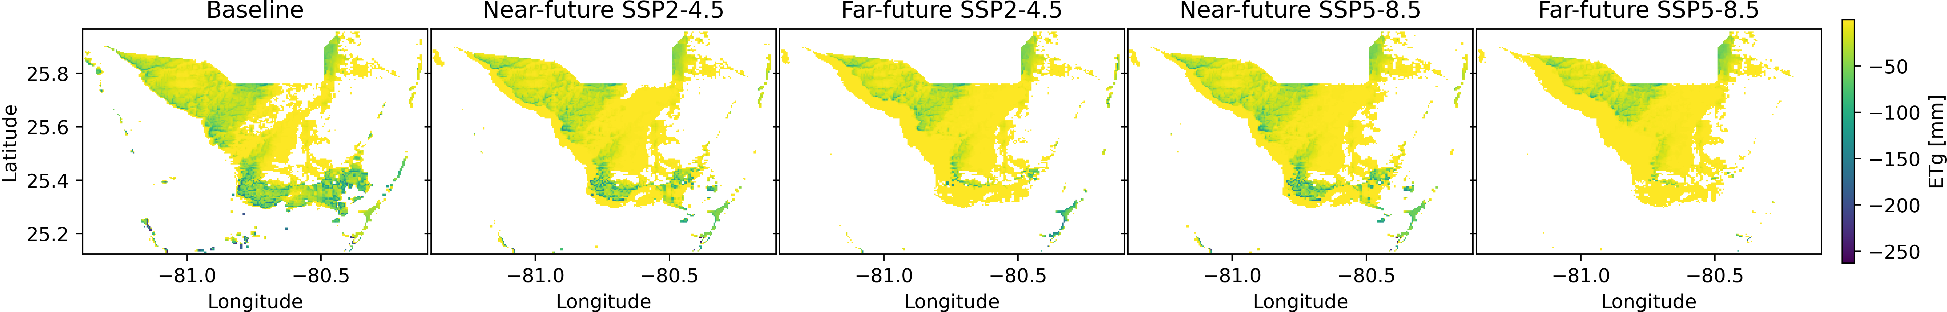
Groundwater fluxes - Evapotranspiration
Future scenarios indicate a pronounced reduction in ET_{g}
This change indicated the change in SW-GW interactions

Slide 18
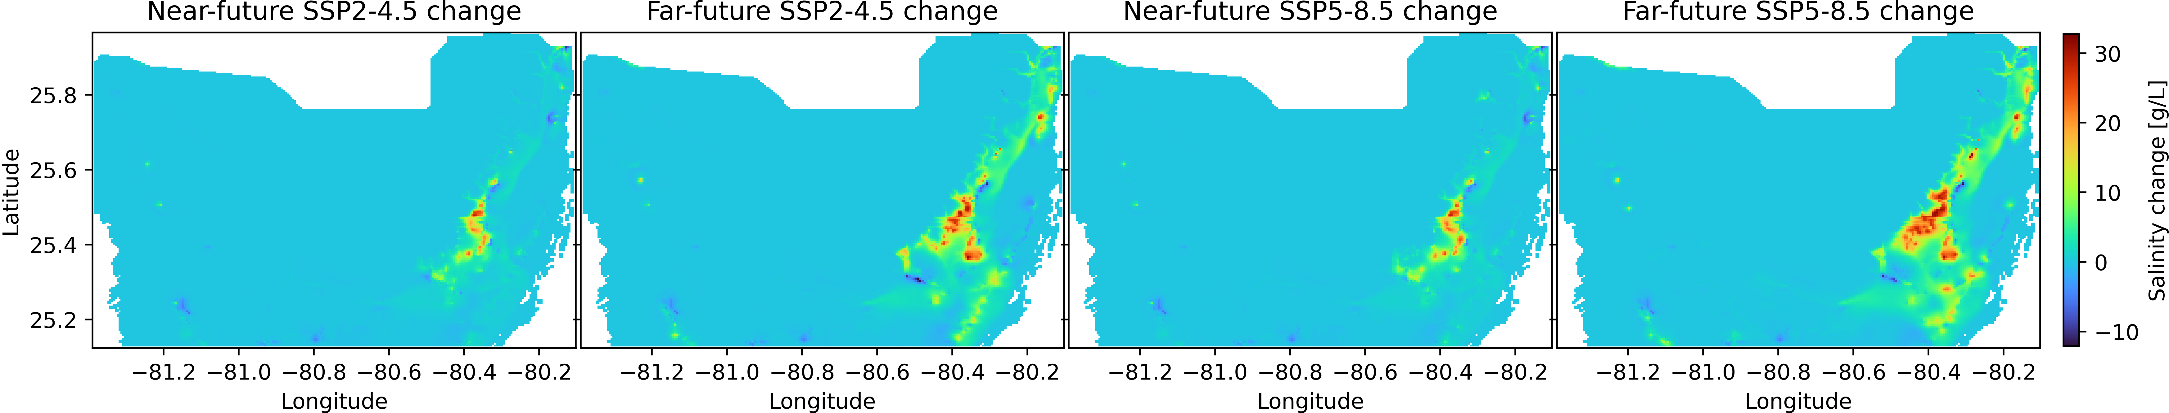
Groundwater fluxes – Salinity
GW salinity at Layer 6

Slide 19
Conclusion
Ensemble means from GCMs showed significantly lower accuracy indicating that averaging models is less effective.
Near-future rainfall is projected to increase moderately, whereas slight decrease in the far-future.
The BISECT model effectively replicated observed state variables trend.
Surface salinity is projected to increase under all future scenarios
Recharge increase in the near-future and get decline in the far-future
Groundwater heads rise across much of the study area, with localized increases ~ 1 m
Groundwater evapotranspiration decreases in future due to higher water tables reducing root-zone interactions, meeting atmospheric demand from surface evaporation.
Groundwater salinity is projected to increase in the future, particularly in eastern Miami-Dade
These findings highlighted the importance of consideration of climate change in restoration/conservation efforts and adaptative practices

Slide 20
Some implications
Water quality issues that may require expensive interventions such as desalination or relocation of wellfields
Flooding and infrastructure damage
Ecosystem change, including loss of habitats due hydrological changes like shifting surface-groundwater interactions
Nature-based tourism concern, tourism and other ecosystem services in South Florida are tied to the sustainable health of the Everglades and coastal environments
Economic consequences
Notes:
Increase flood risk as a response of groundwater rise or field capacity in the unsaturated zone
Salinity intrusion threatens freshwater supplies
Hydrologic changes challenge ecosystem stability
Peat soil collapse
Surface water-groundwater interaction shift - seasonal wetness
Tourism and infrastructure risk

Slide 21
Future – NBI evaluation
Hydrological and management criteria
Weight the criteria
[expert and stakeholder]
Suitability of NBIs
[spatial]
A framework for suitability of the NBIs on mitigating the climate change impact using multi-criteria decision-making approach

Slide 22
Thank you!

